Slide 1
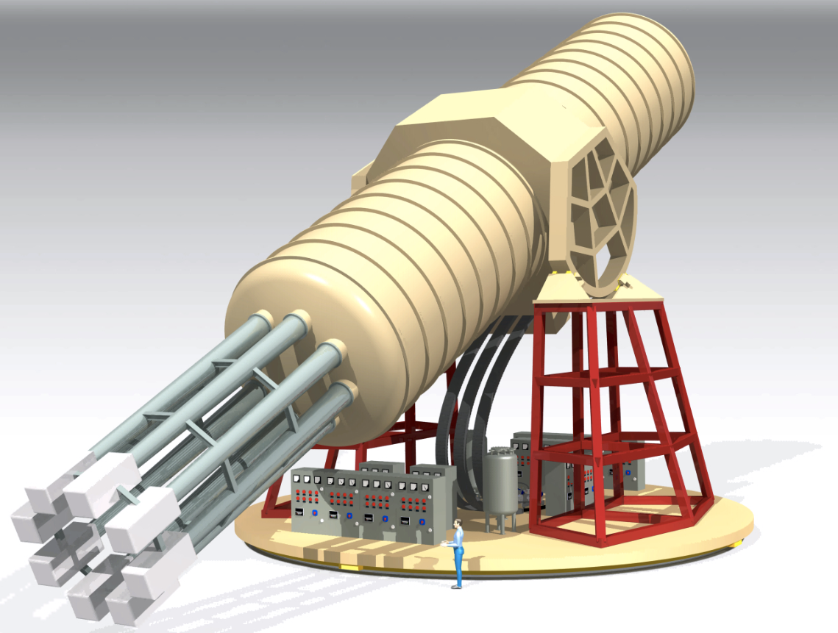

Status of IAXO
(International AXion Observatory)
Igor G. Irastorza
Universidad de Zaragoza
MADMAX meeting, Zaragoza, 9 September 2018

Slide 2
Axion motivation in a nutshell
Most compelling solution to the Strong CP problem of the SM
Axion-like particles (ALPs) predicted by many extensions of the SM (e.g. string theory)
Axions, like WIMPs, may solve the DM problem for free. (i.e. not ad hoc solution to DM)
Astrophysical hints for axion/ALPs?
  Transparency of the Universe to UHE gammas
  Stellar anomalous cooling → g_{aγ} ~ few 10⁻¹¹ GeV⁻¹ / m_{a} ~few meV ?
Relevant axion/ALP parameter space at reach of current and near-future experiments
Experimental efforts growing fast but still small (when compared e.g. to WIMPs…)
recent experimental review:
I. G. Irastorza & J. Redondo, PNPP2018 (arXiv:1801.08127)
New experimental approaches in the search for axion-like particles

Slide 3
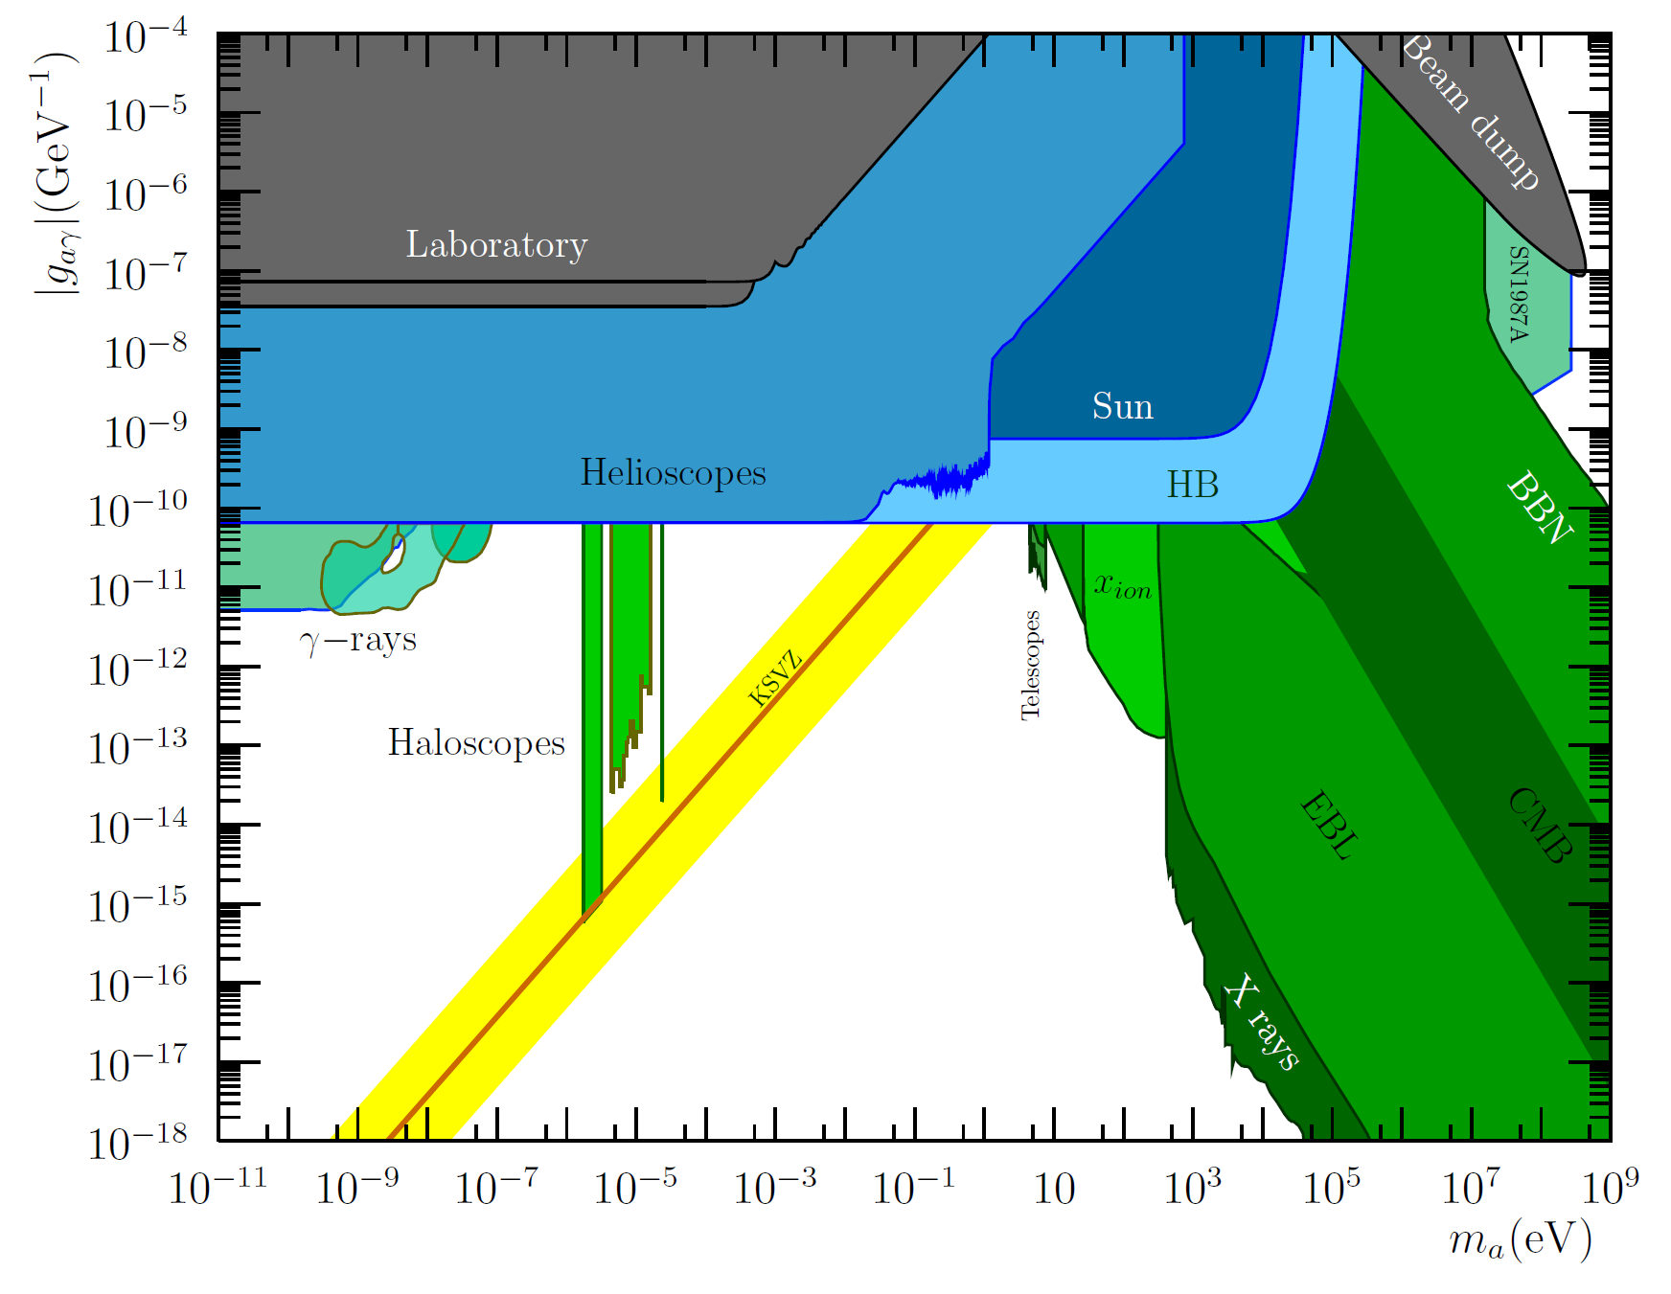

Axion/ALP searches motivation
IAXO
“Focuses of interest” in the ALP parameter space
Theory
Astrophysics
Cosmology
IAXO addresses partially all of them
meV+ QCD axion region exclusive target of IAXO

Slide 4



Detection of axions
Source | Experiments | Model & Cosmology dependency | Technology
Relic axions | ADMX, HAYSTAC, CASPEr, CULTASK, CAST-CAPP, MADMAX, ORGAN, RADES, QUAX, … | High | New ideas emerging, Active R&D going on,…
Lab axions | ALPS, OSQAR, CROWS, ARIADNE,… | Very low
Solar axions | SUMICO, CAST, (Baby)IAXO | Low | Ready for large scale experiment

Slide 5
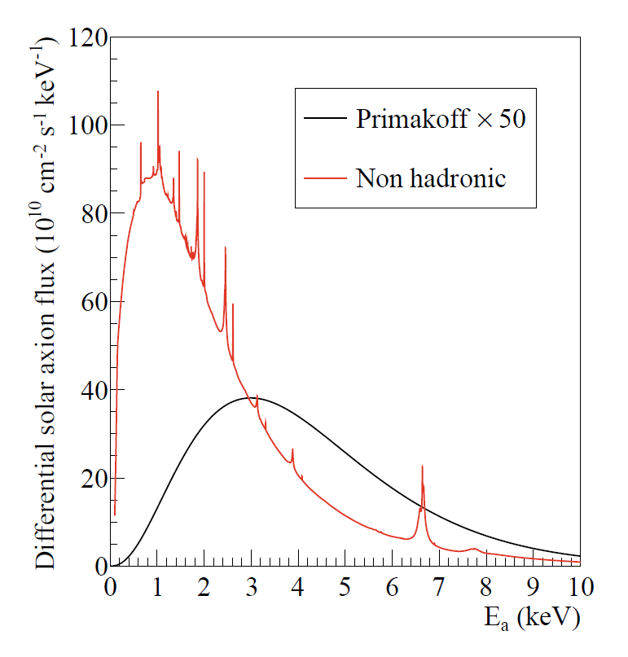
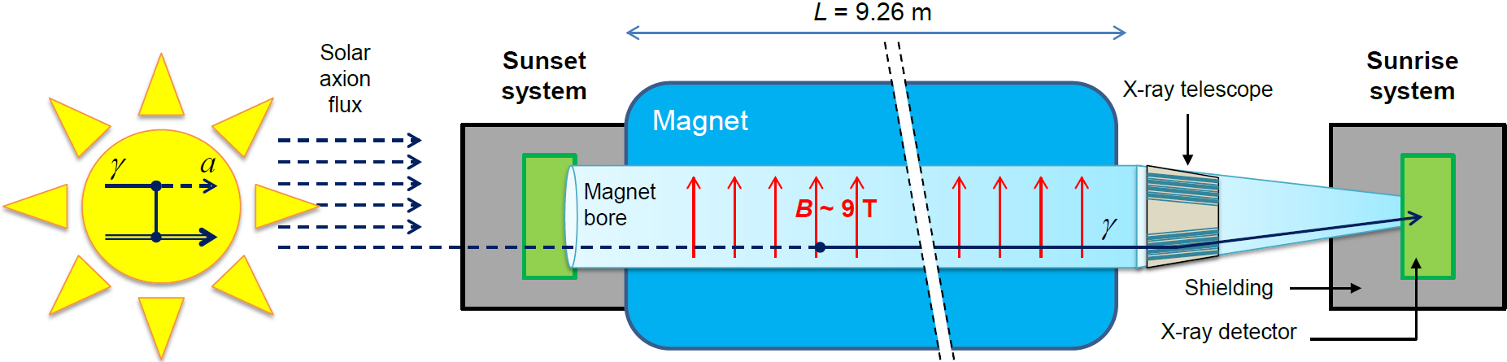
Axion Helioscopes
Previous helioscopes:
  First implementation at Brookhaven (just few hours of data) [Lazarus et at. PRL 69 (92)]
  TOKYO Helioscope (SUMICO): 2.3 m long 4 T magnet
Standard Primakoff spectrum
Axion helioscope concept
P. Sikivie, 1983
+ K. van Bibber, G. Raffelt, et al. (1989)
(use of buffer gas)
Non-hadronic “ABC” Solar axion flux at Earth
JCAP 1312 008
(only if axion couples to electron)
Current state-of-the-art:
CERN Axion Solar Telescope (CAST)
First helioscope using low background techniques & x-ray focusing

Slide 6
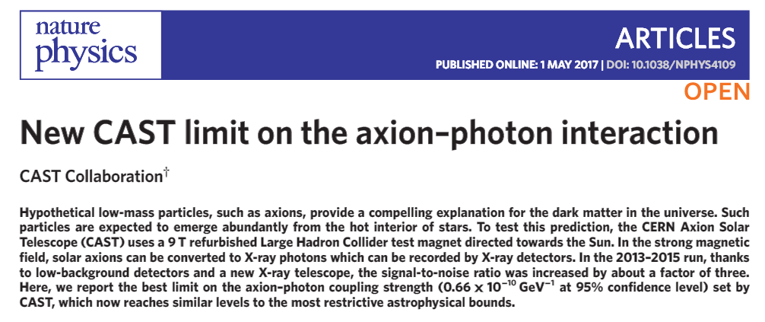
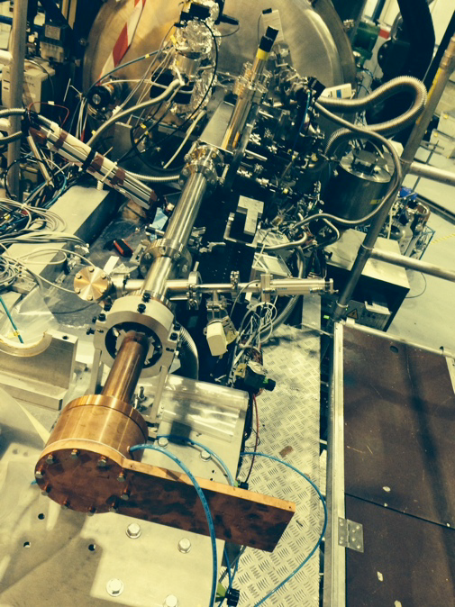
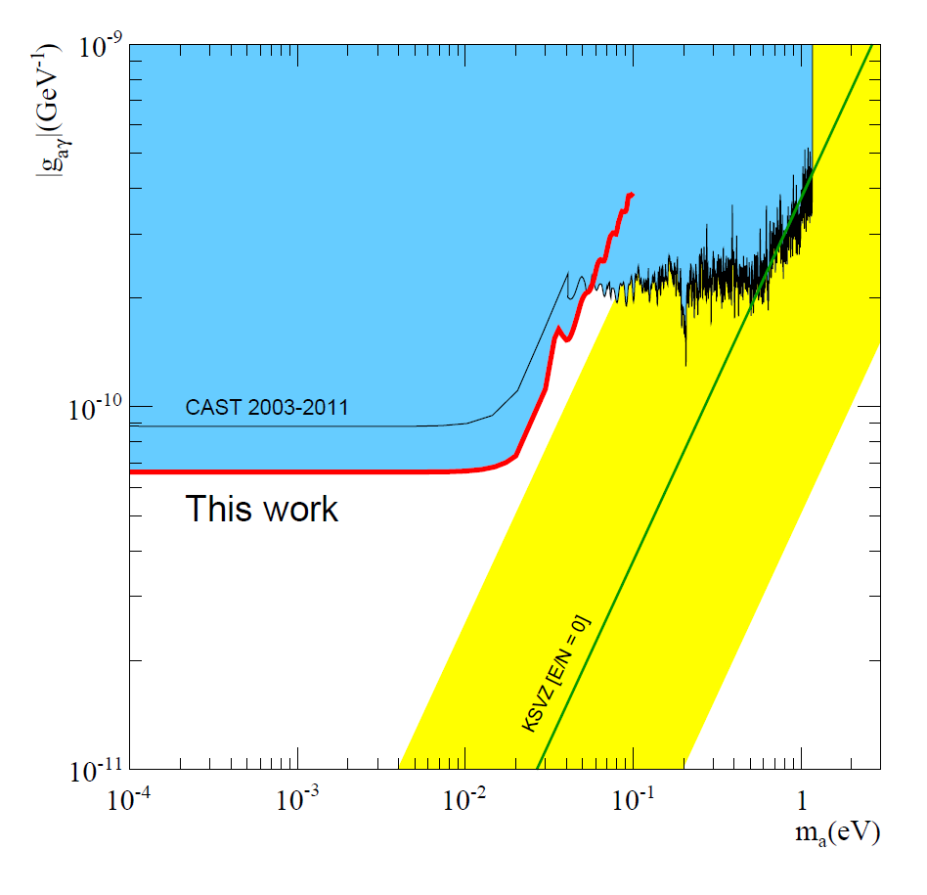

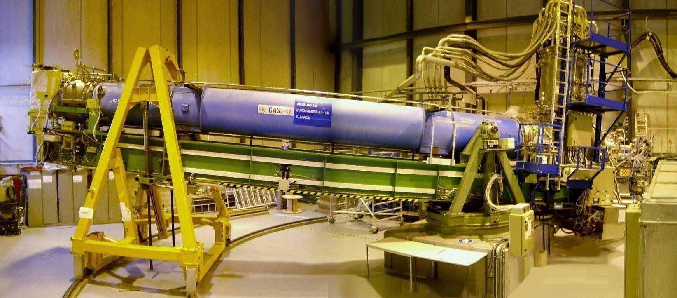
Latest CAST limit
IAXO pathfinder system at CAST:
x-ray focusing + low background detector combined in same system
Small-scale version of IAXO baseline detection lines
X-ray optics specifically built for axions
Low background Micromegas

Slide 7
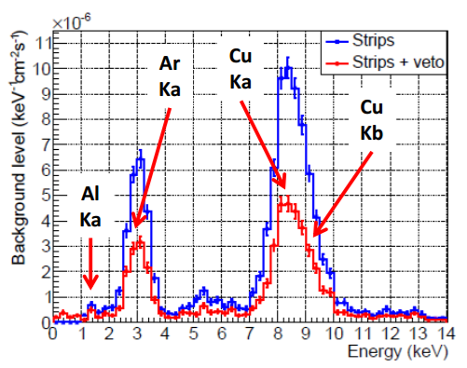
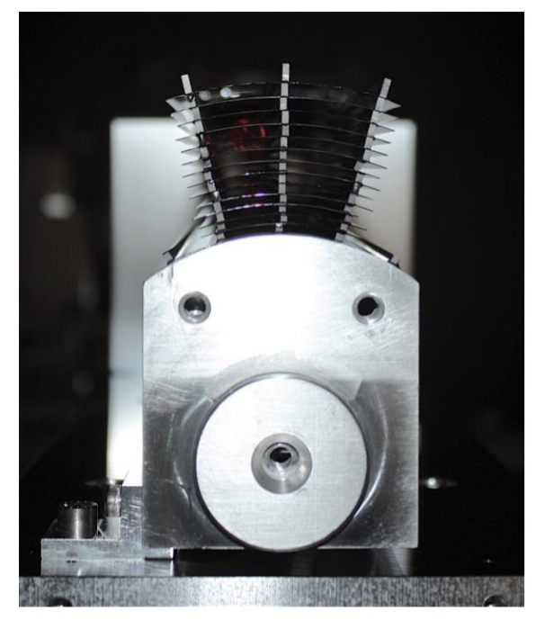
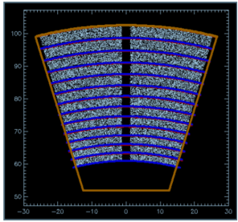
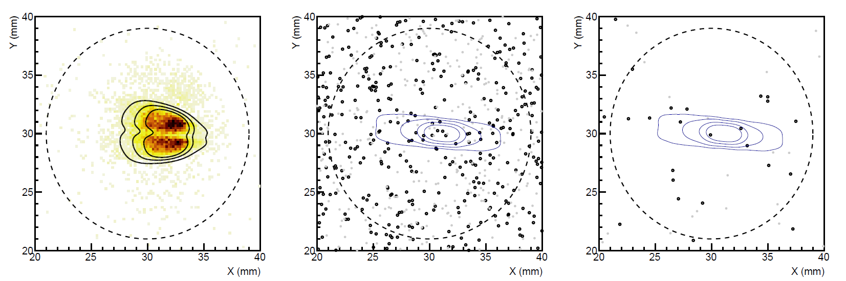
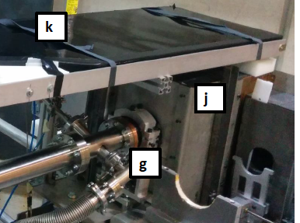
IAXO pathfinder system in CAST
Test MM detector + slumped-glass x-ray optics together
X-ray optics specifically built for axions
Detector: JCAP12 (2015)
Physics: Nature Physics (10.1038/nphys4109)
Background spectrum
Best SNR of any previous detector
290 tracking hour acquired (6.5 months operation)
3 counts observed in RoI (1 expected)
5 mm
Low background Micromegas at the focal point
Calibration data
“axion” data

Slide 8
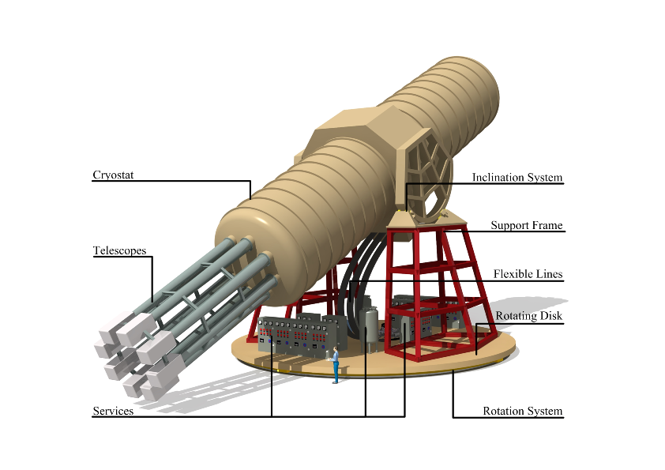
IAXO – Conceptual Design
Large toroidal 8-coil magnet L = ~20 m
8 bores: 600 mm diameter each
8 x-ray telescopes + 8 detection systems
Rotating platform with services

Slide 9
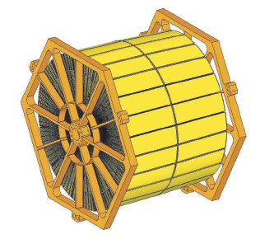
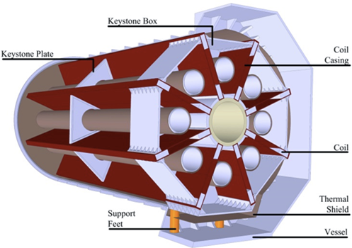
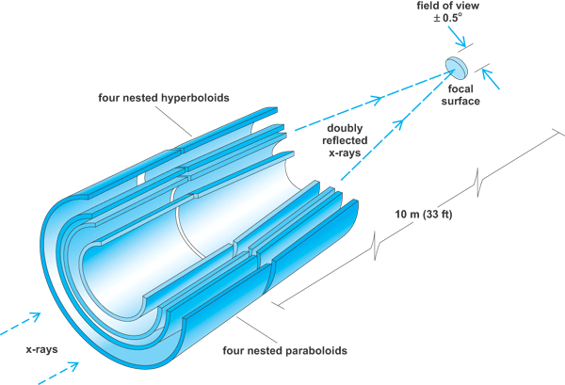
IAXO technologies
IAXO telescopes
Slumped glass technology with multilayers
Cost-effective to cover large areas
Similar to NuSTAR optics
Focal length ~5 m
60-70% efficiency
LLNL+UC+DTU
+ MIT + INAF
IAXO magnet
Superconducting “detector” magnet.
Toriodal geometry (8 coils)
Based on ATLAS toroid technical solutions.
CERN+CEA expertise
8 bores / 20 m long / 60 cm Ø per bore
Focal length
Baseline developed at:
IAXO Letter of Intent: CERN-SPSC-2013-022
IAXO Conceptual Design: JINST 9 (2014) T05002 (arXiv:1401.3233)

Slide 10
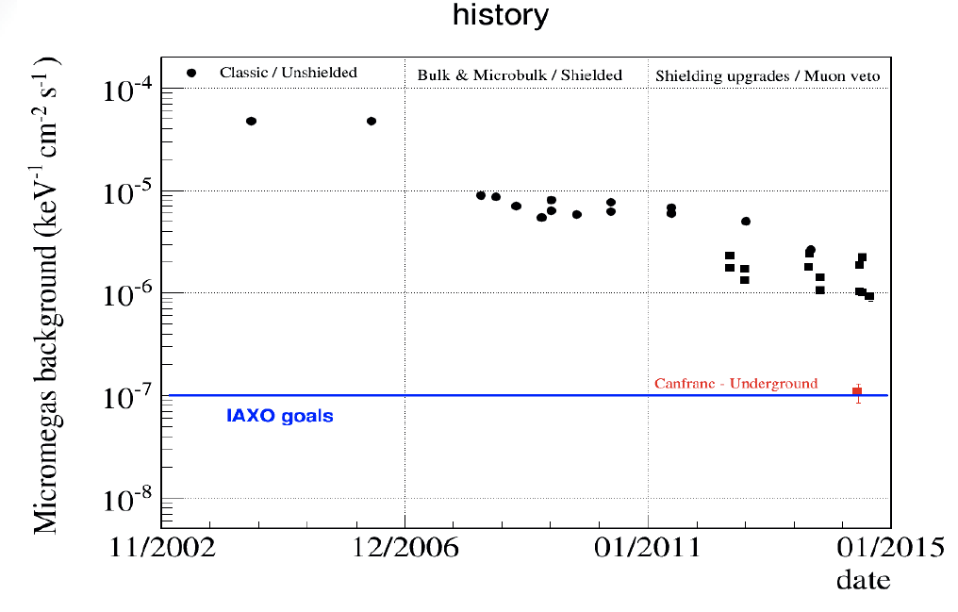
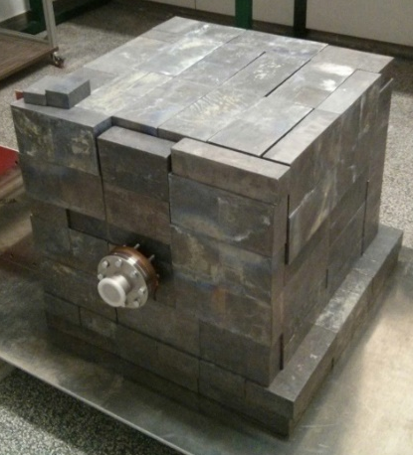
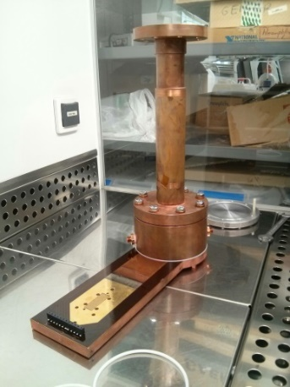
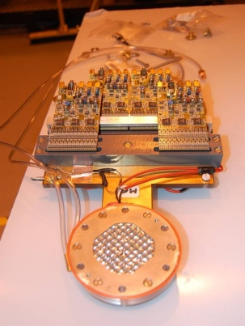
IAXO low background MM detectors
History of background improvement of Micromegas detectors at CAST
Goal background level for IAXO:
  10⁻⁷ – 10⁻⁸ c keV⁻¹ cm⁻² s⁻¹
Already demonstrated:
~8×10⁻⁷ c keV⁻¹ cm⁻² s⁻¹
  (in CAST 2014 result)
  10⁻⁷ c keV⁻¹ cm⁻² s⁻¹
  (underground at LSC)
IAXO goals
Nominal values at CAST
Active program of development.
IAXO-D0 test-platform to explore background sources and improve levels

Slide 11
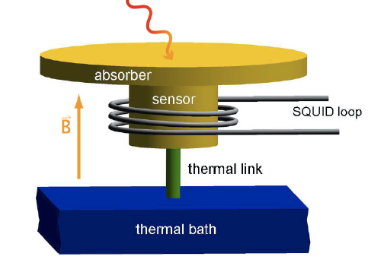
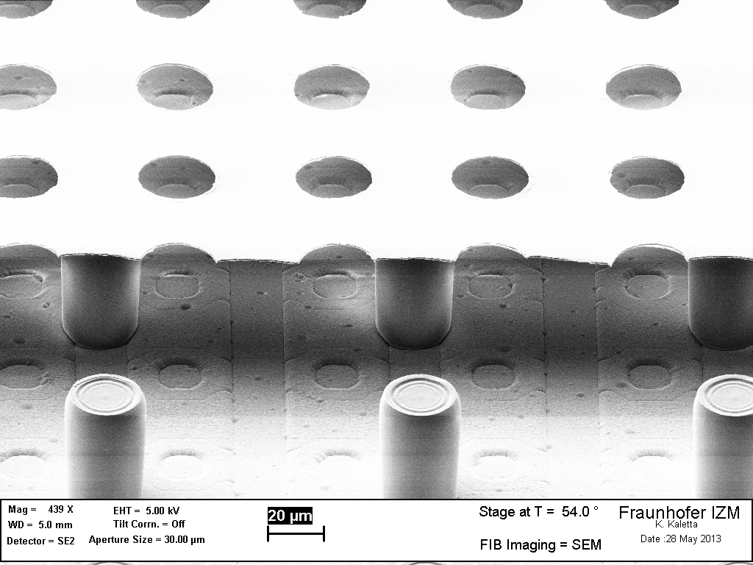
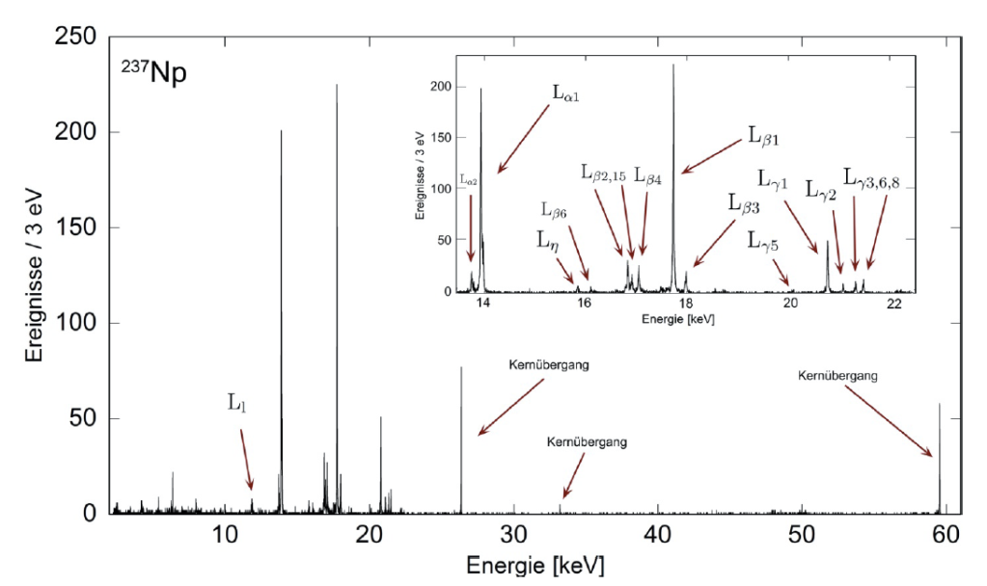
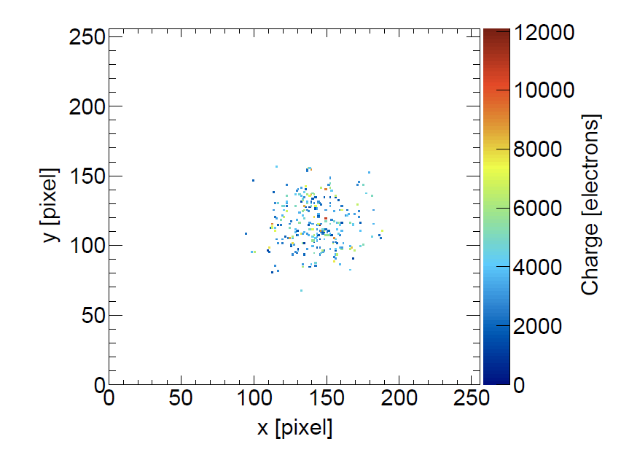
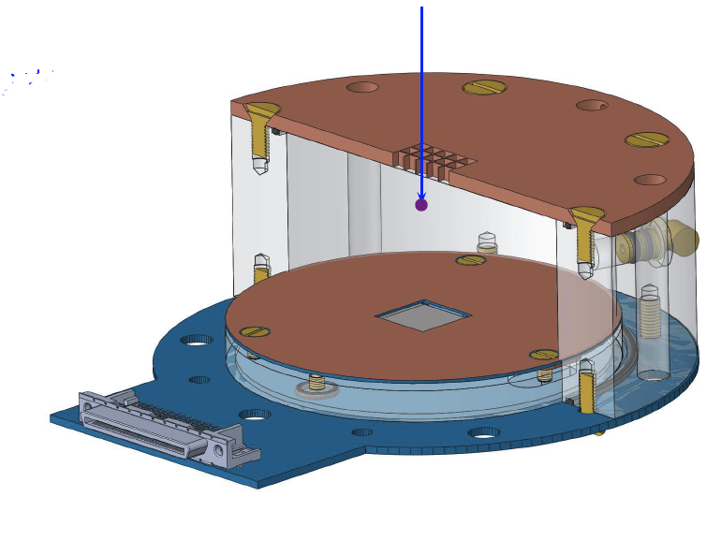
Additional detector technologies for IAXO
GridPix detectors (U. Bonn):
Micromegas on top of a CMOS chip (Timepix)
Very low threshold (tens of eV)
Tested in CAST
MMC detectors (U. Heidelberg):
Extremely low threshold and energy resolution (~eV scale)
Low background capabilities under study
Typical X-ray event
Single e- visible
Also:
Transition Edge Sensors (TES)
Si- detetors

Slide 12
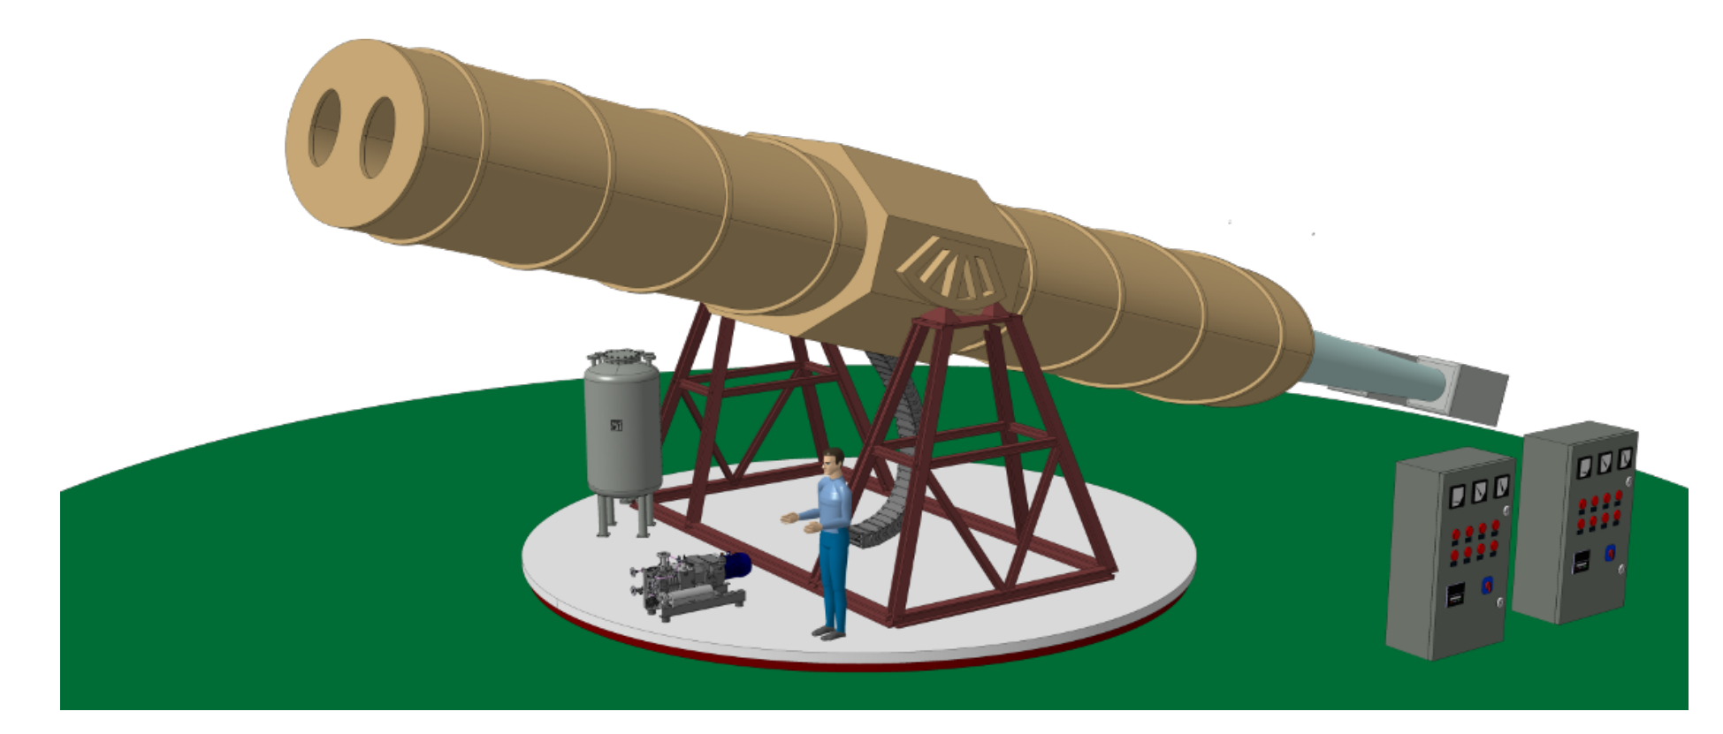
BabyIAXO
Intermediate experimental stage before IAXO
Two bores of similar dimensions of final IAXO bores → detection lines representative of final ones.
Test & improve all systems. Risk mitigation for full IAXO
Will produce relevant physics
Move earlier to “experiment mode”
Magnet Technical Design ongoing at CERN
Free bore [m] | 2 x 0.7
Magnetic length [m] | 10
Field in bore [T] | ~2-3
Stored energy [MJ] | 40-50
Peak field [T] | ~4
~10x CAST B²L²A
ERC-AvG 2017 IAXO+

Slide 13
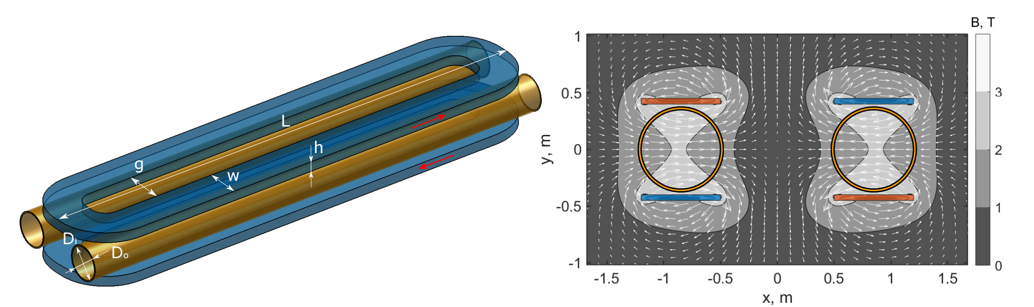
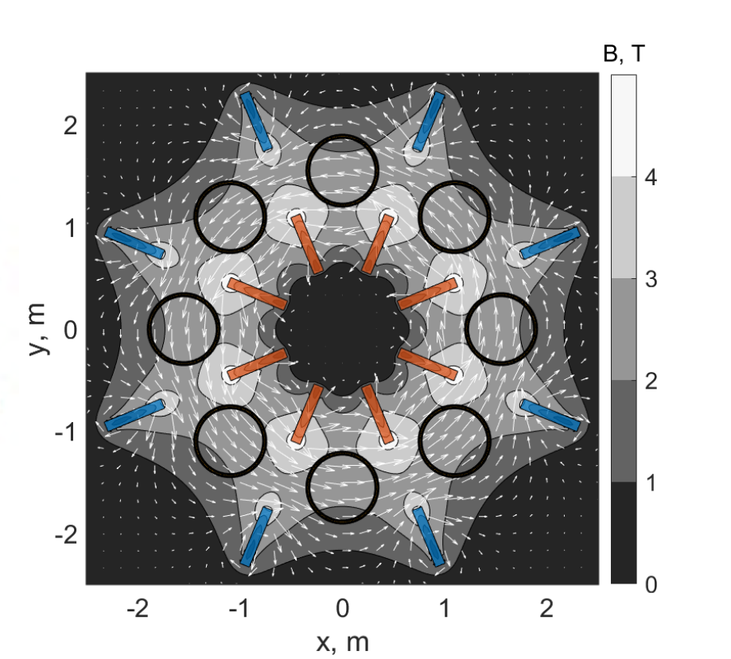
BabyIAXO magnet
“Common coil” configuration chosen
  Minimal construction risk: move to construction asap
  Cost-effective: Best use of existing infrastructure (tooling) at CERN
  Winding layout very close to current IAXO toroidal design.

Slide 14
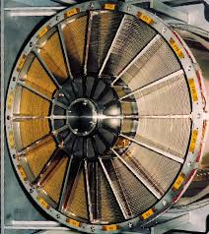
BabyIAXO optics & detectors
Optics:
  Baseline option: Segmented-glass and flight spare XMM optics from ESA
  Minimal risk to the project
    Risk reduction for final IAXO segmented-glass optics
    XMM optics specs very close to IAXO optics design
Detectors:
  Baseline option: 2 Micromegas setups
  In addition: a R&D generic platforma to improve and tests all other detection technologies

Slide 15
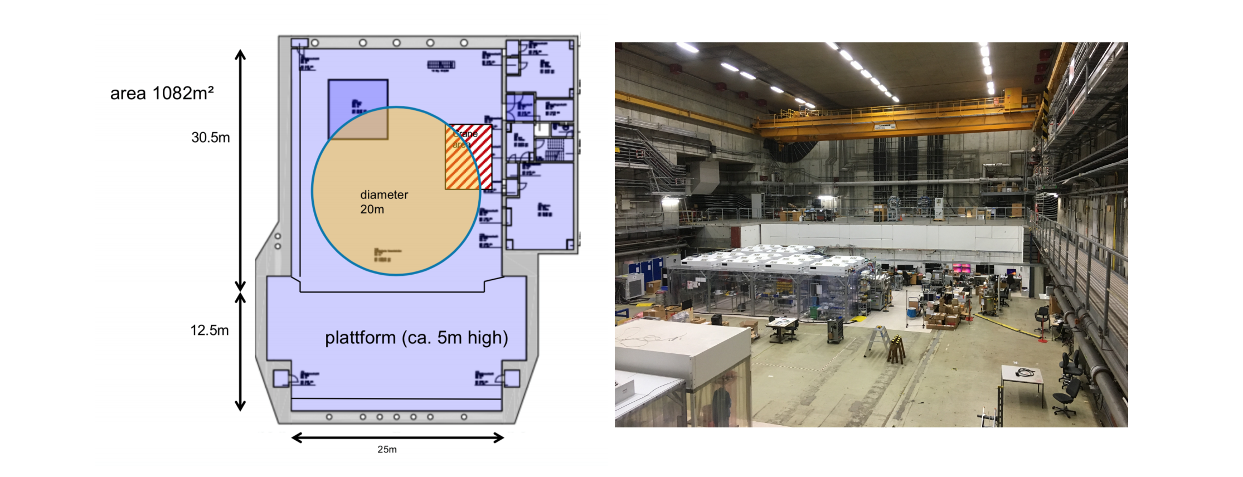
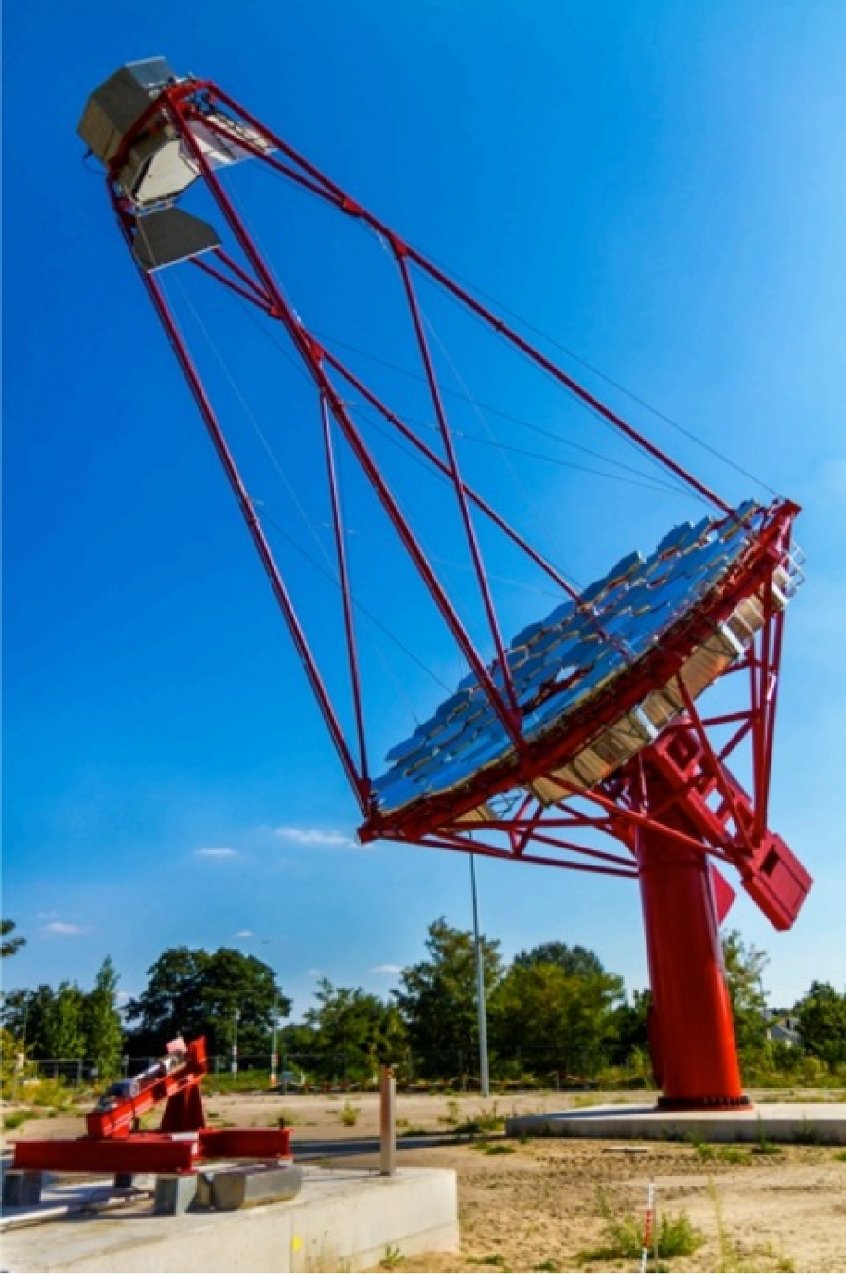
BabyIAXO @ DESY
HERA South hall: preferred site for BabyIAXO
DESY infrastructure & expertises very well suited to IAXO

Slide 16
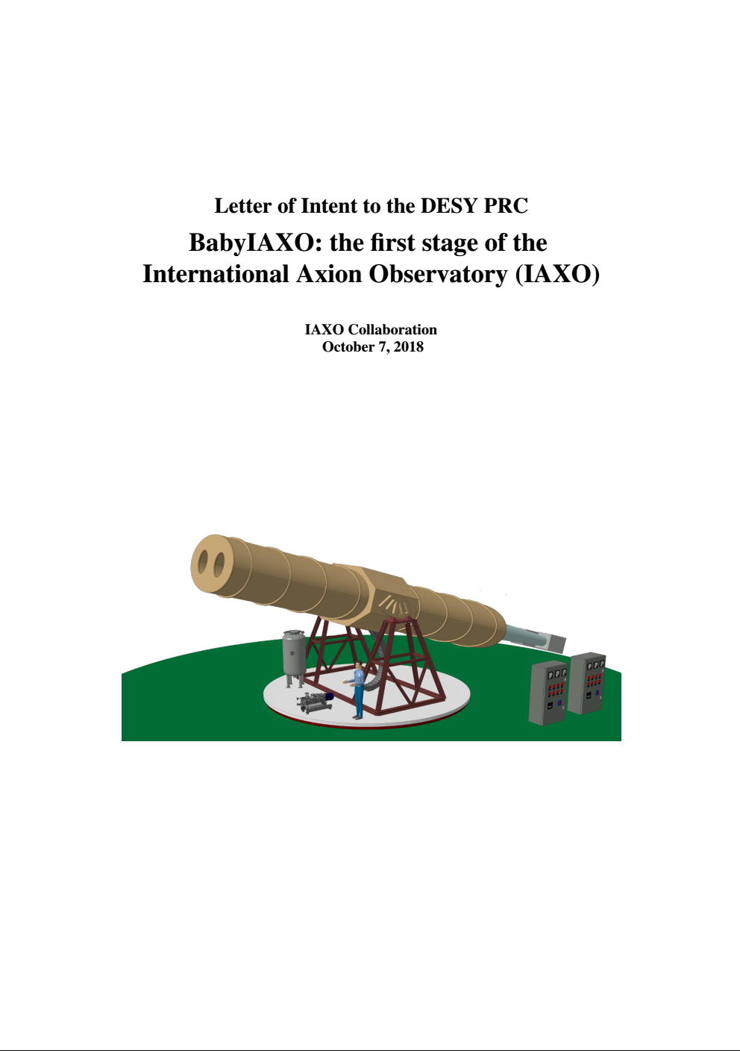
DESY PRC
Just submitted a LoI to DESY PRC
Detailed review expected to take place after presentation next week.
Full detailed proposal for next meeting.
BabyIAXO construction could happen in 3-4 years.

Slide 17
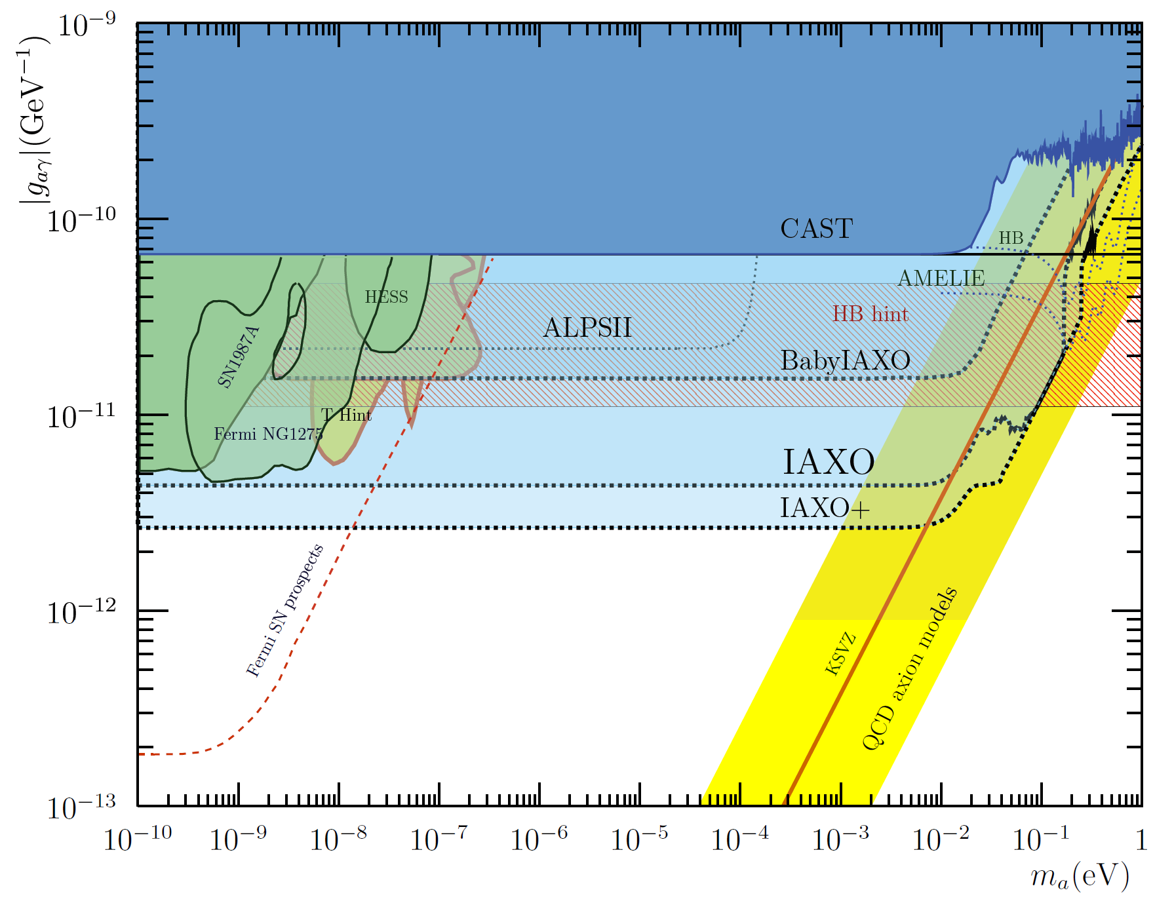
Helioscopes & astrophysics hints
BabyIAXO prospects:
10xFOM magnet + optics and detector from conservative scenario of LoI
IAXO+: enhanced scenario with x4 higher MFOM with respect LoI
… as well as a large fraction of the axion & ALP models invoked in the “stellar cooling anomaly”
But for this the g_{ae} is particularly interesting
IAXO will fully explore ALP models invoked to solve the “transparency hint”

Slide 18
IAXO & stellar cooling
Multiple stellar anomalies (HB, RG, WD, NS,..). Overall 3σ effect.
g_{ae} channel
IAXO will explore most of the relevant models (especially with IAXO+)
Only experiment with such capability
Region of QCD axion models that solve the stellar anomaly
M. Giannotti et al.
JCAP 1710 (2017) 010
arXiv:1708.02111

Slide 19
IAXO most recent milestones & plans
Collaboration formally established in last year’s collaboration meeting at DESY (last July):
  17 institutions to sign IAXO bylaws
  Management structure defined.
Near term goal defined for the collaboration: BabyIAXO
  Full intermediate experiment with relevant physics potential
Experimental site for IAXO: Strong interest from DESY
BabyIAXO Magnet under design at CERN.
IAXO progress is being followed by “Physics Beyond Colliders” process at CERN (to provide feedback for the European Strategy Part Phy)
MoU under preparation with financial plan. ERC funding obtained.
Solid plans towards BabyIAXO. First physics could come in 3-4 years.
Letter of Intent submitted to DESY PRC few days ago.

Slide 20
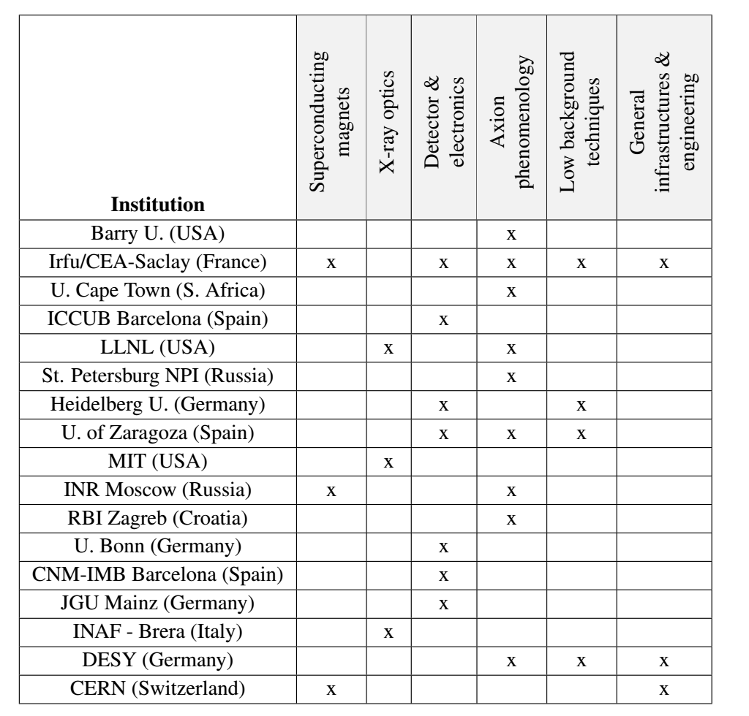
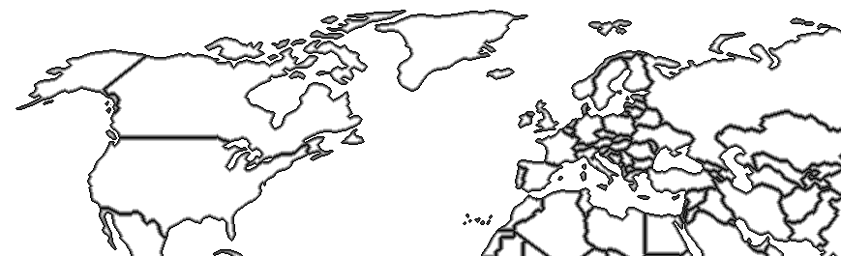
IAXO collaboration
17 institutions from Germany, Spain, US, France, Russia, Croatia, S. Africa, CERN.
DESY (Germany)
U. Bonn (Germany)
U. Heidelberg (Germany)
St. Petersburg (Russia)
MIT (US)
U. Mainz (Germany)
CEA (France)
INR-Moscow (Russia)
LLNL (US)
RBI (croatia)
CERN
U. Barry (US)
INAF-Milano (Italy)
U. Zaragoza (Spain)
CNM (Spain)
U. Cape Town (S. Africa)
ICCUB (Spain)
Likely to grow in the future, more groups showing interest…
New partners welcome…

Slide 21
Conclusions
Important milestones regarding establishment of the collaboration
Near term plans towards BabyIAXO better defined.
Project backed up by ERC AdV grant. Expected to move forward quicker in next years…
Great opportunity for our community.
New partners are welcome!

Slide 22
Backup slides

Slide 23
IAXO and CERN
[from PBC technology subgroup meetings]
IAXO crucially relies on CERN’s expertise on large-scale superconducting detector magnets. Both BabyIAXO and IAXO detector magnets are systems of a scale for which CERN’s expertise and infrastructure is almost unique.
The collaboration expects support and significant participation of CERN, in particular, but not exclusively, with knowledge and expert personnel to the Technical Design Report of magnets and related infrastructure, as well as the technical follow-up during construction, testing and commissioning, first of BabyIAXO and then for IAXO.
CAST is still active at CERN hosting a number of small-scale prototypes for testing novel concepts or performing R&D. There is potential in further using CAST infrastructure for providing feedback during the preparatory phase of IAXO, for example, to improve the insight on detector backgrounds

Slide 24

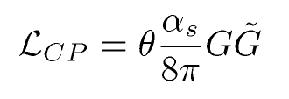

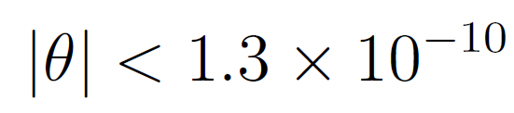
Axions: theory motivation
Axion: introduced to solve the strong CP problem
In QCD, nothing prevents from introducing a term like:
2 contributions of
very different origin…
This term is
CP violating.
From non-observation of neutron electric dipole moment:
Why so small?
High fine-tunning required for this to work in the SM

Slide 25
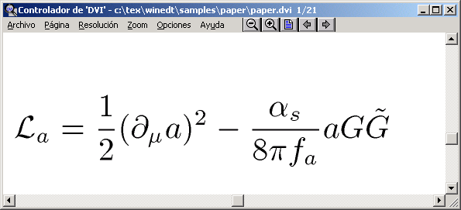
Axions: theory motivation
Peccei-Quinn solution to the strong CP problem
New U(1) symmetry introduced in the SM: Peccei Quinn symmetry of scale f_{a}
The AXION appears as the Nambu-Goldstone boson of the spontaneous breaking of the PQ symmetry
“Axion lagrangian”
θ absorbed in
the definition of a
θ = a/f_{a} relaxes to zero…
CP conservation is preserved “dynamically”

Slide 26
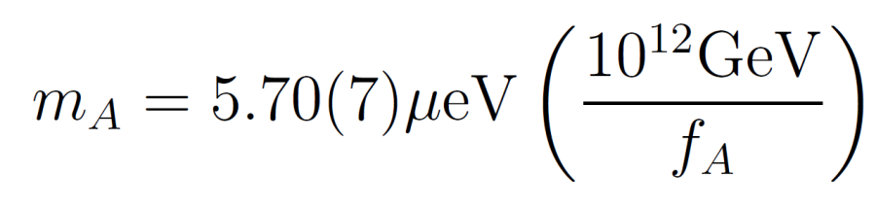
The axion
The PQ scenario solves the strong CP-problem. But a most interesting consequence is the appearance of this new particle, the axion.
(Weinberg, Wilcek)
Basic properties:
  Pseudoscalar particle
  Neutral
  Gets very small mass through mixing with pions
  Stable (for practical purposes).
  Phenomenology driven by the PQ scale f_{a}. (couplings inversely proportional to f_{a})

Slide 27

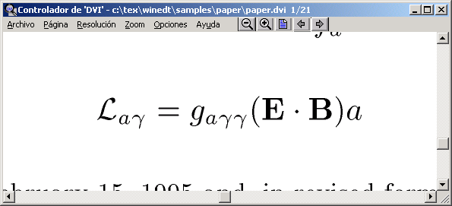
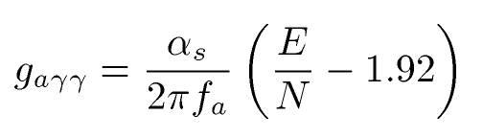
Axion phenomenology
Some phenomenology depends on the “axion model”, e.g.
  KSVZ axions are “hadronic axions” (no coupling with leptons at tree level)
  DFSZ axions couple to electrons
Gluon coupling
generic
Mass
generic
Photon coupling
generic but value
model dependent
Fermion couplings
Electron coupling
Nucleon coupling
…
Model dependent
×

Slide 28
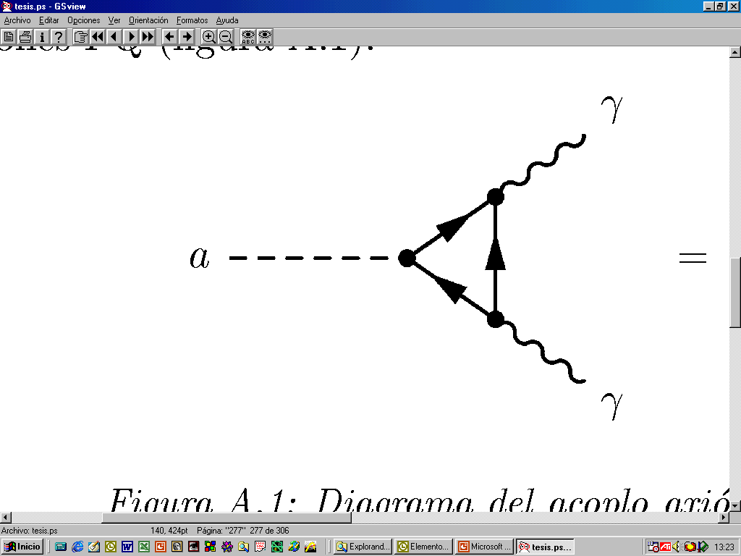
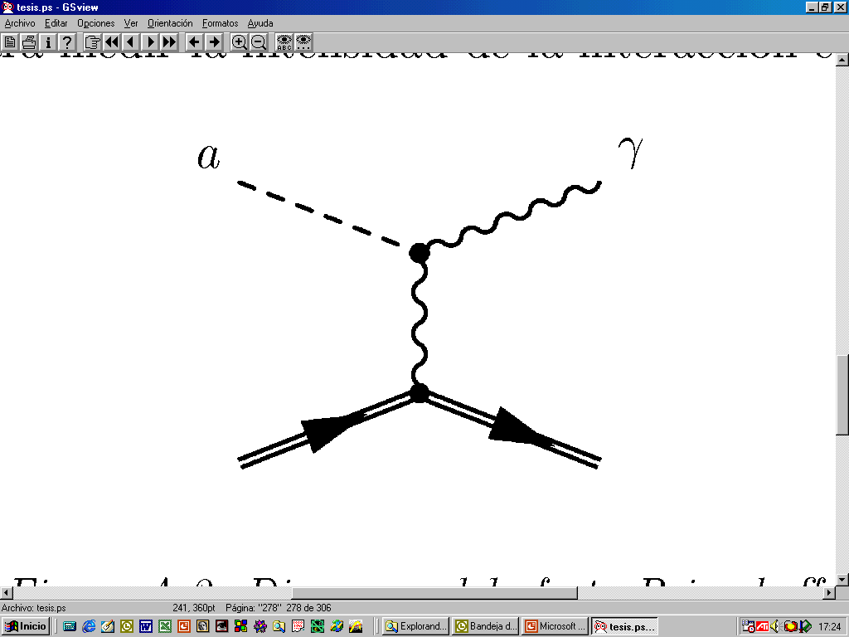
Axion phenomenology
Axion-photon coupling present in every model.
Axion-photon conversion in the presence of an electromagnetic field (Primakoff effect)
This is probably the most relevant of axion properties.
Most axion detection strategies are based on the axion-photon coupling

Slide 29


Beyond axions
Many extensions of SM predict axion-like particles
  Higher scale symmetry breaking
Generic ALPs parameter space →
Weakly Interacting Sub-eV Particles
(WISPs)
Hidden Photons
(HPs)
Axion Like particles
(ALPs)
AXIONS
Stringy ALPs
Arion
Majoron
Familon
Millicharged Particles
String theory predicts a plenitude of ALPs
Chameleons

Slide 30
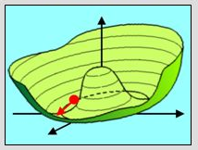

Cosmological axions: axion realignment
  When T > T_{QCD}
  <a_{phys}> is arbitrary
  When T ~ T_{QCD}
  <a_{phys}> → 0
  When T ~ T_{QCD}
  <a_{phys}> → 0
V
V
a
a
As the Universe cools down below T_{QCD}, space is filled with low energy axion field fluctuations → act as cold dark matter
Their density depends on the initial value of <a_{phys}> (“misalignment angle”) which:
Unique (but unknown) for all visible Universe in pre-inflation models
Effectively averaged away in post-inflation models

Slide 31
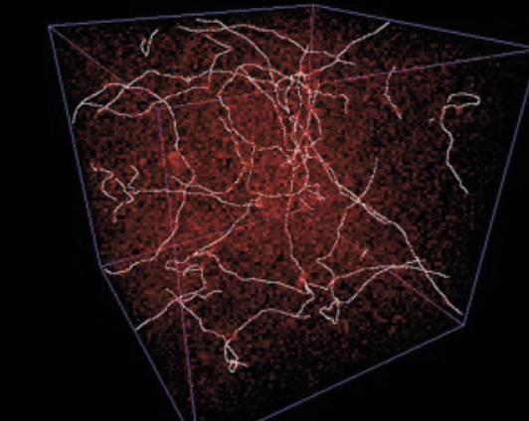
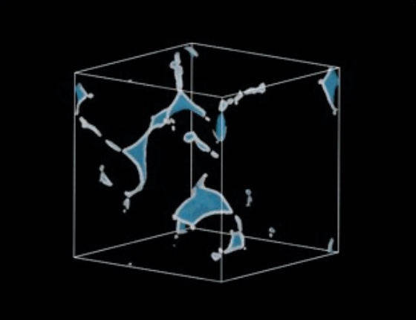
Cosmological axions: topological defects
  When T ~ T_{QCD}
  <a_{phys}> → 0
Axion strings
Domain walls
But inflation may “wipe out” topological defects… Did inflation happen before or after the creation of defects (PQ transition) ?
pre-inflation or post-inflation scenarios
Computation of axion DM density from defect decay is complicated (→ big uncertainty)

Slide 32
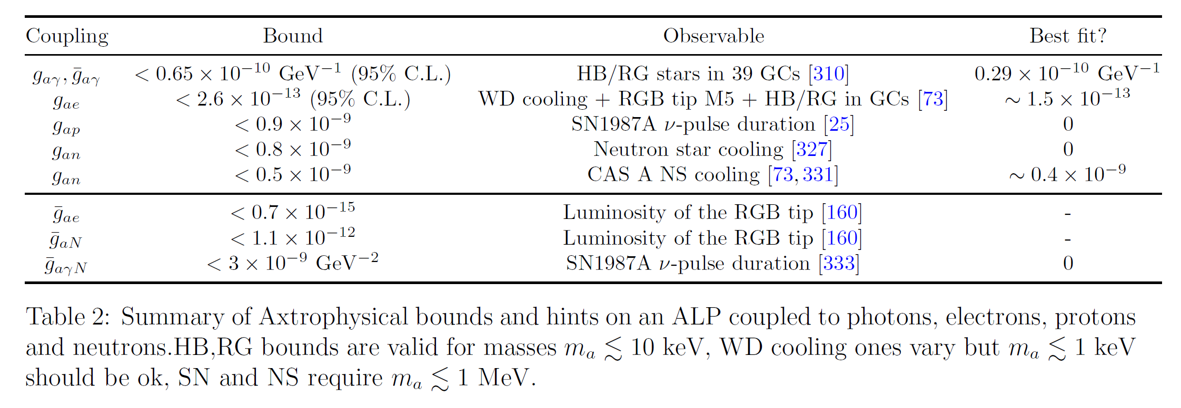
Astrophysical bounds

Slide 33
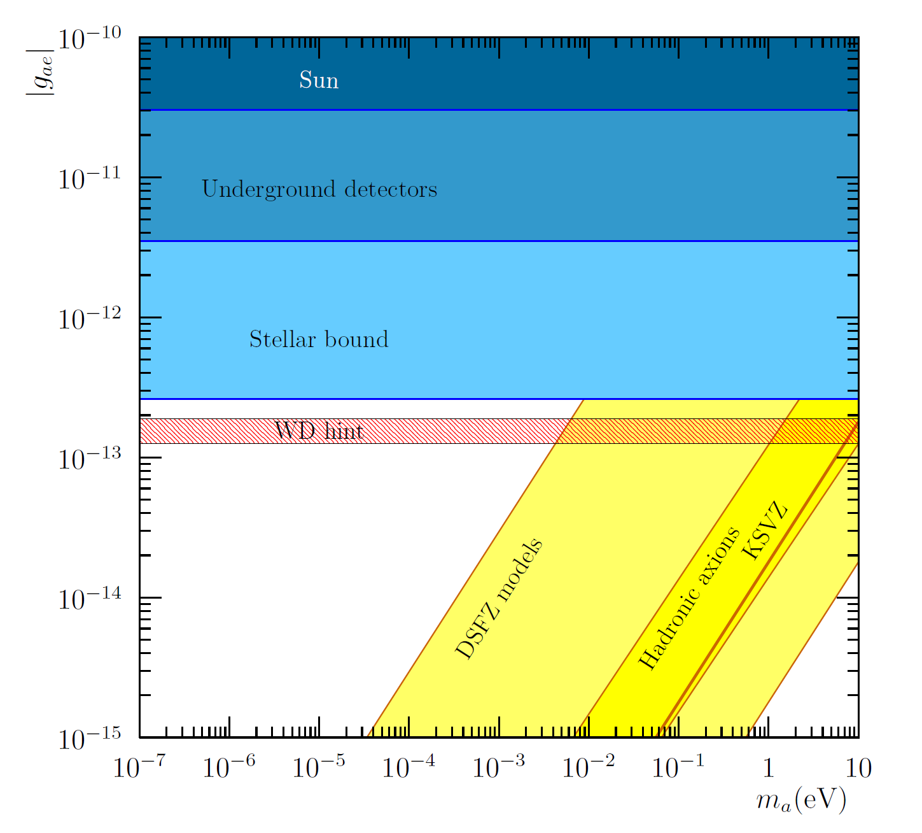
Astrophysical hints for axions
g_{aγ}
g_{ae}

Slide 34
Axion/ALP searches motivation
“Focuses of interest” in the ALP parameter space
Theory
Astrophysics
Cosmology
Generic
ALP DM models

Slide 35
Cosmological axions
  When T ~ T_{QCD}
  <a_{phys}> → 0
Axion strings
Domain walls
Axion realignment
(initial misalignment angle?)
But also… topological defects
(inflation can wipe them out if it happens afterwards)
Note: thermal production of axions (as neutrinos) gives hot DM (upper limit ma~1 eV)

Slide 36
Axion DM density vs axion mass
Axions are good DM candidates → for which m_{a} do we get Ω_{a} ~ Ω_{DM} ?
  Pre-inflation models → only misalignment contribution, but initial angle unknown → very large m_{a} range possible (even very low m_{a} values with anthropic tuning)
  Post-inflation models → misalignment becomes more predictive as initial angle gets averaged. BUT, topological defects are now important ( source of uncertainty).
In any case, for Ω_{a} < Ω_{DM} → m_{a} increases as m_{a} ~ Ω_{a}⁻¹
Note: thermal production of axions (as neutrinos) gives hot DM (upper limit m_{a}~1 eV)

Slide 37
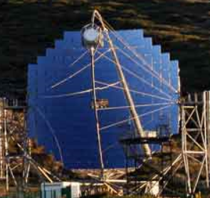




Astrophysical hints for axions
Gama ray telescopes like MAGIC or HESS observe HE photons from very distant sources…
ALP:

Slide 38




Astrophysical hints for axions
Most stellar systems seem to cool down faster than expected.
Presence of axions/ALPs offer a good joint explanation (Giannotti et al. JCAP05(2016)057 [arXiv:1512.08108])
Parameters at reach of IAXO
Red Giants
White dwarfs
g_{aγ}
g_{ae}
Neutron star
CAS A

Slide 39
Irastorza & Redondo PPNP 2018

Slide 40

Sources of axions
Natural sources
Laboratory sources
Photon-ALP conversion in strong magnetic fields (axion-photon coupling)
ALP fields from macroscopic bodies (fermionic couplings)
Dark matter
Dark radiation
Stellar

Slide 41

Axion detection strategies
Most detection strategies rely on the axion-photon conversion

Slide 42


ALP generic couplings

Slide 43

IAXO & meV axion cosmology
“ALP miracle” region
ALPs solving both
DM & inflation
Daido et al. 2017
arXiv:1710.11107
IAXO will explore viable
QCD axion DM models
Ringwald, Saikawa 2016
arXiv:1512.06436

Slide 44


Other types of helioscope
Instead of magnetic field, one can use the electromagnetic field of crystals…
« Primakoff-Bragg » effect
WIMP-like experiments provide limit to axions: SOLAX, COSME, DAMA, EDELWEISS, CDMS, etc…
Characteristical temporal pattern:
axions

Slide 45


Other types of helioscope
« TPC in a magnetic field »: conversion and absorption happening in the gas
Competitive only for high axion mass ~0.1-10 eV
No coherence, but large volume can compensate. Also no preferred direction, so no tracking needed
axions
Galán et al, arXiv:1508.03006

Slide 46




Solar axions
Solar axions produced by photon-to-axion conversion of the solar plasma photons in the solar core
axions
Solar axion flux at Earth
van Bibber PRD 39 (89)
CAST JCAP 04(2007)010

Slide 47
Solar Axions
In addition to Primakoff, “ABC axions” may be x100 more intense… but model-dependent.
axions
Non-hadronic “ABC” Solar axion flux at Earth
JCAP 1312 008
* if the axion couples with the electron (g_{ae})
(non hadronic axion)

Slide 48

Axion helioscopes
Axion helioscope concept
P. Sikivie, 1983
+ K. van Bibber, G. Raffelt, et al. (1989)
(use of buffer gas)
axions
Transverse magnetic field (B)
L
X ray
detector
X ray

Slide 49



Buffer gas for higher masses
Coherence condition (qL << 1) is recovered for a narrow mass range around m_{γ}
axions
Transverse magnetic field (B)
Buffer gas
L
X ray
detector
X ray
N_{e}: number of electrons/cm³
r: gas density (g/cm³)

Slide 50


IAXO – Concept
IAXO
International Axion Observatory
Enhanced axion helioscope: JCAP 1106:013,2011
4+ orders of magnitude better SNR that CAST

Slide 51




IAXO magnet
TOROIDAL CONFIGURATION
specifically built for axion physics
Each conversion bore (between coils)
600 mm diameter
Cryostat
Cold mass
Magnetic length 20 m Total cryostat length 25 m
Bores go through cryostat

Slide 52

IAXO x-ray optics
X-rays are focused by means of grazing angle reflection (usually 2)
Many techniques developed in the x-ray astronomy field. But usually costly due to exquisite imaging requirements
ABRIXAS spare telescope, in use in one of the 4 bores of CAST
(pioneer use of x-ray optics in axion research)
Focal length

Slide 53
IAXO x-ray optics
Each bore equipped with an x-ray optics
Exquisite imaging not required
BUT need cost-effective way to build 8 optics of 600 mm diameter each.

Slide 54


IAXO x-ray optics
Technique of choice for IAXO: optics made of slumped glass substrates coated to enhance reflectivity in the energy regions for axions.
Same technique successfully used in NuSTAR mission, recently launched
The specialized tooling to shape the substrates and assemble the optics is available
Hardware can be easily configured to make optics with a variety of designs and sizes
NuSTAR optics assembly machine
NuSTAR telescope
~400 mm Ø

Slide 55



IAXO x-ray optics
IAXO optics conceptual design
AC Jakobsen et al, Proc. SPIE 8861 (2013)

Slide 56


IAXO low background detectors
8 detector systems
Baseline: small Micromegas-TPC chambers:
  Shielding
  Radiopure components
  Offline discrimination

Slide 57

IAXO technologies – Baseline
IAXO detectors
Micromegas gaseous detectors
Radiopure components + shielding
Discrimination from event topology in gas
Long trajectory in CAST
Zaragoza + CEA + Bonn + others expertise
IAXO detectors
Ingrid detectors
Better threshold
U. Bonn
MMC (Magnetic Metallic Calorimeters)
TES (Transition Edge Sensors)
Very good E resolution & threshold
Heidelberg + CEA + CNSMS
Low noise CCDs
Optics+detector IAXO pathfinder system
(in operation in CAST during 2014-5)
Solar axion spectroscopy:
Axion-electron ABC spectrum
Axion mass determination
5 mm
8.5 mm
Calibration photons (source 14 m away) focused onto the Micromegas

Slide 58


Additional physics cases
Use of (Baby)IAXO large magnetic volume for axion DM setups.
Various possible arrangements in IAXO. Leverage the huge magnetic volume available:
  Single large cavity tuned to low masses
  Thin long cavities tuned to mid-high masses. Possibility for directionality. Add several coherently? → e.g. RADES R&D
  Pick-up coils for vely low mass detection
RADES concept: array of small cavities interconnected with irises:
Installed successfully in CAST last year, and first engineering run took place Nov-Dec2017

Slide 59

Additional IAXO physics cases direct detection or relic axions/ALPs
Promising as further pathways for IAXO beyond the helioscope baseline
First indications that IAXO could improve or complement current limits at various axion/ALP mass ranges…
Caution: preliminary studies still going on. Important know-how to be consolidated. Precise implementation in IAXO under study.
sensitivity prospects to be considered tentative
See J. Redondo, talk at Patras2014, CERN

Slide 60


RADES
V is usually linked with
m_{a} ( V ~ 1/m_{a}³ )
how to go to much higher V and higher m_{a} ?
Haloscope FOM:
RADES concept: array of small cavities interconnected with irises:
  No need to phase match externally
  Clear prescription to optimize coupling to axion:
  Robust and flexible scaling up
  Preference for long aspect-ratio: CAST (and IAXO) magnets
  Problem: how to tune.
First RADES cavity with 5 subcavities, non-tunable (f = 8.5 GHz; m_{a} = 34.75 μeV)

Slide 61
RADES in CAST
Installed successfully in CAST last year, and first engineering run took place Nov-Dec2017

Slide 62
RADES in CAST
Sensitivity to (optimistically coupled) QCD axions with this very simple setup.
Only a factor of a few away from KSVZ.
[But at a fixed m_{a} value]
Challenge for next runs:
Larger cavities
Tuning
RADES
QCD axion
band

