Slide 1
Intro to Collaboration meeting
Where are we?
Critical Decisions? Potential show stoppers?
Prepare phase transition for innovation partnership
Phase II of experiment → WPs: Magnet, Booster, … Shape of collaboration: Where do we need more help?
A bit of terminology

Slide 2
Bottlenecks last meeting:
Where are we now?
Manpower & financial situation → IMPROVING, still subcritical
Understanding of reflections and losses → see presentations
Magnet for characterizations needed! → ALPS & CEA ERC
Prototype magnet can not be used for physics? → CEA ERC
Complicated booster Mechanics & Cryogenics → Design phase
Our quota! → 100% improvement!

Slide 3
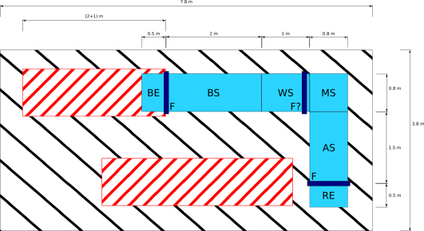
Critical Decisions last meeting
Which mass range to cover → Already taken?? At least for the start → ~20 GHz → 1mm thick discs; ~10mm displacement
Magnet: Interfaces → Design pending → Booster vessel as defined earlier → Thermal shield
Characterization & Prototype Magnet → Demonstrator and Prototype → Where to set it up? → Characterization measurements → First physics
Nec. booster temparature → As low as possible around 4K → Plan with ~LHe temperature, should be ok
Influence of mini clustering? → Up to 60% in MC → need to gain Factor 2 in sensitivity elsewhere?
Axion line shape → ?? Stay with Δν~10⁻⁶ for the time being

Slide 4
Critical Decisions last meeting
Characterization & Prototype Magnet → Demonstrator and Prototype → Where to set it up? → Characterization measurements → First physics
Nec. booster temparature → As low as possible around 4K → Plan with ~LHe temperature, should be ok
Influence of mini clustering? → Up to 60% in MC → need to gain Factor 2 in sensitivity elsewhere?
Axion line shape → ?? Stay with Δν~10⁻⁶ for the time being

Slide 5
Magnet Project Time Plan 2016:
May 2, 2017
~3 months
Aug. 2018
~12 months
Evaluate how it is most efficient to move on: multiple partners for design, production and characterization?
Design studies
Negotiations
Mutiple partners possible
Nov. 2019
Time Plan from Nov 2016
~15months (?)
Prototype magnet
Mutiple partners possible
Nov. 2020 ?
~12months (??)
Integration of prototype setup, characterization
Evaluation of prototype results, negotiations for final magnet production
Evaluations and negotiations
~ ?? Months ??
Feb. 2021 ?
Final magnet production
? 2022 ?

Slide 6
Magnet Project Time Plan 2018:
Sep, 2017
Dec. 2018
~15 months
Evaluate how it is most efficient to move on: multiple partners for design, production and characterization?
Design studies
Mutiple partners possible
Jun. 2021
~24 + 6 months (?)
Demonstrator & Prototype magnet
Mutiple partners possible
Jun. 2021 ?
~6months (??)
Prototype Integration
Evaluations
of deomsntrator results, negotiations for final magnet production
~ 80 Months
Aug. 2021 ?
Final magnet production
? 2025 ?

Slide 7
Phase transition innovation partnership: Deliversables
For the demonstrator coil
Technical design for demonstrator & prototype
Procurement of Conductor for demonstrator and prototype (Rutherford cable on copper basis)
Tooling (design and procurement) for winding of coils
Definition of cryogenic interfaces
Production of coil(s)
Testing of demonstrator coil under nominal condition (forces and peak field reached)
For the prototype magnet
Availability of coils for prototype magnet (2 coils)
Power supply system
Design and production of cryostat incl. required testing and certifications
Delivery of Di-pole magnet in cryostat including necessary infrastructure
For demonstrator & prototype:
Technical design report and manufacturing drawings incl. detailed design of final magnet & updated cost estimate

Slide 8
Phase transition innovation partnership: Offers
Continuation with either one or two innovation partners!
Project coordination & documentation
Technical design of demonstrator coil and prototype magnet (infrastructure, incl. Cryostat, etc.)
Build and test demonstrator
- Procurement of conductor
- Establishing of tooling - Production of coil(s) - Testing of demonstrator coil
Build and deliver prototype (full setup: two coils in cryostat with power supply,
ready to ship)

Slide 9
Phase transition innovation partnership: Offers
Continuation with either one or two innovation partners!
Evaluation criteria:
As defined in tender documentation:
Assessment factor
Procurement costs of final magnet
Operating costs for final magnet
Construction time for final magnet
Magnet cooling
Interface to haloscope
Shielding of stray magnetic fields
Additionally the following criteria will be applied:
Concept for quench protection
Homogeneity of field
Recommendation by external expert committee
?
?
?

Slide 10
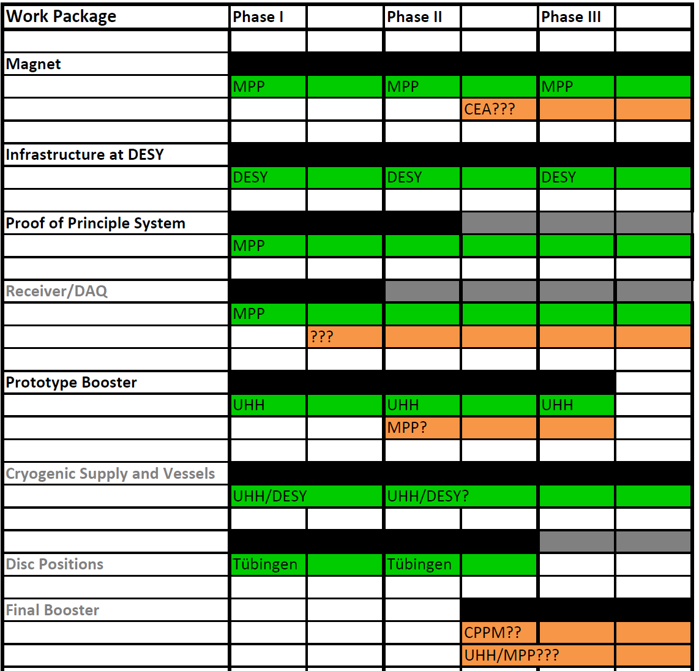
Phase transition for whole project:

Slide 11
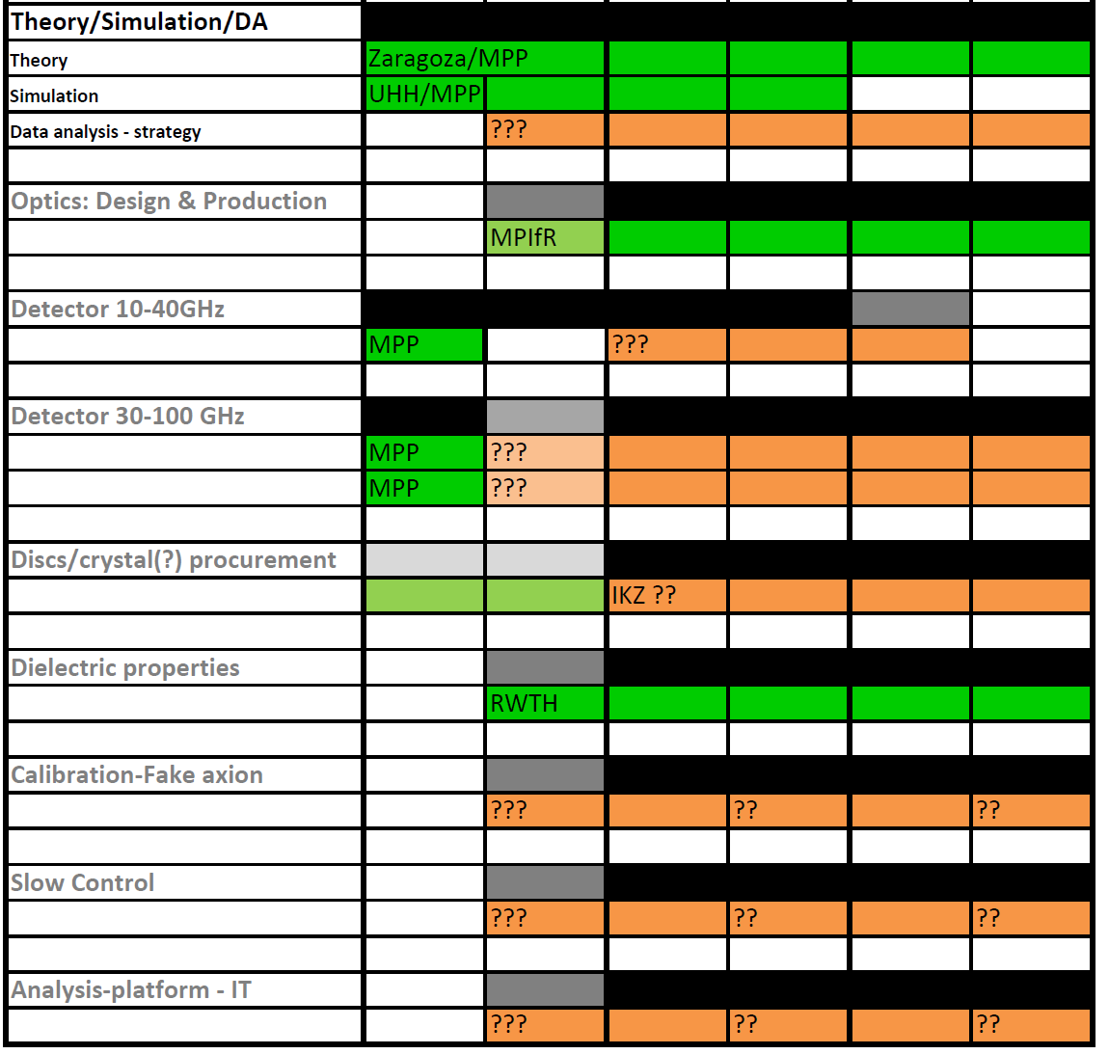
Phase transition for whole project:

Slide 12
Shape of collaboration:
 | Aachen |  | DESY | Uni Hamburg |  | MPP, München |  | Tübingen | MPIfR | Saclay CEA | Zaragoza |  | Total
 | available | hiring |  | available | hiring | available | hiring
Man/PI | 0.4 |  | 0.3 | 0.5 |  | 0.8 |  | 0.1 | 0.1 |  |  |  | 2.2
Exp Staff |  |  |  |  |  | 0.7 |  |  | 0.4 |  |  |  | 1.1
Exp PD |  | 1 | 0.5 | 1 | 1 | 2 |  | 0.3 |  |  |  |  | 5.8
Exp PhD |  |  |  |  |  | 1 | 1 |  |  |  |  |  | 2
Eng |  |  |  | 2 |  | 1.2 |  |  |  |  |  |  | 3.2
Tech Staff |  |  |  |  |  | 0.7 |  |  |  |  |  |  | 0.7
Th Staff |  |  |  |  |  | 0.6 |  |  | 0.1 |  | 0.2 |  | 0.7
Th PD |  |  |  |  |  | 0.5 |  |  |  |  | 0.3 |  | 0.5
Not bad for a start
But Phase II & III needs MORE!
→ IKZ / CPPM / ???

Slide 13
Phase transition for whole project:

Slide 14
A little bit of terminology
Booster+Vessel
Magnet
Seed setup
Block design
Cos theta design
Phase I
Proof of principle system
Booster
Receiver
Antenna
Phase II
Prototype booster
Booster endcap (BE)
Booster section (BS)
Waveguide section (WS)
Mirror section (MS)
Antenna section (AS)
Receiver endcap (RE)
Demonstrator magnet
Prototype magnet
Phase III
Final booster system
B.F.M.

Slide 15
A little bit of terminology
Bandwidth Boost factor Axion line Mirror Receiver
Boost Amplitude Power
Mirror parabolic copper
… you continue

