Slide 1
Approach to Quench for the MADMAX Magnet
MADMAX Fall Meeting – Zaragoza – 08-09 October 2018
C. Boffo – Bilfinger Noell GmbH

Slide 2
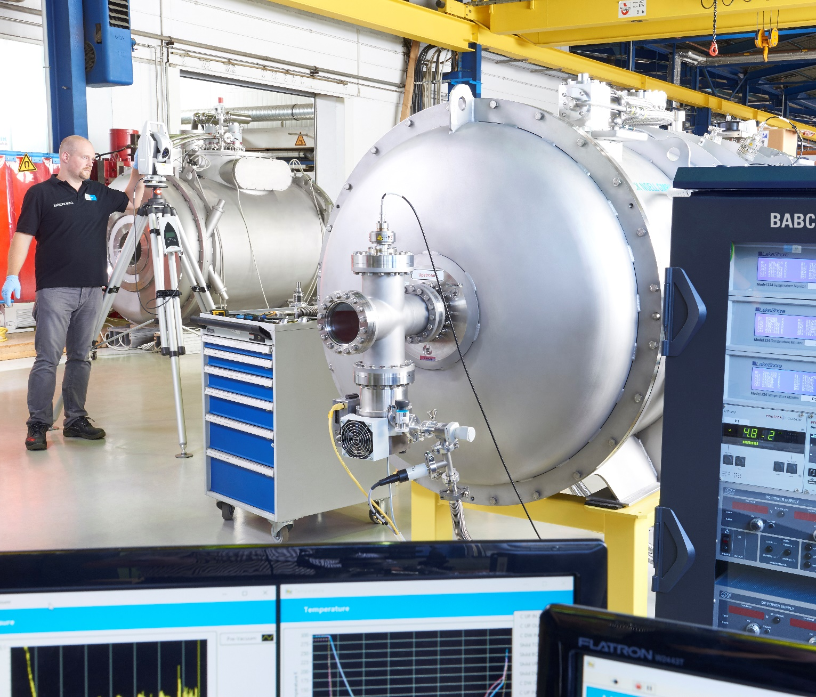
Outline
Magnet concept
Stability of SC wires
Cryostable vs Adiabatic
Quench Detection and Protection
Case
Conclusion
C. Boffo – Bilfinger Noell GmbH – Innovation is our Tradition
Page 2

Slide 3
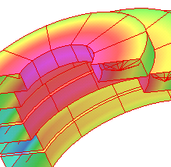
Framework
of the Design
Figure of Merit
Homogeneity
100 T²m²
Superconductor: NbTi
Better than +/-5 % on the disk surface assuming negligible distribution along length.
Fringe Field
Length
Bore
Cooling
Fringe field should be within 50 mT in a range between 4 to 10 m.
Evaluation of length impact (0.5 to 2.0 m) on cost and performance
Warm bore (or intermediate temperature) for maximum flexibility of the system. The coils inner diameter is 1.5 m with 1.25 m disks.
Different options based on level of heat losses in operation and during ramping (15 minutes to max current).
C. Boffo – Bilfinger Noell GmbH – Innovation is our Tradition
Page 3

Slide 4
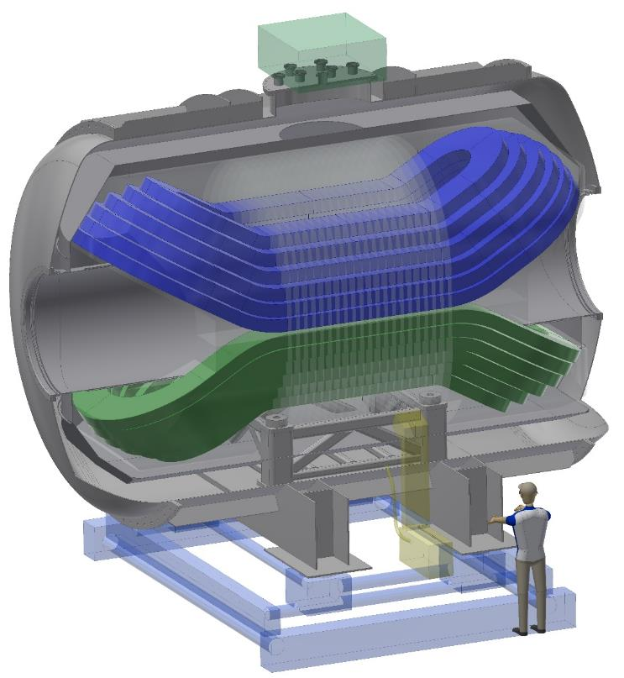
Magnet How it could look like
Weight: < 200.000 Kg
Length: 6900 mm
Diameter: 4400 mm
Warm bore: 1350* mm
Superconducting cable: 35.000 m
Bela
Superconducting wire: > 700.000 m NbTi
Operating temperature: ~2 K
C. Boffo – Bilfinger Noell GmbH – Innovation is our Tradition
Page 4

Slide 5
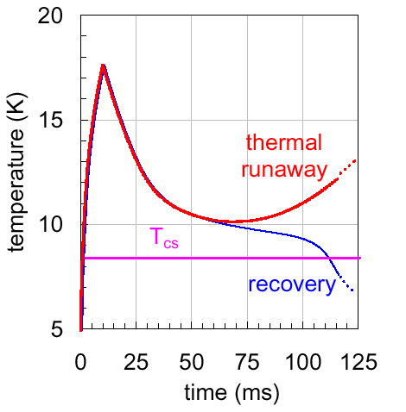
Stability in Superconducting Magnets
Stability is the capability of a superconducting magnet to operate reliably under external disturbances such as:
Mechanical:
-Wire motion
-Structure deformation
-Epoxy craking
J. G. Weisend II
Electromagnetic:
-Current transient
-Field transient
-Flux jump
Thermal:
-Conduction
-Lack of cooling
Stability margin is the minimum energy density that leads to a quench
C. Boffo – Bilfinger Noell GmbH – Innovation is our Tradition
Page 5

Slide 6
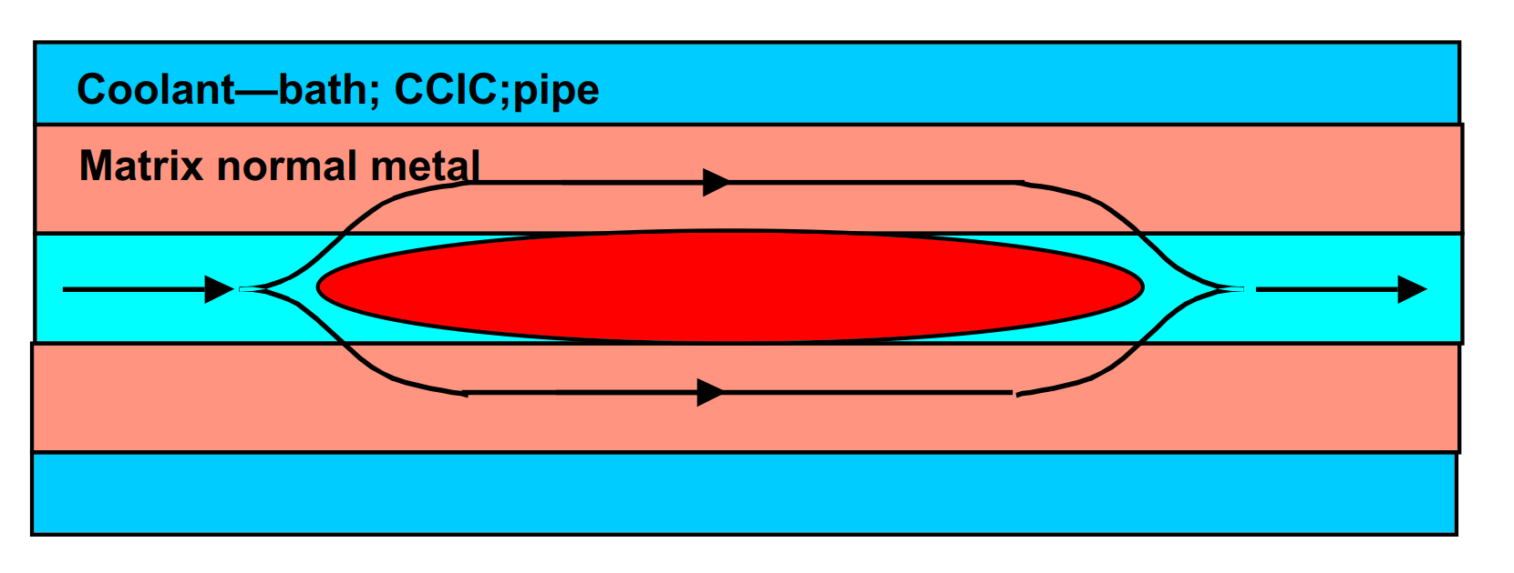
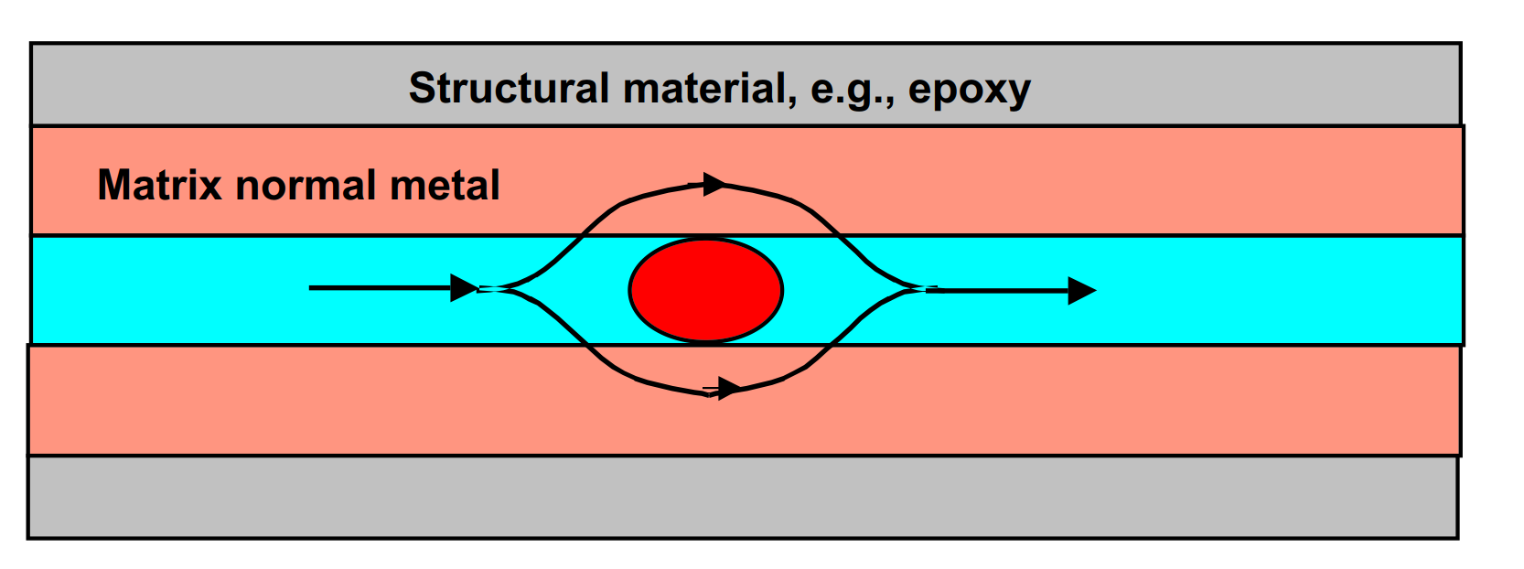
Cryostable vs Adiabatic
magnet will recover regardless of size of normal zone
magnet will recover if normal zone is not too big
Stekly Criteria – most conservative, doesn’t account for end cooling
Hot spot temperature management required in case of non recovery
Equal area theorem takes into account the cooling of the conductor via conduction at the ends
Active quench protection might be required
Optimized for safety and stability with coolant in close contact with conductor
Optimized for performance with coolant in the vicinity of the conductor
C. Boffo – Bilfinger Noell GmbH – Innovation is our Tradition
Page 6

Slide 7
Quench detection and Protection
Rapidly and precisely detect a quench and safely extract the energy from the system:
Possibly distribute energy evenly in the magnet
Quench heaters
Use an external energy storage
External dump resistors
Subdivide the magnet with voltage taps and build a bridge circuit that cancels-out voltage due to ramping
Apply redundancy in order to minimize risks
Measurements such as temperature, helium level or vacuum level can be used to look for precursors to trouble
Achieve a healthy balance between interlock and magnet operability.
C. Boffo – Bilfinger Noell GmbH – Innovation is our Tradition
Page 7

Slide 8
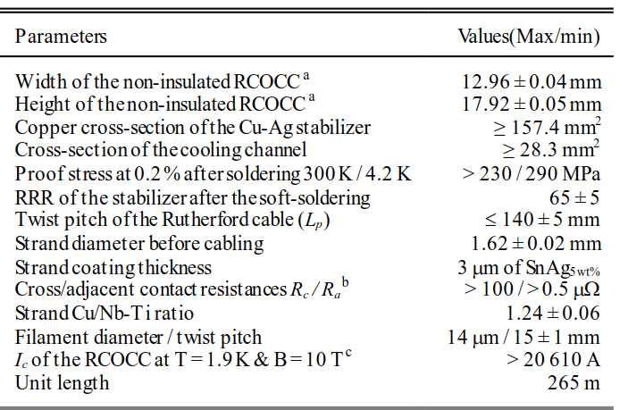
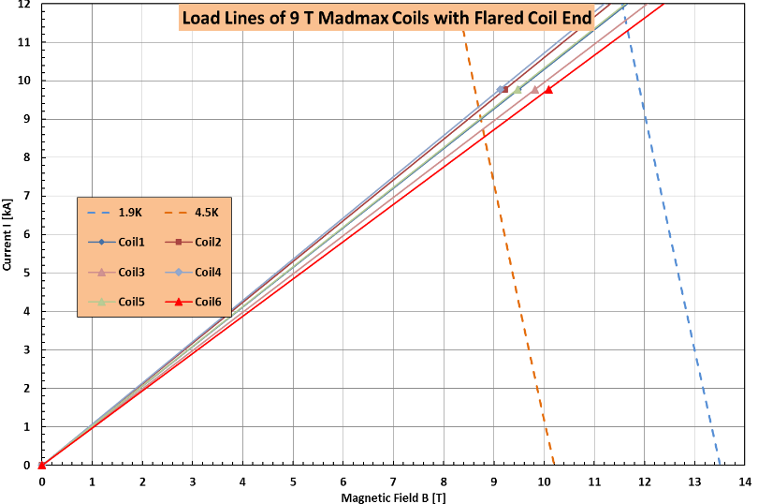
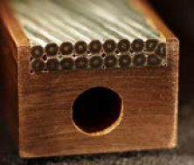
Magnetic Design Superconductor
4.5 K
1.9 K
Existing cable designed by CEA/CNRS
for the LNCMI hybrid magnet being manufactured at Noell
C. Boffo – Bilfinger Noell GmbH – Innovation is our Tradition
Page 8

Slide 9
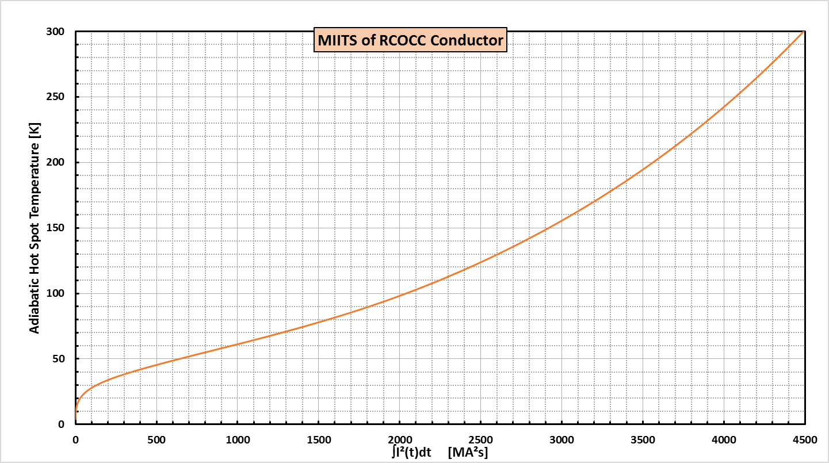
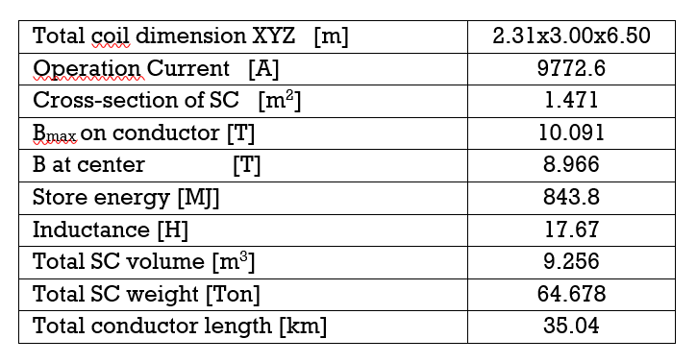
Quench Behavior Parameters
MIITS evaluated using RCOCC Cable
MIITS evaluated using RCOCC Cable
Inductivity matrix extrapolated from energy in OPERA
Inductivity matrix extrapolated from OPERA
Quench protection scheme using external dump resistor
Quench protection scheme using external dump resistor
C. Boffo – Bilfinger Noell GmbH – Innovation is our Tradition
Page 9

Slide 10
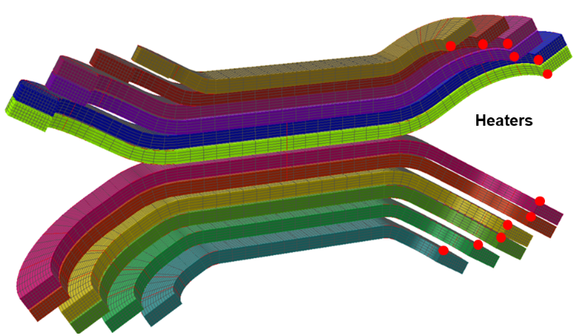
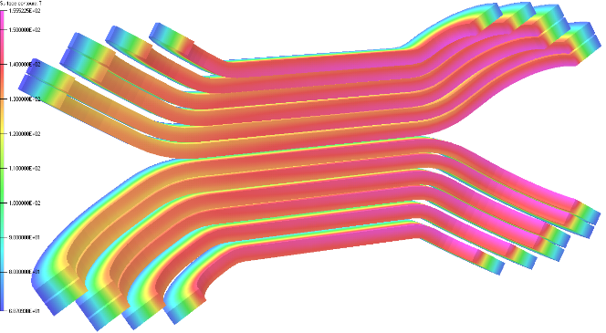
Quench Behavior 3D Adiabatic method (OPERA)
The whole energy released during a quench is absorbed by the coils and the external dump resistor
High Cu/SC ratio of 10 and large filling factor lead to lower quench propagation velocity and good thermal conduction
In the model a quench is induced in coil 6 by firing a 160 W heater for 50 ms
To reduce the hot spot temperature heaters are fired in coils 1 to 5 for 50 ms starting at 100 ms from quench start
Model with 37000 elements
t = 80 s, T_{max} = 155.5 K
C. Boffo – Bilfinger Noell GmbH – Innovation is our Tradition
Page 10

Slide 11
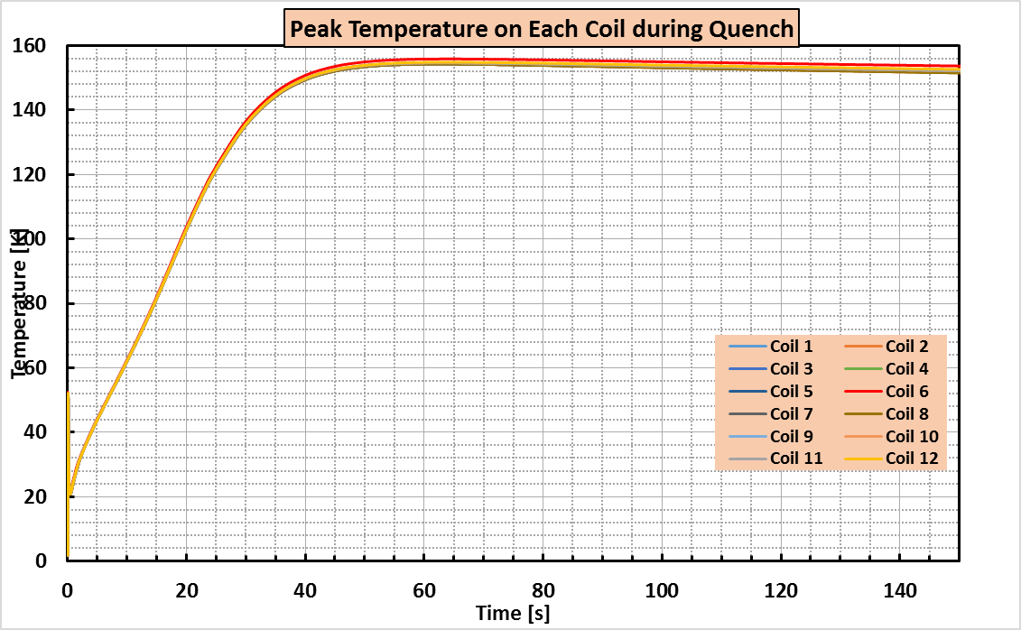
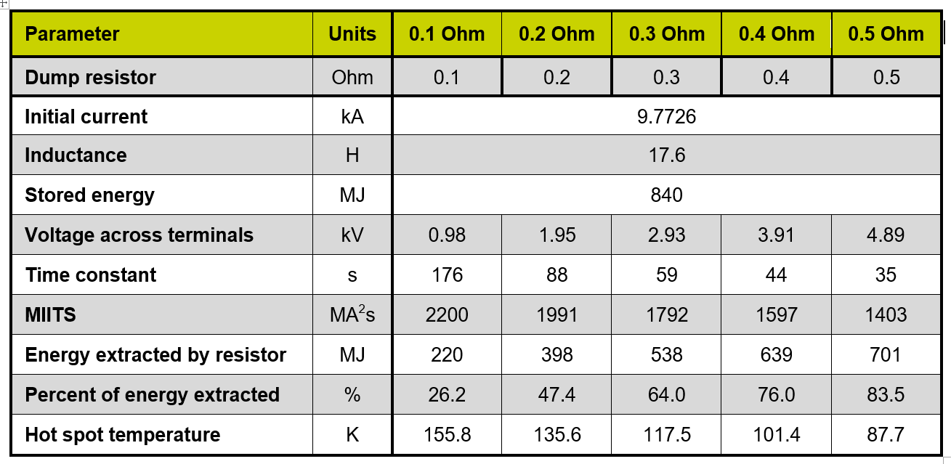
Quench Behavior 3D Adiabatic method (OPERA)
The heater output had to be carefully optimized due to the slow quench velocity of the system (quench start 55 K)
Peak hotspot temperature 155.5 K with 0.1 Ohm resistor and 87.7 K with 0.5 Ohm resistor
MIITS Calculations consistent with OPERA model with a starting temperature of 55 K
Peak voltage across terminals <5kV
Energy adsorbed by the dump resistor up to 83.5%
C. Boffo – Bilfinger Noell GmbH – Innovation is our Tradition
Page 11

Slide 12
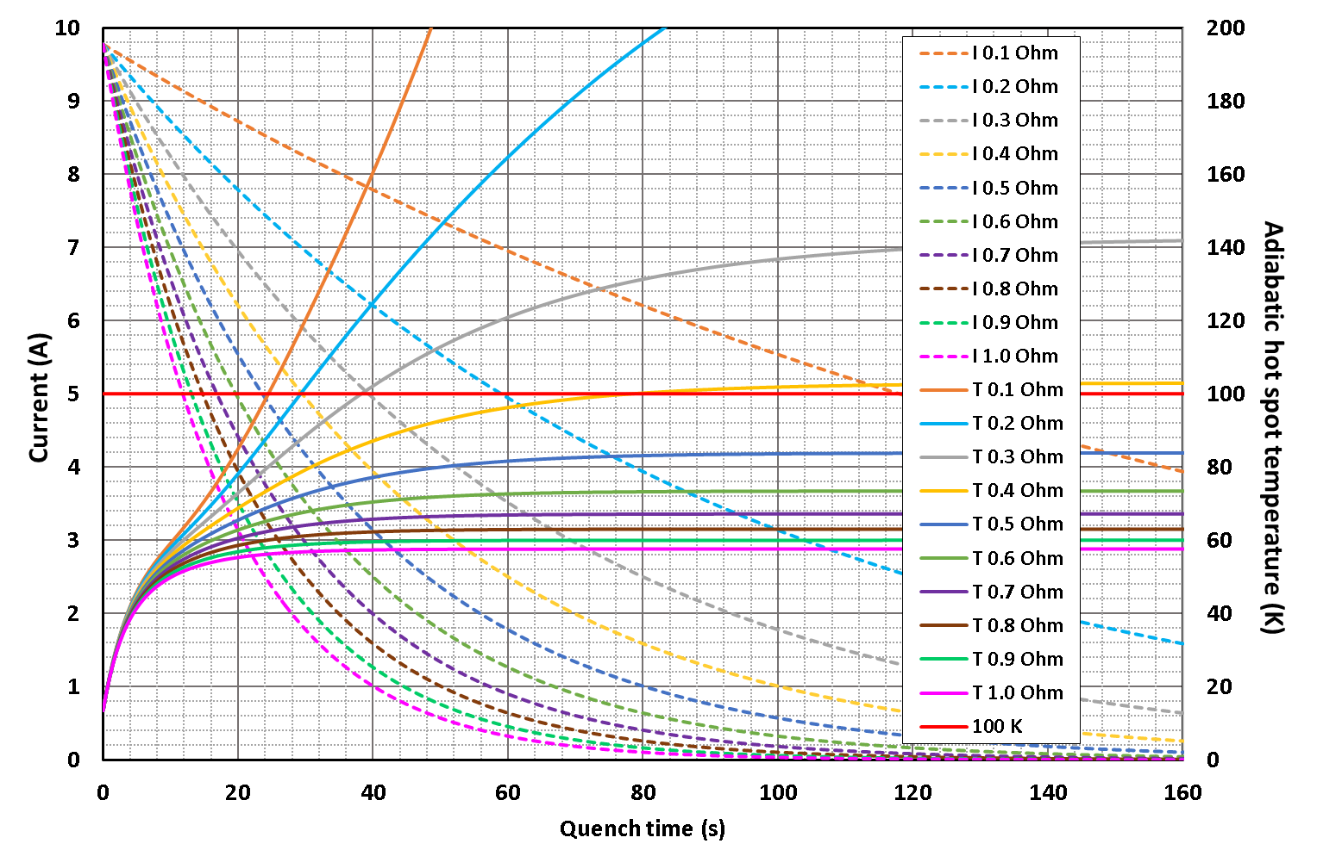
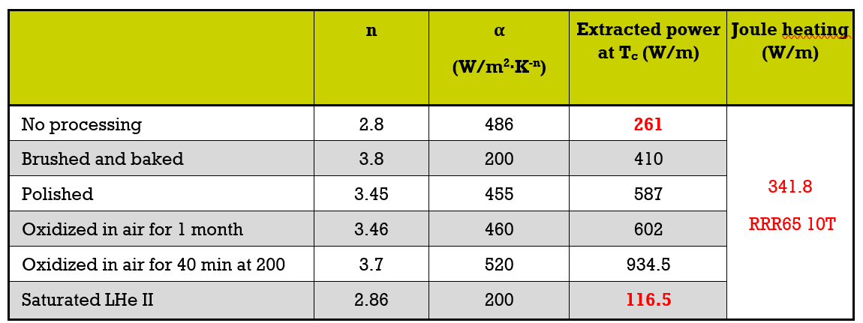
Quench Behavior Cryostability method
Balance between energy generated and extracted
No quench propagation
Extracted energy function of Kapitza resistance
System IS ALMOST CRYOSTABLE
Dump resistor 0.5 Ohm: peak voltage ~ 5 kV and peak temperature ~83 K
P. Fazilleau et al., “Final Design of the New Grenoble Hybrid Magnet,” IEEE Trans. Appl. Superc., vol. 22, No.3, 2012.
C. Boffo – Bilfinger Noell GmbH – Innovation is our Tradition
Page 12

Slide 13
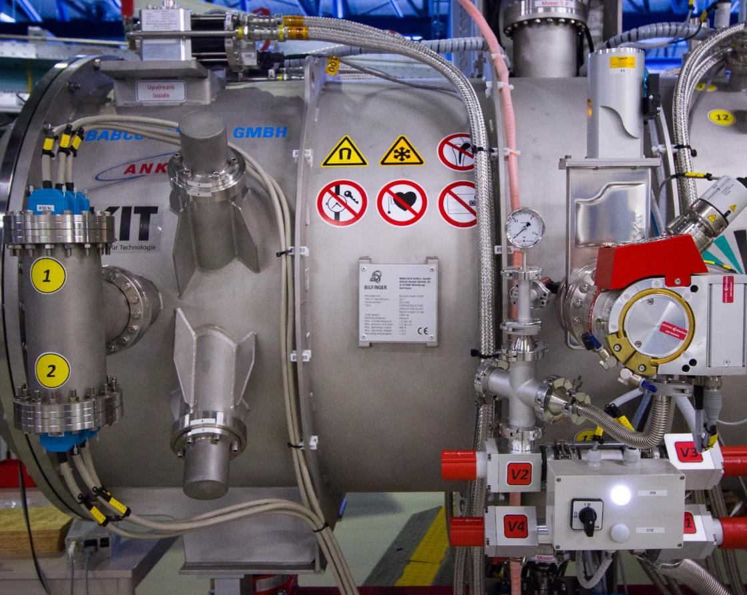
Summary
SC CABLE DESIGN AVAILABLE
Eliminates the need for cable development with a positive impact on the project schedule
QUENCH IMPACT EVALUATED
The conductor has been checked against both cryostable and adiabatic models
0.5 OHM DUMP RESISTOR
Optimal conceptual solution for both models
5kV INSULATION
Both solution allow to keep voltages below acceptable limits
<100 K HOT SPOT
Both solution allow to keep the temperature within a safe range
Page 26

Slide 14
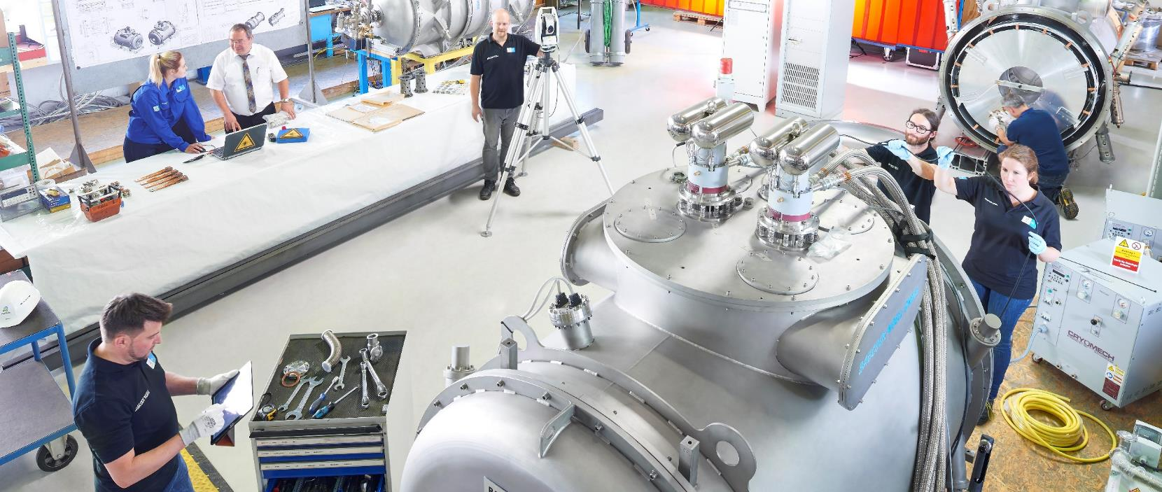
Together toward the Future

