Slide 1
Towards a Specification of the MADMAX Prototype Cryostat
Christoph Krieger
University of Hamburg
Joern Schaffran
DESY

Slide 2
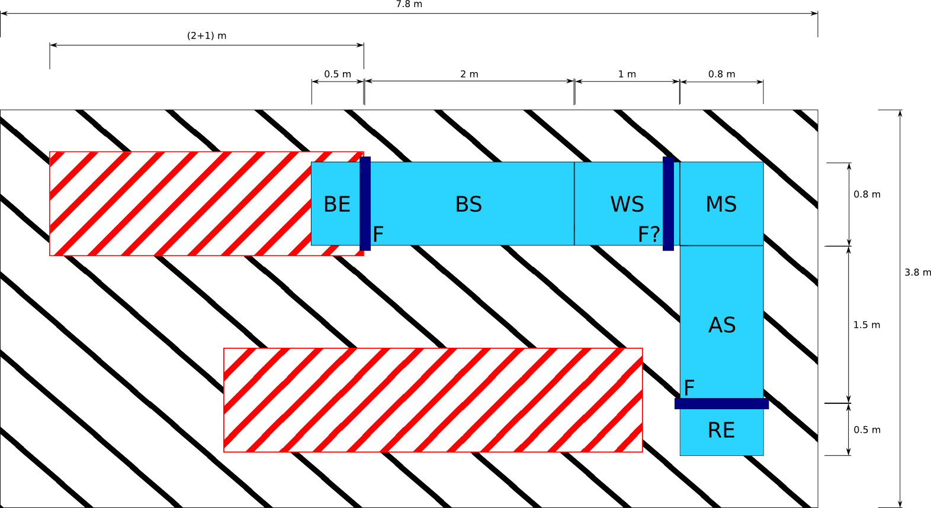
Sketch of the cryostat
Based on sketch by Olaf (not changed since 22.06.18)
L-shape preferred (ExeB call 18.07.2018)
Inner vacuum vessel: 400 mm inner diameter
Single mode of operation: 4 K
Divided in sections:
Booster endcap (BE)
Booster section (BS)
Waveguide section (WS)
Mirror section (MS)
Antenna section (AS)
Receiver endcap (RE)
Three flanges/intersections (Access to booster mechanics, antenna/receiver and for commissioning)
Reserved area for Booster retraction
Reserved area for electronic cabinets and infrastructure

Slide 3
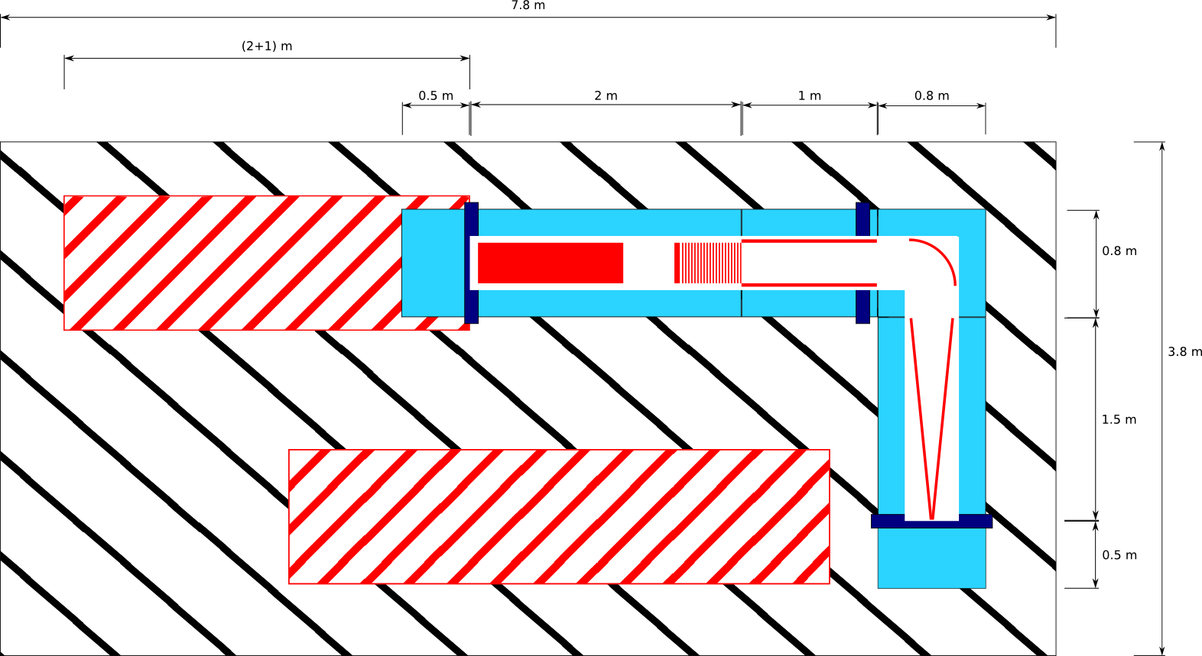
Sketch of the cryostat
Based on sketch by Olaf (not changed since 22.06.18)
L-shape preferred (ExeB call 18.07.2018)
Inner vacuum vessel: 400 mm inner diameter
Single mode of operation: 4 K
Divided in sections:
Booster endcap (BE)
Booster section (BS)
Waveguide section (WS)
Mirror section (MS)
Antenna section (AS)
Receiver endcap (RE)
Three flanges/intersections (Access to booster mechanics, antenna/receiver and for commissioning)
Reserved area for Booster retraction
Reserved area for electronic cabinets and infrastructure
Antenna movable?

Slide 4
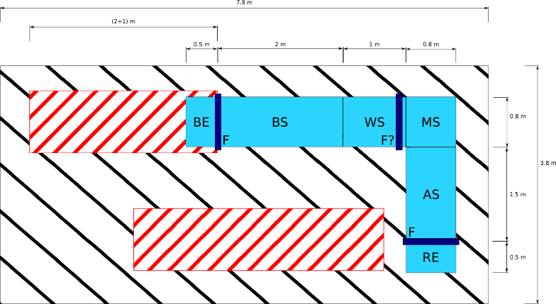
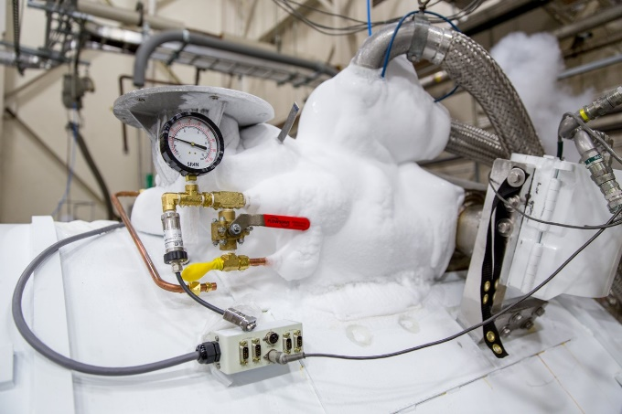
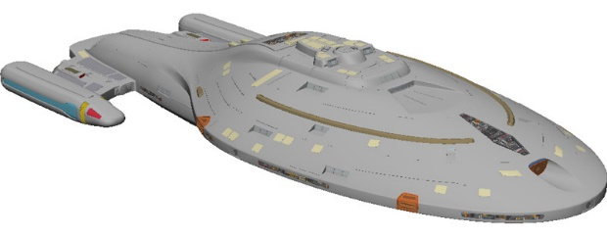
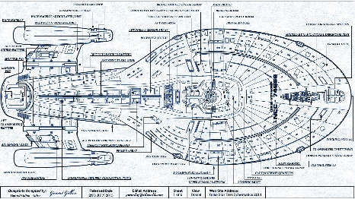
Towards the cryostat
Sketch
Cryostat (image similar)
Company
Jörn & Christoph
Companies
We are here!
Specification document
Design proposal

Slide 5
Specification document
Need to specify the cryostat for companies to propose designs (and build the cryostat)
In the end: ~ 60 pages (estimate by Jörn):
Specification of the inner vacuum vessel housing the MADMAX prototype “organs”
Specification of interfaces (mounts, feedthroughs, etc.)
Specification of cryostat (type of cooling, insulation layers, etc.)
Specification of diagnostics (temperature and pressure sensors, etc.)
Specification of materials and manufacturing technics to use
Specification of test procedures and engineering standards to follow
Many more…
Current status: started with preparatory work for the specification document (gathering information and decisions…)
When specification document is complete → call for designs and tender
Decide for a specific design (with external experts) and place order
Specification document

Slide 6
Some known facts
Inner diameter of inner vacuum vessel: 400 mm
Inner vacuum: 10⁻⁶ mbar at room temperature
Mode of operation: whole cryostat cold mass at 4 K
Approximate dimensions (see sketch)
Outer diameter of cryostat: 700 to 800 mm (realistic ballpark number)
Bath cooling, no forced flow helium
Operation with Dewars (fill cryostate from Dewars, no helium lines)
Possibility to inject helium into vacuum vessel to increase heat conductivity for cooldown of discs etc.
Cryostat has to be suited for high magnetic fields (at least partially)
Need to keep heat load low to increase time between refills (Dewar operation)

Slide 7
Simplified cross section
Ø 700 to 800 mm
Outer shell
Isolation vacuum
Multi-layer insulation (MLI)
Liquid Nitrogen bath (pressure vessel)
Thermal shield
Isolation vacuum
MLI
Liquid Helium bath (pressure vessel)
Inner vacuum vessel
Not shown: supports for cold mass
Ø 400 mm
Not to scale!

Slide 8
Open questions
Size of prototype magnet (especially diameter of warm bore, avoid force fit!)
Stray field of magnet? (Return yoke? Impact on electronics, pumps, etc.?)
Space required for prototype magnet and its infrastructure
Are vibrations of vacuum pumps an issue? (inner vacuum & isolation vacuum)
Maximum weight of cryostat? (depends on location and available cranes)

Slide 9
Open questions
Need information on inner “organs” as soon as possible to start specification document: Booster, Waveguide, Parabolic Mirror, Antenna & Receiver
Responsible needed for each “organ” (Booster → UHH, Michael)
Information needed for each “organ”:
Interfaces: mounts, mechanical and electrical feedthroughs (type & number)
Thermal connection necessary?
Electrical ground connection necessary?
Weight?
Expected thermal stress (on mounts)?
Expected heat load?
Reliable dimensions?
Don’t forget: “organs” have to be installed → access requirements, inner diameter of vacuum vessel is 400 mm!

Slide 10
How to proceed?
What is needed to proceed with specification document?
Responsible and contact person(s) for antenna, waveguide and parabolic mirror
Information on booster mechanics, waveguide, parabolic mirror and antenna
???

Slide 11
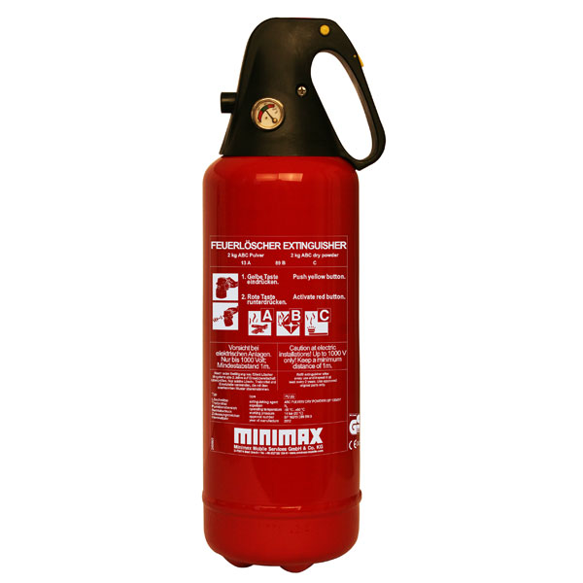
Naming
Can we name it MiniMax (or MiDiMAX) and paint it fire extinguisher red?

Slide 12
Location
From Jörn’s talk of previous CM
Possible to put prototype vessel in North Hall?
Depends on prototype magnet size and infrastructure requirements

