Slide 1
Infrastructure for
Axel Lindner presenting work mainly done by Jörn Schaffran
MADMAX collaboration meeting Zaragoza, October 2018
https://madmaxiot.com/

Slide 2
General
There is no significant change since the last May meeting. See Jörn’s slides at https://indico.mpp.mpg.de/event/5777/session/1/contribution/11/material/slides/0.link
Good news:
QU excellence cluster of Hamburg University approved: DESY will get additional funds for the cryo-platform (details to be clarified).
Position for an engineer at DESY for axion experiments opened.

Slide 3
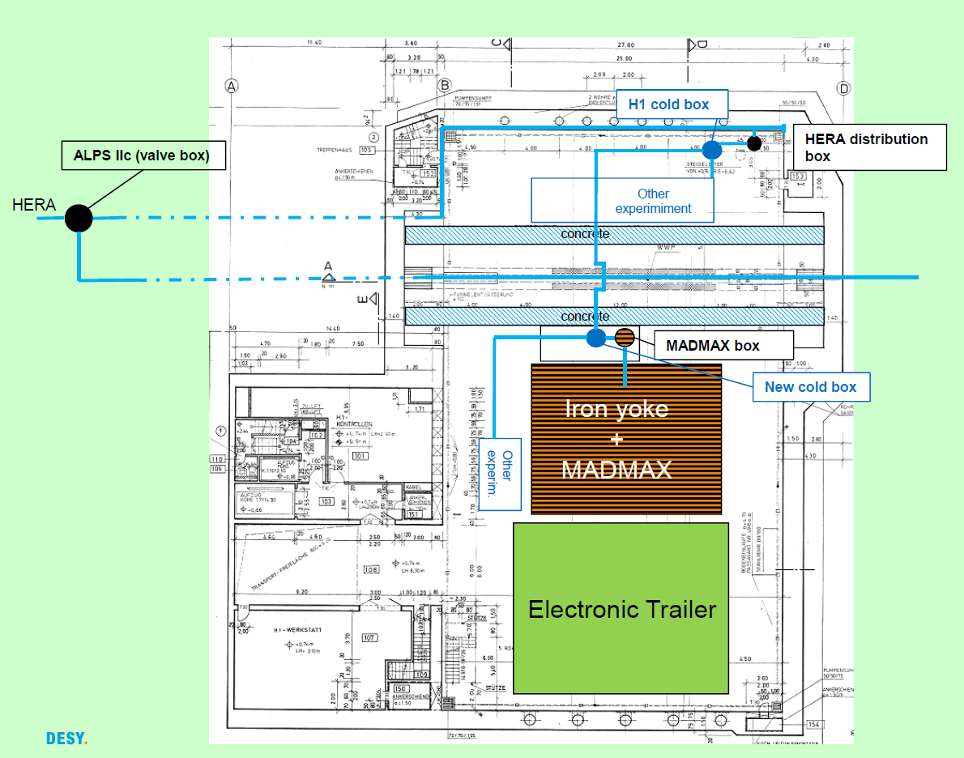
HERA North hall
ALPS IIc
under construction
Cryogenics available in summer 2020
MADMAX
Further smaller scale experiments requiring cryogenics (planning).
Cold mirrors for GWD.
Test magnet for detector R&D.
Have to consider MADMAX magnetic fringe fields!

Slide 4
Some selected details
Power supply
Might be located in the floor above the hall to save space in the experimental area. This floor might also house the dump switch.
Providing 10 kA down the hall might be easier than going for 30 kA.
H1 iron yoke
The yoke is not homogeneous, but consists of plates. This might improve the shielding.
Cutting a large hole might be difficult due to the internal structure of the yoke to compensate for forces. Hence the yoke might have to stay open when housing MADMAX.
A calculation of the forces on the (open) yoke due to the MADMAX fringe fields remains to be done.
Prototype site
Booster: HERA North unclear; potential conflicts with ALPS II are being investigated.
There is very likely no space in HERA North for a prototype magnet; also fringe fields might be a problem for other experiments. Magnetic fringe fields might also be a problem for other potential DESY locations.

Slide 5
Collection of space requirements
item | space [m²] | place (bldg. 51) | comment
magnet | 7 x 6(Ø) | R100/inner yoke | complete inner yoke
cold box (+ dewar?) | 4 x 7 | R100/He plattform | next to distribution system (cryo platform); access from the top necessary
power supply | 6 |  | place depends on suitable distance power supply-magnet
dump switches + dump resistors | 6 | R100 or R601 | close to power supply
current leads |  | R100/yoke? | probably close to magnet
booster vessel (complete) |  | R100/inside magnet and extended outside of the yoke | main part are inside the magnet bore; yoke will not completely closed => gap of ~1.5m
electronics (booster/magnet/ slow control/cryogenic) | 6.5 x 5.5 | R100/electronic tailor | 10 standard racks; dimensions of electronic trailor: ~6.5m x 11m
working places (PC) | 5 x 3 | R100/electronic tailor | 2 PC working places
assembly area |  | work shop? | is this required or a "nice to have"?

Slide 6
Next steps
HERA North hall
Start a 3D modelling of the hall for a more detailed planning.
H1 iron yoke
Understand effect of magnetic fringe field.
Prototype magnet
Need to also estimate fringe field to look for site options.

