Slide 1
Performance and Validation of Jet Calibration in ATLAS
Paola Giovannini
MPP ATLAS-HEC group

Slide 2
Scientific Background
Oct07 PhD candidate at the Technical University Munich
now Marie Curie ERS and IMPRS associate student
Oct 07 Msc In Particle Physics at the University of Bologna
working on beam test data for the LUCID detector in ATLAS
Oct05 Erasmus Student at Trinity college Dublin
Feb06 working on Nanosphere lithography and PLD
July04 DESY summer student
Sept04 working on deep inelastic scattering in ZEUS
July 04 Bsc in Physics at the University of Bologna
working on the bbar production cross section at HERA-B

Slide 3
The Large Hadron Collider
pp collisions
27 km circumference
4 experiments

Slide 4
The Large Hadron Collider
LHC is designed to run at 14 TeV center of mass energy
and at a luminosity of 10³⁴ cm⁻² s⁻¹
After the accident occurred on the 19th of September 2008
a major repair effort has taken place
With the current magnet set-up, collisions are possible
up to energies of 7->10 TeV in the center of mass
In 2010 10 month of data taking are foreseen before
the winter shutdown… ☺

Slide 5
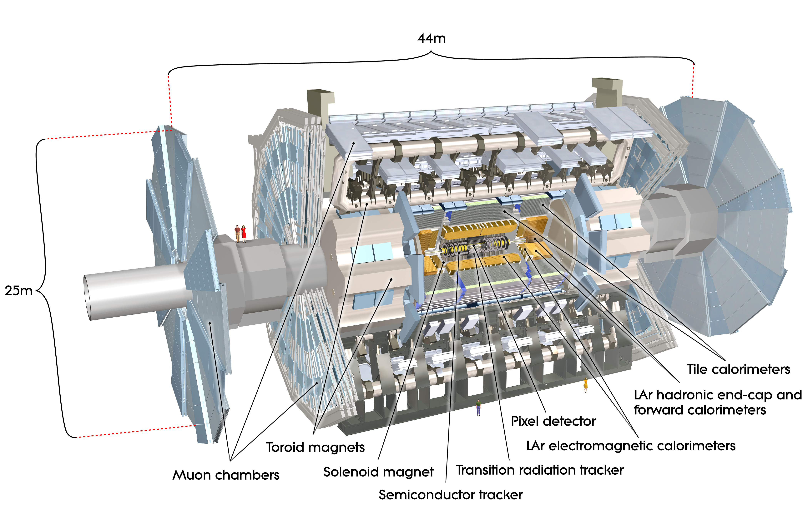
The ATLAS Experiment
is a collaboration of 2900 physicists from 37 countries
700 of them are PhD students
ATLAS has a multi-purpose detector :

Slide 6
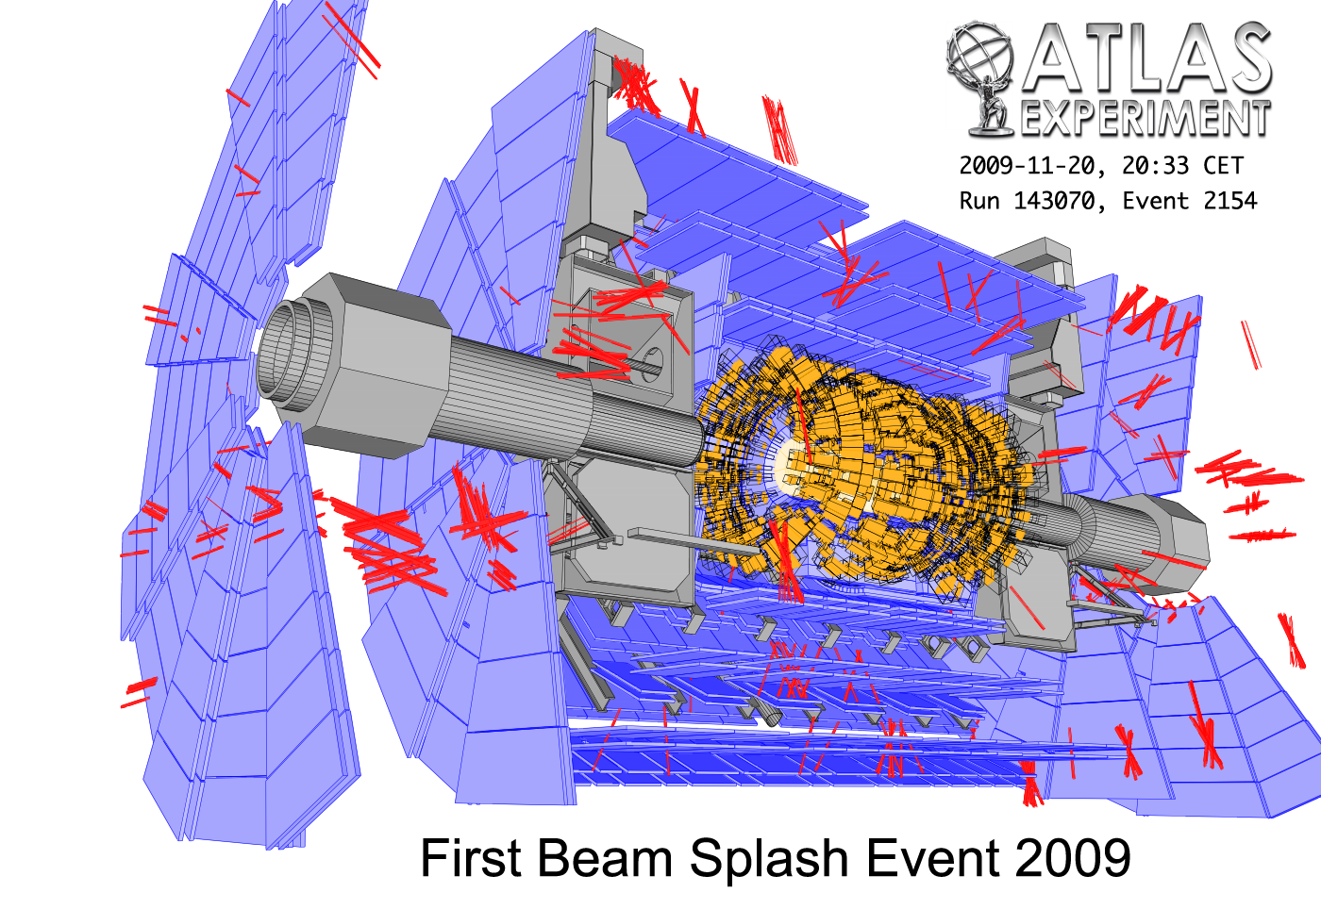
The ATLAS Experiment

Slide 7
The ATLAS Experiment
on Friday the 20th of November 2009:
20.30: beam 1 threading -> 1st beam splash event in ATLAS!
Beam Splash event:
-1 beam is dumped onto closed collimators located 140 meters
upstream and downstream of the detector
-impressive amount of energy deposited:
~ 3000TeV from the 4*10⁹ proton in a bunch
used for detector testing and synchronizing purpose
on Monday the 23rd of November 2009:
-13.20: 2 beams injected for collisions
-14.22: first collision in ATLAS!!!!! at 900 GeV cm energy

Slide 8
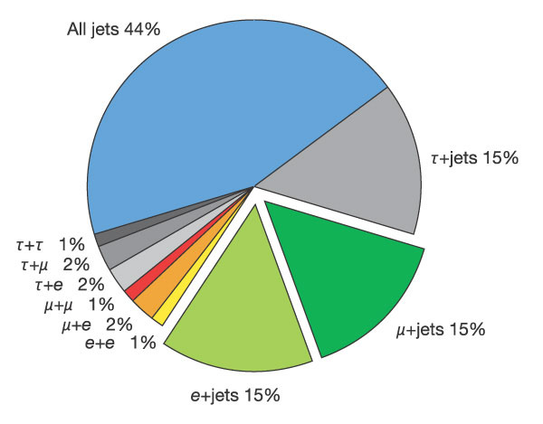
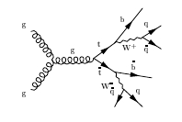
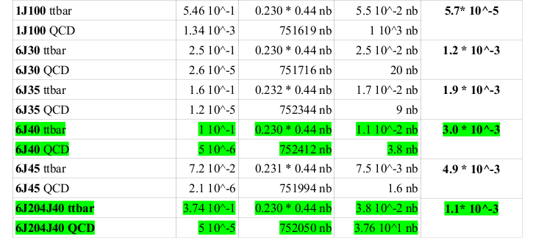
Top mass measurement
All hadronic decay channel:
~ 6 high pT jets, 2 b-jets
full event reconstruction
largest statistics
high QCD background
high combinatorics (90/event)
Pythia
studies on
QCD
rejection
➔
trigger and
offline
selection

Slide 9
Top mass measurement
MC@NLO event generator studies on combinatorics rejection
Minimum ΔM method:
very effective on this channel
needs very good knowledge of
the (parton) -> jet energy
approach applicable because of
full event reconstruction ➔
no νp_{Z} component approximation..

Slide 10
Top mass measurement
CDF and D0 combined result
M=173.1±0.6(stat.)±1.1(syst.) GeV/c²
[hep-ex/0903.2503]
σ(Tevatron) = 7.02 ± 0.63 pb
σ(LHC@10TeV)= 400 ± 6% pb
the largest contribution
to the systematic error comes
from the Jet Energy Scale (JES)
LHC will be a Top Factory!!!
JES == how well do we measure
the energy of partons <-> jets?
The real challenge for the top mass measurement
in ATLAS is the JES determination…

Slide 11
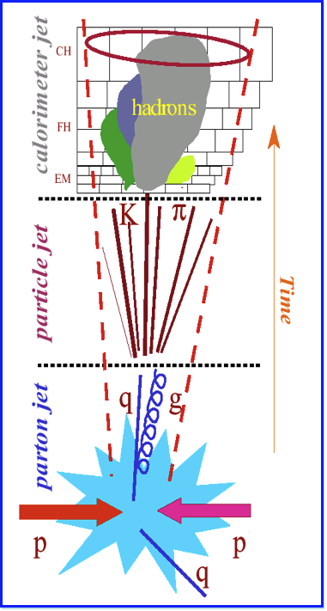
JES with Local Hadron Calibration
Local
Calibration
Corrections
detector response (e/π)
electronic and detector noise
out of time pile-up
dead material and leakage
LC Jet
Level
Corrections
jet algorithm
in time pile-up
lost soft particles
to be addressed
separately in
every physics
analysis
underlying event
parton level corrections

Slide 12
JES with Local Hadron Calibration
3D Topo Clustering Algorithm
group cells in Clusters
suppressing noisy cells
classifies Clusters in em or had
applies had weights (W)
corrects non-compensation
applies Out Of Cluster (OOC) weights
recovers for noise suppression of good cells
applies Dead Material (DM) weights
recovers for energy lost upstream and leakage
runs jet finding on CaloCalTopoClusters
after all local corrections are applied
applies Jet Level Corrections
recovers for particles lost before the calorimeter

Slide 13
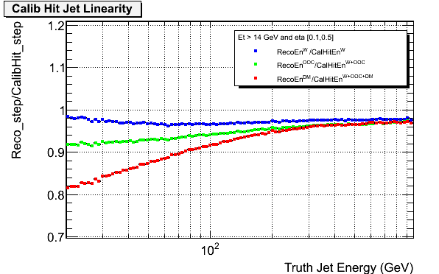
Performance of LC for Jets
Linearity studies respect to “local truth”
AntiKt4 Jet Algorithm
the truth energy of
clusters after each correction
is build from cell truth
energy deposits (Calibration Hit)
summing the energy for all
the clusters in one jet ➔
jet energy after each correction
(before Jet Level)
Pythia di-jet simulations
corrected for had
compensation (W)
Reco/Truth
corrected for had
compensation
and out of cluster (OOC)
corrected for had
compensation
and out of cluster
and dead material (DM)
Ratio should be 1 … need of EXTRA correction based on Jet properties!

Slide 14
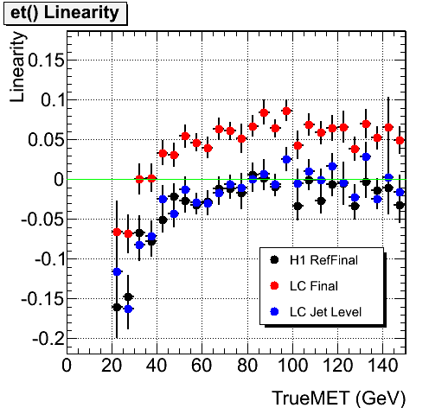
Performance of LC for MET
Missing Transverse Energy (MET) -> “film negative”
trueMET-recoMET
Linearity= ---------------------------
trueMET
should be 0!
needs a cut (20 GeV)
on the true MET
valid only for physics WITH REAL MET
Semi-leptonic top simulation
MET from LC after
all Local Corrections
MET from LC after
all Local Corrections
and Jet Corrections
MET RefFinal
ATLAS reference

Slide 15
Validation of LC on data ...
Local Hadron Calibration is a Monte Carlo based approach
validation implies Monte Carlo validation
LC provides “candles” for MC validation
variables on which data/MC comparison is meaningful
each LC correction is obtained
based on a specific cluster property
(Cluster Moments like
energy density, shape ...)
when looking at the data/MC
comparison of a specific level
of correction
Cluster Moments
are the LC candles for
Monte Carlo validation
if there are discrepancies
the simulation
of the cluster property
probably went wrong..

Slide 16
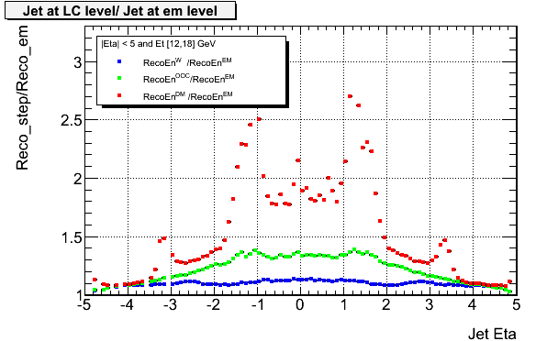
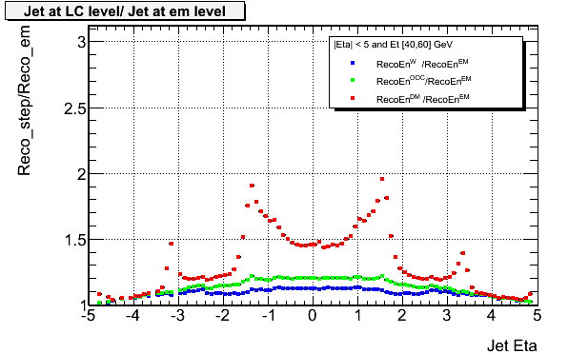
Validation of LC on data ...
No “proper truth” is provided by nature…
the energy of each step
is normalized to the em scale
15 GeV Jets
same plot done for data
and MC reco simulation
corrected for had
compensation (W)
corrected for had
compensation
and out of cluster (OOC)
50 GeV Jets
corrected for had
compensation
and out of cluster
and dead material (DM)

Slide 17
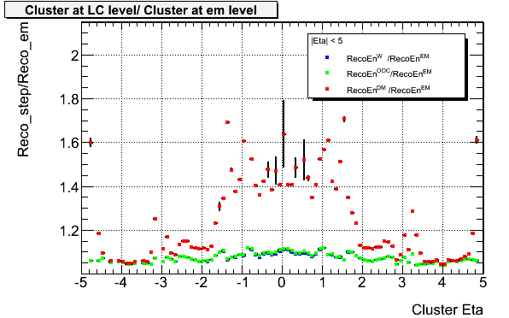
Validation of LC on data ...
Beam Splash Events
4500 clusters !
beam splash events have a completely weird geometry ➔
jets don’t make any sense… but clusters are still interesting..
ATLAS
work in progress
clusters are
very energetic:
small DM corrections
no OOC corrections
(clusters due to split!)
The reconstruction machinery seems to work!!!!!!!

Slide 18
Validation of LC on data ...
900 GeV Collision Events
Some technical detail for reproducibility…..
very little statistics : ~ 200 collisions
used ESD.run140541.LArAndMBTSInTime.reco_f175.pool.root
for the Monte Carlo:
mc09_900GeV.105001.pythia_minbias.recon.ESD.e466_s604_s582_r851
over data taking the solenoid field was off, while it’s on in the simulation
over data taking toroid was only at 50% of the nominal field, while it’s
on in the simulation
new Monte Carlo simulation are being processed, to reproduce data
taking conditions
look at clusters, no energy bins (Et> 1. GeV)
very preliminary result (but still very enjoyable!!! )

Slide 19
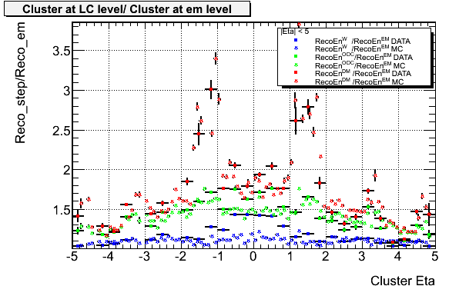
Validation of LC on data ...
900 GeV Collision Events
ATLAS
work in progress
hadronic scale discrepancy not fully understood….

Slide 20
Conclusions
understanding of the Local Hadronic Calibration in ATLAS has
improved thanks to the performance studies
validation of the calibration and the underlying simulation on
real data just started, it’s an exiting moment!
top mass physics analysis is ongoing, the all hadronic channel is
is a perfect battlefield for hadronic calibration
working at MPP for the last two years
has been an unique opportunity for my education
THANKS!

Slide 21
Back-Up slides

Slide 22
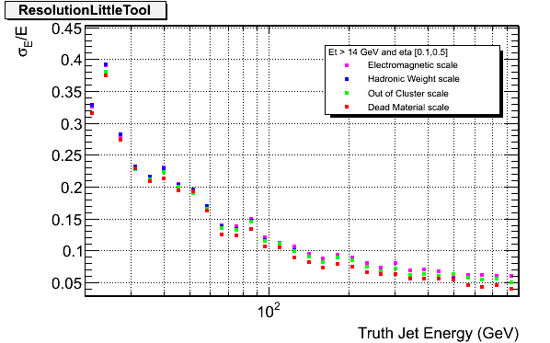
Performance of LC for Jets
Resolution studies respect to truth jet
Resolution after each step of LC
The response is made linear, before calculating resolution,
in order to avoid “fake improvements”

Slide 23
DM distribution

