Slide 1

HAWC Dark Matter Searches
Pat Harding
Los Alamos National Laboratory
17 January 2019

Slide 2
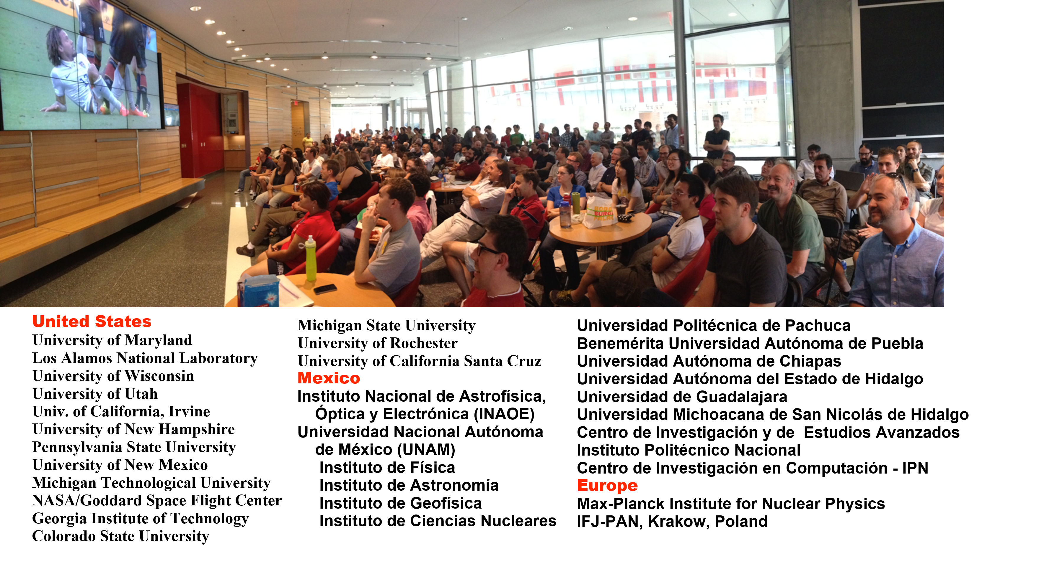
The High Altitude Water Cherenkov Collaboration

Slide 3
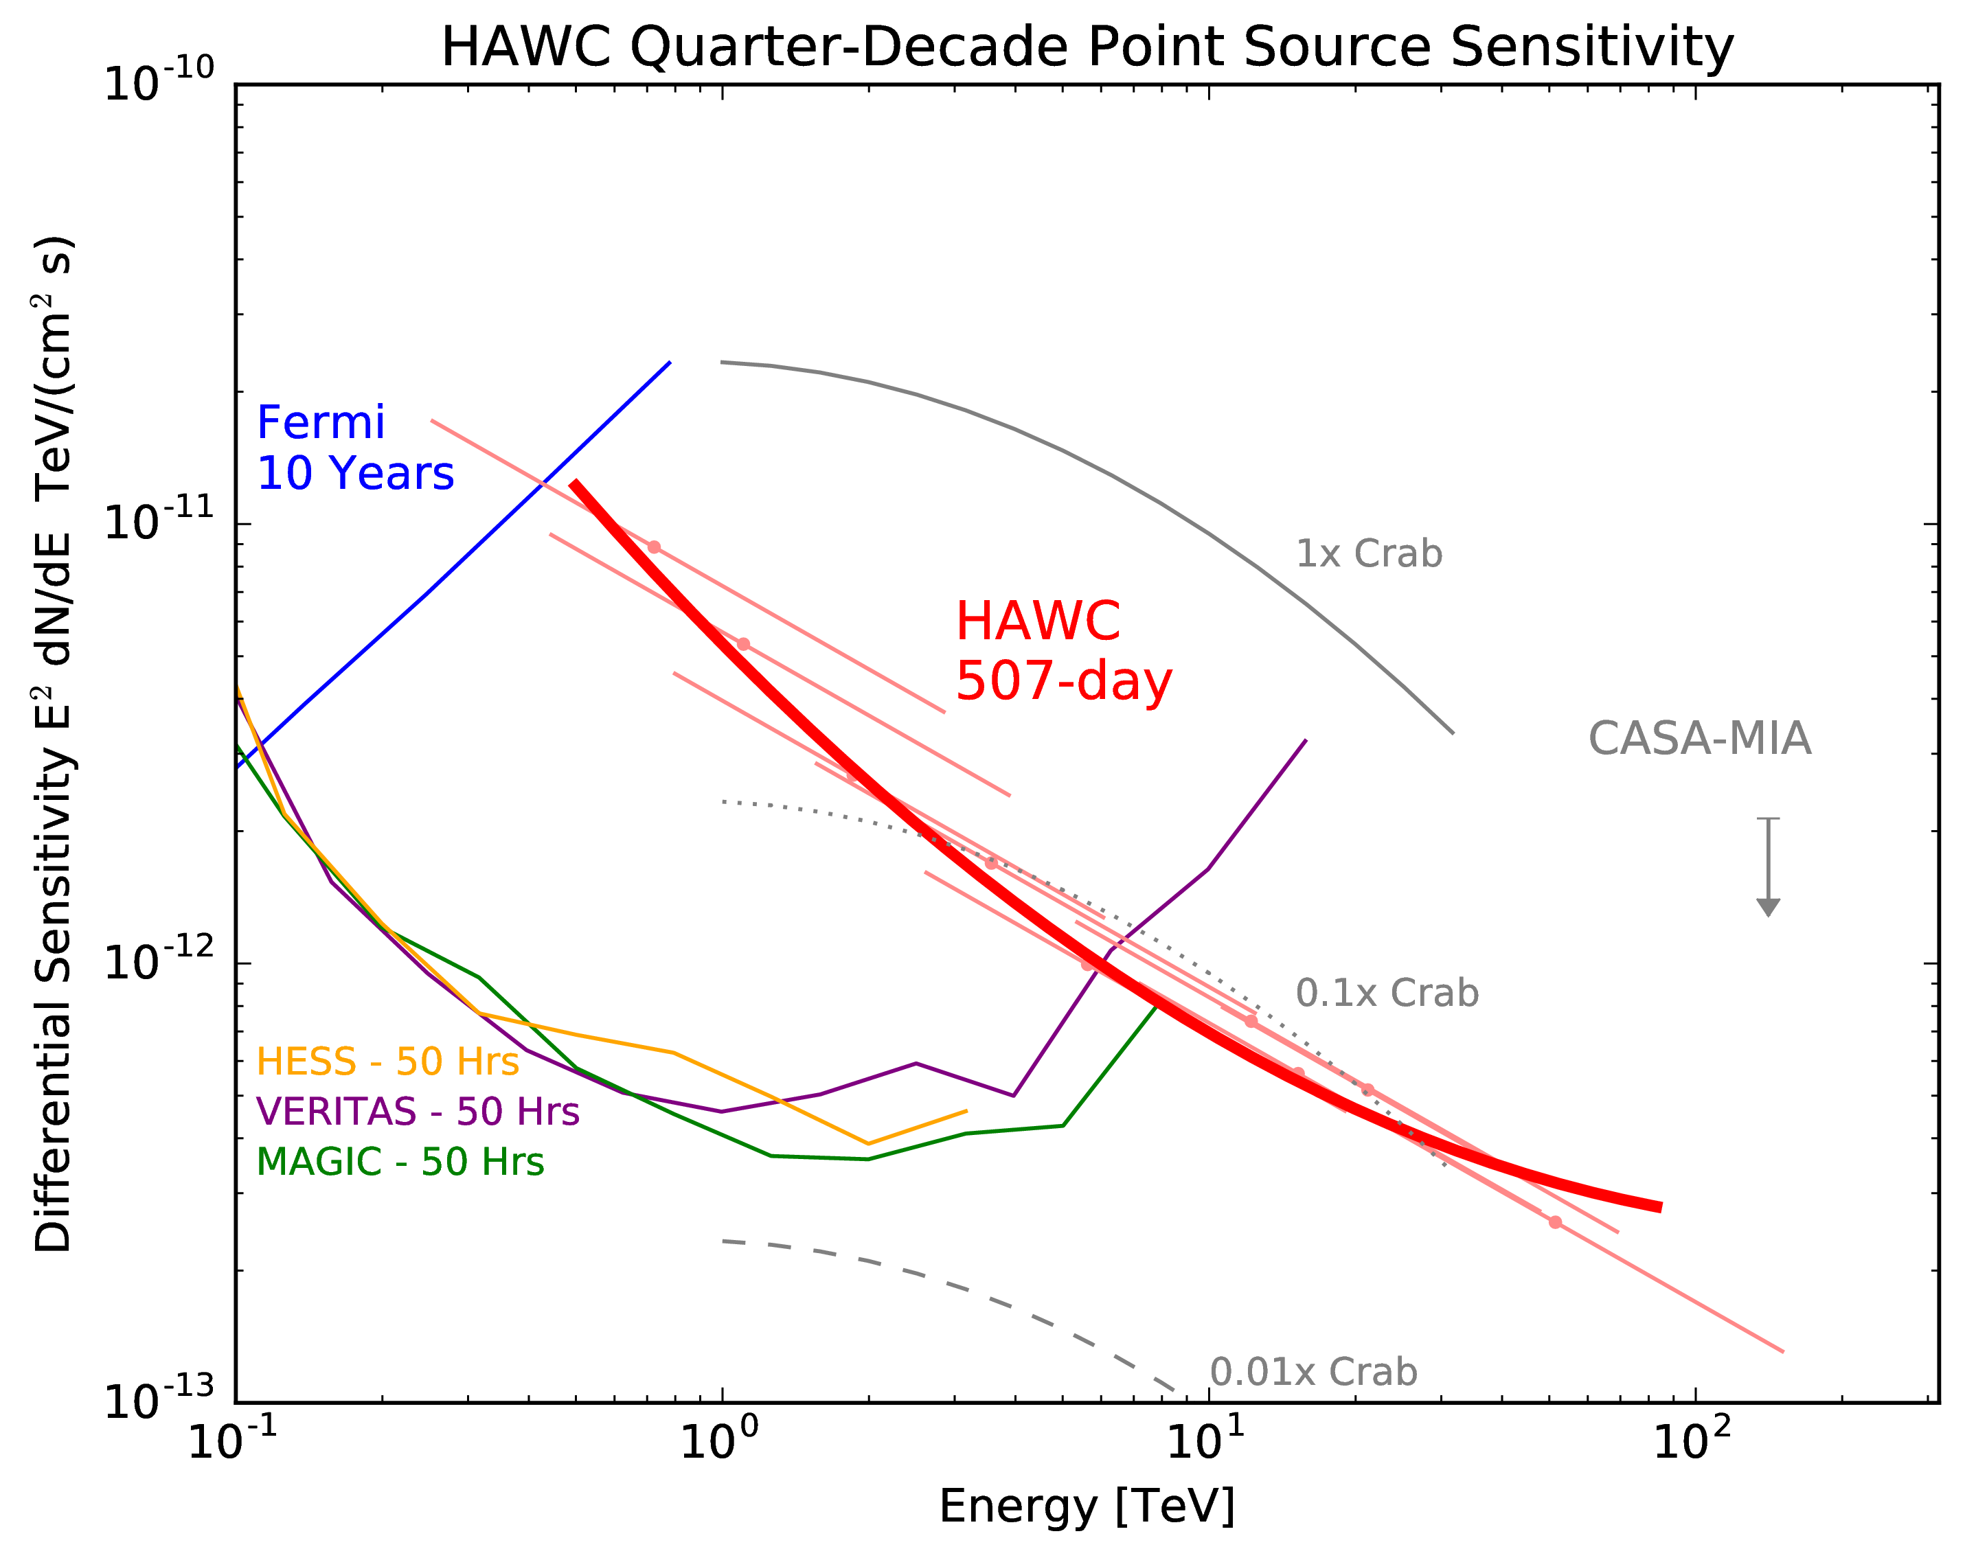
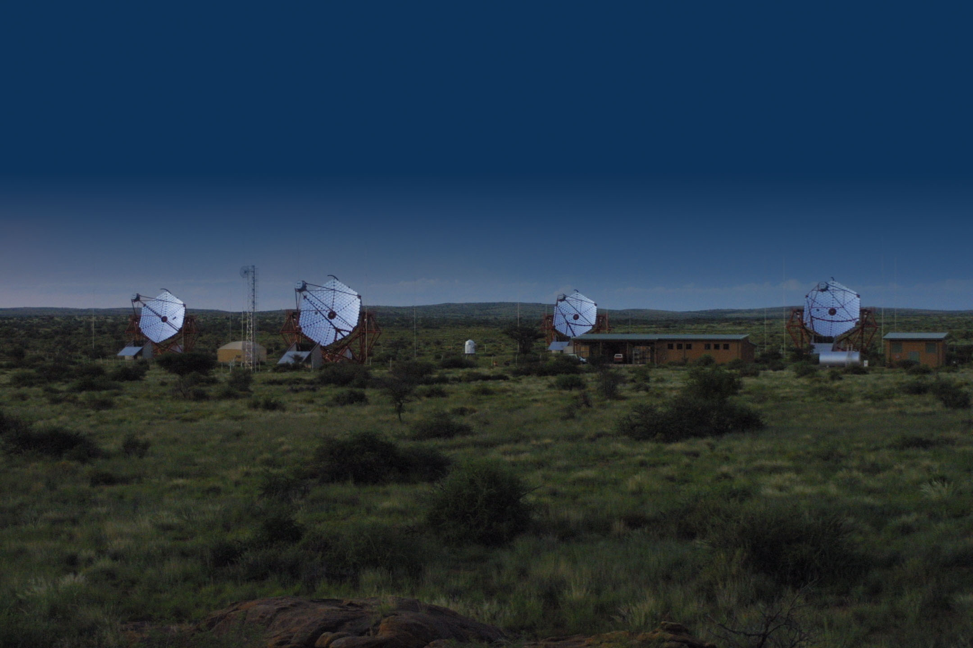
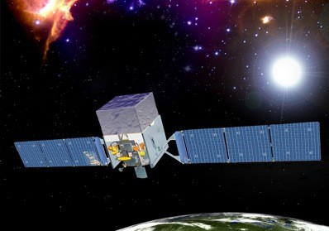
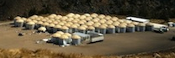
Complementarity of Gamma-Ray Detectors
Space-based detectors - continuous full-sky coverage in GeV
Ground-based detectors have TeV sensitivity
IACTs (pointed) excellent energy and angle resolution
HAWC has 24-hour >1/2 sky coverage
TeV Sensitivity
Wide field-of-view,
continuous operation
VERITAS
HESS
MAGIC
HAWC
Milagro
ARGO
Tibet
Fermi
Agile
Egret

Slide 4
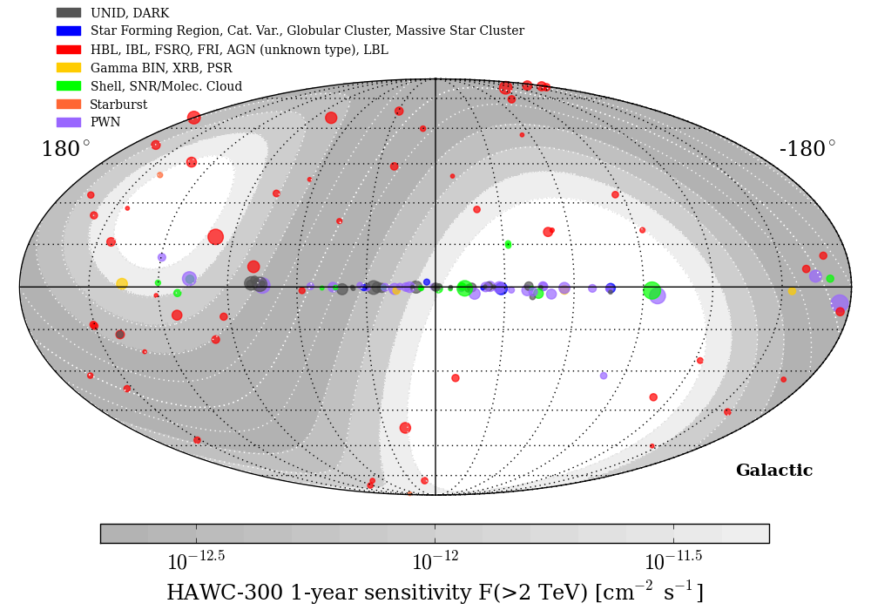
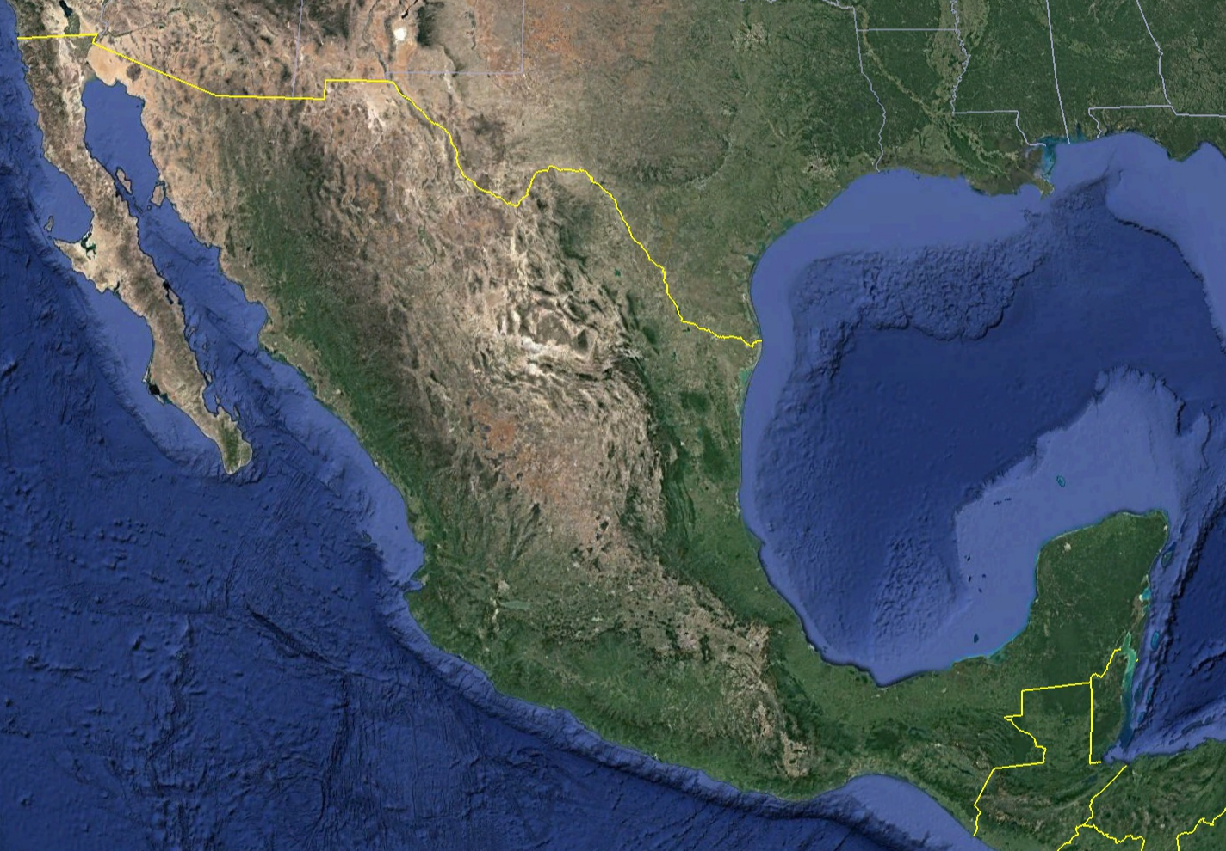

TeV Sky Observable By HAWC
Latitude: 18°59.7’N
Longitude: 97°18.6’W

Slide 5
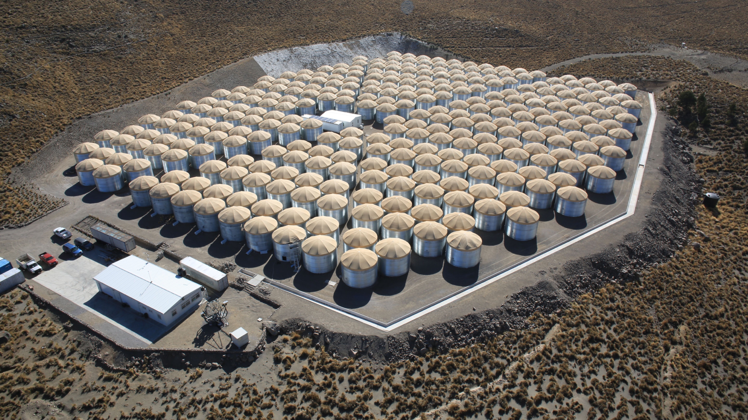
An Array of Water Cherenkov Detectors
300 close-packed optically isolated water Cherenkov detectors
Construction began early 2012
Full detector inaugurated March 2015
Funding from a combination of US and Mexican agencies
High energy extension: Outrigger array, installed and operating

Slide 6
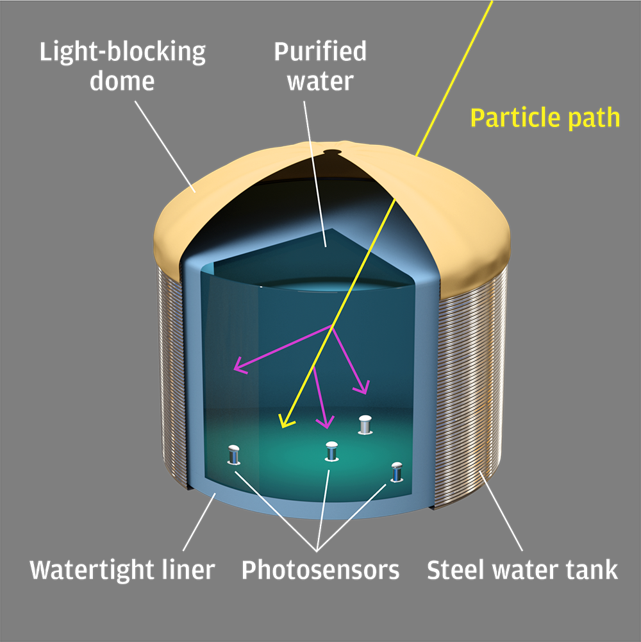
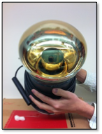
An Array of Water Cherenkov Detectors

Slide 7
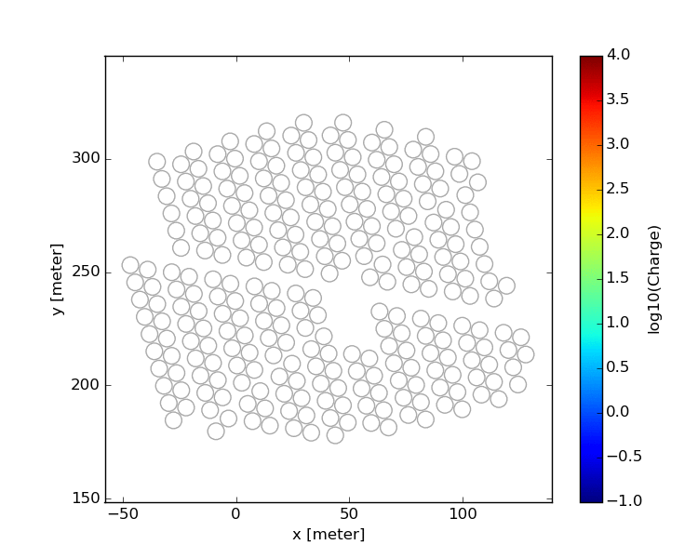
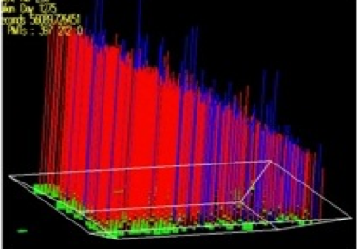
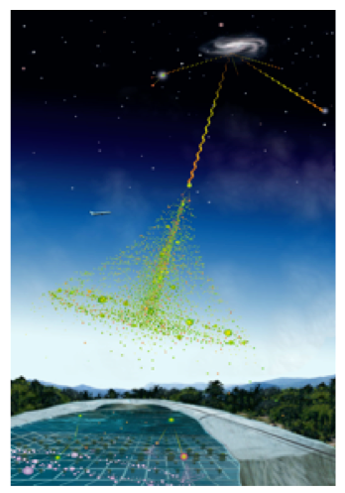
Direction
As the shower sweeps across the WCDs, we can reconstruct the direction it’s sweeping from

Slide 8
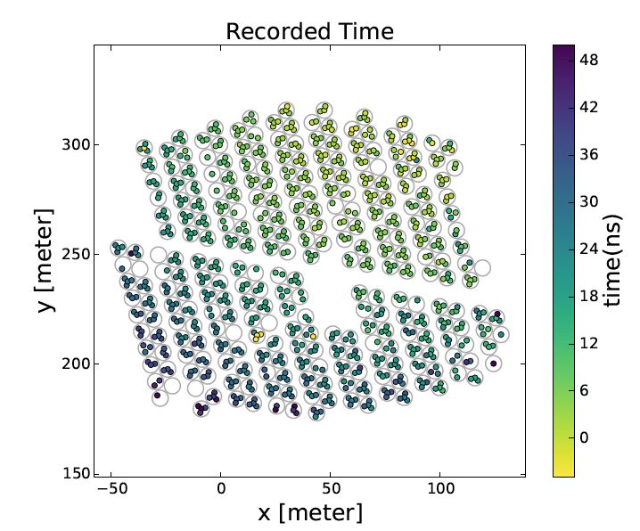
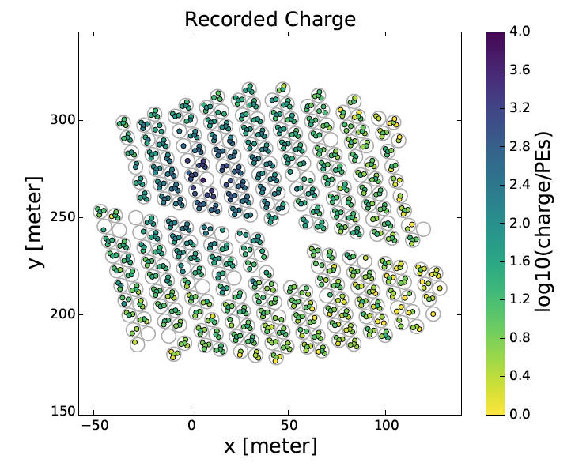
Energy
The light level is each PMT and its Lateral Distribution Function (LDF) correlates with energy
More PMTs hit, more light in PMTs → higher energy

Slide 9
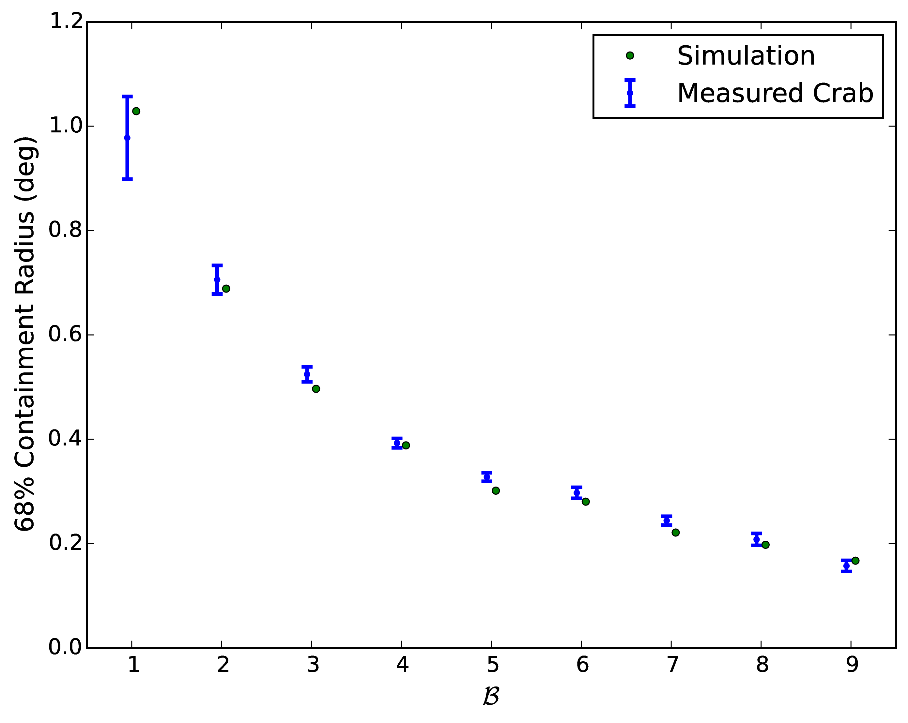
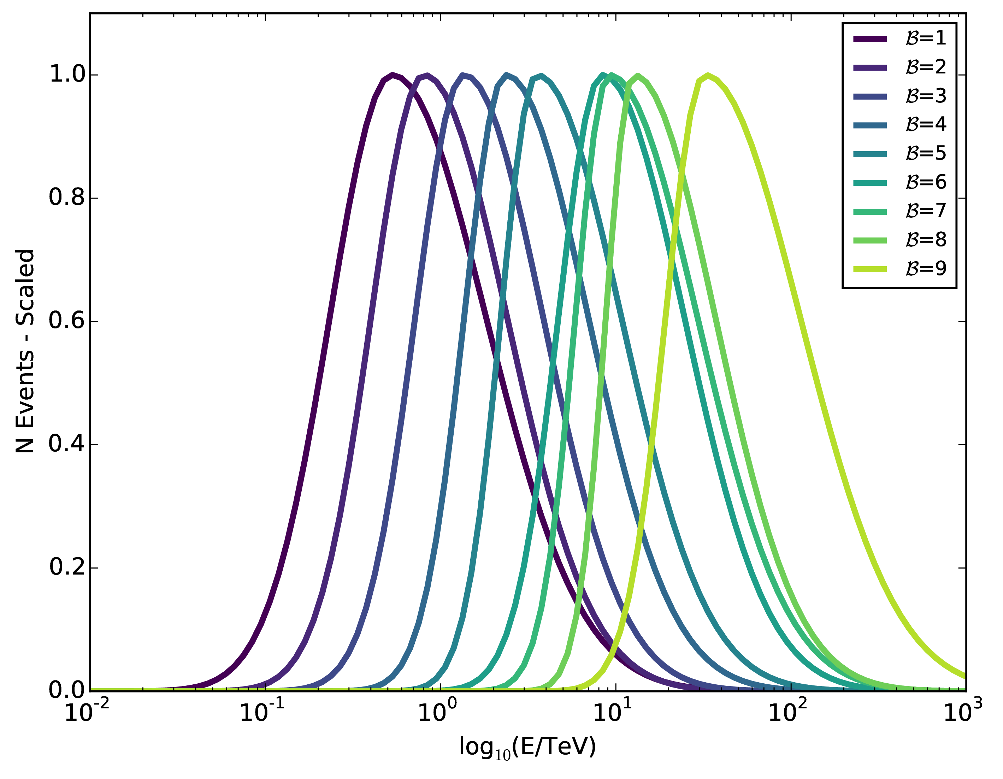
HAWC Resolution
Angular Resolution
Tuned on Crab Nebula
Energy Resolution
from Monte Carlo Simulations

Slide 10
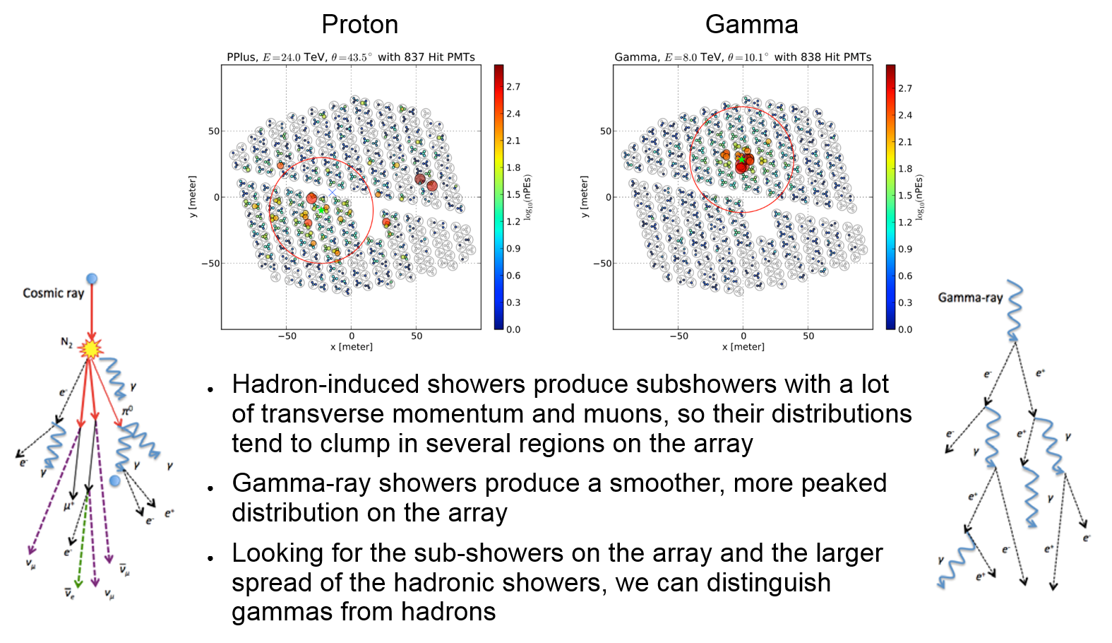
Particle Type

Slide 11
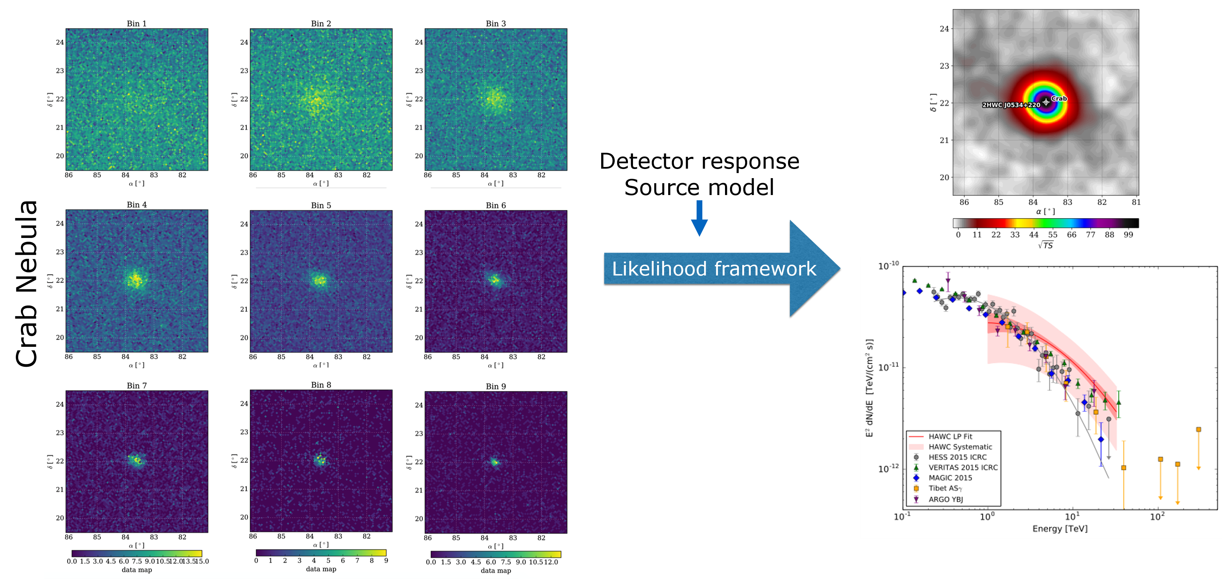
Source Characterization – Forward Folding
Events sorted by “size” in n bins (with characteristic Point Spread Function, S/N ratio, energy), make n maps
Likelihood framework uses n maps to test the presence of sources and characterize them
Reference: Crab paper, ApJ 843 (2017), 39 (here: 507 days of data)
Use HAWC LiFF likelihood code or open 3ML likelihood code (threeml.readthedocs.io)

Slide 12
Background Estimation – Direct Integration
HAWC sensitivity is primarily dependent on the source declination, with smaller exposure corrections in RA
Instead of On-Off in a small field-of-view, HAWC uses “Direct Integration” to calculate its backgrounds (post-cuts) (Atkins+ ApJ 595, 2003)
This gets the background around a source by looking a the same HAWC-local coordinates over 2 hours of RA from the source at the same declination and averaging the counts in that region
  Large Background region enables search for highly extended source, like DM
Signal
Background Background
(To Scale)

Slide 13
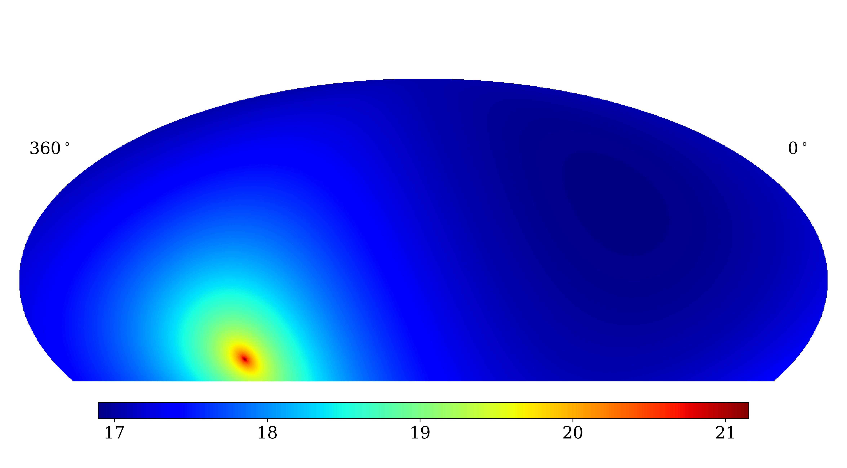
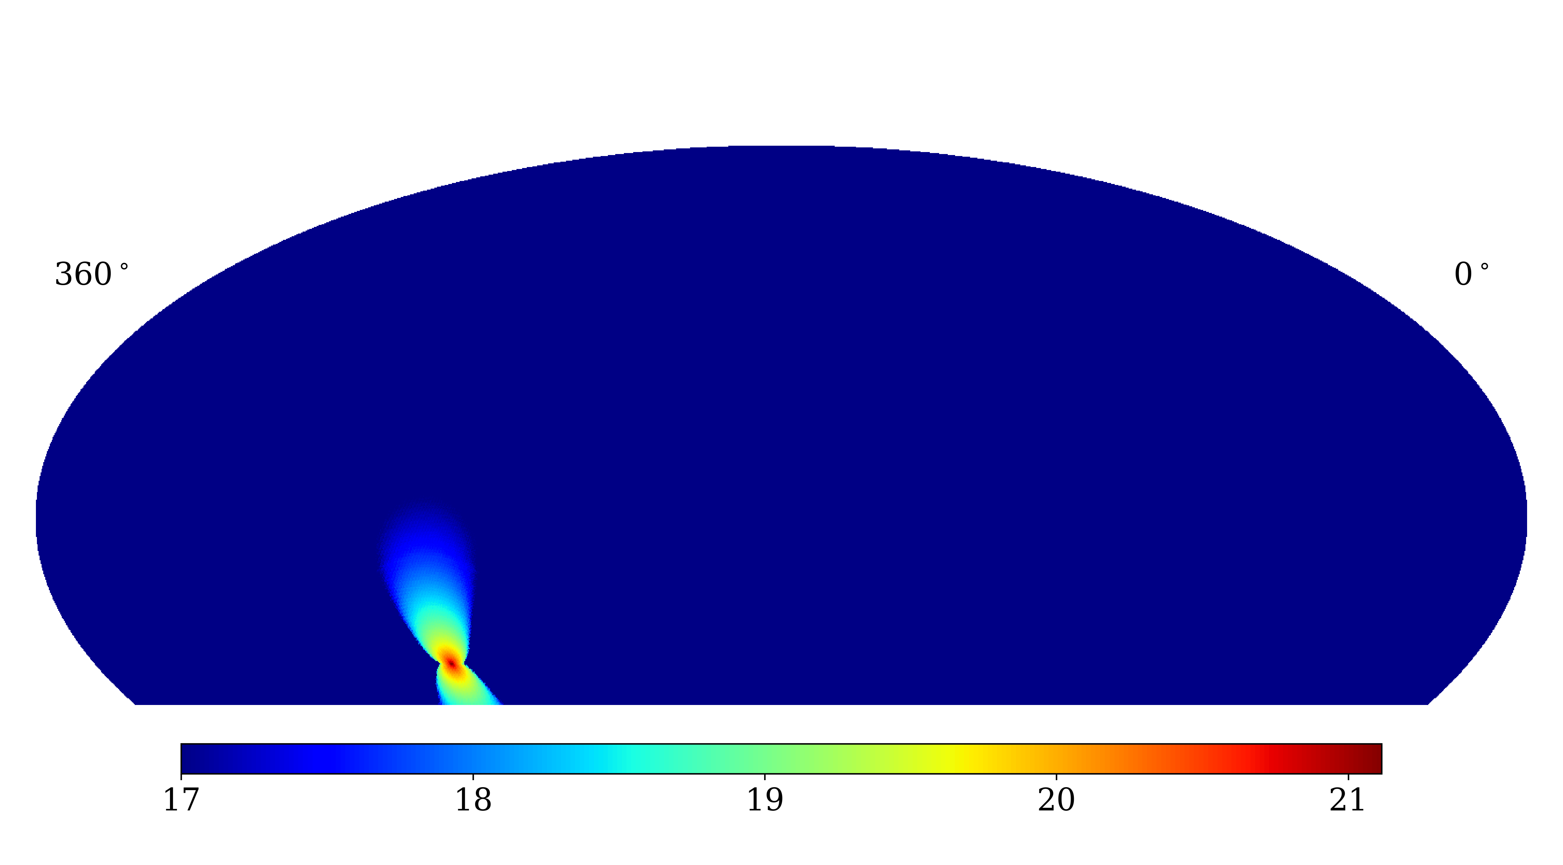
Background Caveat – Signal in the Background
All background estimations from data have a subtraction issue if there is signal in the region of background estimation
For small background regions near extended objects, this is particularly an issue. A lesser issue for large-angle direct integration
Masking. Restrict your background region to be far from your contaminating signal. Works if signal is not too extended
Use a larger background region that extends beyond any mask
Account for signal loss in your background
Example: 2-hour Direct Integration on Galactic Center DM signal

Slide 14
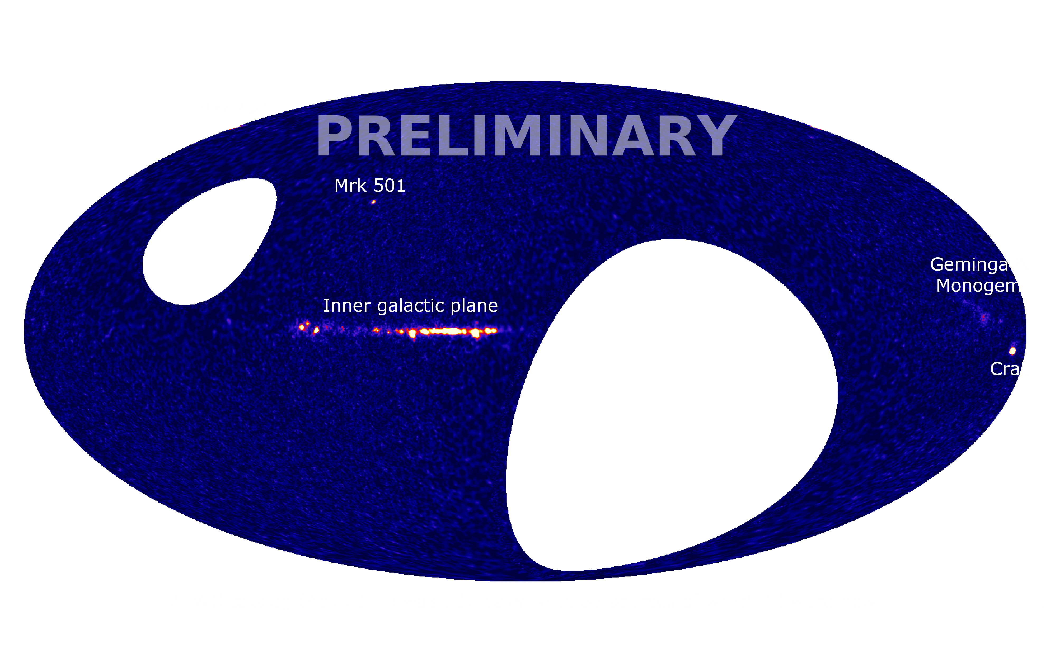
HAWC 3-year Skymap – 1017 days from 11/14 – 12/17

Slide 15
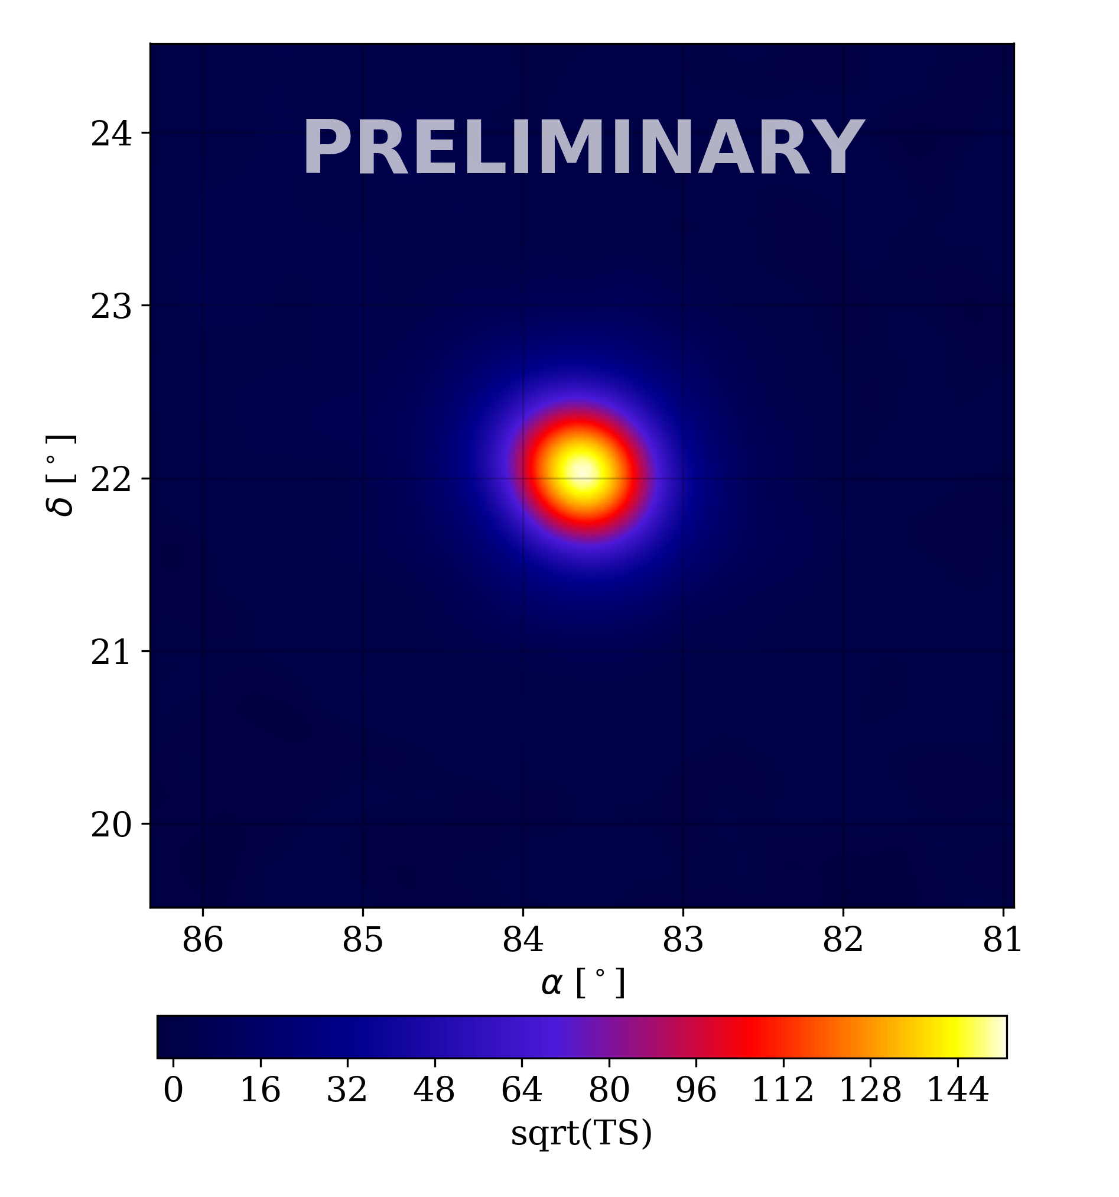
HAWC 3-year Skymap – 1017 days from 11/14 – 12/17

Slide 16
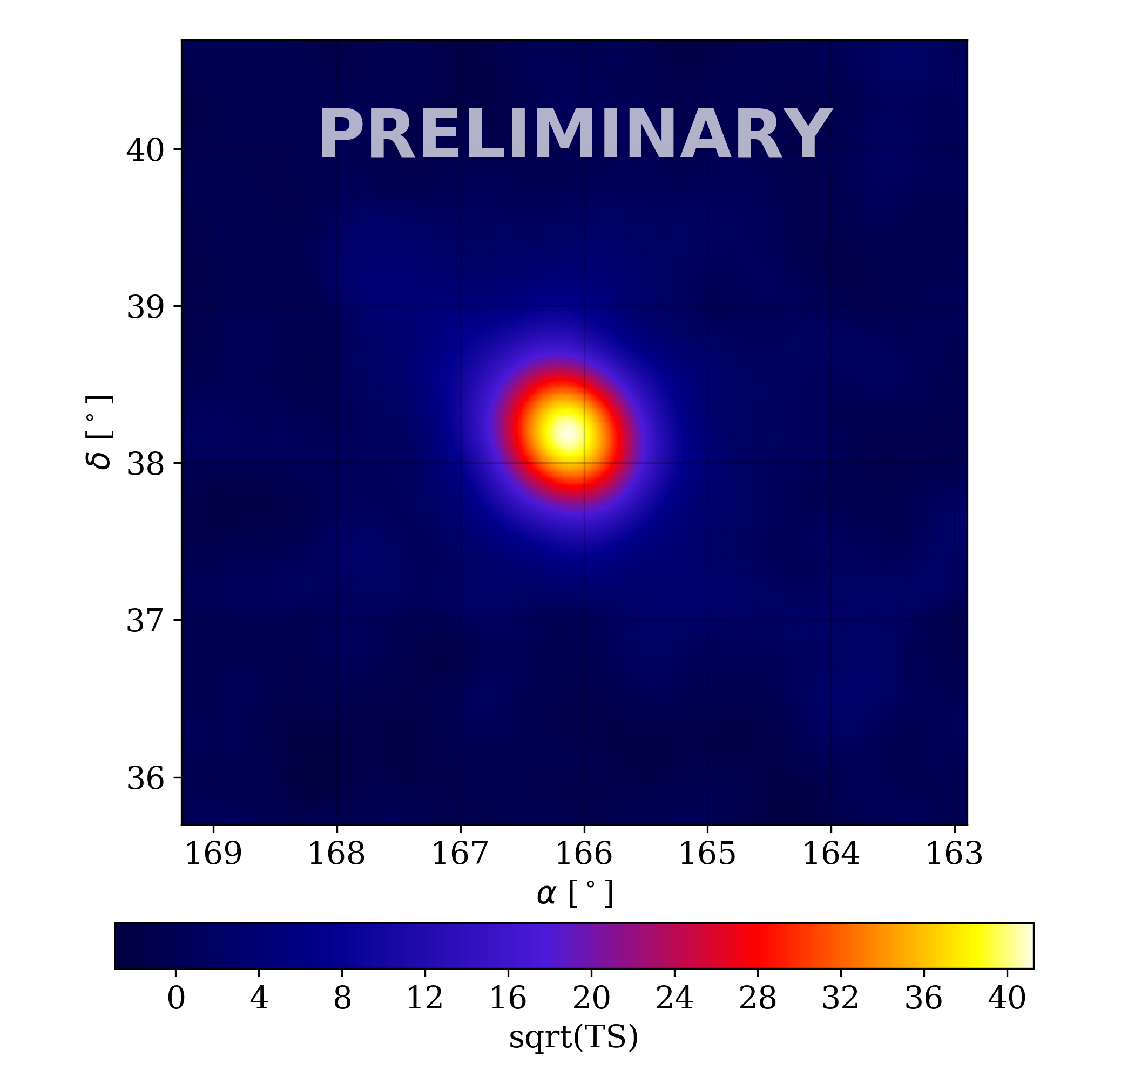
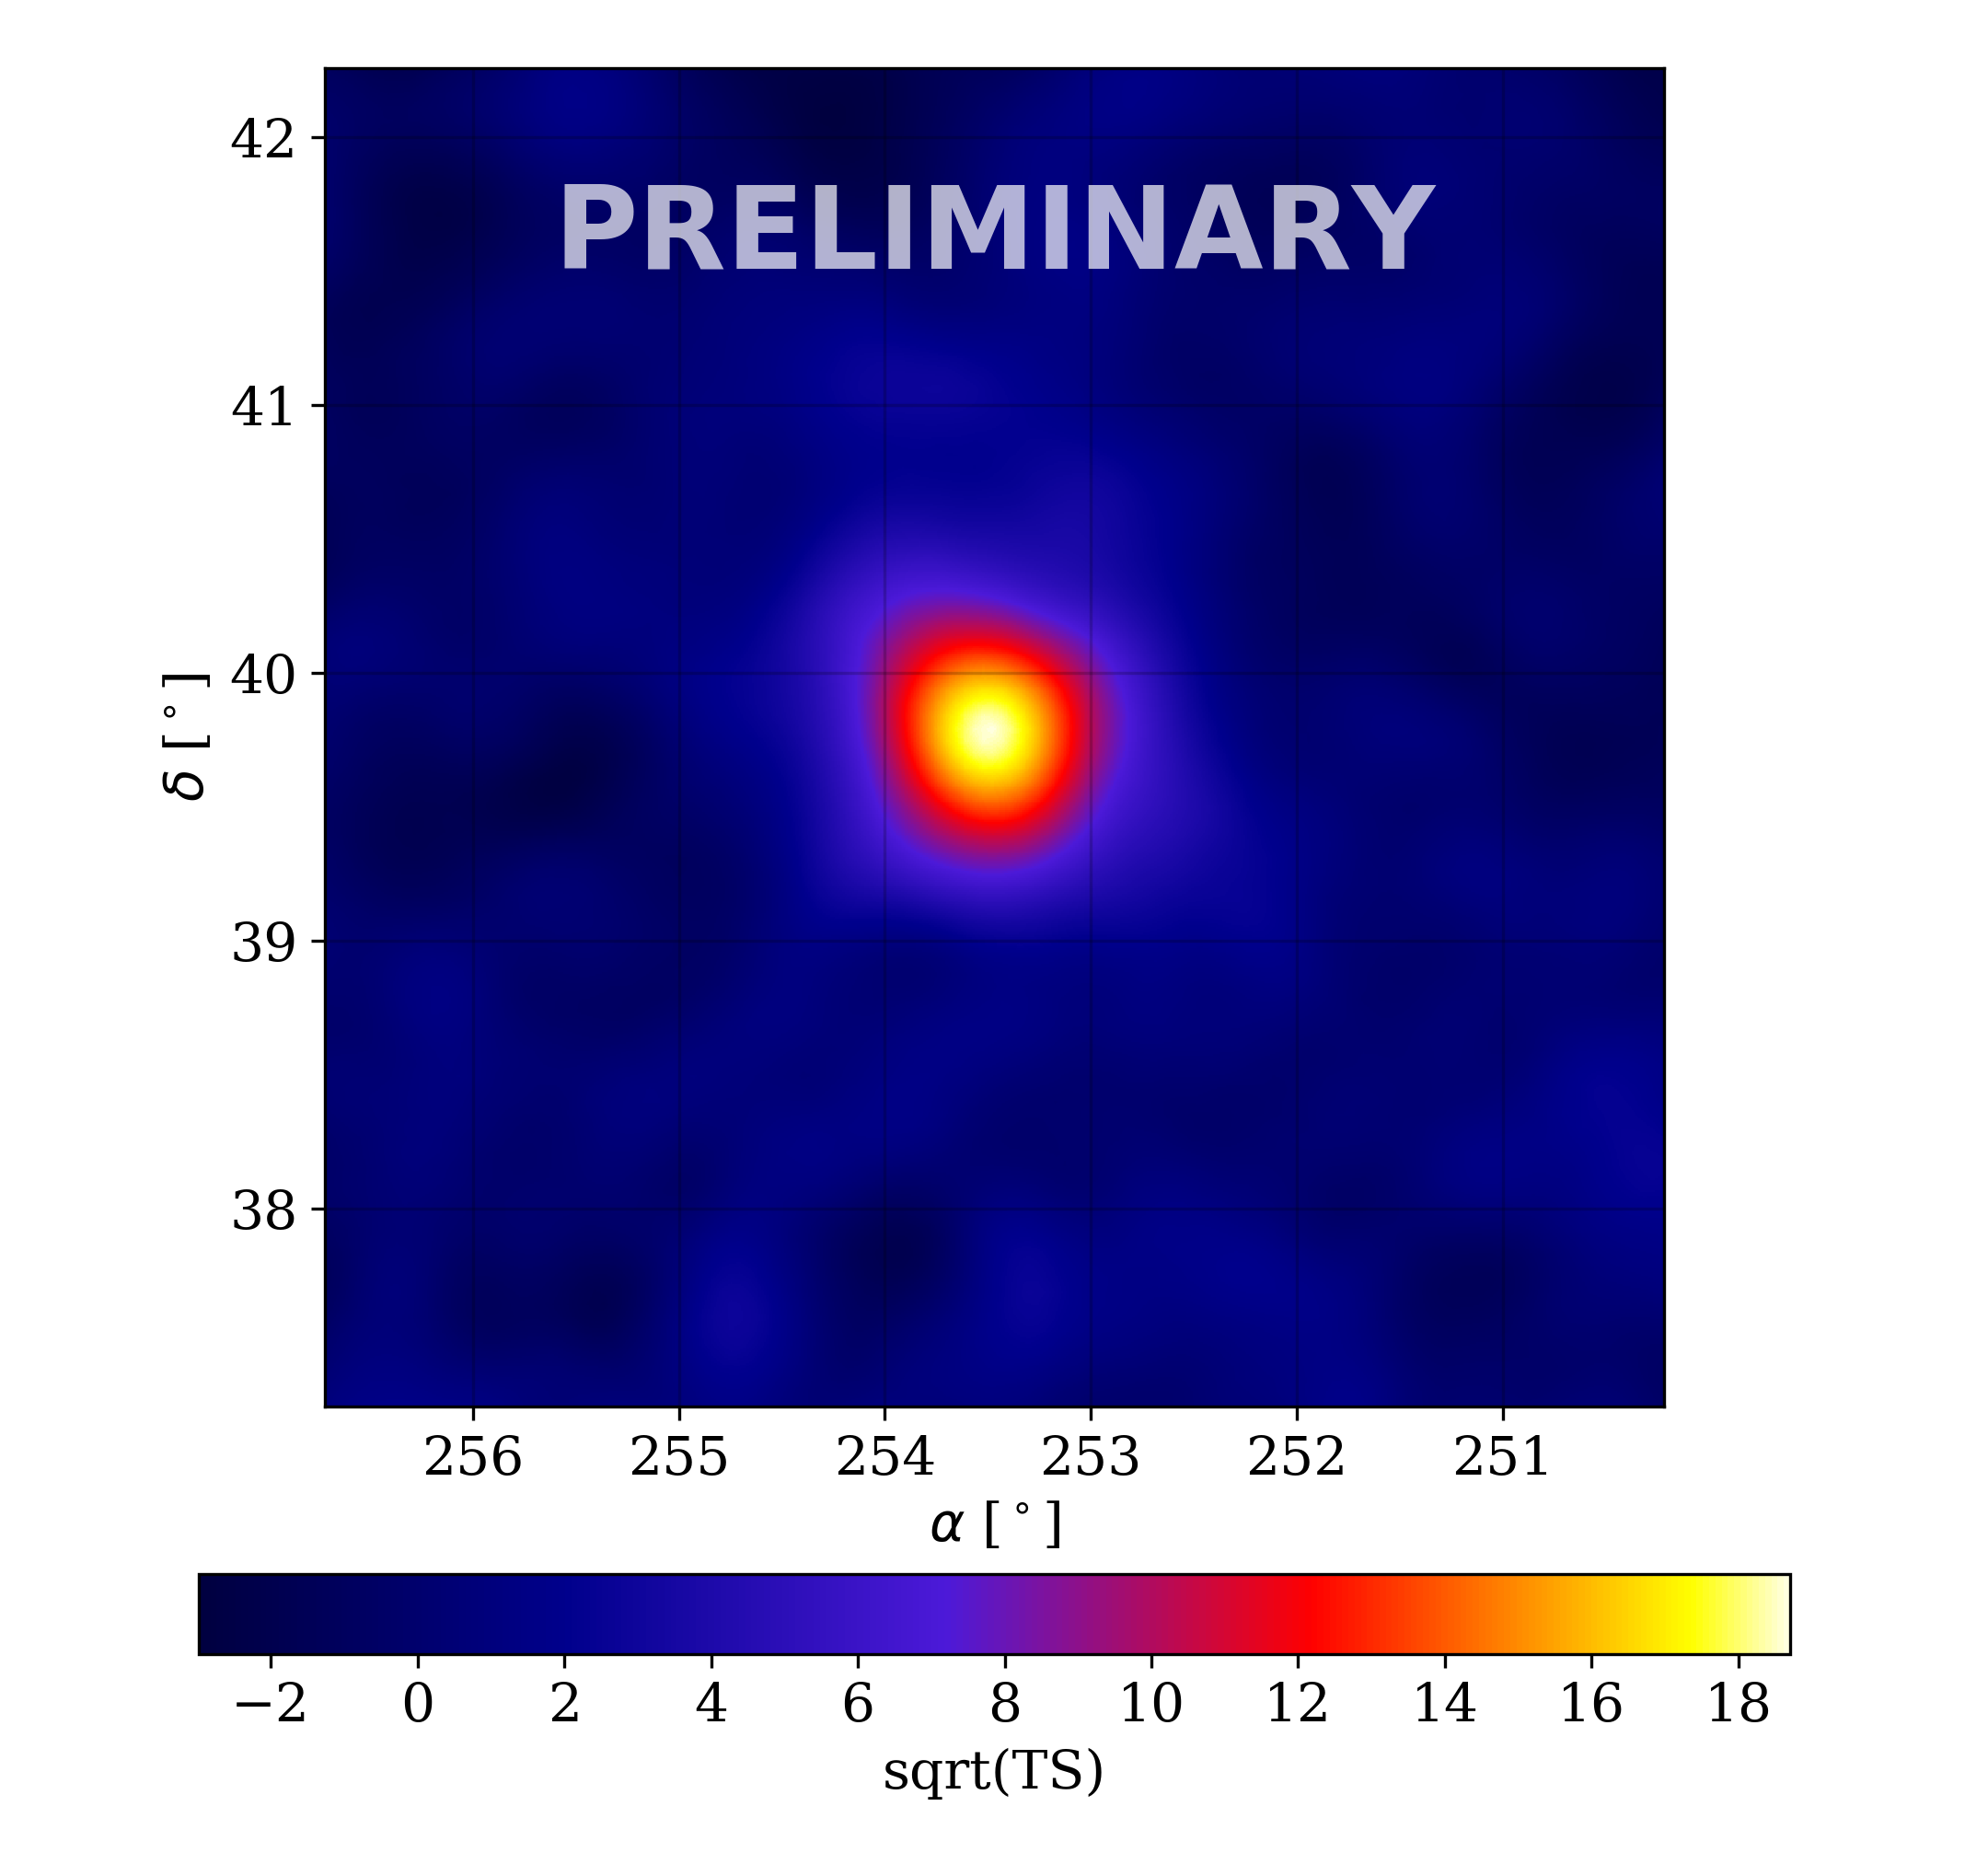
HAWC 3-year Skymap – 1017 days from 11/14 – 12/17
They flare – See Michelle Hui’s talk on Friday

Slide 17
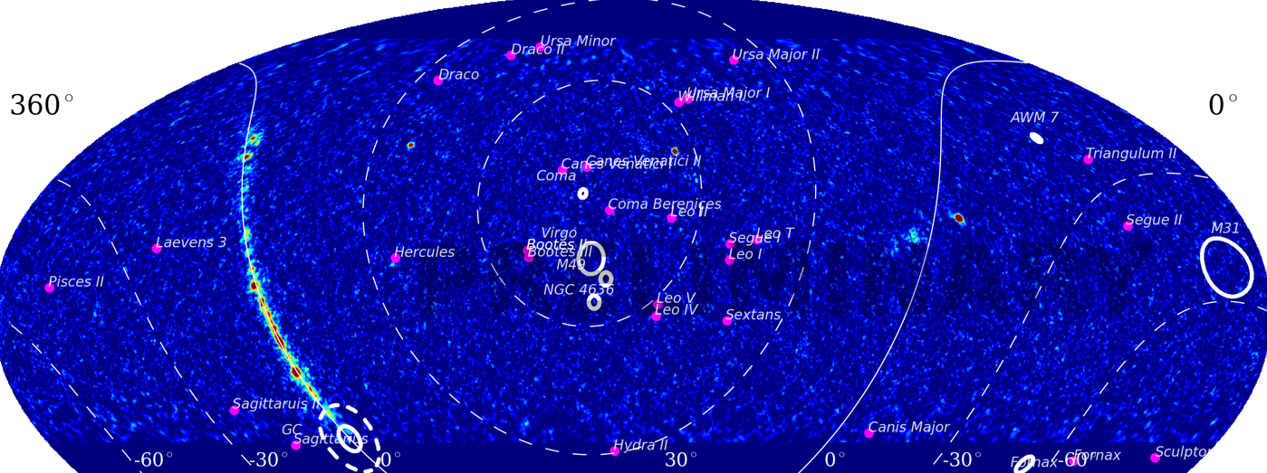
Dark Matter with HAWC
Lots of source classes to look at
  Milky Way Galactic Center, dwarf galaxies, galaxy clusters, M31 (Andromeda) galaxy
  Large statistical sample

Slide 18
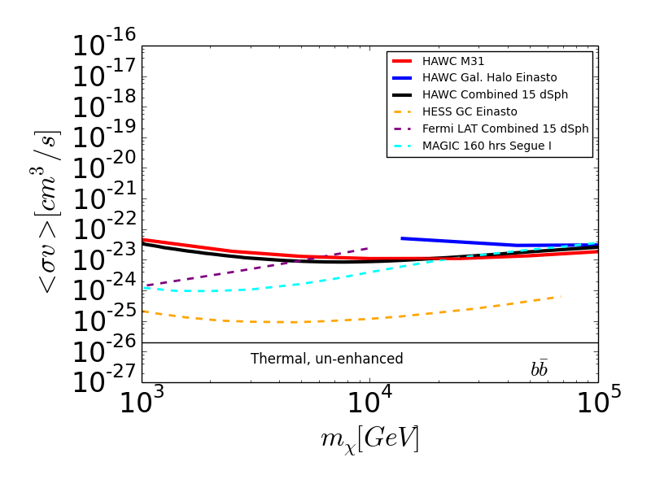
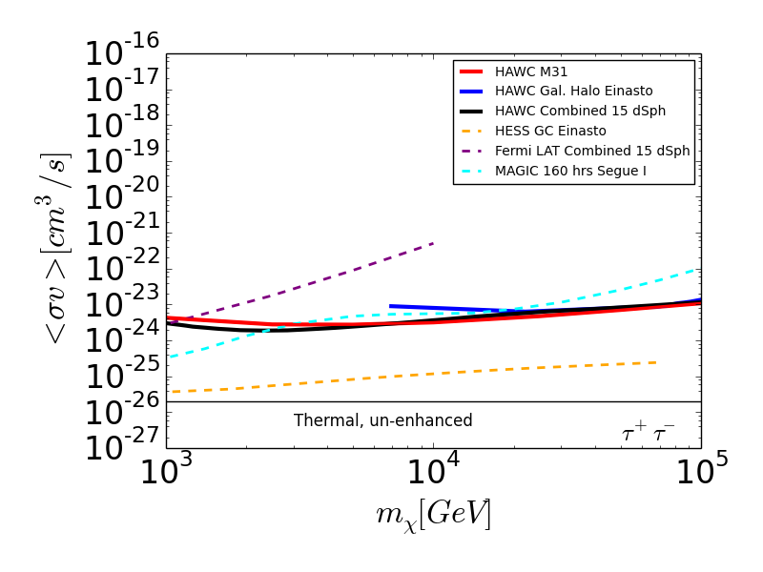
Dark Matter Annihilation Limits with HAWC
Allowed
Allowed
Multiple sources make HAWC limits robust
  Detection requires observations in multiple targets

Slide 19
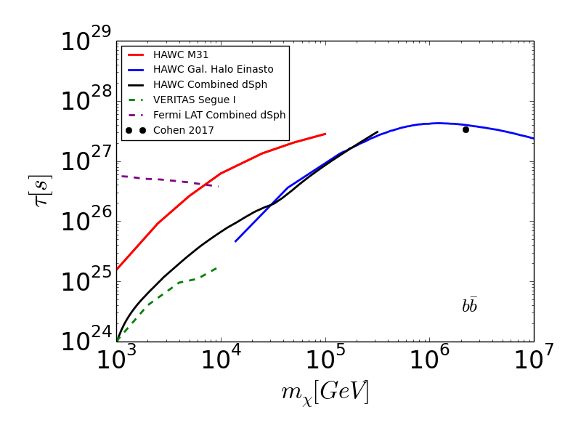
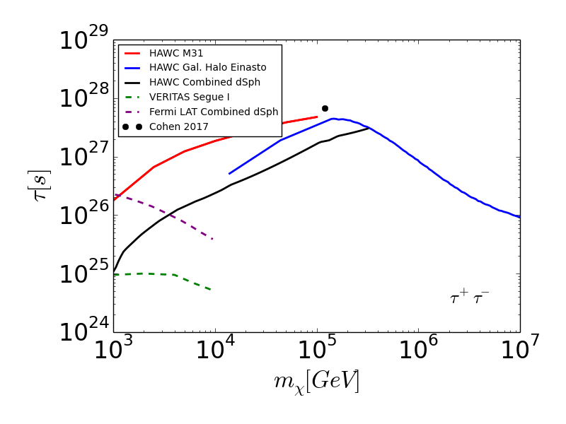
Dark Matter Decay Limits with HAWC
Allowed
Allowed
MAGIC Perseus 202h (approx.)
MAGIC Perseus 202h (approx.)
DM decay signal is angularly extended so requires large field of view of HAWC
DM decay is not as sensitive to DM distribution uncertainties as annihilation is
HAWC can exclude IceCube DM interpretations (Cohen, 2017) for hadronic DM

Slide 20
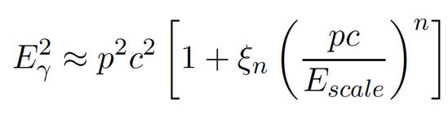
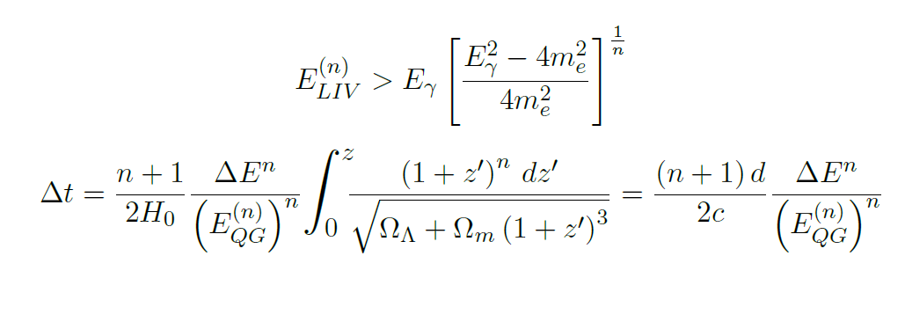
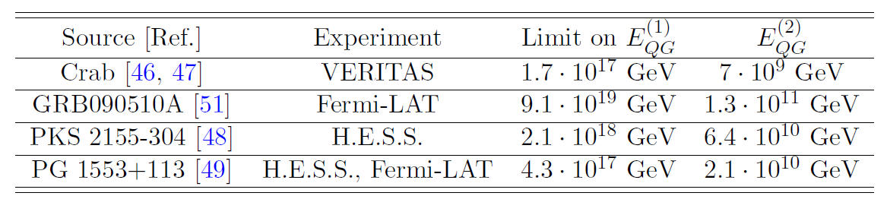
Lorentz Invariance Violation
HAWC can constrain violations of Lorentz invariance 2 ways:
Observing high-energy, Observing extremely short-duration transients high-energy photons
(Nellen 2015) (Martinez-Huerta & Perez-Lorenzana 2017)

Slide 21
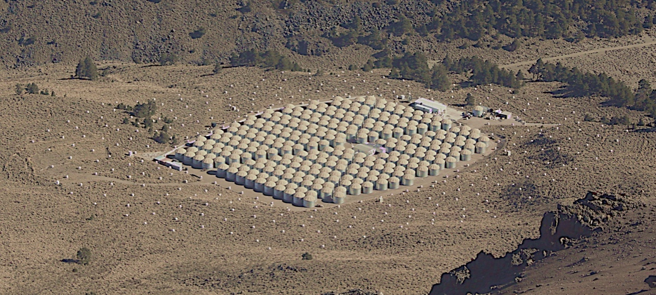
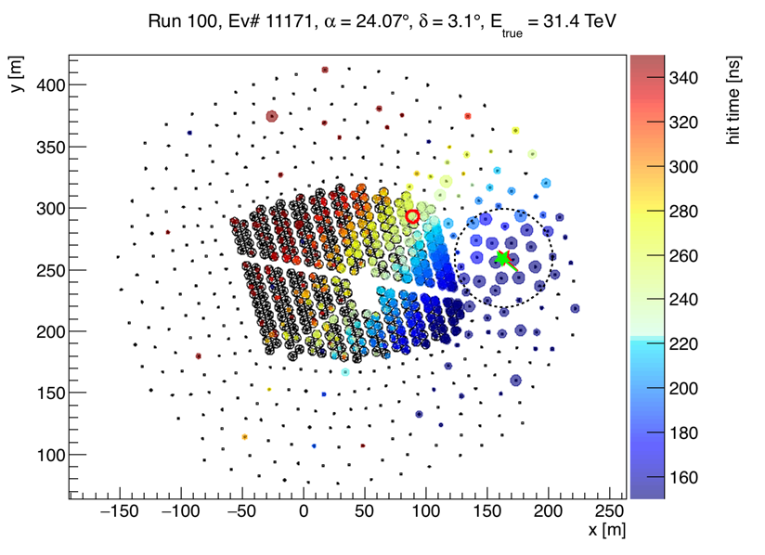
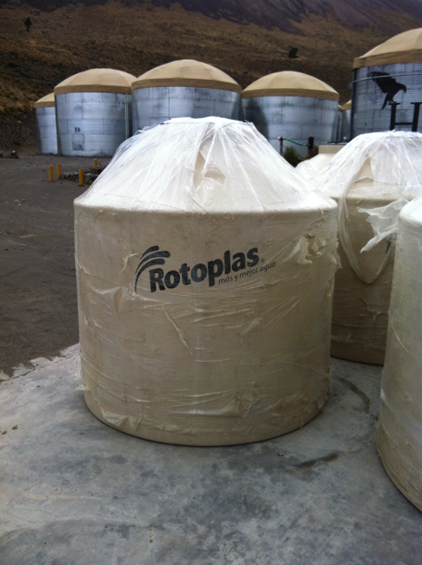
HAWC Upgrade: Outriggers
Expands total effective area >10TeV with the addition of 350 outrigger tanks spread over 100,000 m2
Funded by LANL LDRD, Max Planck Institute in Heidelberg, and CONACyT in Mexico
All tanks are deployed,
100% are cabled, and
80% are taking data
100% operational by June 2018
With the outriggers, HAWC will see the highest energy photon ever detected

Slide 22
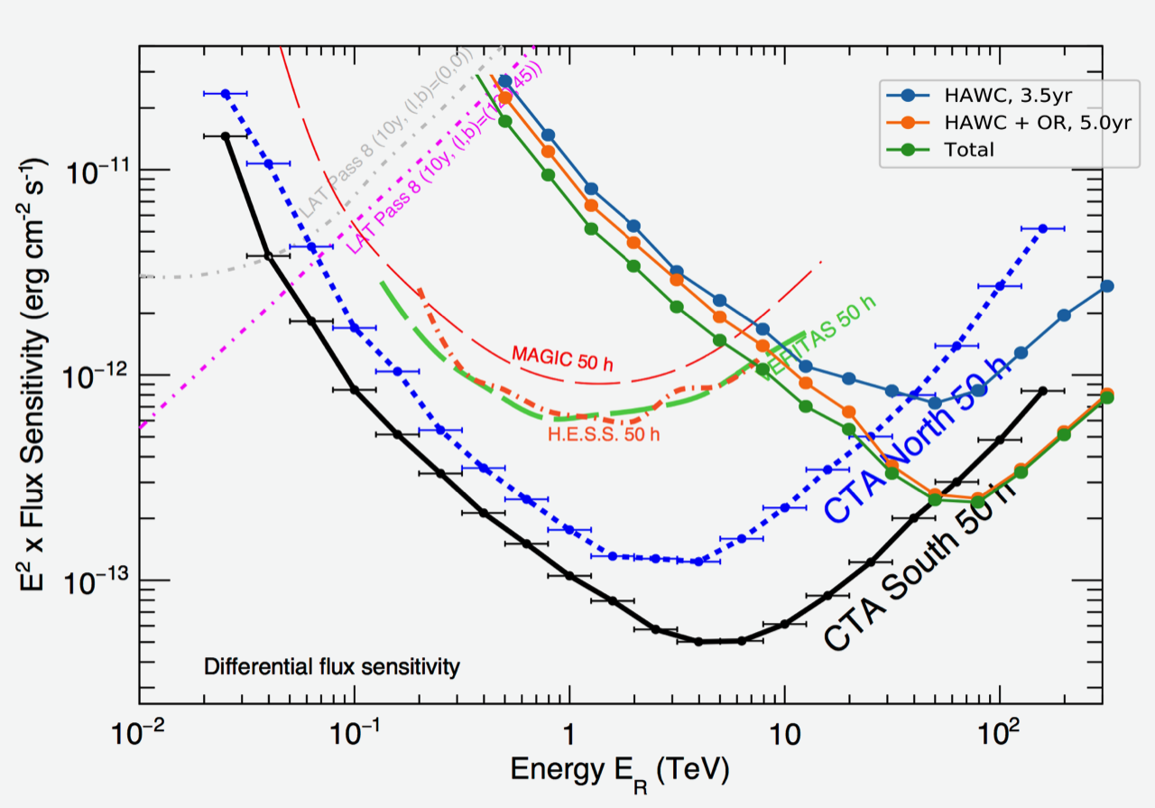
HAWC Sensitivity with Outriggers
This sensitivity does not include improvements in HAWC reconstruction and analysis algorithms which are about to be implemented retroactively

Slide 23
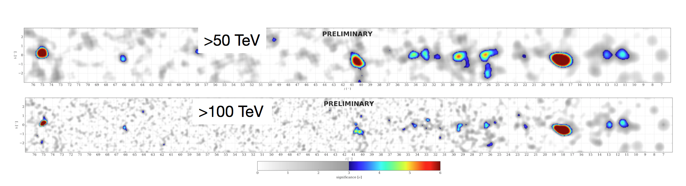
Pushing HAWC to the Highest Energies
HAWC already detects sources > 50 TeV, so outriggers will detect even more
Detection of >100 TeV gamma-rays stresses models of particle acceleration
Essential to discovering the source of cosmic rays up to the knee (3x10¹⁵ eV protons produce 100-200 TeV gamma-rays)
Algorithm development will improve HAWC energy response
  First papers on improvements due out later this year

Slide 24

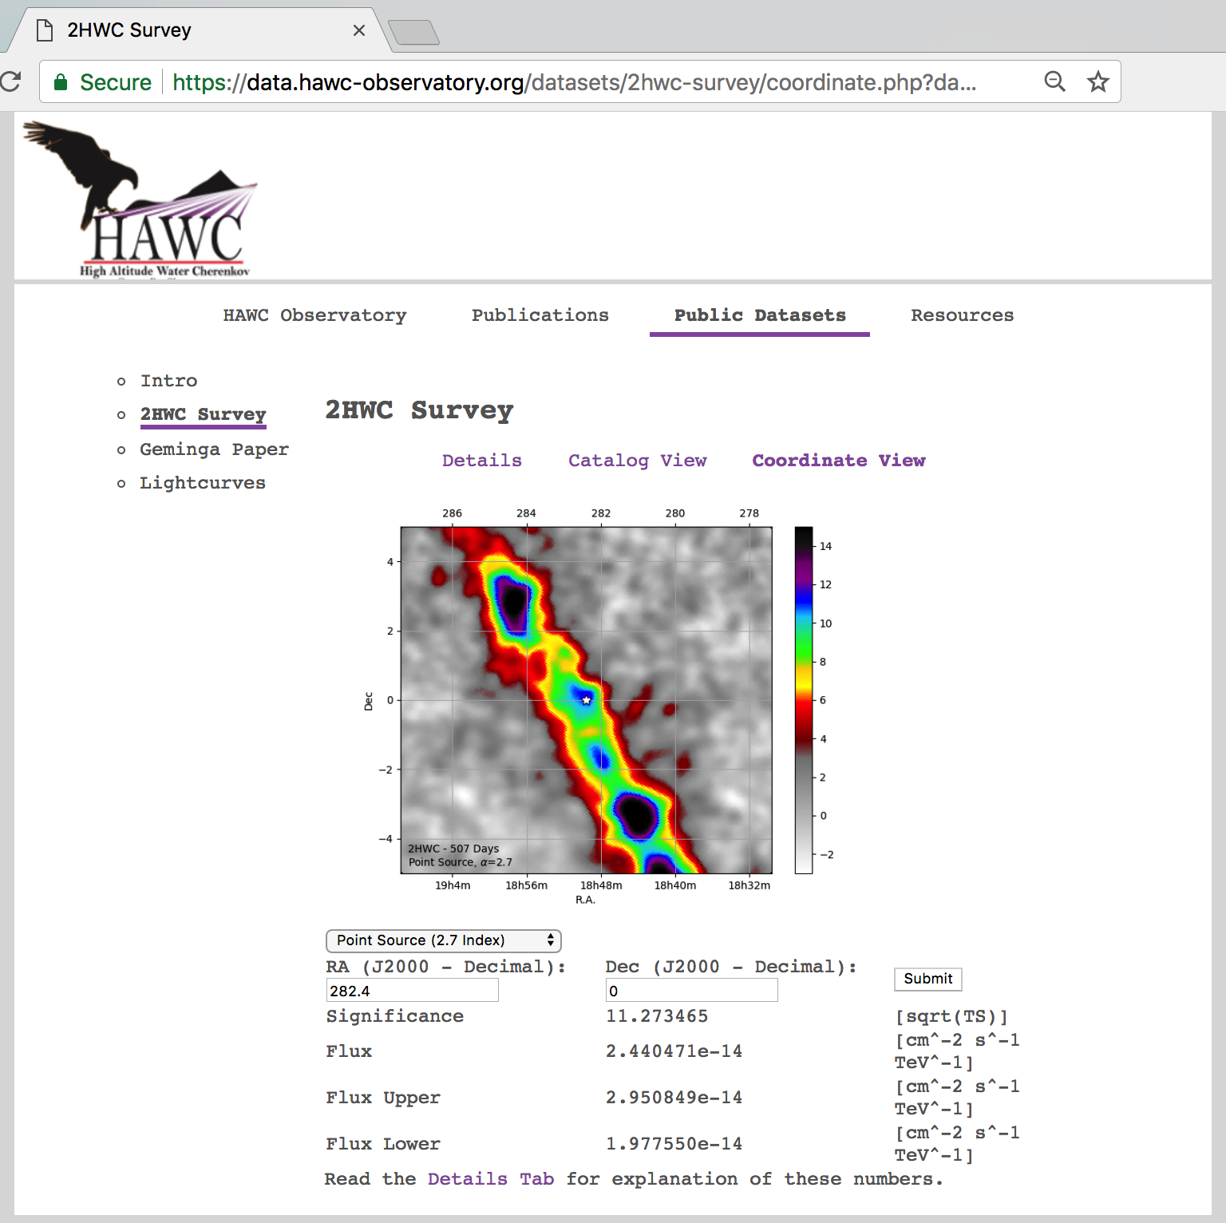
Where do I get some HAWC data to play with?
Public data: data.hawc-observatory.org
Some dataset already available, planning to add more:
  Significance and flux maps corresponding to the 2HWC paper (507d livetime).
  Geminga & Monogem dataset.
  Daily light curves (2014-11-26 to 2016-04-20):
    Crab
    Mrk 421
    Mrk 501
Please use for your own analysis, and contact us if you want to collaborate or for more information!
  Joint Fermi/HAWC/HESS/MAGIC/VERITAS dwarf analysis in progress

