Slide 1
Embedded Optical Fiber Sensor Monitor
3th DEPFET Int. Workshop, BCN 8th October 2009
Iván Vila Álvarez
Instituto de Física de Cantabria [CSIC-UC]

Slide 2



Outline
Statement of the issue
Optical Fiber Sensors 101
Current R&D projects:
  Integration of OFS on a silicon dummy sensors
  Integration of Fiber Optic Sensors on CF composites.
Possible implementation for a DEPFET-like ladder.

Slide 3
Statement of the issue
Structural monitoring:
  Ladder deformations due to mechanical and thermal loads.
Environment monitoring:
  Temperature, humidity, magnetic field?
  Temperature distribution on the ladder can be quite non-uniform.
Design constrains:
  Very low material (zero)
  Relatively radiation resistant system.
  EMC compatible
  No extra heating

Slide 4
Bending of a Dummy sensor
Simulated stack: passivation layer + Si bulk
                Passivation layer deposited with low temperature PECVD
                Sensor dimensions
                12 cm x 2 cm
                Mechanical parameters provided by CNM-IMB integrated-optics group
Si3N4 1um
Si02 1um
Si 250um

Slide 5
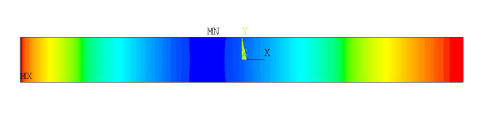

Gravitational bending - no surface stress
Si3N4 1um
Si02 1um
Si 250um
g
Z AXIS
Bow around 30 um

Slide 6
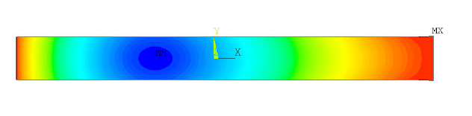

SiO2 passivation induced bend
Si3N4 1um
Si02 1um
Si 250um
Z AXIS
Bow around 41 um

Slide 7
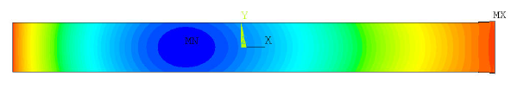
SiO2+Si3N4 passivation induced bow
Si3N4 1um
Si02 1um
Si 250um
Z AXIS
Bow around 15 um

Slide 8
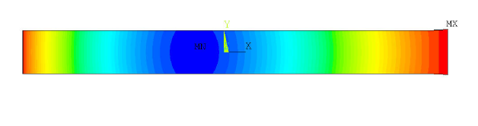

Gravity + full passivation bending
Si3N4 1um
Si02 1um
Si 250um
g
Z AXIS
Bow around 45 um

Slide 9
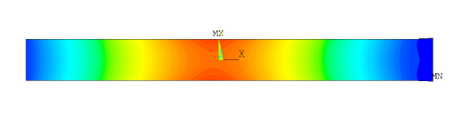

Reverse gravity + passivation induced bending
Si3N4 1um
Si02 1um
Si 250um
g
Z AXIS
Bow about 17 um

Slide 10
FEA Simulation conclusions
Bow induced by very thin layers of unequal CTE can introduce large sensor bending similar o larger than the gravitational bow.
Very difficult to predict the actual induced bending.
Smart combination of layers may allow to compensate de bow.

Slide 11
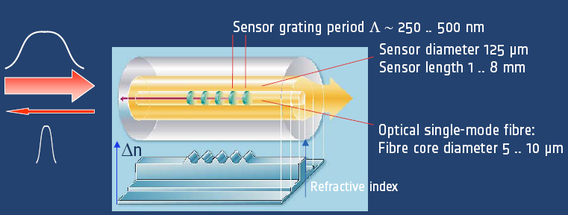
Bragg grating sensors basics
Fiber Bragg Grating optical transducer

Slide 12
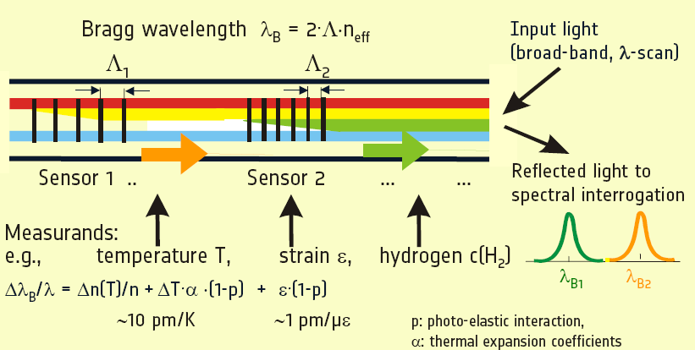
Multiplexing Bragg grating

Slide 13
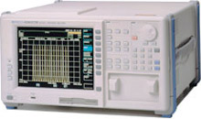
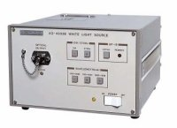
Basic system
The number of different Braggs is more than 100; moreover by using an optical switching we can use tents of sensing fiber
Optical Spectrum Analyzer
Large Bandwidth
Light source
1x2 coupler
λ_{B1}
λ_{Bn}
λ_{B2}
λ_{B3}

Slide 14
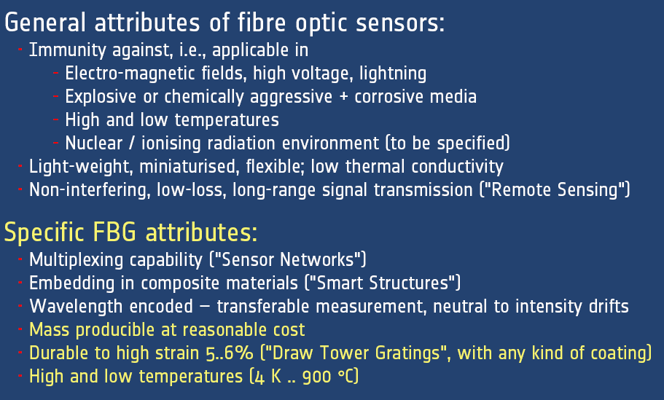
OFS & FBG advantages

Slide 15
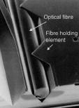
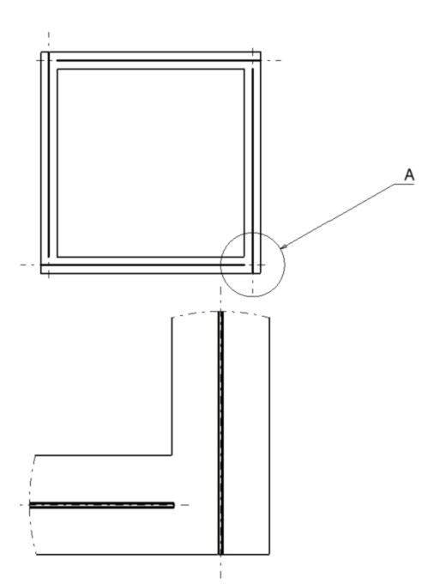
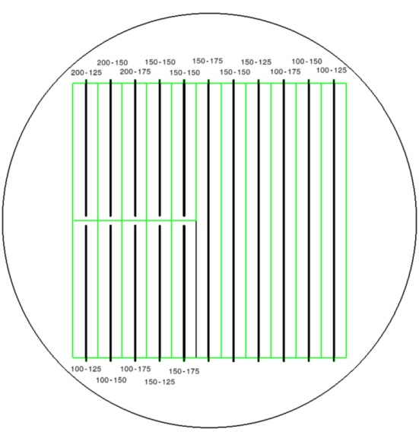
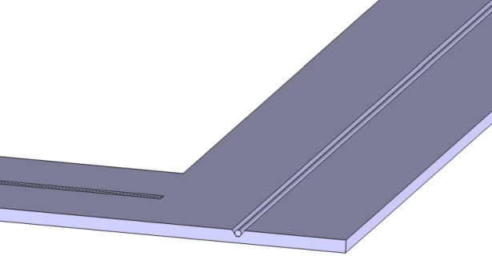
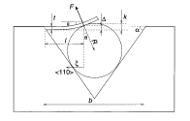
Current R&D activities
(OCT’ 09) MECHANICAL DUMMIES &
multi-groove wafer structures.
Exp. validation of FEA simulations.
Conventional KOH anisotropic etching on SOI wafer.

Slide 16
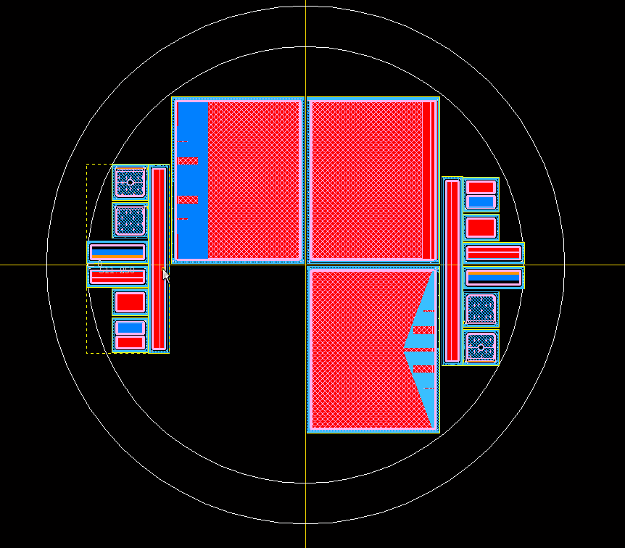
Current R&D activities (2)
  (2nd step) PRODUCTION FULL FLEDGED SENSORS equipped with OFS: Standard, DML, Integrated pitch adapter, PolySi electrodes.

Slide 17
Current R&D activities and plans
Preparation of experimental test stand (profilometer + miniclimate chamber and tensile test machine):
  Fiber embedding quantitative evaluation.
  Validation of FE simulation and extraction of mechanical parameter for thin layers.
Still waiting for equipment delivery.
Thermal test of instrumented dummies to be completed at IFIC

Slide 18
OFS work plan – Integration on CF
Integration on CF composite part of CMS R&D
Currently working collaboration agreement with Spanish Aerospace Agency (INTA) for a two year period.
The preliminary plan includes:
  Complete the market survey.
  Proposal of fiber routing for CMS upgraded tracker
  Testing of standalone fibers (irradiation).
  CF test structures with bonded or embedded fibers.
  Mechanical expansion and compression test under several thermal and humidity conditions.
  Experimental validation of OFS vs. electrical expansion gauges.
  Comparison with FEA simulations

Slide 19

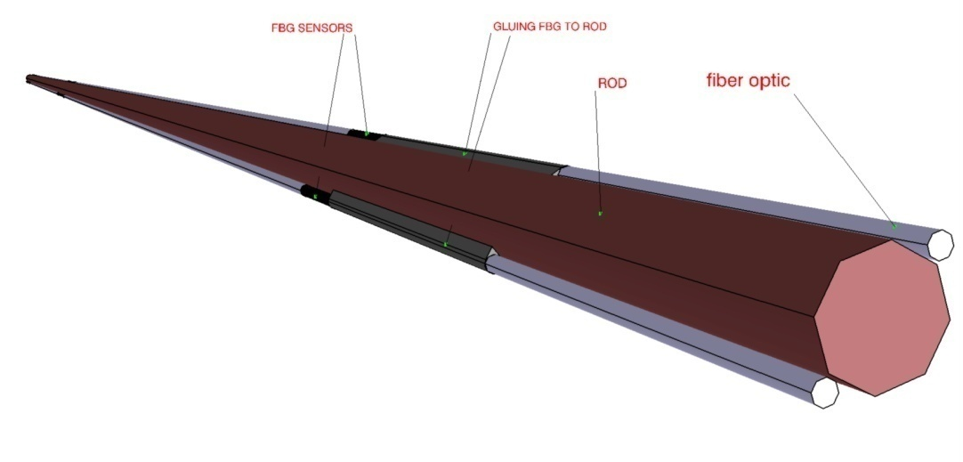
What about DEPFETS?
During the thinning process V-groove could be also etched.
Integration on other Vertex supporting structures very doable

Slide 20
Summary
OFS is a proven technology suitable for building a very fast deformation and temperature monitor
Zero impact on the system material and heat dissipation, and 100% EMC
Other monitoring quantities are in the technology scope: humidity, B field, CO2
Initial R&D embedding fibers on Silicon.
Preparing R&D on fiber embedding on FC.

Slide 21
BACKUP

Slide 22
IR-Transparent sensors
See Marcos Fernandez talk
Test Beam last August with “alignment HPK sensors” (Jointly with HEPHY)
PLANS
  Sensors almost finished, last passivation layer.
  Electric characterization of each geometry and layout.
  Optical characterization with laser.
  Response characterization with laser and Sr-90 source.
  R/O with ALIVABA system (pitch adaptor and sensor boards to be produced soon)
  Irradiation.

Slide 23
Thin ustrips
PROCEDURE: SOI n-type wafers + deep anisotropic etching. (already in house)
GOALS:
  Establish handling procedure for thin sensors.
  Mechanical characterization of thinned sensors (150, 200 & 250 um thick + 300um frame)
  quantitative study of the effect of passivation layer on sensor deformation (FEA).
  Evaluation of Integrated Pitch Adapter and DML readout
  Integration of fiber optics sensors on silicon

Slide 24
Thin ustrips (2)
WORK Sequence:
  (OCT’ 09) MECHANICAL DUMMIES & multi-groove wafer structures.
    Exp. validation of FEA simulations.
    Fiber Optic Sensor insertion test on silicon.
  (NOV ‘09) PRODUCTION FULL FLEDGED SENSORS: Standard, DML, Integrated pitch adapter, PolySi electrodes.

Slide 25
Structural & Enviromental Monitoring - OFS
Well know monitoring technologies in aeronautics and civil works based on optical fiber sensors (OFS)
Distributed strain & temperature sensors are conventionally used for structure health monitoring : SMART structures
Other OFS: dosimetry, humidity, B field, acceleration, etc.
In aeronautics (embedded or bonded) on the of the CFRP composite ( for instance, plane radar redome)

Slide 26
Deformation monitoring with FBG sensors
Diffracted wavelength depends on FBG geometry, that is affected by stress and temperature.
Typical values:
Δσ = 1-0.1με ⇨ Δλ = 1pm
SMART MECHANICS FOR SILICON TRACKERS

Slide 27
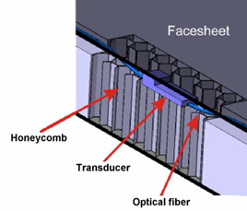
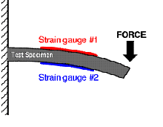
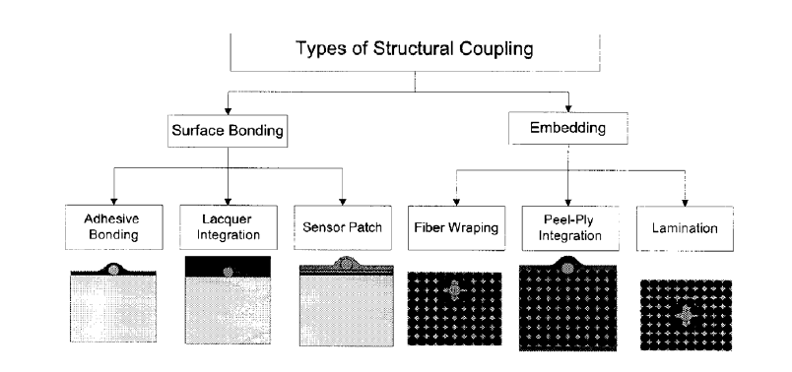
Integrating OFS & carbon fiber composites
For the Track structure would be interesting to use a embedded fiber optic sensor.
  more precise and reliable data
It could be use 2 side solution
  Better understanding of the results
  Useful to quantify the thermal strain

Slide 28
OFS work plan – Integration on CF
Currently working collaboration agreement with Spanish Aerospace Agency (INTA) for a two year period.
The preliminary plan includes:
  Complete the market survey.
  Proposal of fiber routing for CMS upgraded tracker
  Testing of standalone fibers (irradiation).
  CF test structures with bonded or embedded fibers.
  Mechanical expansion and compression test under several thermal and humidity conditions.
  Experimental validation of OFS vs. electrical expansion gauges.
  Comparison with FEA simulations

Slide 29
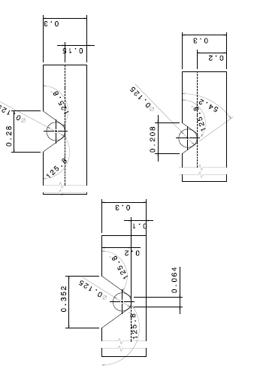
Ataching to silicon
Attaching Procedure to be tested on multigroove
wafer and thin mechanical dummies

Slide 30
Brief Summary
IR-Transparent sensors almost ready.
Thin sensors with DML and Integrated PA production starting before the end of the year.
OFS R&D program still to be better defined / still on market survey phase.

Slide 31
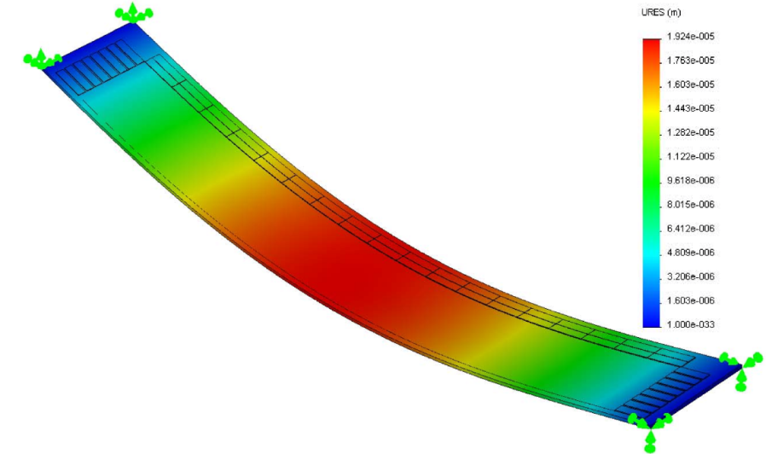
Naïve FEA model
Simple Geometry with frame + thinned area.
Support: Four corners fixed.
All Silicon structure
Measured dummy structure shows 20 um bow
Notes:
Recordar lo que sabemos, la información que tu mismo me pasaste…

Slide 32
Naïve FEA: gravitational bend
Gravity parallel to Z axis
Deformation in Z direction
Max deformation 12 um
Notes:
Resultado deformación en z

Slide 33

Naïve FEA: Longitudinal (X) strain
Top surface
Notes:
Resuldados del strain en la dirección longitudinal para la cara superior. La unidad de medida del strain es “epsilon” que es el strain relativo.
La gráfica de abajo es un zoom de la de arriba.

Slide 34
Naïve FEA: Transversal (Y) strain
Top surface
Notes:
Lo mismo que la anterior pero para el strain en la dirección transversal

Slide 35
Naïve FEA: Strain vs. Deformation
Notes:
Relación entre los strain longitudinal y transversal; y la relación entre el strain longitudinal y la deformación gravitatoria.
Estas gráficas demuestran que midiendo el strain podemos determinar la deformación.

Slide 36
Naïve FEA: Conclusions
Gravitation bend depends linearly with top surface strain
Output values for nominal conditions:
  Maximum deformation of 12 um
  Maximum longitudinal strain about 2.5 με at the middle of the DEPFET “frame”.
  Maximum transversal strain about 1 με at the middle of the DEPFET “frame”.
Notes:
Conclusiones de la simulación

Slide 37
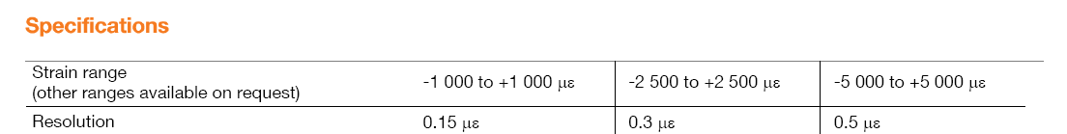

A possible commercial solution
Deformation monitoring with 750nm resolution
Notes:
Una solución comercial no he buscado mucho, este sensor ya lo conocía y está hecho en fibra es una versión modificada del FBG.

Slide 38
An event cleaner/lighter solution ?
Several options:
  Embdeding of fiber sensors on suporting structures (BTeV)
  Or event much better, embedding the sensing element on the depfet frame,
  Integrating a Bragg grating on it, still studying its feasibility.
Notes:
Esto se probó en parte para el malhadado BTeV… se hicieron pruebas de laminas de carbono con sensores embebidos….
Con respecto a integrar un sensor en el propio marco del DEPFET estoy hablando esto con un grupo de óptica integrada
Del cnm pero todavía no tengo una idea clara de como se puede hacer también necesito algún input en cuanto a la
Fabricación de los marcos… me llevará sus semanas ir convergiendo en una propuesta más concreta seguramente.

Slide 39
Summary and next steps
FBG commercial sensor will provide 750nm monitoring resolution with small amount of extra material.
More realistic FEA simulations are still needed: thermal loads, better mechanical supports,…
Eventually, a realistic test with a mock-up will be needed.
Notes:
Bueno y todo esto es un poco de sentido común.

Slide 40
________________________
BACK - UP

Slide 41
RD on Sensors: IRuS for alignment
Statement of the issue:
  The ultimate alignment precision will be achieved by track-based alignment algorithms. BUT …
  ….a real time monitoring of the vtx/tracker stability/deformation during detector normal operation (gravitational, thermal, magnetic loads) must provide a quick a precise starting point and cover some difficult degrees of freedom.
  Name of the game, increase the IR transmitance of the sensors without introducing minimal modifications to the sensor layout: Same materials, avoid fine tuning

Slide 42
RD on Sensors: IRuS for alignment (2)
1st Validation of optical simulation software with material samples. (done)
2nd Babysensor baseline design (p on n; AC coupling, 50 um pitch) minimal design modifications to boost sensor IR transmittance. (done)
3th Production of IR babysensors. (on progress)
4th Bench and beam testing of sensors
5th Know-how transfer to main manufactures

Slide 43
RD on Sensors: IRuS for alignment (3)
Raised issues this meeting:
  Binary read-out.
  Minimal strip width vs voltage bias.
  Material Radiation resistance.
  Other pasivation materials.
  Fine tuning of pasivation layers

