Slide 1
Florian Lütticke
New Offset Calibration Algorithm
Universität Bonn, Physikalisches Institut, Nußalle 12

Slide 2
Offset Algorithm
Task: Compress Pedestal using 2bit current source. Reach small distribution
Settings:
2bit setting for each pixel. Can add 0, I₀, 2I₀, 3I₀
pDAC: Defines strength of 2bit setting I₀
SubIn: Global subtraction to all pedestals
Pedestal I_{meas}=I_{ped} – I_{SubIn} + N*I₀

Slide 3
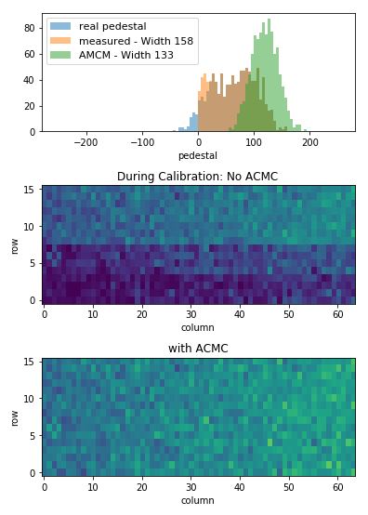
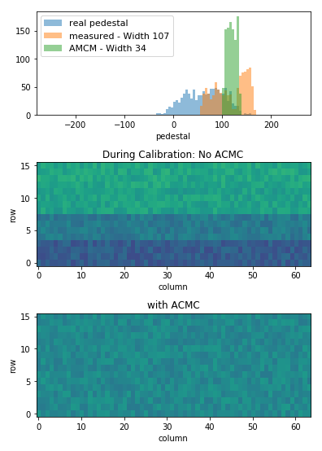
Example
No Offsets
Optimal Offsets
No ACMC during calibration possible
ACMC active during operation

Slide 4
How to select offsets
Ideal world: We know the pedestal distribution.
Split pedestals in 4 bins. Add 3I₀ to lowest bin, 2I₀ to 2nd lowest bin, …
Select pDAC strength accordingly (pDAC= pedestal spread/4)
Done!
+3I₀
+2I₀
+I₀
I_{ped}
I_{ped}

Slide 5
Idea of the algorithm
Assumption: DACs can be nonlinear. ADC curves can be nonlinear. DACs can differ between pixels. Pedestal distribution is unknown and potentially wider than the dynamic range.
Calibration data available for each pDAC /2bit DAC setting
Choose a target value in the dynamic range
For each pixel, for each pDAC strength
Choose 2bit DAC so that each pixel is closest to target value
Get quality number for the resulting distribution.
Repeat the above for different target values.
Select strength and target value for best distribution.
TARGET
DAC=0
DAC=1
DAC=2
DAC=3
I_{ped}

Slide 6
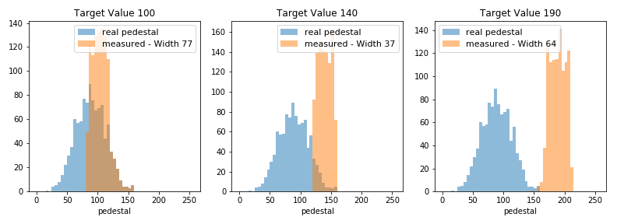
Influence of target value
The optimal target value is at 7/8th of the distribution widht.

Slide 7
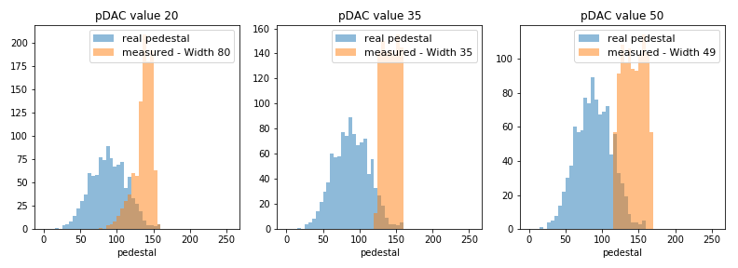
Influence of PDAC
Resulting optimal width is at least as wide as pDAC strength. Choose low PDAC value
Too low pDAC can’t compress all pedestals

Slide 8
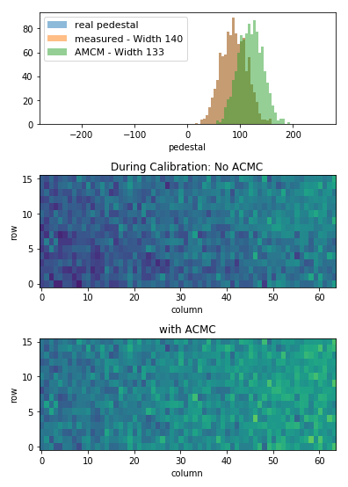
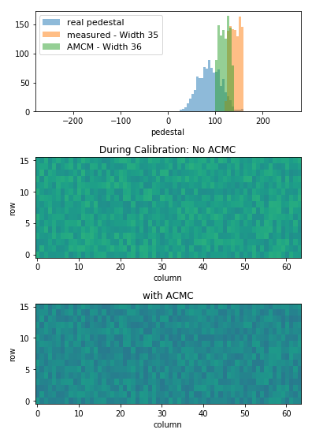
Result
No Offsets
Optimal Offsets
Optimal pedestal distribution is small and has no hits outside the dynamic area.

Slide 9
Are we done?
No Offsets
No, because we have gradients along the matrix
Analog common mode correction fixes gradients along columns.
The old offset correction is unaware and tries to fix it.
Solution: Calculate Offsets per Gate.

Slide 10
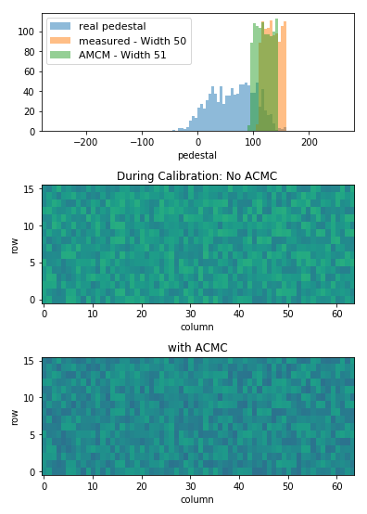
Gate Offset Calibration
No Offsets
Per Module Offsets
Optimal Offsets

Slide 11
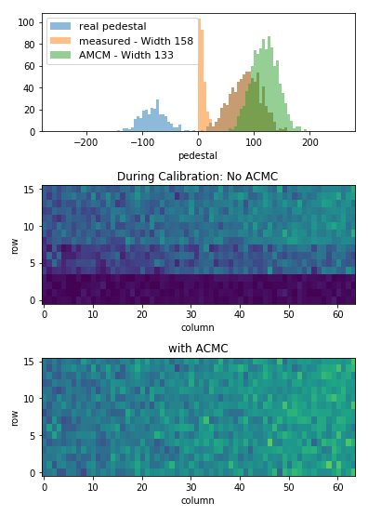
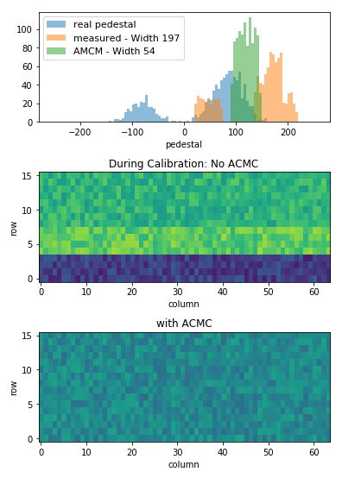
Are we done?
No Offsets
Gate Offsets
No, because this does not work well if some gate is far off
Calibration can only analyze what it can see.
Need strong pDAC to get data into dynamic range
Calibrate at different SubIn

Slide 12
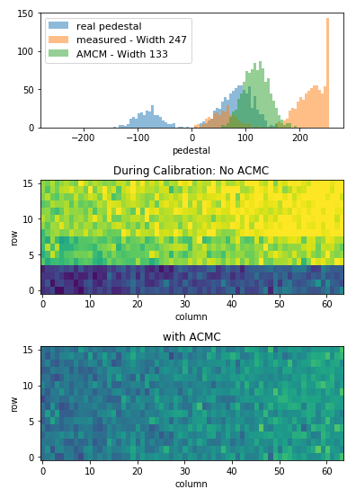
Different SubIn
No Offsets
No Offset – different Subin
Combine knowledge from both views.
Right one tells how gate 1 can be optimized
Left one tells how the other gates can be optimized
Use best result from both plots.

Slide 13
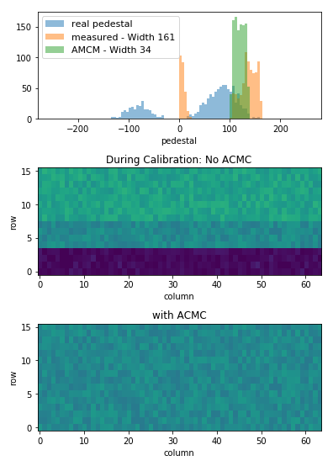
Final Result
No Offsets
Gate Offsets
Optimal Offsets

Slide 14
Pedestal Quality
Pedestal spread should be small.
Pedestal outside the dynamic range can have any value. Penalty given for each bad pedestal.
For per gate calibration: Take quality for each gate
Add? <- Not optimal
Optimize worst gate? <- Not working if we have one bad gate
Optimize N worst gates <- way to go

Slide 15
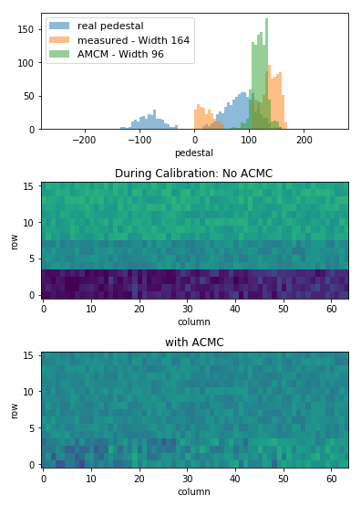
Difference in choosing optimal values
No Offsets
Use mean of all Gates
Use mean of N worst gates

Slide 16
Data examples
H1072
H1031

Slide 17
Quality

Slide 18
New Offset calibration algorithm developed
New Offset calibration needs changing SubIn. Longer data taking (3-5x longer)
It only improves the situation when some gates are very different.

