Slide 1
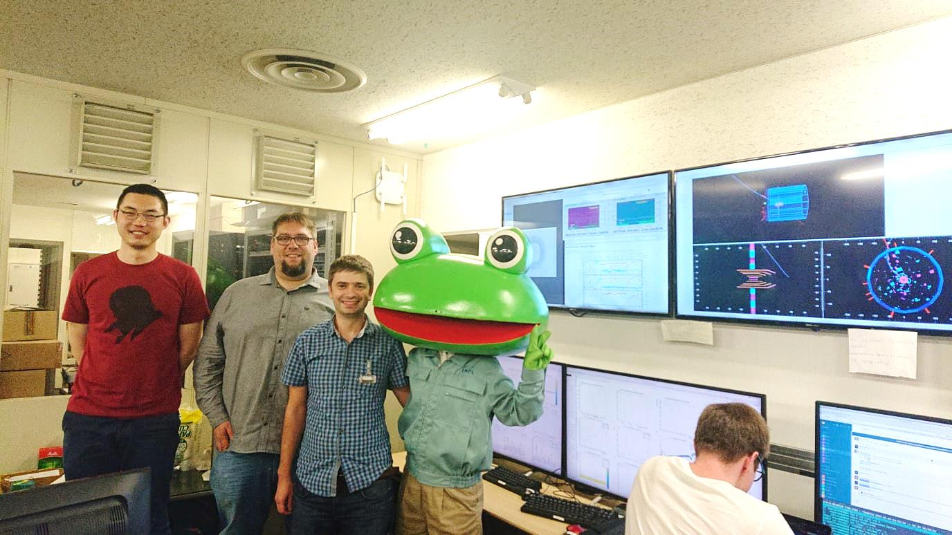
•Florian Lütticke
Local DAQ Status
•Florian Lütticke
Universität Bonn, Physikalisches Institut, Nussallee 12
Universität Bonn, Physikalisches Institut, Nussallee 12

Slide 2
Software
DAQ:
Unified changes between Lab/TB Version and Belle 2 version
Filtering known follow-up errors.
Limited error count displayed per time interval (50 errors per 10 sec per DHC)
Improved buffer size and timeout of event builder.
Bugfixes
pyDepfetReader
Added error counters. Added option to readout trigger-offset.
Big cleanup of underlying code. (Removed DHP02 and Hybrid 6 support)
TCP Stability

Slide 3
Server
Improved network settings.
Need to verify that they are applied after restart
SSDs currently unused – needs some software changes to take data on them
HDDs sometimes in slow when too many analysis are running.

Slide 4
Power Issue
Error at startup: Power redundancy lost, System halted because itvdraws too much power.
Only observed at startup. No problem running.
All time power spike was 295W – System as 2x 495W PS.
Dell support not helpful so far: Proposed solutions bad ( give up redundant PS and lower performance)

Slide 5
Issues
Zombie process observed once:
Could not be killed and blocked a port - restart of the server required.
I don’t know how this can happen. It happened once.
Server firmware and drivers are outdated – need to be updated during next maintenance
Backup server still unusable. Was converted to IOC Server.

Slide 6
Services on DAQ Server
We have several IOCs running on the DAQ Server.
They are started as services which autorestart on crash.
I think this is a bad idea. It hides bugs.
IOCs should never crash.
If they do, a bug report is needed.
So the shifter should notice…
Example: right now, the elog server needs username and password after startup. It autostarts and hangs… but no one notices.

Slide 7
Todo
Investigation of DHE/DHP problems
Read and store error counters from local DAQ. (Number of CRC Errors, number of frames with bad size). Should be done in local DAQ IOC (elog server).
Harrison prepared something like this for the TB.
Analyze runs with new pyDepfetReader and have a look when errors appear.
ONSEN got flooded by errors when data format checks were active
Server
Maintenance
Backup server needs to be prepared

