Slide 1
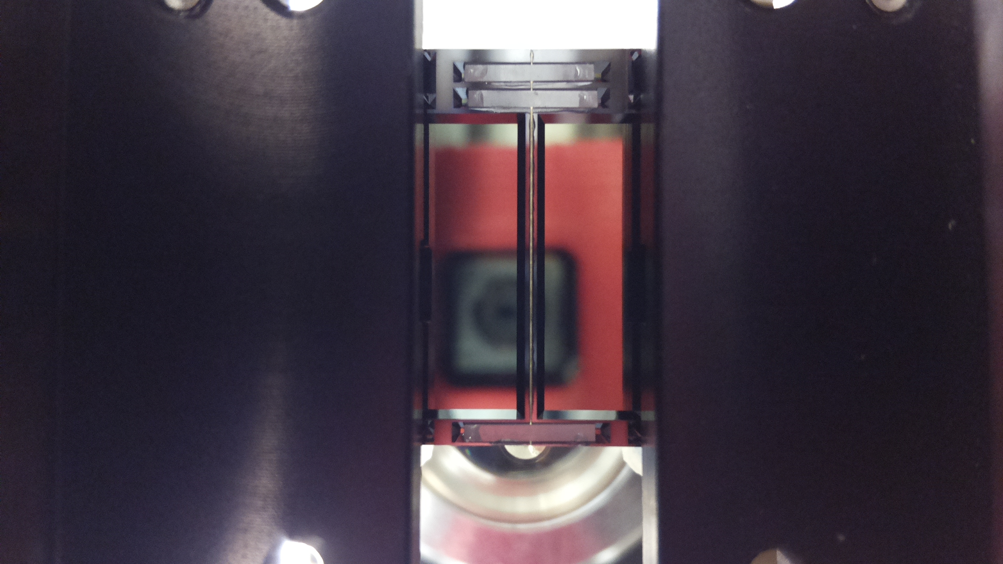
Ladder Assembly
New Method
Review
Changes
Test production
Results
Summary
New gluing procedure

Slide 2
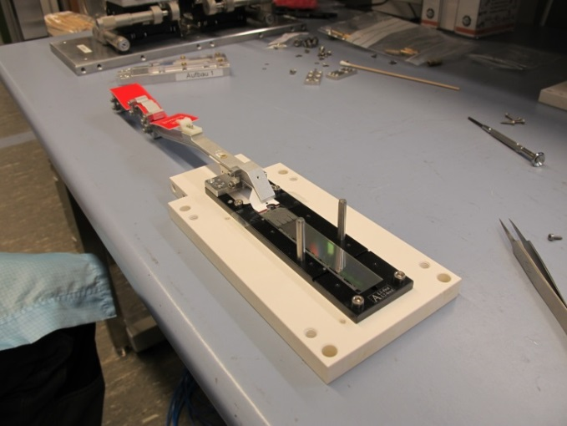
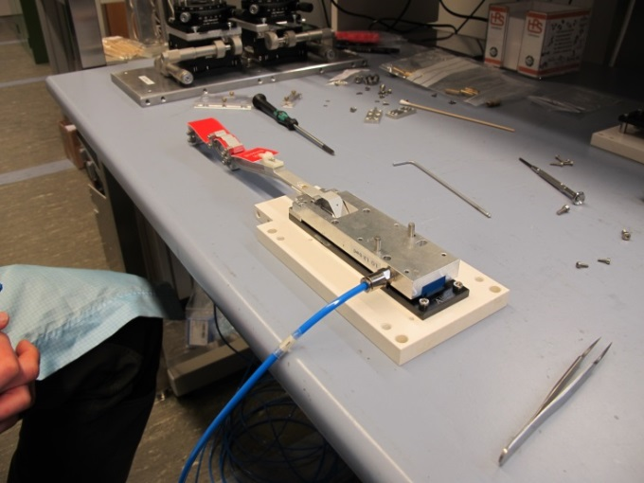
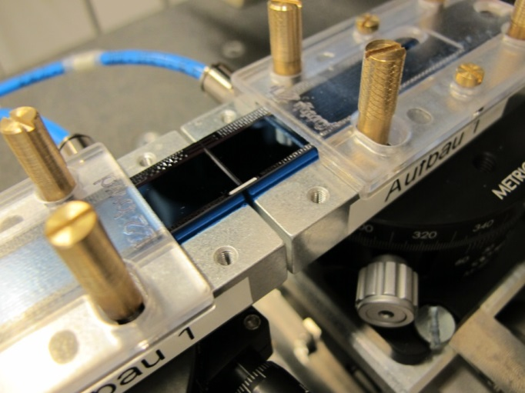
Old procedure
Module face up on jig Assembly jig put on Ceramic stiffeners insert manually
Module fixed by vacuum from above
Problem: Particles pressed by into module surface (sensitive) leading to shorts:
- dead drain lines
- complete failure of the module

Slide 3
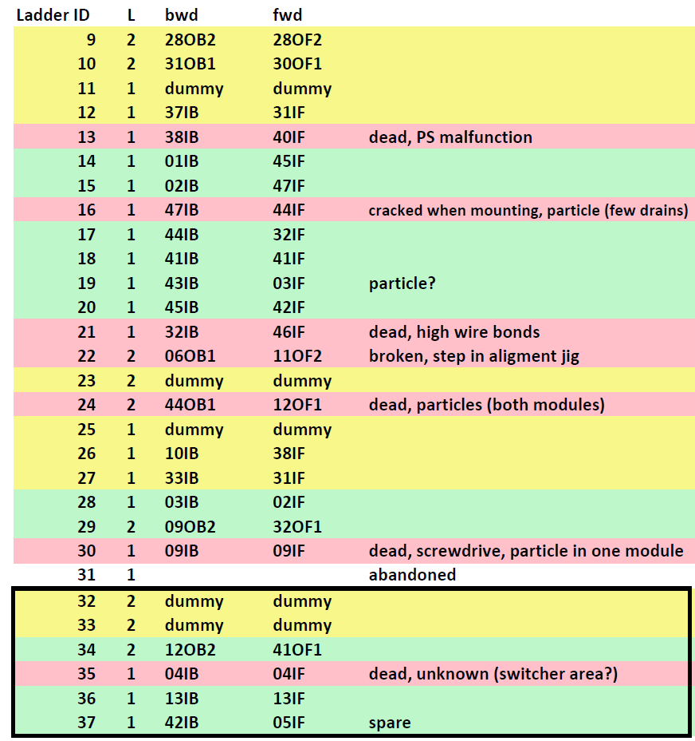
Statistics
18 ‘hot’ ladders glued
11 working ladders (10 in Phase III)
1: PS malfunction
1: jig misaligned
1: hit by screwdriver
1: particle
1: high wire bonds
1: cracked when mounting
1: unknown
Damage by particles
Some drain lines in 1 module
2 dead modules (in one ladder)
unknown (hidden by screwdriver acc).
~ 4 occasions
With nylon mesh

Slide 4
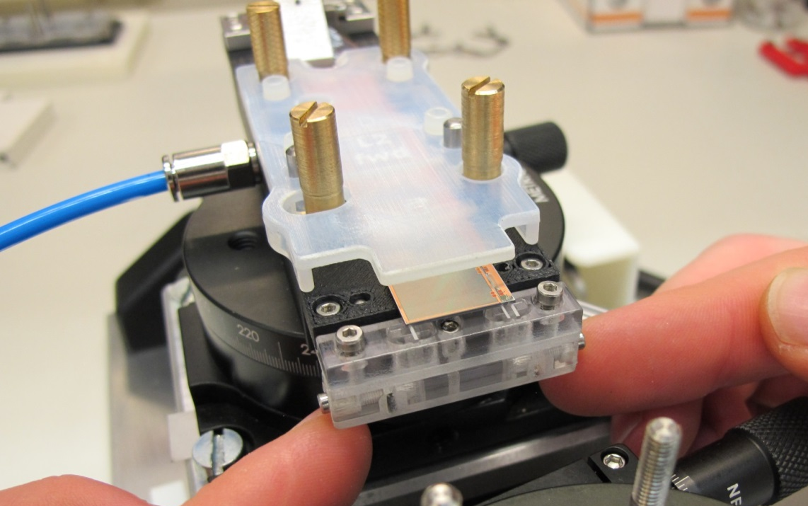
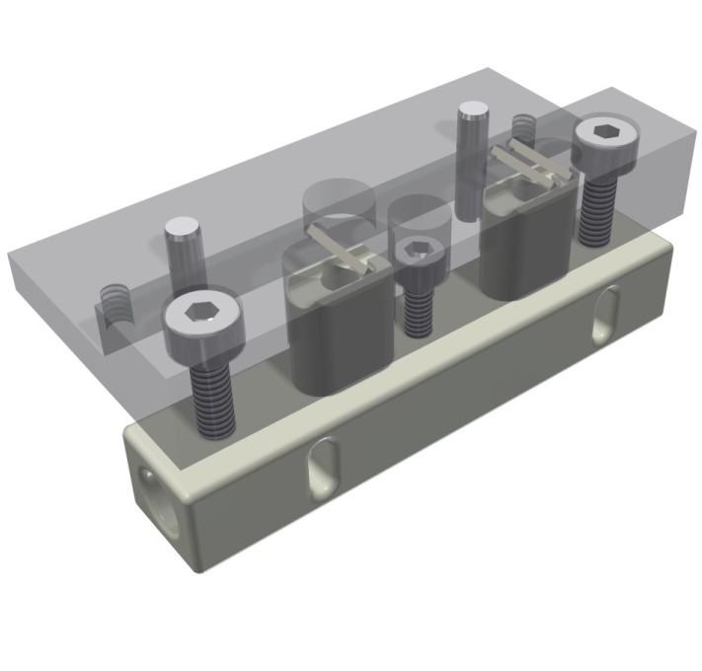
New Method
Mount modules face up on alignment jig: surface not touched anymore
Insert stiffeners using a tool from below
First prototype for tests (made in 3D printed plastic)
Insertion is made once both modules are together
2nd module removed here for visibility

Slide 5
Lifting
Watch for over-travel optically and acoustically (vacuum!)
Height changes measured before/after alignment and after insertion

Slide 6
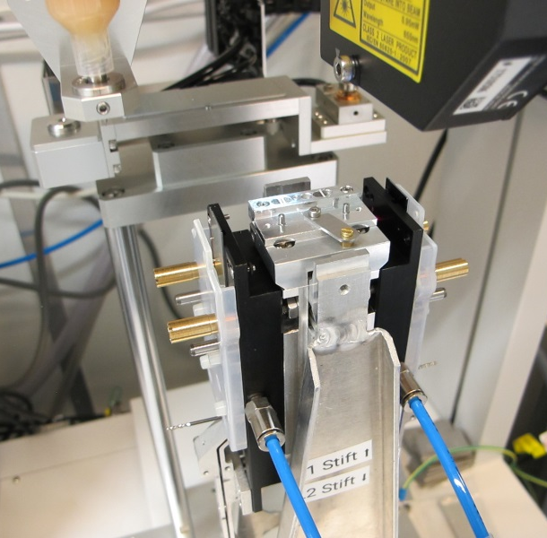
Other changes
Transfer module manually form storage jig to alignment jig
Automatic glue dispensing on ceramics
Transfer to ladder gig using a ‘bone’ tool (like for ladder mounting)
Rather easy
No flip over and risk of jamming
Guiding pillars added (proposed at review)
Better reproducible
Glue dispenser tested
(series of test dispensing)
No flip over and risk of jamming

Slide 7
Review
Review held end of February
Reviewers: Jelena Ninkovic, Ariane Frey, Igor Konorov, Hans Krüger, Christian Irmler
Participants: Carsten Niebuhr, Laci Andricek, Karl-Heinz Ackermann, Hans-Günther Moser
General recommendations on workspace
Cleanliness of the assembly area and of the tables inside clean room should be improved.
Materials like wood, paper, carton boxes, etc. should be removed as much as possible done
Unused setups and equipment should be, so far possible, dissembled and stored somewhere outside the assembly room. Done (ATLAS MTD equipment, unused measuring microscope removed
A systematic cleaning of the room and all tools is required done, regular cleaning
Operator policies must be defined: clothes, gloves, static check, ESD-safety, who should be in, etc. done
Gloves should be worn all the times done
Tables and floor should be equipped with ESD mats done
Use cleanroom sticks with soft Teflon tips or equivalent soft material instead of tools with metal tips (in particular no metal tweezers to handle the ceramic inserts) done
Proper microscope for visual inspection and quality control should be in place. Two microscopes available (classical and digitial, final survey by Keyence microscope outside)
Usage of the clean room should be exclusively granted to PXD group for ladder assembly and module testing until work is completed. Exclusively PXD

Slide 8
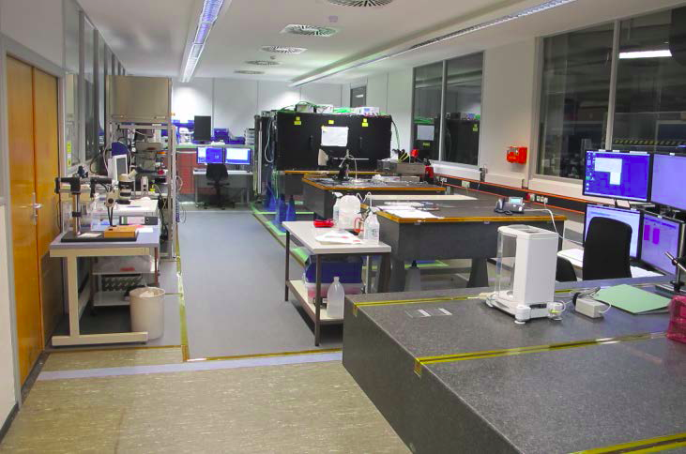
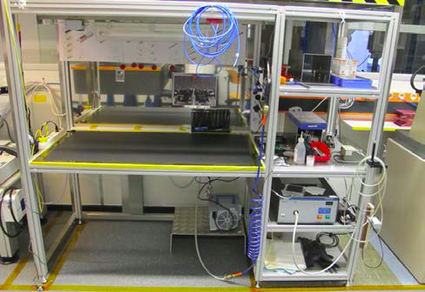
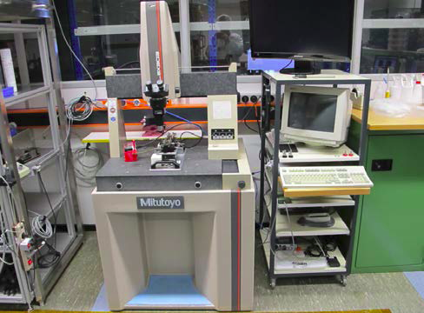
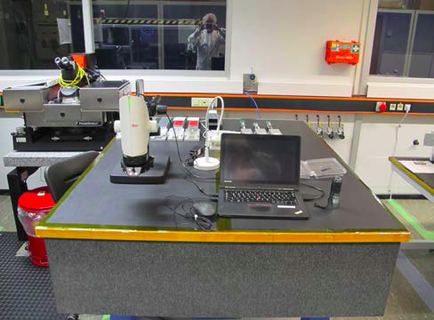
Cleanroom
Unused equipment removed
Better access to alignment setup
ESD mats on floor and tables
No loose cables etc (easier cleaning)
2x cleaning/week
Overall view
Assembly workspace (flowbox)
Algnment setup, Mitotoyo CMM
Inspection

Slide 9
Review
B) Detailed recommendations
• Characterize glue dispenser to ensure homogenous and repeatable dispensing results
Test gluings performed, glue amount determined, parameters and procedure optimized
• Modify lift-up jig to its final dimension (fixed part), polish surface of moveable part
Tool optimized after several trial assemblies
• Finalize procedures and documentation, implement mentioned modifications and add additional quality checks. Done
• Acquire a second person for ladder gluing, make use of students
2nd person identified (technician) and trained
• Once final procedure and documentation are ready and results of critical steps are reasonably good, produce at another class C ladder, by following the full final procedure.
C class ladder successfully produced
• Present and discuss results within PXD group, e.g. in coarse of a remote follow-up review to gain class B qualification (CBQ) . Results discussed, go to next step due to time pressure
• If CBQ is granted, produce a first electrically functional ladder from class B modules.
• Consider class B assembly as a dress rehearsal. Record all steps and provide movies to reviewers.
Class B ladder produced, pictures taken
• Fully characterize assembled class B ladder mechanically and electrically
To be done

Slide 10
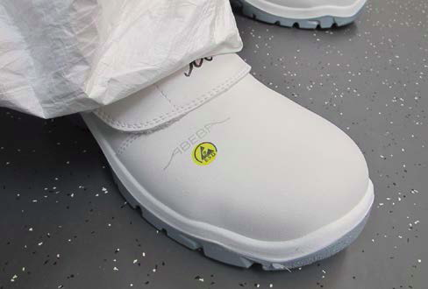
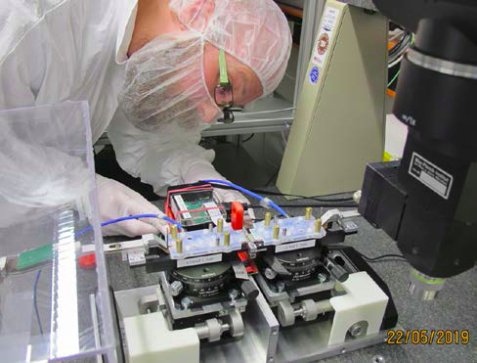
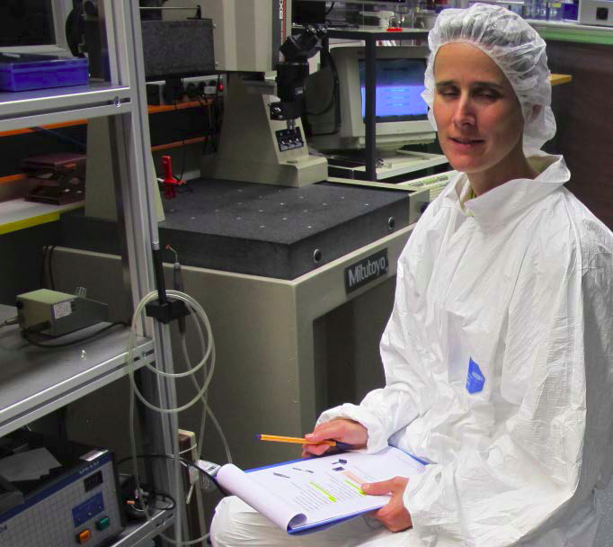
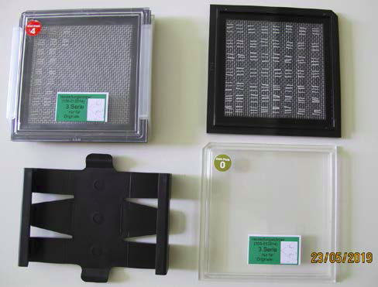
Cleanroom
ESD protection
Gloves, net….
2nd person for coordination & protocol
Ceramic was cleaned and is stored in gel-packs

Slide 11
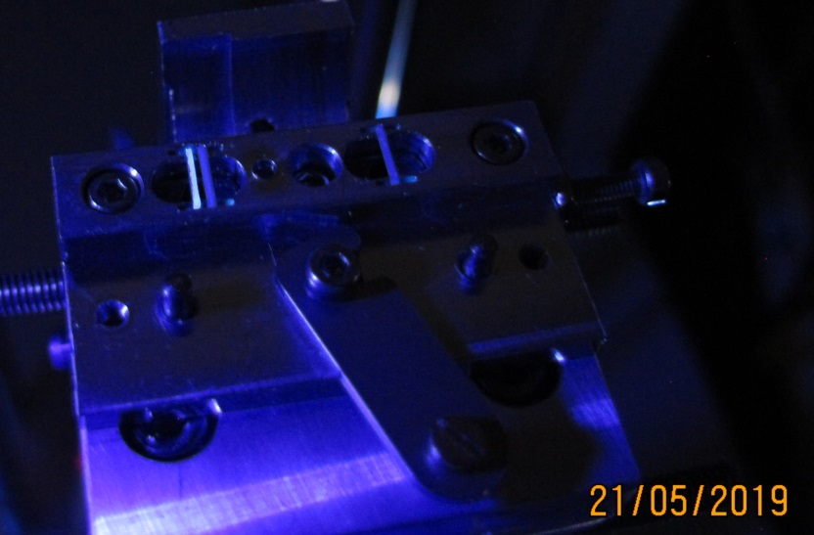
New Features I
Control of glue dispensing using UV light
(with bare eye even better)
Additional guiding pin (red) to reduce roll and till of lifter
=> Exact positioning of stiffeners

Slide 12
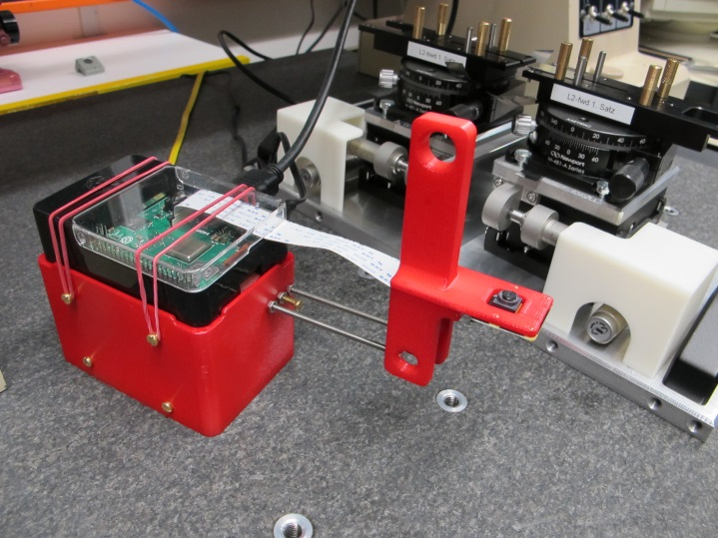
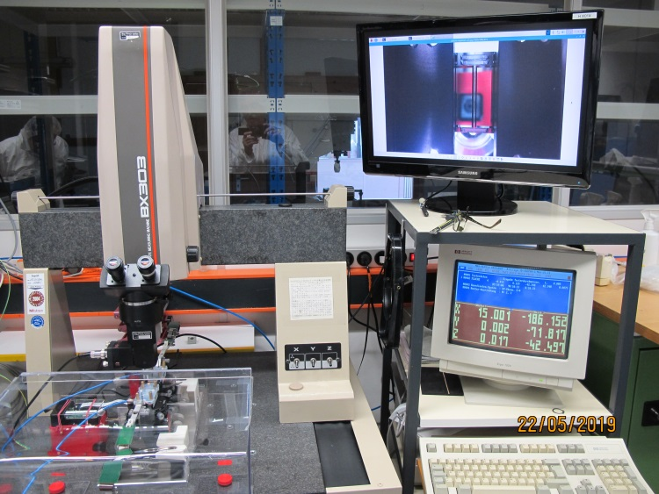
New Features II
Raspberry Pi camera module for control of stiffener insertion
Life picture after insertion
(after removal of liftener)
Enables manual corrections, if needed

Slide 13
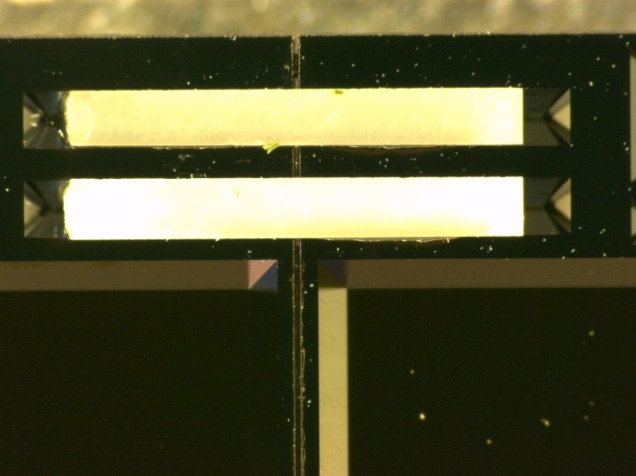
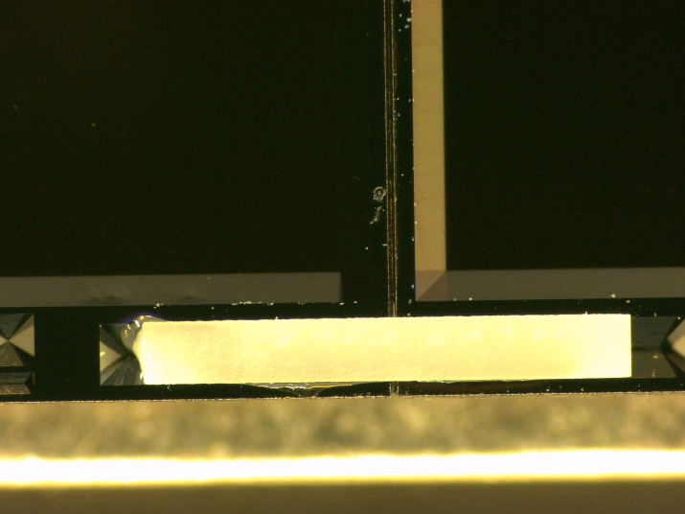
Controls & Survey
After curing, before packing
Pictures of backside showing position of stiffeners
Then
Survey and documentation with high resolution digital microscope (Keyance)
Finally: electrical test
Ceramic stiffener position
Ladder | Type | gap | Δx | Δh(wide) | Δh(small)
#39 | Dummy | 118µm | 6.9µm | 22µm | 1µm
#40 | Dummy | 113µm | 4.0µm | 14µm | 11µm
#41 | Dummy | 115µm | 2.2µm | 5 µm | 9µm
#42 | Grade B | 115µm | 5.7µm | 15µm | 6µm
Survey
High resolution picture (to zoom in on pixel level)

Slide 14
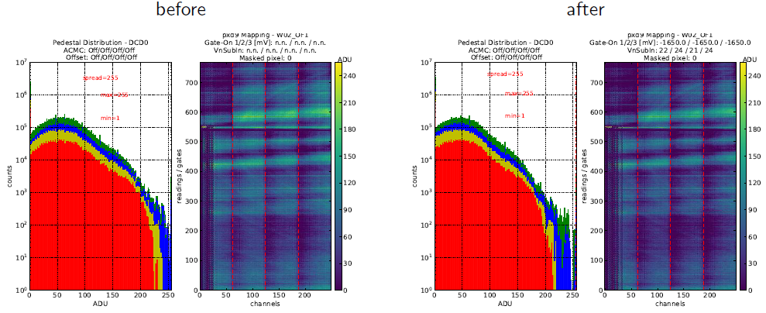
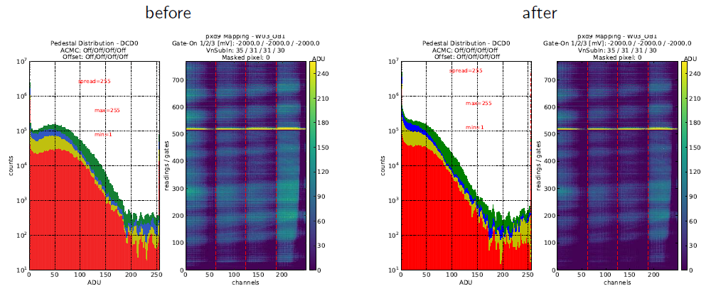
Electrical Tests
L42
Functionality test
No optimization yet
W02_OF1
W03_OB1

Slide 15
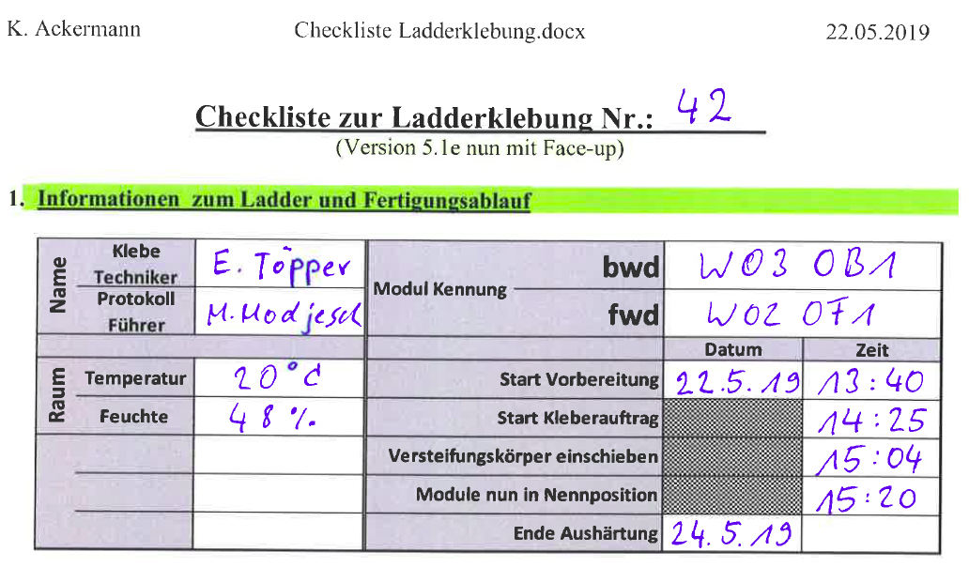
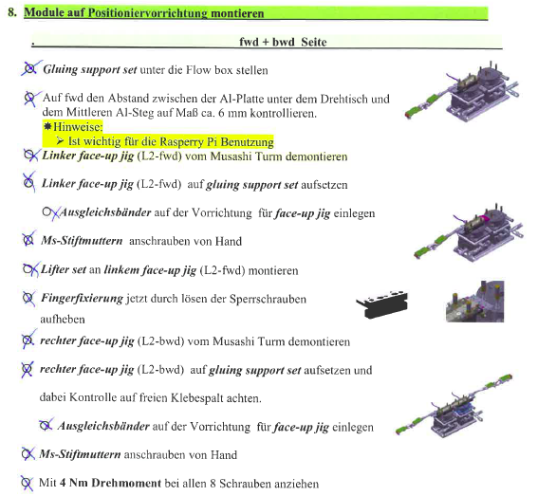
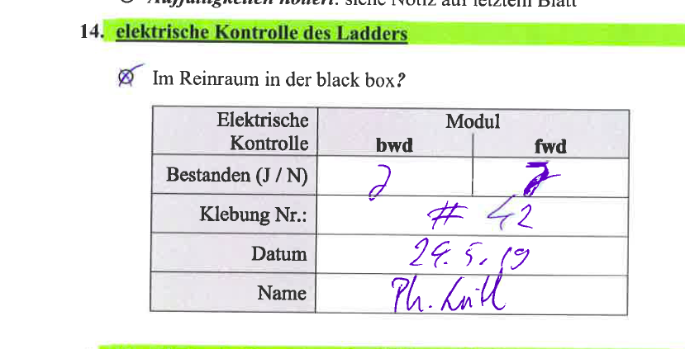
Protocol
Detailed step by step instructions
Used for assembly protocol
Scanned and stored with survey information

Slide 16
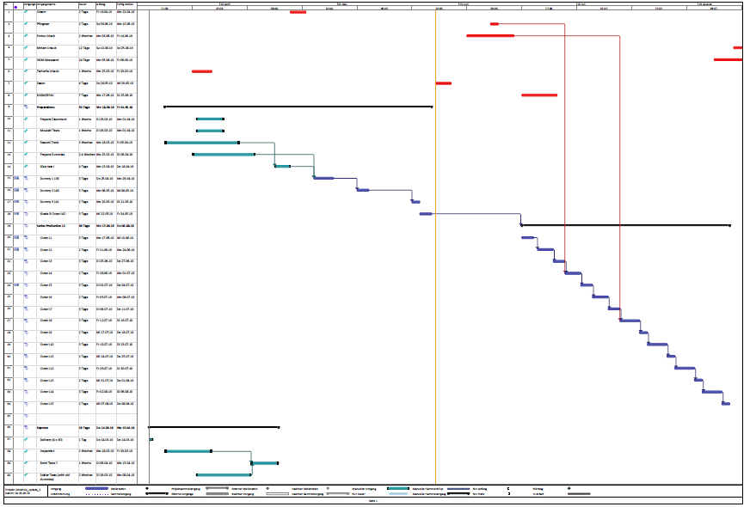
Schedule
Seeon/Vacation
15 L2 ladders could be ready by mid August
25.7.
11 L2_FWD available

Slide 17
Summary
Assembly procedure changed:
sensor surface not touched,
stiffeners inserted from below using a tool
Method and facilities were reviewed end of February
(Most) suggestions realized
Test with dummy (1 simple dummy, 3 Kapton dummies)
Some improvements needed
last 3 assemblies very successful
Grade B ladder successfully glued and tested
Gluing procedure needs 1:40h (plus time for module test & inspection)
Curing time 48h
1h to take out and pack (plus survey and electrical test)
Can comfortably glue two ladders a week
Hope to get green light for series production (mid June, till mid August)

