Slide 1
Irradiation status & plans
Mitja Predikaka
Edet session @ Kloster Seeon
28/05/2019

Slide 2
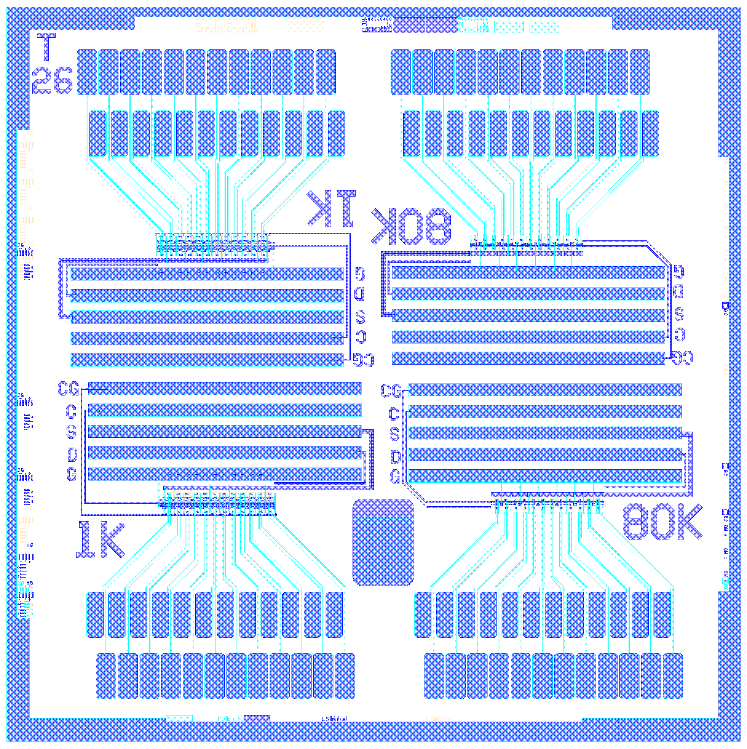
Devices – availability
4 wafers in PXD10:
W09 (50 μm SOI)
W10 (30 μm SOI)
W11 and W12 (450 μm)
6 devices per wafer:
4 without backside imp – TL, TR, BR, BL
2 with backside – ML, MR
none of the devices are backthinned

Slide 3
Devices - structure
4 quarters: 2 x 80k (of interest) + 2 x 1k
Contacts per quarter:
Gate (sweep)
Clear Gate (sweep)
Drift (not connected)
Source (static)
Clear (static)
PT (not connected, therefore you bias it through 1k Drift contact – common)
Cutting Edge (common)
All Drain (two voltages)
8 x drain for PXs with G length of 3.8 μm
8 x drain for PXs with G length of 4.8 μm
8 x drain for PXs with G length of 5.8 μm
Connections per device: 59!

Slide 4
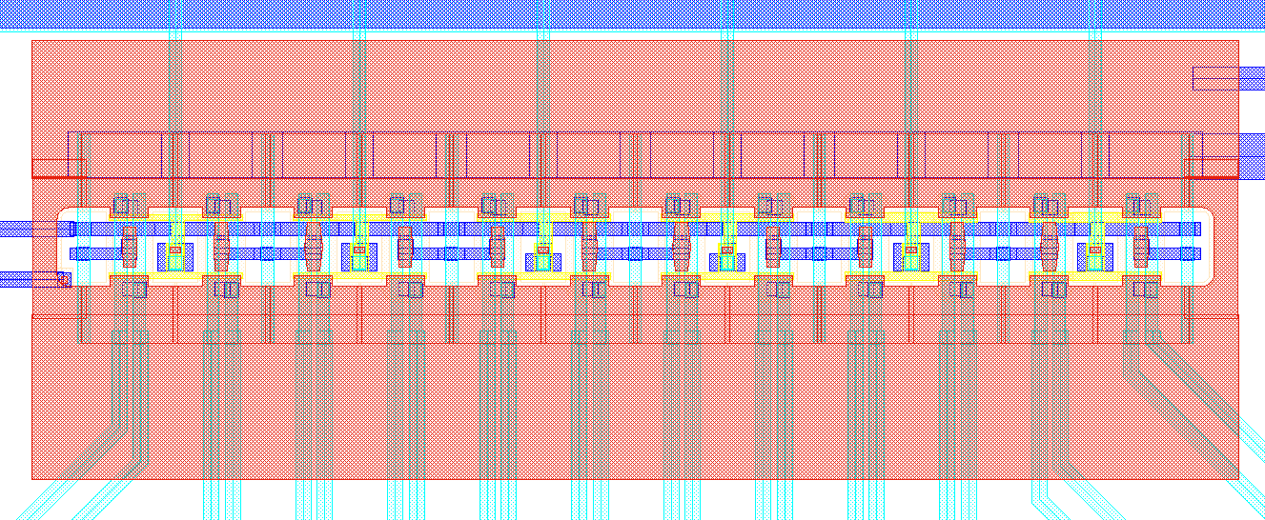
Devices – area of interest
100 μm
300 μm
800 μm
1500 μm
5000 μm
1000 μm
Area of interest: 800x100 μm²
Area to be irradiated: 1000x300 μm²
5000 μm

Slide 5
Setup for Irr. S. (v1)

Slide 6
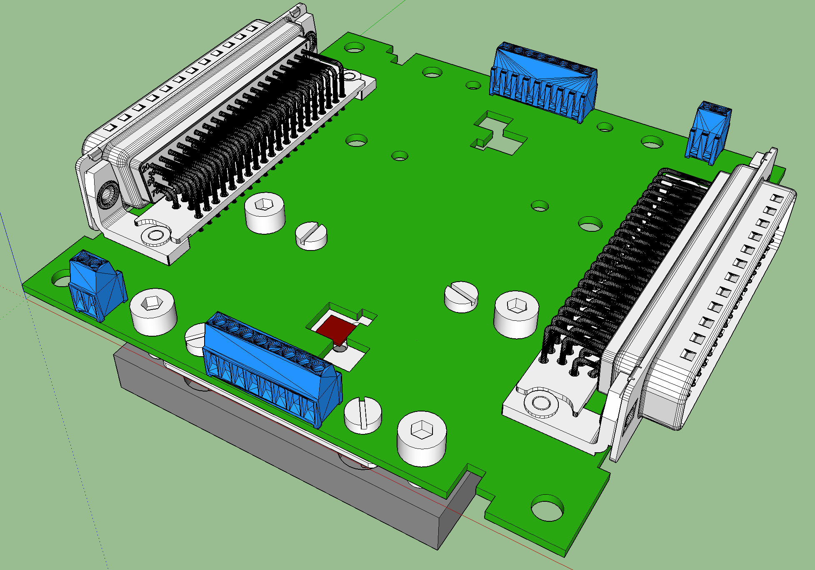
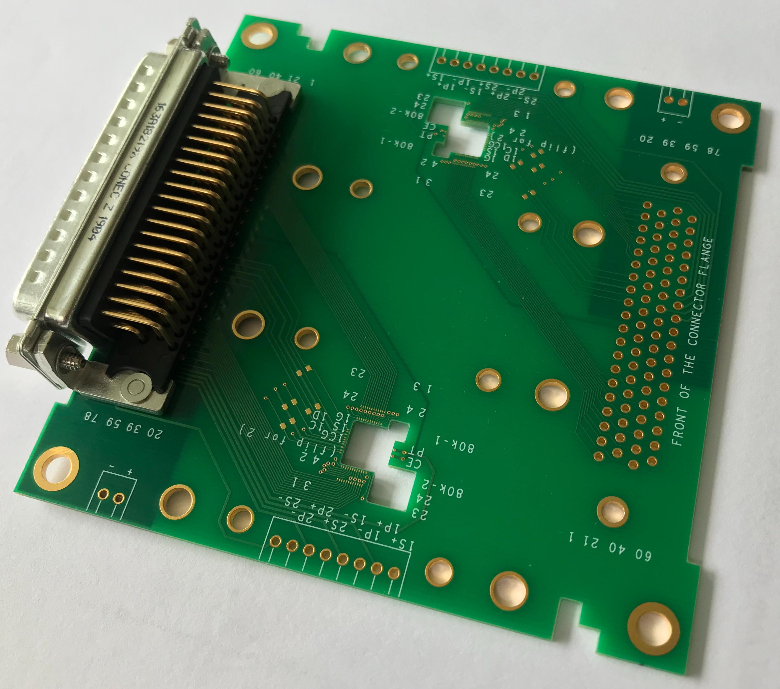
Setup for Irr. S. – inside of the Vacuum Box
Device carrier PCB @ HLL
HD DSUB 78 pin male @ HLL (tested with Allectra HD DSUB 78 pin female)
Terminal blocks @ HLL
Coarse positioning of the electron beam

Slide 7
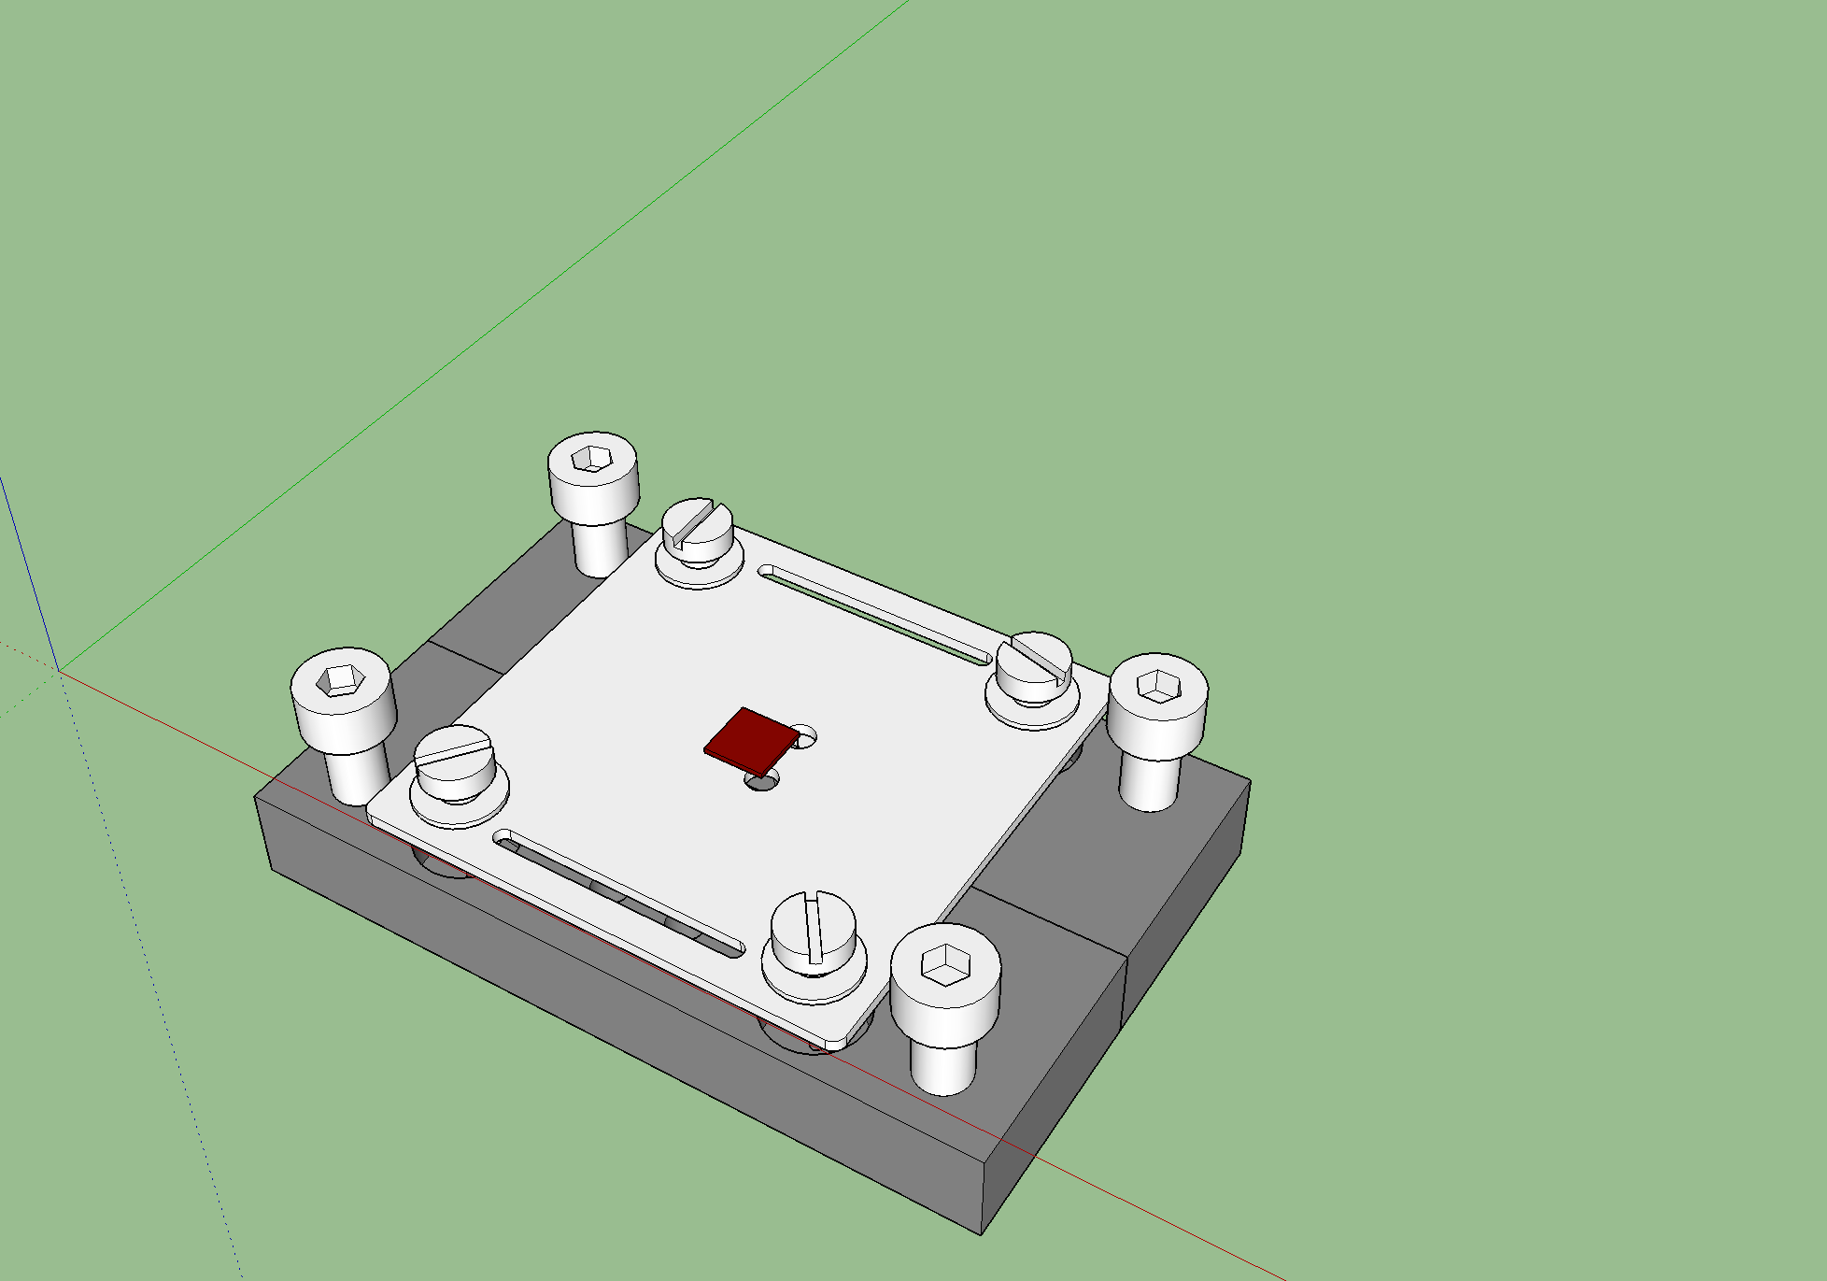
Setup for Irr. S. – inside of the Vacuum Box
DUTs @ HLL
Ceramics @ in production with A.L.L Lasertechnik
Screws @ HLL (has to be checked, planned is that the ones from SPIX setup fit here as well)
Cold plates @ in production with Thomas Markl GmbH
Due to the Terminal Block connector above
For precise positioning of the electron beam on the edges of DUT

Slide 8
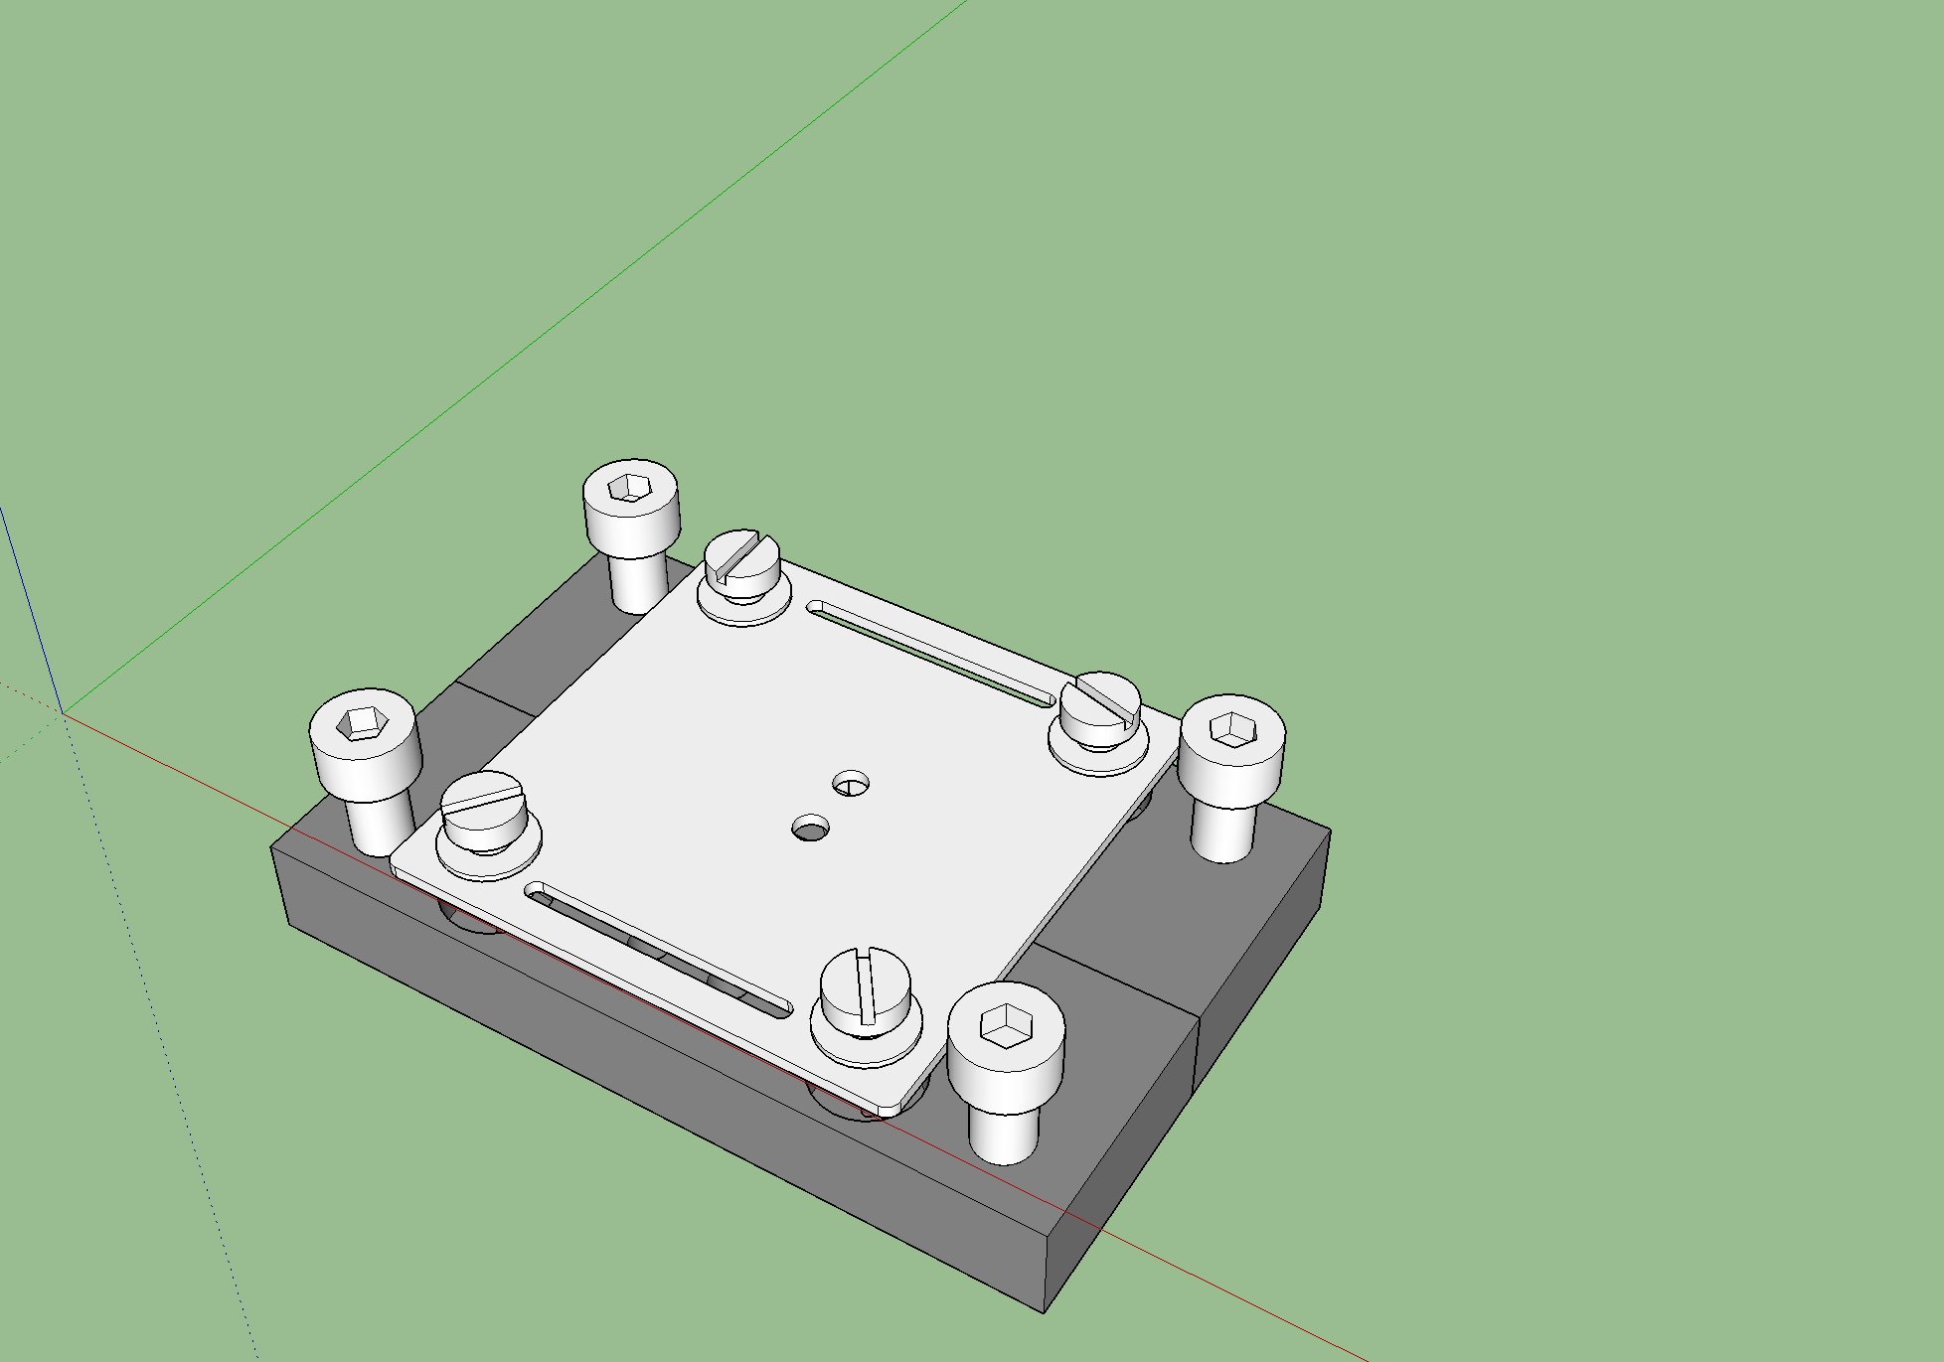
Setup for Irr. S. – inside of the Vacuum Box
DUTs @ HLL
Ceramics @ in production with A.L.L Lasertechnik
Screws @ HLL (has to be checked, planned is that the ones from SPIX setup fit here as well)
Cold plates @ in production with Thomas Markl GmbH
Due to the Terminal Block connector above
Alignment holes
for precise positioning of the electron beam on the edges of DUT

Slide 9
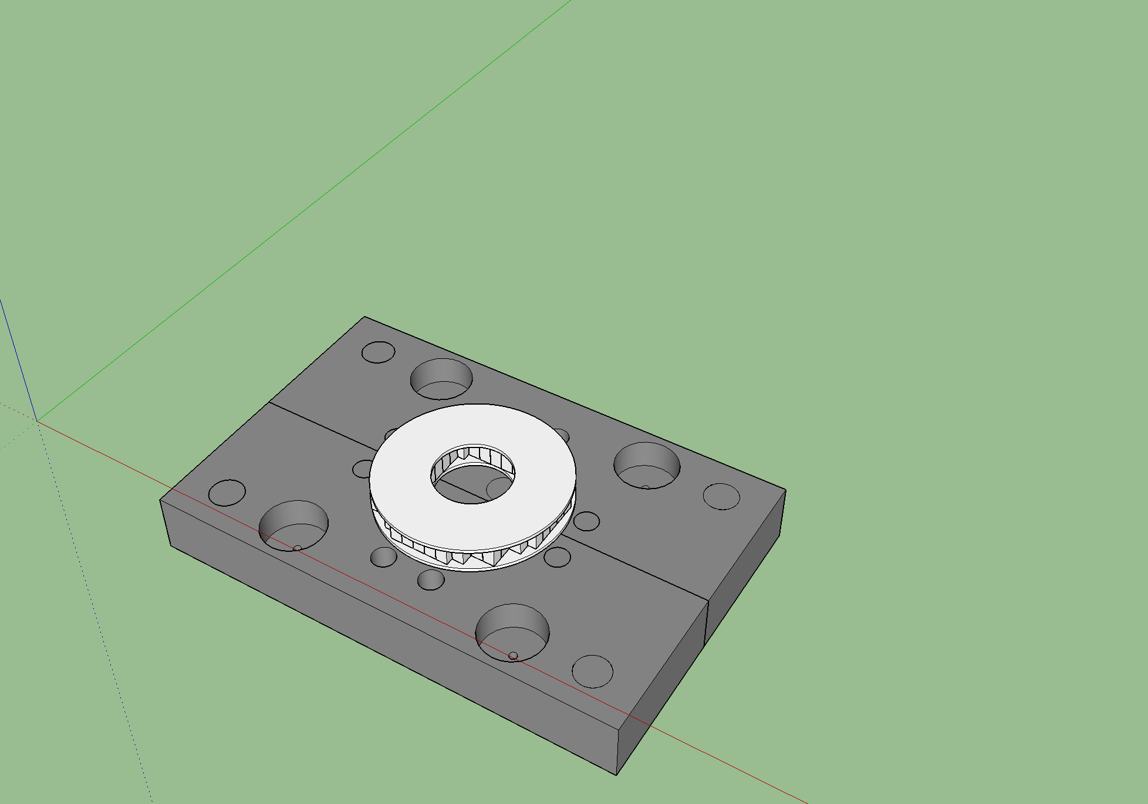
Setup for Irr. S. – inside of the Vacuum Box
Peltier elements @ HLL (test of cooling/heating capabilities still pending)
For attaching of ”cold fingers” and temperature sensors (8 x M3)
For fastening to the PCB (creation of a sandwitch (CP, Peltier, Ceramics, PCB)

Slide 10
Setup for Irr. S. – inside of the Vacuum Box
Peltier elements @ HLL (test of cooling/heating capabilities still pending)
For attaching of ”cold fingers” and temperature sensors (8 x M3)

Slide 11
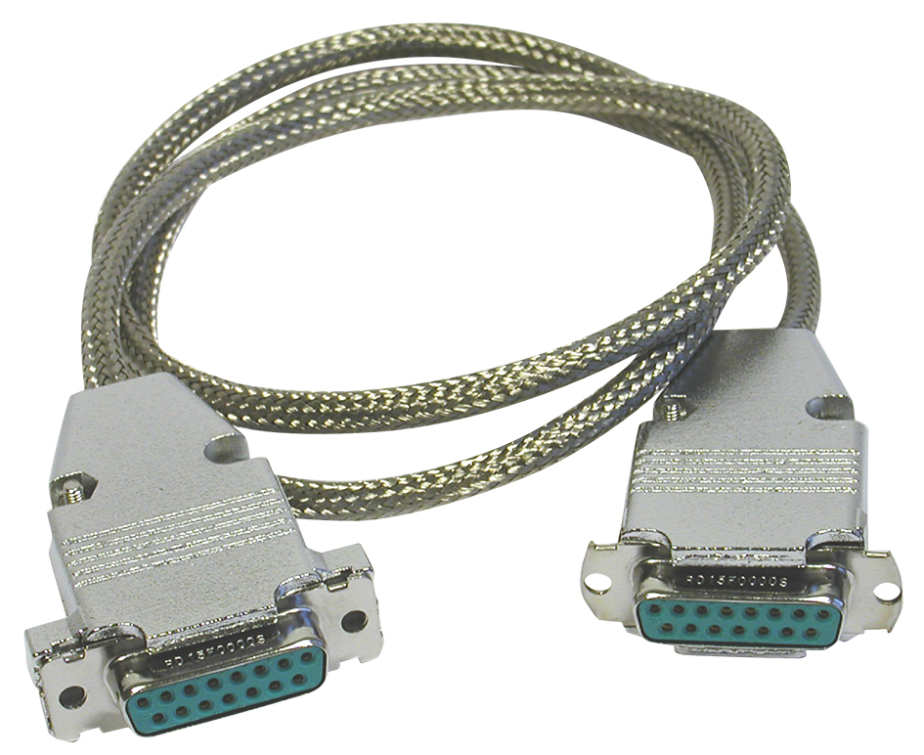
Setup for Irr. S. – inside of the Vacuum Box
1 to 1 cable from Allectra
  2 x Peek UHV Female HD DSUB 78 pin
  0.5 m Kapton ribbon cable
  @ to be ordered (production time on the order of 3 weeks)

Slide 12
Setup for Irr. S. – outside of the Vacuum Box
Breakout PCB:
  6 layer rigid part (19 mm x 70 mm) with 78 pin HD DSUB Female connector
  2 layer flexible part (48 mm x 70 mm)
  6 layer rigid part (160 mm x 100 mm) with
    DUT quarter selection jumpers,
    LEMO connectors for drains,
    TRIAX/Terminal Block connectors for common terminals
    Terminal Block connectors for temperature sensors and Peltier element
  @ PCB to be ordered (asking for quotes – 1 offer from Beta LAYOUT with production time of 16 WD), all other components already at HLL

Slide 13
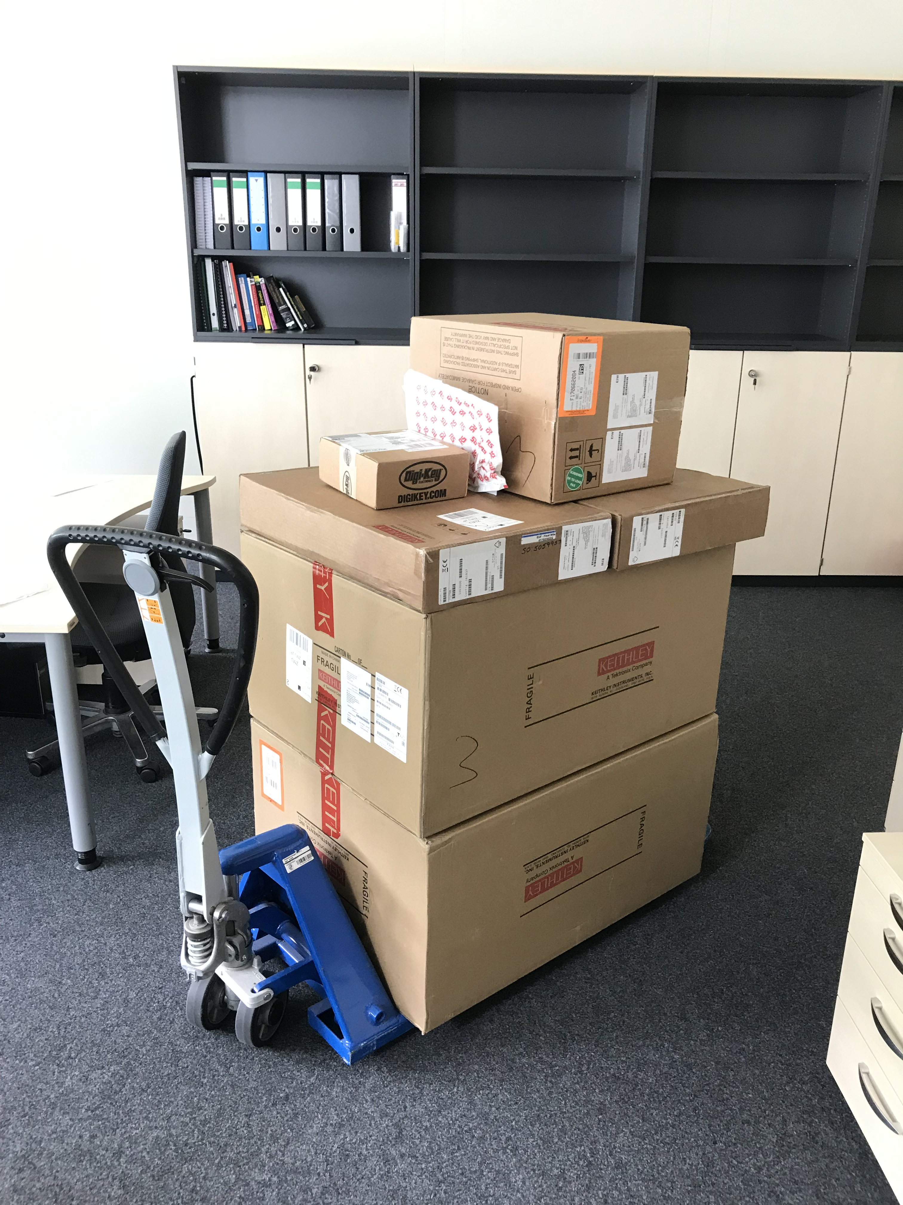
Setup for Irr. S. – PSU + DAQ
PSU @ HLL
Keithley 4200A-SCS (9x SMU) @ HLL
Sw. Mat. rack (2x Keithley 708B) @ HLL
Sw. Mat. (2x Keithley 7174A) @ HLL
40k € shipment from yesterday

Slide 14
Setup for Irr. S. – PSU + DAQ
PSU @ HLL
Keithley 4200A-SCS (9x SMU) @ HLL
Sw. Mat. rack (2x Keithley 708B) @ HLL
Sw. Mat. (2x Keithley 7174A) @ HLL
Simple cable connections to
terminal blocks. GND shared from
Keithley over the Breakout PCB.
Triax cables to Breakout PCB;
Afterwards only Force line over the PCBs
and Kapton cable in vacuum.
40k € shipment from yesterday
Triax cables to the Switching Matrix

Slide 15
Setup for Irr. S. – PSU + DAQ
PSU @ HLL
Keithley 4200A-SCS (9x SMU) @ HLL
Sw. Mat. rack (2x Keithley 708B) @ HLL
Sw. Mat. (2x Keithley 7174A) @ HLL
Triax Cables to the Keithley 4200
40k € shipment from yesterday
Triax –> BNC –> Lemo adapter, Lemo cable, PCBs and Kapton cable.

Slide 16
Setup for Irr. S. – PSU + DAQ
PSU @ HLL
Keithley 4200A-SCS (9x SMU) @ HLL
Sw. Mat. rack (2x Keithley 708B) @ HLL
Sw. Mat. (2x Keithley 7174A) @ HLL
Triax Cables to the Keithley 4200
40k € shipment from yesterday
Triax –> BNC –> Lemo adapter, Lemo cable, PCBs and Kapton cable.

Slide 17
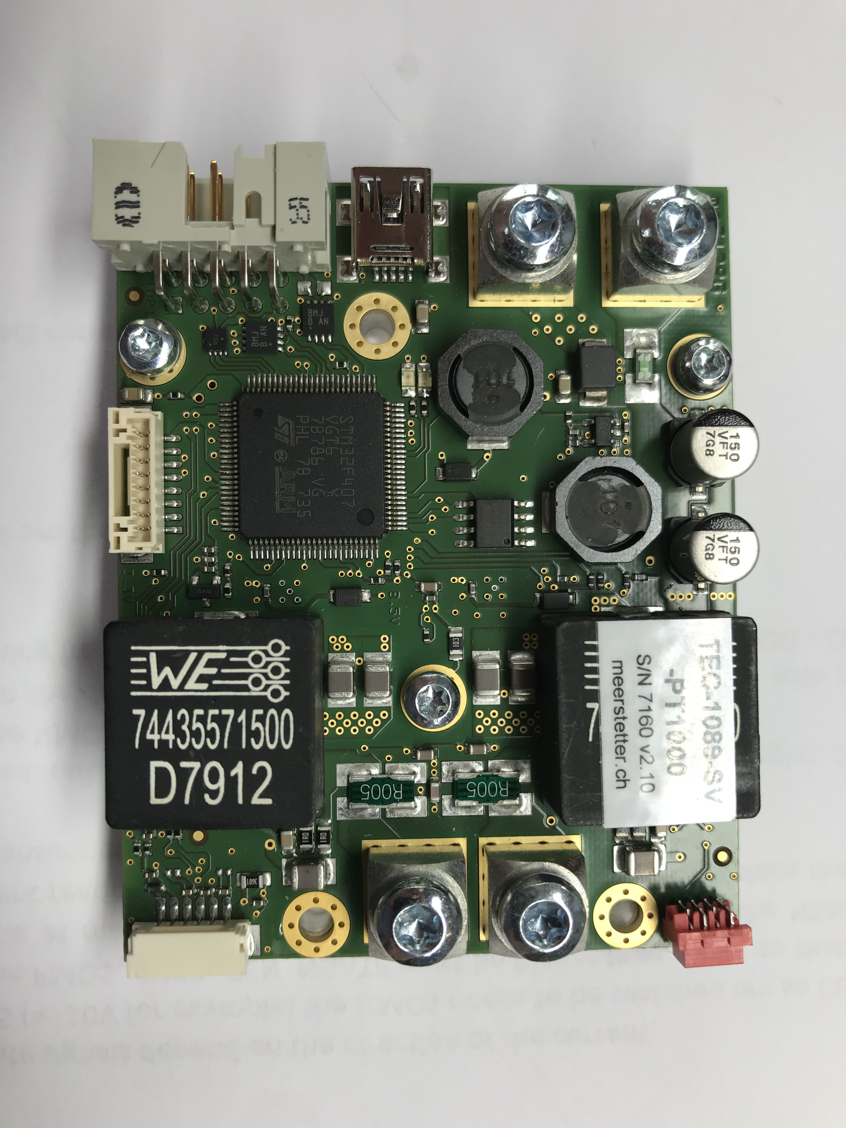
Setup for Irr. S. – Peltier controller
Controller board (TEC-1089-SV-PT1000) @ HLL
Thermometers @ HLL
Cables for Thermometers @ ordered
Power suppy (12 V)
Peltier potentials
Temperature sensors
4 wire PT1000 for the DUT
2 wire 10kOhm Thermistor for the cold plate
Computer interface

Slide 18
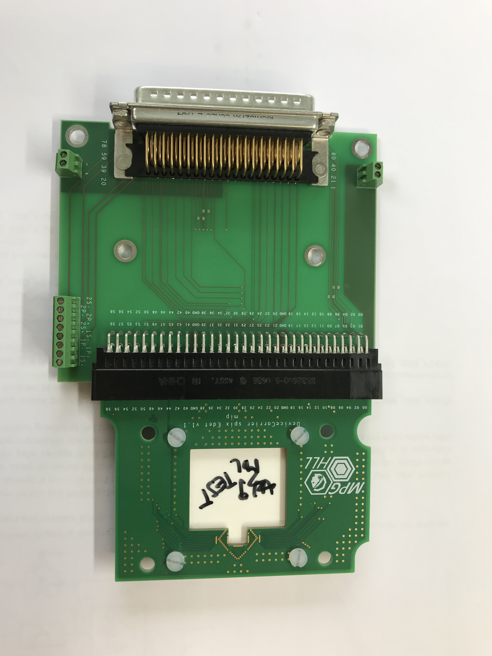
Setup for Irr. S. – hybrid for preparations
Already populated and tested devices for the SPIX setup
Breakout PCB
connector

Slide 19
Irradiation procedure
  Only 1 device (2 quarters) per Device carrier PCB due to large distances
  2nd quarter more or less safe when 1st is irradiated
  While irradiation:
    all potentials applied to the DUT to mimic real life operation
    gate potentials in the OFF state (4/512 rows are in OFF state during the imaging)
    DUT kept at the fixed temperature: TBD
  Dose rate:
    Ideally we should aim for the same dose rate as in real life operation: 100 e–/px @ 10 kHz; if too slow we will speed it up
  Max Dose: TBD
  Dose step: should be extrapolated from Martin’s thesis
  Measurements between dose steps:
    1st device: frequent measurements to observe the transient behaviour of self annealing(?) until plateau is reached
    2nd device: trying to speed up the transient behaviour through heating (~50 °C) with Peltier element
    rest: 1 measurement after plateau has been reached
From my point we could do 1st irradiation session in the first half of June 2019(?)

Slide 20
Components provided by MPSD
  Mechanical
  vacuum feedthrough flange – Allectra
  holder for the Device holder PCB – Djordje(?)
  copper braids – Djordje(?)
  copper braids connection sandwitch – Djorjde(?)
  heat sink flange – Djordje(?)
  2D moving stages + software for the control – Djordje and Sascha(?)
  mechanical holder for the breakout board – Djordje(?)
  mechanical holder for the Peltier controller – Djordje(?)
  mechanical holder for feedthrough flange with connected Kapton cable and Breakout PCB for when it is not in use
  Simulations
  dose absorbed by silicon oxide for 450 um thick devices – Ibrahym(?)
Please give me an estimation about timeline.

Slide 21
Annealing studies
    ?
regular studies with heating of the DUTs in the oven
modification of planned laser annealing system (timeline?)

Slide 22


Slide 23
Setup for Irr. S. – Keithley connections
Keithley Model 4200A-SCS Parameter Analyzer
Reference Manual Jan. 2019
page 2-7 (38/1606)
Keithley - Low Level Measurements Handbook
7th Edition
page 2-18 (56/244)
20/5/19 … Daniel tasked with checking the possibility of floating SMUs … you can bring grounding plane closer.

Slide 24
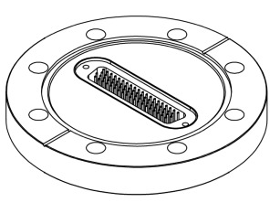
Setup for Irr. S.– Vacbox feedthrough v1
High density Sub-D 78 pin from Allectra:
3 A/pin
Cable made by Allectra:
1st end: SUB-D 78-WAY PEEK
Cable: Kapton Ribbon cable 0.5m
2nd end: SUB-D 78-WAY PEEK
Connections (not actual pin numbers):
01 – 60 … for the device
61 – 68 … for the temperature sensors
69 – 78 … for the Peltier element

