Slide 1
Software development status
Andrey Vostrukhin

Slide 2
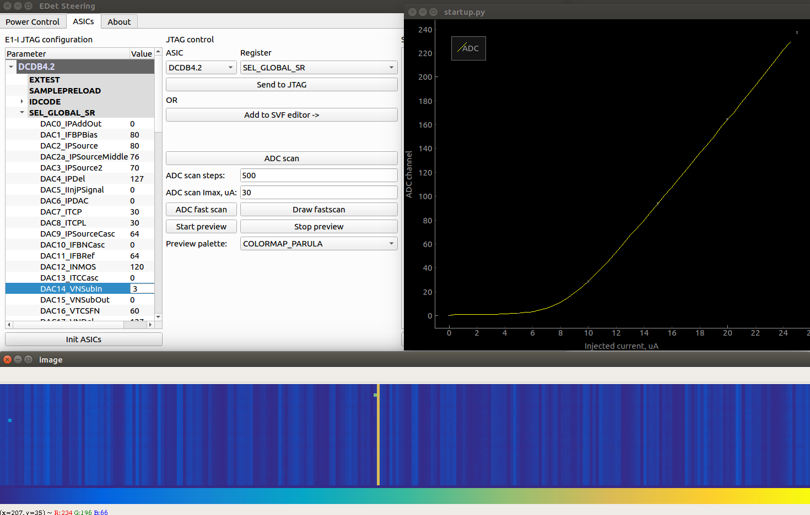
High level functions: ADC transfer curves
ADC transfer curve measurements implemented with two options:
Fast Scan to identify optimal parameters for given gain and measure one ADC channel
Full Scan to characterize all ADC channels
Measurement procedure was tested and validated with Hybrid E1 board s/n 04
Reference measurements started for Hybrid E1 board s/n 05, when completed (~1 week):
Go for matrix population and wirebonding
Physical measurements with sensor in cleanroom
Now data available for scientific analysis

Slide 3
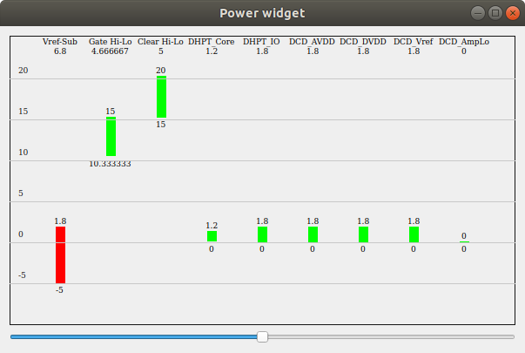
User-friendly GUI
User-friendly GUI is under development.
New power widget to be added soon that allows:
Quickly overview all voltages
See if the voltages are within allowed limits

Slide 4
Transition to full ASM control software
JTAG
files
Container
Class
GUI
DHPT
DHPT
DHPT
DHPT
DHPT
DHPT
DHPT
DHPT
import/export functions
DCD
DCD
DCD
DCD
DCD
DCD
DCD
DCD
SW
SW
SW
SW
SW
SW
SW
SW
Log/config
First version of ASIC container class is complete
Working on GUI to control all ASIC settings
Hard-coded ASIC initialization procedure to be replaced with generated sequence for compatibility

Slide 5
Todo list
High level-functions: implement DCD delay scan
User friendly GUI: add power widget
Physical measurements: make reference measurements with E1-05 board and populate sensor
Full ASM control software: deploy first version on a testbed for testing

