Slide 1
Prototyping Activities and Recent Technologies Studies
PARTS.FUSED
Full-Speed Edet
Andrey Vostrukhin

Slide 2
Prototyping Activities and Recent Technologies Studies
PARTS.FUSED
Full-Speed EDet
“Go” or “no-go”
point for Full-Speed EDet

Slide 3
Technology evaluation and tests
You have to run to stay in the same place
To be up-to-date with modern developments we must evaluate recent technologies and test design options.
Being inexpensive feasibility study for Full-Speed EDet, it also provides important ground for ongoing projects
Key technologies are:
Samtec FireFly Copper and Fiber
Vacuum feedthrough for high-speed data link
High-speed data capture
High-density wirebonding with height difference
Packaged DCD
In-house PCB bumping
DCD and FPGA compatibility tests
These tasks can be effectively done in parallel with “background priority” or outsourced.

Slide 4
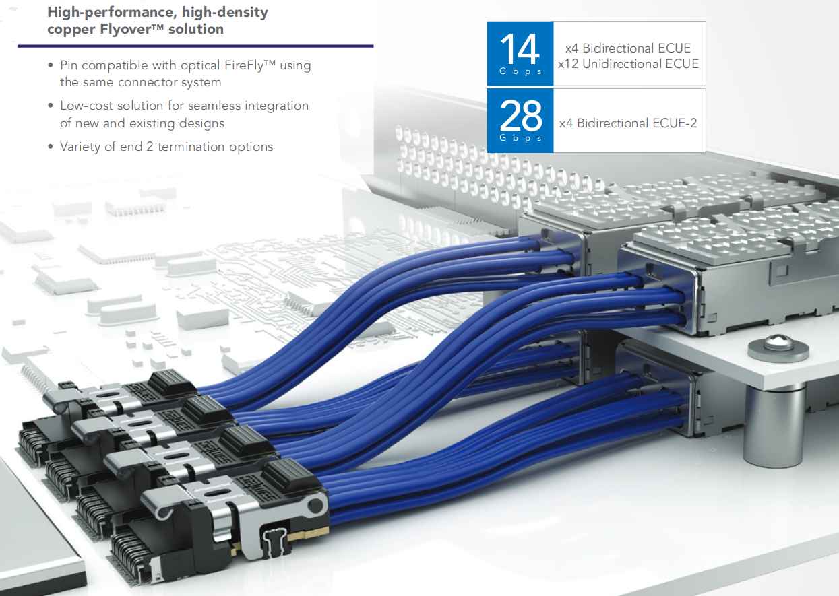
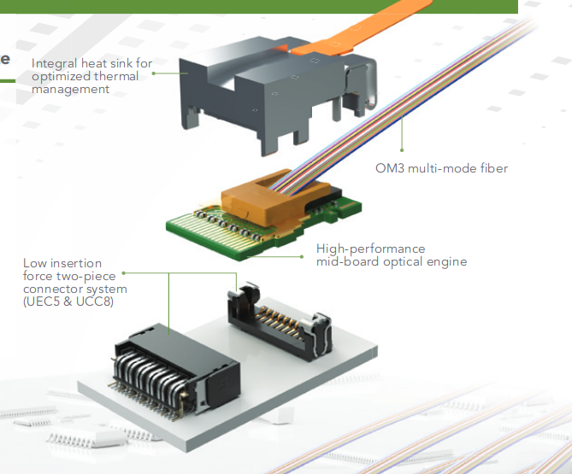
Samtec FireFly Copper and Fiber
Task: evaluate high-speed data links
Copper
Fiber
Features
10+ Gbps out-of-the-box
Dramatically improved signal integrity, compared to PCB traces
Galvanic isolation and EMI immunity for Fiber option
Direct-to-Ethernet connection for Fiber option
Advantages
Up to 30x less signal wires
Much less “my eye diagram so small, that I can’t receive data” stories
Improved reliability
Simple and clean design
Test plan
Assemble set of PCBs with different usage scenarios
Test link reliability and data integrity using existing hardware

Slide 5
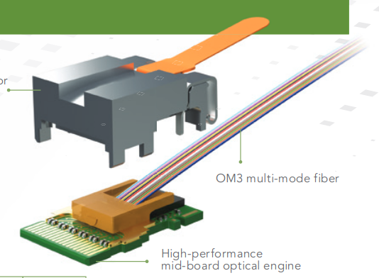
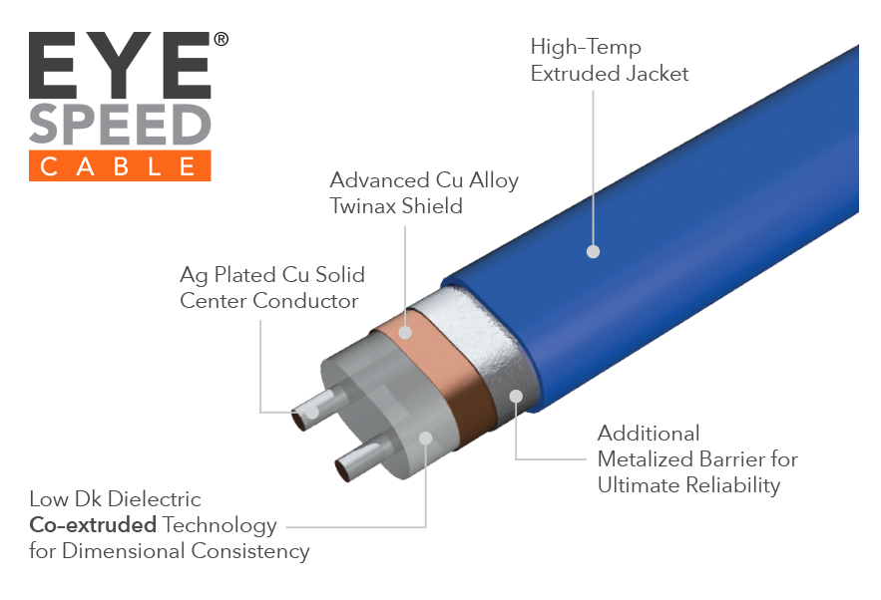
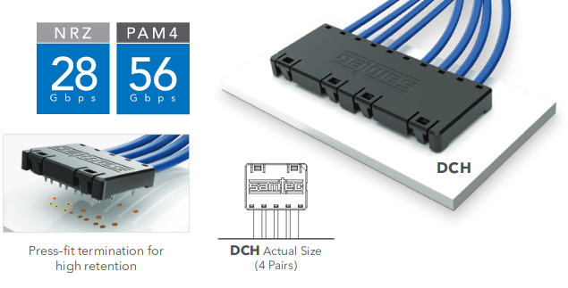
Vacuum feedthrough for high-speed data link
Task: find best solution for vacuum feed-through
Test plan:
Order standard vacuum flanges and make CNC-cuts for cables
Order Samtec cables and PCBs
Assemble flanges
Vacuum test
Assemblies aging by thermal cycling or shelf life
Repeat vacuum test
Analyze results
Test samples
Fiber Twinax Twinax-PCB

Slide 6
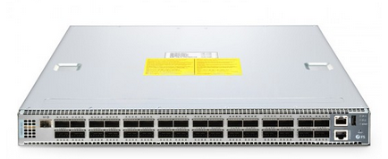
High-speed data capture
Task: test solution for 100G packet capture
Sensor dummy data generator: 16x10G
Sensor dummy data generator
We can use lab servers or FPGA evaluation boards
100G network switch ~10KE
Available domestically for 30 days free testing
100G packet capture device ~40KE
Manufacturer is in Japan, but they offer 30 days free testing with free FedEx shipping
Test plan:
Get all hardware together. Same time, same place
See if packet capture server performs as advertised

Slide 7
High-density wirebonding with height difference
Task: test wirebonding technology limits
Test plan:
Order test PCBs with:
bonding pads
test pads (open/short verification)
Glue PCBs together in variety of spacing and height
Perform electrical open/short test
Test board
Height adjustment
insert
Test board
FR-4 Base

Slide 8
Packaged DCD
Task: make packaged DCD that we can use for prototyping
Implementation plan:
Design and manufacture interposer PCB to carry DCD and passives
Solder DCD and passives
Interposer bumping (next slide)
0402
DCD
0402

Slide 9
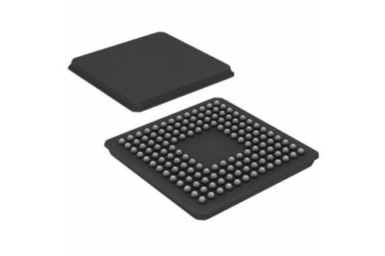
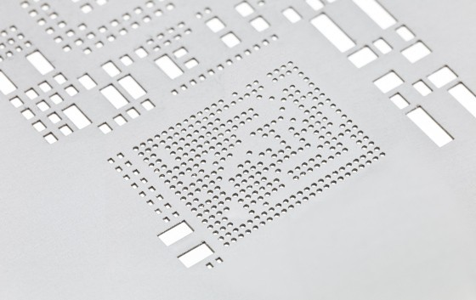
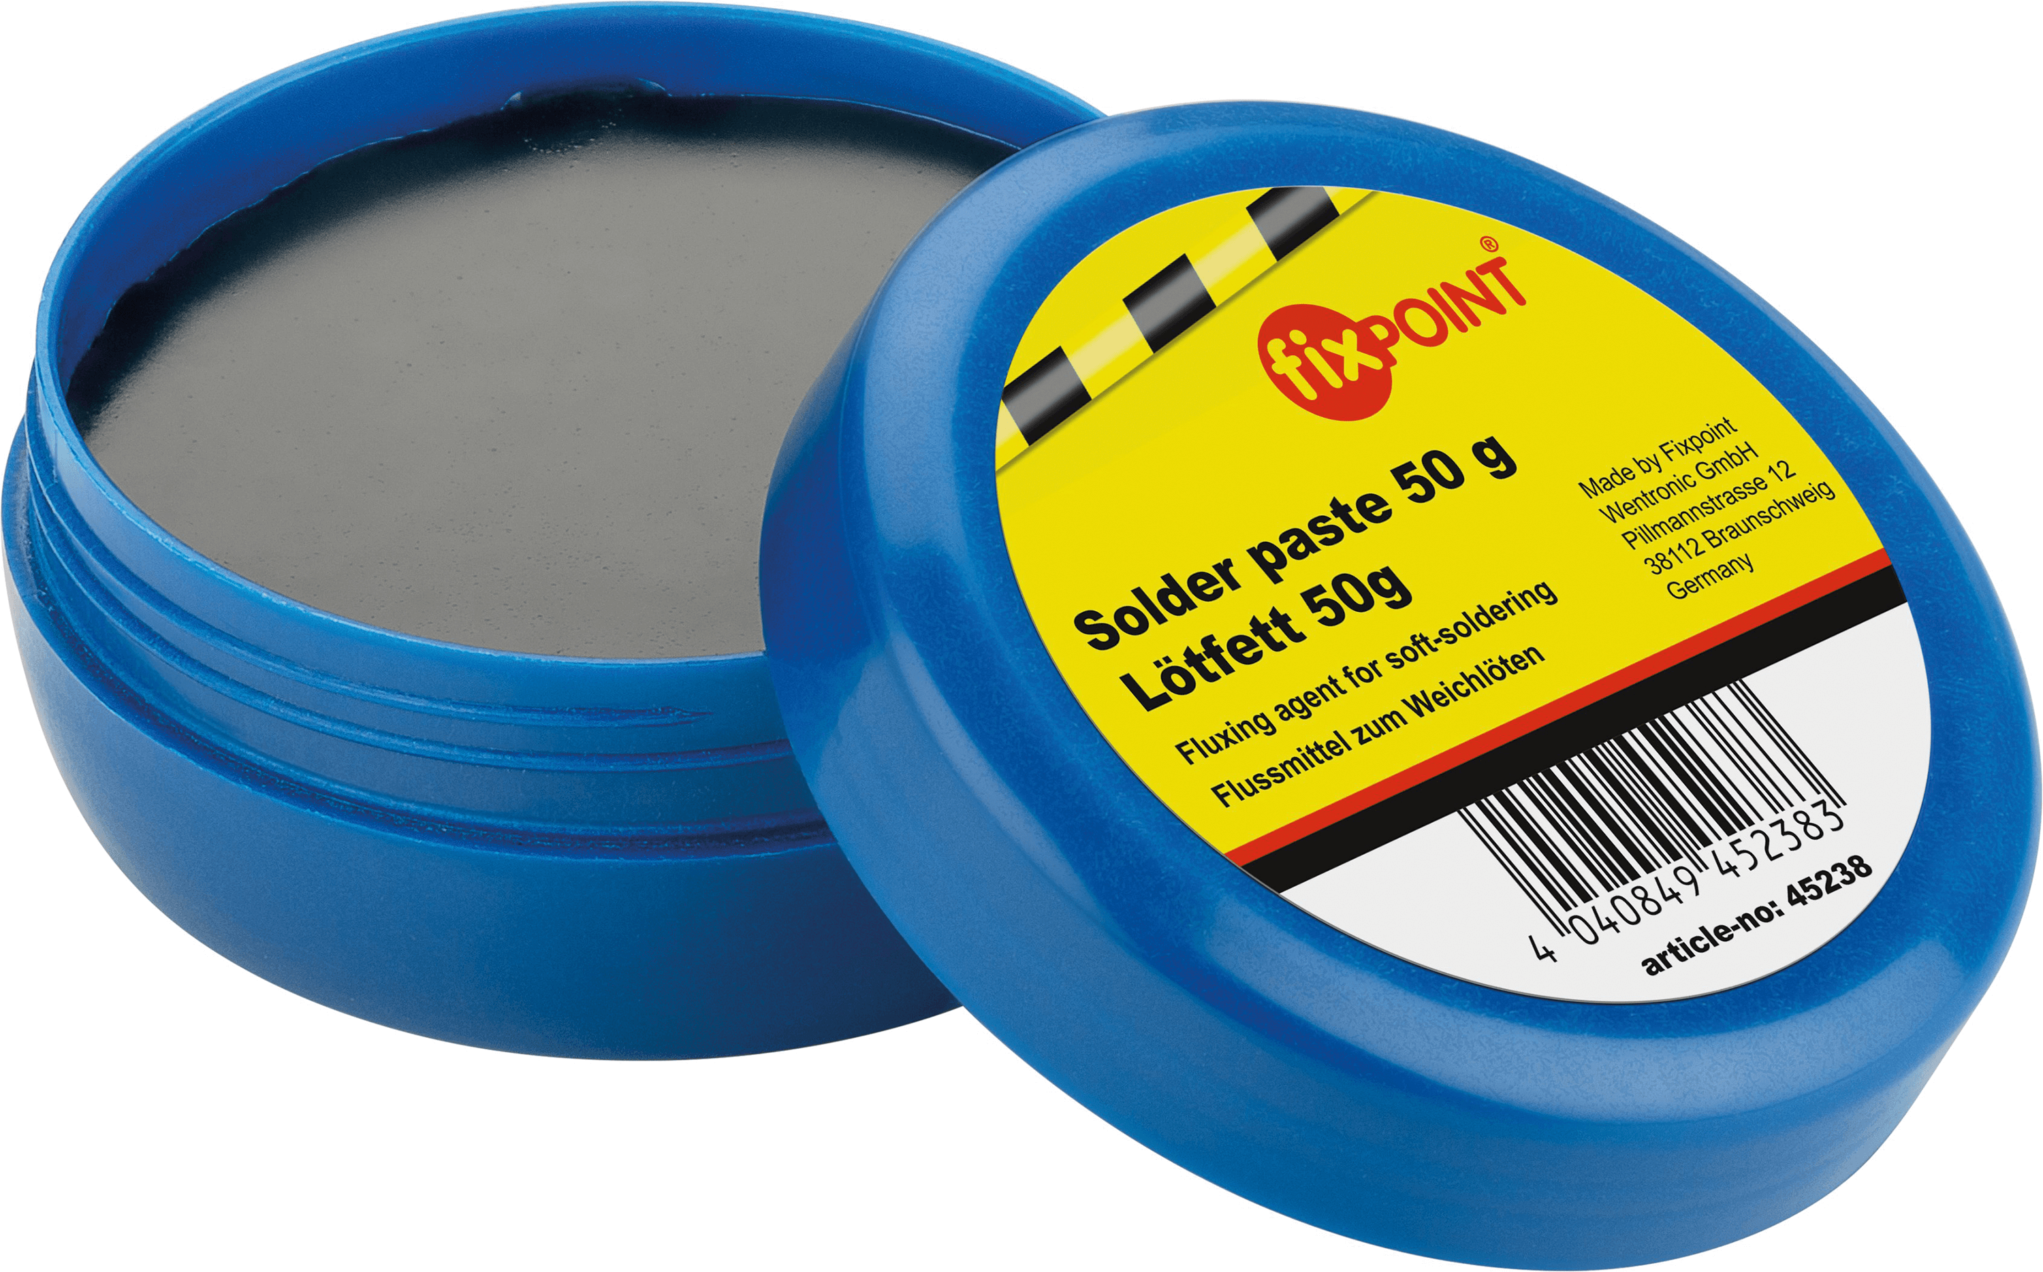
In-house PCB bumping
Task: obtain in-house experience on PCB bumping and re-balling
Implementation plan:
Order test PCBs, fixtures, stencils and solder pastes
Find optimal parameters for bumping/re-balling
Personnel training

Slide 10
DCD and FPGA compatibility tests
Task: test DCD “single-ended LVDS” output compatibility with FPGAs input
Implementation plan:
Use evaluation boards before going to PCB design
Use drop-in FPGA modules or use evaluation boards as a reference design
Design and manufacture compatibility test boards for SRAM and Flash based FPGAs
Use biggest building blocks available, ie power modules instead of discrete parts and ICs, etc
Test compatibility!

Slide 11
Thanks for attention!
Questions?

