Slide 1
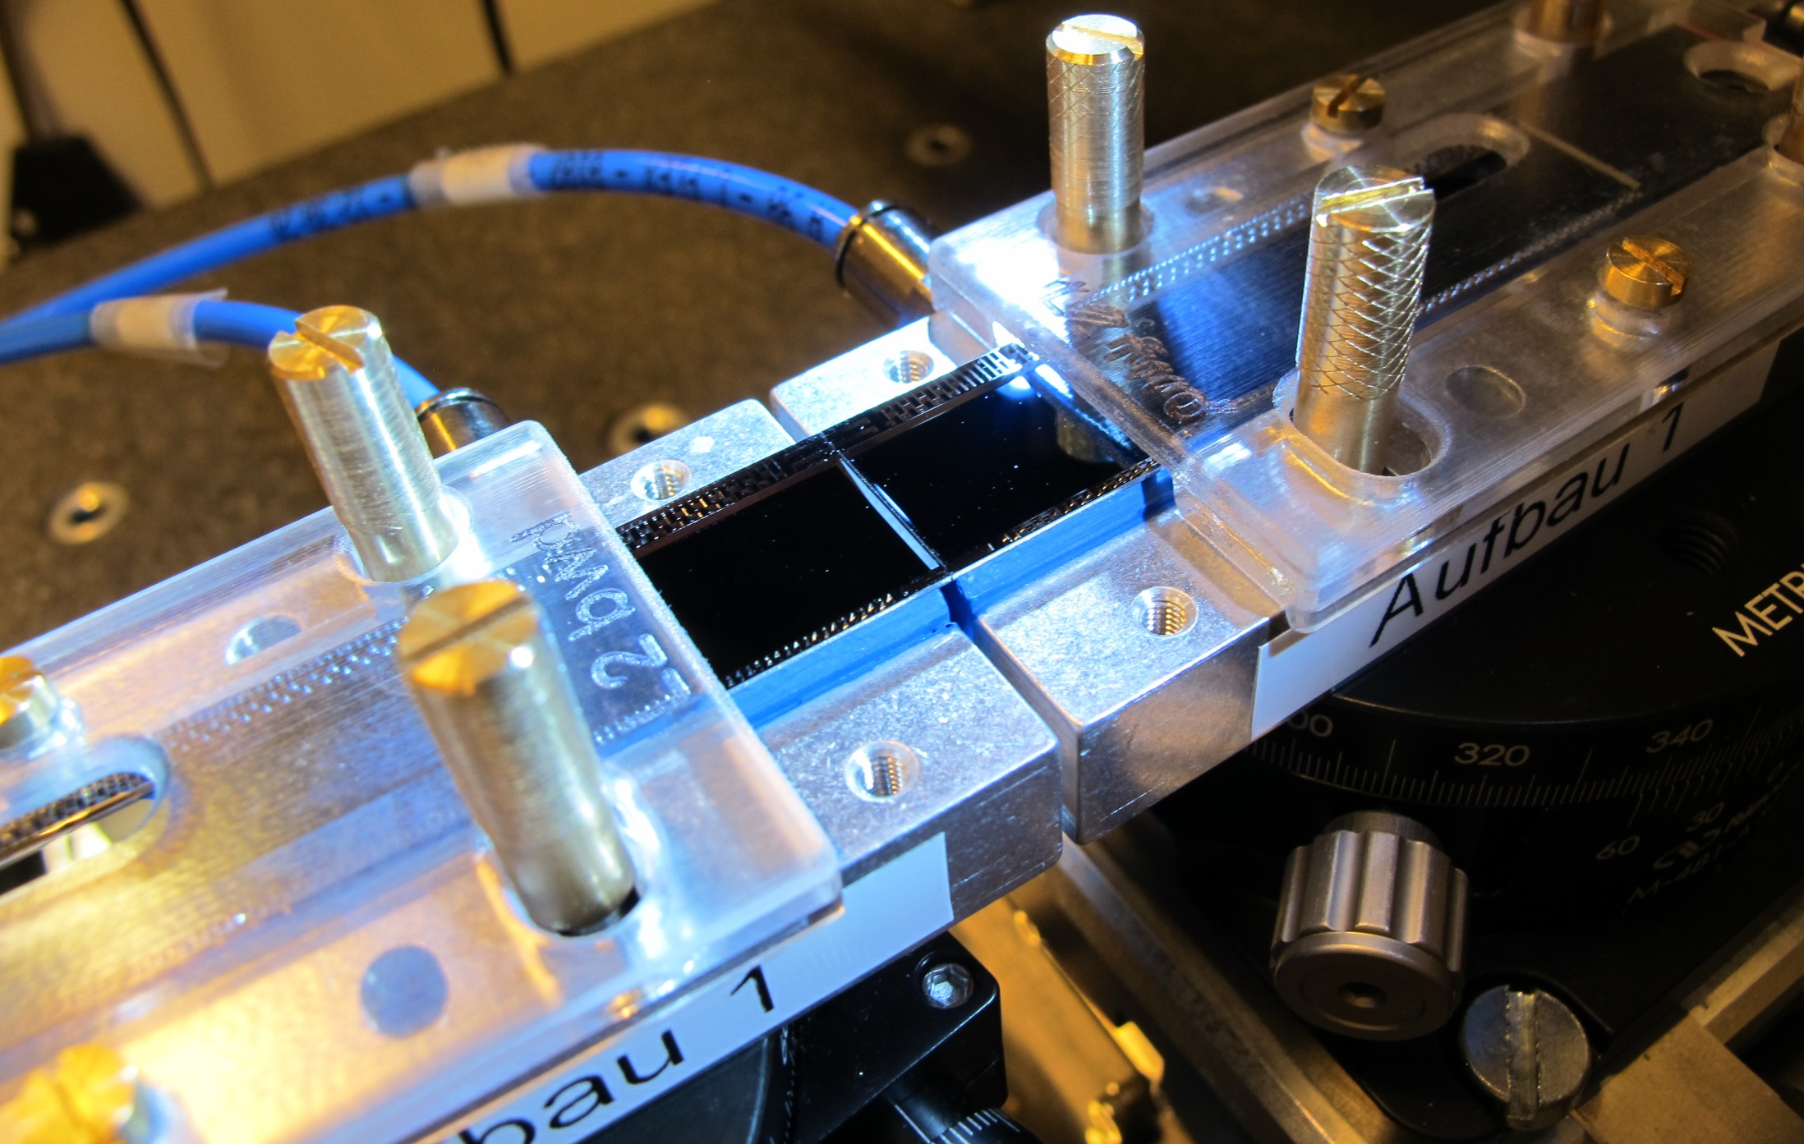
Ladder Assembly
New gluing procedure

Slide 2
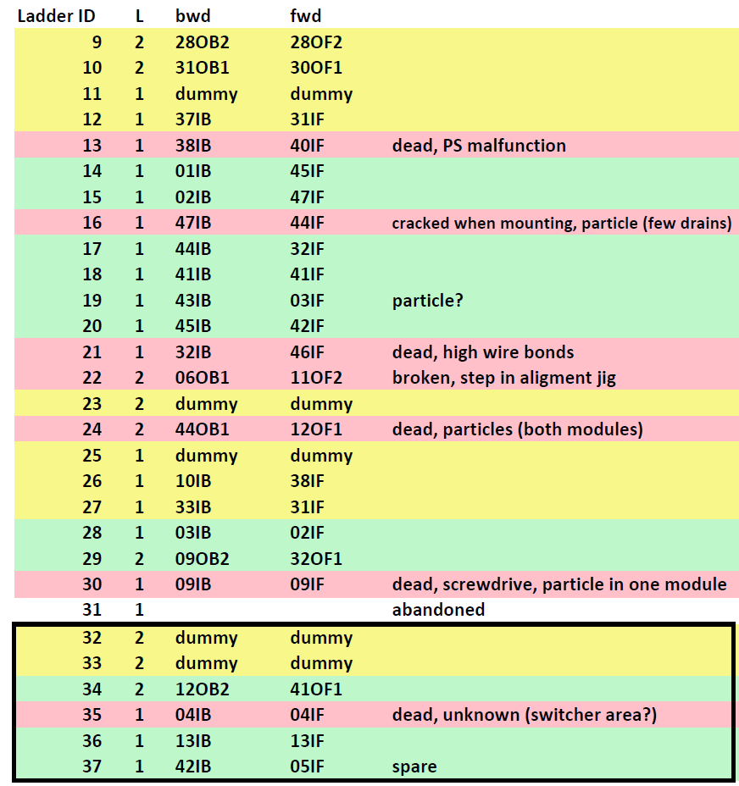
Statistics
18 ‘hot’ ladders glued
11 working ladders (10 in Phase III)
1: PS malfunction
1: jig misaligned
1: hit by screwdriver
1: particle
1: high wire bonds
1: cracked when mounting
1: unknown
Damage by particles
Some drain lines in 1 module
2 dead modules (in one ladder)
unknown (hidden by screwdriver acc).
~ 4 occasions
With nylon mesh

Slide 3
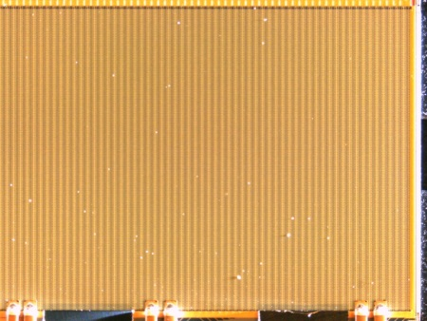
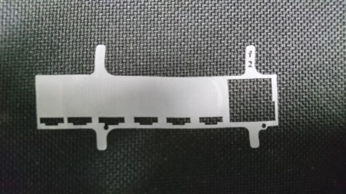
Problems
Particles pressed by into module surface (sensitive) leading to shorts:
- dead drain lines
- complete failure of the module
Measures:
- strict inspection and cleaning of modules and jigs
- nylon mesh
No such failures any more but:
- small statistics
- no absolute guarantee that all particles can be removed
- time consuming (45 min -> 4h)
Modify assembly procedure such that the module surface is not touched
Keep steps which are proven to work

Slide 4
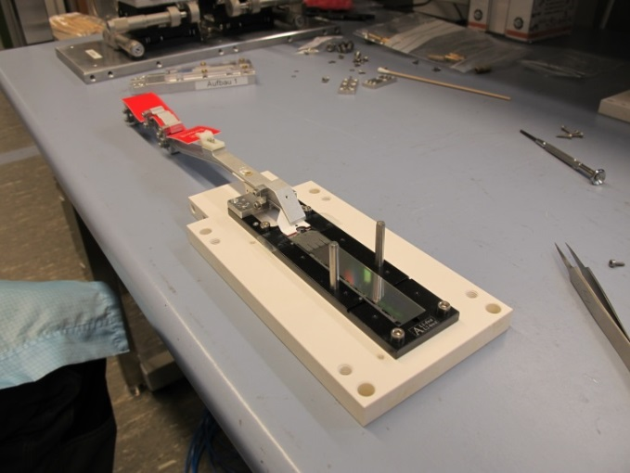
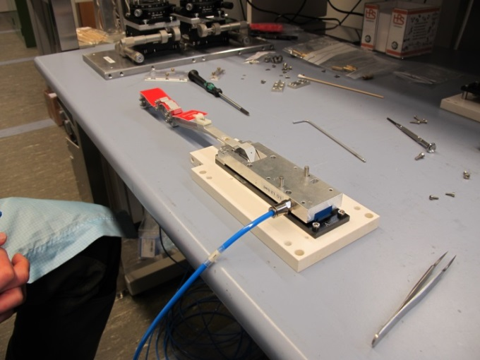
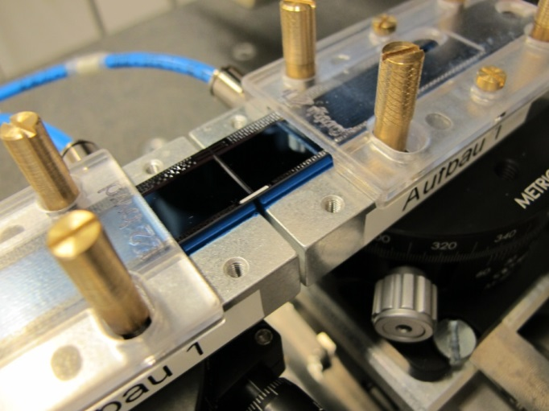
Old procedure
Module face up on jig
Transfer too put on top
Module fixed on transfer tool by vacuum
Flip and put on alignment stage
Groves on top
Glue and ceramic stiffeners are inserted by hand
Modules were glued face down, to get ceramic stiffeners into the grooves on the backside.
Can these stiffeners be inserted from below?

Slide 5
New Method:
Tscharlie Ackermann, Enrico Töpper:
1) Module on transport & test jig
2) Take off and put on glue jig
Glue jig almost identical with test jig, just shorter
Held by vacuum (balcony and EOS)
Similar procedure as after Kapton soldering
3) Cover with protective cover & clamp
Repeat with 2nd module

Slide 6
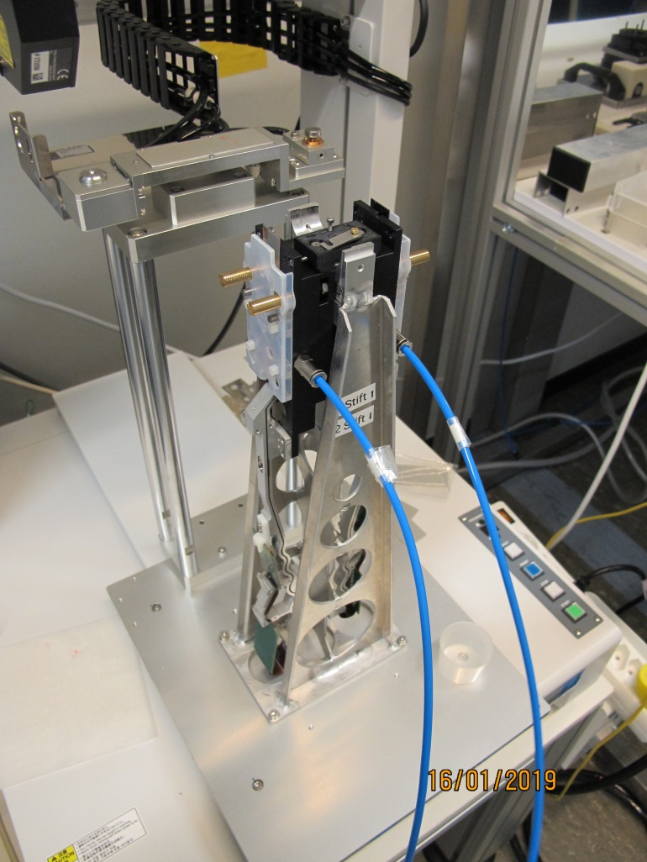
Glue Dispensing
6) Afterwards modules mounted at the Musashi and glue is dispensed
4) Place ceramic stiffeners in slots in a tray
5) Musashi dispenser applies glue on the stiffeners
(this was already tested with glue)

Slide 7
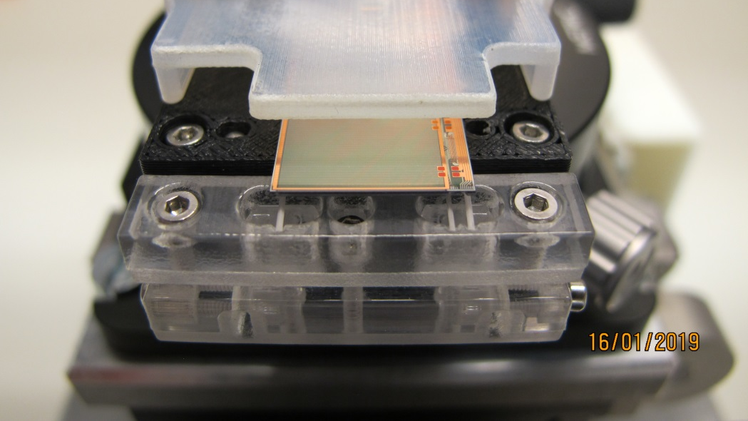
Mounting on alignment stage
7) Place on alignment stage and add table with
stiffeners
Side view of tray mounted
During mounting the lifter is blocked

Slide 8
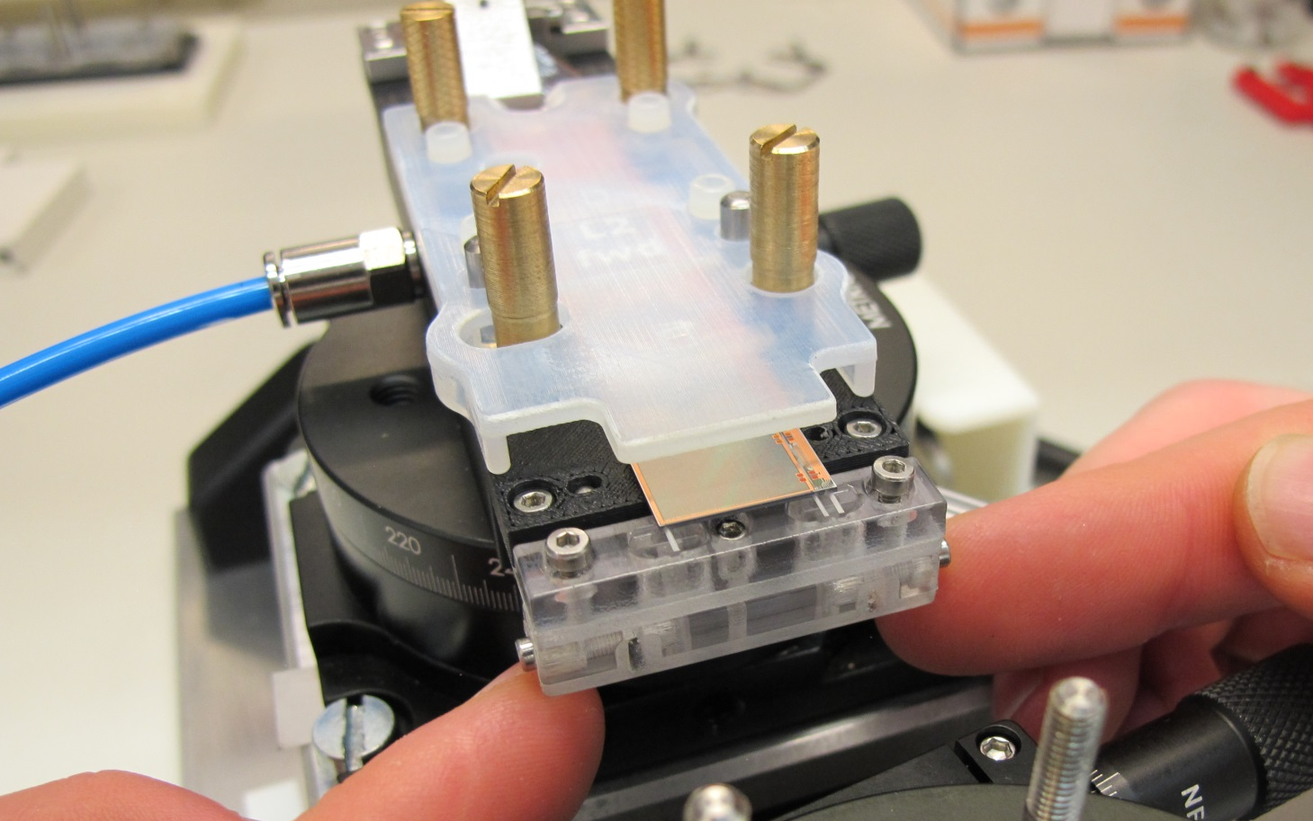
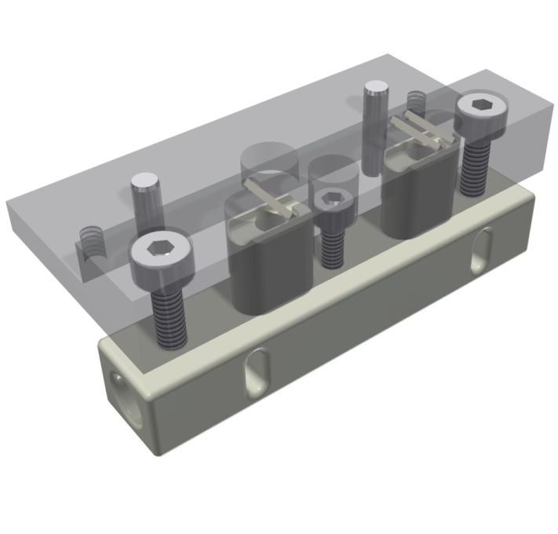
Lifting procedure
Fingers in the tray lift the stiffeners so that they are inserted in the grooves of the module
Overtravel is blocked, to avoid breakage of module
Just for demonstration, this is not done at this stage

Slide 9
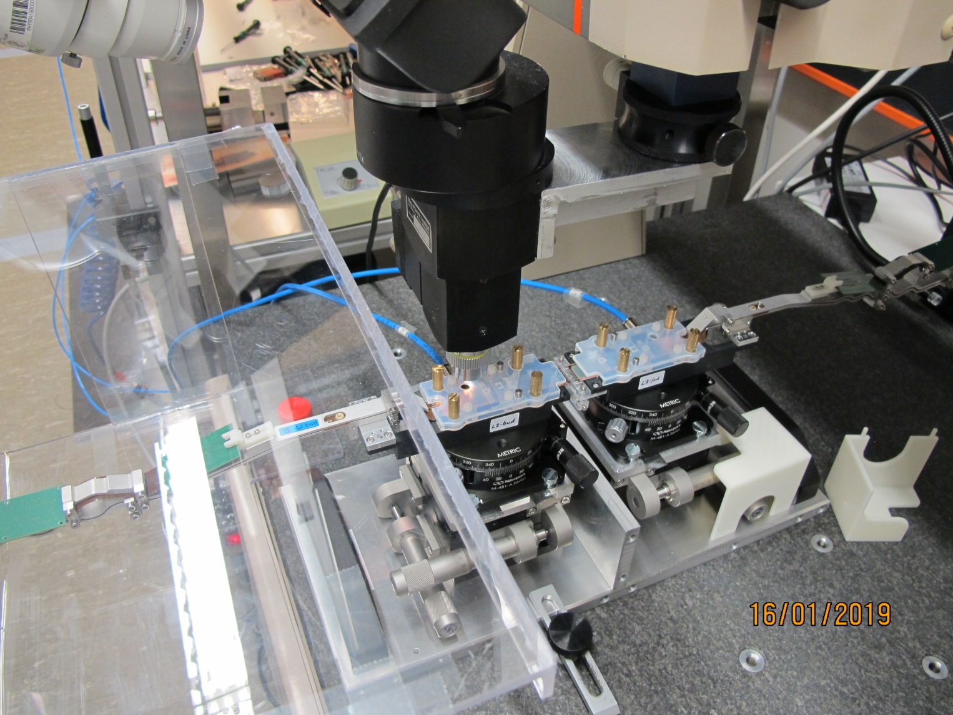
Alignment
8) 2nd module is mounted and both are aligned using a Mitotoyo CMM

Slide 10
Insertion of Stiffeners
9) As shown before stiffeners
are inserted in module grooves
lifting up the support fingers
10) The assembly rests for 48h for curing

Slide 11
Lifting off
11) After curing the ladder needs to be taken off the alignment stage and put on the transport jig
13) Lift tool (‘Knochen’) is put on ladder and Kapton extensions are screwed to it
14) Ladder is lifted off and placed on the transport jig
12) Covers are removed

Slide 12
Finished
15) Kapton extensions are screwed to transport jig and lift off tool is removed
Lift off procedure and tool is a copy of the procedure used to mount the ladders on the cooling blocks. Well tested
(Real one is made of metal)

Slide 13
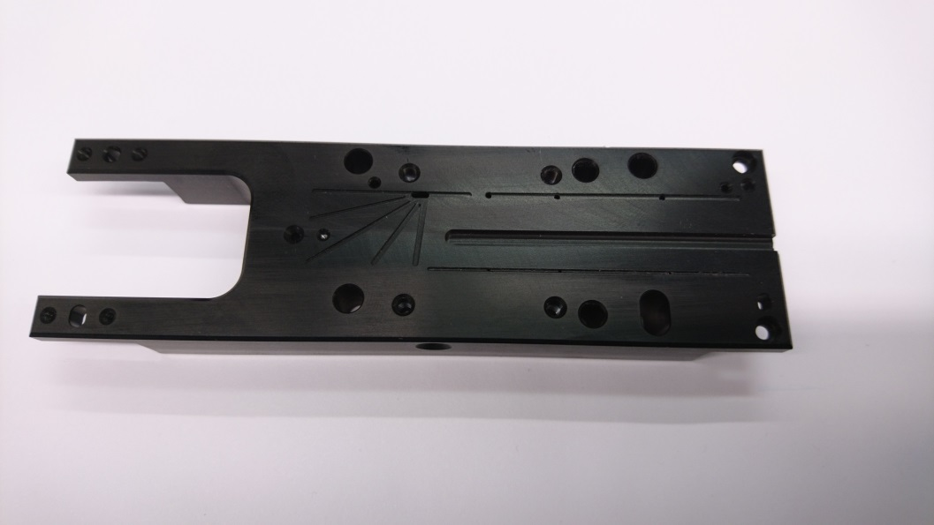
Tests
Dry assemblies (no gluing) worked
Procedure even simpler than old one
no turn-over (was critical)
automatic glue dispensing on stiffeners (better reproducibility)
less manual steps
Next step: gluing of dummy ladders
Test glue dispensing on ceramics
Does self alignment work?
Can the stiffener jam?
Need to stop over-travel, don’t apply too much force which can break module
5 pairs of modules available
Jigs produced, some rework needed
Week 5: glue dispensing tests
Week 6,7: dry assembly with final tools,
adjustments
Week 7: glue dummy 1
Week 8: glue dummy 2
Week 9: glue dummy 3, review

Slide 14
Results
Dummy 1 and 2 without Kapton, test only glue joint
Dummy 3 with Kaptons, test complete procedure including handling
All 3 ladders glued without observable damage
Ladder are mechanically sound
However, in all three case one stiffener did not end up immediately in its final position and
Some rework was needed
One of the wide balcony stiffeners was inclined. Manually adjusted with needle. Due to reworked tray (slot too wide)
Small balcony stiffener fell from lifter. Jammed due to glue remains (spring effect). Was successfully inserted in a second try
Narrow balcony stiffener inclined. Successfully adjusted with needle
=> Need to understand and avoid these problems. More dummies needed.

Slide 15
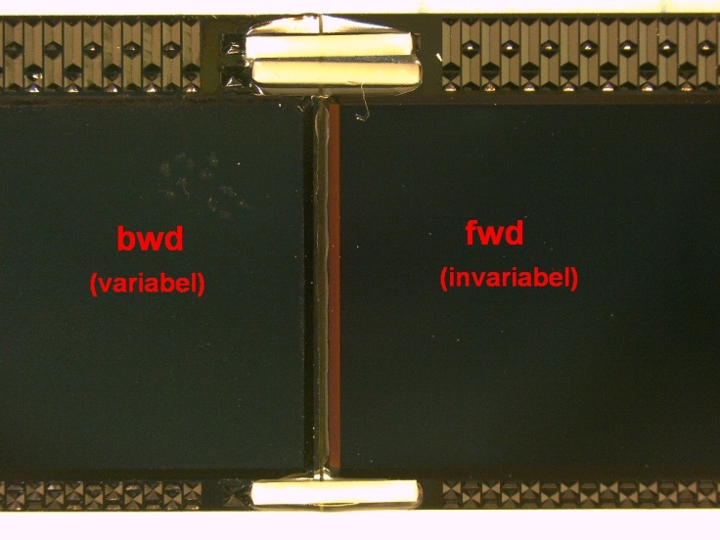
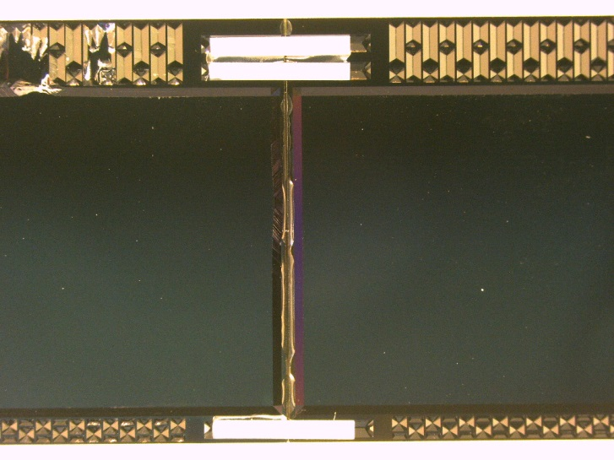
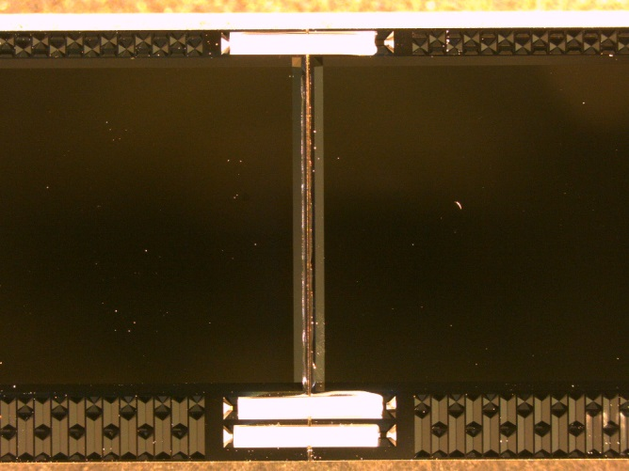
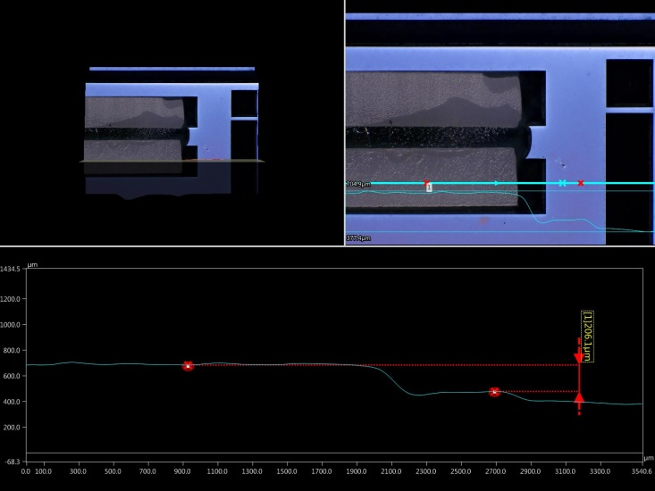
Dummy Assemblies
1st Dummy
2nd Dummy
3rd Dummy
1
1
1
2
2
2
3
3
Hight offset of stiffeners
 | Δh left | Δh right
1 | 573µm | 159µm
2 | 404µm | 238µm
3 | 145µm | 234µm
 | Δh left | Δh right
1 | 36µm | 139µm
2 | 129µm | 206µm
3 | 180µm | 145µm
Not yet evaluated for 3rd dummy, but looks < 200µm

Slide 16
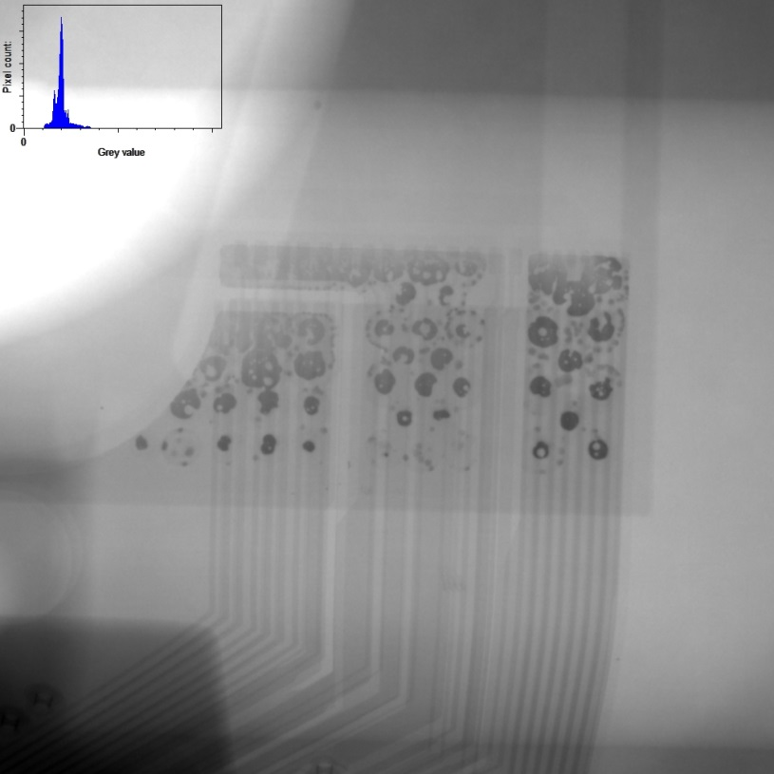
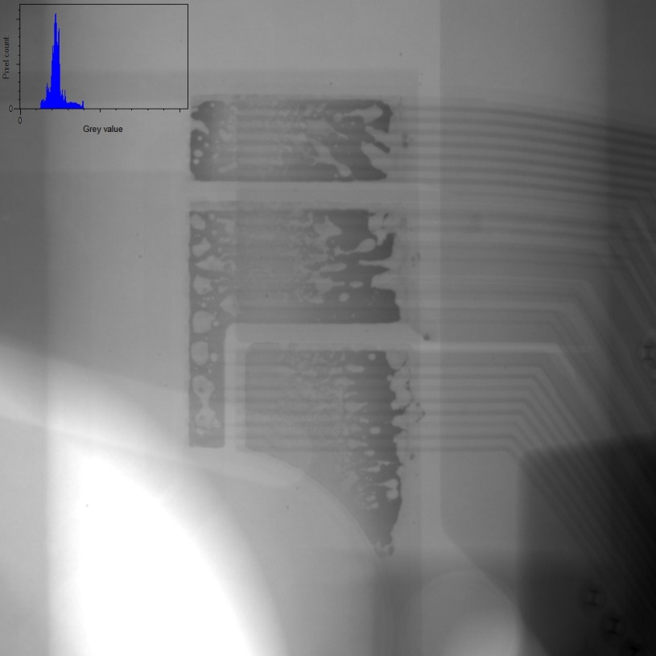
Kapton Soldering
With the old setup the coverage of the solder pads was often not satisfactory (though no failure was observed)
A new clamp equalizes the pressure during soldering and leads to a better coverage
Electrically ok, no shorts observed
More tests under way (adjust amount of solder to avoid spilling out ad module edge)
Old setup
New setup

Slide 17
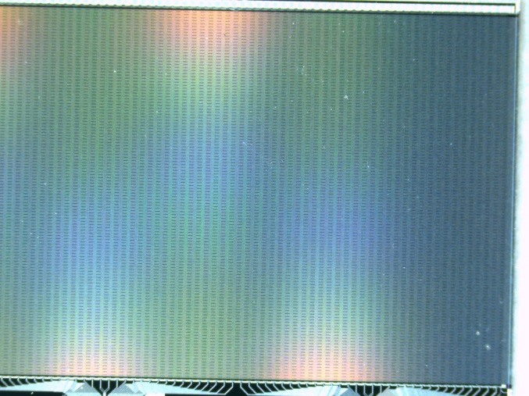
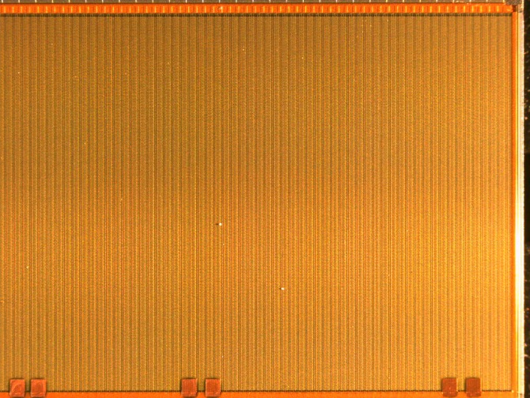
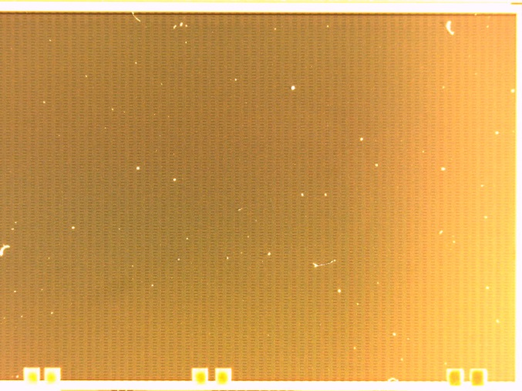
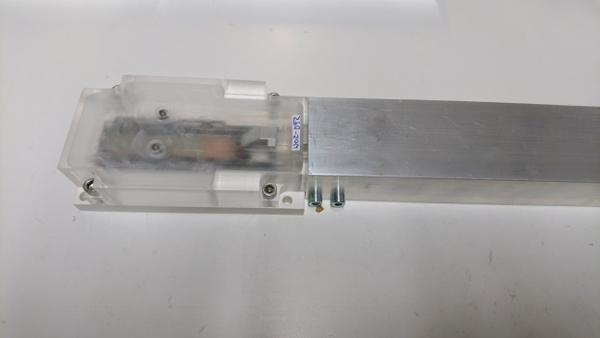
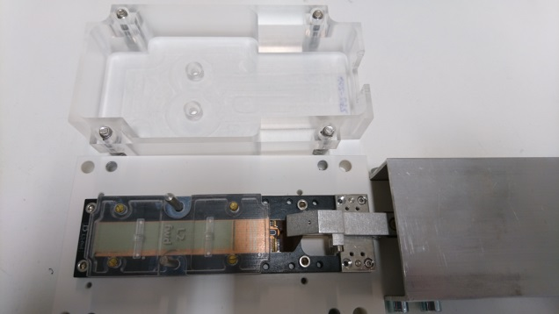
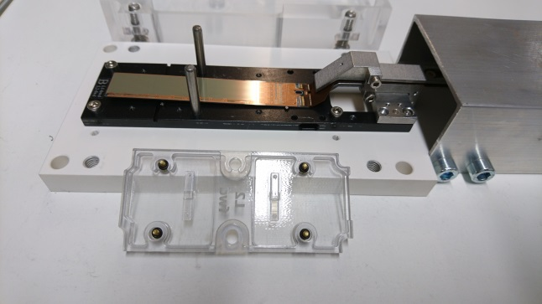
Module Inspection
Fresh from gel pack
After Kapton attachment
1 day in storage box
> 1 month in storage box
Storage box: 3-D printed, perhaps residuals of support material or 3D powder itself
Was cleaned in ultrasonic bath

Slide 18
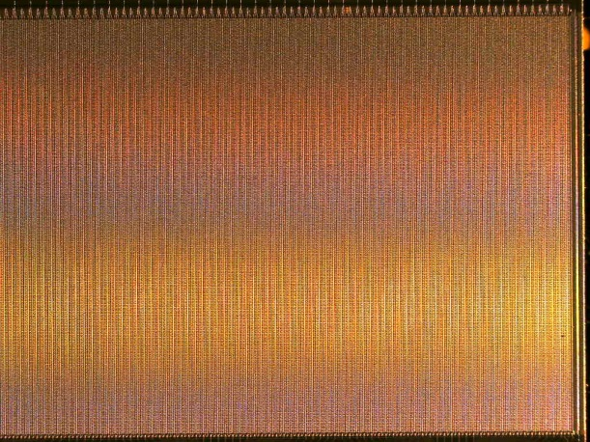
Dust Test
25.1.19
29.1.19
18.2.19

