Slide 1
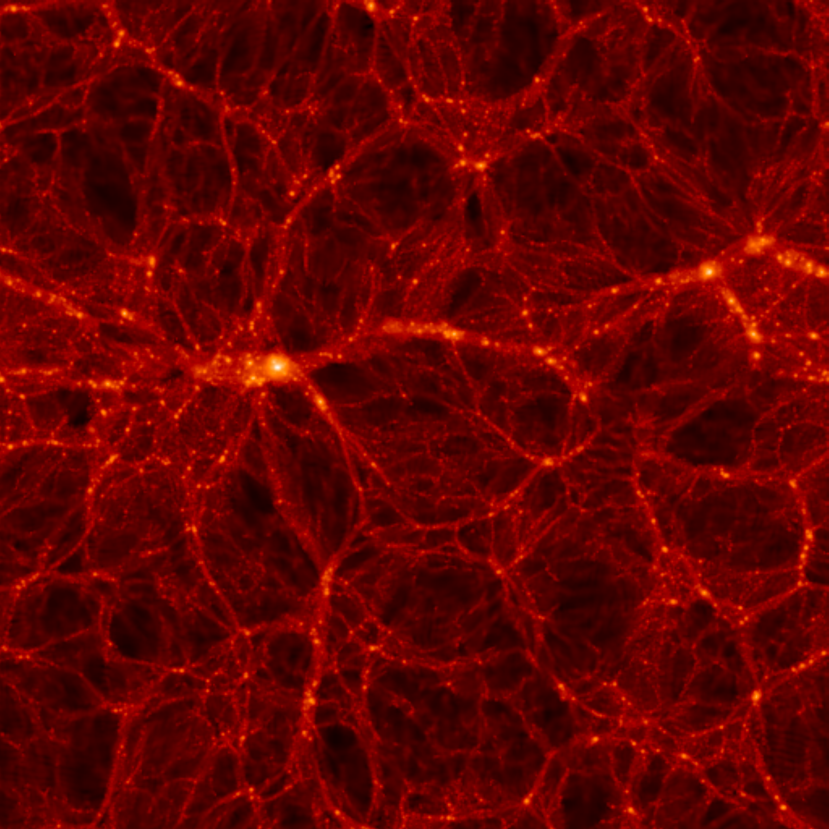
NEUTRINOS IN COSMOLOGY
CURRENT STATUS AND FUTURE PROSPECTS
$$ν_{e}$$
$$ν_{μ}$$
$$ν_{S}$$
$$ν_{τ}$$
Steen Hannestad, Aarhus University
Ringberg, 23 July 2019

Slide 2
What do we know about neutrinos?
They are light (but not massless) fermions - $m_{ν}≤eV$
The carry no electric or strong charge
They do carry weak charge
3 known charged current eigenstates: $ν_{e}, ν_{μ}, ν_{τ}$
Must correspond to three eigenstates of energy and
momentum: $ν_{1},ν_{2},ν_{3}$
Charged current eigenstates and energy/momentum
eigenstates are NOT identical
Provided that $m\left(ν_{1}\right), m\left(ν_{2}\right), m\left(ν_{3}\right)$are not identical this
leads to neutrino oscillations

Slide 3
NEUTRINO MIXING IN THE STANDARD PICTURE
FLAVOUR STATES
PROPAGATION STATES
$\left(\begin{matrix}ν_{e} \\ ν_{μ} \\ ν_{τ}\end{matrix}\right)=U$ $\left(\begin{matrix}ν_{1} \\ ν_{2} \\ ν_{3}\end{matrix}\right)$
U$=\left(\begin{matrix}1 & 0 & 0 \\ 0 & c_{23} & s_{23} \\ 0 & −s_{23} & c_{23}\end{matrix}\right)\left(\begin{matrix}c_{13} & 0 & {e^{−iδ}s}_{13} \\ 0 & 1 & 0 \\ {{−e}^{iδ}s}_{13} & 0 & c_{13}\end{matrix}\right)\left(\begin{matrix}c_{12} & s_{12} & 0 \\ −s_{12} & c_{12} & 0 \\ 0 & 0 & 1\end{matrix}\right)\left(\begin{matrix}1 & 0 & 0 \\ 0 & e^{i\frac{α_{1}}{2}} & 0 \\ 0 & 0 & e^{i\frac{α_{2}}{2}}\end{matrix}\right)$
Atmospheric
Long Baseline
Solar
Reactor
Only relevant
for 0ν2β decay
Reactor
$c_{23}=cos θ_{23}$ etc., $θ_{12},θ_{13},θ_{23}$ are the Euler angles of 3D rotation
$δ$ is the Dirac CP phase
$α_{1},α_{2}$ are Majorana phases (relevant only if neutrinos are Majorana particles)

Slide 4
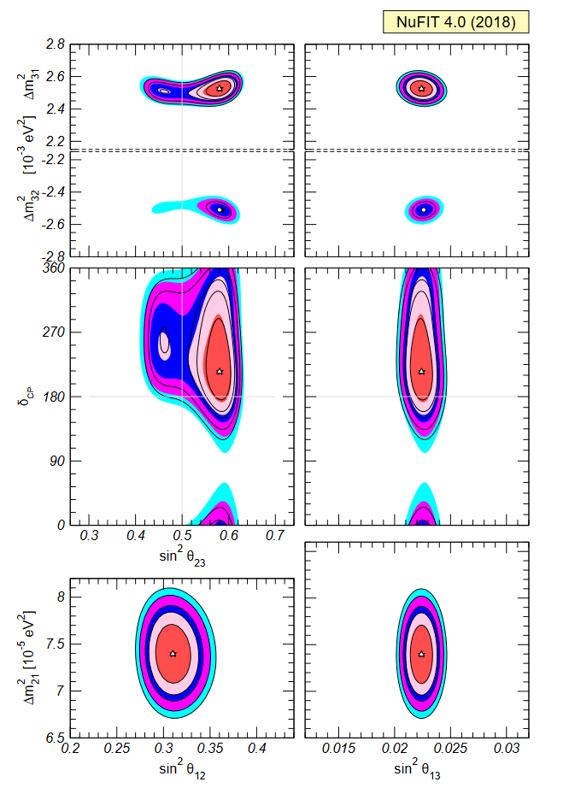
Status of 3-neutrino oscillations
Esteban et al. 1811.05487

Slide 5
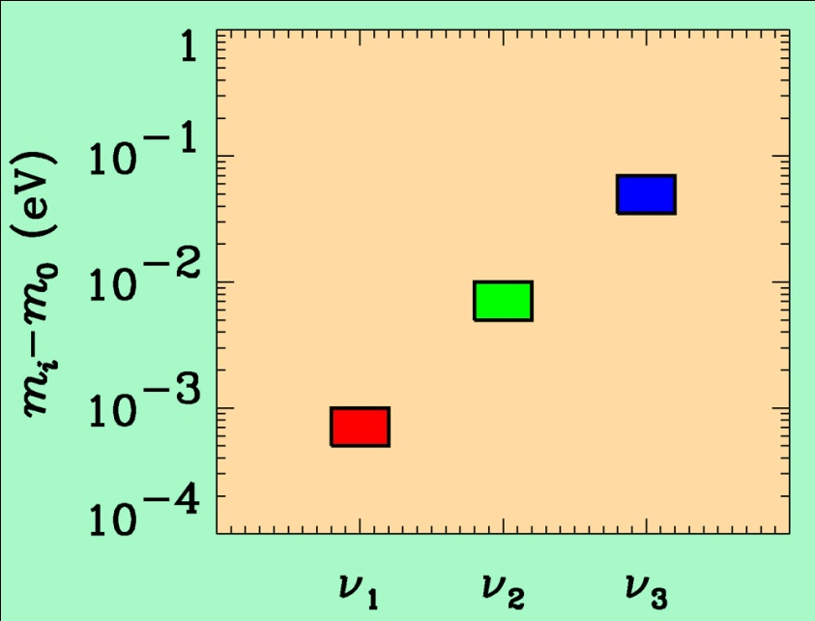
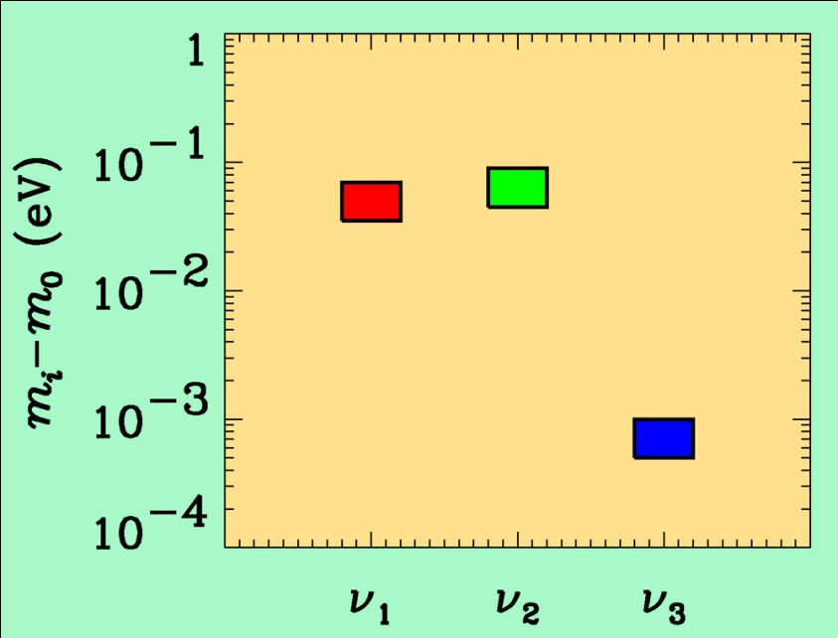
If neutrino masses are hierarchical then oscillation experiments
do not give information on the absolute value of neutrino masses
ATMO. ν
K2K
LBL
SOLAR ν
KAMLAND
Normal hierarchy
Inverted hierarchy
However, if neutrino masses are degenerate
no information can be gained from such experiments.
Experiments which rely on either the kinematics of neutrino mass
or the spin-flip in neutrinoless double beta decay are the most
efficient for measuring m₀

Slide 6
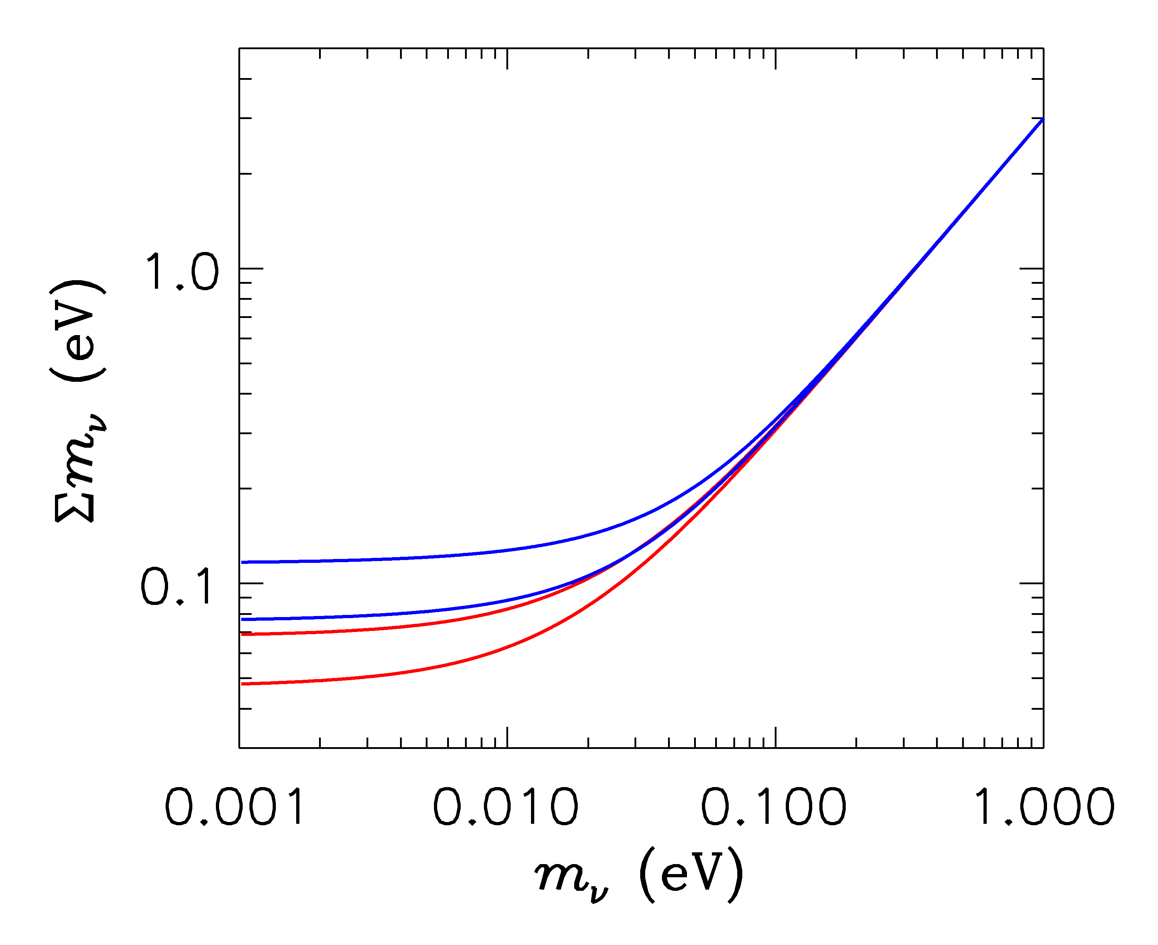
HIERARCHICAL
DEGENERATE
INVERTED
NORMAL
LIGHTEST

Slide 7
ß-decay and neutrino mass
Model independent neutrino mass from ß-decay kinematics
Only assumption: relativistic energy-momentum relation
experimental observable is m_{ν}²
T₂:
E₀ = 18.6 keV
T_{1/2} = 12.3 y

Slide 8
Tritium decay endpoint measurements have provided limits
on the electron neutrino mass
Mainz experiment, final analysis (Kraus et al.)
This translates into a limit on the sum of the three mass
eigenstates

Slide 9
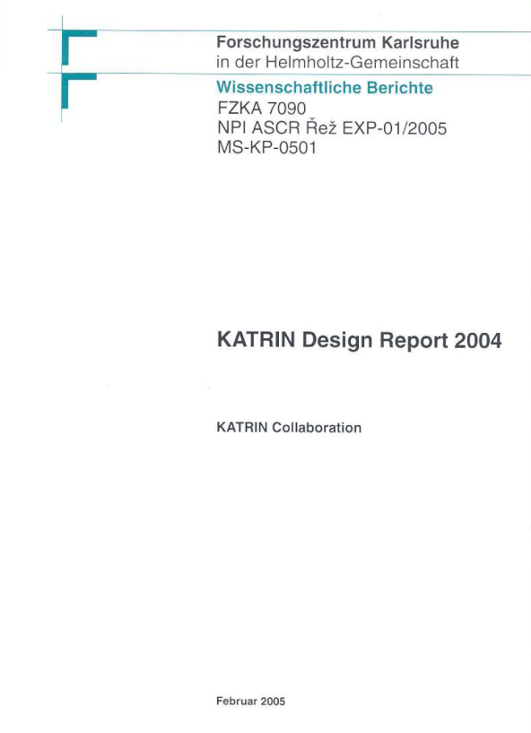
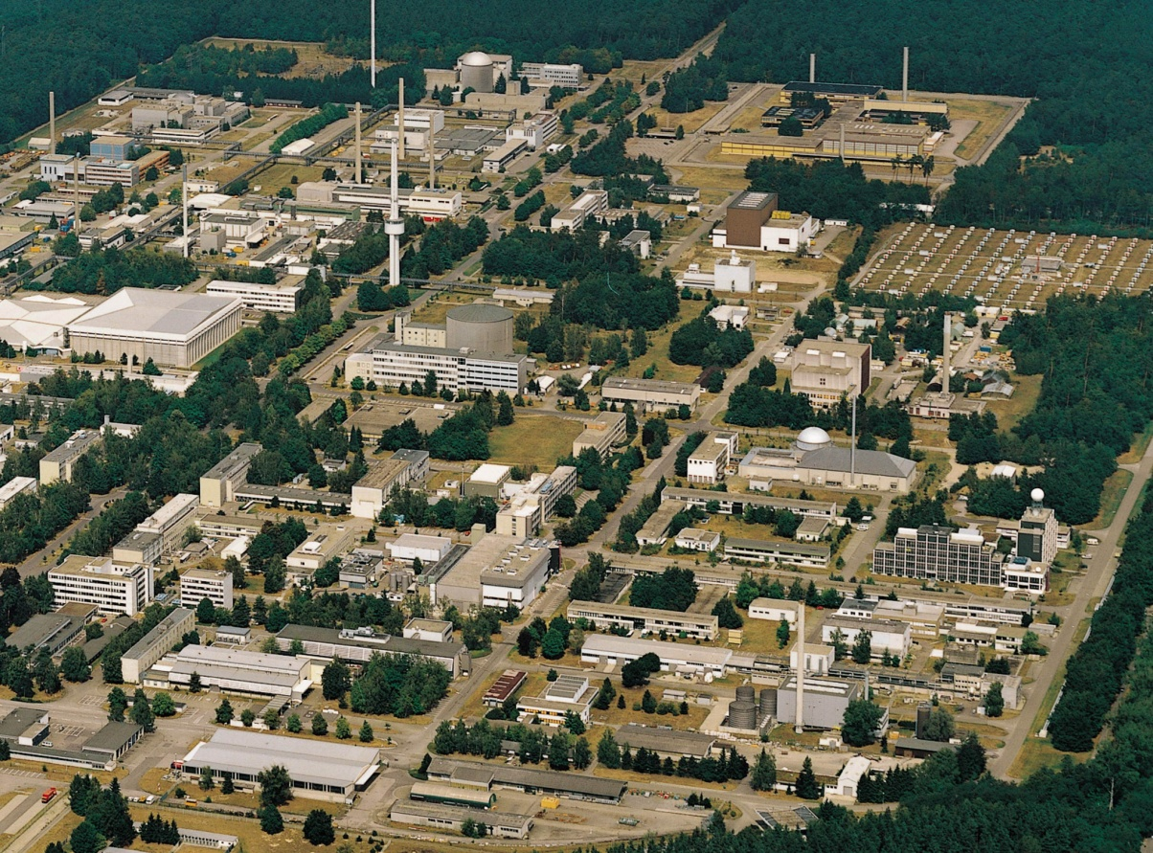
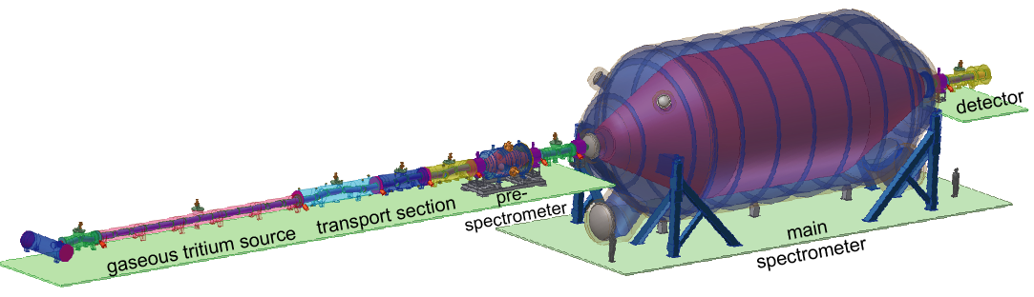
KATRIN experiment
Karlsruhe Tritium Neutrino
Experiment
Data taking ongoing
(first results by September)
TLK
25 m

Slide 10
NEUTRINO MASS AND ENERGY DENSITY
FROM COSMOLOGY
NEUTRINOS AFFECT STRUCTURE FORMATION
BECAUSE THEY ARE A SOURCE OF DARK MATTER
(n ~ 100 cm⁻³)
FROM
HOWEVER, eV NEUTRINOS ARE DIFFERENT FROM CDM
BECAUSE THEY FREE STREAM
SCALES SMALLER THAN d_{FS} DAMPED AWAY, LEADS TO
SUPPRESSION OF POWER ON SMALL SCALES

Slide 11
N-BODY SIMULATIONS OF ΛCDM WITH AND WITHOUT
NEUTRINO MASS (768 Mpc³) – GADGET 2
256
Mpc
T Haugboelle, Aarhus University

Slide 12
AVAILABLE COSMOLOGICAL DATA

Slide 13
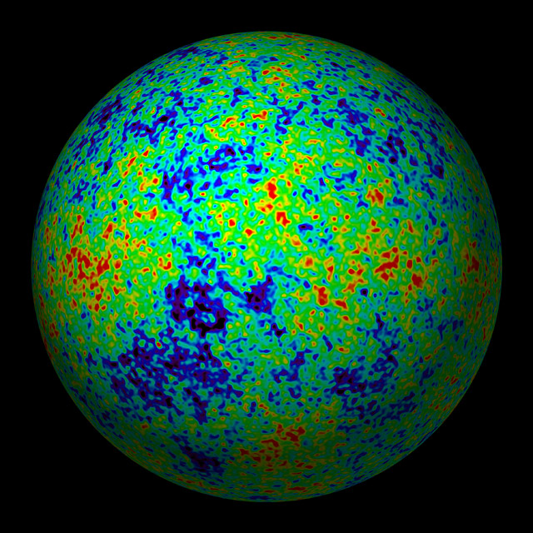
THE COSMIC MICROWAVE BACKGROUND
CMB TEMPERATURE AND POLARISATION

Slide 14
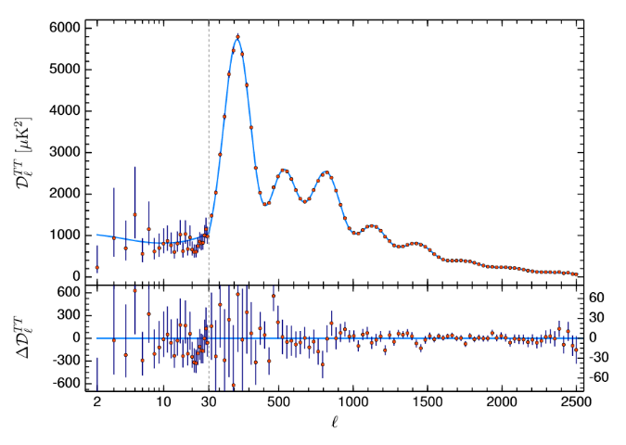
Aghanim et al. 2018 (Planck)

Slide 15
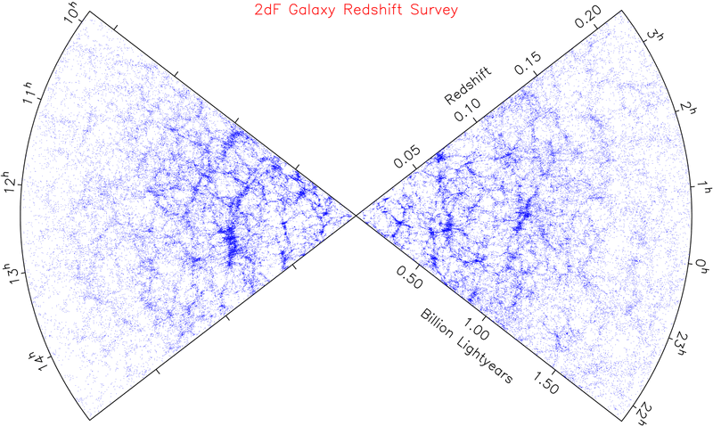
LARGE SCALE STRUCTURE SURVEYS

Slide 16
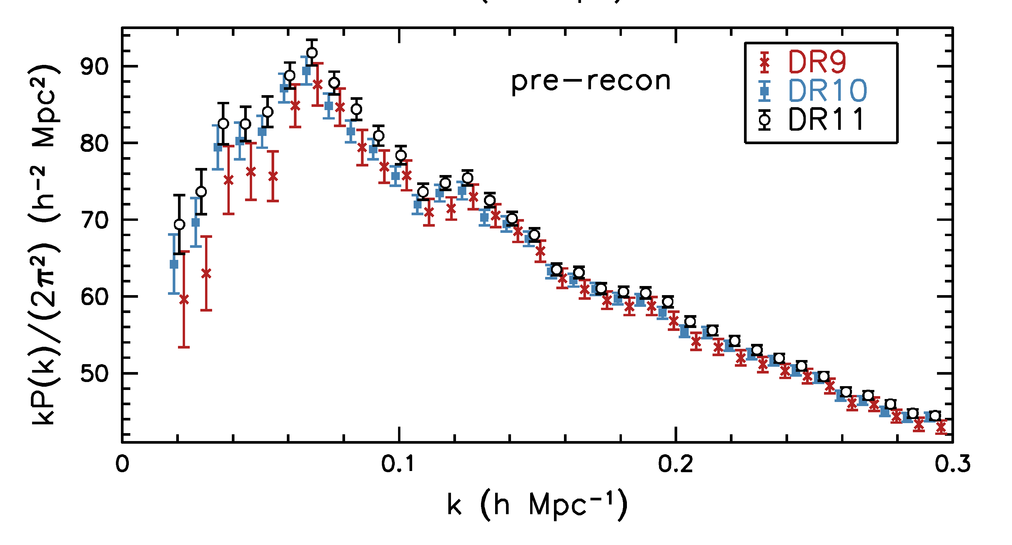
Anderson et al. 1312.4877 (SDSS)

Slide 17
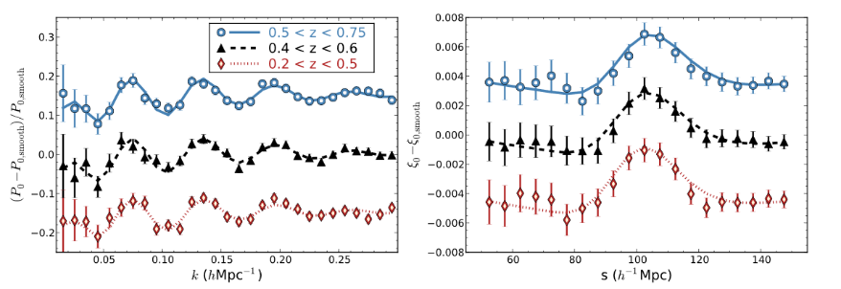
Alam et al. 1607.03155 (SDSS DR12)

Slide 18
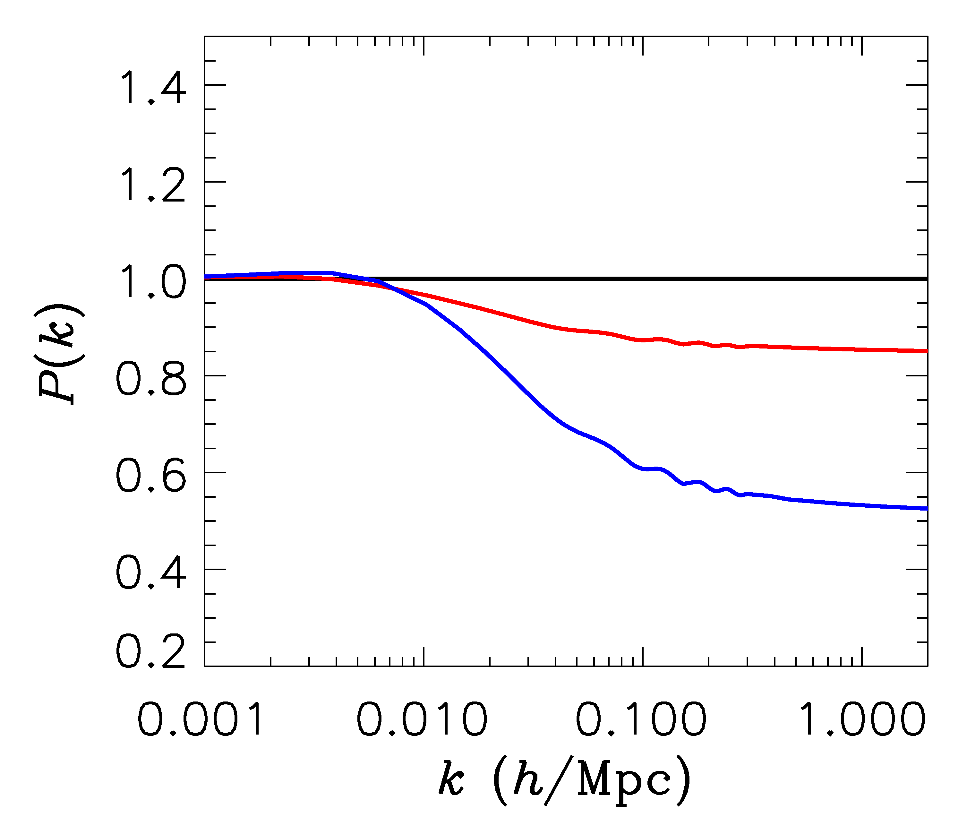
FINITE NEUTRINO MASSES SUPPRESS THE MATTER POWER
SPECTRUM ON SCALES SMALLER THAN THE FREE-STREAMING
LENGTH
Sm = 0 eV
P(k)/P(k,m_{ν}=0)
Sm = 0.3 eV
Sm = 1 eV

Slide 19
NOW, WHAT ABOUT NEUTRINO
PHYSICS?

Slide 20
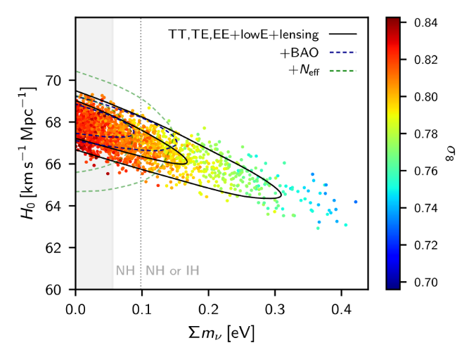
WHAT IS THE PRESENT BOUND ON THE NEUTRINO MASS?
DEPENDS ON DATA SETS USED AND ALLOWED PARAMETERS
THERE ARE MANY ANALYSES IN THE LITERATURE
AGHANIM ET AL.
(PLANCK 2018)

Slide 21
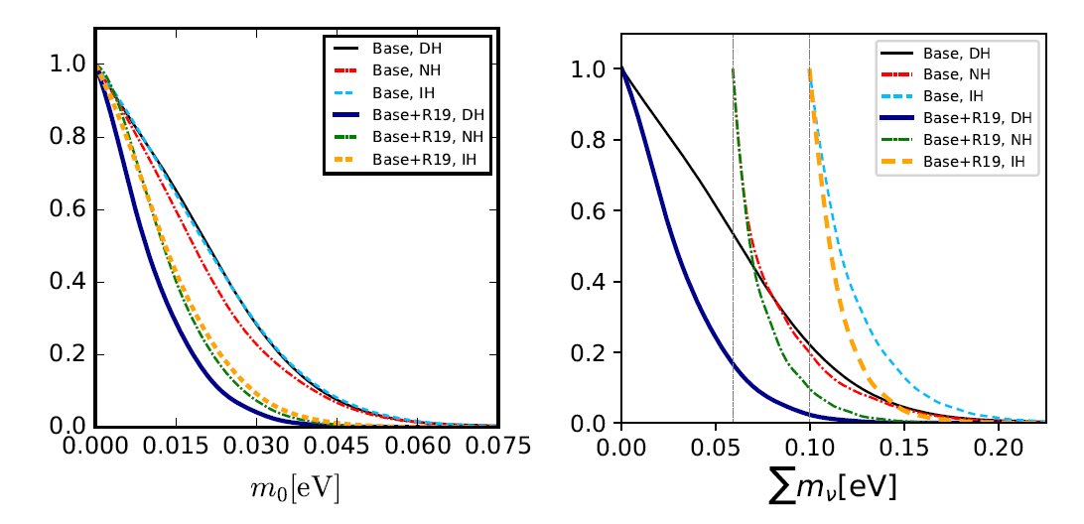
THE CURRENT BOUND IS ROUGHLY $∑m_{ν}<0.10−0.12$ eV BUT
THIS DEPENDS SIGNIFICANTLY ON THE DATA USED AND THE
MODEL SPACE
Choudhury & STH 1907.xxxx

Slide 22
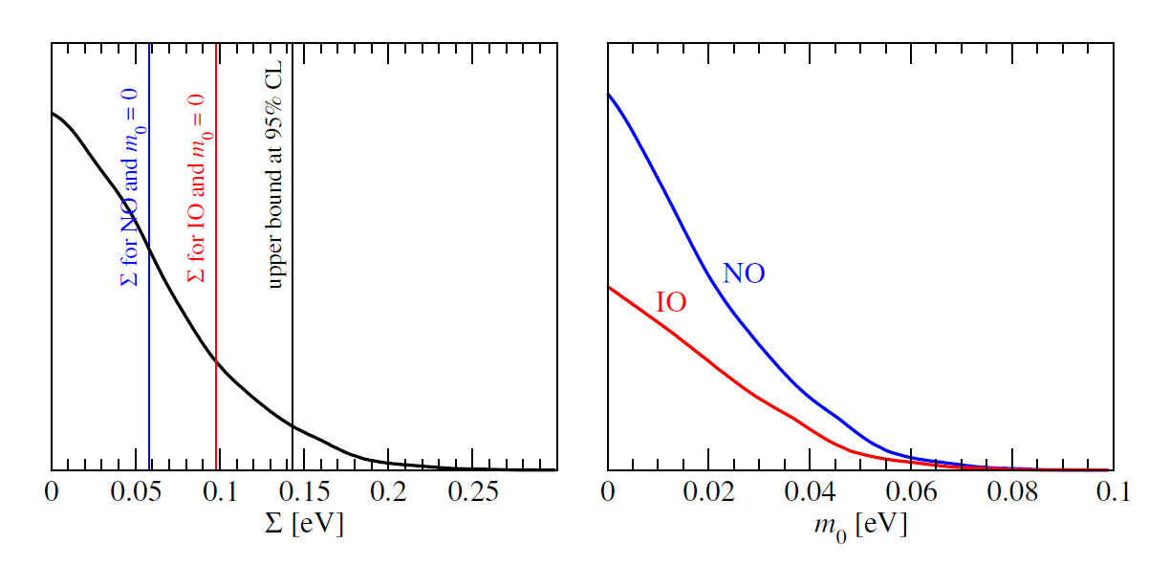
Is the inverted hierarchy already disfavoured?
Not really – a significantly better sensitivity is still required for such a statement
even with the most optimistic data combinations
A conclusive measurement requires $σ(∑m_{ν})∼0.01−0.02$ eV
(see STH & Schwetz 16, Mahony et al. 19)
STH & Schwetz, 1606.04691 (JCAP)

Slide 23
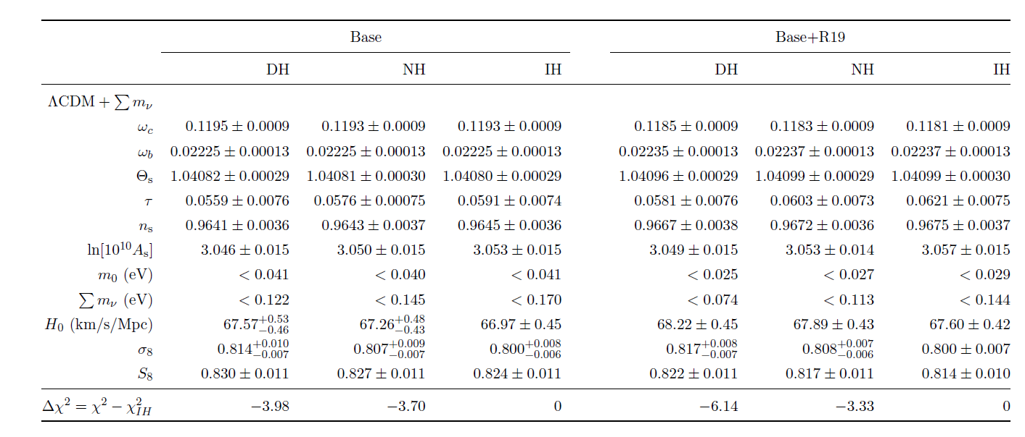
Choudhury & STH 1907.xxxx
Note that the normal hierarchy is also favoured by oscillation data by
$Δχ^{2}∼4−9$ (depending on the data used, see Esteban et al. 1811.05487).

Slide 24
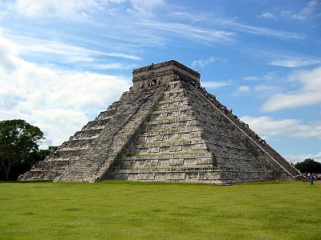
THE NEUTRINO MASS FROM COSMOLOGY PLOT
More data
+Ly-alpha
~ 0.1 eV
0.2-0.3 eV
0.2-0.3 eV
+ SNI-a
+WL
~ 0.15 eV
~0.5 eV
0.5-0.6 eV
+ SDSS
~0.15 eV
~ 0.5 eV
~0.5 eV
CMB only
0.7 eV
~ 1 eV
1.? eV
??? eV
Minimal
ΛCDM
+N_{ν}
+w+……
Larger model
space

Slide 25
HOW CAN THE BOUND BE AVOIDED?
Without modifying either cosmology or neutrino physics
The current bound is robustly below $\sum{m_{ν}<0.5}$ eV
Modifying cosmology?
Changing dark energy behaviour
Coupling neutrinos and dark energy
Modifying neutrino physics?
Make neutrinos strongly interacting
Late time neutrino mass generation (Dvali & Funcke 16)

Slide 26
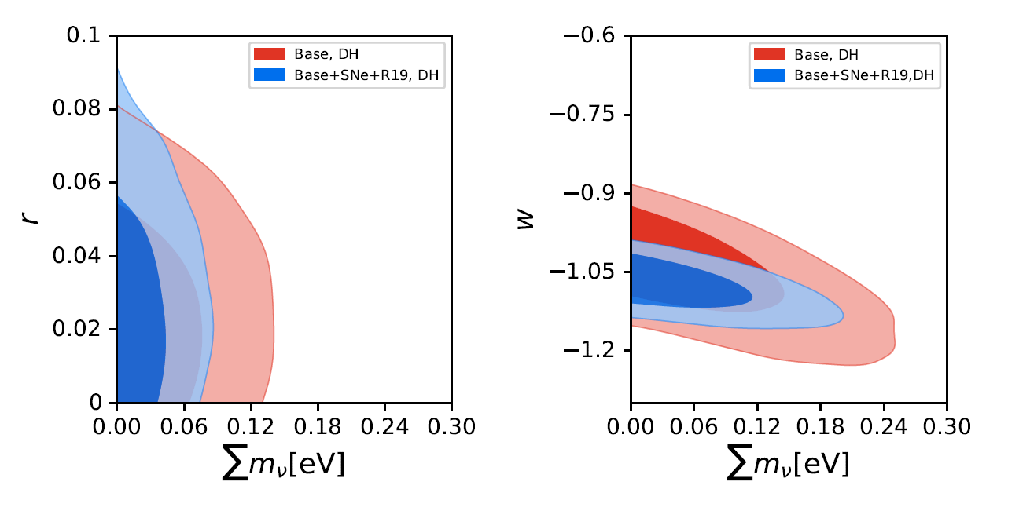
Choudhury & STH 1907.xxxx

Slide 27
GOING BEYOND THE MASS
$$Ω=\frac{ρ}{ρ_{c}}=∑m_{ν,i}n_{ν,i}$$
$$n_{ν}=\frac{3}{4}{\left(\frac{T_{ν}}{T_{γ}}\right)}^{3}n_{γ}$$
Normally $T_{ν}={\left(\frac{4}{11}\right)}^{1/3} T_{γ}$ , but could be different. Normally the relativistic
energy density in neutrinos is quantified through the relation
$$ρ_{ν0}=\frac{7}{8}{\left(\frac{T_{ν}}{T_{γ}}\right)}^{4}ρ_{γ}$$
$$N_{eff}=\frac{ρ_{ν,rel}}{ρ_{ν0}}$$
$N_{eff}$ is a measure of any type of ”dark radiation”

Slide 28
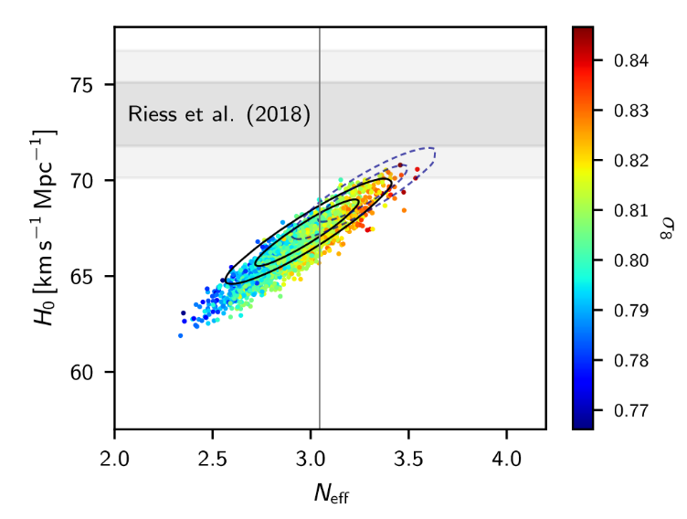
AGHANIM ET AL.
(PLANCK 2018)
THE CONCLUSION SEEMS TO BE THAT THERE IS NO EVIDENCE
FOR ANY PHYSICS BEYOND THE STANDARD MODEL
BUT BE AWARE THAT IN EXTENDED MODELS THIS CAN BE
VERY DIFFERENT

Slide 29
Cosmology shows no evidence for non-standard physics in the neutrino sector. However, cosmology might have to accomodate it after all.
A variety of different terrestrial experiments show hints of the presence of a 4th neutrino mass state (possibly even a 5th), most likely with a mass around 1-10 eV
However, the evidence is conflicting
(see e.g. Böser et al. 19 for a recent review)

Slide 30
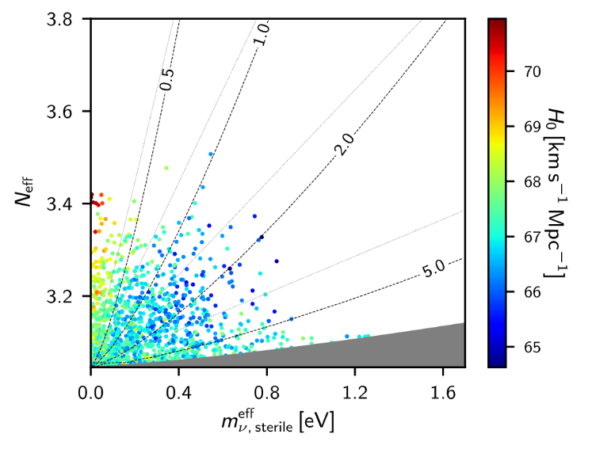
$$N_{eff}= \frac{ρ_{s}+ρ_{a}}{ρ_{ν,0}}$$
AGHANIM ET AL. (Planck 2018)

Slide 31
Bottom line: Sterile neutrinos in the
mass range preferred by SBL data
can be accomodated by cosmology,
but ONLY if they are not fully
thermalised

Slide 32
Sterile neutrinos are thermalised via a combination of oscillation and scattering
(Barbieri & Dolgov 91; Enqvist, Kainulainen & Maalampi 91, Raffelt & Sigl 93, McKellar & Thomson 94)
The neutrino matter potential is important and a very large potential could in principle prevent thermalisation
How can this be achieved?
A large neutrino lepton asymmetry
(see e.g. STH, Tamborra, Tram 1204.5861, Saviano et al. arXiv:1302.1200)
New, non-standard interactions in the sterile sector
(e.g. STH, Hansen, Tram, 1310.5926, Dasgupta & Kopp 1310.6337, Bringmann, Hasenkamp & Kersten 1312.4947, Archidiacono, STH, Hansen, Tram 1404.5915
Chu, Dasgupta & Kopp 1505.02795)

Slide 33
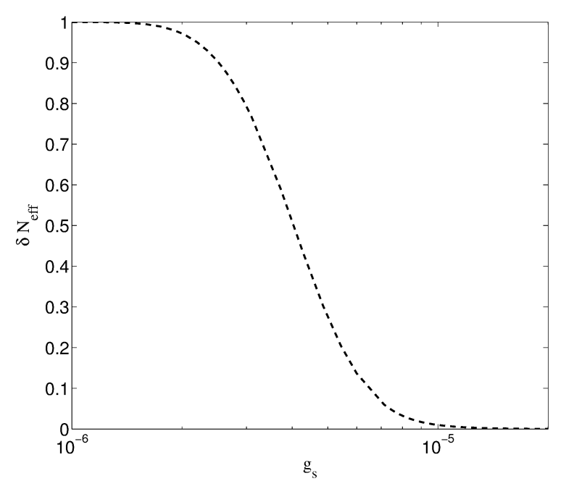
Sterile neutrinos can couple to a light or massless pseudoscalar.
In that case a background potential appears even in a CP-symmetric medium and suppressing oscillations requires only a very weak coupling.
Archidiacono,
STH, Hansen, Tram
(arXiv:1404.5915)

Slide 34
If the mediator is massless the sterile couples strongly at low temperatures
As soon as it goes non-relativistic it annihilates and leads to what is known
as the ”neutrinoless universe”
(Beacom, Bell & Dodelson 2004, STH 2004)
Very different low energy phenomenology: The combined sterile/pseudoscalar fluid is strongly self-interacting and has no anisotropic stress (STH 2004)
The model with a strongly interacting, new mass state in the eV range actually provides a better fit to all cosmological data than $Λ$CDM and favours a Hubble parameter compatible with local measurements
(Archidiacono, STH, Hansen, Tram, arXiv:1404.5915)
This conclusion is unchanged with Planck2015 (and 18) data (Archidiacono, STH, Hansen, Tram 15)
Evidence further increases with new Hubble measurement (Riess et al. 19) to $Δχ^{2}>10$ from cosmology alone

Slide 35
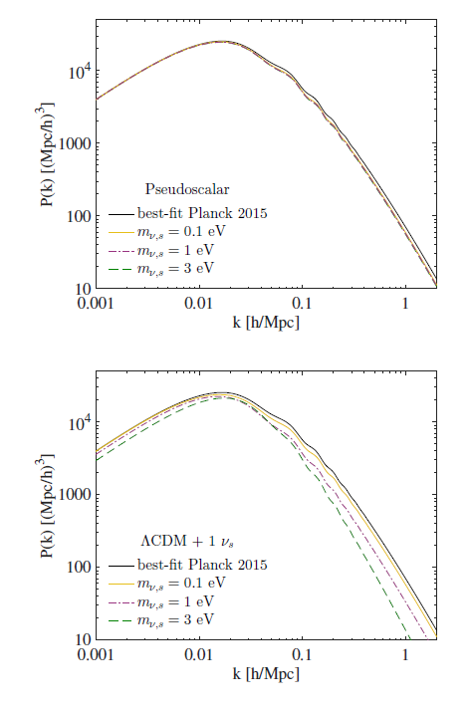
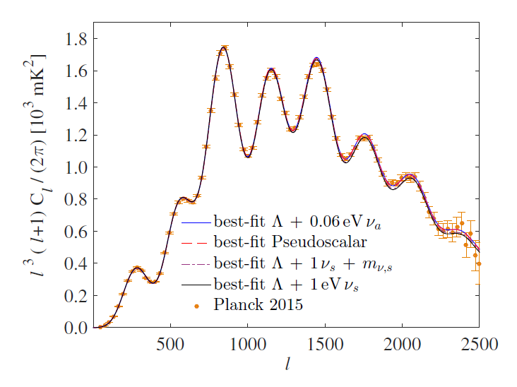
The usual suppression of matter
power does not occur because
the massive neutrinos disappear
as soon as they go non-relativistic
It does not create excess power
in the CMB spectrum
Archidiacono, STH, Hansen, Tram, arXiv:1508:02504

Slide 36
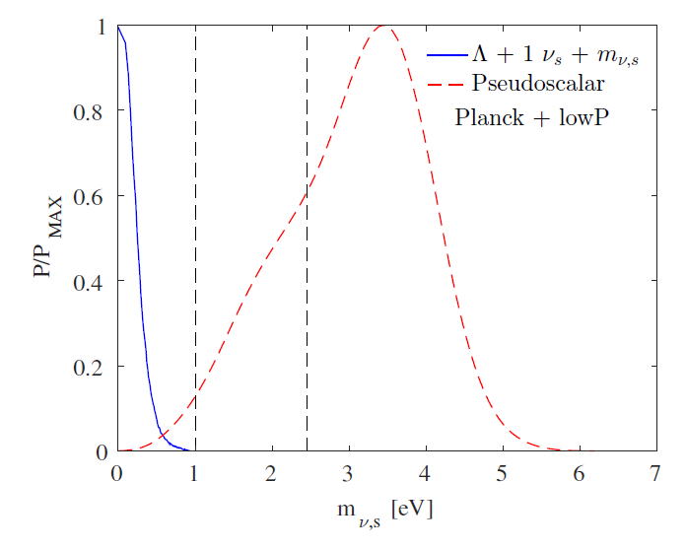
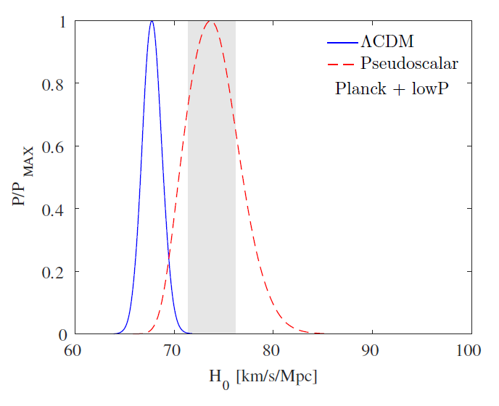
The model naturally predicts a high
value of the Hubble parameter, in
accordance with local Universe
Measurements
(see Riess et al. 19, Taubenberger et al. 19)

Slide 37
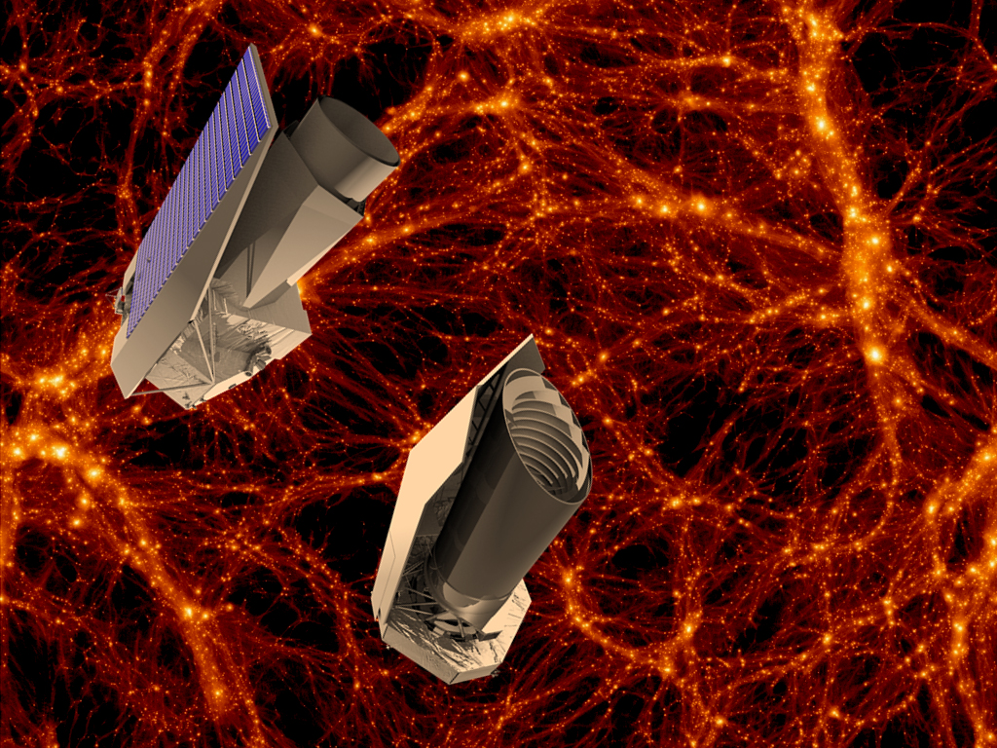
The future

Slide 38
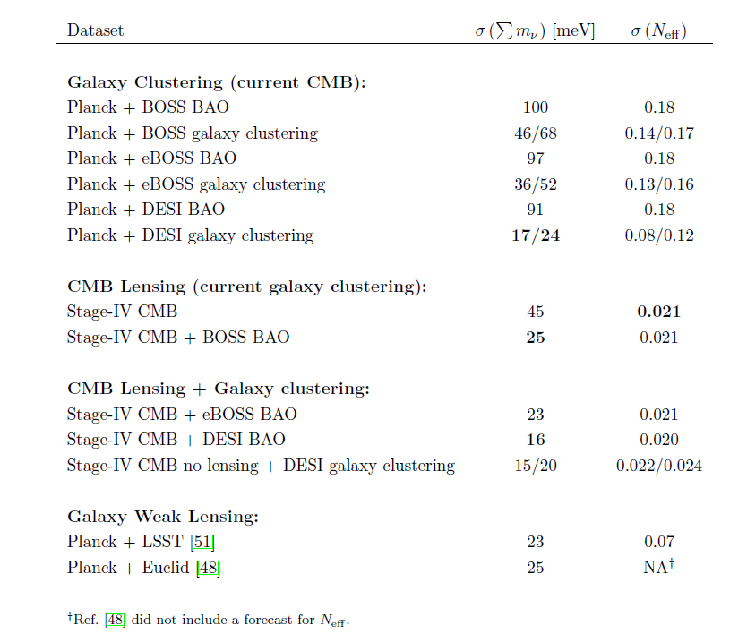
Abazajian et al., arXiv:1309.5383

Slide 39
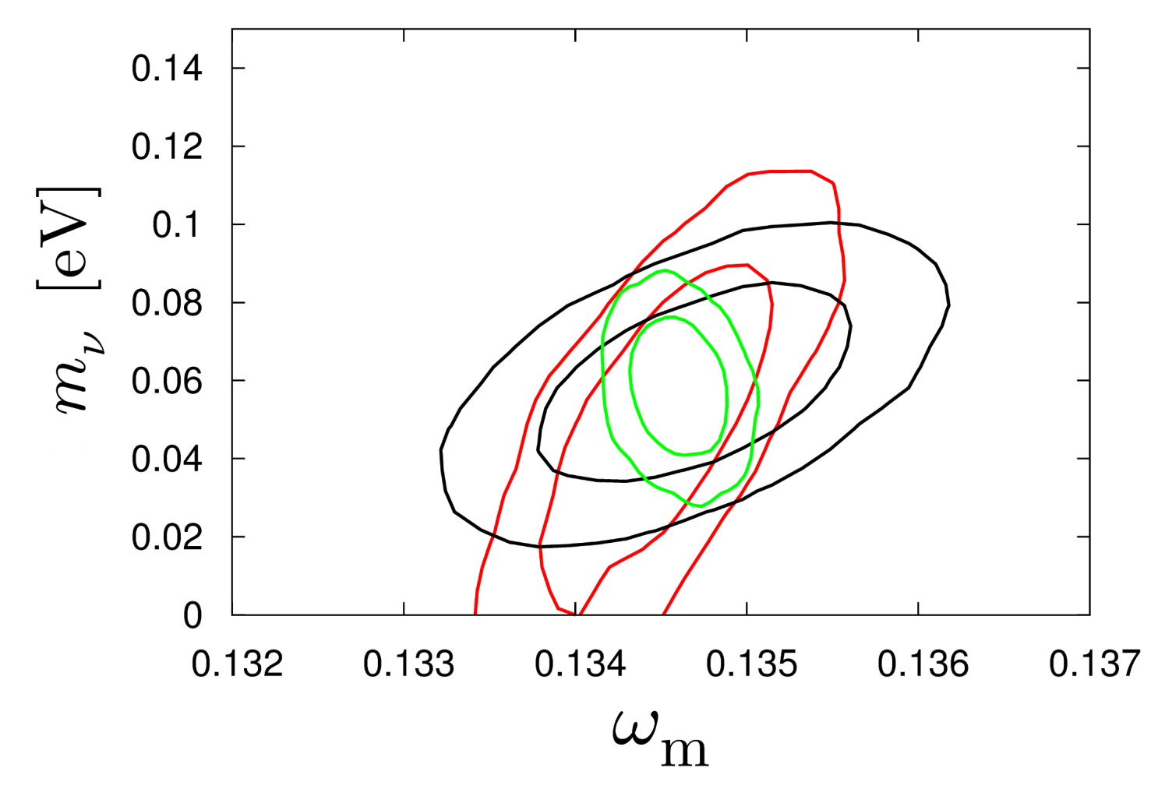
HAMANN, STH, WONG 2012: COMBINING THE EUCLID WL AND GALAXY
SURVEYS WILL ALLOW FOR AT A 2.5-5σ DETECTION OF THE NORMAL
HIERARCHY (DEPENDING ON ASSUMPTIONS ABOUT BIAS)
CMB+WL
CMB+WL+GAL
CMB+GAL
arXiv:1209.1043 (JCAP)

Slide 40
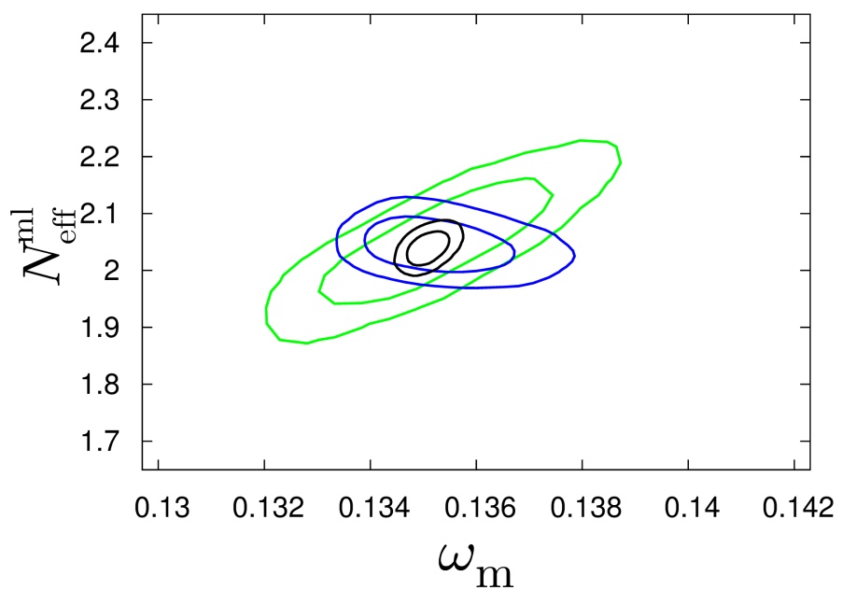
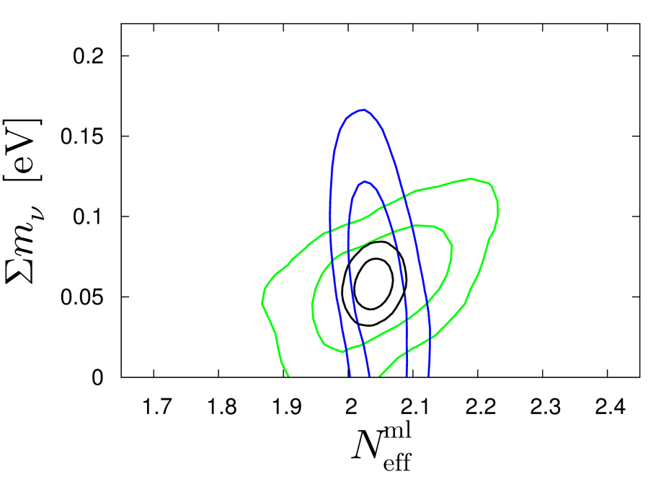
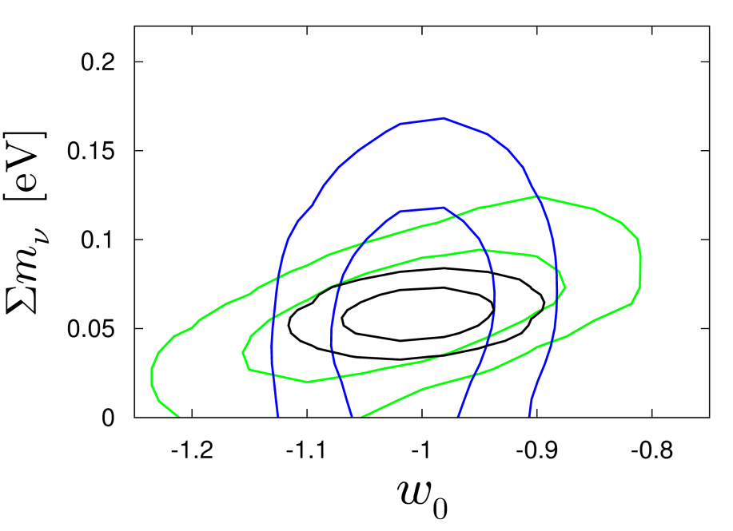
Basse, Bjælde, Hamann, STH, Wong 2013: Adding information on the
cluster mass function will allow for a 5σ detection of non-zero neutrino
mass, even in very complex cosmological models with time-varying
dark energy
arXiv:1304.2321
(JCAP)
CMB+CL
CMB+GAL+WL
ALL

Slide 41
THIS SOUNDS GREAT, BUT UNFORTUNATELY THE THEORETICIANS
CANNOT JUST LEAN BACK AND WAIT FOR FANTASTIC NEW DATA
TO ARRIVE…..

Slide 42
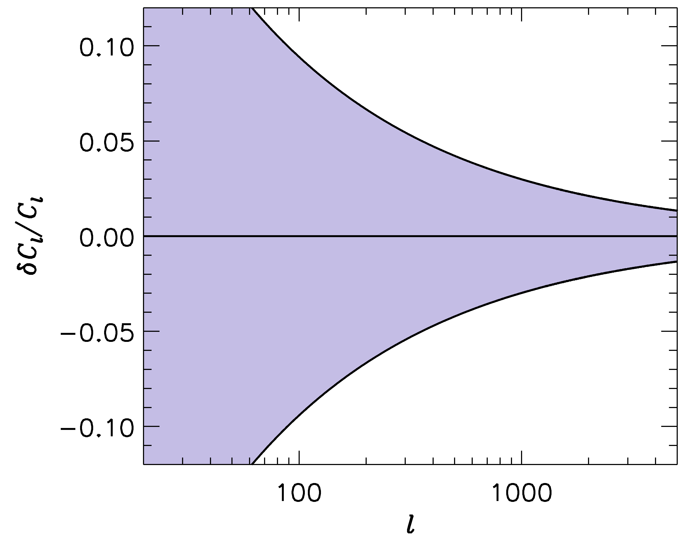
FUTURE SURVEYS LIKE LSST WILL PROBE THE POWER SPECTRUM
TO ~ 1-2 PERCENT PRECISION
-1
”LSST” ERROR BARS
WE SHOULD BE ABLE TO CALCULATE THE POWER SPECTRUM
TO AT LEAST THE SAME PRECISION!

Slide 43
IN ORDER TO CALCULATE THE POWER SPECTRUM TO 1%
ON THESE SCALES, A LARGE NUMBER OF EFFECTS MUST
BE TAKEN INTO ACCOUNT
BARYONIC PHYSICS – STAR FORMATION, SN FEEDBACK,…..
NEUTRINOS, EVEN WITH NORMAL HIERARCHY
NON-LINEAR GRAVITY
……………………..

Slide 44
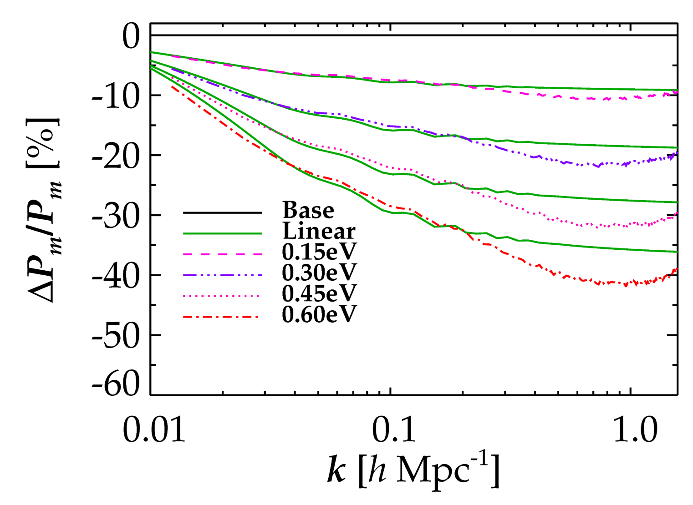
NON-LINEAR EVOLUTION PROVIDES AN ADDITIONAL SUPPRESSION OF
FLUCTUATION POWER DUE TO NEUTRINOS
LINEAR THEORY
FULL NON-LINEAR
Brandbyge, STH, Haugbølle, Thomsen, arXiv:0802.3700 (JCAP)

Slide 45
J. Brandbyge, S. Hannestad, T. Haugbølle and B. Thomsen, “The Effect of Thermal Neutrino
Motion on the Non-linear Cosmological Matter Power Spectrum,” JCAP 0808 (2008) 020
[arXiv:0802.3700 [astro-ph]].
M. Viel, M. G. Haehnelt and V. Springel, “The effect of neutrinos on the matter distribution as
probed by the Intergalactic Medium,” JCAP 1006 (2010) 015 [arXiv:1003.2422 [astro-ph.CO]].
S. Agarwal and H. A. Feldman, “The effect of massive neutrinos on the matter power
spectrum,” Mon. Not. Roy. Astron. Soc. 410 (2011) 1647 [arXiv:1006.0689 [astro-ph.CO]].
S. Bird, M. Viel and M. G. Haehnelt, “Massive Neutrinos and the Non-linear Matter Power
Spectrum,” Mon. Not. Roy. Astron. Soc. 420 (2012) 2551 [arXiv:1109.4416 [astro-ph.CO]].
F. Villaescusa-Navarro, F. Marulli, M. Viel, E. Branchini, E. Castorina, E. Sefusatti and
S. Saito, “Cosmology with massive neutrinos I: towards a realistic modeling of the relation
between matter, haloes and galaxies,” JCAP 1403 (2014) 011 [arXiv:1311.0866 [astro-ph.CO]].
E. Castorina, C. Carbone, J. Bel, E. Sefusatti and K. Dolag, “DEMNUni: The clustering of
large-scale structures in the presence of massive neutrinos,” JCAP 1507 (2015) no.07, 043
[arXiv:1505.07148 [astro-ph.CO]].
J. D. Emberson et al., “Cosmological neutrino simulations at extreme scale,” Res. Astron.
Astrophys. 17 (2017) no.8, 085 [arXiv:1611.01545 [astro-ph.CO]].
J. Adamek, R. Durrer and M. Kunz, “Relativistic N-body simulations with massive neutrinos,”
JCAP 1711 (2017) no.11, 004 [arXiv:1707.06938 [astro-ph.CO]].
J. Brandbyge and S. Hannestad, “Grid Based Linear Neutrino Perturbations in Cosmological
N-body Simulations,” JCAP 0905 (2009) 002 [arXiv:0812.3149 [astro-ph]].
Y. Ali-Haimoud and S. Bird, “An efficient implementation of massive neutrinos in non-linear
structure formation simulations,” Mon. Not. Roy. Astron. Soc. 428 (2012) 3375
[arXiv:1209.0461 [astro-ph.CO]].
J. Liu, S. Bird, J. M. Z. Matilla, J. C. Hill, Z. Haiman, M. S. Madhavacheril, A. Petri and
D. N. Spergel, “MassiveNuS: Cosmological Massive Neutrino Simulations,” arXiv:1711.10524
[astro-ph.CO].
J. Brandbyge and S. Hannestad, “Resolving Cosmic Neutrino Structure: A Hybrid Neutrino
N-body Scheme,” JCAP 1001 (2010) 021 [arXiv:0908.1969 [astro-ph.CO]].
+many others

Slide 46
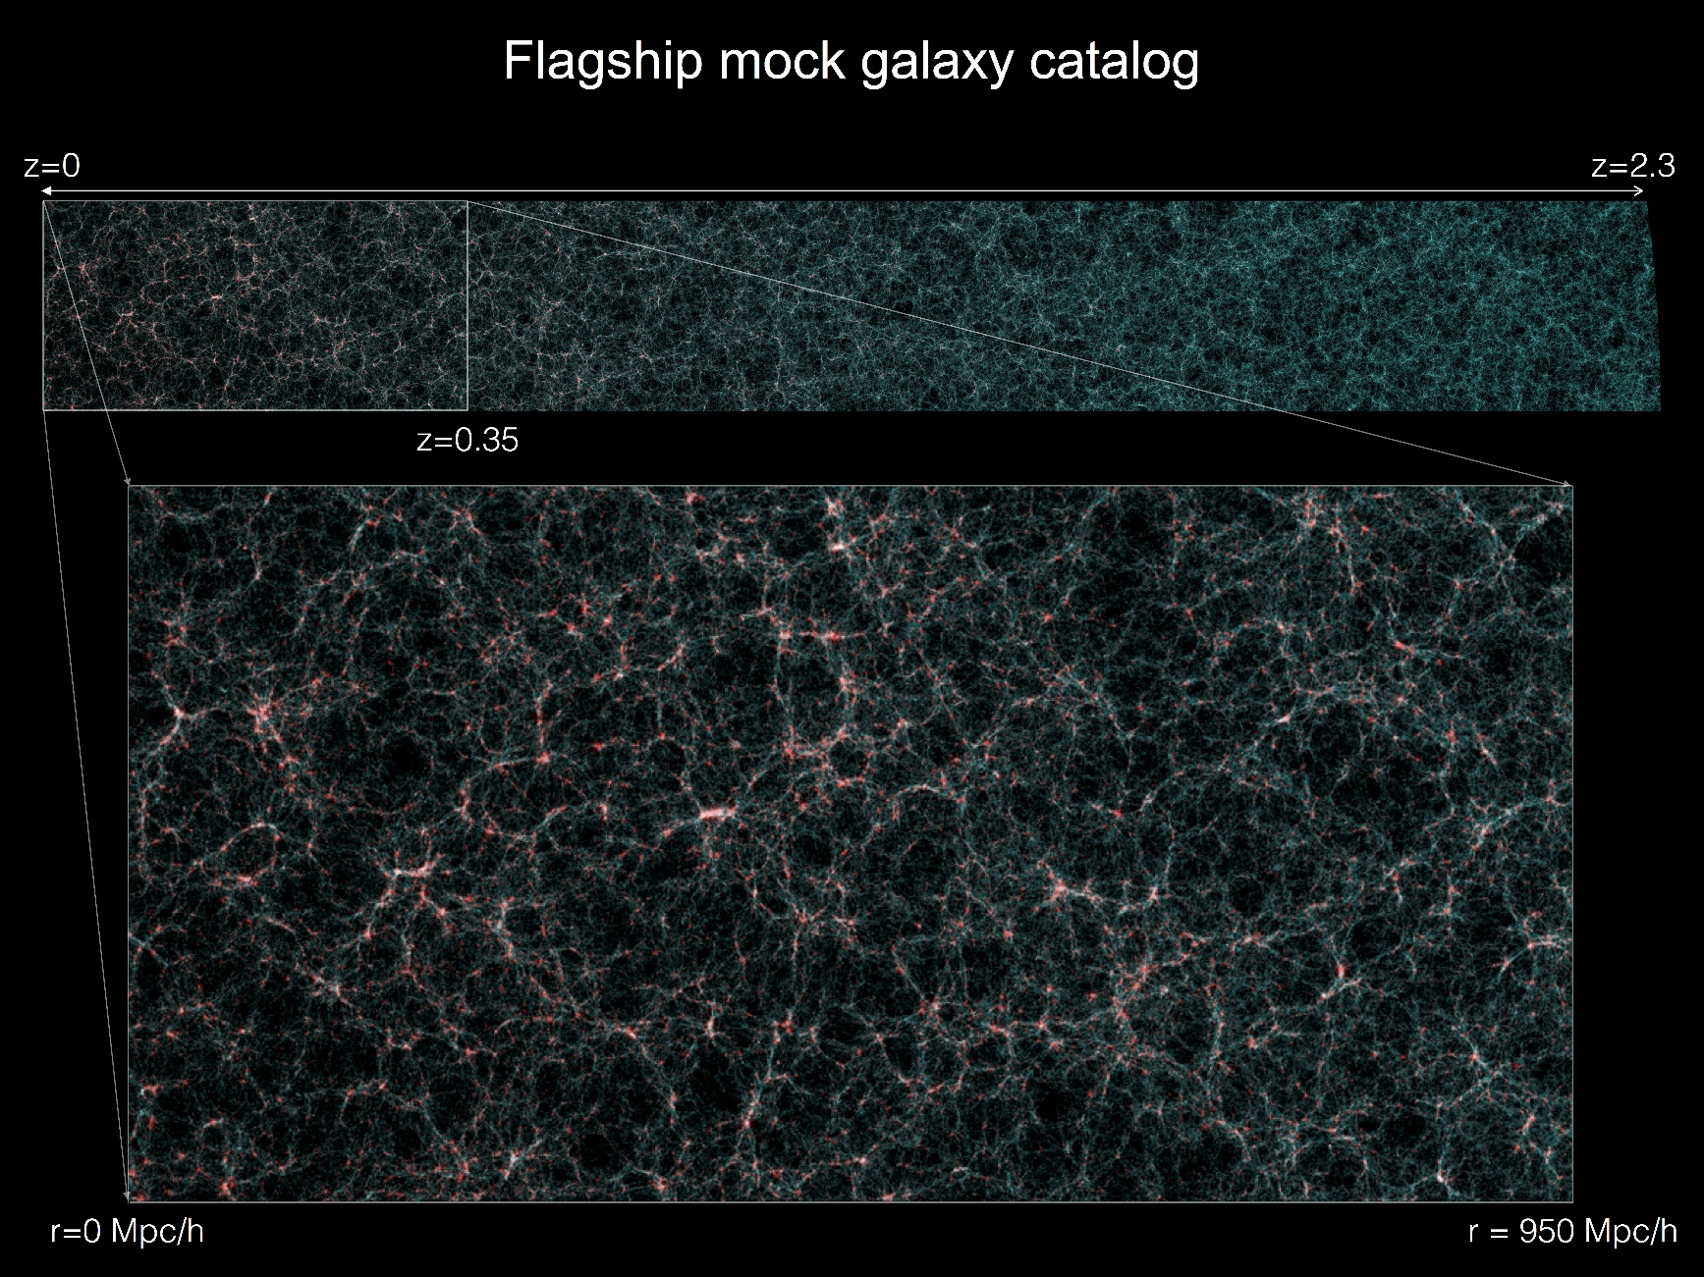
EUCLID ”flagship 2.0 run”: 4x10¹² particles in 4Gpc side-length box
(run spring 2019 on Piz Daint, Swiss HPC centre (under PRACE scheme),
using PKDGRAV3 with modifications developed using the
CONCEPT N-body code https://github.com/jmd-dk/concept)

Slide 47
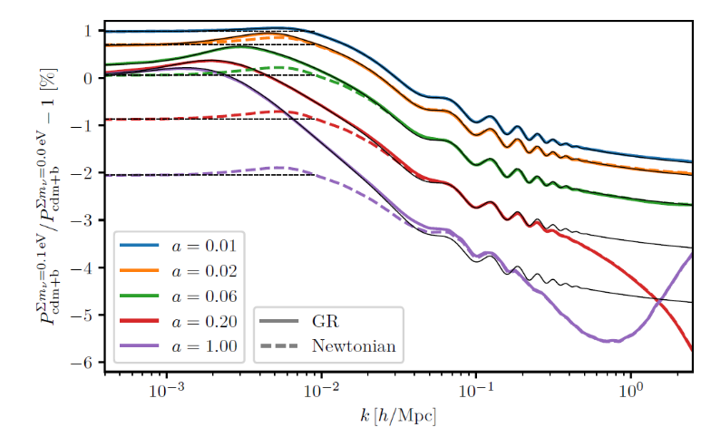
Tram et al. 1811.00904 (fully compatible with GR at the linear level)

Slide 48
CONCLUSIONS
NEUTRINO PHYSICS IS PERHAPS THE PRIME EXAMPLE OF HOW
TO USE COSMOLOGY TO DO PARTICLE PHYSICS
THE BOUND ON NEUTRINO MASSES IS SIGNIFICANTLY
STRONGER THAN WHAT CAN BE OBTAINED FROM DIRECT
EXPERIMENTS, ALBEIT MUCH MORE MODEL DEPENDENT
COSMOLOGICAL DATA SHOWS NO EVIDENCE FOR NEW
PHYSICS. HOWEVER, IF eV STERILE NEUTRINOS EXIST THERE
MUST BE NEW PHYSICS IN ORDER TO RECONCILE THEM WITH
COSMOLOGY
NEW DATA FROM PLANCK AND EUCLID WILL PROVIDE A
POSITIVE DETECTION OF A NON-ZERO NEUTRINO MASS

