Slide 1
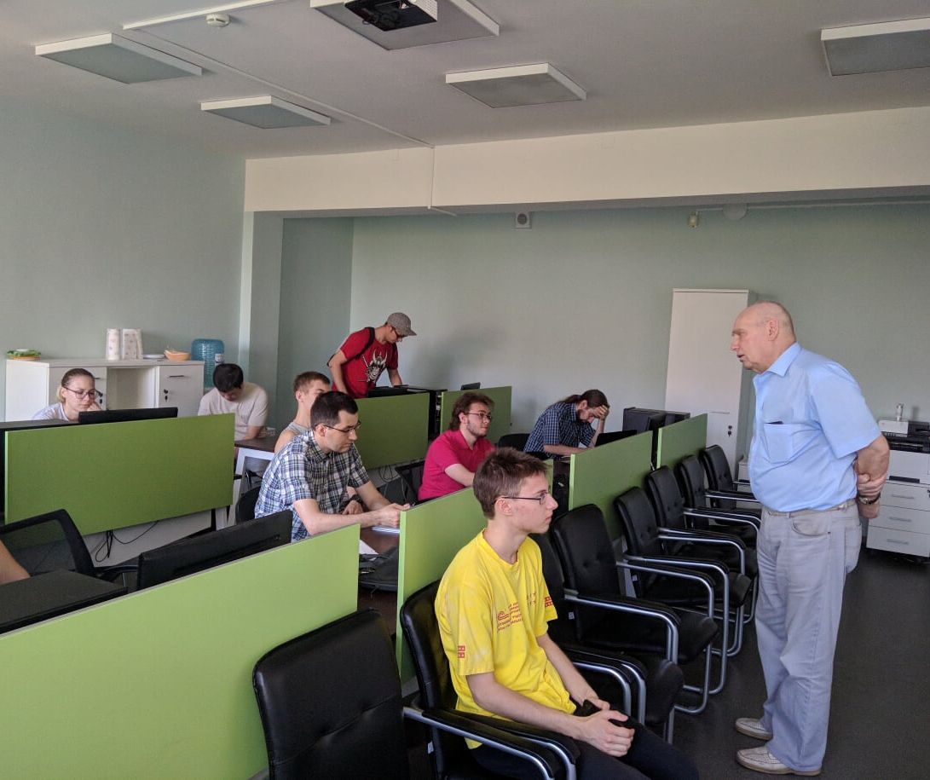
Status 2019

Slide 2
MIPT-NPM lab
x2

Slide 3
Projects
Non-accelerator particle physics (Troitsk nu-mass, KATRIN, IAXO)
Simulations (Atmosphere physics, education and other interesting things)
Software:
Kotlin tools (kmath, plotly.kt, DataForge)
Visualization tools (NICA, IAXO, stand-alone tools)
Bayesian tools (Nozik, Khudyakov, Abramova, Tovstun)
Parallel processing (?)

Slide 4
Future project
Bayesian Monte-Carlo engine (joint effort for software, simulation and physics teams):
Use Bayesian network instead of cuts
Auto-balancing of simulation performance
Parallel processing via coroutines (asynchronous branching)
Remote and cluster computation
Got support from JetBrains (with possible compiler tweaks to improve performance).
Currently searching for additional funding.
Phd-student and/or postdoc position at MIPT

Slide 5
Quarks-2020
Quarks 2020 will have a section on computer methods in particle physics (not only theory).
BAT team is welcome to participate full support for invited speakers and local expenses coverage for students

Slide 6
Next meeting in Moscow?

Slide 7
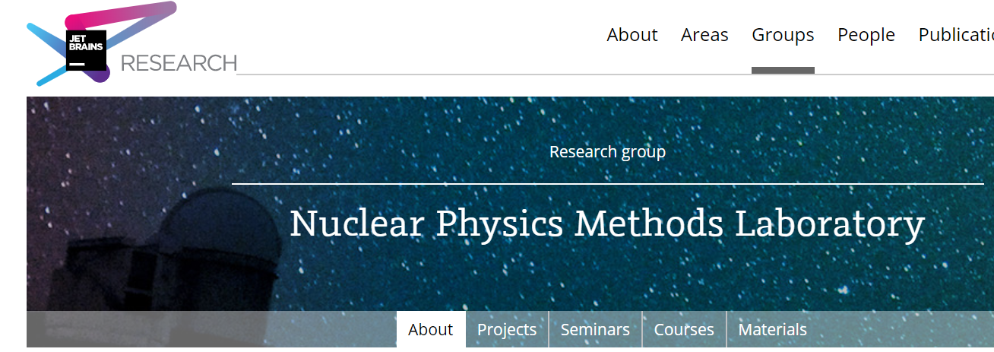
References
JetBrains research page: https://research.jetbrains.org/groups/npm
Github organization: https://github.com/mipt-npm

