Slide 1
Application of Parallel MCMC Sampling for Proton Bunch Analysis in the AWAKE Experiment
Student: Vasyl Hafych
Project supervisor: Allen Caldwell
C2PAP supervisor: Jovan Mitrevski
Co-Supervisor: Oliver Schulz
August 13, 2019

Slide 2
Outline of the Presentation
Statistical analysis
Bayesian model
Noise & resolution effects
Serial MCMC sampling
Simulated events
Simulation results
Parallel MCMC sampling
Likelihood parallelization
Parameter space partitioning
AHMI algorithm
Preliminary results

Slide 3
Outline of the Presentation
Statistical analysis
Bayesian model
Noise & resolution effects
Serial MCMC sampling
Simulated events
Simulation results
Parallel MCMC sampling
Likelihood parallelization
Parameter space partitioning
AHMI algorithm
Preliminary results

Slide 4
Experimental Setup & Measurements
Optical transition radiation (OTR) light produced by protons crossing the OTR screen has been measured by using 4 SSD cameras:
BTV50 (3 m upstream).
BTV53 (1.5 m upstream).
BTV26 (2 m downstream).
IS2 (10 m downstream).
OTR screens
Rubidium vapor source
BEAMLINE
BTV50
BTV53
BTV26
IS2

Slide 5
Experimental Setup & Measurements
Set 1
Population 3e11 [p];
Set 2
Population 3e11 [p];
Set 3
Population 1e11 [p];
Set 4
Population 1e11 [p];
Bunch rotation ON;
120 events;
Bunch rotation OFF;
120 events;
Bunch rotation ON;
120 events;
Bunch rotation OFF;
120 events;
Example of the data that has been collected
1 event = 1 proton bunch extraction = 4 images from cameras
~ 7 hours of measurements, 800 events

Slide 6
Statistical Analysis
We would like to learn $λ$ (parameters of a proton bunch) from data. Bayes' theorem:
$$P\left(λ | D\right)= \frac{\int{P\left(D | λ, θ\right)P_{0}\left(λ\right)P_{0}\left(θ\right)dθ}}{\int{P\left(D | λ, θ\right)P_{0}\left(λ\right)P_{0}\left(θ\right)dθ}dλ}$$
Where:
$P\left(D | λ, θ\right)= \prod_{j=1}^{N_{screens}}{P\left(D_{j} | λ, θ\right)}$ — product over different screens.
$D_{j}=\left\{D_{j}^{rc}\right\}$ — row and column index of a camera, $θ$ nuisance parameters.
$P\left(D_{j}^{rc}\right)=P\left(D_{j}^{rc} | S(r,c), N(r,c)\right)$ — probability distribution for the given row and
column of the camera ”j”, where S and N are resolution and noise effects respectively.
The task is generic, and one can consider similar analysis for different applications.
Likelihood Function, needs modelling!

Slide 7
Particle Propagation Model
Assumption:
Proton bunch is Gaussian in 4D phase space.
Linear particles propagation model:
$$r_{i}\left(s\right)=r_{i}\left(0\right)+{r′}_{i}∙s$$
where
$r_{i}=\left(x_{i}, y_{i}\right)$, $i$ is a particle number.
$s$ is a position along the beamline.
DATA
$$P\left(λ | D\right)$$
MODEL: $λ$, $θ$
p+
BEAMLINE
S, [m]
BTV50
BTV53
BTV26
IS2

Slide 8
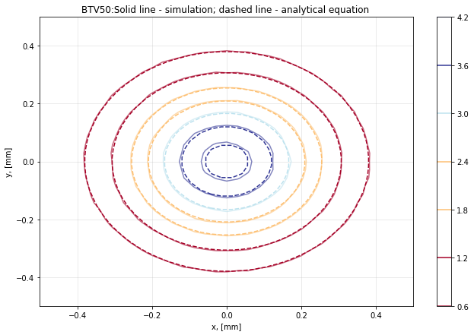
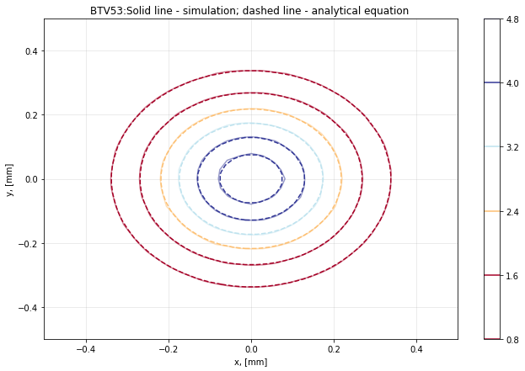
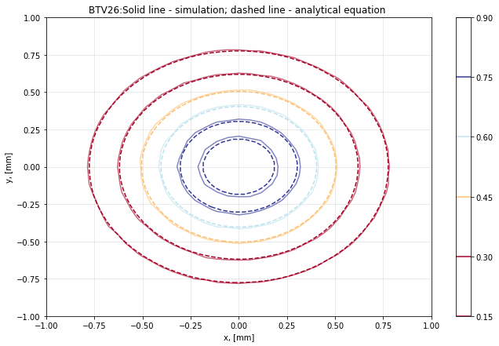
Particle Propagation Model
Envelope equation that describes evolution of $σ\left(s\right):$
Physical parameters:
${σ(s)}^{2}=σ_{0}^{2}−2 s_{waist}σ^{′2}s+σ^{′2}s^{2}$.
$$λ=\{σ_{x}, σ_{y},{σ′}_{x}, {σ′}_{y}, s_{waist}\}$$
Where $σ^{′}$ is the angular spread. Probability distribution of a proton bunch:
Nuisance parameters (alignments)
$P\left(x,y | σ\left(s\right), μ\right)=\frac{1}{2 πσ_{x}\left(s\right)σ_{y}\left(s\right)}e^{−\frac{{\left(x−μ_{x}\right)}^{2}}{2σ_{x}{\left(s\right)}^{2}}}{∙e}^{−\frac{{\left(y−μ_{y}\right)}^{2}}{2σ_{y}{\left(s\right)}^{2}}}$.
$$θ =\{μ_{1x},μ_{1y},μ_{2x},μ_{2y},μ_{3x},μ_{3y},μ_{4x},μ_{4y}\}$$

Slide 9
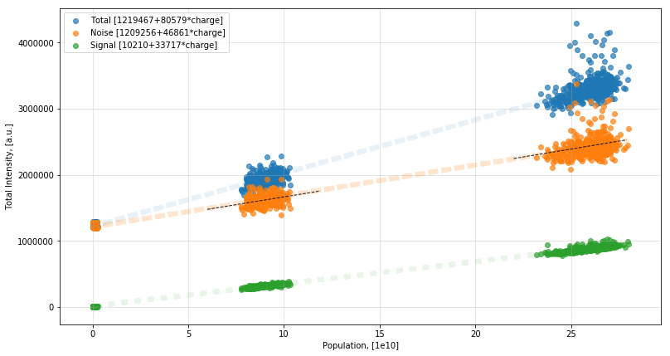
Preliminary analysis
Total intensity of the OTR light captured by the BTV camera depends linearly on the proton bunch population:
$$S\left(r,c\right)=N_{p}k\int_{A_{rc}}^{ }{P\left(x,y | σ\left(s\right), μ\right)⨂R(x,y)dx dy}$$
$N_{p}$ is a proton bunch population.
$k$ is a signal intensity factor.
$R(x,y)$ is a resolution function.
To be determined:
Noise distribution.
Resolution effects

Slide 10
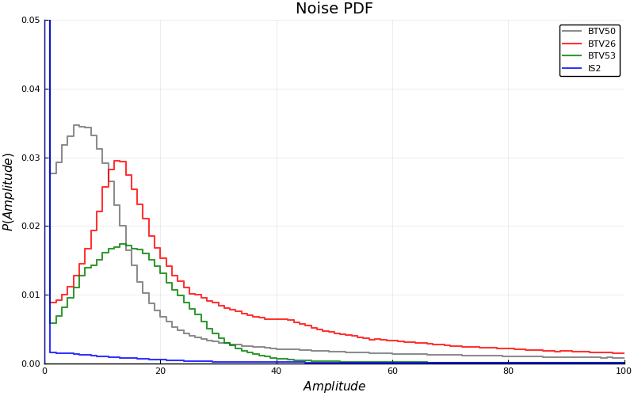
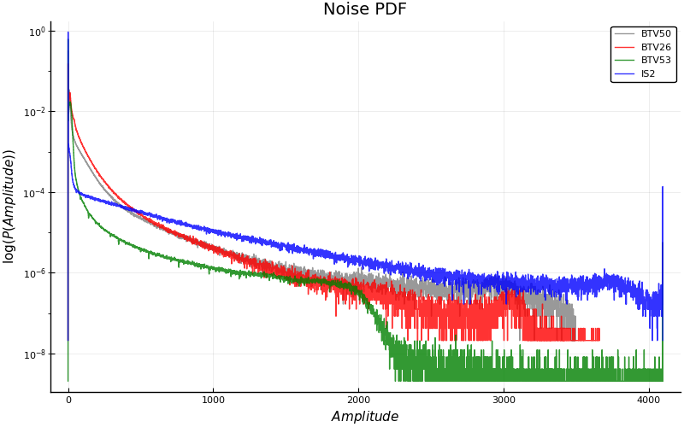
Noise Distribution
Noise distribution for a single pixel of the BTV50

Slide 11
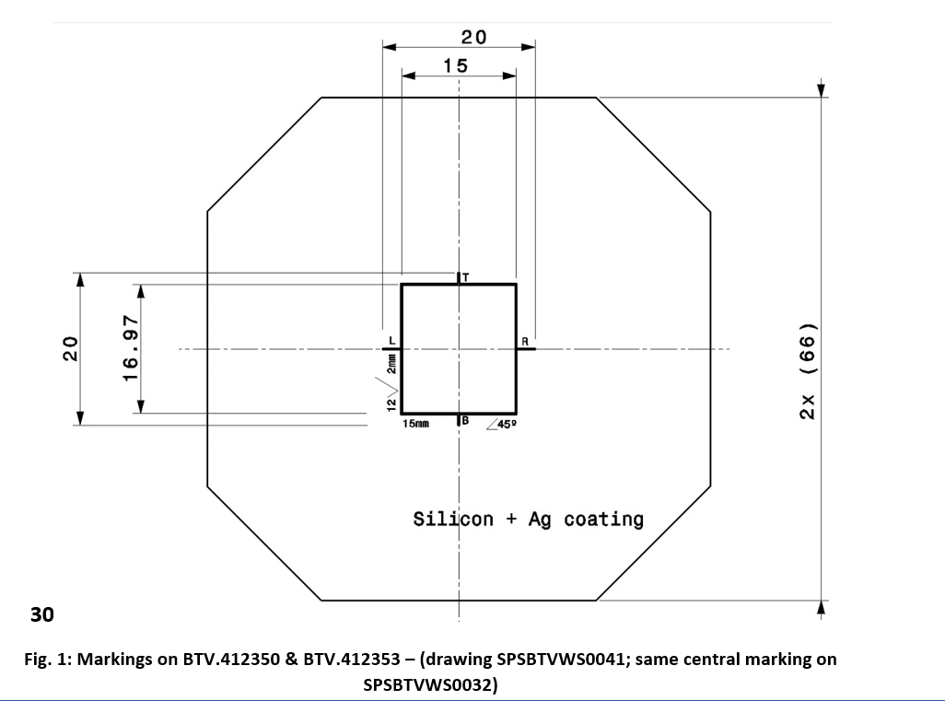
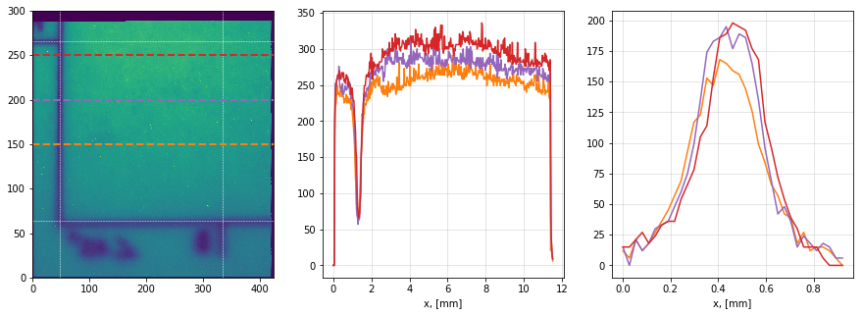
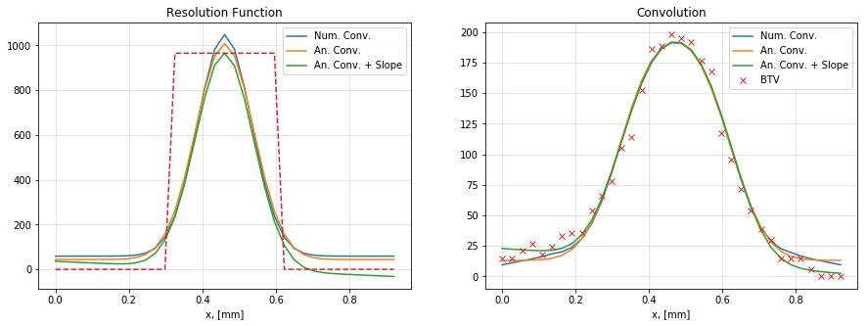
Resolution Function
A task to be solved
$$f_{resp}\left(x\right)= \int_{−∞}^{∞}{g_{res }\left(x−θ\right) f_{sign}\left(θ\right)dθ}$$
$g_{res }\left(x\right)$ is a resolution function.
$f_{sign}\left(x\right)$ is the original signal.
$f_{resp}\left(x\right)$ is a response of the camera.

Slide 12
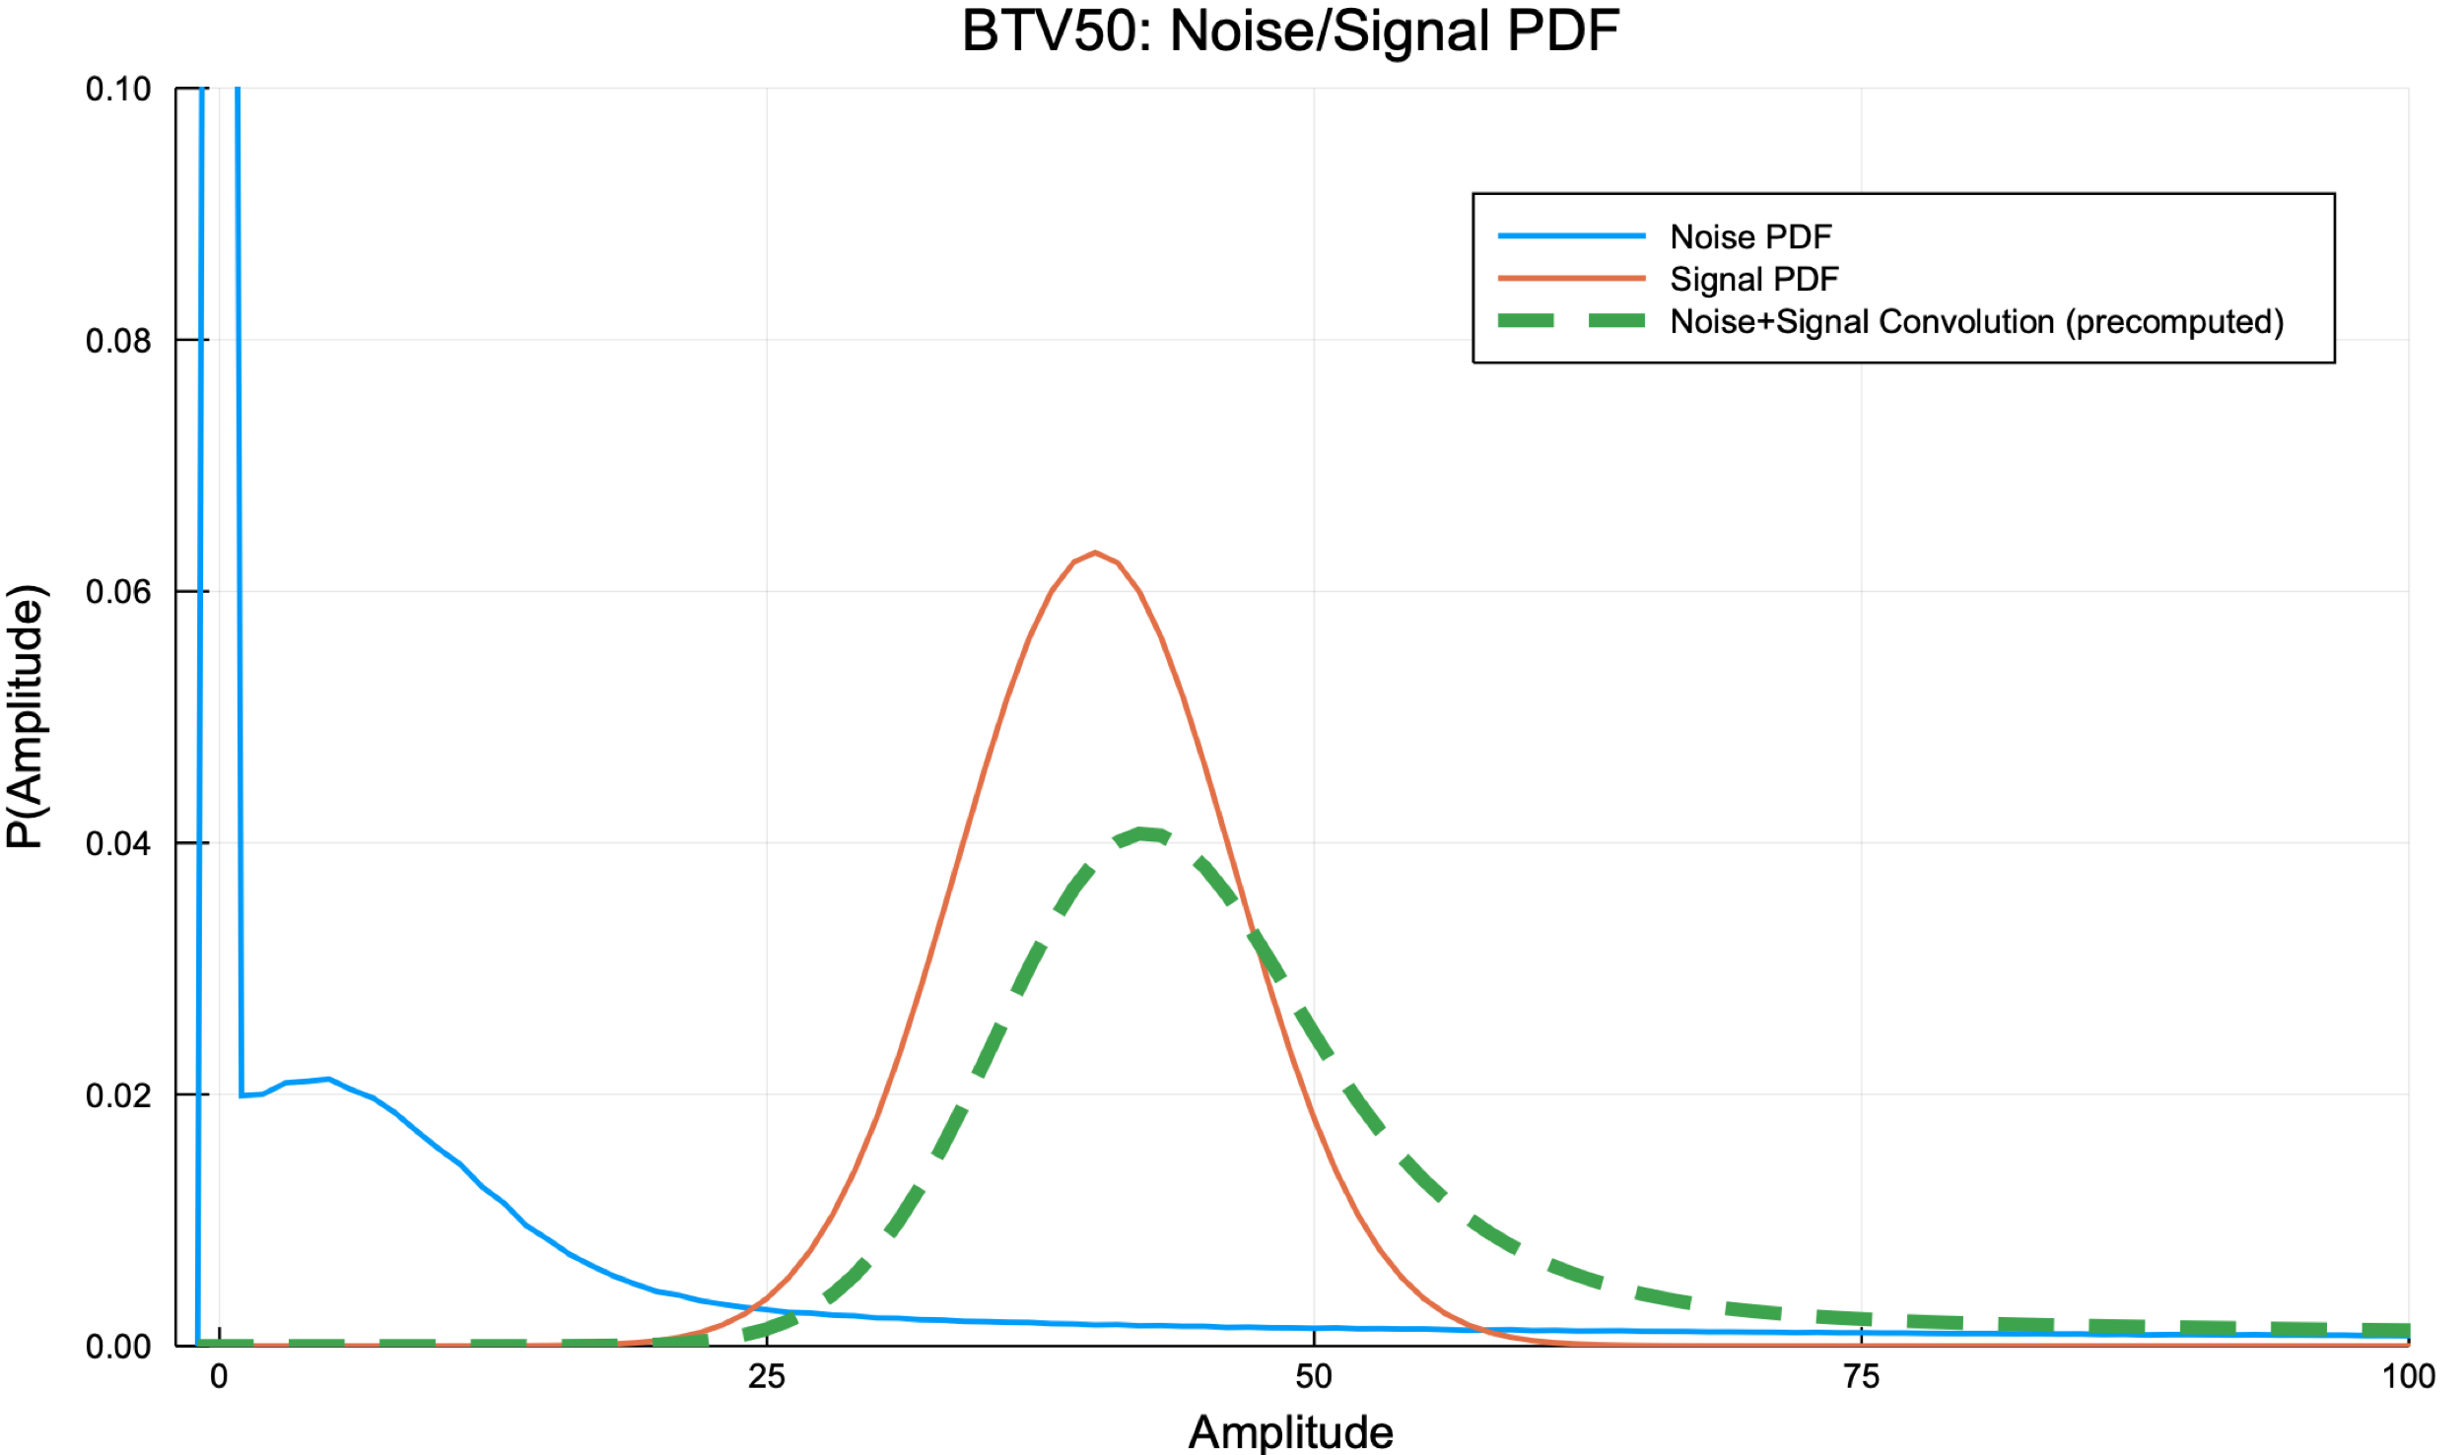
Likelihood Function
Assumption: Light fluctuations are Gaussian
$P_{l}\left(A | λ, θ\right)$ = $\frac{1}{\sqrt{2π} σ_{light}} e^{−\frac{1}{2}{\left(\frac{A−s\left(λ, θ\right)}{σ_{light}}\right)}^{2}}$
Where $σ_{light}=α\sqrt{s\left(λ, θ\right)} ,s\left(λ, θ\right)$ is an expected signal strength for the given r/c.
The likelihood function should return:
$$P\left(A | S(r,c), N(r,c)\right)=\int_{−∞}^{∞}{\frac{1}{\sqrt{2π} σ_{light}} e^{−\frac{1}{2}{\left(\frac{τ−s\left(λ, θ\right)}{σ_{light}}\right)}^{2}}N(τ−A)}dτ$$
Example: ${N\left(A\right), P}_{l}\left(A | s\left(λ, θ\right)=40\right)$ , $P\left(A | s(λ, θ)=40\right).$

Slide 13
Outline of the Presentation
Statistical analysis
Bayesian model
Noise & resolution effects
Serial MCMC sampling
Simulated events
Simulation results
Parallel MCMC sampling
Likelihood parallelization
Parameter space partitioning
AHMI algorithm
Preliminary results

Slide 14
Outline of the Presentation
Statistical analysis
Bayesian model
Noise & resolution effects
Serial MCMC sampling
Simulated events
Simulation results
Parallel MCMC sampling
Likelihood parallelization
Parameter space partitioning
AHMI algorithm
Preliminary results

Slide 15
Simulated Events
Experimental data
Let us generate a “fake” data with known parameters to test if MCMC is capable to reconstruct them. To do so, we need:
Determine contours of the probability distribution of protons at each screen.
Convert contours of the probability distribution into light intensity at each pixel.
Add resolution effects.
Add noise effects.
Simulated Event

Slide 16
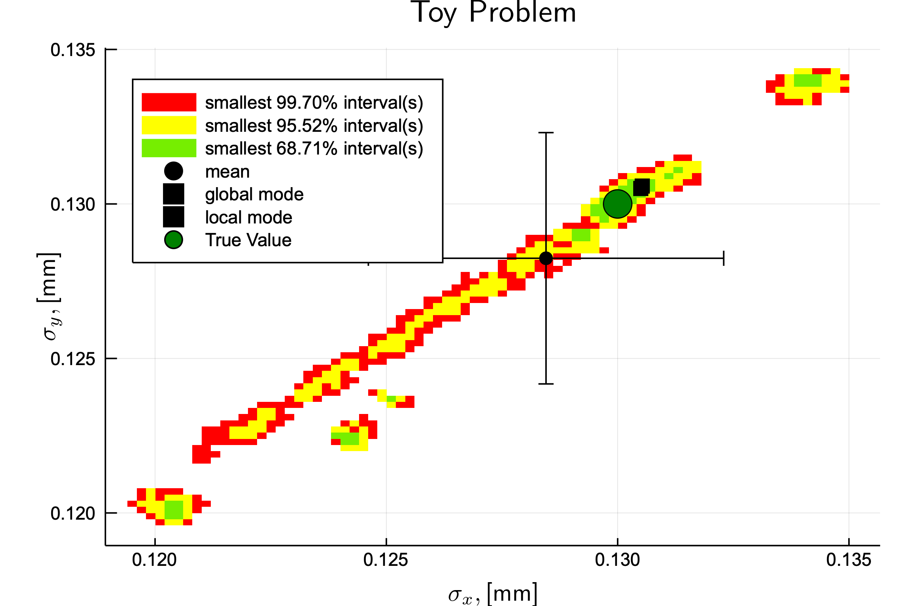
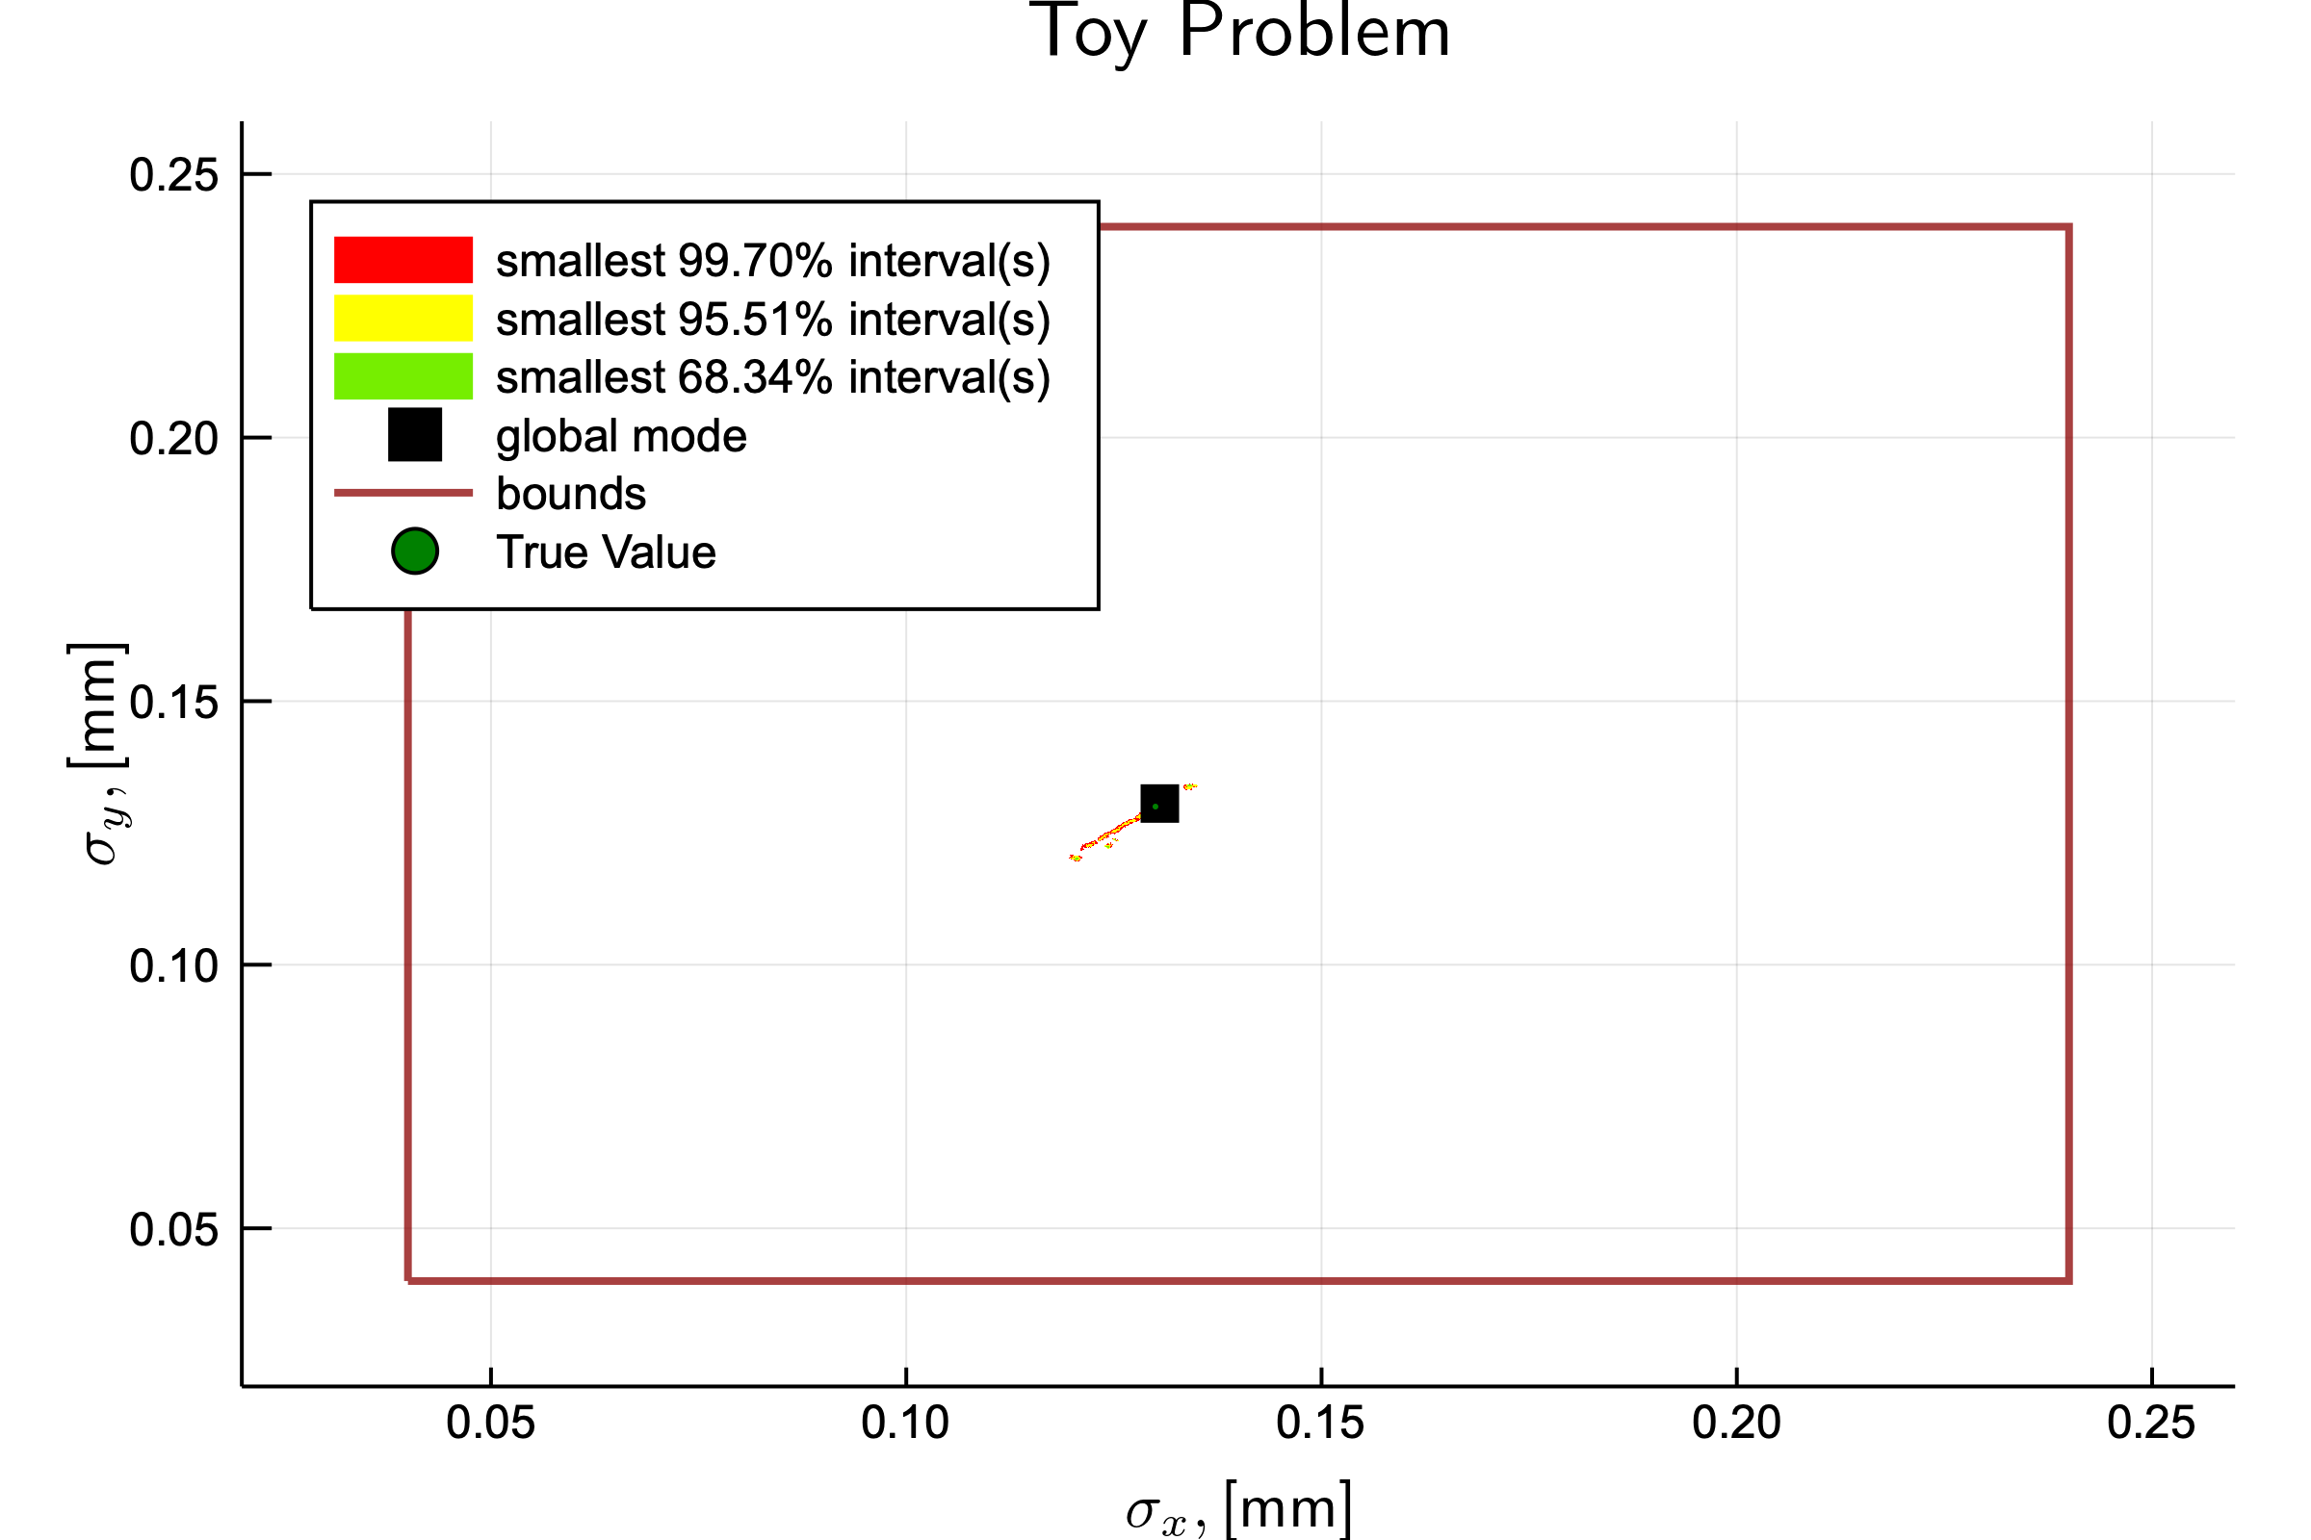
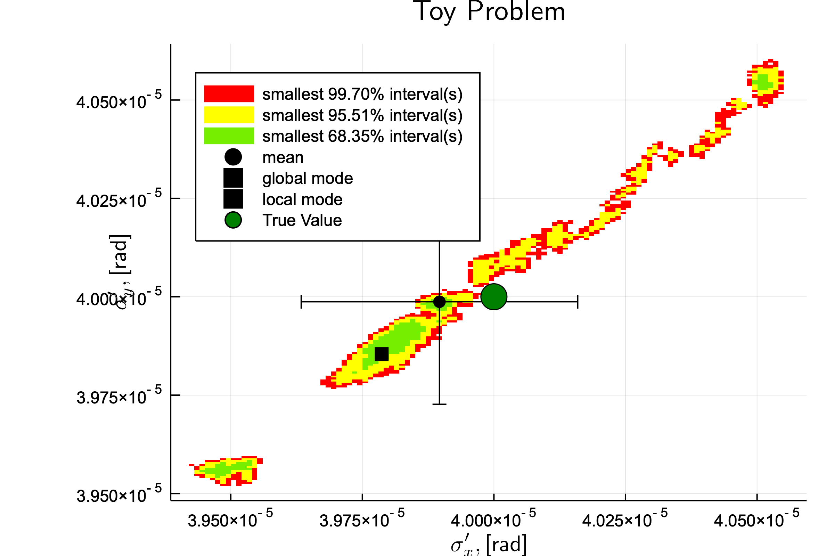
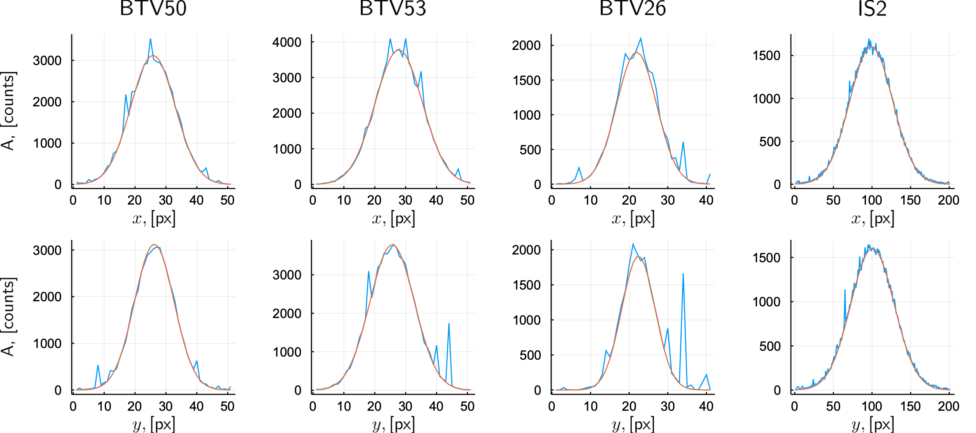
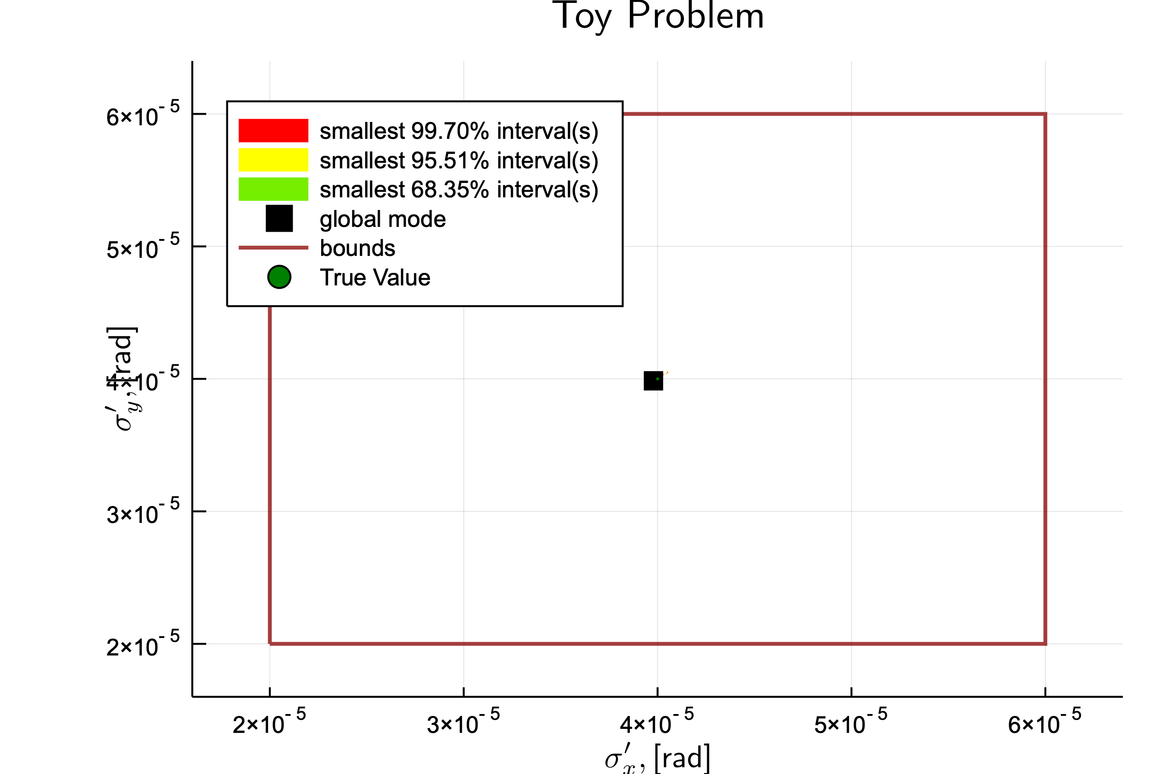
MCMC Analysis
MCMC analysis of the simulated data is performed by using BAT.jl [see details Julia, C++ ].

Slide 17
Outline of the Presentation
Statistical analysis
Bayesian model
Noise & resolution effects
Serial MCMC sampling
Simulated events
Simulation results
Parallel MCMC sampling
Likelihood parallelization
Parameter space partitioning
AHMI algorithm
Preliminary results

Slide 18
Outline of the Presentation
Statistical analysis
Bayesian model
Noise & resolution effects
Serial MCMC sampling
Simulated events
Simulation results
Parallel MCMC sampling
Likelihood parallelization
Parameter space partitioning
AHMI algorithm
Preliminary results

Slide 19
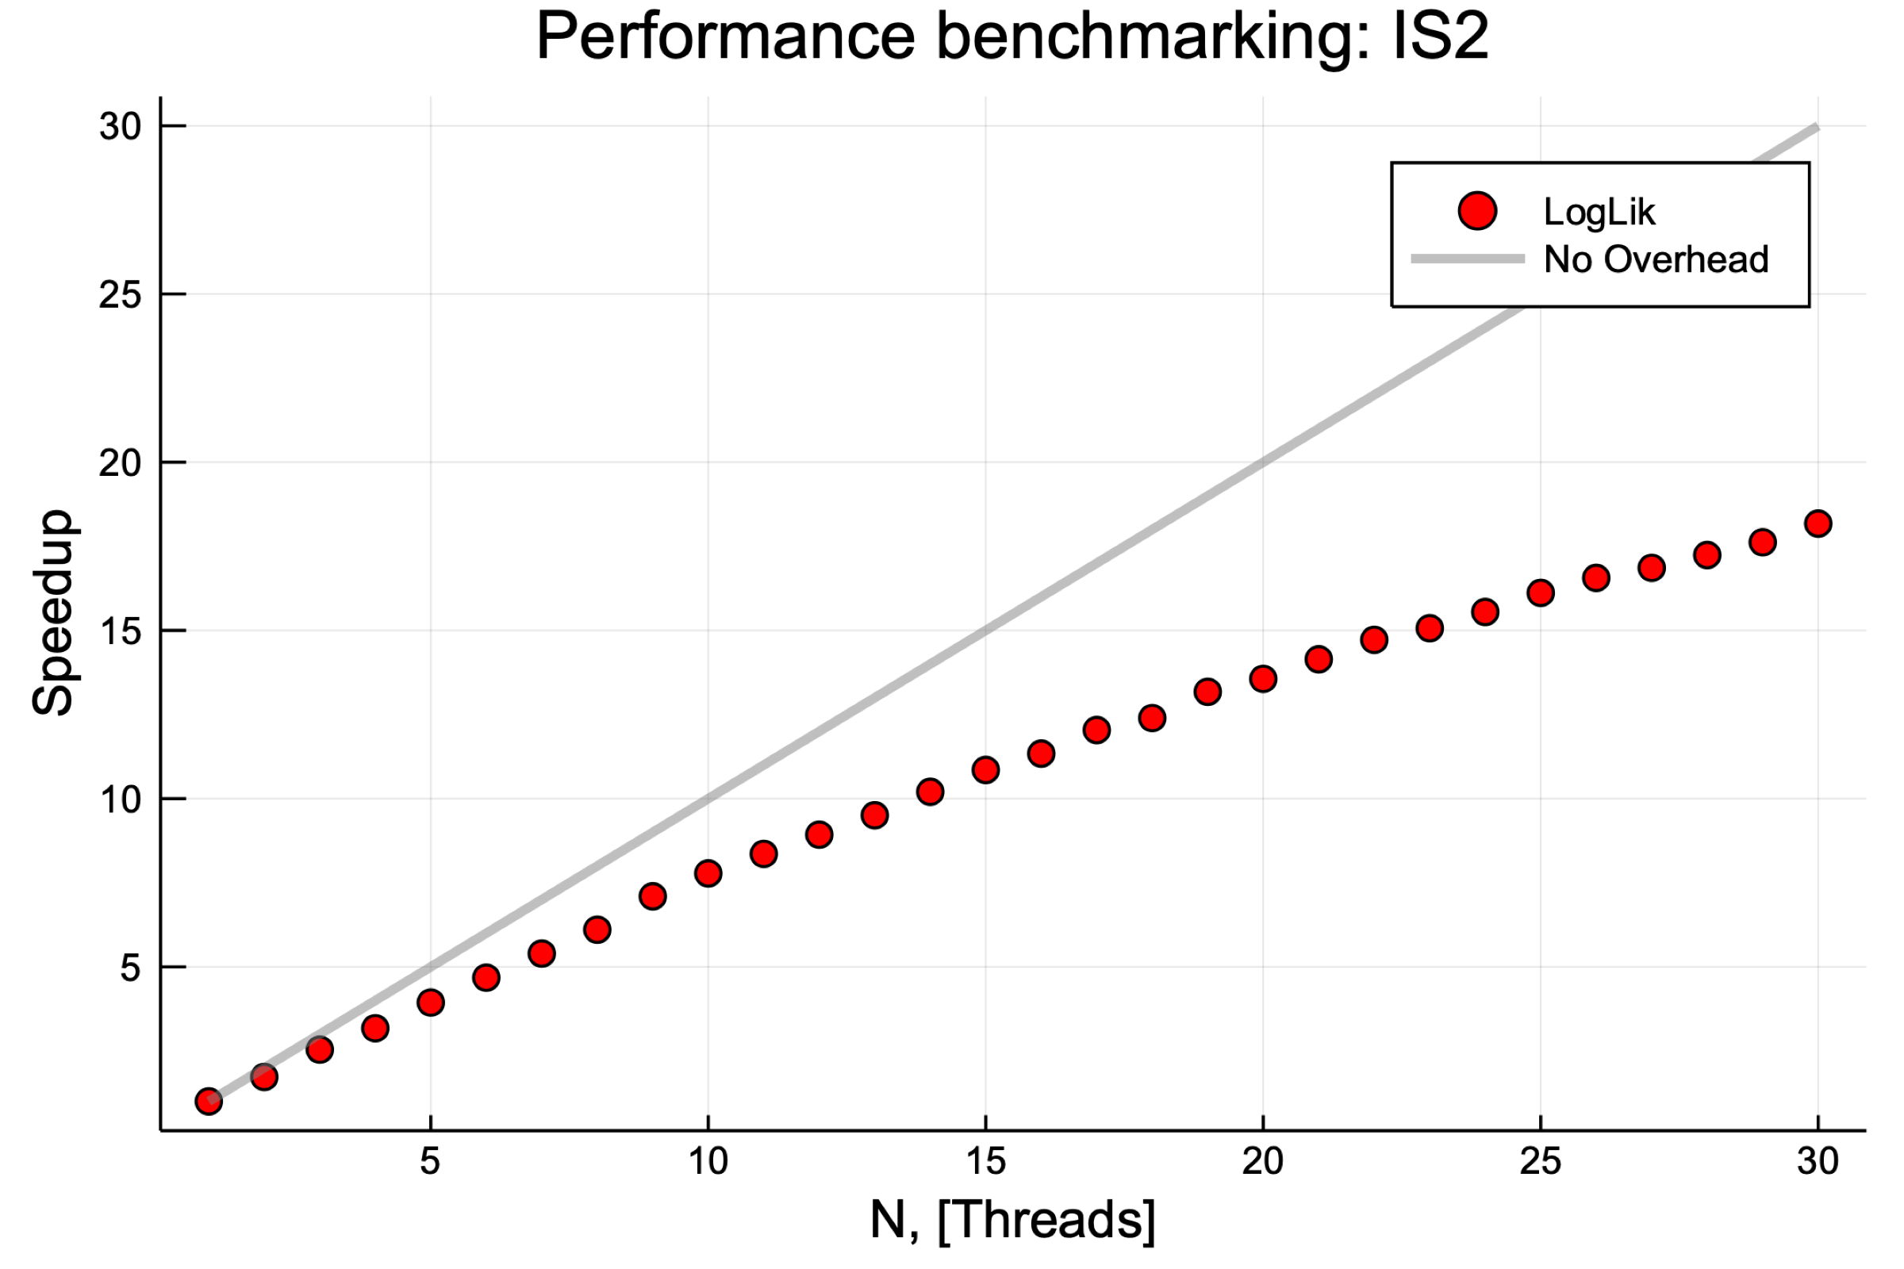
MCMC Parallelization
Step 1: Parallelize MCMC sampling using N threads for likelihood evaluation.
MCMC Chain
Thread #1
Thread #2
…
Thread #3
Thread #N
Likelihood Evaluation
The speedup is getting suppressed due to the overhead for a large number of threads. The limit of likelihood parallelization is reached, how to parallelize it further?
16 physical cores (32 logical) have been used

Slide 20
MCMC Parallelization
Step 2: Parallelize MCMC sampling using P nodes with N threads.
Comp. Node #1
Thread #1
Thread #2
…
Thread #3
MCMC Chain #1
Thread #N
Control Process
Thread #1
Comp. Node #2
Thread #2
…
Thread #3
Thread #N
Distributes work
Comp. Node #3
Thread #1
Thread #2
MCMC Chain #P
…
Thread #3
Running many MCMC chains is inefficient due to the long burn-in time.
How can one use many MPI processes without increasing number of chains?
…
Thread #N
Comp. Node #P
Thread #1
Thread #2
…
Thread #3
Thread #N
MPI processes are used to
sample different MCMC chains.
Thread-parallelization

Slide 21
MCMC Parallelization
Thread #1
Comp. Node #1
Subspace #1
Thread #2
Step 3: Parallelize MCMC sampling using P nodes, M subspaces and N threads.
Thread #3
…
Comp. Node #2
Subspace #2
Thread #N
Chain #1
Comp. Node #3
Subspace #3
Control Process
Comp. Node #4
Subspace #4
Comp. Node #5
Subspace #1
Distributes work
Chain #2
Comp. Node #6
Subspace #2
…
The AHMI technique should be used to reweight
samples obtained from the different subspaces
Comp. Node #P
Subspace #M
Chain #K
MPI processes are used to
sample different subspaces of MCMC chains
Thread-parallelization

Slide 22
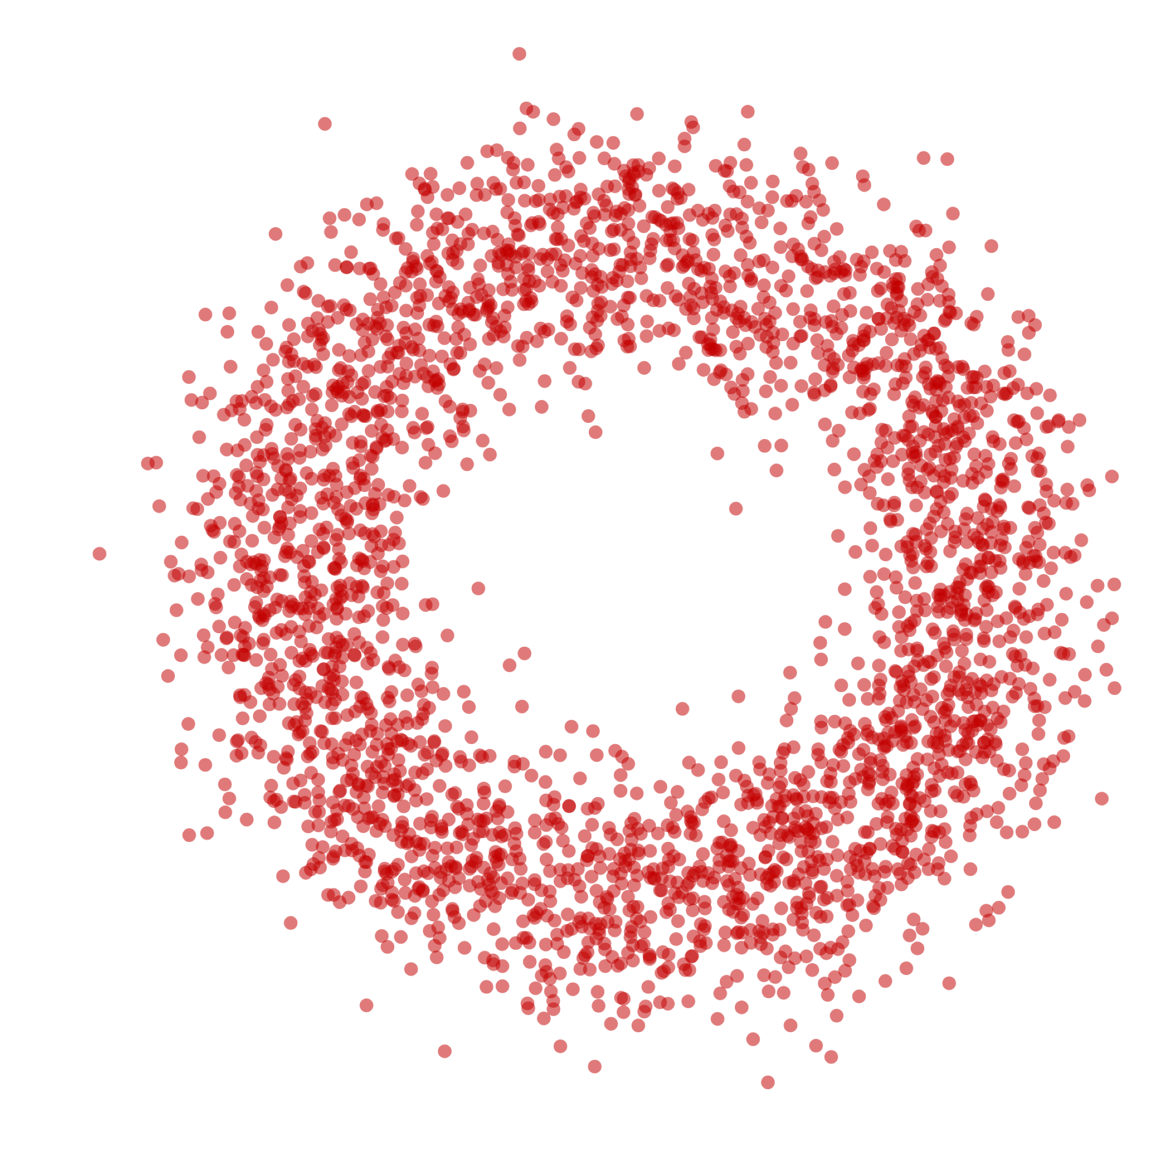
AHMI Algorithm
Samples from different subspaces can be reweighted by integrating over subspaces using Adaptive Harmonic Mean Algorithm (AHMI) [A.Caldwell, R.C. Schick, O.Schulz, M.Szalay arXiv:1808.08051] implemented in BAT.jl:
We are interested in solving
$$I=\int_{Ω}^{ }{f\left(λ\right)dλ},$$
where $f\left(λ\right)>0$ and $Ω$ is the support of the function.
$I_{∆}=\int_{∆}^{ }{f\left(λ\right)dλ}$
$$r=\frac{I_{∆}}{I},\hat{ r}= \frac{{\text{N}}_{∆}}{{\text{N}}_{Ω}}⟶I=I_{∆}∗\frac{1}{\hat{ r}}$$
Evaluating $I$ reduces to integrating the function $f\left(λ\right)$ over a well-chosen region $∆∈Ω$ around local modes, and multiplying the integral with $1/\hat{ r}$.
$$Ω, I$$
$$∆,I_{∆}$$

Slide 23
AHMI Algorithm
Samples from different subspaces can be reweighted by integrating over subspaces using Adaptive Harmonic Mean Algorithm (AHMI) [A.Caldwell, R.C. Schick, O.Schulz, M.Szalay arXiv:1808.08051] implemented in BAT.jl:
Integrals $I_{∆}$ can be computed by using harmonic mean estimate, where $∆$ is selected in such a way that variance is bounded
$$E{\left[\frac{1}{f\left(λ\right)}\right]}_{{\hat{f}}_{∆}\left(λ\right)}=\int_{∆}^{ }{\frac{1}{f\left(λ\right)}\frac{f\left(λ\right)}{I_{∆}}dλ}=\frac{V_{∆}}{I_{∆}} → {\hat{I}}_{∆ }=\frac{f_{min}{\text{N}}_{∆}V_{∆}}{\sum_{Λ_{i}ε∆}^{ }{\frac{f_{min}}{f(Λ_{i})}}}$$
Estimator for the integral of interest
$${\hat{I}}_{ }=\frac{f_{min}{\text{N}}_{Ω}V_{∆}}{\sum_{Λ_{i}ε∆}^{ }{\frac{f_{min}}{f(Λ_{i})}}}$$
$$Ω, I$$
$$∆,I_{∆}$$

Slide 24
AHMI Algorithm
Samples from different subspaces can be reweighted by integrating over subspaces using Adaptive Harmonic Mean Algorithm (AHMI) [A.Caldwell, R.C. Schick, O.Schulz, M.Szalay arXiv:1808.08051] implemented in BAT.jl:
$${\hat{I}}_{ }=\frac{f_{min}{\text{N}}_{Ω}V_{∆}}{\sum_{Λ_{i}ε∆}^{ }{\frac{f_{min}}{f(Λ_{i})}}}$$
$$I_{1}=I_{∆1}∗\frac{1}{\hat{ r_{1}}}$$
$$I_{2}=I_{∆2}∗\frac{1}{\hat{ r_{2}}}$$
…
$$I_{k}=I_{∆k}∗\frac{1}{\hat{ r_{k}}}$$
$$Ω, I$$
$$∆_{1},I_{∆1}$$
$$∆_{k},I_{∆k}$$
$$∆_{2},I_{∆2}$$

Slide 25
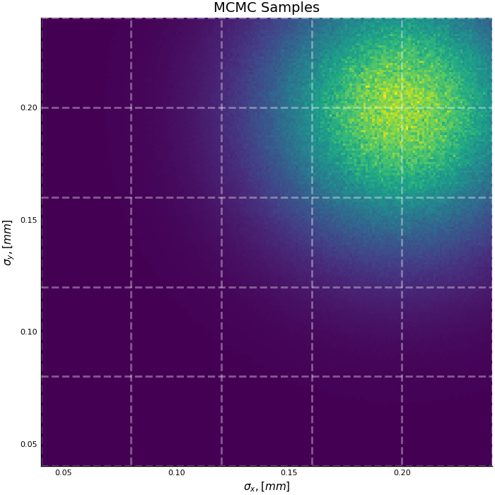
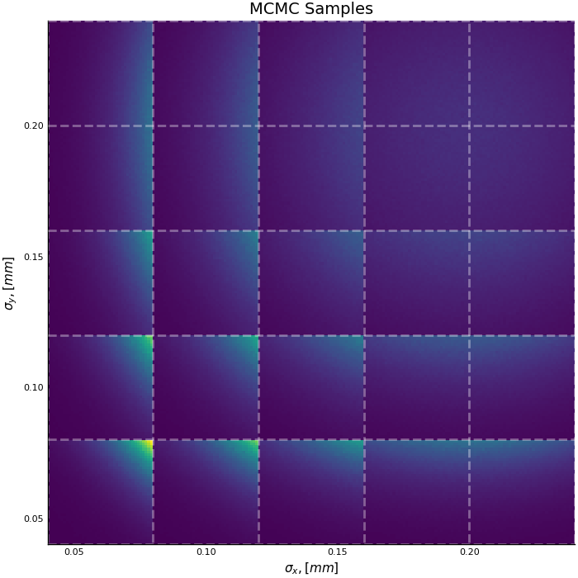
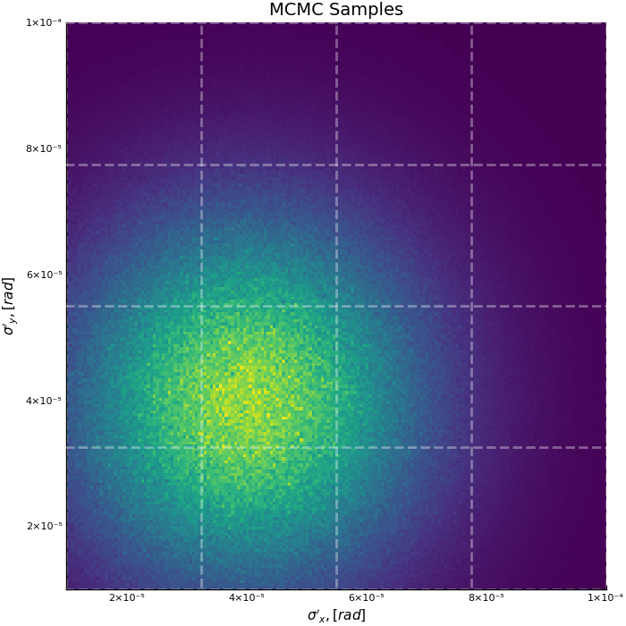
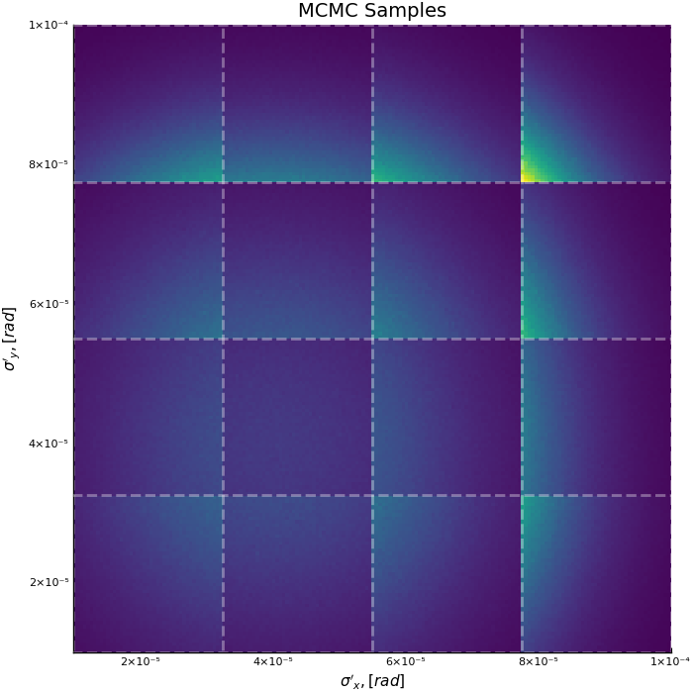
MCMC Parallelization
Parallelization example for 13D Gaussian distribution:
$$P_{0}\left(λ\right) \sim \prod_{i=1…13}^{ }{e^{−\frac{{\left(λ_{i}−λ_{i0}\right)}^{2}}{2σ_{i}^{2}}}}$$
Divide parameter space by 1200 (5*5*4*4*3) subspaces.
Perform MCMC sampling at each subspace (in parallel) using equal number of samples.
Compute AHMI integral at each subspace (in parallel).
Reweight samples.

Slide 26
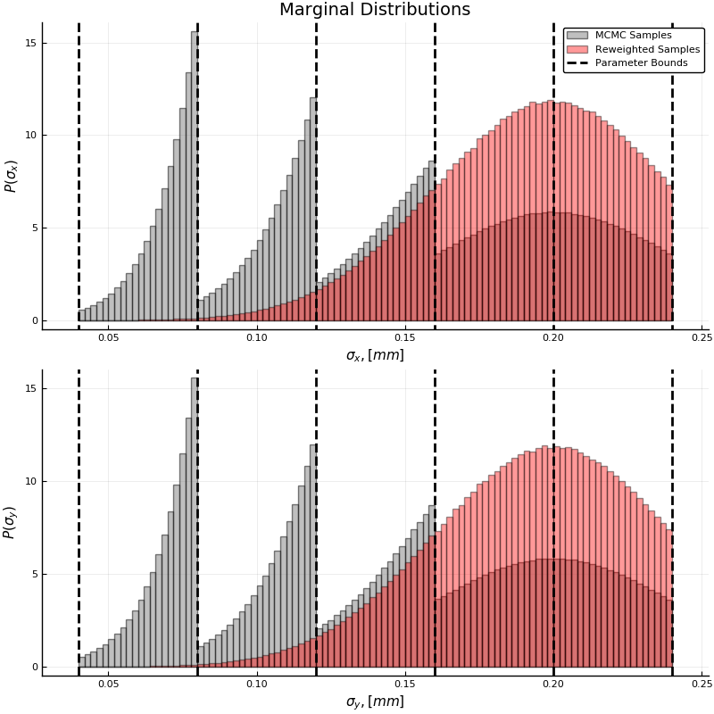
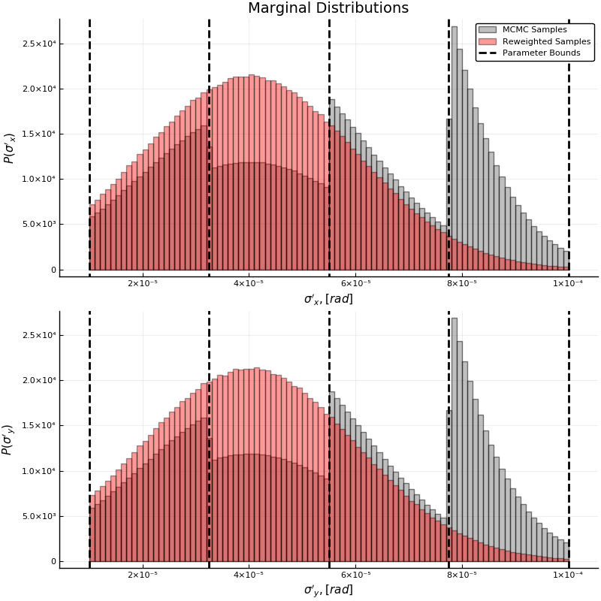
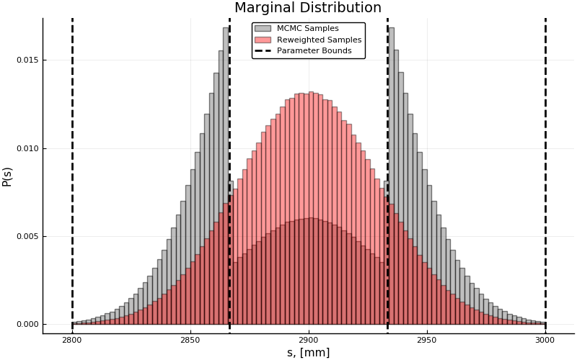
MCMC Parallelization
Parallelization example for 13D Gaussian distribution:

Slide 27
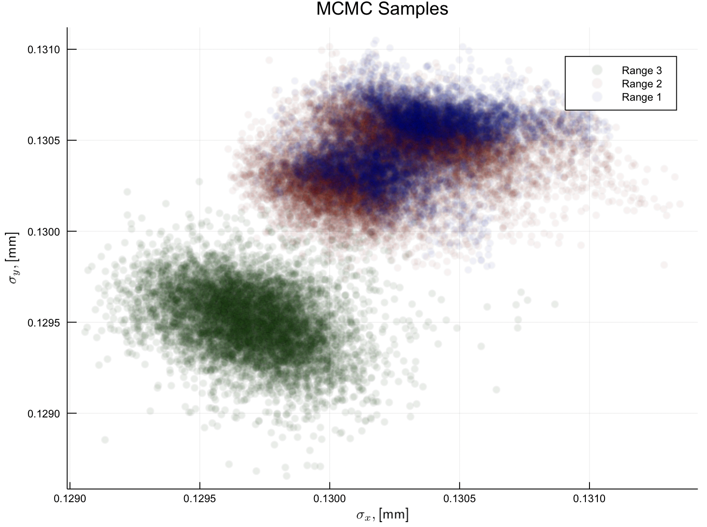
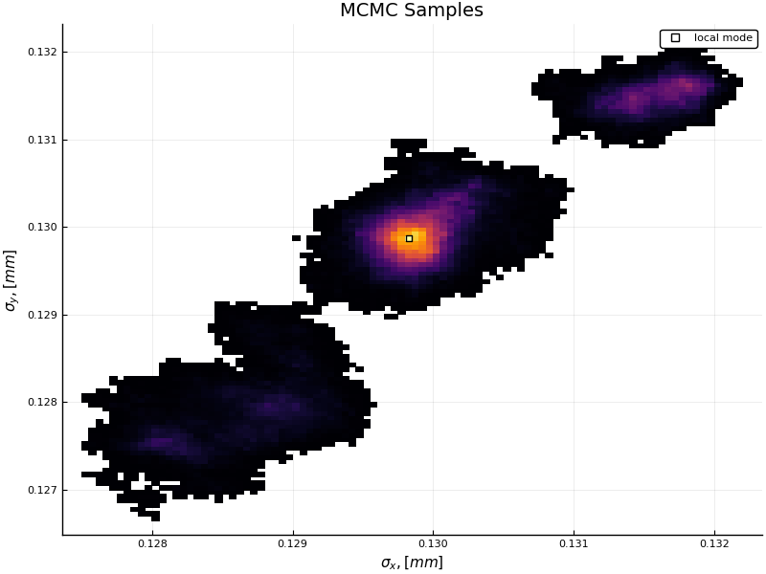
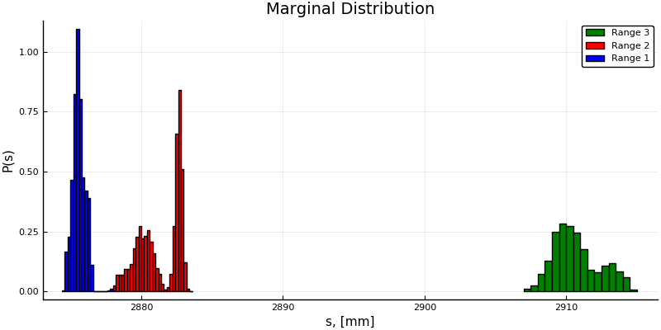
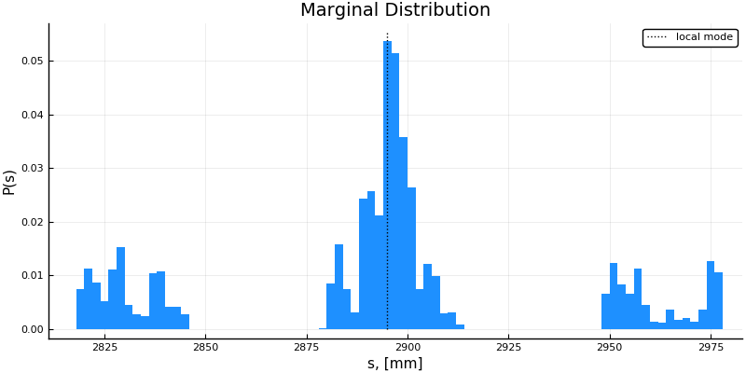
MCMC Parallelization
Simulated event analysis (in progress): Divide waist position by multiple regions and compute normalization integrals at each slice:
Subspace #3
Subspace #2
Subspace #1

Slide 28
Summary
Milestones:
It has been demonstrated that noise and resolution effects introduce important correction to the proton bunch parameters and MCMC simulations allows determining them.
Serial MCMC sampling is very time-consuming.
It has been demonstrated that the AHMI integration algorithm allows normalizing correctly samples in 13D parameter space (for normal distribution) and this technique can be used to parallelize MCMC sampling by partitioning parameter space.
Further plans:
Test parallelization algorithm by using the full likelihood (include all cameras).
Develop an algorithm to partition efficiently parameter space.

Slide 29
Acknowledgments
Project supervisor: Allen Caldwell
C2PAP supervisor: Jovan Mitrevski
Co-Supervisor: Oliver Schulz
Members of the AWAKE & C2PAP.
This project has received funding from the European Union’s Framework Programme for Research and Innovation Horizon 2020 (2014-2020) under the Marie Sklodowska-Curie Grant Agreement No.765710.

Slide 30
Thank You for Your Attention

