Slide 1


Progress toward a FBG Monitor for PXD
DEPFET Workshop, Prague 27th January 2010
Iván Vila Álvarez
Instituto de Física de Cantabria [CSIC-UC]

Slide 2
Caveat
Third Talk on Bragg Grating Fiber Optic Sensors
Not going to reiterate the goodness and working principle of the technology.
Here, I will point out which are the FBG sensors weak points with respect to the HEP applications, please do not get scared !

Slide 3
Outline
R&D on Fiber Optics Sensors for HEP.
  Reliability and response reproducibility (T,ε).
  Embedding and bonding of the sensors.
  Radiation resistance.
  A displacement sensor base on FBG

Slide 4
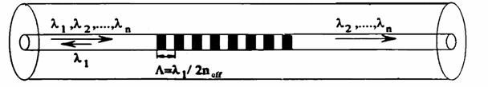
R&D targets: Sensor reliability
Stability of the FBG FOS response write in a bare fiber (same response under same conditions T, ε)
Bragg Grating
TEMPERATURE CHANGE
Selective narrow
band mirror
Thermal expansion for
Termo-optic effect for
STRESS
Depends on refraction Index and geometry stability
Elasto-optic effect for
Direct Strain for

Slide 5
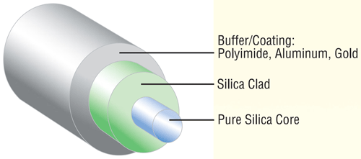
R&D targets: Sensor reliability
“Bare” Optical Fibers are quite inhomogeneous
Many coating available:
Acriyate, polyimide, ormocer, metalic, …
External agents can induce changes of the mechanical properties of the fiber materials (young, poisson parameters) ⇒ Λ changes
Others (radiation) can also induce changes in n

Slide 6
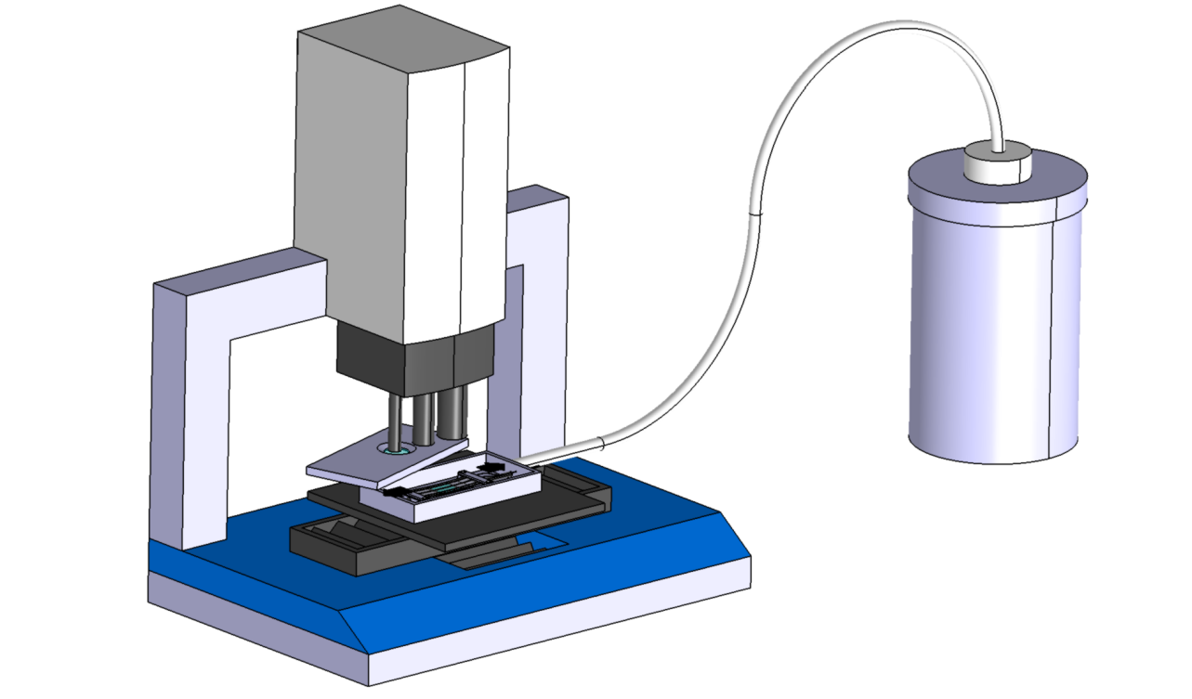
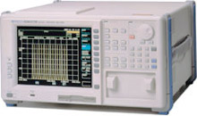
R&D Targets: Test Setup (1)
Calibration of bare fibers with different coattings (acrylate, polyimide, ormocer) and without coattings.
Confocal profile meter
15nm resolution with
3mm range
(Installed Dec ‘09)
Nitrogen Dewar (Feb ‘10)
Miniclimatic chamber Temp range (-196 to 350 deg) +-0.2 deg.
with optical window
Contains the FBG FOS
(Feb ‘10)
Interrogating unit (March ‘10)

Slide 7
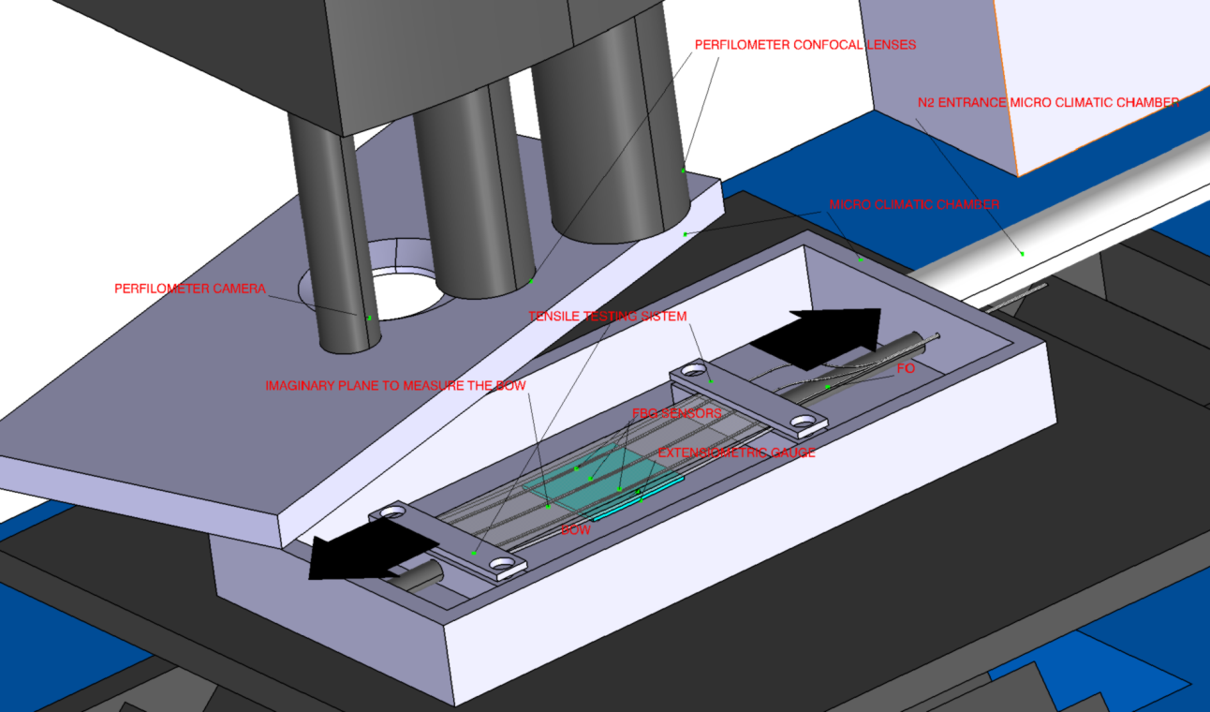
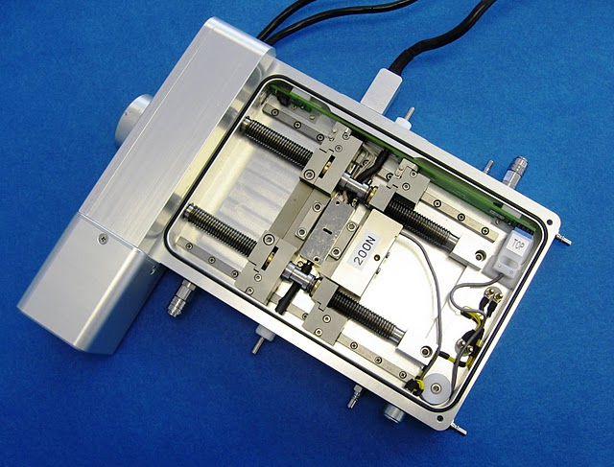
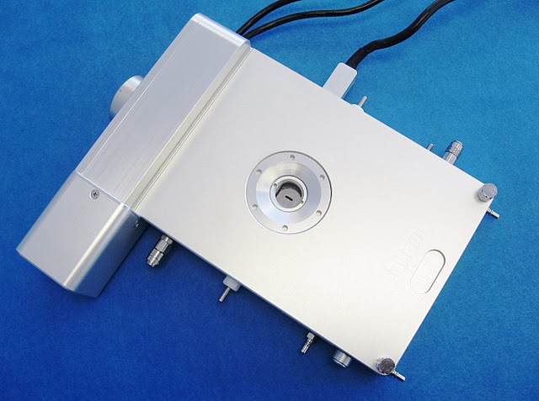
R&D Targets: test setup (2)
Redundant calibration:
Reference T and ε sensors.
Tensile testing system and confocal profile meter

Slide 8
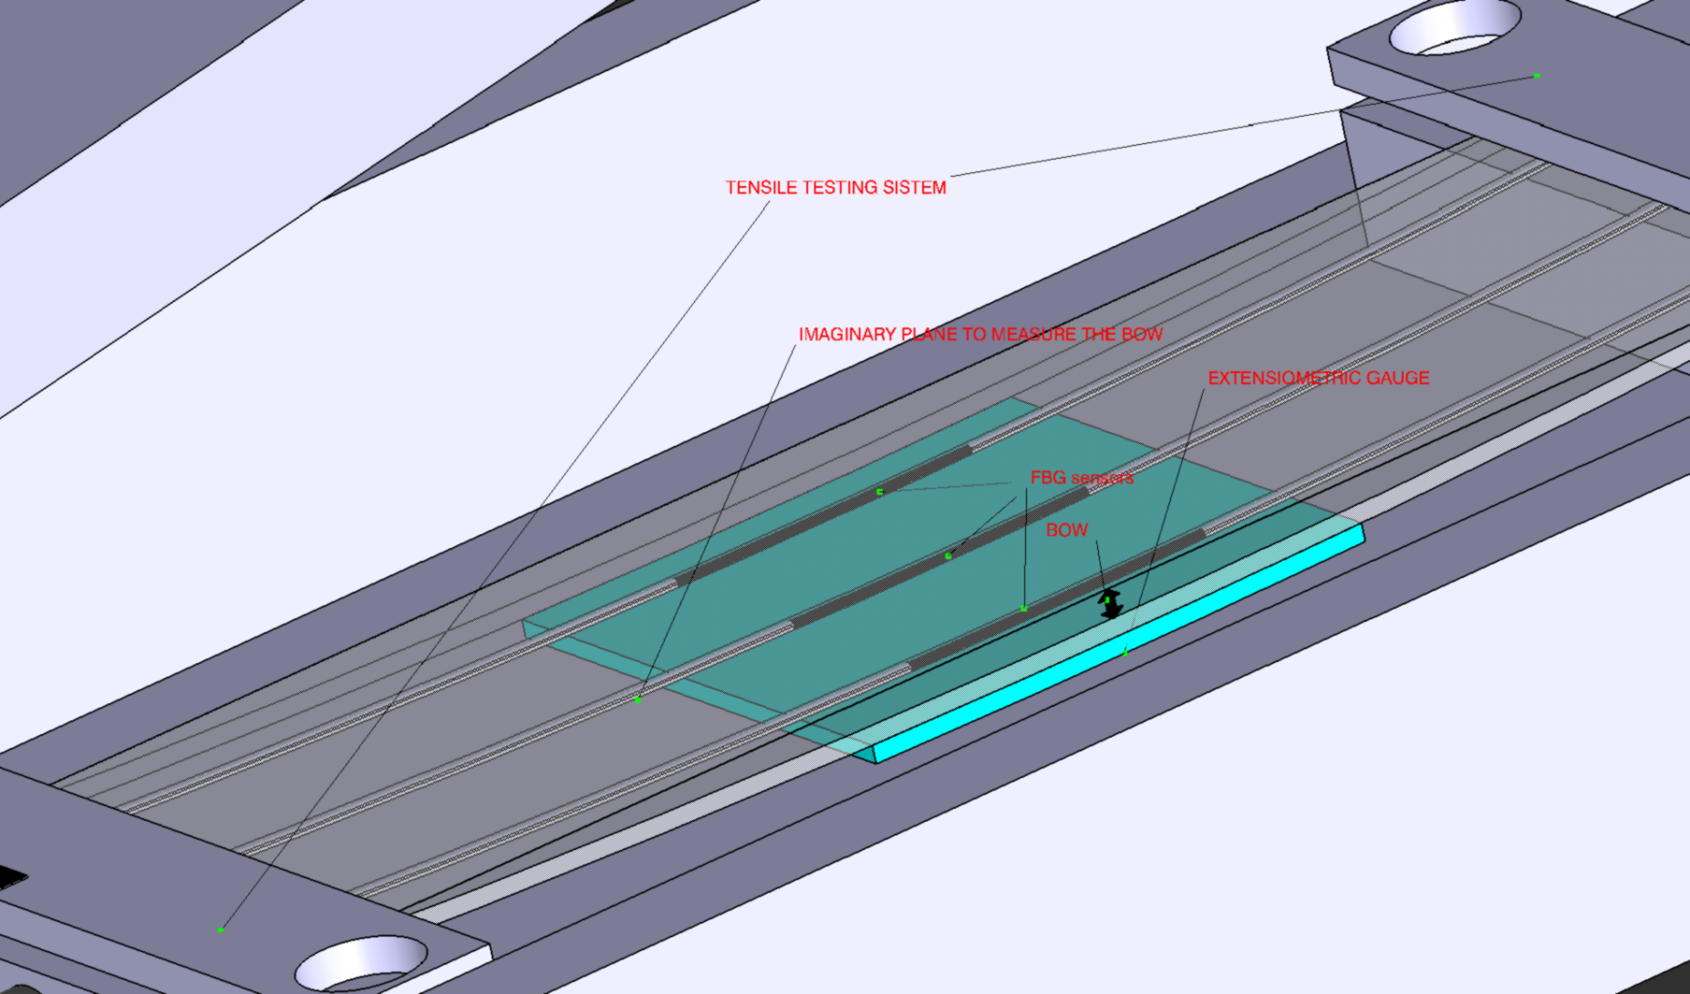
R&D Targets: Test setup (3)

Slide 9
FBG direct bonding to DEPFET frame
Direct monitoring temp. & deformation of sensor
“Easy” solution gluing the Optical fiber (good for temperature monitoring )
Glue act as a mechanical interface, BUT glue may age, change its mechanical properties ⇒ change in the FBG sensor sensitivity
Second approach micro-mechanical fixation elements in Silicon

Slide 10



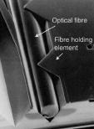
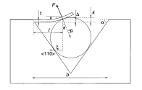
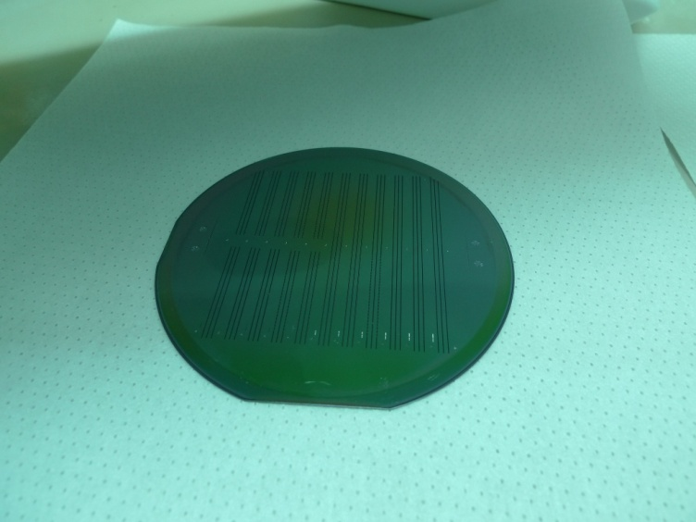

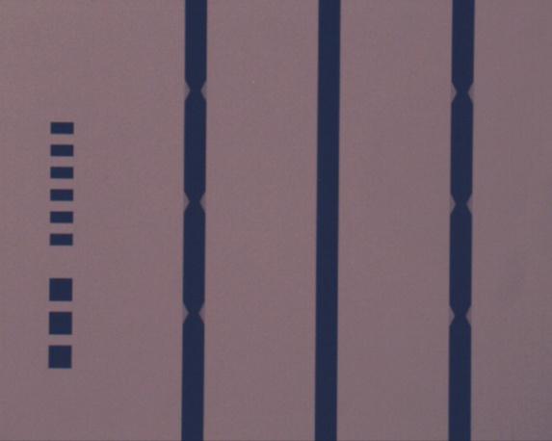
Sensors attachment to Silicon
Which fixation is the best ?
Multi-groove wafer produced(CNM, HEPHY)

Slide 11
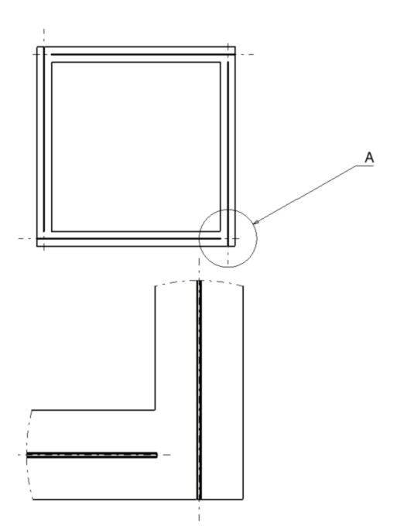
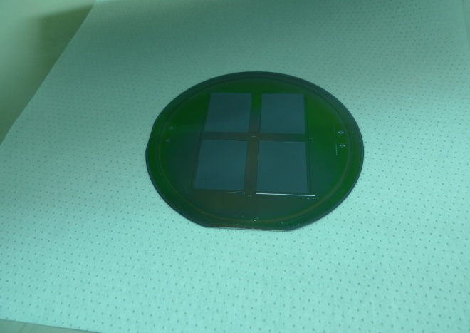
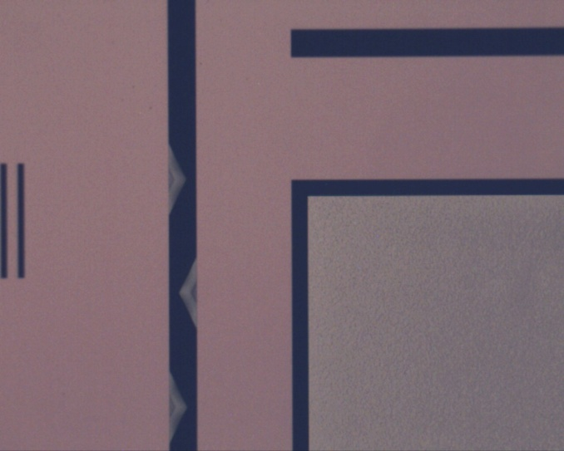
Thin Sensor mechanical dummies
Thinned (100, 150, 200 um) sensor mechanical dummies.
Thin area
Frame
Exp. validation of FEA simulations.
Conventional KOH anisotropic etching on SOI wafer.
Microgroove

Slide 12
Embedding in CF composites (or other materials)
When embedding the FBG sensor in material (CF laminate) new issues arise because of the different effect of external agents (like radiation) in thermal expansion coefficient of the host material and the optical fiber.
Temperature variations can be expressed in terms of equivalent strain (ε_{T})
FBG Sensor radiation resistance does not guaranty the “resistance” of the embedded sensor
α_{H} : Host material temperature expansion coefficient
α_{F} : Fiber material temperature expansion coefficient

Slide 13

Embedding on CF composites
Joint project with Spanish Aerospace Agency (INTA)
Initial step: irradiation of embedded fibers with different coatings (required to increase the mechanical resistance of the non-coated bare fiber)
Small samples 15x3x3 mm³ of composite laminates with different stack configurations with and without optical fiber embedded in preparation
Nano-indentation characterization of the different components of the samples (coating, cladding) and composite matrix for extracting the mechanical parameters: poisson, young, …

Slide 14
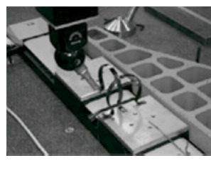
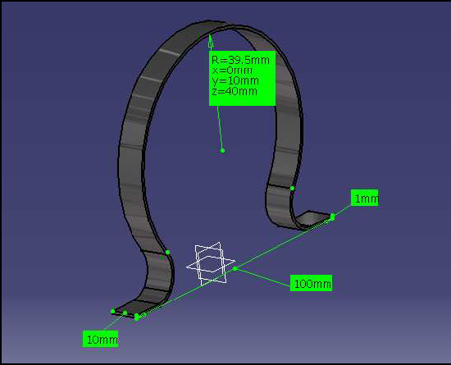
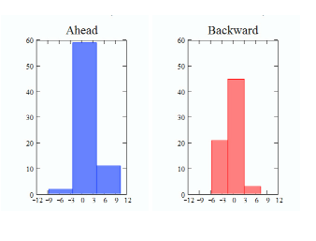
Displacement sensors based on strain FBG
Original idea from the late BTeV vertex detector: “ The omega-like gauge”
Mechanical displacement range adapter.
STRAIN FBG SENSOR ON THE TIP
Temperature
Compensating
“omega”

Slide 15
Displacement sensors based on strain FBG
Improvement paths:
  Adjust the mechanical design to our displacement range.
  Embedding of the fiber, avoid glues.
  Integrate the temperature compensation of FBG
  Now first toy montecarlos.

Slide 16
Short term plans
Working together with the thermo-mechanical group on a strawman design for a temperature and position monitor for the PXD
Use FBG in the Valencia thermal test stand.
Expect first results concerning the FBG sensors calibrations (reliability studies) in the 3QT of 2010.
By the end of the year characterization of the fiber materials and embedded fibers in Carbon Fiber composites.
Design of displacement FBG sensors by the end of the year.

Slide 17
Summary
Temperature monitor: having a system with many distributed measurement points supported by a single fiber is essentially already available.
Deformation and displacement monitoring requires much work.
Good news is that a community of interested experimental HEP group is been created around this technology aiming to extend also the scope of the technology: CO₂, Humidity, O₂, magnetic field ⇒ 22nd December EU F7 proposal filed FOS4HEP

Slide 18
BACKUP

Slide 19
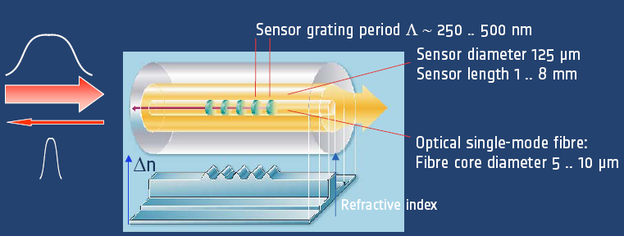
Bragg grating sensors basics
Fiber Bragg Grating optical transducer

Slide 20
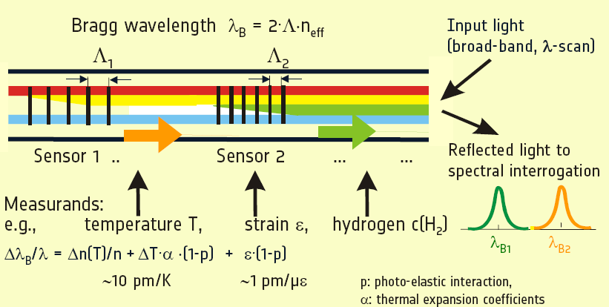
Multiplexing Bragg grating

Slide 21
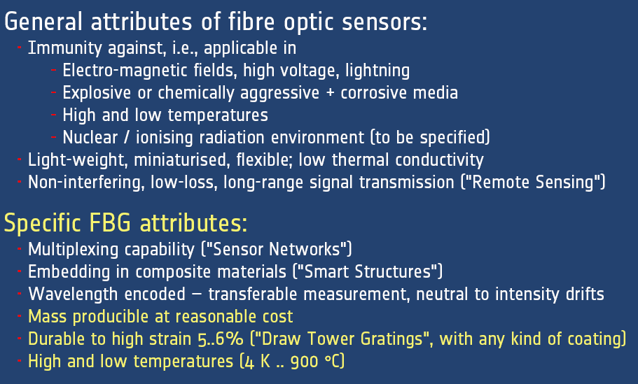
OFS & FBG advantages

Slide 22
IR-Transparent sensors
See Marcos Fernandez talk
Test Beam last August with “alignment HPK sensors” (Jointly with HEPHY)
PLANS
  Sensors almost finished, last passivation layer.
  Electric characterization of each geometry and layout.
  Optical characterization with laser.
  Response characterization with laser and Sr-90 source.
  R/O with ALIVABA system (pitch adaptor and sensor boards to be produced soon)
  Irradiation.

Slide 23
Thin ustrips
PROCEDURE: SOI n-type wafers + deep anisotropic etching. (already in house)
GOALS:
  Establish handling procedure for thin sensors.
  Mechanical characterization of thinned sensors (150, 200 & 250 um thick + 300um frame)
  quantitative study of the effect of passivation layer on sensor deformation (FEA).
  Evaluation of Integrated Pitch Adapter and DML readout
  Integration of fiber optics sensors on silicon

Slide 24
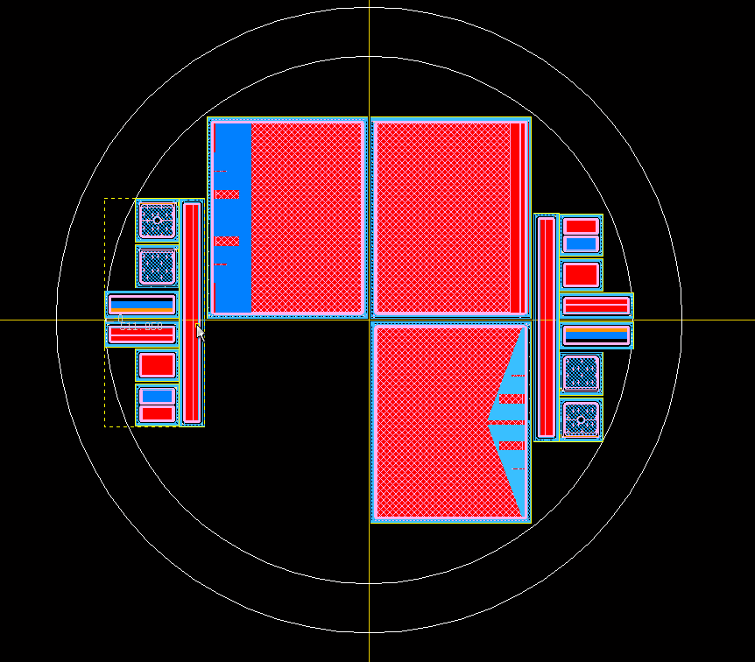
Thin ustrips (2)
WORK Sequence:
  (OCT’ 09) MECHANICAL DUMMIES & multi-groove wafer structures.
    Exp. validation of FEA simulations.
    Fiber Optic Sensor insertion test on silicon.
  (NOV ‘09) PRODUCTION FULL FLEDGED SENSORS: Standard, DML, Integrated pitch adapter, PolySi electrodes.

Slide 25
Structural & Enviromental Monitoring - OFS
Well know monitoring technologies in aeronautics and civil works based on optical fiber sensors (OFS)
Distributed strain & temperature sensors are conventionally used for structure health monitoring : SMART structures
Other OFS: dosimetry, humidity, B field, acceleration, etc.
In aeronautics (embedded or bonded) on the of the CFRP composite ( for instance, plane radar redome)

Slide 26
Deformation monitoring with FBG sensors
Diffracted wavelength depends on FBG geometry, that is affected by stress and temperature.
Typical values:
Δσ = 1-0.1με ⇨ Δλ = 1pm
SMART MECHANICS FOR SILICON TRACKERS

Slide 27
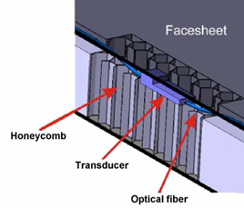
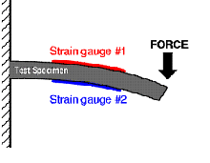
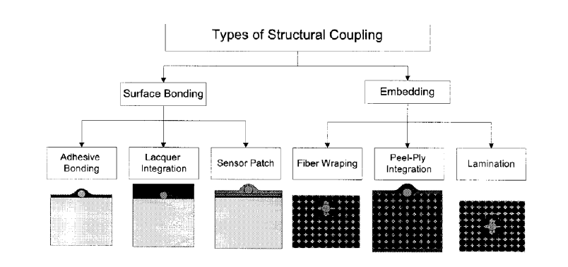
Integrating OFS & carbon fiber composites
For the Track structure would be interesting to use a embedded fiber optic sensor.
  more precise and reliable data
It could be use 2 side solution
  Better understanding of the results
  Useful to quantify the thermal strain

Slide 28
OFS work plan – Integration on CF
Currently working collaboration agreement with Spanish Aerospace Agency (INTA) for a two year period.
The preliminary plan includes:
  Complete the market survey.
  Proposal of fiber routing for CMS upgraded tracker
  Testing of standalone fibers (irradiation).
  CF test structures with bonded or embedded fibers.
  Mechanical expansion and compression test under several thermal and humidity conditions.
  Experimental validation of OFS vs. electrical expansion gauges.
  Comparison with FEA simulations

Slide 29
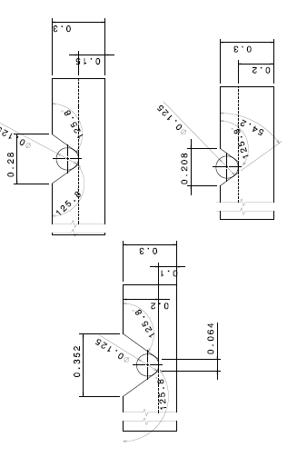
Ataching to silicon
Attaching Procedure to be tested on multigroove
wafer and thin mechanical dummies

Slide 30
Brief Summary
IR-Transparent sensors almost ready.
Thin sensors with DML and Integrated PA production starting before the end of the year.
OFS R&D program still to be better defined / still on market survey phase.

Slide 31
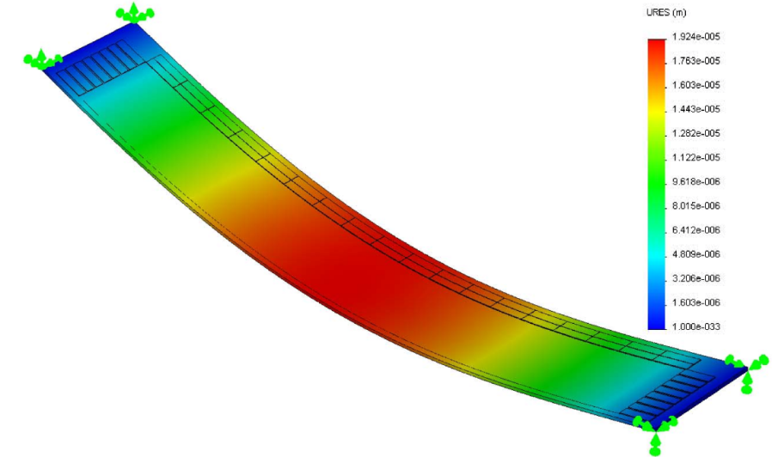
Naïve FEA model
Simple Geometry with frame + thinned area.
Support: Four corners fixed.
All Silicon structure
Measured dummy structure shows 20 um bow
Notes:
Recordar lo que sabemos, la información que tu mismo me pasaste…

Slide 32
Naïve FEA: gravitational bend
Gravity parallel to Z axis
Deformation in Z direction
Max deformation 12 um
Notes:
Resultado deformación en z

Slide 33

Naïve FEA: Longitudinal (X) strain
Top surface
Notes:
Resuldados del strain en la dirección longitudinal para la cara superior. La unidad de medida del strain es “epsilon” que es el strain relativo.
La gráfica de abajo es un zoom de la de arriba.

Slide 34
Naïve FEA: Transversal (Y) strain
Top surface
Notes:
Lo mismo que la anterior pero para el strain en la dirección transversal

Slide 35
Naïve FEA: Strain vs. Deformation
Notes:
Relación entre los strain longitudinal y transversal; y la relación entre el strain longitudinal y la deformación gravitatoria.
Estas gráficas demuestran que midiendo el strain podemos determinar la deformación.

Slide 36
Naïve FEA: Conclusions
Gravitation bend depends linearly with top surface strain
Output values for nominal conditions:
  Maximum deformation of 12 um
  Maximum longitudinal strain about 2.5 με at the middle of the DEPFET “frame”.
  Maximum transversal strain about 1 με at the middle of the DEPFET “frame”.
Notes:
Conclusiones de la simulación

Slide 37
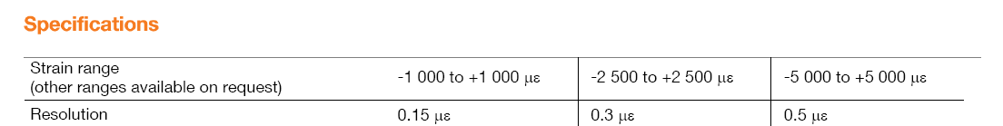

A possible commercial solution
Deformation monitoring with 750nm resolution
Notes:
Una solución comercial no he buscado mucho, este sensor ya lo conocía y está hecho en fibra es una versión modificada del FBG.

Slide 38
An event cleaner/lighter solution ?
Several options:
  Embdeding of fiber sensors on suporting structures (BTeV)
  Or event much better, embedding the sensing element on the depfet frame,
  Integrating a Bragg grating on it, still studying its feasibility.
Notes:
Esto se probó en parte para el malhadado BTeV… se hicieron pruebas de laminas de carbono con sensores embebidos….
Con respecto a integrar un sensor en el propio marco del DEPFET estoy hablando esto con un grupo de óptica integrada
Del cnm pero todavía no tengo una idea clara de como se puede hacer también necesito algún input en cuanto a la
Fabricación de los marcos… me llevará sus semanas ir convergiendo en una propuesta más concreta seguramente.

Slide 39
Summary and next steps
FBG commercial sensor will provide 750nm monitoring resolution with small amount of extra material.
More realistic FEA simulations are still needed: thermal loads, better mechanical supports,…
Eventually, a realistic test with a mock-up will be needed.
Notes:
Bueno y todo esto es un poco de sentido común.

Slide 40
________________________
BACK - UP

Slide 41
RD on Sensors: IRuS for alignment
Statement of the issue:
  The ultimate alignment precision will be achieved by track-based alignment algorithms. BUT …
  ….a real time monitoring of the vtx/tracker stability/deformation during detector normal operation (gravitational, thermal, magnetic loads) must provide a quick a precise starting point and cover some difficult degrees of freedom.
  Name of the game, increase the IR transmitance of the sensors without introducing minimal modifications to the sensor layout: Same materials, avoid fine tuning

Slide 42
RD on Sensors: IRuS for alignment (2)
1st Validation of optical simulation software with material samples. (done)
2nd Babysensor baseline design (p on n; AC coupling, 50 um pitch) minimal design modifications to boost sensor IR transmittance. (done)
3th Production of IR babysensors. (on progress)
4th Bench and beam testing of sensors
5th Know-how transfer to main manufactures

Slide 43
RD on Sensors: IRuS for alignment (3)
Raised issues this meeting:
  Binary read-out.
  Minimal strip width vs voltage bias.
  Material Radiation resistance.
  Other pasivation materials.
  Fine tuning of pasivation layers

