Slide 1
Status of UBM Development (3rd Metal layer in Cu)
Mechanical, thermal, electrical samples

Slide 2
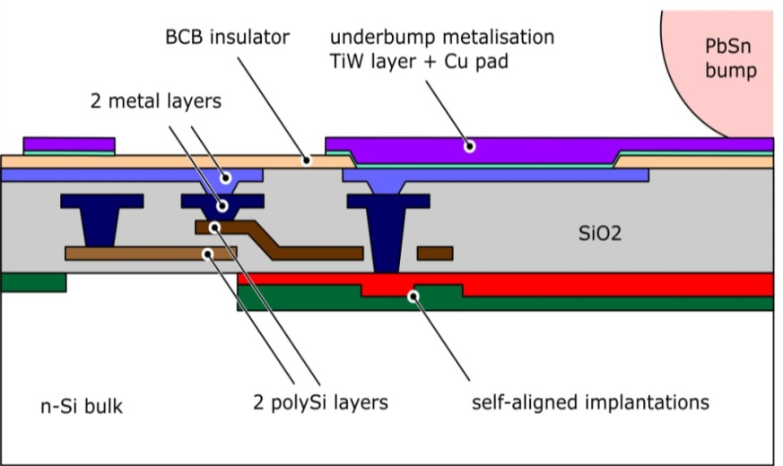
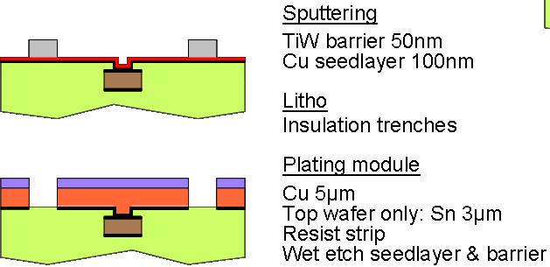
Reminder …
-: Assuming we get bumps on the ASICs - Pactech machine or already bumped by IBM/external
bumping services – we still need a solderable pad on the sensor!
-: two options:
a. coined gold studs directly on Alu
b. Landing pad Cu/Sn by electroplating at HLL
-: for PXD6 we have to use option a.
→ if this works, it can well be used also for the final run
-: but keep option b. open, it is effectively a 3rd metal layer, which we might need at the end

Slide 3
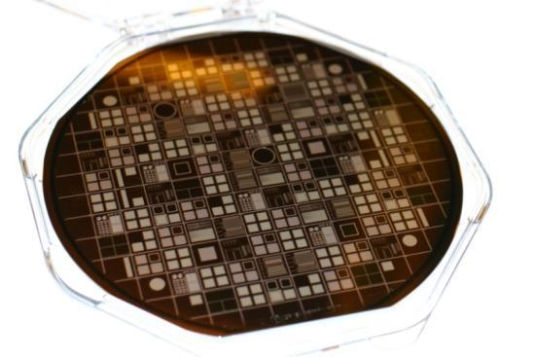
Small Project with CNM → Cu layer on HLL test diodes
at HLL:
a. Pre-processing of 3 SOI and 3 Std. up to BCB openings
PiN Diodes, MOS Caps. many test structures for:
- design rules
- contact and sheet resistance
- contact “chains”
b. characterization before Cu
-: at CNM, Barcelona :
a. sputter barrier and seed layer
b. thru mask electroplating of Cu
Notes:
Tests with CNM Barcelona ongoing….you may want skip that …

Slide 4
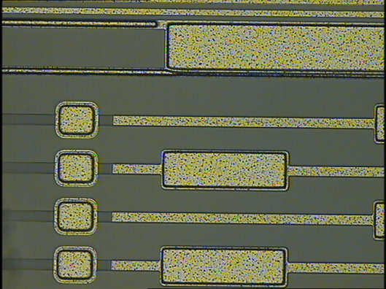
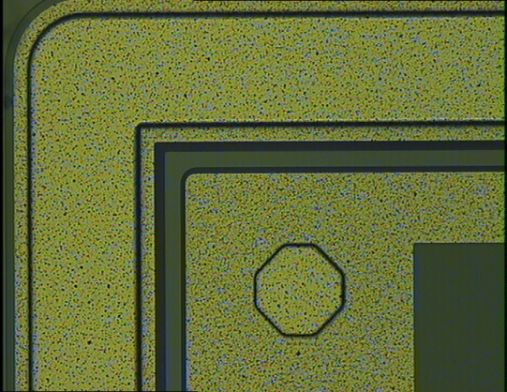
A few details: before and after Cu
Alu
BCB open
→ Al etched by Ti/W etchant
Alu pads
Copper

Slide 5
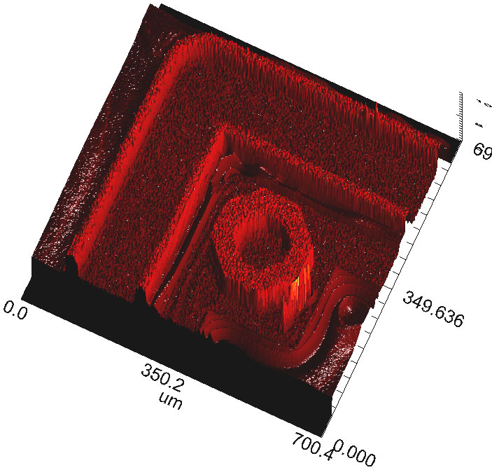
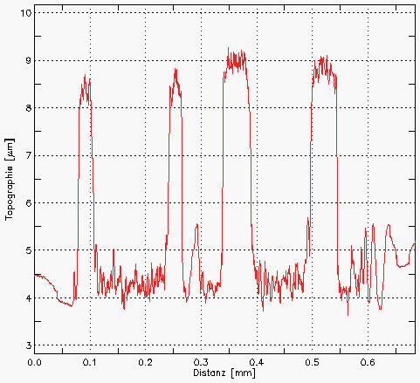
Cu lithography, thickness

Slide 6
Reverse currents, before and after (std. Wafer)
After Copper
PiN diodes on std.. Wafer,
450 µm thick fully depleted
Before Copper

Slide 7
The other wafer … residues (Ti/W???) and shorts

Slide 8
More tests under the way …
Contact resistance
Contact yield
…. and more
Sheet resistance
CV after Cu

Slide 9
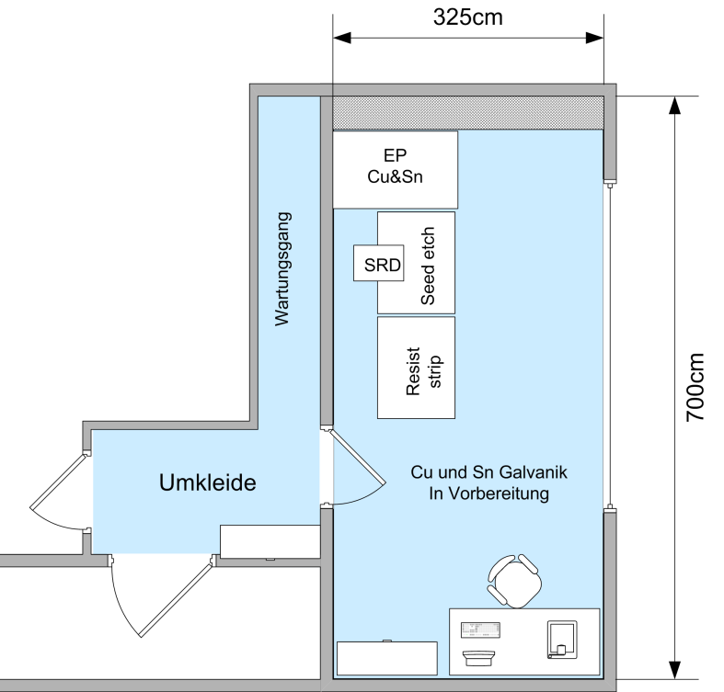
UBM Process at HLL
Sputter Ti:W und Cu (externally at the beginning)
Lithography: thick photo resist
Thru mask EP: 3-5 um Cu, ca. 2-3 um Sn
Resist strip
wet etch Cu
Wet etch Ti:W: H2O2 (with additives)
→ install step 2.-6. at HLL
Result after….
-: a lot of discussions with two equipment manufacturers
-: consultation of process experts and chemical
suppliers for electro-plating
Fountain plater for Cu and Sn,
etch baths for seed layer removal,
solvent wet bench
Status: ordered, prepare installation

Slide 10
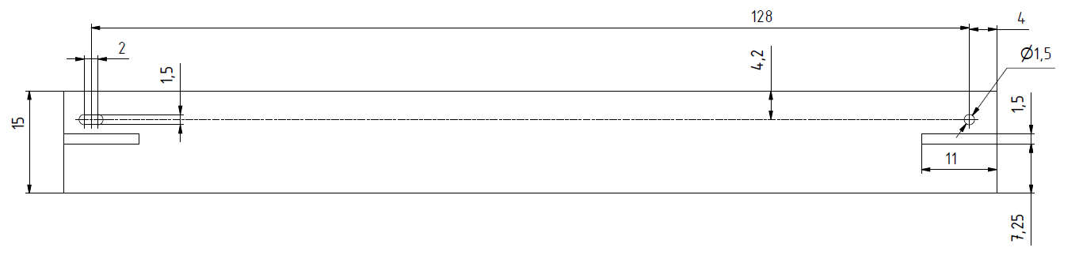
Types of samples (I)
for mechanical mockups: plain Si slabs, first layer ladder, single piece
material available
make cutting mask, in-house laser cutting (because of holes in Si)
start after Prague meeting, end depends on availability of laser expert
for the beginning: 5 wafers → ~ 25 .. 30 first layer ladders

Slide 11
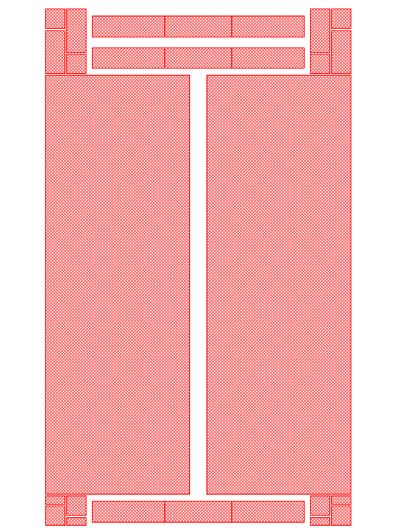
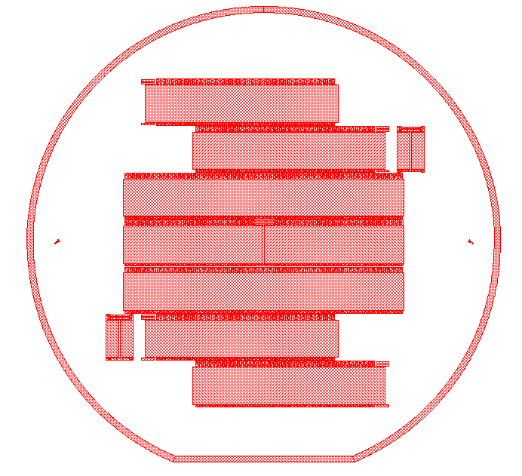
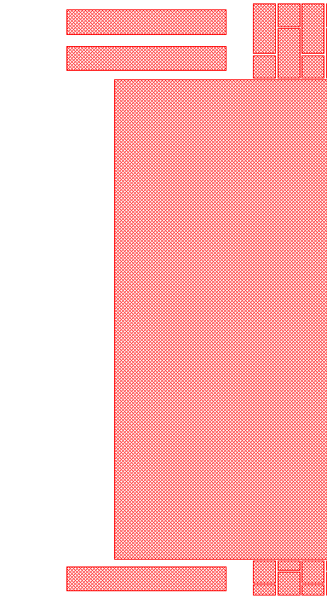
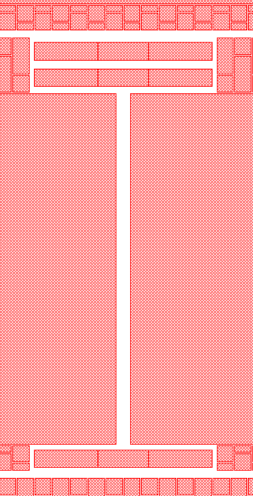
Types of samples (II)
for mechanical and thermal studies and evaluation of micro-joint
→ fully Al coated on top wafer, back-thinned, BelleII layout
61,78
28
90
Status:
  mask and wafer available, litho starts after Prague
  3..5 wafer
  end depends again on laser cut availability

Slide 12
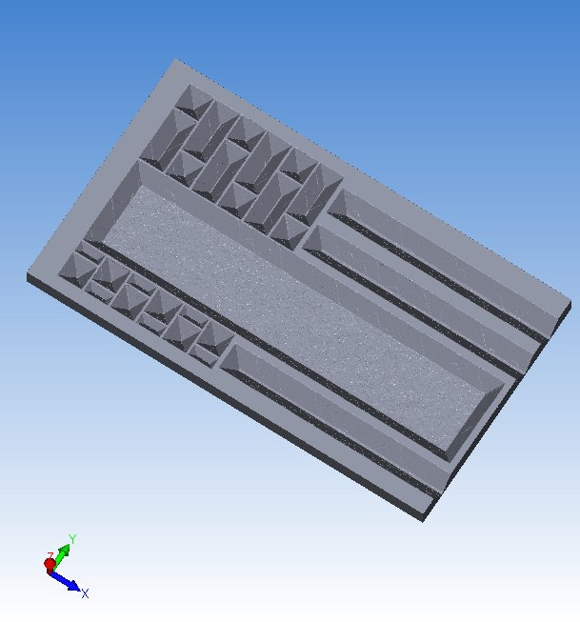
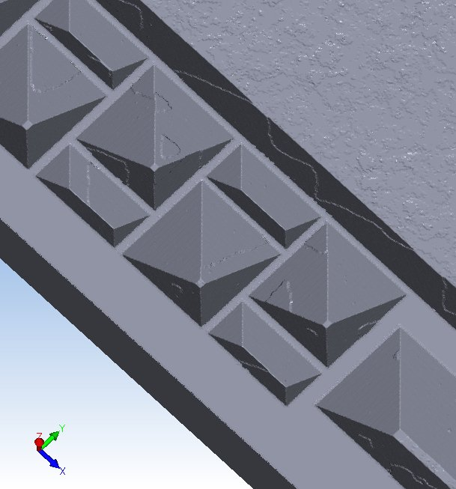
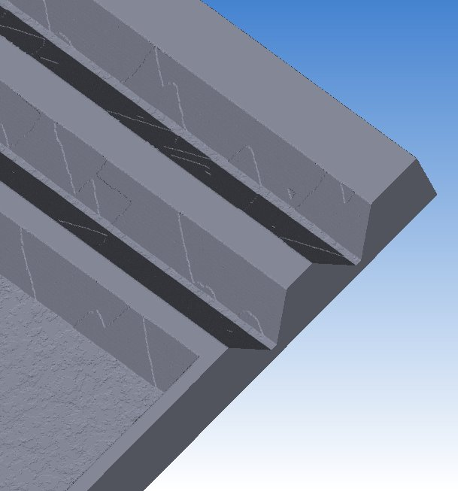
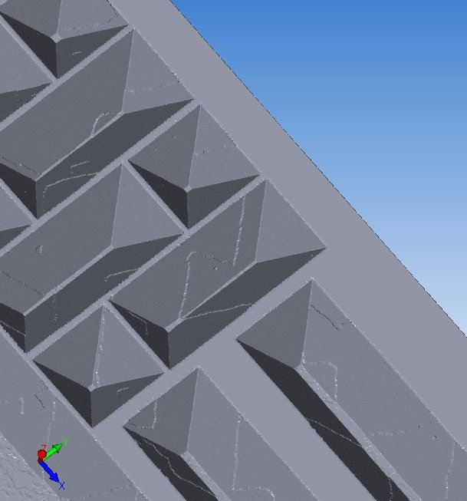
Types of samples (III)
mask layout → etch simulator
material reduction on the order of 30%

Slide 13
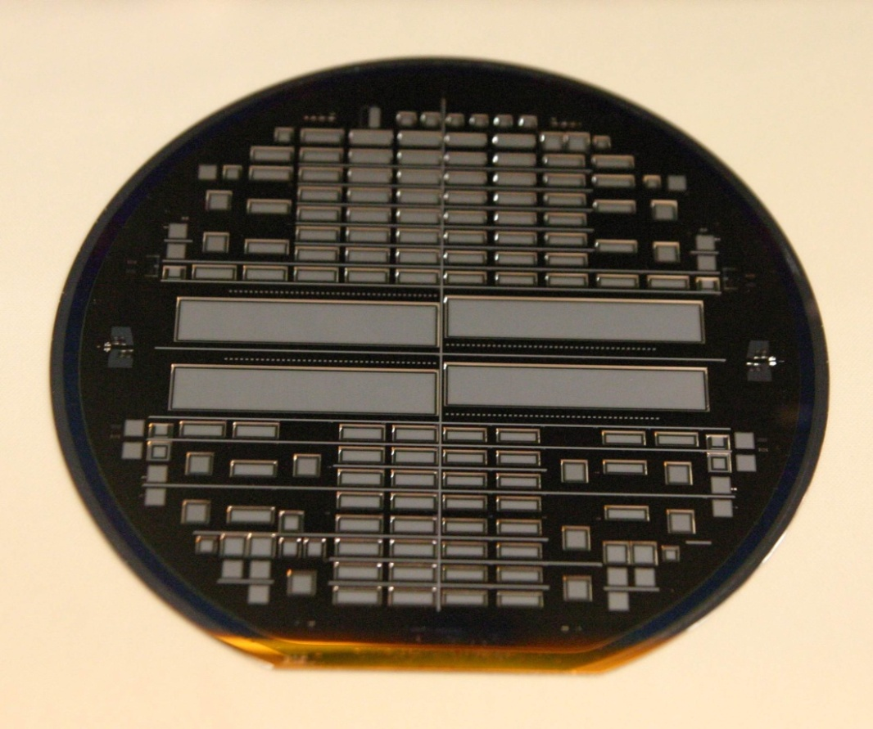
Types of samples (III)
PXD6 samples:
  diode wafer D9 (full sheet n-implant instead of DEPFETs and PXD6 back side)
  PXD6 top wafer Al, PXD6 back side like → practice back etching and test diode currents
  samples for wafer probing
  samples for PXD6 module assemblies
Status:
  first tests (back side) done
  Wafer and front side masks available
  front side Al litho starts this week
  thick wafer probing samples
  available next week
  thinning by the end of February

Slide 14

First PXD6 sample
A-A
A
B
B-B
B
A

Slide 15
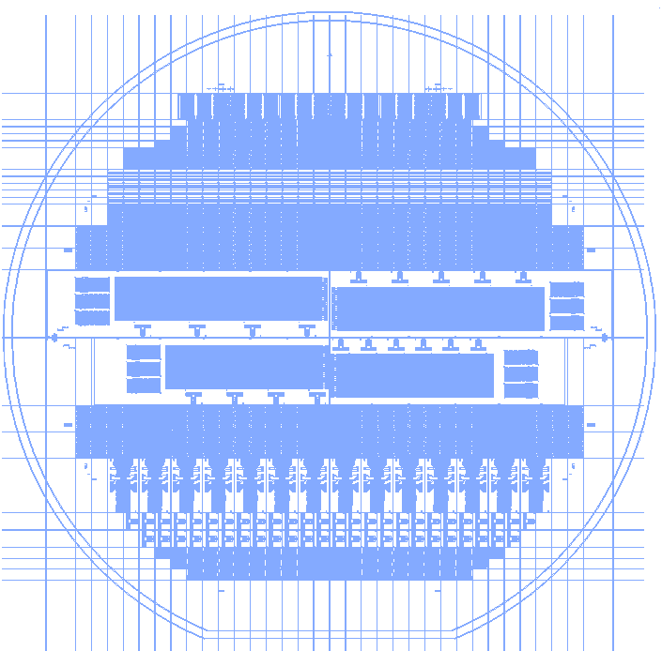
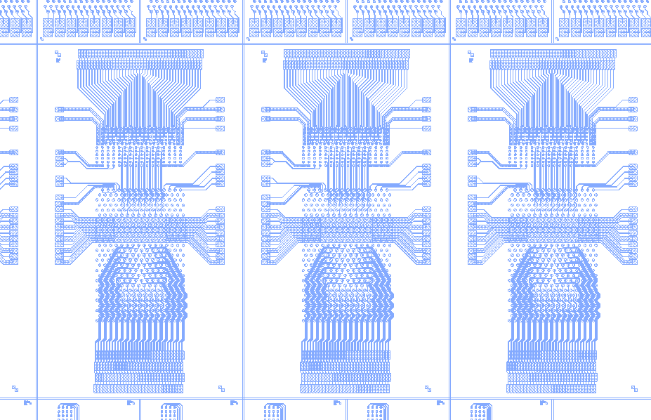
Types of samples (IV)
-: 450 micron thick Wafer
-: single Al layer on 230 nm oxide
-: Alu traces designed by Christian Kreidl
→ Chips (footprint) and landing pattern for
-: DCDs
-: Switchers
-: DCDROs
-: DCD bump-wirebond adapter
-: landing pattern for PXD6 large ladders
-: Al etching at HLL, Dicing at Disco
-: Status: start litho this week, to Disco week 6
17
40
5
2
0.6
12
1

Slide 16
Summary
Cu BEOL installation on track
first tests with CNM reasonably successful, continue 2010
Fabrication of Dummies has started
  purely mechanical samples with latest dimensions
  thinned BelleII ladders (L1 and L2), micro joint tests
  PXD6 Al samples, thinned, with back side diodes
  Bump test chips and bump-wire bond adapter

Slide 17
Backup slides follow

Slide 18
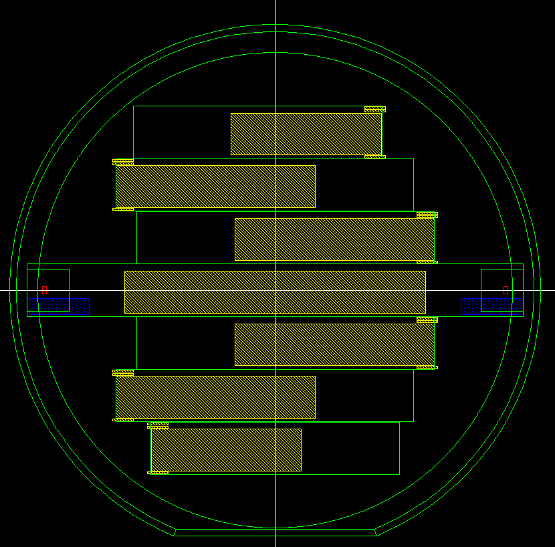
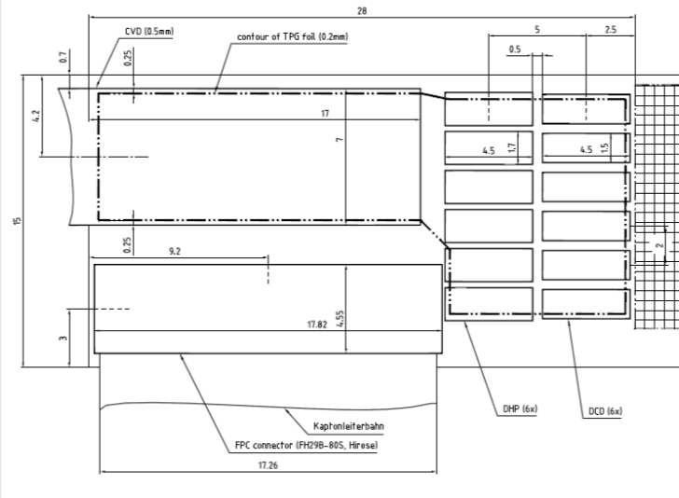
Current ladder design (V06a)
150mm
length of layer 1: 142 mm!!!
with metal traces for connector
Because of alignment structures
metal layers only possible for ≈ 120 mm,
Ladder can be longer, but no structured
metal beyond ±60 mm from center !
≈120mm

