Slide 1
Testsystems
PXD6 - testing plans overview - by Jelena NINKOVIC
Hybrid Boards for PXD6 - by Christian KOFFMANE
Source measurements on DEPFET matrices using DCD2 readout - by Manuel
KOCH
Testbeam/Lab DAQ for DCDB readout – by Sergey FURLETOV
Measuring DEPFET matrices: ASTEROID readout ASIC and VAKDAQ system
- by Sven Herrmann
Minimatrix setup - by Jan SCHEIRICH

Slide 2
PXD6 - testing plans
What do we want to learn from PXD6?
Wafer level testing
Dynamic testing

Slide 3
What do we want to learn from PXD6 ?
  Back side contact or punch trough via front side
  Select preferred design
    Yield
    Homogeneity over matrix
    Signal height (CCE, gQ etc. )
    Voltage operation window
    Clear scheme (CCG or CCCG)
  Bump bonding
    Yield
    Compatibility of the technologies

Slide 4
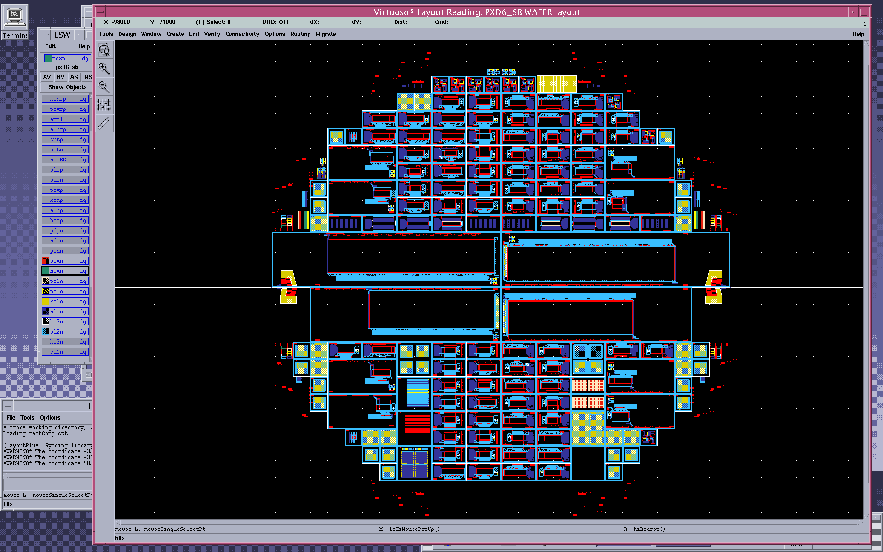
Wafer summary
8 (6+2) SOI wafers + 2 reference wafers
2SOI + 2 Ref in the first iteration
half-modules 768x120-160 pixels
bump bonded, 4 different design options
(2 inner modules, 2 outer modules)
128x16 matrices for bump-bonding
same design options as for the big chips (2 of each)
128x16 matrices for wire bonding
128x8 matrices for wire bonding
85 standard 8 of them on thin oxide
6 ILC (128x128) 2 of them on thin oxide – (2 best DUTs from TB2009)
Mini matrices (9 of which 2 on thin oxide)
single DEPFETs (24 pairs with varied channel and clear gate geometry)
Special test structures
First wafers ready Sep 2010

Slide 5
Pre testing after front side processing
Wafer level measurements
Goal:
  punch through biasing → define complexity of back side processing
  M1-M2 yield
Planed for July 2010

Slide 6
Testing plans
Static measurements - Wafer level measurements:
  Special test devices – qualification of the production quality
    Leakage currents
    Depletion voltage
    Threshold voltage of DEPFET
    Threshold voltage of Clear
    Break down voltages of oxides : Poly 1 to Poly 2 and Al 1 and Al 2
    Contact resistance
    Sheet resistance
  Matrices pretesting – selection of matrices for further testing
    Leakage current of the back diode
    Clear vs. Source
    Gate vs. Source
    Clear Gate vs. Gate
    Some representative sample of IV curves
    Planned for end September/October 2010

Slide 7
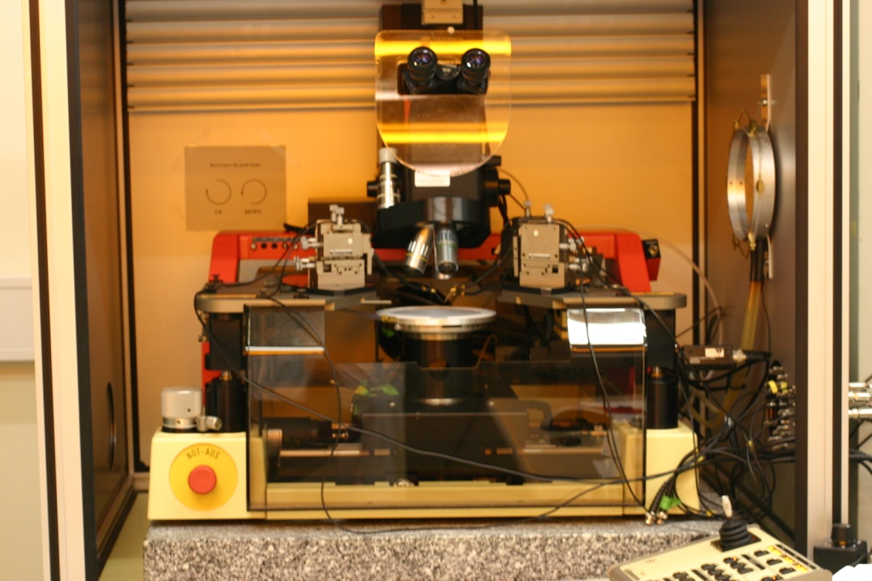
Testing systems status
Wafer level
  Semiautomatic wafer probing is planned (1-2 weeks /wafer)
SUSS PA150 Semiautomatic
Probe System
Existing system
I/V,C/V – wafer level on diodes and matrices

Slide 8
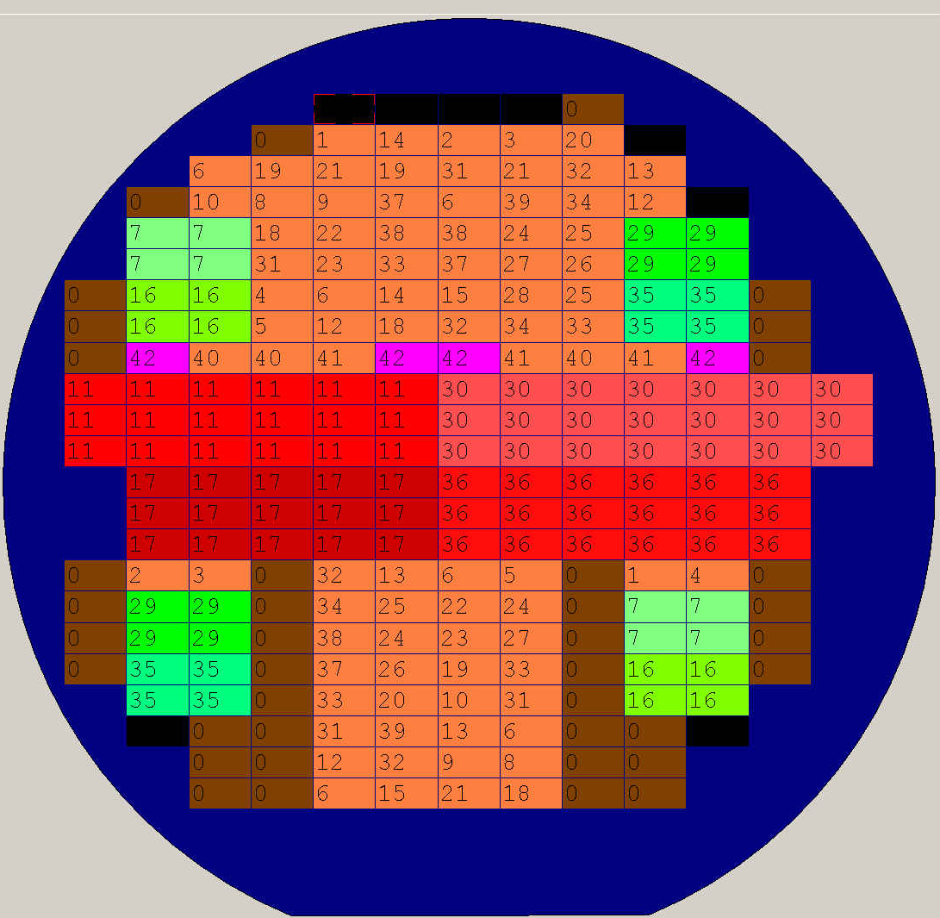
Wafer map

Slide 9
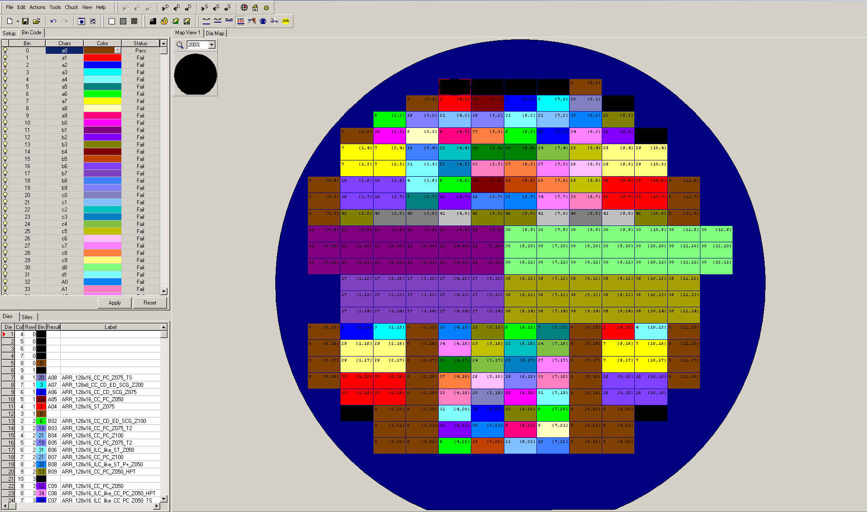
Wafer map

Slide 10
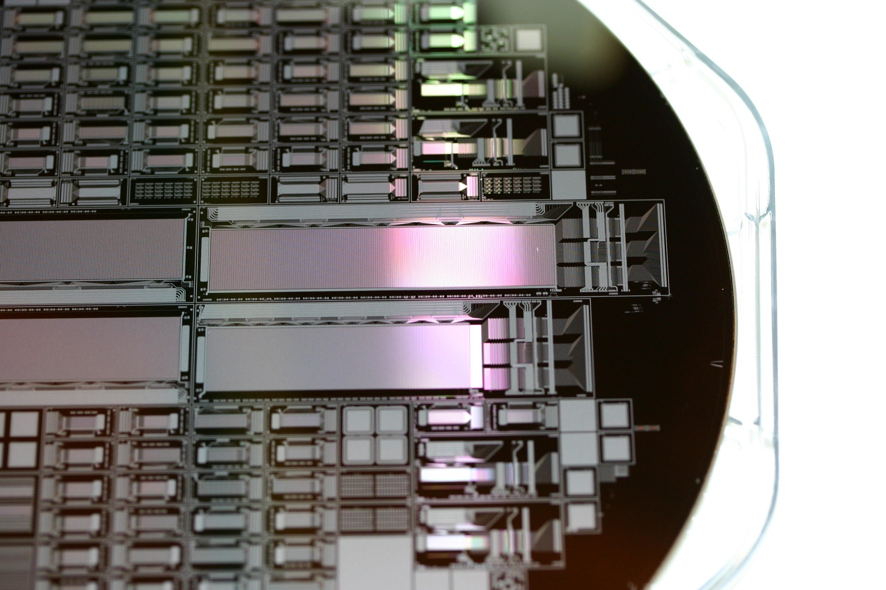
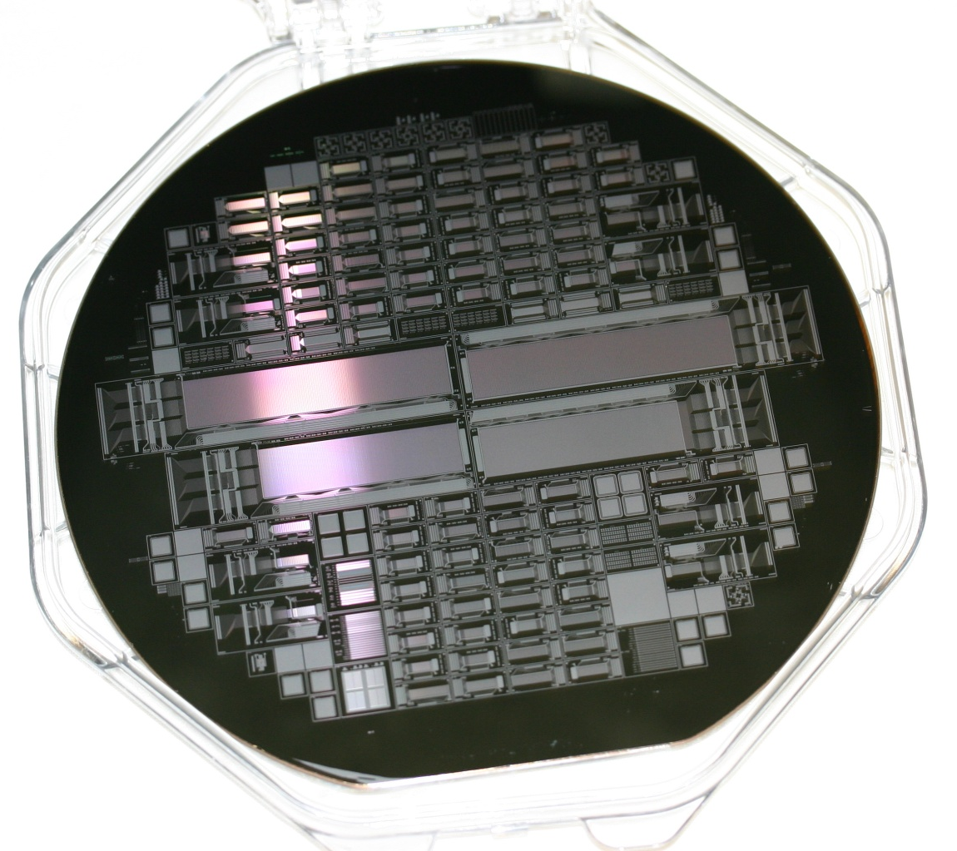
Wafer map

Slide 11
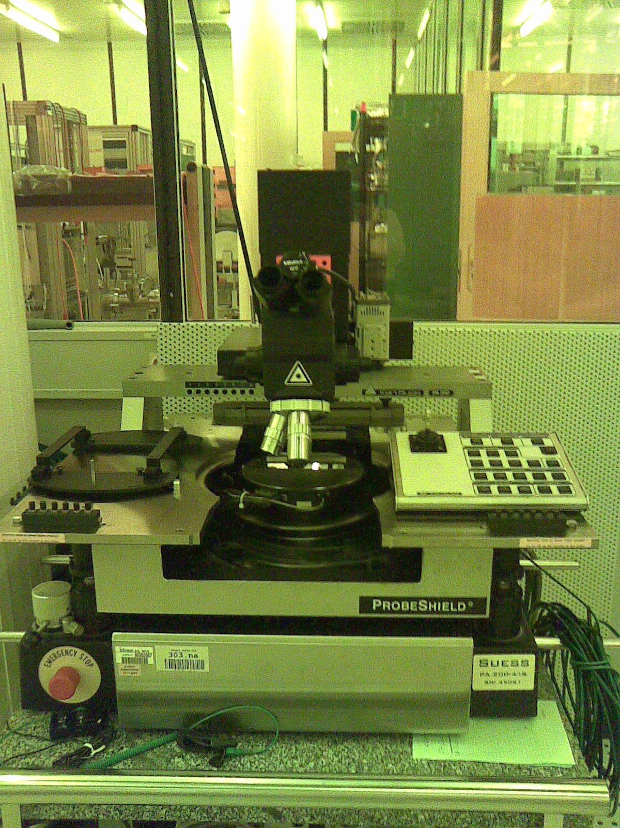
Second PA system – making of a clone
Used PA200
Refurbishment/ upgrade - ordered
Measurement system order - ongoing
Backup system for the PXD6 testing
Cu line testing

Slide 12
Testing plans
Dynamic measurements – Bonded structures
  Functionality of the matrices (laser and source measurements)
  Gain
  Noise
  Homogeneity
  Read-out schemes
  …

Slide 13
Dynamic tests
Milestones:
1. Testing of DCDB/DCDRO
fine
New hybrid
New firmware for FPGA board
New DAQ system
2. PXD6 production
Test the system using PXD5 matrices
(Christian’s talk!)
Labtest DCDB read out system for
PXD6 BelleII and ILC type matrices

Slide 14
Bonded structures : Dynamic measurements
128 channel :
  Working S3B System can be used for ILC type matrices (CURO & SW3)
  New read out system based on DCD & Switcher B (DCDB & DCDRO & SWB ) for Belle and ILC matrices (only smaller part of the ILC type matrix)

Slide 15
Bonded structures : Dynamic measurements
All Si Module:
  Bump bonding of chips to the matrix
  2 batches – DCDB & DCDRO → FPGA
  DCDB & DHP → new FPGA
Alternative :
testing on the probe station
with probe card contacts and an
external switcher
pro : fast testing of yield
non dependant on bump bonding
experience for final production
con : high cost
probe card specific for the layout
probably we can not contact all pads in a single touch down
5x SWB
3 x DCD-B DHP
Hybrid Board

Slide 16
Bonded structures : Dynamic measurements
Mini matrices:
  4 structures on 5x5 mm² chip different channel length same other geometry
  System ready
Single pixel setup
  System ready

Slide 17
Time schedule for the test system with DCDB/DCDRO ???
SWB is back → testing → adapter boards are needed –> July 2010
DCDB/DCDRO → waiting for hybrid
Hybrid for DCDB/DCDRO ready till mid Jun 2010
Firmware and DAQ changes Jun 2010
PXD5 matrix - debugging and testing of the system
September /October preparations/changes for PXD6 matrix

Slide 18
Time schedule PXD6
First wafer tests in July or August – before backside processing
punch trough biasing
yield of double metal process
Full wafer tests by end September/October – fully processed wafers
wafer
2 weeks
Clean room
1-2 weeks
Diced wafer
static measurements
wafer cutting
Bonding
1week
1 month from the production end till first hybrid test!!!
First test hybrid

Slide 19
Dynamic tests
Milestones:
1. Testing of DCDB/DCDRO
PROBLEMS
Use S3Bsystem for PXD6
  New hybrid with SWB
  Modification of FPGA
2. PXD6 production
Use reference thick wafers to have higher signal
Thin wafers with CURO still fine but at the limit
Labtest S3B read out system for
PXD6 BelleII and ILC type matrices

Slide 20
Modular Hybrid Concept
All-Silicon Module & Bump Bond Matrix
5x SWB
3 x DCD-B DHP
Hybrid Board
To measure the signals of SWB and inject currents for testing DCD-B/DCDRO
Pin Header Connectors
Debug Board
Matrix Board
PXD6
SWB
Matrix Board
DCD-B/DCDRO
FPGA Board
Hybrid Board
Power
SAMTEC ST/SS connector series
High pin count, Low profile 3mm
ST4-50-3.00-L-D-P-TR
SS4-50-3.00-L-D-K-TR

