Slide 1
Testing plans for TB2010

Slide 2
Options we will have in case of …
PXD6
On time
Late
DCDB
PXD6
ILC type matrix
PXD5
ILC type matrix
24x24
μ
μ
μ
μ
m
or 20x20
m
2
2
24x24
m
or 20x20
m
2
2
YES
&
&
DCDB/DCDRO
test
DCDB/DCDRO
test
system
system
X
for ILC type matrix
for ILC type matrix
X
PXD6
ILC type matrix
PXD5
ILC type matrix
24x24
μ
μ
m
or 20x20
m
2
2
24x24
μ
μ
m
or 20x20
m
TB2009
2
2
NO
&
&
S3B
test system
S3B
test system
for ILC type matrix
- modified -
for ILC type matrix

Slide 3
PXD6
YES
NO
DCDB
PXD6
ILC type matrix
PXD5
ILC type matrix
24x24
μ
μ
μ
μ
m
or 20x20
m
2
2
24x24
m
or 20x20
m
Option A
2
2
Option B
YES
&
&
DCDB/DCDRO
test
DCDB/DCDRO
test
system
system
for ILC type matrix
for ILC type matrix
PXD6
ILC type matrix
PXD5
ILC type matrix
24x24
μ
μ
m
or 20x20
m
2
2
24x24
μ
μ
m
or 20x20
m
TB2009
Option C
2
2
NO
&
&
S3B
test system
S3B
test system
for ILC type matrix
- modified -
for ILC type matrix

Slide 4
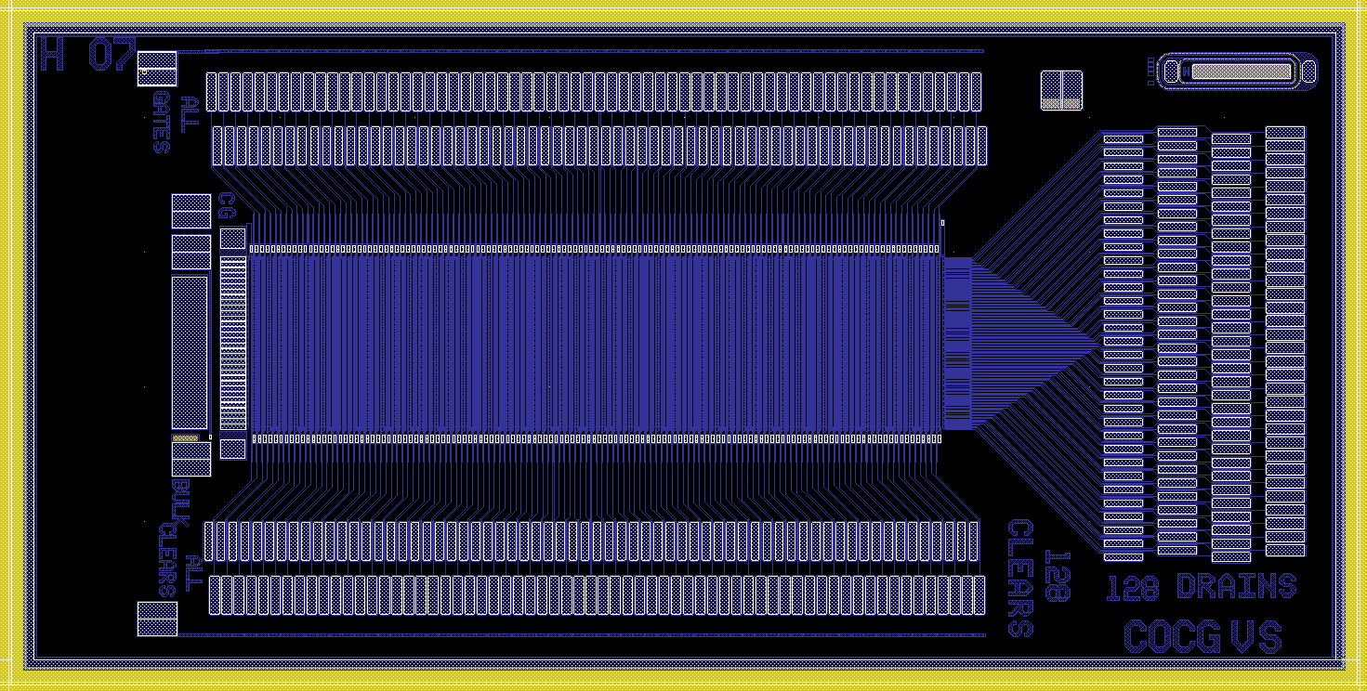
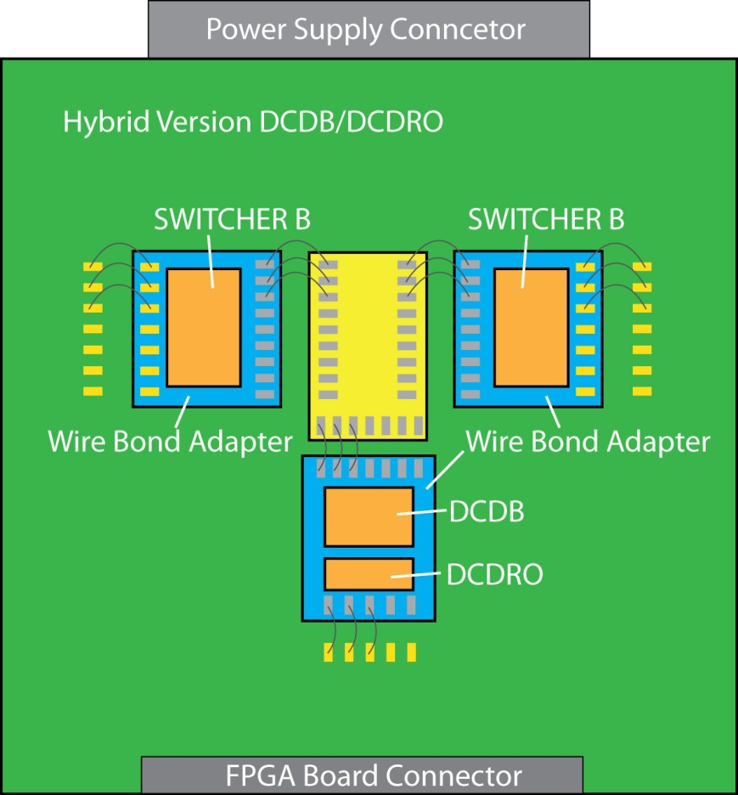
Option A
PXD6 and Hybrid - DCD-B/DCDRO + SWB
PXD6 ILC type
PXD6
ILC type 24x24μm² or 20x20μm²
Same as 2 best DUTs from PXD5
50μm thick
New read out system with DCDB and SWB

Slide 5
Option B
PXD5 and Hybrid - DCD-B/DCDRO + SWB
PXD5 ILC type
PXD5
ILC type 24x24μm² or 20x20μm²
Same as 2 best DUTs from PXD5
450μm thick
New read out system with DCDB and SWB

Slide 6
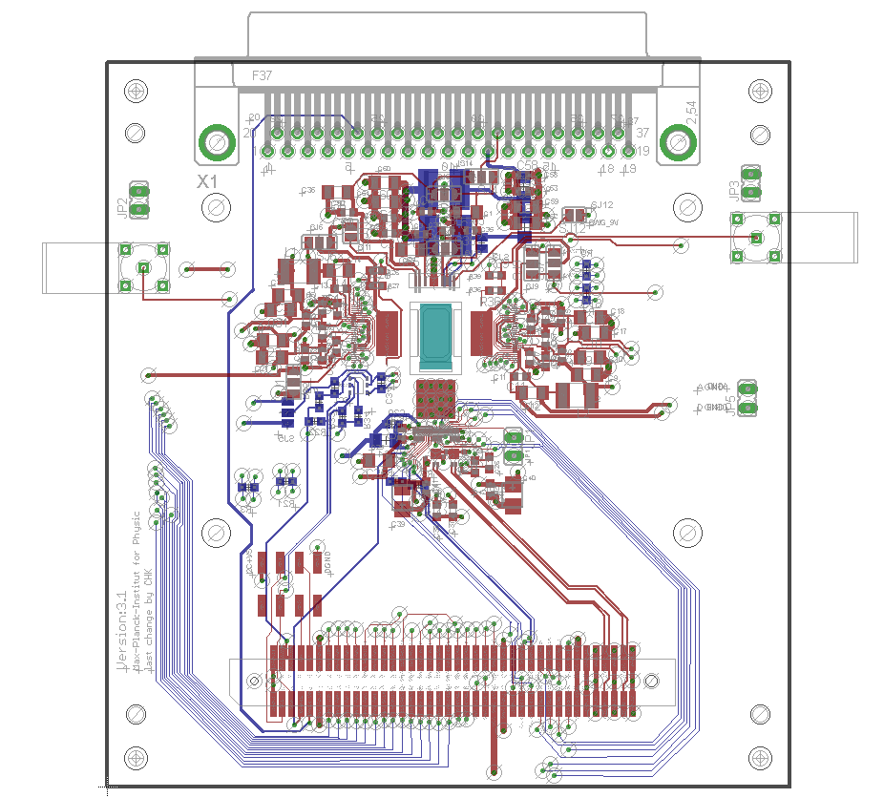
Version C
PXD6 – ILC Type S3B system (CURO + SW3)
PXD6
ILC type 24x24μm² or 20x20μm²
Same as 2 best DUTs from PXD5
50μm thick
Old read out system with CURO and SW3

