Slide 1
S/N for thin DEPFETs in the Belle II environment – simple calculus –

Slide 2
Assumptions …
DEPFET: 50x50 μm²
g_{Q} = 400 pA/e g_{Q} ~ (d_{OX}/L_{gate}³ )^{1/2}
Electronic noise
Single sampling no pedestal correction with 20μs read out time
47nA → ENC = 117e
Single sampling with pedestal correction with 20μs read out time
30nA → ENC = 88e
Double correlated sampling with 20μs read out time
102nA → ENC = 300e
Device noise
DEPFET noise 40e

Slide 3
Assumptions …
Bulk contribution
1% occupancy → Φ = 1·10¹³ n/cm²
I₀= 100pA/cm² (bulk leakage current from produced thin PIN diodes)
Surface generated current (10Mrad)
I (depfet area) = 12 pA

Slide 4
S/N for the thin DEPFETs in the Belle II environment …
Noise [e]
Single sampling w/o pedestal subtraction

Slide 5
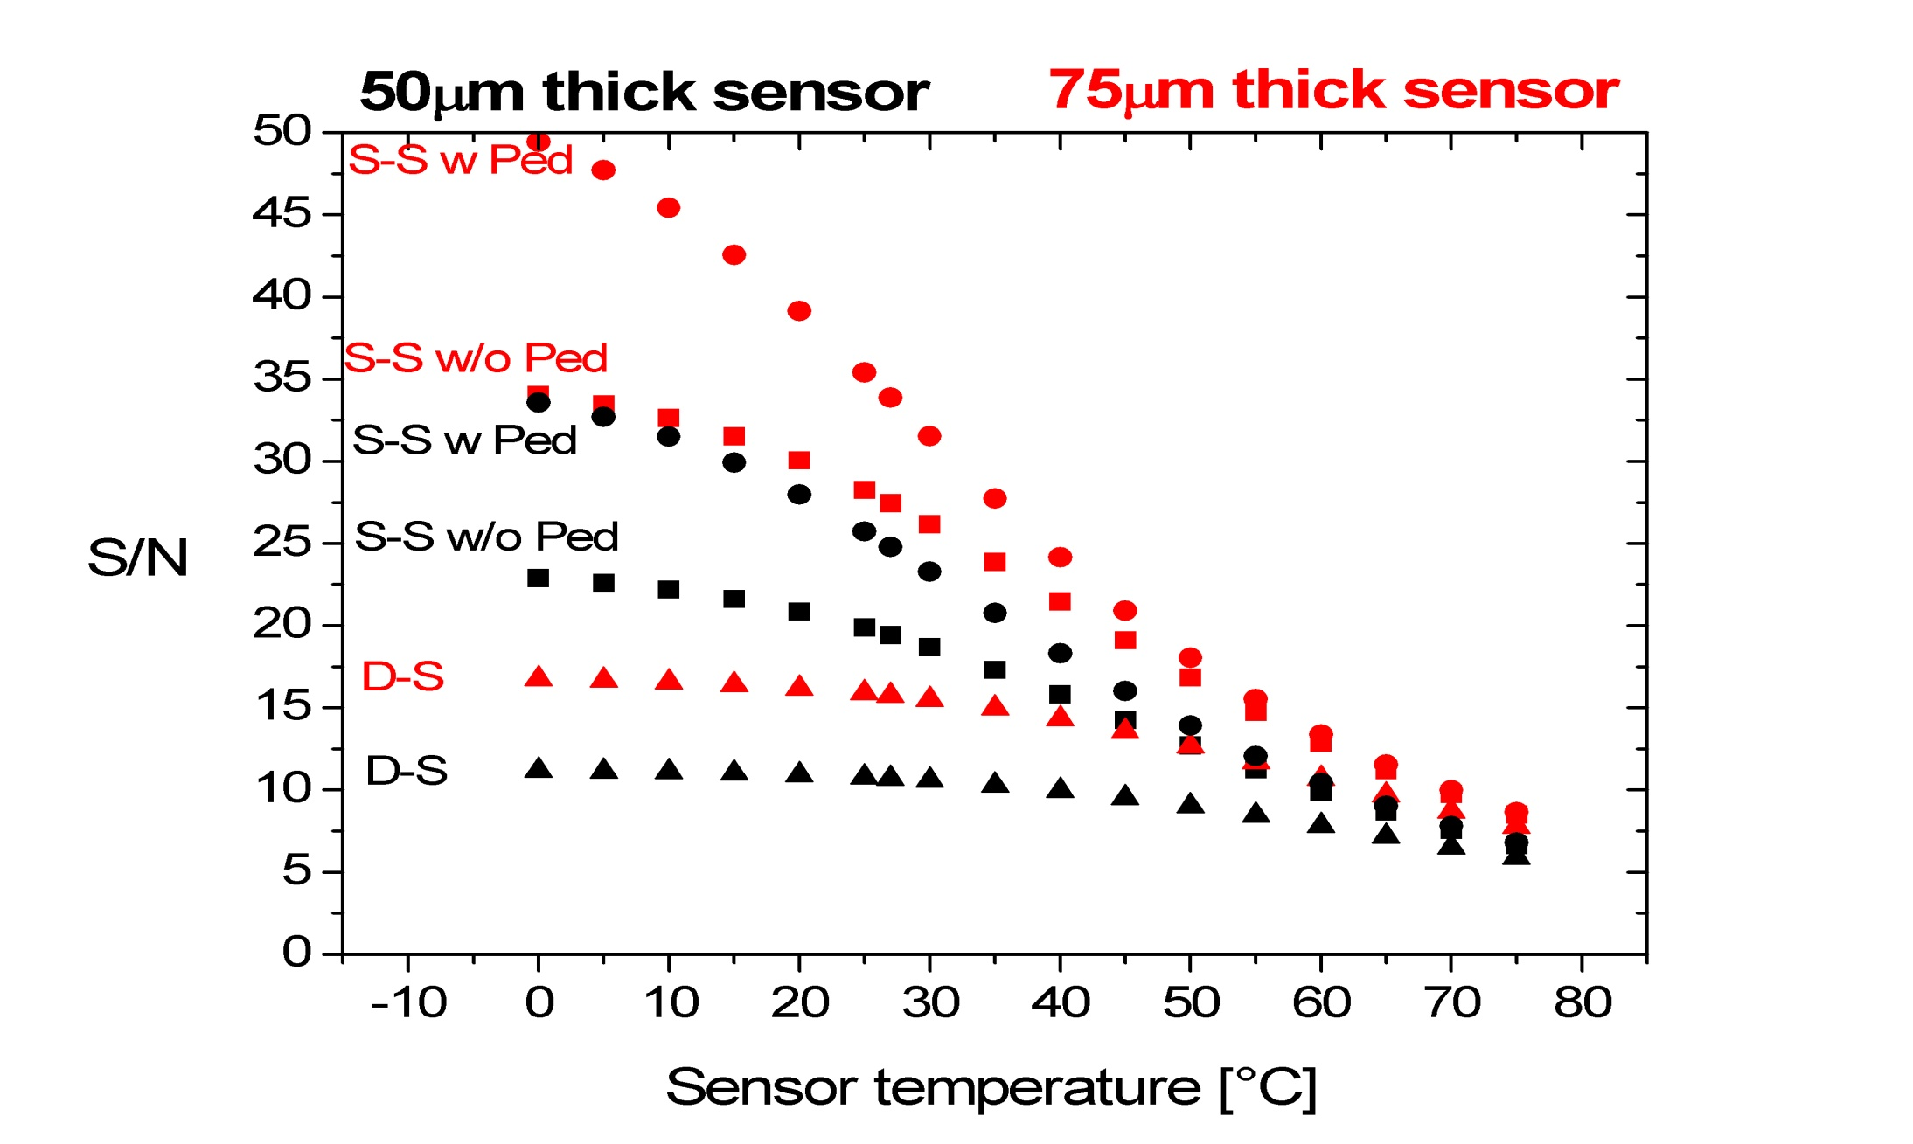
S/N for the thin DEPFETs in the Belle II environment …

Slide 6
S/N for the thin DEPFETs in the Belle II environment …

Slide 7
S/N for the thin DEPFETs in the Belle II environment …
Thickness Elect. noise T[°C] | 50μm S-S w Ped | 75μm S-S w Ped | 50μm S-S w/o Ped | 75μm S-S w/o Ped | 50μm D-S | 75μm D-S
20 | 28 | 39 | 21 | 30 | 10.9 | 16.2
30 | 23 | 32 | 19 | 26 | 10.6 | 15.5
40 | 18.3 | 24.2 | 15.8 | 21.5 | 10.0 | 14.3

Slide 8
DEPFET – Transconductance
g_{m} is 25% lower after 7.5MRad

Slide 9
S/N for the thin DEPFETs in the Belle II environment …

Slide 10
S/N for the thin DEPFETs in the Belle II environment …
Thickness Elect. noise T[°C] | 50μm S-S w Ped | 75μm S-S w Ped | 50μm S-S w/o Ped | 75μm S-S w/o Ped | 50μm D-S | 75μm D-S
20 | 28 | 39 | 21 | 30 | 10.9 | 16.2
30 | 23 | 32 | 19 | 26 | 10.6 | 15.5
40 | 18.3 | 24.2 | 15.8 | 21.5 | 10.0 | 14.3
7.5 MRad
Thickness Elect. noise T[°C] | 50μm S-S w/o Ped | 75μm S-S w/o Ped
20 | 18.4 | 26.7
30 | 16.8 | 23.9
40 | 14.6 | 20.2

Slide 11
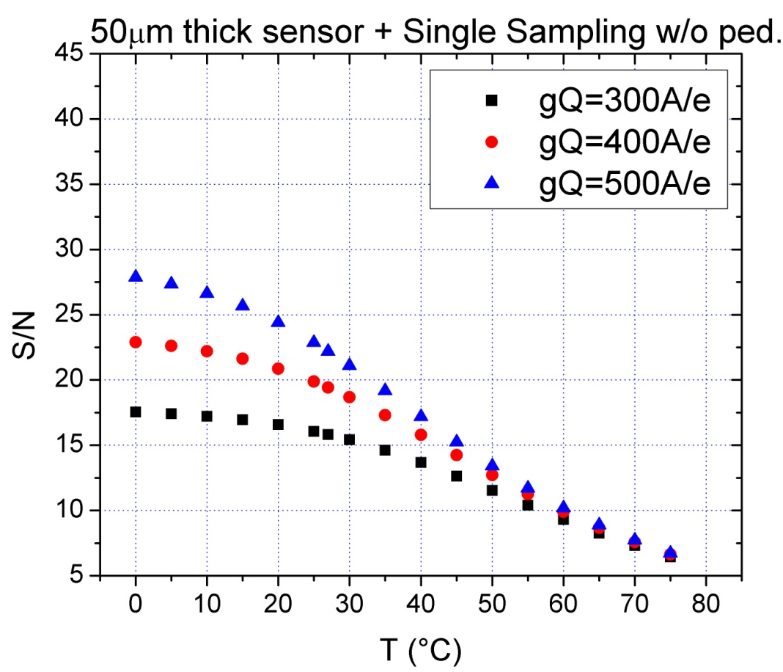
g_{Q} variations

Slide 12
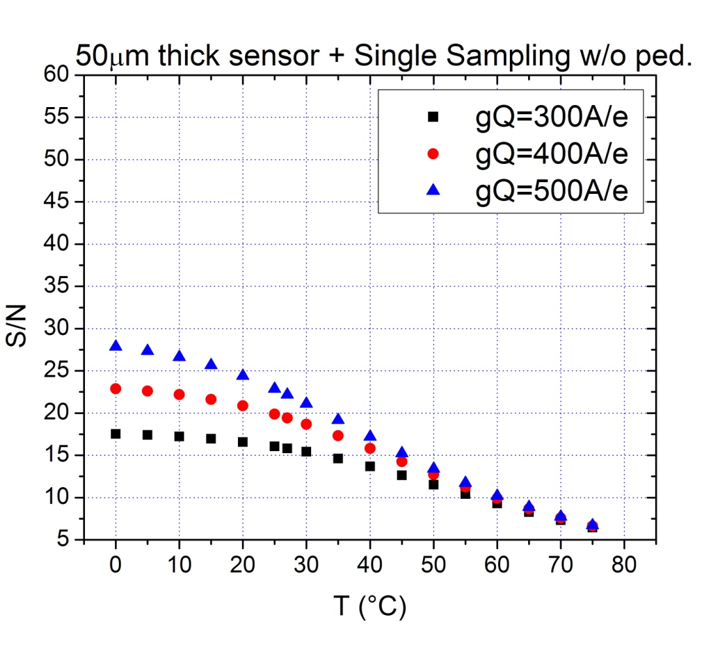
g_{Q} variations

