Slide 1
The Data Handling Hybrid
TUM Physics Department E18
I.Konorov

Slide 2
Overview
DHH functionality
Proposal for DHH architecture based on SODA -Time Distribution system for PANDA
DHH design
Project time estimate

Slide 3
DHH

Slide 4
Proposal for DHH
Based on our prototype development of Time Distribution System for PANDA
FPGA based, commercial components
Not radiation hard
Anticipated location : DOCK ~2m away from half ladder
*SVD group measured radiation dose in the DOCK recently and within few weeks they accumulated 5 kRad

Slide 5
DHH functionality
Voltage regulators
Slow control support:
Provision of JTAG interface to configure PXD
Provision of slow control interface to configure DHH cards
Monitoring voltages, currents, temperature
CLOCK synthesis from COMMON clock and distribution
DAQ functionality
Synchronous distribution of TRIGGER, RESET(?), … signals
Data buffering : 4x1Gb/sec
Sub event building : merging 4 data blocks into one
Transmission of merged data to DAQ via high speed optical serial link

Slide 6
SODA serial interface
Optical network with STAR topology using passive optical splitters
125 MHz or 1.25 Gb/s now, in future may go up to 2.5Gb/s
Bidirectional link :
Controller -> Receivers full bandwidth of 125 MB/s
Broadcast synchronous commands with fixed latency, 32 bit long:
RESET, Start/Stop data taking, Start/End of burst
Asynchronous commands , 32 bit long
Scanning connected modules
Control
Packets up to 1kB
Receivers -> Controller
Time sharing principle, similar to common bus
Only one receiver can send data at a time
Controller schedules Receivers access
Switching from one receiver to another takes 400 ns
Laser OFF - Laser On – Relock SERDES to new receiver
Heartbeat packet
Status packet
RCV
CNTR
RCV
RCV

Slide 7
SODA –PANDA time distribution system
Passive splitter
1x8, 1x16
SODA
controller
SODA
receiver
Multiplexer/
Data Concentrator
155.52 MHz
Reset
Burst
Start/Stop
HESR
PCI-e
SODA controller :
Provision of 155.52 MHz reference clock, 10ppm or better
Provision of RESET, Burst, SuperBurst, Start/Stop
PC interface for configuration and status information
Lattice FPGA with SERDES
Optical splitter :
1x8; 1x16; 1x32
SODA receiver:
Mounted directly on Data Concentrator/Multiplexer module
155.52 MHz
RESET, SOB, EOB, Start/Stop

Slide 8
SODA interface
8/10 bit encoding
Command(packet) transmission/handshake
IDLE status
Synchronous command:
RESET, SOB, EOB, SuperBurst, Start, Stop, Trigger, 3 spare bits
Asynchronous commands
K28.7
K28.7
K28.7
K28.7
K28.7
0
10 bits
ECC(5b)
K28.7
K28.7
1
8 bits
ECC(7b)
K28.7
K28.7
K28.7

Slide 9
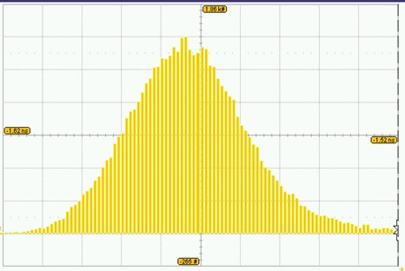
Test setup
Lattice PCI-e evaluation card
Optical splitter 1:8
2x SODA receivers mounted on evaluation cards
Reference Clock vs Recovered Rx Clock
10ps/div
RMS 15ps

Slide 10
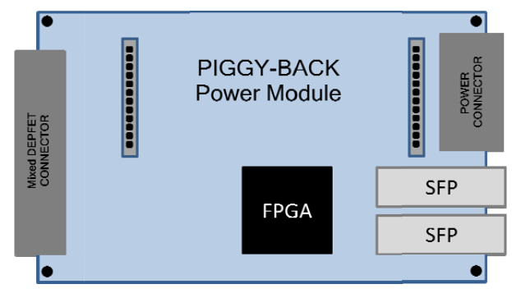
Proposal: DHH card design
DHH design based on commercial components :
FPGA(Lattice/Xilinx)
Optical transceivers
to DAQ
to DHH Controller

Slide 11
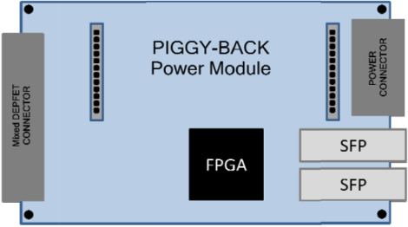
Proposal: DHH system architecture
DHH Controller
RJ45
FPGA
Trigger
Belle
Trigger
Distr.
System
Clock
Reset
Ackn
PCIe , USB, Ethernet
JTAG

Slide 12
DHH ⬄ Trigger interface
Belle II Trigger Distribution System provides:
LVDS: Common clock – 127 MHz (508.87 MHz/4)
LVDS DDR Serial link 254 Mb/s: Trigger, Hard Reset, Soft Reset, Event number(8 bits)…
DHH :
Trigger Acknowledge LVDS within 30 us after trigger
*@PXD-DAQ work shop Japanese colleagues proposed to come with trigger copper cable directly to DHH cards
Issues to be addresses:
Grounding
Additional interfaces for Slow Control and JTAG
No final decision yet, although advantage of optical network solution was acknowledged

Slide 13
DHH ⬄ DHP
DHH generates two clock signals
Frame clock: 508.87 MHz/10240 = 49.69 kHz (~20 μs period)
Switcher clock: 508.87 MHz * 5/32 = 79.5 MHz or 508.87 MHz * 3/20 = 76.3 MHz
Propagate Soft/Hard RESET signal ?
Convert pulsed trigger signal to level trigger signal
Belle Trigger
DHP Trigger

Slide 14
DHH⬄DAQ
Compute
Node
Compute
Node

Slide 15
PXD⬄DHH⬄DAQ interface
PXD => DHH
4 copper serial links, 1.5 Gb/s each
Aurora protocol, 8/10 bit encoding
One data block is one or more events
Data format defined
Average network bandwidth utilization – 80-90%
DHH => DAQ
6 Gb/s or 2x3 Gb/s
“Sub event” building

Slide 16
PXD frame timing
Rows
Part of frame N
Event M
Frame N+2
Event M+1
Frame N+2
Event M+2
Frame N+2
Event M+1
Part of frame N+1
Event M
T
Trg M
Trg M+1
Trg M+2
Belle II dead time:
in current scenario SVD requires not more than 5 triggers in 125us – 18% dead time
PXD: data block combines up to 5 events ☺
Due 18% dead time more probable scenario for SVD is 10 events in 125 us
Probability for 10 triggers within 180us is 2.6%
PXD data block is not limited by any number of events

Slide 17
New collaborator
Ricard Aquilué, from La Salle Engineering – Universitat Ramon Llull, Barcelona
Experience in FPGA designs, High Speed Serial Links
Expressed interest to participate in development of DHH system
Contribution:
Implementing precise time distribution functionality using Xilinx FPGAs
Slow Control Functionality by employing soft μP core in FPGA and Linux OS

Slide 18
Time lines (preliminary)
Requirements and specification - 09.2010
Prototype development - 03.2011
Test, debugging, final specification - 01.2012
Final prototype - 03.2012
Final production - 09.2012

Slide 19
Summary
DHH location to be defined
Radiation conditions to be clarified
Trigger interface specified - OK
Trigger distribution scheme to be defined
via DHH controller
Directly to DHH card
Maximum number of events per data block is not limited
Introduce PXD dead time to limit number of events ?
DHP ⬄DHH interface in progress
Goal:
Fix DHH specification by September 2010 !!

