Slide 1
Advanced Proton Driven Plasma Wakefield Acceleration Experiment (AWAKE)
Jan Pucek
Pablo I. Morales Guzman
Max Planck Institute for Physics, Munich, Germany
IMPRS Seminar Series
29th April 2021
jan.pucek@cern.ch | pmorales@mpp.mpg.de

Slide 2
Why joint presentation?
Simulation and experiment are working very closely
Many experimental results are supported by simulation results
Several simulation results are compared to experimental data

Slide 3
Contents
Wakefield introduction
Plasma and its quantities
Driving and “surfing” wakefields
Simulation introduction
PIC simulations
Self modulation
What is AWAKE today
Plasma gradients
Seeded modulation or instability?
Conclusions
Virtual visit

Slide 4
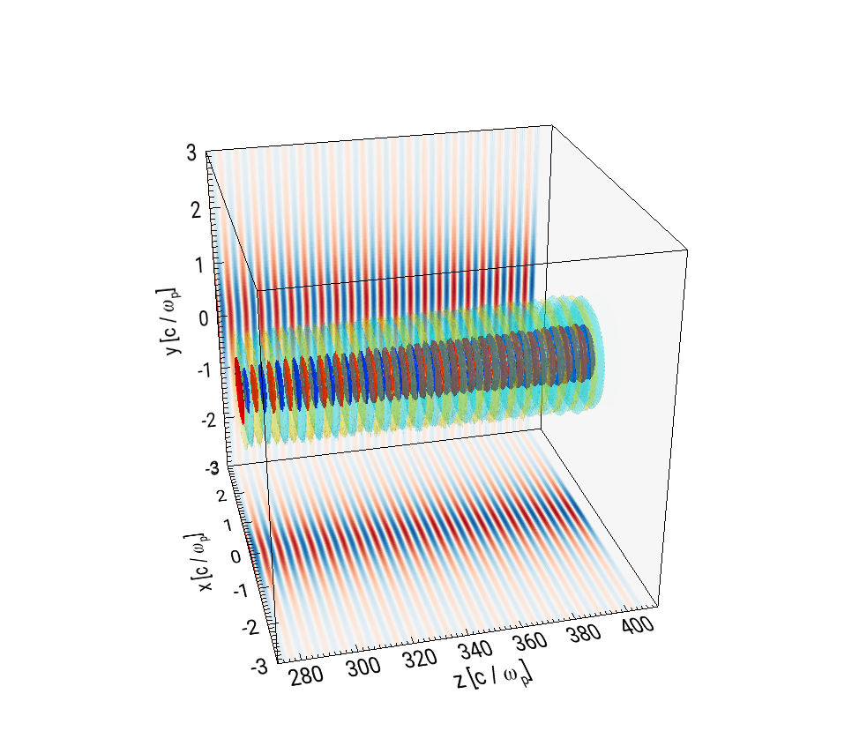
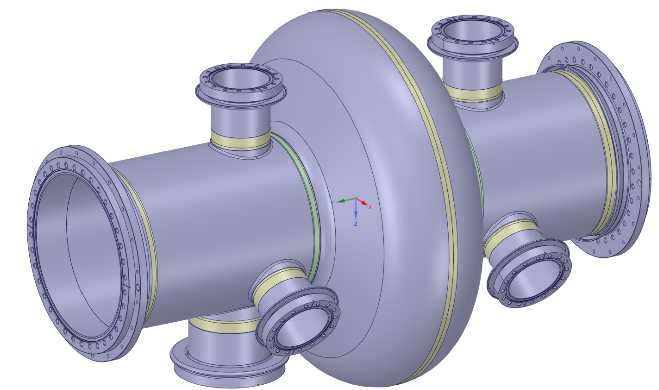
Why plasma?
Future of e⁻ acceleration?
Conventional acceleration cavities
Plasma wakefield acceleration
At the material limit
Gradient 100 MV/m
Gradients of 100 GV/m can be sustained
1 meter
λ ≈ 1 mm
≈ 12 cm
10 cm
4
Broeck (2019), Robotic solutions – RF cavities visual inspection system
Mariana Moreira, Unpublished
Notes:
In order to reach 209 GeV collision energy at LEP, 3% of energy was lost each turn! In comparison, today protons at LHC loose 10e-7%

Slide 5
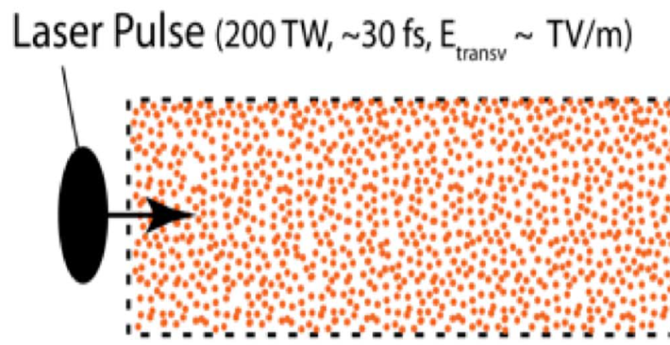
Plasma
= free electrons and ions
Our case – cold neutral plasma, electrons and ions at rest
Ions are heavy – ignore their motion
Driving wakefields = creating harmonic oscilations of plasma electrons
Oscillation frequency: $ω_{pe}\sim \sqrt{n_{pe}}$ depends on plasma density
Driver
Plasma
Witness
Driver
Ions
Electrons – oscillating at ω_{pe}

Slide 6
Driving wakefields
$$W_{z}(ξ)=K\int_{−∞}^{ξ^{}}{n_{b}\cos{[k_{pe}\left(ξ−ξ^{′}\right)]}dξ^{′}}$$
Effectively?
Made by John Farmer
Driver longer than half of the period cannot drive wakefields effectively
+
Maximum sustainable wakefield amplitude:
$E_{wb}= \frac{m_{e}cω_{pe}}{e}=\frac{2πm_{e}c^{2}}{eλ_{pe}}≈\frac{1}{σ_{z}}$

Slide 7
Driving wakefields
To highest energies in one stage
Plasma does not provide energy, the drive bunch does
=> Energy gained by witness ≤ Energy lost by driver
Energy carried by:
Laser pulse | ≈ 10s J, < 100 fs
Electron bunch | ≈ 10s J, < 1 ps
Proton bunch | ≈ 10s kJ, ≈ 1 ns
Short plasma stage with high gradient
$$E_{wb}\sim \frac{1}{σ_{z}}$$
Reminder -
Very long plasma stage, but small gradient
How to use large energy from a long proton bunch?

Slide 8
Simulations
Solve Newton equations of motion and Maxwell equations numerically to describe the plasma processes.

Slide 9
Particle-in-cell (PIC) simulations
$$\left(B_{j},E_{j}\right)$$
$$\frac{du}{dt}=\frac{q}{m}\left(E+\frac{1}{γc}u×B\right)$$
$$u_{j}$$
$$x_{j}$$
$$\left(B_{j},E_{j}\right)$$
apply equations of motion
deposit charge density and current on the grid
apply Maxwell’s equations
interpolate fields to particle positions
$$F_{i}→u_{i}→x_{i}$$
$$\left({ρ_{i},j}_{i}\right)$$
$$\left({ρ_{i},j}_{i}\right)$$
$$\left(B_{j},E_{j}\right)→F_{i}$$
$$Δt$$
$$\left(x_{j},u_{j}\right)→{ρ_{i},j}_{i}$$
Particles placed inside the cells
Density, current, and fields calculated on the grid
Particles pushed
$$\left({ρ_{i},j}_{i}\right)→B_{j},E_{j}$$
$$\frac{∂E}{∂t}=c^{2}\vec{∇}×B−\frac{μ_{0}}{ε_{0}}j$$
$$\frac{∂B}{∂t}=−\vec{∇}×E$$
$$\frac{ρ}{ε_{0}}=\vec{∇}∙E$$

Slide 10
Osiris at AWAKE

Slide 11
Self-modulation
The genius idea behind AWAKE
[*] N.Kumar et al (2010) Phys. Rev. Lett. 104, 255003

Slide 12
Wakefields driven by a proton bunch
decelerating fields for protons
defocusing fields for protons
Plasma electron
Proton bunch drive
-
-
-
-
-
-
-
-
-
-
-
-
-
-
-
-
-
+ + + + + + + + + + + + + + + + + + + + + + + + + + + + + + + + + + + + + + + + + + + + + + + +
+ + + + + + + + + + + + + + + + + + + + + + + + + + + + + + + + + + + + + + + + + + + + + + + +
+ + + + + + + + + + + + + + + + + + + + + + + + + + + + + + + + + + + + + + + + + + + + + + + +
+ + + + + + + + + + + + + + + + + + + + + + + + + + + + + + + + + + + + + + + + + + + + + + + +
+ + + + + + + + + + + + + + + + + + + + + + + + + + + + + + + + + + + + + + + + + + + + + + + +
+ + + + + + + + + + + + + + + + + + + + + + + + + + + + + + + + + + + + + + + + + + + + + + + +
-
-
-
-
-
-
-
-
-
-
-
-
-
-
-
-
-
-
-
-
-
-
-
-
-
-
-
-
-
-
-
-
-
-
-
-
-
-
-
-
-
-
-
-
-
-
-
-
-
-
-
-
-
-
-
-
-
-
-
-
-
-
-
-
-
-
-
-
-
-
-
-
-
-
-
-
-
-
-
-
-
-
-
-
-
-
-
-
-
-
-
-
-
-
accelerating fields for protons
focusing fields for protons
Plasma ion background
Proton bunch attracts plasma electrons transversely
Plasma electrons concentrate on axis and repel each other
Then they are pulled back to axis by the ion background
The process repeats

Slide 13
Self-modulation (SM) process
decelerating fields for protons
defocusing fields for protons
Plasma electron
Proton bunch drive
-
-
-
-
-
-
-
-
-
-
-
-
-
-
-
-
+ + + + + + + + + + + + + + + + + + + + + + + + + + + + + + + + + + + + + + + + + + + + + + + + + + Rb Rb
+ + + + + + + + + + + + + + + + + + + + + + + + + + + + + + + + + + + + + + + + + + + + + + + + + + + Rb Rb
+ + + + + + + + + + + + + + + + + + + + + + + + + + + + + + + + + + + + + + + + + + + + + + + + + + + Rb Rb
+ + + + + + + + + + + + + + + + + + + + + + + + + + + + + + + + + + + + + + + + + + + + + + + + + + + Rb Rb
+ + + + + + + + + + + + + + + + + + + + + + + + + + + + + + + + + + + + + + + + + + + + + + + + + + + Rb Rb
+ + + + + + + + + + + + + + + + + + + + + + + + + + + + + + + + + + + + + + + + + + + + + + + + + + + Rb Rb
-
-
-
-
-
-
-
-
-
-
-
-
-
-
-
-
-
-
-
-
-
-
-
-
-
-
-
-
-
-
-
-
-
-
-
-
-
-
-
-
-
-
-
-
-
-
-
-
-
-
-
-
-
-
-
-
-
-
-
-
-
-
-
-
-
-
-
-
-
-
-
-
-
-
-
-
-
-
-
-
-
-
-
-
-
-
-
-
-
-
-
-
accelerating fields for protons
focusing fields for protons
Ionizing laser pulse
Plasma ion background
Bunch with a steep cut in the density profile drives seed wakefields
Protons are repelled or attracted to the axis due to the focusing and defocusing fields

Slide 14
Self-modulation (SM) process
decelerating fields for protons
defocusing fields for protons
Plasma electron
Proton bunch drive
-
-
-
-
-
-
-
-
-
-
-
-
-
-
-
-
+ + + + + + + + + + + + + + + + + + + + + + + + + + + + + + + + + + + + + + + + + + + + + + + + + + Rb Rb
+ + + + + + + + + + + + + + + + + + + + + + + + + + + + + + + + + + + + + + + + + + + + + + + + + + + Rb Rb
+ + + + + + + + + + + + + + + + + + + + + + + + + + + + + + + + + + + + + + + + + + + + + + + + + + + Rb Rb
+ + + + + + + + + + + + + + + + + + + + + + + + + + + + + + + + + + + + + + + + + + + + + + + + + + + Rb Rb
+ + + + + + + + + + + + + + + + + + + + + + + + + + + + + + + + + + + + + + + + + + + + + + + + + + + Rb Rb
+ + + + + + + + + + + + + + + + + + + + + + + + + + + + + + + + + + + + + + + + + + + + + + + + + + + Rb Rb
-
-
-
-
-
-
-
-
-
-
-
-
-
-
-
-
-
-
-
-
-
-
-
-
-
-
-
-
-
-
-
-
-
-
-
-
-
-
-
-
-
-
-
-
-
-
-
-
-
-
-
-
-
-
-
-
-
-
-
-
-
-
-
-
-
-
-
-
-
-
-
-
-
-
-
-
-
-
-
-
-
-
-
-
-
-
-
-
-
-
-
-
accelerating fields for protons
focusing fields for protons
Ionizing laser pulse
microbunches
Plasma ion background
The modulation of the proton bunch density makes the plasma electrons more attracted or repelled from axis
→ feedback loop: protons completely expelled from or focused to the axis.
→ train of microbunches separated by $\sim λ_{p}$,
coherently drives wakefields

Slide 15
SM in simulations

Slide 16
AWAKE today
CERN project in collaboration with almost 20 institutes (MPP is the main one)
Construction started in 2014, finished 2016
First electron acceleration in 2018

Slide 17
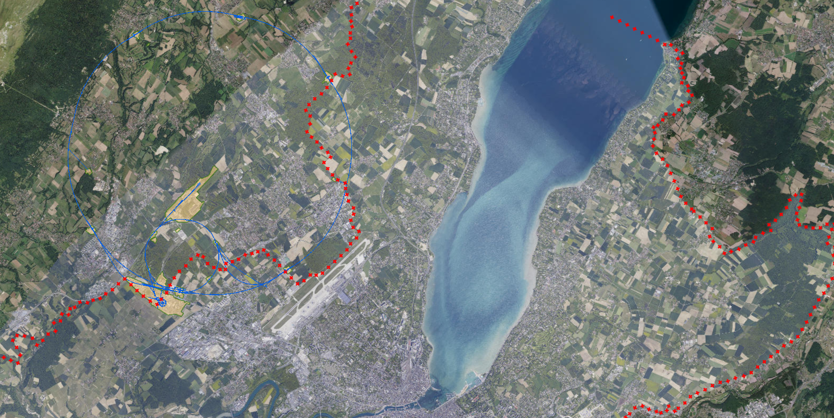
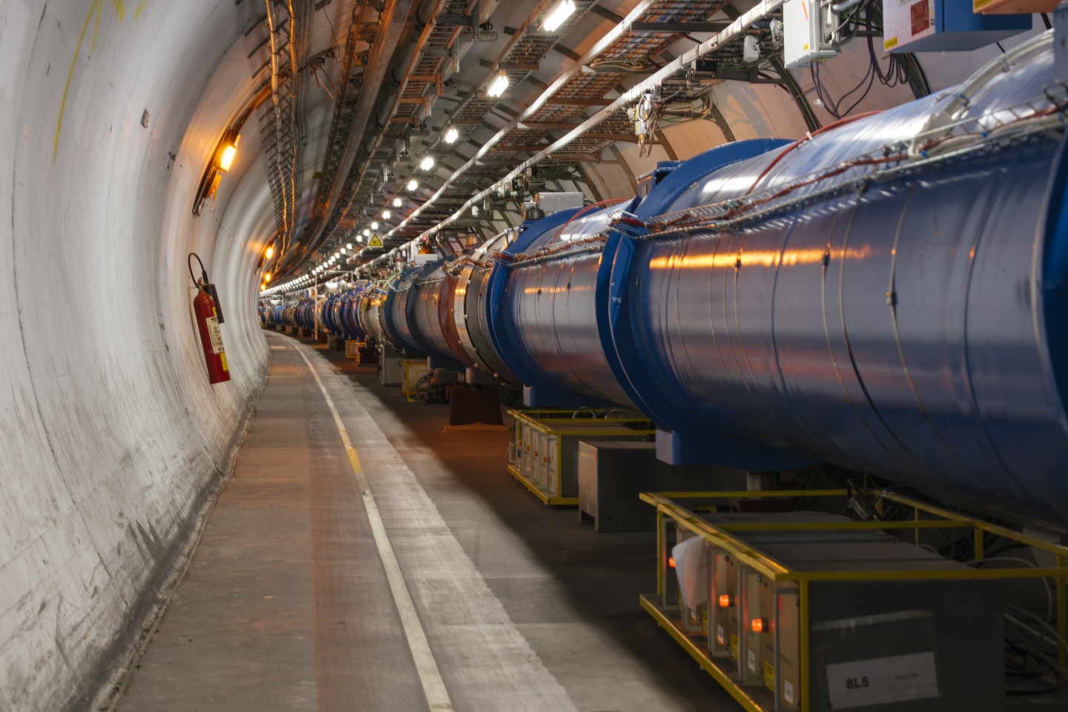
LHC
AWAKE
Geneva

Slide 18
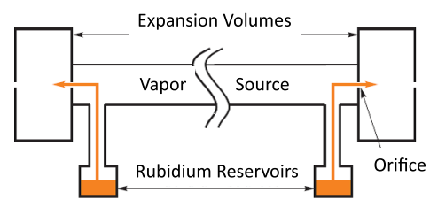
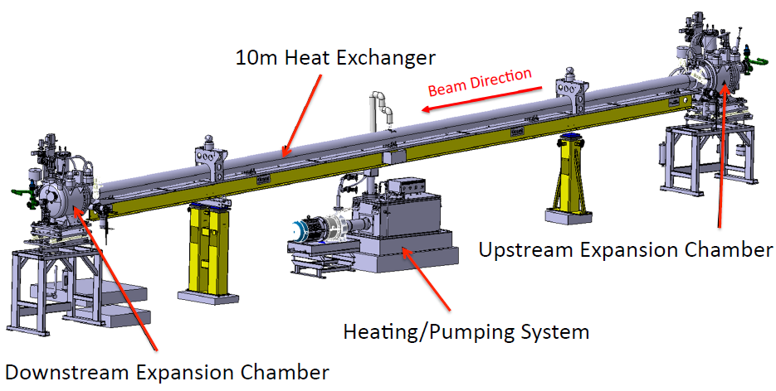
AWAKE today
Use rubidium for the plasma because:
Low ionization potential of the first electron (4.1 eV)
High vapor pressure, meaning desired density achievable around 200°C
Melting point 39.48°C, condensates on the walls maintained at room temperature
G. Plyushchev et al 2018 J. Phys. D: Appl. Phys. 51 025203

Slide 19
AWAKE today - facility
Vapor source is heated to obtain sufficient Rb density
Laser pulse ionizes Rb -> vapor density = plasma density
Proton bunch drives wakefields
Electron bunch is injected and gains energy
Demonstrated 2 GeV (2018)

Slide 20
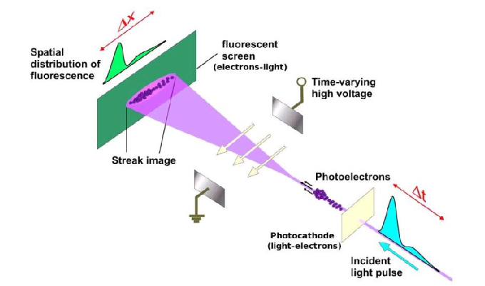
AWAKE today – streak camera
Make self modulation visible
Time resolved measurement of the bunch is needed
Optical Transition Radiation is prompt, easy to operate and has good spatial resolution
x
t [1 ns]
M. Mahgoub et al., MOPPP032

Slide 21
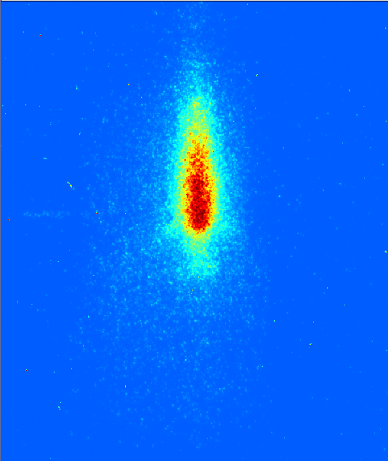
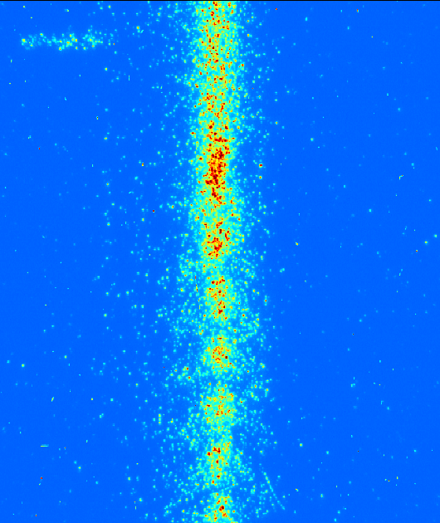
AWAKE today – streak camera
No plasma
Plasma
73 ps time window
Laser pulse
@ n_{Rb,e}= 2.13e¹⁴cm⁻³
@ n_{Rb,e}= 2.13e¹⁴cm⁻³
Position (px)
Position (px)
Time (ps)
Courtesy of Fabian Batsch

Slide 22
Self-modulation in plasmas with linear density gradients

Slide 23
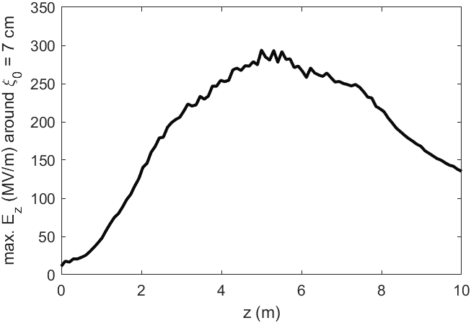
Wakefields’ amplitude
In a constant density plasma, wakefields’ amplitude driven by a modulated bunch decays
phase shift during SM growth ($v_{ph}<v_{b}$) [3,4]
→ fields and microbunches are out of phase
→ continuous evolution of the microbunch train
phase velocity of the wakefields
velocity of the bunch
position along the bunch
[3] A. Pukhov et al (2011) Phys. Rev. Lett. 107, 145003
[4] C. B. Schroeder et al (2011) Phys. Rev. Lett. 107, 145002.

Slide 24
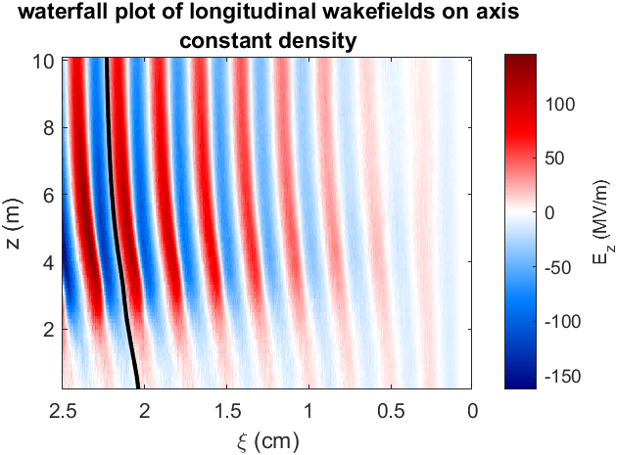
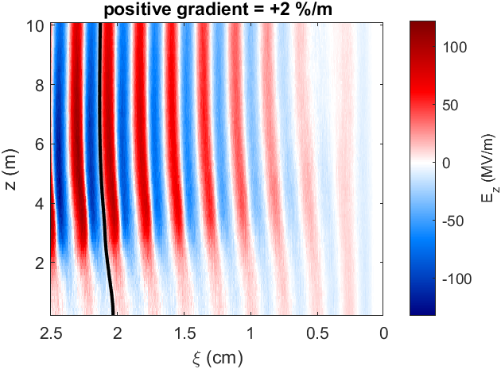
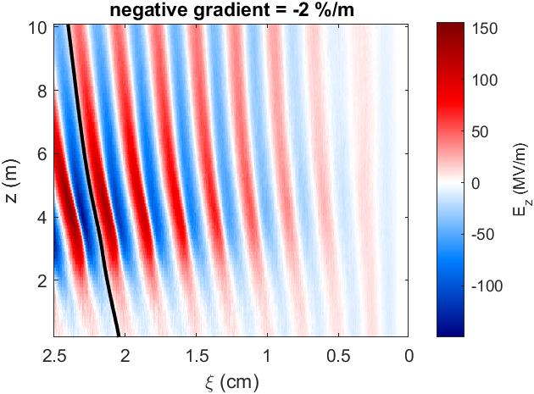
Linear plasma density gradient
By introducing a density gradient, λp either
… lengthens, enhancing …
… shortens, counteracting …
the phase shift during the SM
Positive gradients can …
mitigate the dephasing and maintain high amplitude wakefields for a longer distance.
preserve more charge in the microbunch train
AWAKE measured its effects through the final state of the microbunches [1].
Decreased phase shift
Larger phase shift
[1] F. Braunmüller and T. Nechaeva (AWAKE Collaboration), PRL 125, 264801

Slide 25
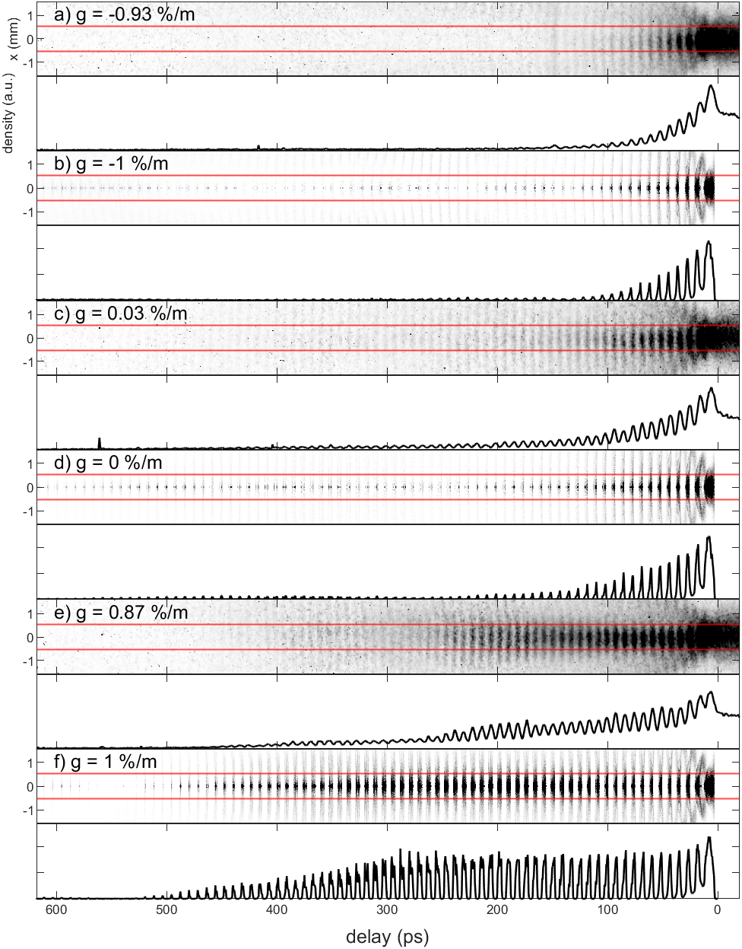
Charge fraction of the modulated proton bunch
$$σ_{r}$$
Charge fraction in the region within one $σ_{r}$ (rms radius) around the axis
(normalized to charge in the same region of an unmodulated proton bunch).
Simulations and experiment show two groups:
$g≤0 \%/m$: low charge fraction.
$g>0 \%/m$: high charge fraction.
Charge from the microbunches
Charge from the co-propagating bunch head
$$+$$
Experimental data from [1].
[1] F. Braunmüller and T. Nechaeva (AWAKE Collaboration), Phys. Rev. Lett. 125, 264801

Slide 26
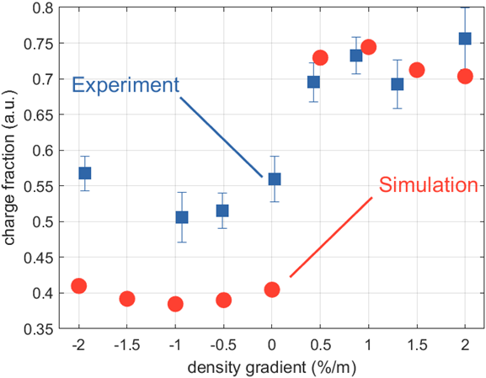
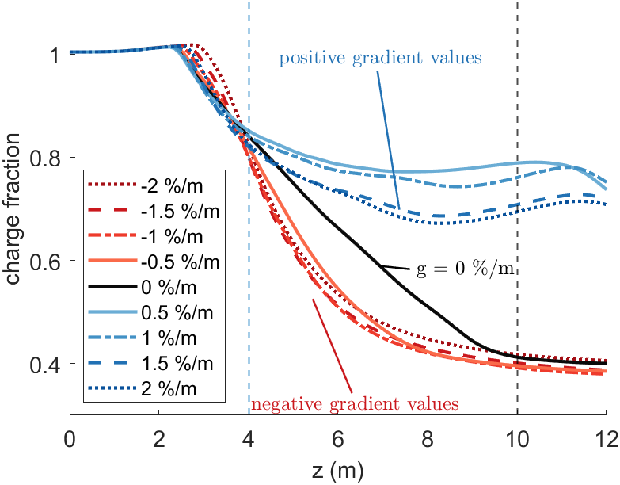
Charge fraction evolution
Plasma 10 m, then ballistic vacuum propagation 2 m.
Positive and negative gradients separate at 4 m, constant density stays in between until before the end of the plasma.
plasma end

Slide 27
Dephasing middle of the bunch, g = -2 %/m

Slide 28
Dephasing middle of the bunch, g = +0.5 %/m

Slide 29
SMI and SSM

Slide 30
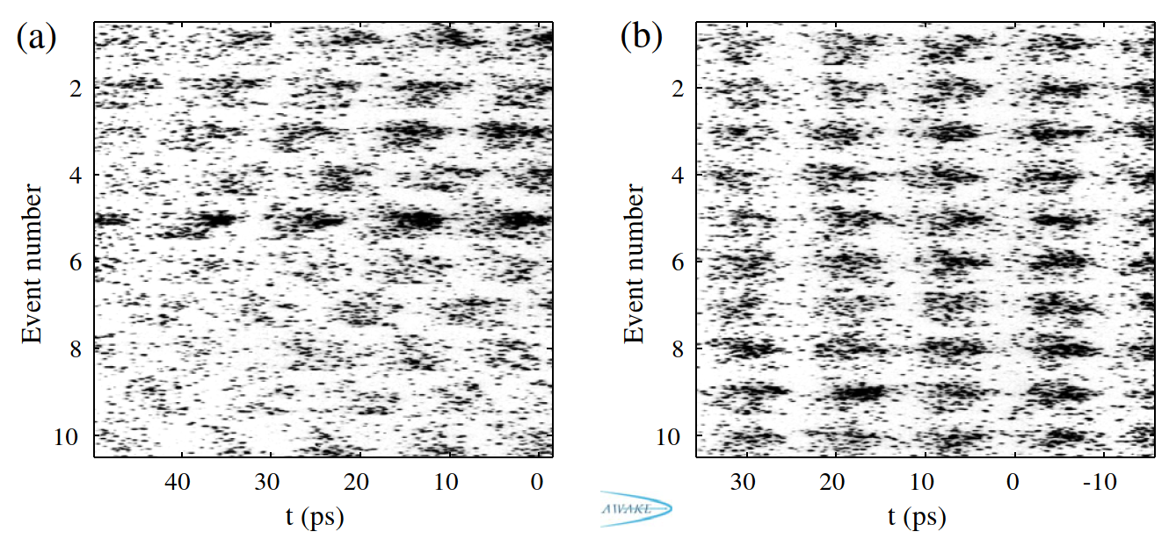
Seeded modulation or instability?
Self modulation instability (SMI)
Self seeded modulation (SSM)
Modulation grows from “noise”
Phase of the wakefields varies from event to event
Modulation grows from a seed
Phase of the wakefields is stable*
* Within measurement error
F. Batsch et al. (2021) PRL

Slide 31
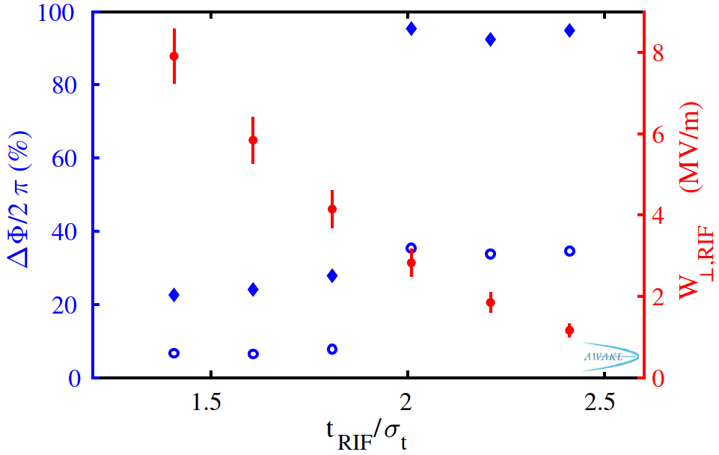
Transition from SMI to SSM
By changing the position of the RIF, one can obtain SSM or SMI
In the SMI case, the modulation start varies wrt RIF
Computed seed amplitude
Phase variations
F. Batsch et al. (2021) PRL

Slide 32
Simulations conclusions
Simulations can …
support and explain experimental results, by showing parts of the process not accessible in the experiment
make predictions when the theoretical solutions have no analytical form
The study and understanding of the self-modulation process is necessary to reliably accelerate electron bunches
The combined simulation and experimental results from the plasma density gradients allowed us to prove the theory behind self-modulation.

Slide 33
Experimental conclusions
The experimental layout of AWAKE has been presented
Long drive particle bunches undergo self modulation, which has been demonstrated by streak camera images
Plasma gradients and their effect on the wakefields has been shown
Different types of self modulation (SMI, SSM) were discussed

Slide 34
Virtual visit
https://my.matterport.com/show/?m=21e5ne2M9TV

Slide 35
Supporting slides

Slide 36
Phase velocity and amplitude of the wakefields
Front
Dephasing is similar in all gradients
Middle
Clear difference in dephasing among gradients.
Charge evolution differs from 4 m.
Back
Difference in dephasing is amplified.
Most negative gradients have close to no charge left.

Slide 37
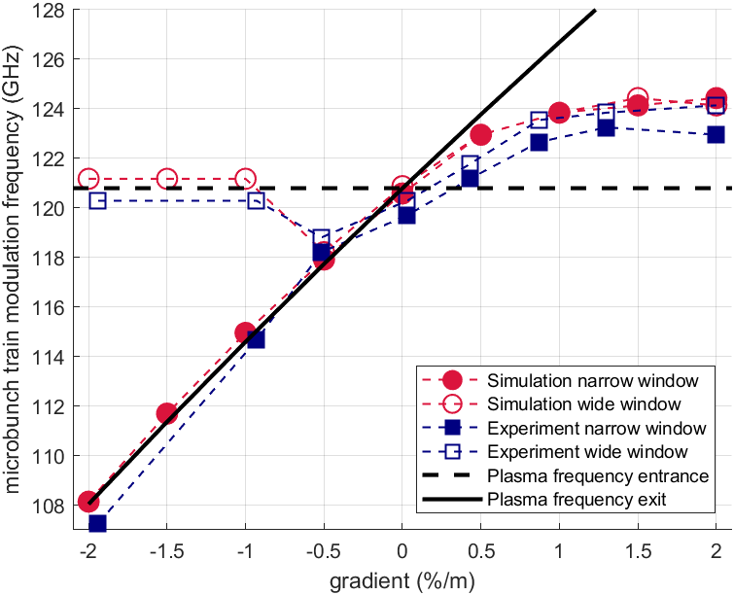
Modulation frequency in two transverse ranges
$$g=0 \%/m$$
Analysis ranges
$$ξ=\left[13,467\right] ps$$
$$r_{narrow}=\left[0,0.03\right] mm≈\left(\frac{σ_{r}}{2}\right)$$
$r_{wide}=\left[0,0.18\right] mm≈\left(3σ_{r}\right)$
for $g≤10 \%/m$:
$f_{mod}$ narrow range $≈f_{pe}(z=10 m)$
$f_{mod}$ wide range $≈f_{pe}(z=0 m)$
Modulation frequency as location of largest peak in DFT power spectrum

Slide 38
Modulation frequency vs transverse distance
A DFT analysis is performed to each slice
2D simulation results are mirrored about the axis to compare to both sides of the experimental images
Good agreement in behaviour between simulation and experiments
Proton distributions at large radii left wakefields early along the plasma

Slide 39
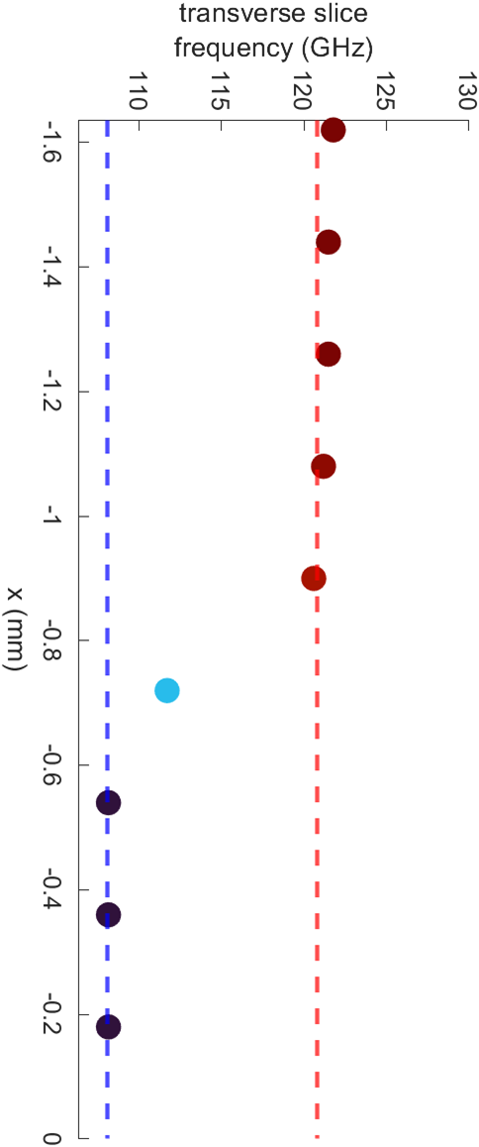
Tracks to confirm the origin of the frequencies
The width of the lines represents $\frac{\text{amplitude} \text{in} \text{power} \text{spectrum} \text{of} \text{frequency} \text{at} \text{z}\text{ = 13.5 }\text{m} }{\text{sum} \text{of} \text{charge} \text{density} \text{at} \text{slice} }$
Lower frequencies start appearing later in the propagation, and closer to the axis.
Higher frequencies start appearing earlier in the propagation, and leave the axis afterwards.

