Slide 1
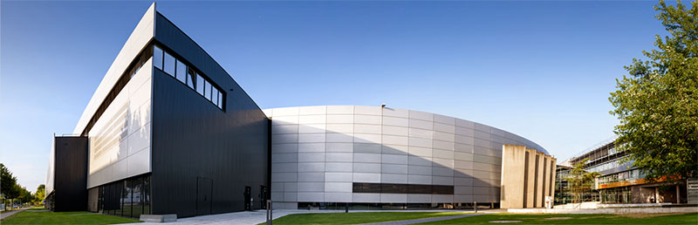
Improving Scanning X-Ray Microscopy
Using Silicon Sensors
Markus Weigand

Slide 2
Outline
STXM: An overview of an established method
Improving Detectors:
Si APDs for time resolved imaging
Fast in Vacuum CCDs for ptychography
Outlook: Detector Wishlist

Slide 3
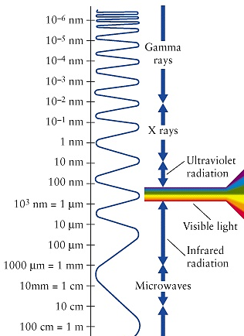
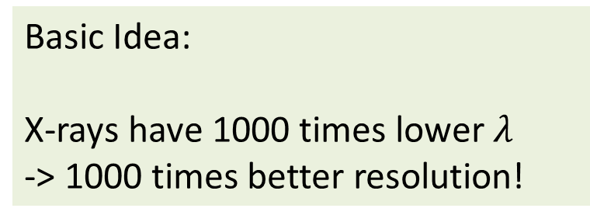
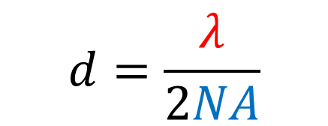
Why X-ray Microscopy?
Basic Idea:
X-rays have 1000 times lower $λ$
-> 1000 times better resolution!
Reality:
(soft) X-rays impossible to focus conventionally, requires diffractive optics
Consequences:
Need for Monochromatic, coherent x-ray light requires synchrotron sources
Resolution set by Abbes Limit:
$$d=\frac{λ}{2NA}$$

Slide 4
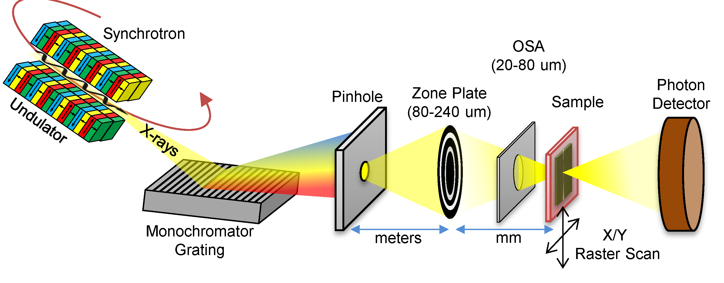
Scanning Transmission X-ray Microscopy
Operation Scheme:
Probe X-ray absorption on tiny focal spot
Image creation by sequential position scanning
Resolution given by spot size (<25nm)
X-ray absorption techniques as contrast mechanism

Slide 5
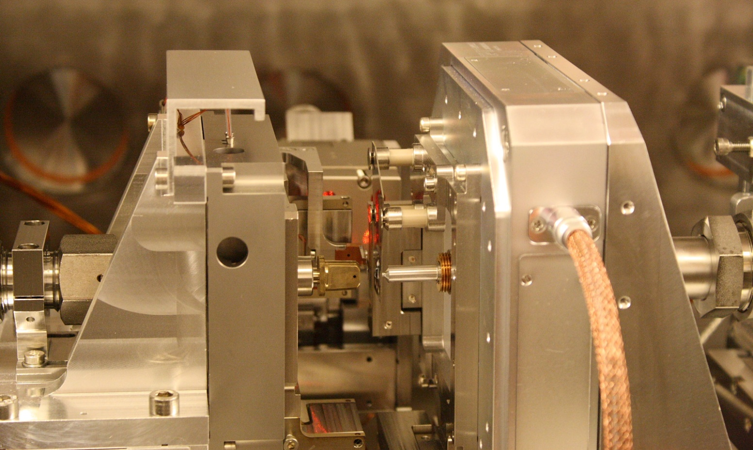
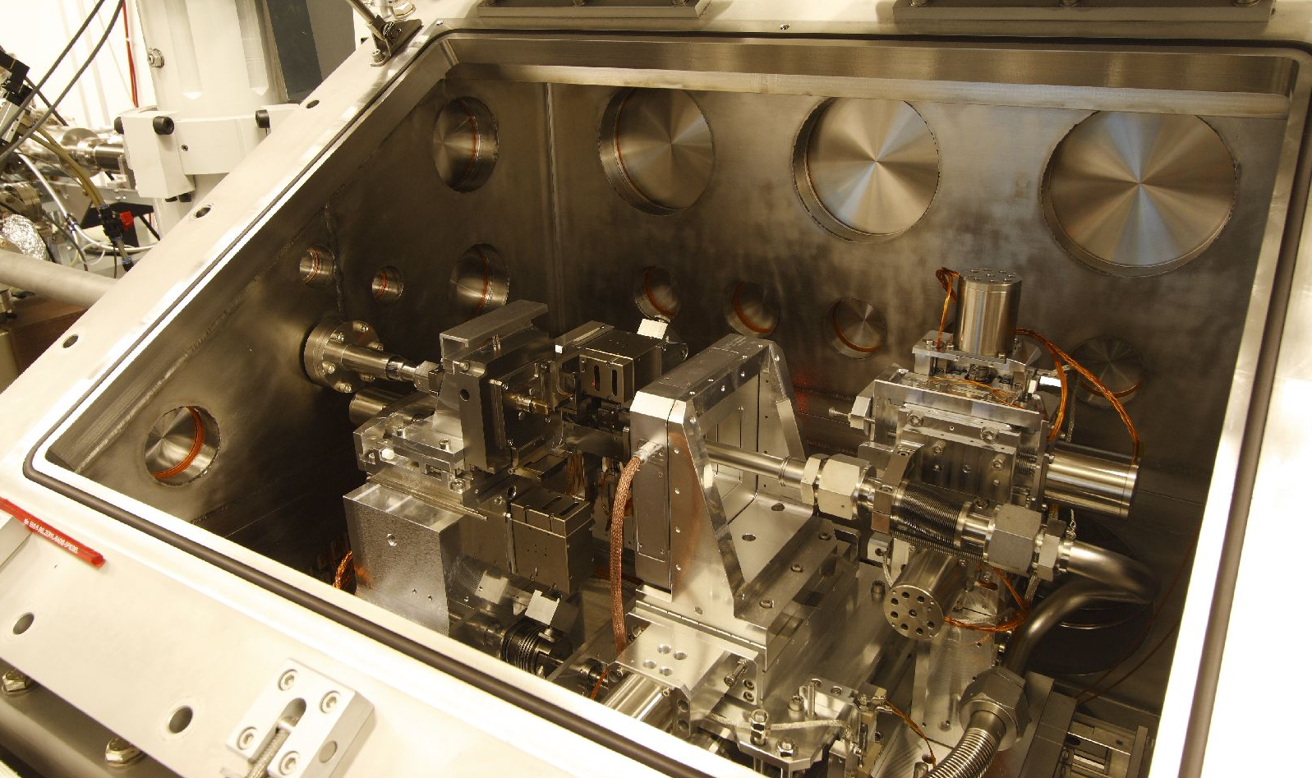
STXM in Real Life

Slide 6
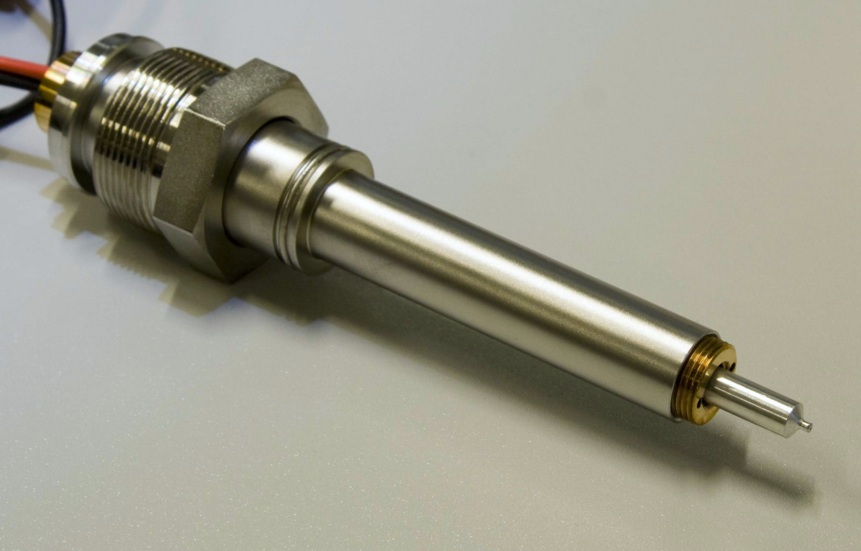
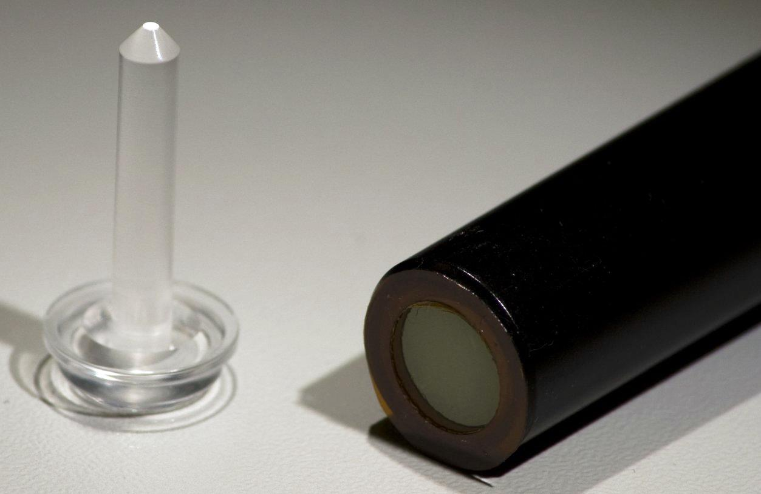
Photon Detection
P43 Phosphor
Lightguide
Photomultiplier Tube
Saturation at about 15M counts/s
Indirect detection -> Photon energy dependent count rate and noise statistics
Amplification of higher harmonic light pollution
Phosphor decay time O(1ms) -> prevents fast scanning
Very sensitive to magnetic fields
High voltage requires encapsulation
Susceptible to helium poisoning
But: Works Ok with good efficiency even at low photon energies

Slide 7
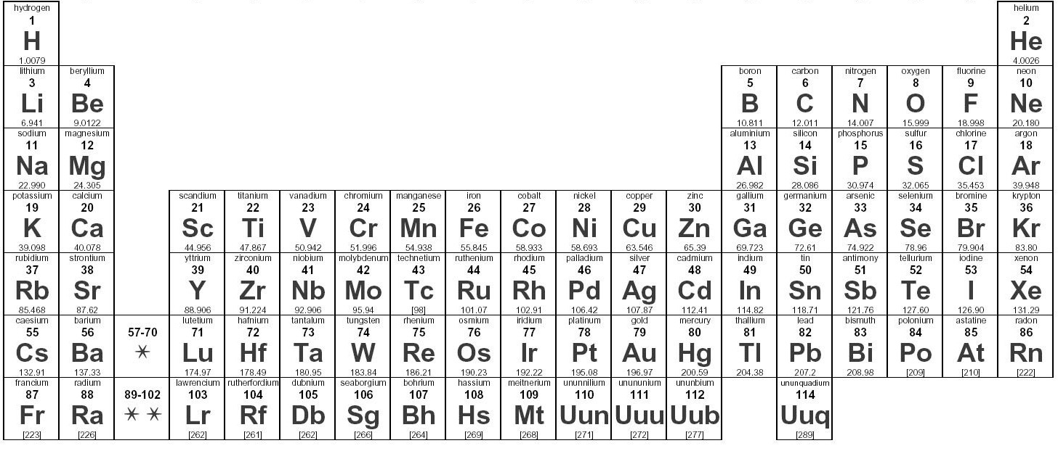
Why Soft X-rays?
Photon Energy not relevant for resolution
Low Photon energy -> high optical density
  Thin samples needed
  High elemental contrast for small objects
150-2000 eV can (almost) cover whole periodic table with single endstation configuration
K
L Edge
M

Slide 8
Analyzing Aerosols
Na pre-edge
Na post-edge
Na map
C map
Ca map
N map
O map
Fe map
Pöhlker et al.,
Science 337 (2012) 1075-1078

Slide 9
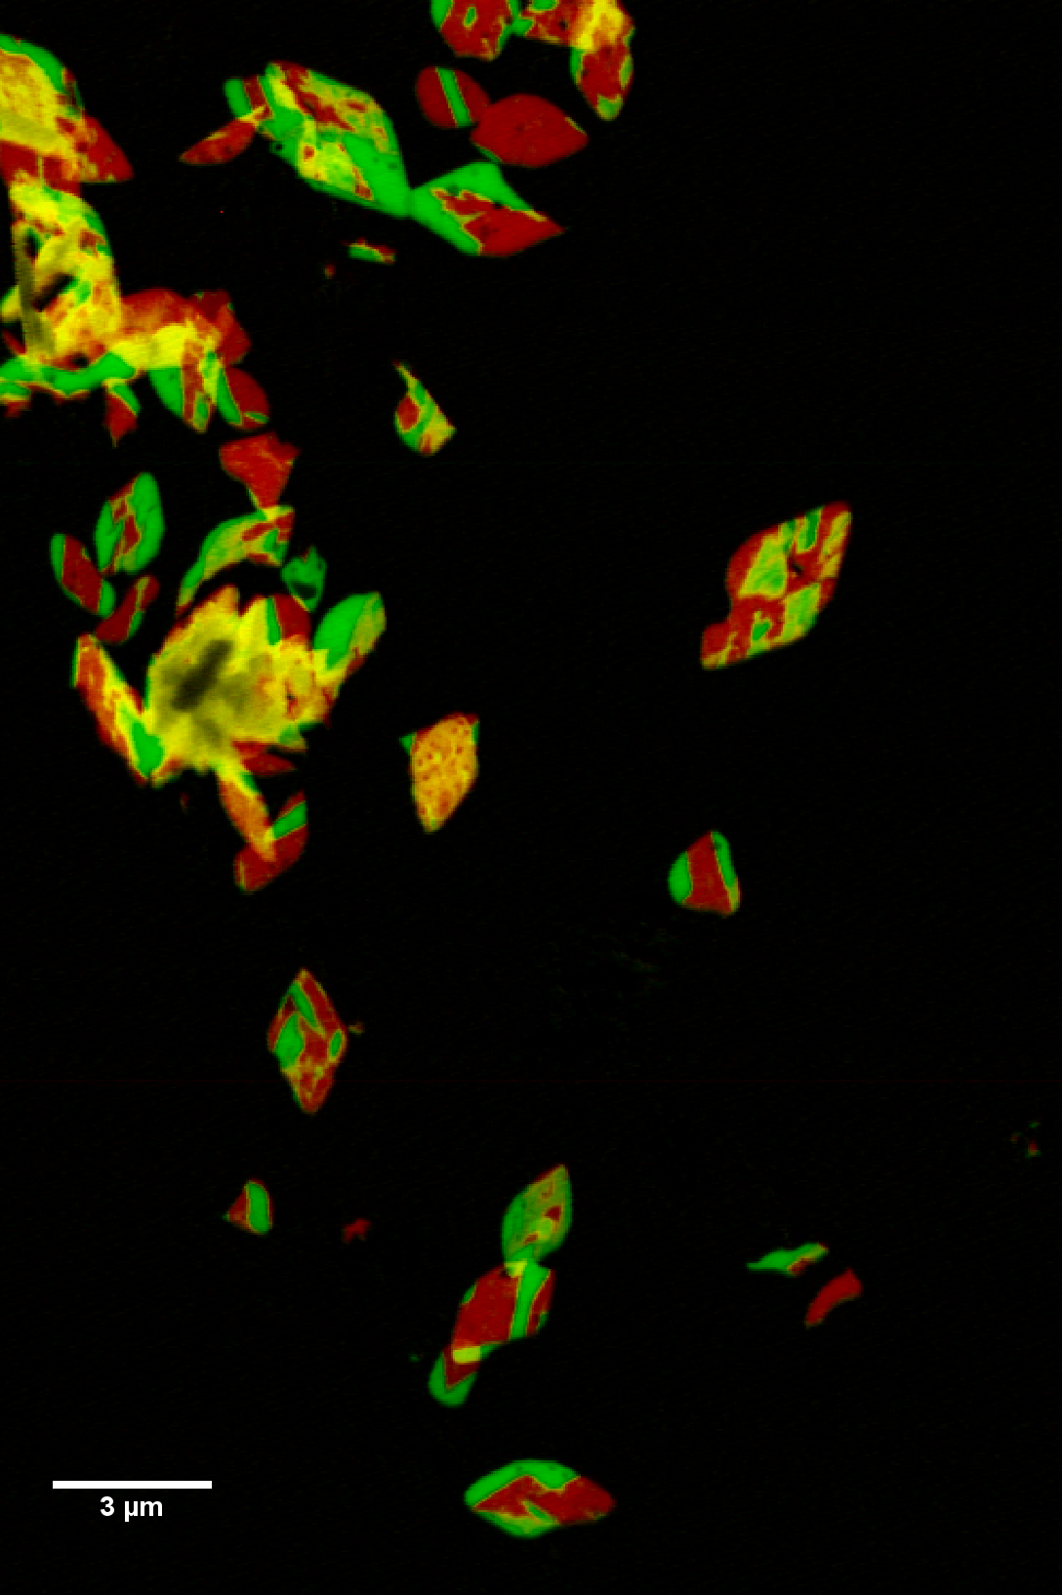
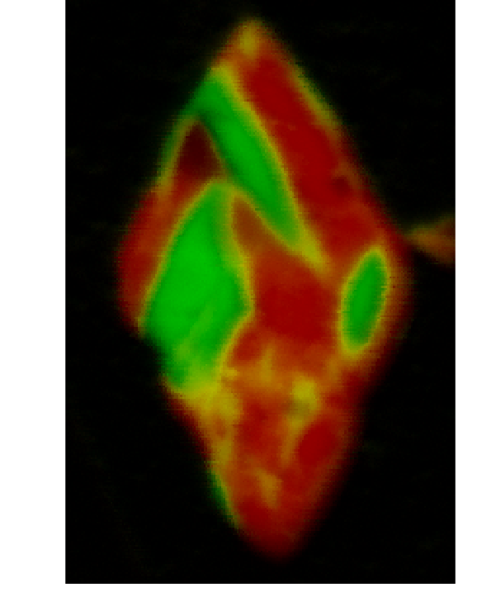
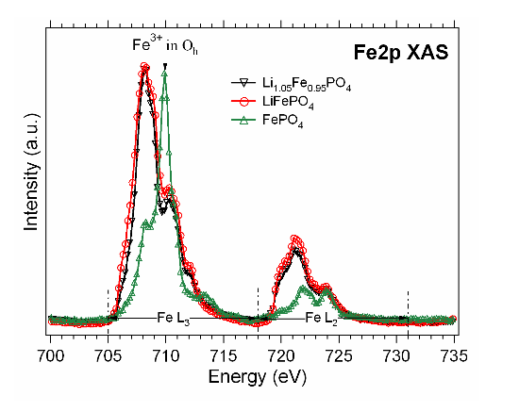

Imaging Battery Materials
Transmission
LiFePO₄
SiN
      Jongwoo Lim, W. Chueh, Y. Li
      William Chueh Group
      Materials Science and Engineering
Stanford University
1 µm
LiFe²⁺PO₄ (Discharged)
Fe³⁺PO₄ (Charged)

Slide 10
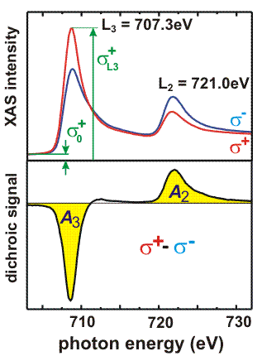
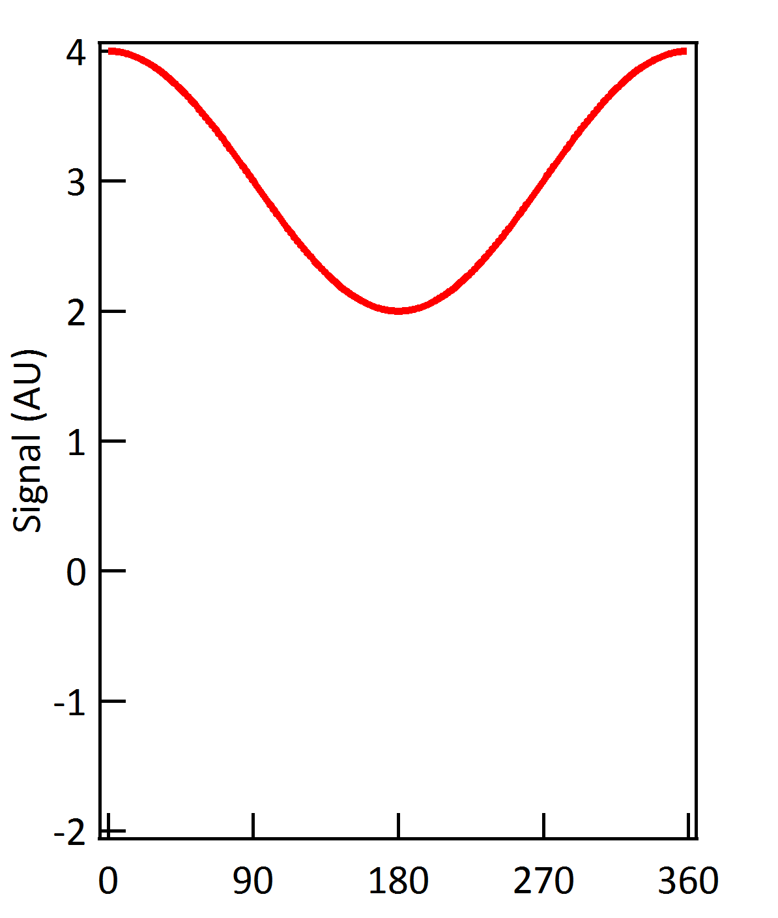
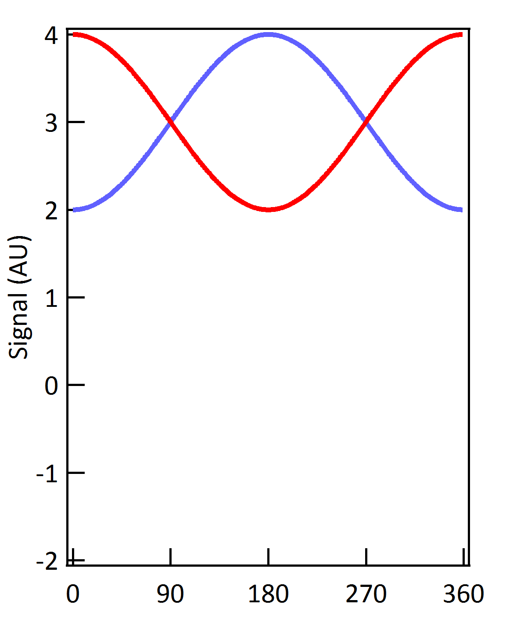
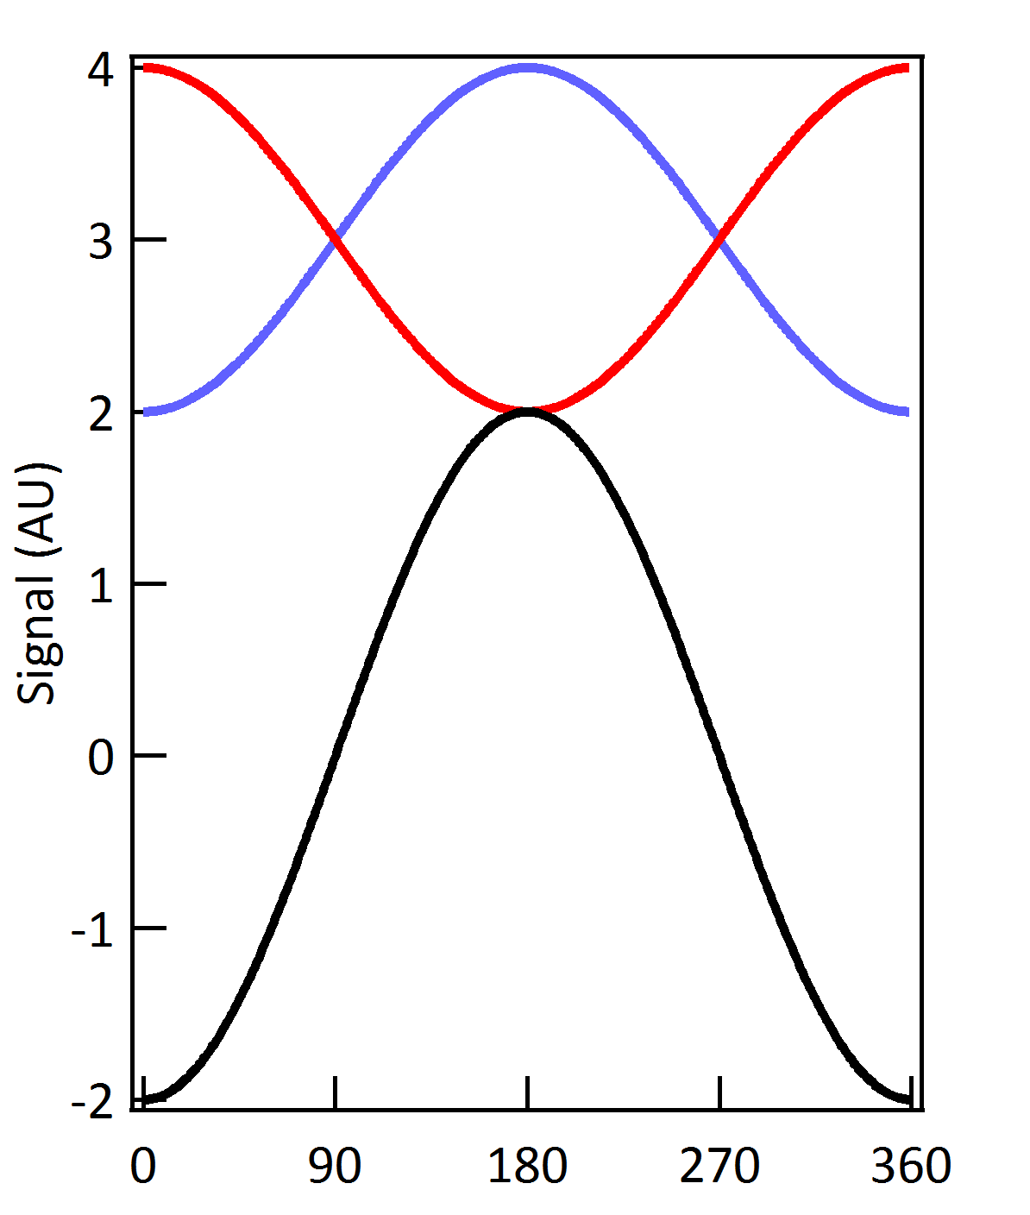
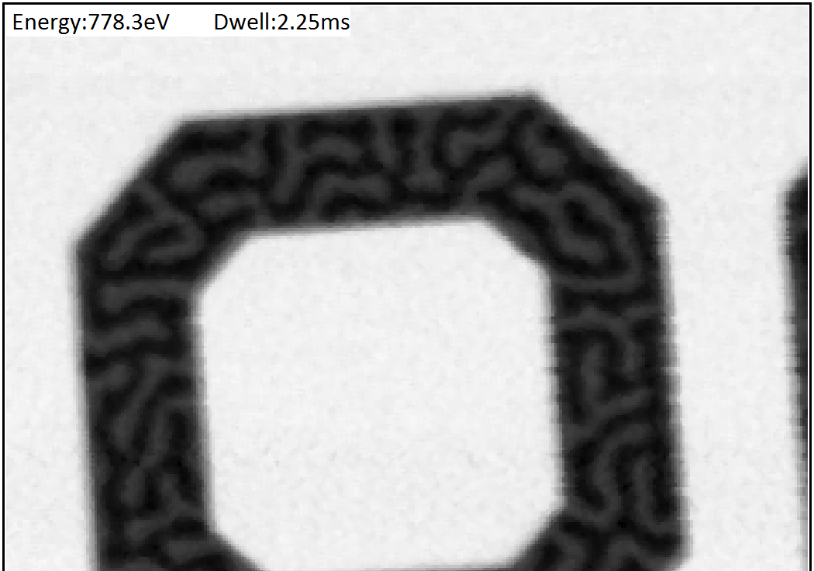
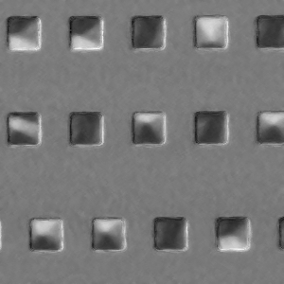



Magnetic Imaging
Thickness | Fe L-3 | Co L-3 | Ni L-3 | Gd M-5
0.1 nm | 0.3% | 0.3% | 0.1% | 0.6%
1 nm | 3.3% | 3.1% | 1.2% | 6.4%
5 nm | 17.6% | 16.5% | 6.2% | 36.3%
25 nm | 50.0% | 46.3% | 16.1% | 117.1%
Imaging local magnetization
Element specific imaging
Extremely fast
Very strong contrast:
$$\vec{M}$$
$$θ$$
$$θ$$
Notes:
Photon helicity erwähnen . > erleutern extraction static contrast
Evtl XMCD bild für domänen

Slide 11
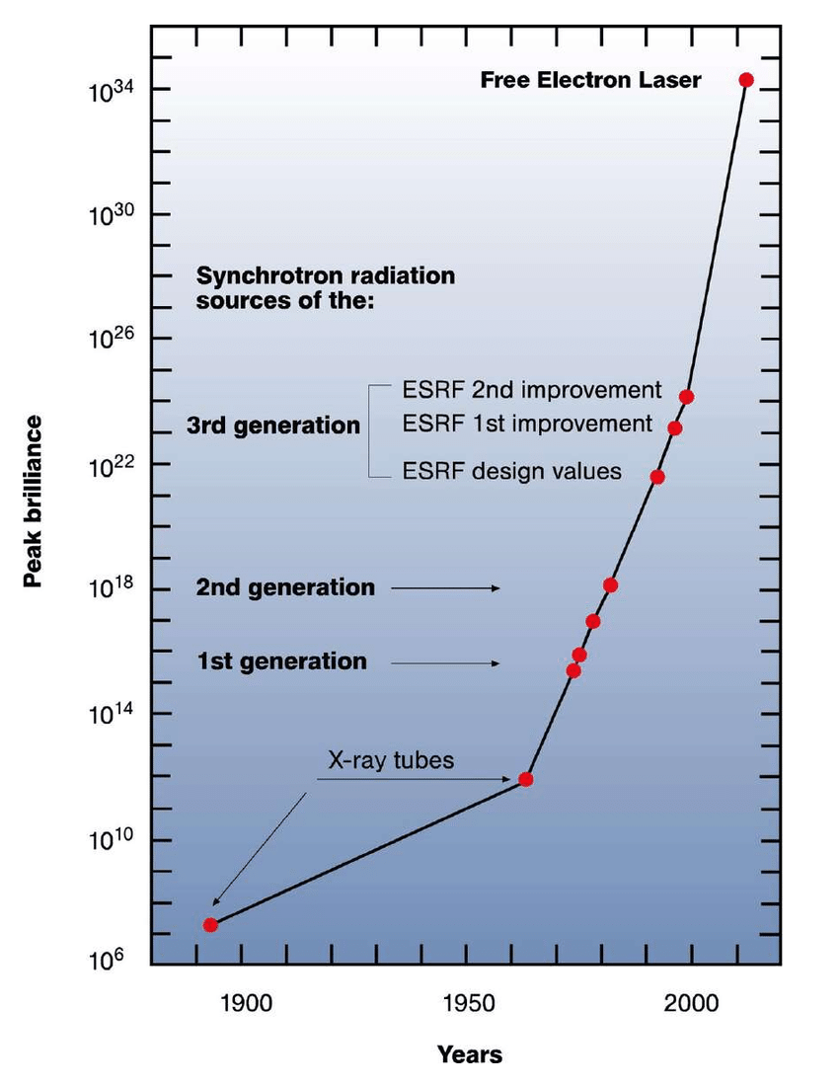
Time Marches ON
Dramatic increase
in light source brilliance
Increasing demands
from Experiments
Better Resolution
Faster Scanning
Better Image Fidelity
Time Resolved Imaging
Exploiting Beam Coherence
PMTs insufficient
for any of these requirements!

Slide 12
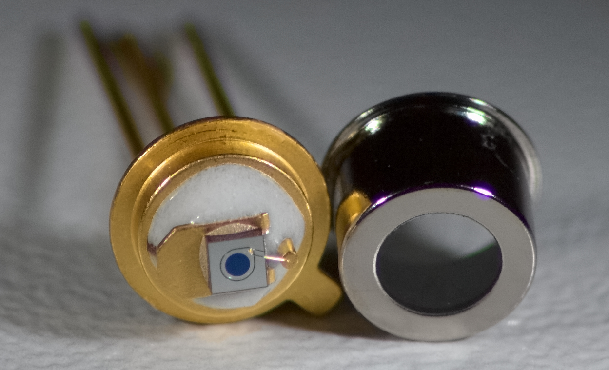
Si Avalanche Photodiodes
Designed for infrared, not x-rays!
Still work when decapped, though!
1300 eV Photons on Hamamatsu S2381
amplified by Femto HSA-Y-2-60
Short recovery times (<1ns), important due to time structure of source
1.5 OOM more linear photon handling capabilities (compared to PMT)
Internal gain: ca 18.5 e⁻ per eV for X-rays
Direct Detection (no phosphor delay) -> Photon tracking capability
SNR >10⁶ @ >10⁸ events/s

Slide 13
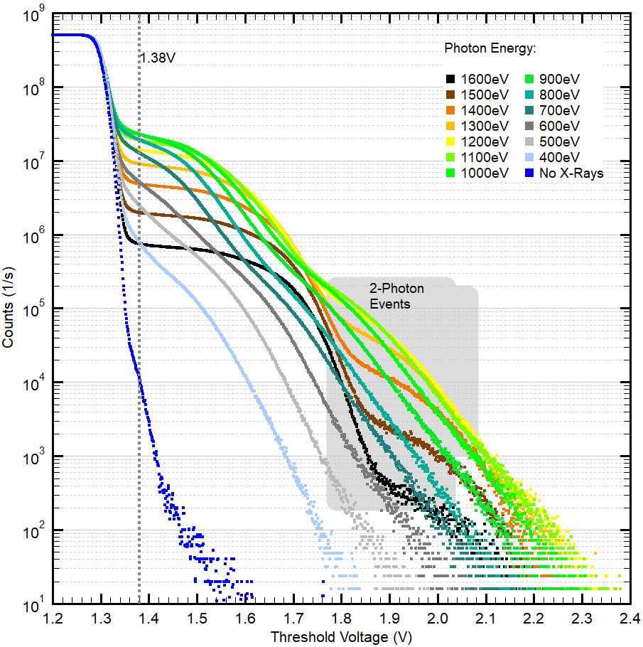
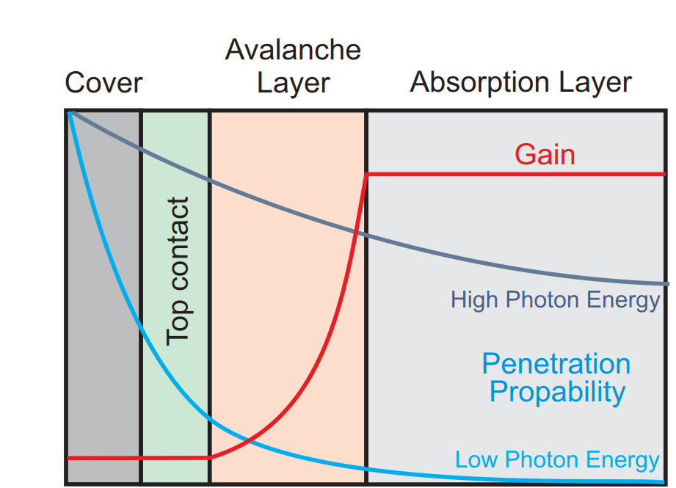
Energy Dependence of APD
Gain drops dramatic below 600 eV!
QE goes from apprx. 50% at 600ev to <1% at 300eV
-> Unusable for biological samples / ps chemistry!

Slide 14
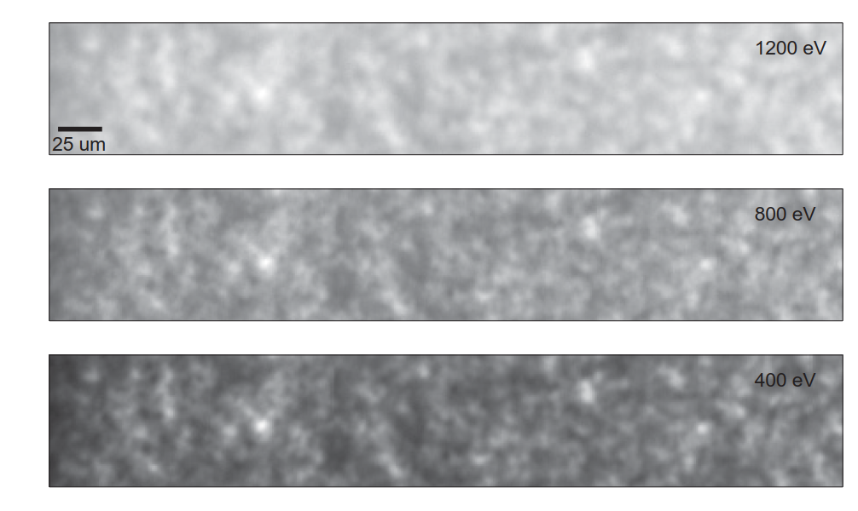
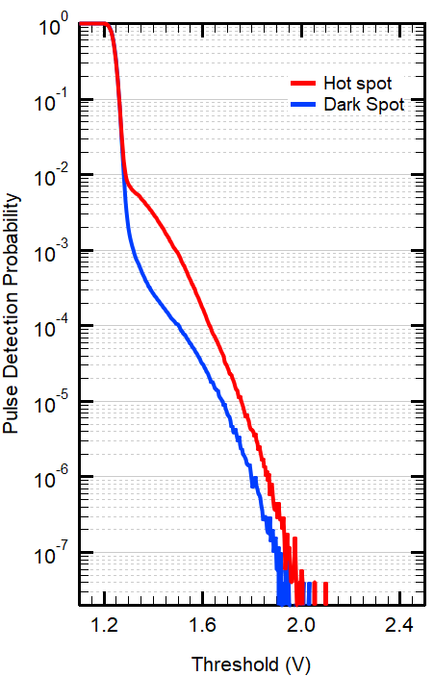
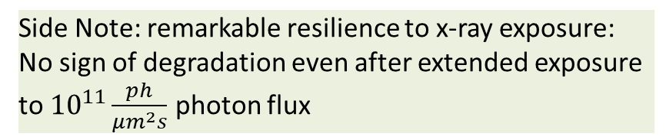
Looking at APDs on the nanoscale
Efficiency plot of the surface of an APD: Lower photon energies make hot and cold spots much more pronounced.
At 400eV, factor 10 split of QE!
Shift in peak indicated only 2 photon
events strong enough to be detected
Side Note: remarkable resilience to x-ray exposure:
No sign of degradation even after extended exposure
to ${10}^{11}\frac{ph}{{μm}^{2}s}$ photon flux

Slide 15
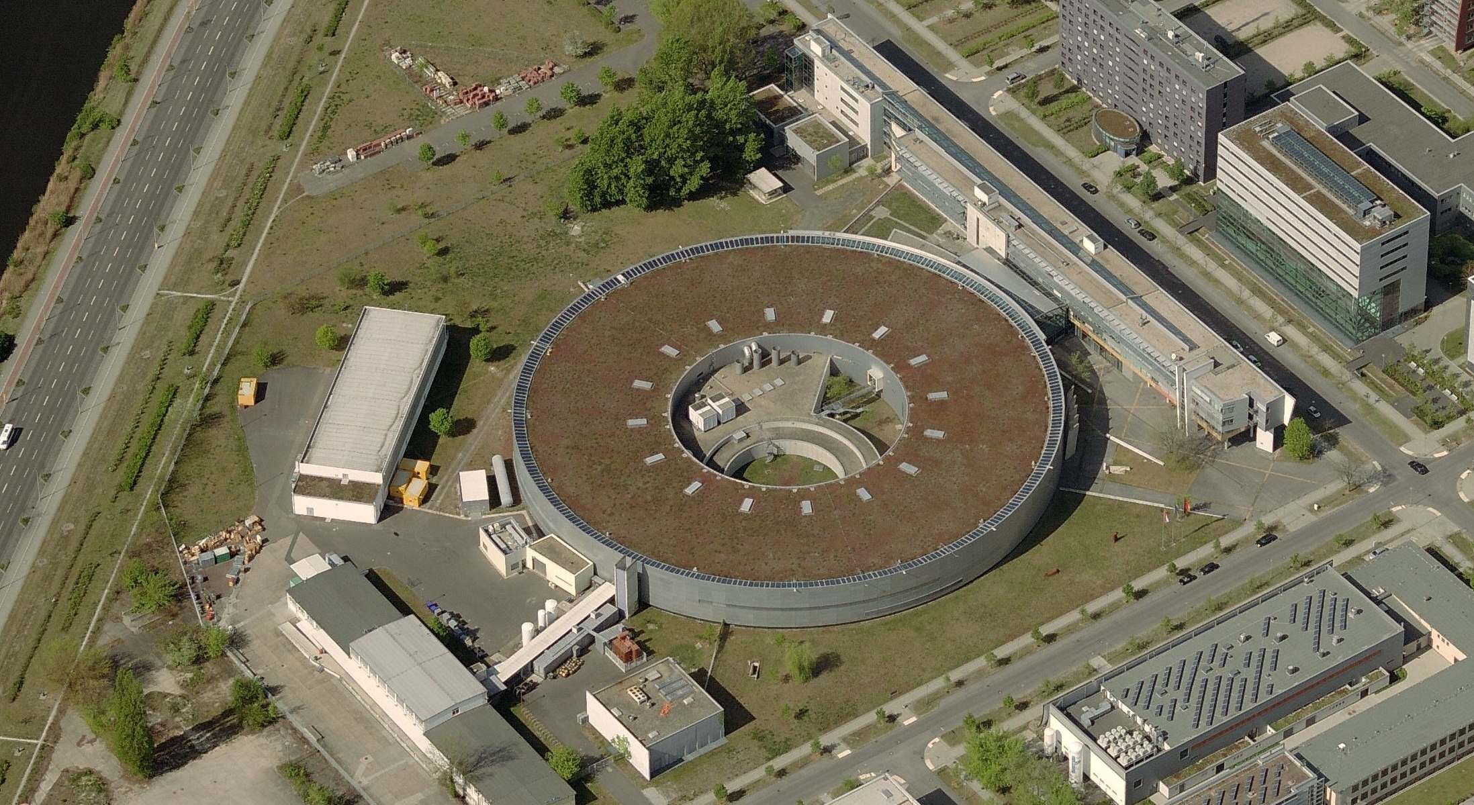
Time Resolved Microscopy
e
X-ray Pulses:
Insertion Device
Repetition Rate O(500 MHz)
Length: <50ps
X

Slide 16
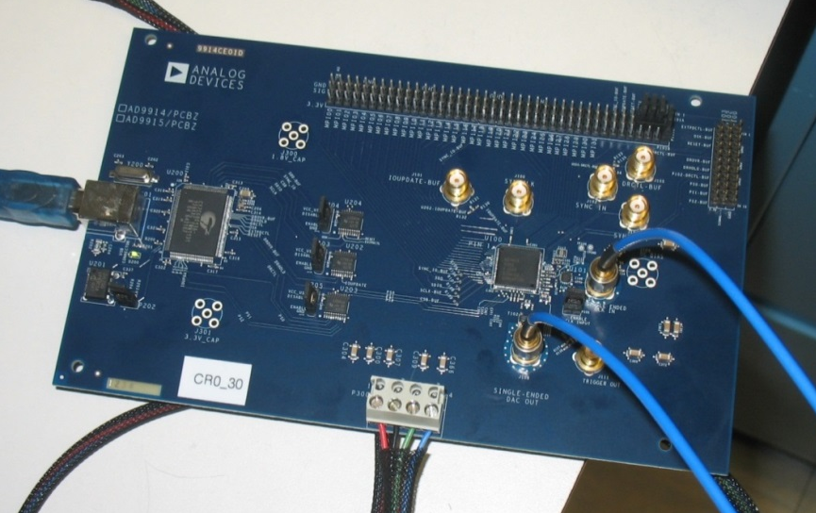
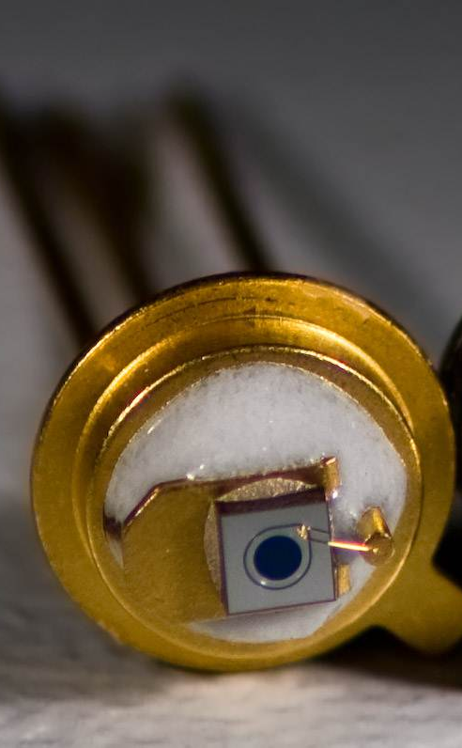
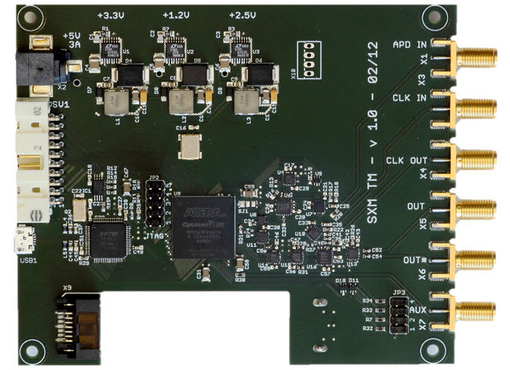

Pump-and-Probe Setup
System
Response
DDS Pump:
Direct RF or Pulse Trigger
Time
2ns
With the right tricks
Free choice of excitation parameters
Simultaneous acquisition of all time channels!
All buckets contribute to all time channels
Photon Detection
Photon Sorting
499.65 MHz
Sync
Synchroton
499.65 MHz
Sync

Slide 17
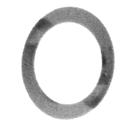

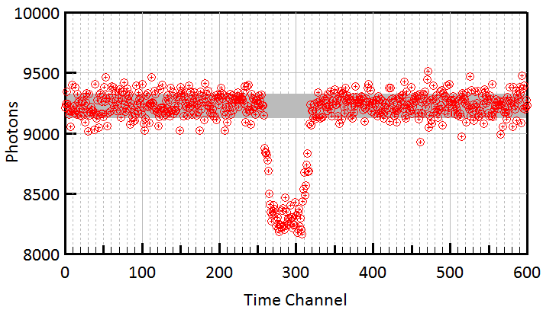

Controlling Domain Wall Motion
601 Channels
1.2us Period
A.Bisig, et. al.
Nature Commun 4, 2328
Raw Data
20 minute
measurement
J-S. Kim, et. al.
Nature Commun 5, 3429
$$\sqrt{N}$$
Purely shot-noise limited,
despite:
Usage of full Filling Pattern
Top-up Operation
Femto-Slicing Bunches

Slide 18
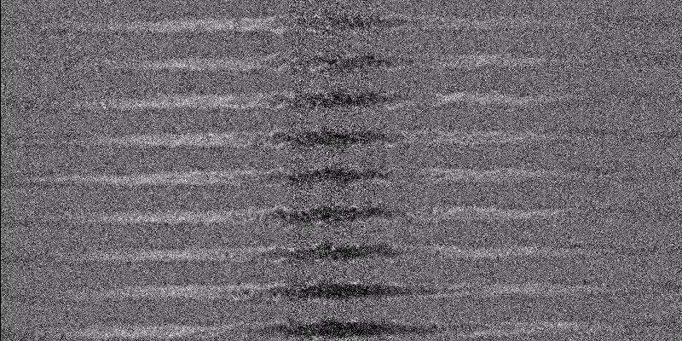

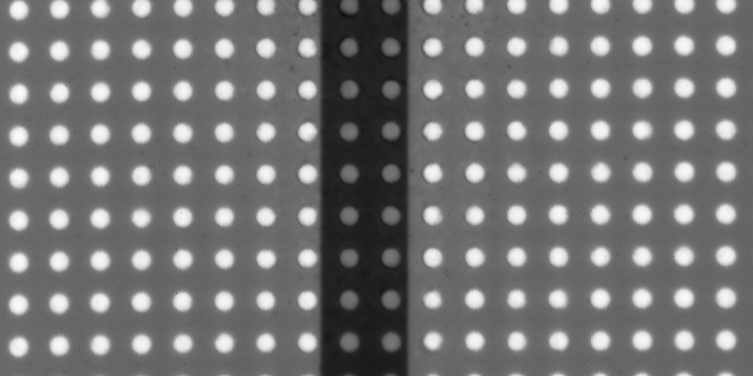
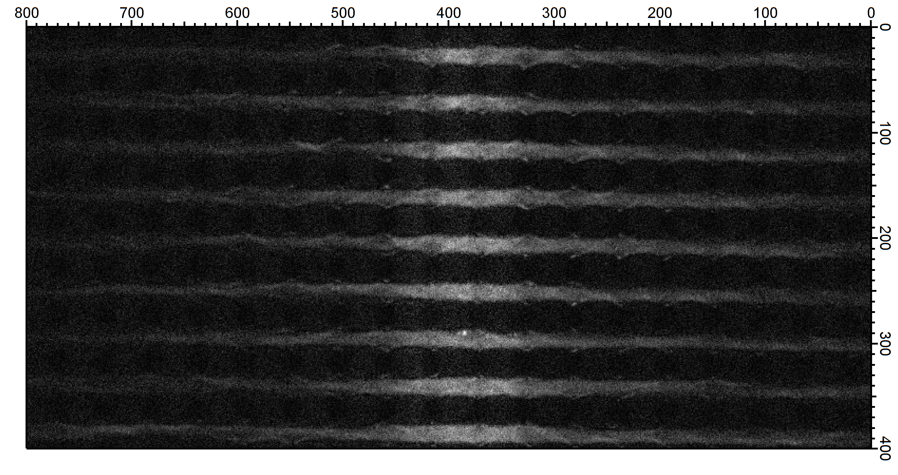
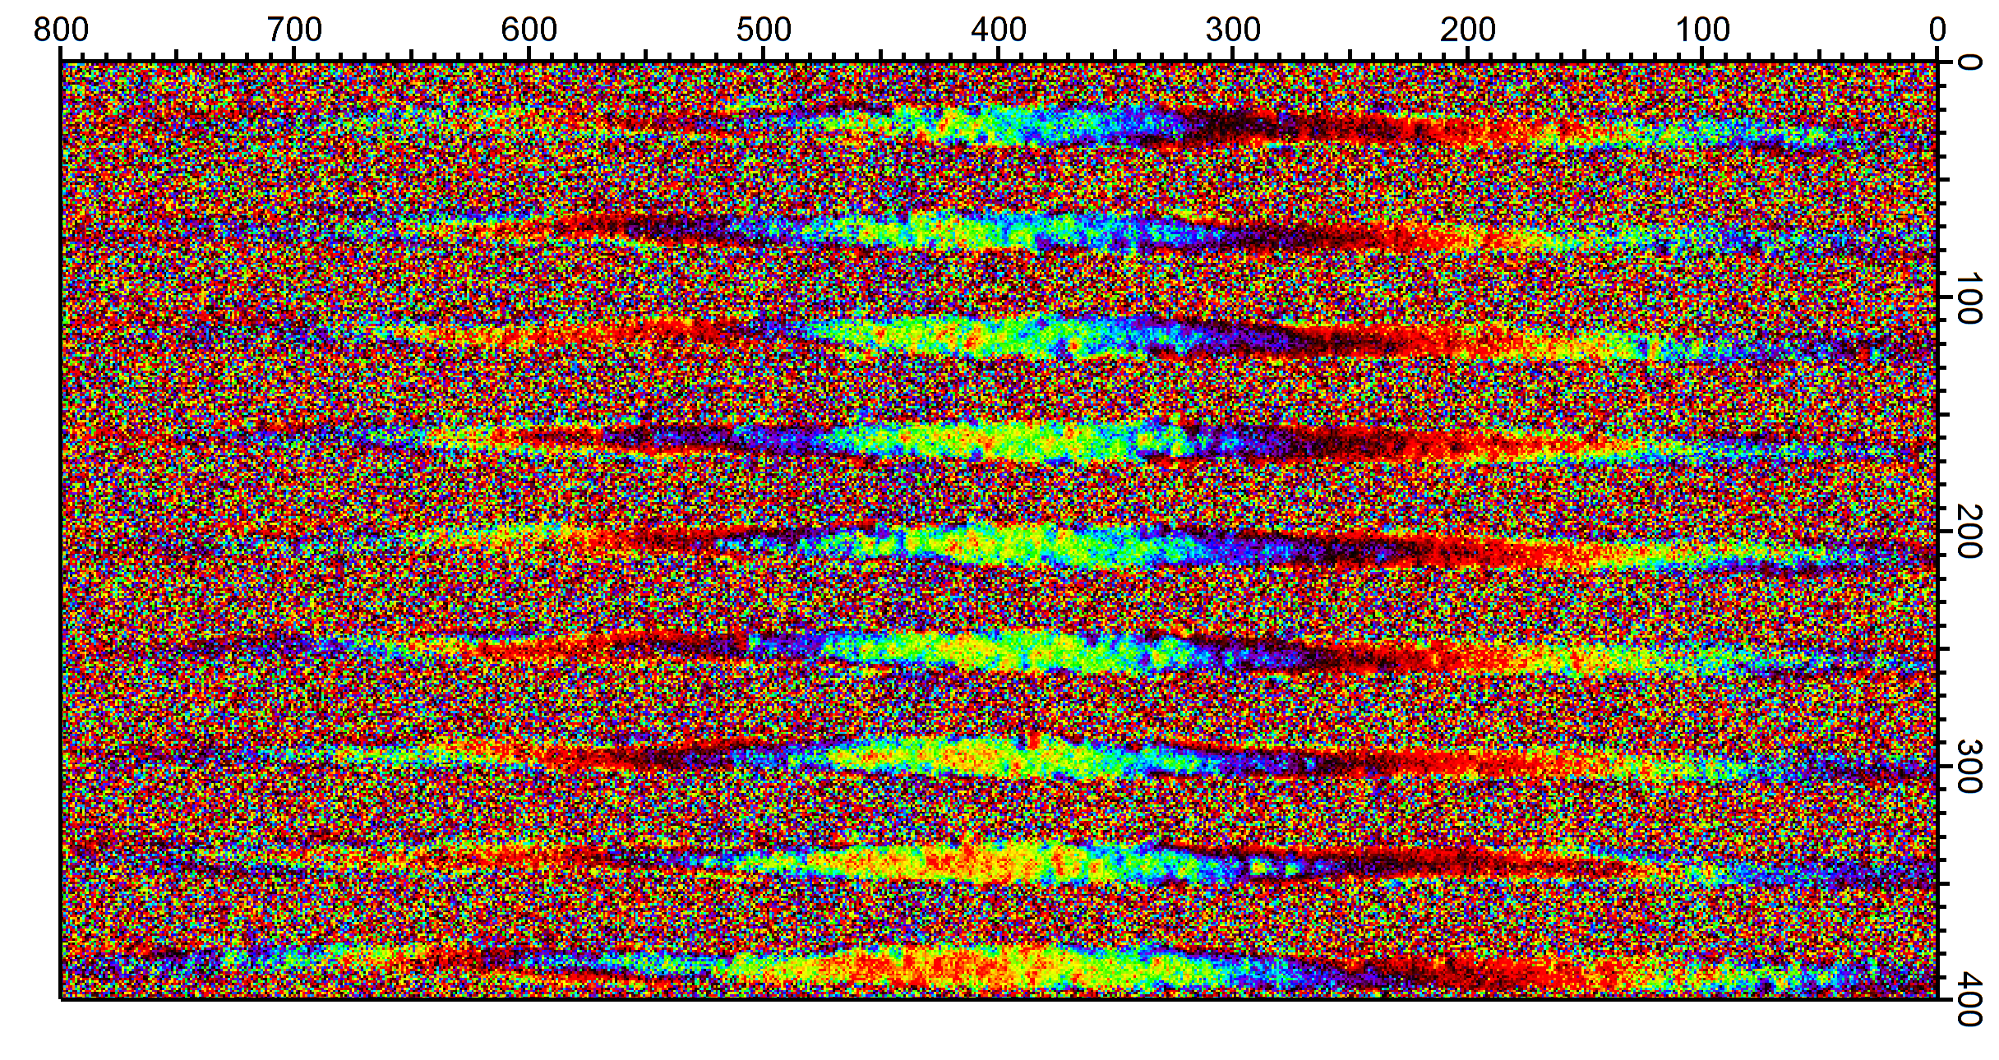
Large-Scale Dynamic Imaging
Multi GHz Spinwaves
in Magnonic Crystals
J. Gräfe, MPI-IS
23 Ch, 300ps Period
16*8 um, 20nm/pixel
Amplitude
Phase
Notes:
Erwähnen 16*8um, 20nm pixel, 5h.

Slide 19
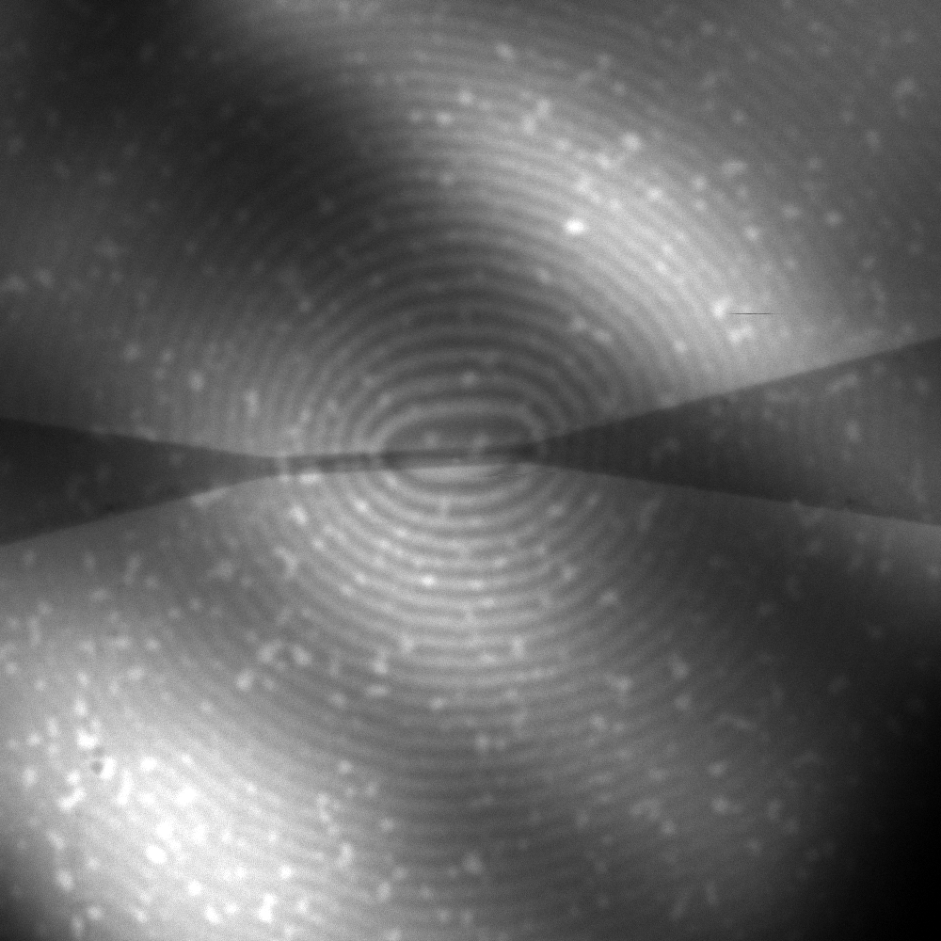
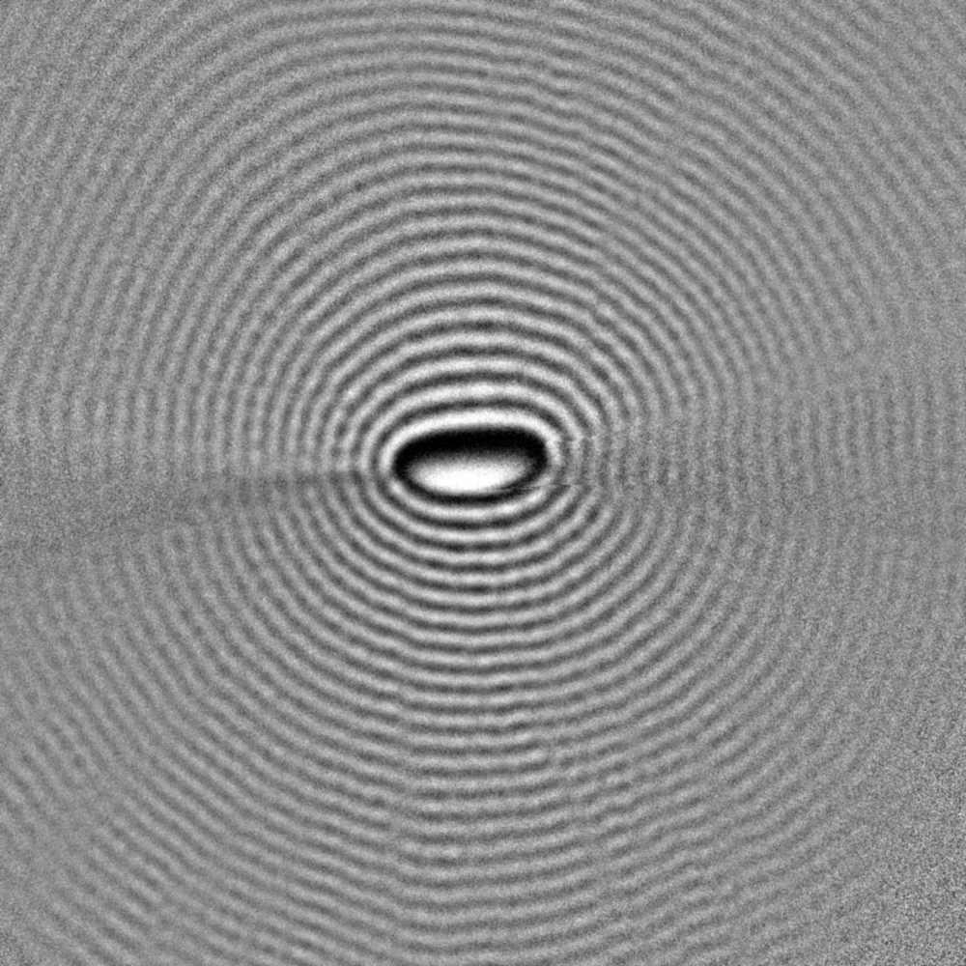
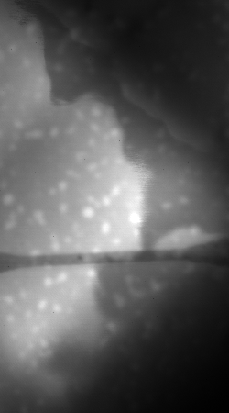
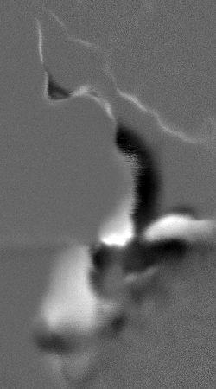
Large-Scale Dynamic Imaging
Ga:YIG Ferrimagnet Sublattice Imaging
S. Mayr et al. (in preparation).
25 µm
Spin Waves | 3.5 GHz | 170 mT
Domain Walls | 118 MHz | 100 mT
Normalized
Diagonal stripes due to substrate thickness variations, can be normalized out
Orders of magnitude of frequency range can be covered in single setup
Unique way to directly image dynamic magnetic behavior!

Slide 20
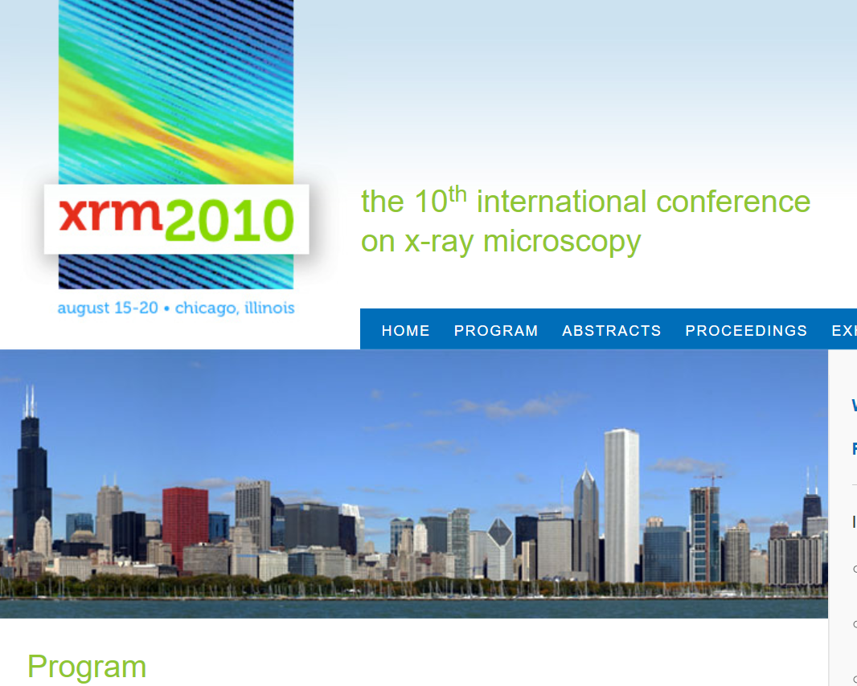
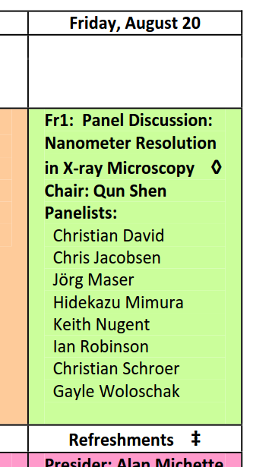

Improving Resolution
Theoretical Limit
$$d=\frac{λ}{2NA}$$
O(1nm) for soft X-rays
Practical Limits:
Zone Plate Production
Mechanical Stability
Focal Length requirements
(Radiation Dosage)
Not going to happen
Reality: 15-20 nm resolution
The whole point of microscopy, is you think about it…

Slide 21
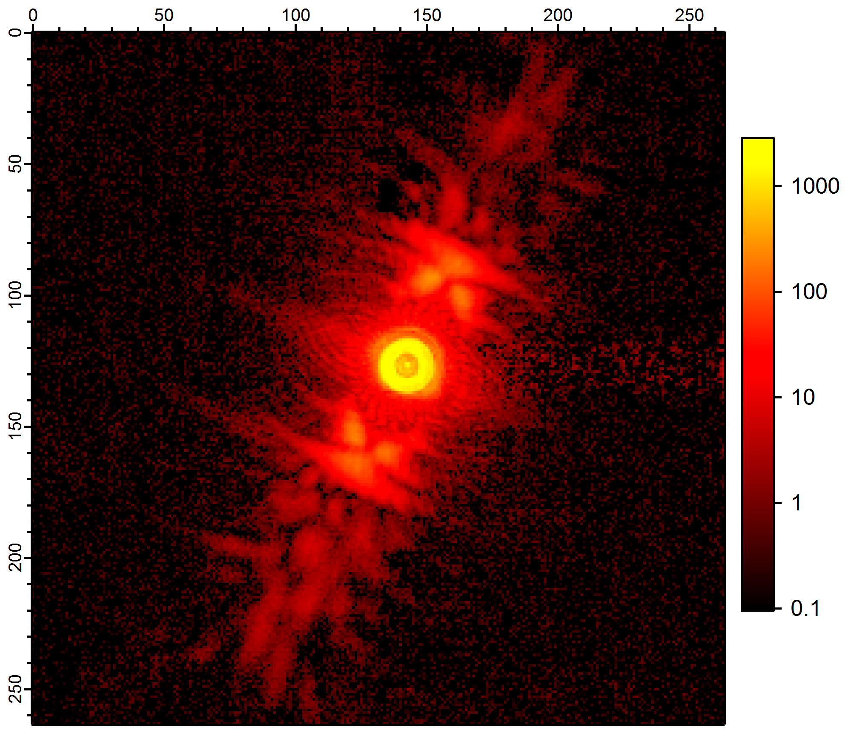
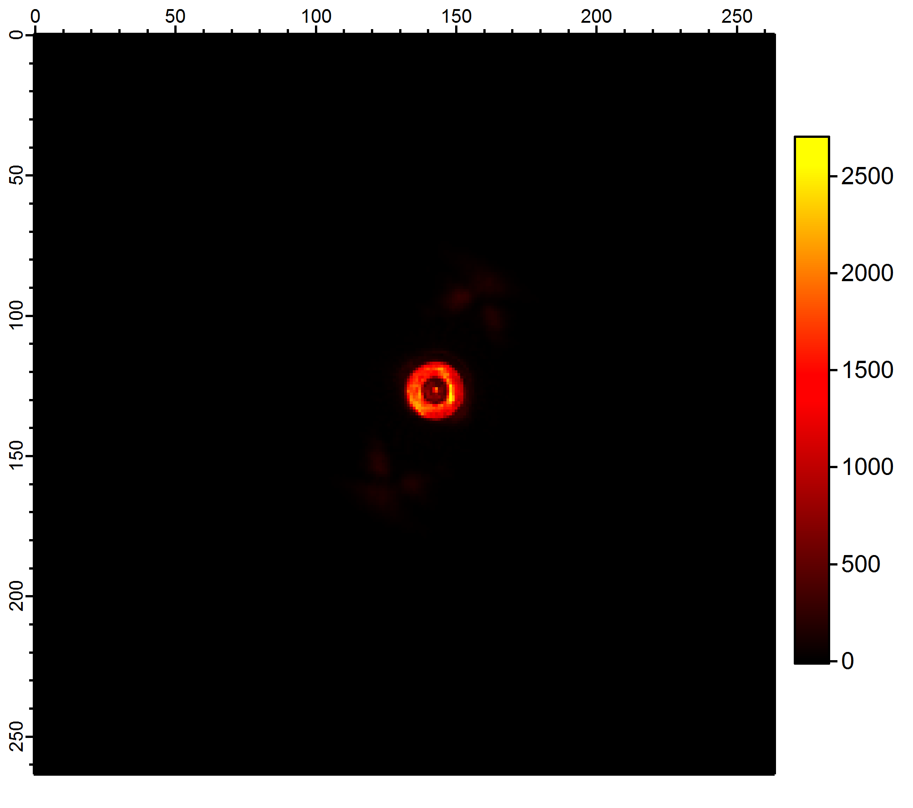
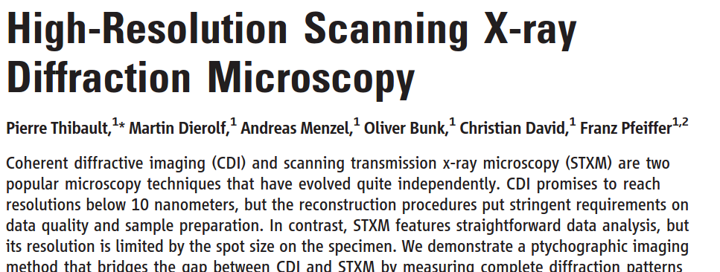
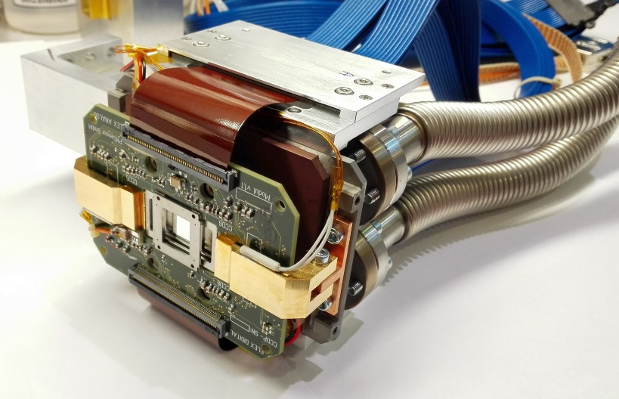
Recording Sample Transmission
Keyword: Ptychography
10.1126/science.1158573
CCD
Intensity behind Sample
Sample Diffraction can be used to improve Resolution!

Slide 22
Camera Requirements
Soft X-rays == In vaccum camera
High dynamic range
Fast readout speed (ideally >100 Hz)
Large photon handling capability (>10^9 ph/s @ 1keV)
Large chip (for covering big numeric apertures)
High resolution is NOT a priority
PnSensor pnCCD
450 fps
264 x 264 pixels (48um size)
Single Photon Detection
About 12 bit dynamic range

Slide 23
Dynamic stacking
Full-well capacity too low for good dynamic range even at lowest gain range -> Need for stacking
Pixels
Frames 450 Hz
Averaged signal
Pixel delay 10 ms
4-5 bit of additional dynamic range for 100ms dwell

Slide 24
Making Output Useable
Raw output 132*528 pixel
CAMEX 1
CAMEX 2
CAMEX 3
CAMEX 4
4 readout chips
132 parallel ADC each

Slide 25
Making Output Useable II
No Global Shutter
Can be reduced pretty well using weighted median subtraction, but still situationally problematic
Frame transfer from center to both sides
Individual lines have different offset

Slide 26
Improving Spatial Resolution
(using „sharp camera“)
Classical STXM
Ptychography
Real Beam
Pattern
100 nm
Flat Contrast Transfer Function
Notes:
Fehlt die Take-home message

Slide 27
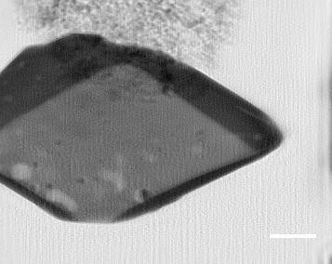
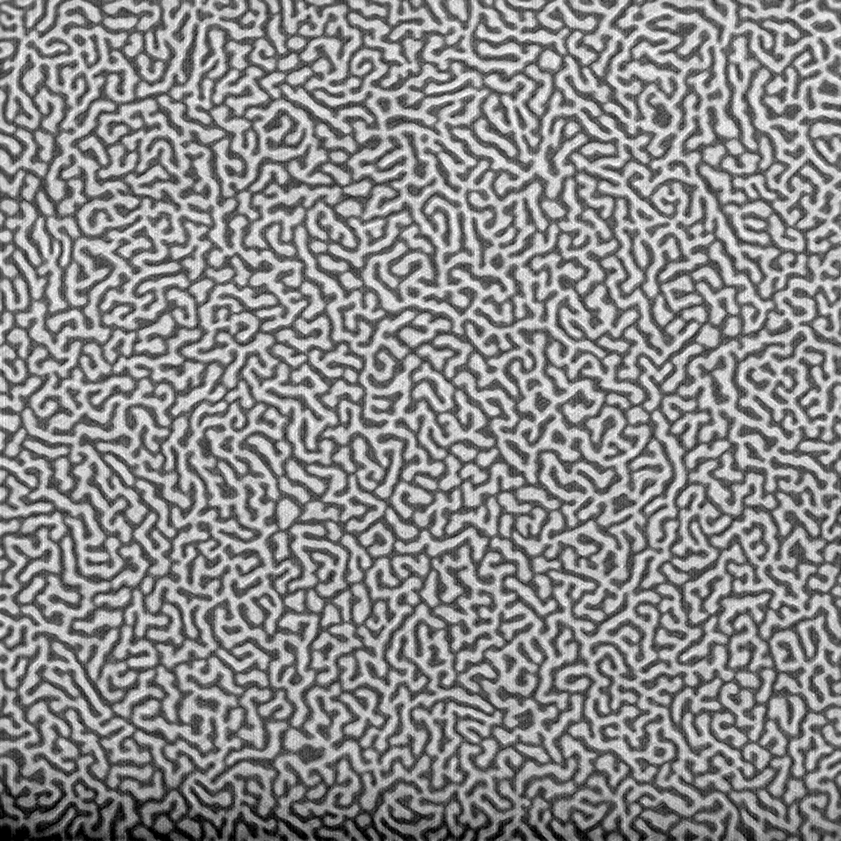
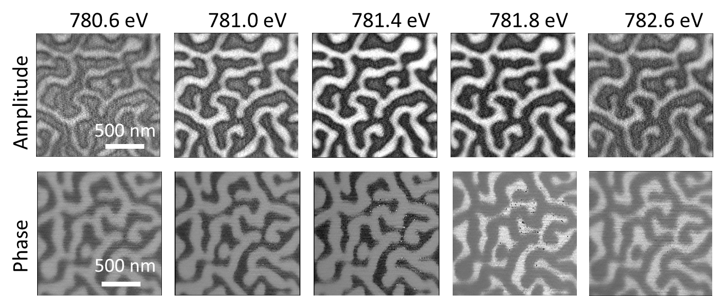
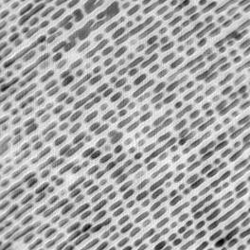
Ptychography Tests at MAXYMUS
Fe³⁺
Ca 6 nm half-pitch Resolution with 100nm FZP
Fe²⁺
500 nm
      Jongwoo Lim, W. Chueh, Y. Li
      William Chueh Group
      Materials Science and Engineering
Stanford University
Benefits from rapid development of X-ray cameras for FELs and upcoming high brilliance sources
Towards few nm resolution
chemical microscopy!
200 nm
Illuminating spot size
1 um

Slide 28
For the future
APD viable for time resolved detection, but could be improved:
Do not apply SiO2 AR layer
Use optically opaque, but x-ray transparent top contact (i.e. 10nm Al, etc.)
Optimize thickness of avalanche layer
Better control of doping homogeneity
Next Generation CCDs
In development with HLL
1024^2 pixels on a 36.8mm^2 chip
Compared to existing camera will allow:
  3x resolution
  10x light gathering
  Any combination
Still no global shutter, also no time resolution
The “perfect Detector”:
Combining ptychography with pump and probe
Large sensitive area
Global shutter
Hybrid design for capturing >10^9 events/s with <1ns time resolution

Slide 29







Thanks to:
  S. Raoux, G. Schneider, S. Rehbein, S. Werner, P. Guttmann, R. Müller, M. Mast, S. Hendel, T. Schlegel-Niedrig
  C. Pratsch, T. Lunkenbein
MPI Stuttgart & MAXYMUS
  I. Bykova, J. Gräfe ,E.Goering, M.Bechtel, H. Stoll, K. Keskinbora, U. Sanli, G. Dieterle, J. Förster, C. Stahl, S. Ruoß, J. Simmendinger, M. Kammerer, M. Noske, M. Curcic, L. Bommer, P. Audehm, C. Wolter, B. Baretzky, K. Fauth, G. Schütz
  S. Eisebitt, B. Pfau, I. Will
  B. Van Waeyenberge
  D. Shapiro
  S. Wintz, R. Follath, J. Raabe
  K. Litzius, A. Bisig, M. Kläui

