Slide 1
Amplituhedron-Geometrical Approach to Scattering Amplitudes
15.11.2021
Amin Raiessi

Slide 2
What is the Amplituhedron and what do we need it for?
Conventional approach to scattering amplitudes inefficient due to large amounts of gauge redundancy
complexity of calculations is a defect of the Feynman diagram approach which make locality and unitarity manifest
We look for a „dual“ approach which unveils the hidden symmetries and exploits the simplicity
Initiator was an observation for NMHV tree amplitudes led by Hodges:
Amplitude can be thought of as the „volume“ of polytope in momentum twistor space
Try to GENERALIZE this idea for all (planar) N=4 SYM
AMPLITUHEDRON → jewel-shaped geometrical object

Slide 3
How can we deal with the Amplituhedron ?
The important question: How can we parametrize a jewel- shaped Amplituhedron ?
Mimick ideas of simple geometries like the triangle and generalize them
2
Y = ?
Y
1
3
Y = $C_{1}Z_{1}$ + $C_{2}Z_{2}$ + $C_{3}Z_{3}$

Slide 4
Amplituhedron
Amplituhedron: mathematically defined via
map ${\overline{Φ}}_{z}$: $G_{+}$(k,n) → $G$(k,m+k),
where C $∈$ $G_{+}$(k,n) and the Amplituhedron $A_{(n,m,k)} ⊆$ $G$(k,m+k)
Calculate the map by parametrizing the Amplituhedron as linear combination of kinematic data Z :
Y = C$⋅$Z
with C & Z having positive minors.
Think of parametrization of the interior of a triangle.

Slide 5
Extract scattering amplitude from canonical form associated to the Amplituhedron
Canonical form obtained from minor positivity
Amplitude = $\int{Ω_{nkL}}$

Slide 6
Central questions for the project
1) How is the Amplituhedron described using topological/ combinatoric methods?
Amplituhedron characterized by winding number → natural
Amplituhedron characterized by k sign flips
Where does the sign flip definition come from?
homeomorphic B-amplituhedron

Slide 7
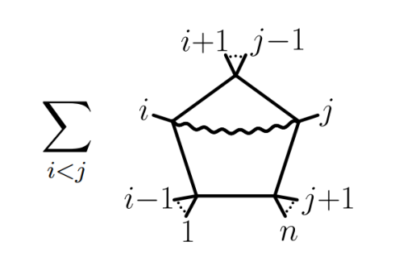
Central questions for the project
Application of Amplituhedron to n= 4 and n= 5 scattering for $l$ = 1, 2
Deriving the canonical forms
$Ω_{l=1}$ =$\sum_{ⅈ<j}{\frac{{\left\langle AB(1 i i+1)∩(1 j j+1)\right\rangle }^{2}}{\left\langle AB1i\right\rangle \left\langle AB1 i+1\right\rangle \left\langle ABi i+1\right\rangle \left\langle AB1 j\right\rangle \left\langle AB1 j+1\right\rangle \left\langle ABj j+1\right\rangle }}$
Comparing to classical approaches:
Local expansion in chiral pentagons
Prooving equivalence between Amplituhedron
approach and pentagon expansion

Slide 8
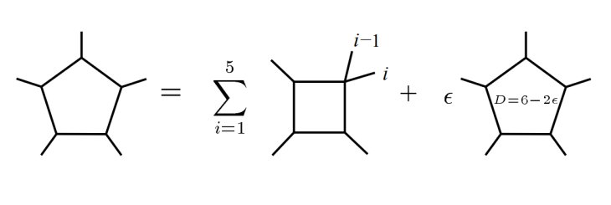
Central questions for the project
Analysing the gluon scattering via box expansion
Result not exact → What is the missing term ?
Discussion on integrand and integral level
Integral level → Deriving the
partial integration technique
$I_{n}=\frac{1}{2N_{n}}\left(\sum{γI_{n−1}}+\left(n−5+2ε\right)Δ_{n}I_{n}^{6−2ε}\right)$

Slide 9
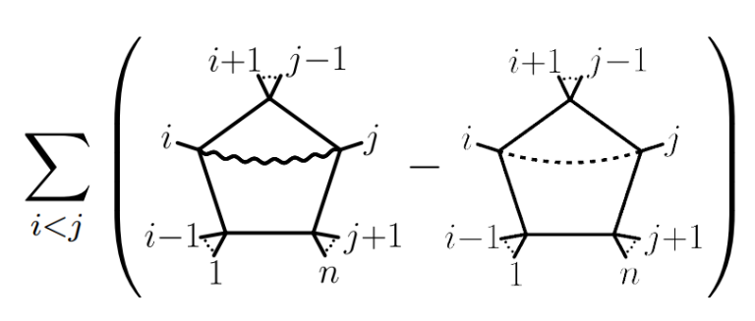
Integrand level:
Emergence of parity odd term:
What do we have to do to get exact result via box expansion?

Slide 10
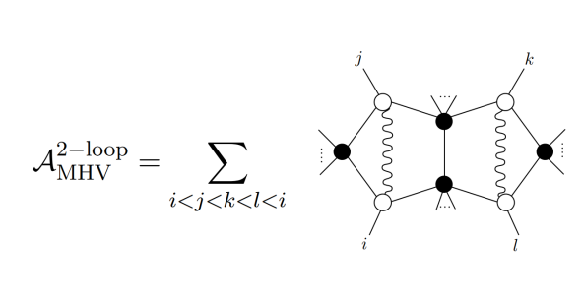
Central questions for the project
At $l$ = 2, prove that chiral double pentagon expansion is equivalent to Amplituhedron

Slide 11
What comes next? What are related topics?
Idea that positive geometries (X, $X_{≥0}$) encodes scattering amplitudes is applicable to a variety of theories
Correlahedron $C_{n,k}$ : geometric encodingof n-point stress tensor correlator function. Extract the correlation function from canonical form
Correlahedron geometry can be projected down to amplituhedron space by taking light-like limits

Slide 12
2) Associahedron $A_{n}:"Amplituhedron„$ for the scalar bi-adjoint $φ^{3}$ theory at tree level
Define $A_{n}$ = $Δ_{n}$ $∩H_{n}$, where $Δ_{n}$ is a positive region and $H_{n}$an affine space

Slide 13
4) Momentum Amplituhedron
Amplituhedron expressed via spinor helicity variables instead of momentum twistor variables
5) Cosmological polytope
Positive geometries in Cosmology relate wavefunction of universe to polyhedral geometry

Slide 14
Open problems
Understanding known geometries more generally
At the moment knowledge based on case-by-case study
Finding new geometries
How can we define the „Loop Momentum Amplituhedron“?
Using Momentum Amplituhedron as starting point to define non-planar theories
Finding geometries for QCD
Finding a single geometry underlying $Ψ_{Ω}$
What role does the Associahedron play for (open) strings?

Slide 15
Sources
See Master thesis

Slide 16
Questions

