Slide 1
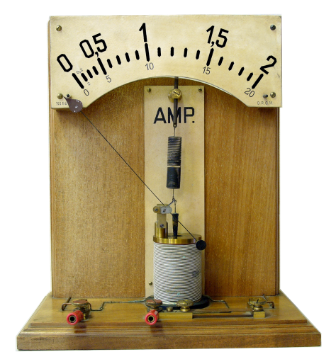
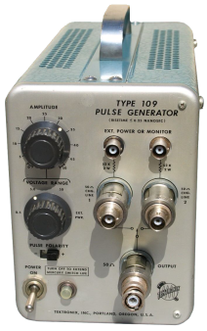
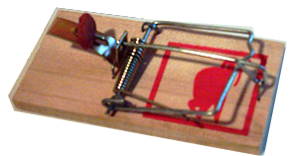
A Reliable Approach to Charge-Pumping Measurements in MOS-Transistors
Paper Presentation for the Students Seminar
Andreas Ritter – 7.4.2010

Slide 2
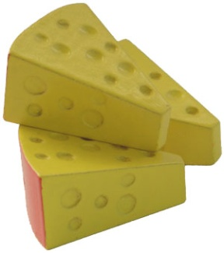
What is this Paper about?
It’s about Traps…
…and how they can be filled

Slide 3
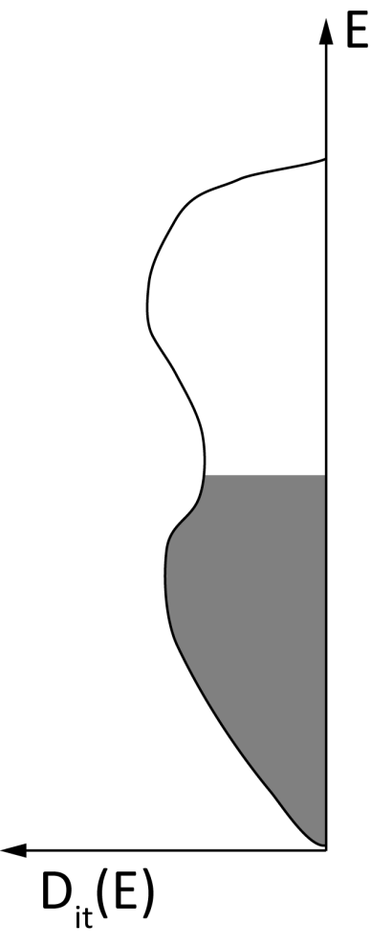
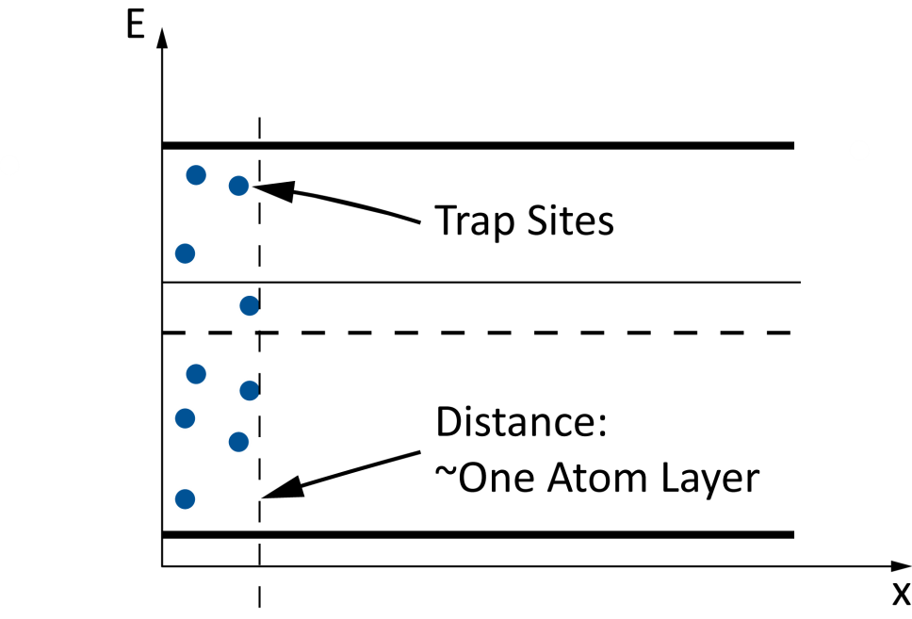
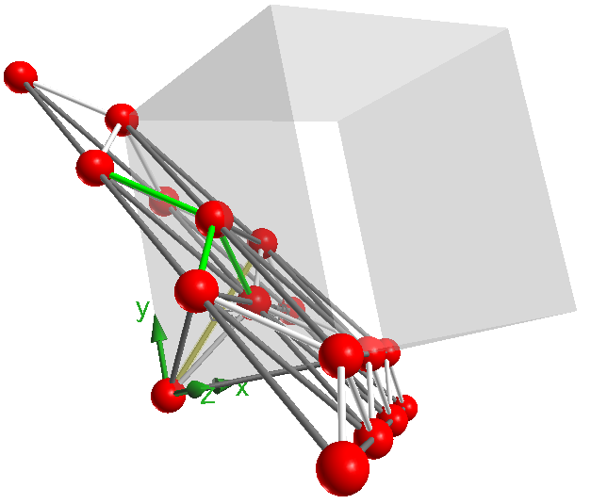
Interface Traps depend on: Density
[111]
[100]
…and Location

Slide 4
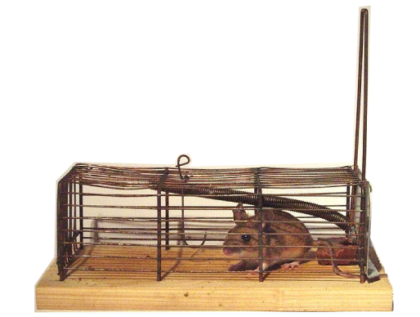
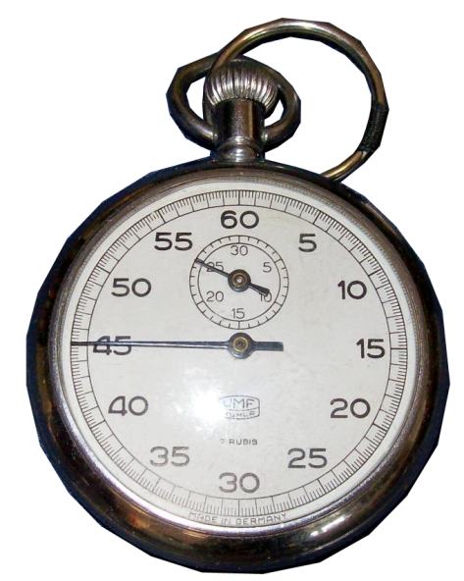
Interface Traps depend on: Speed

Slide 5
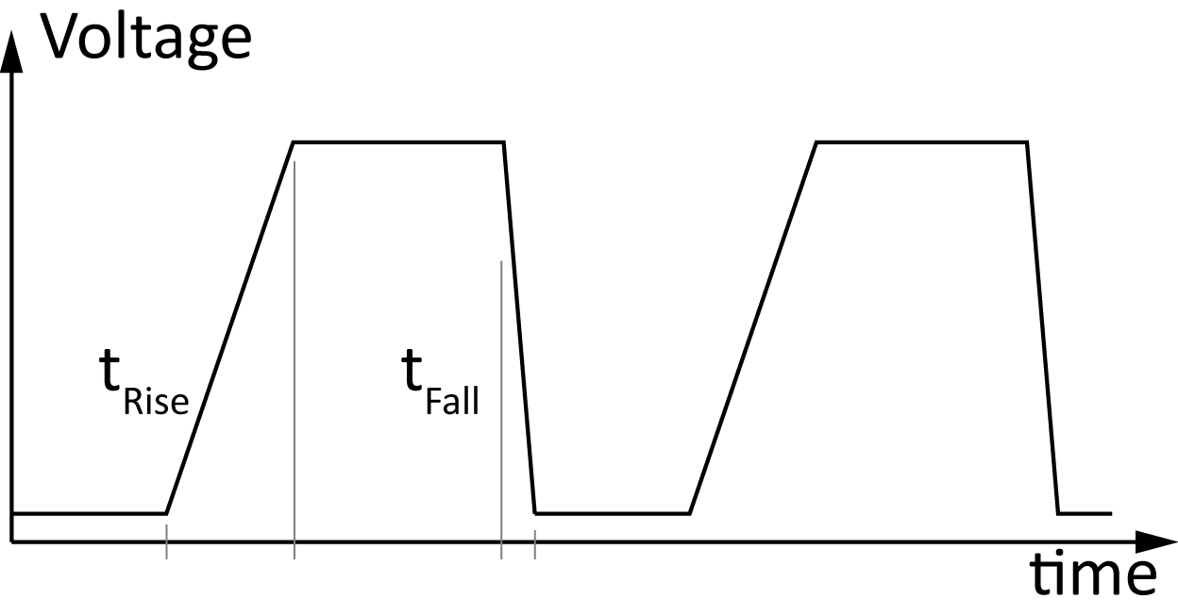
Interface Traps depend on: Speed

Slide 6
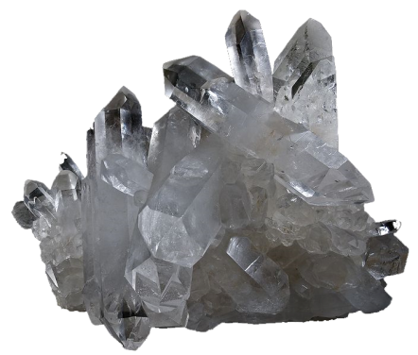
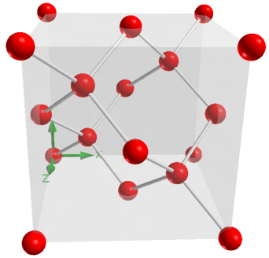
Interface Traps – Origin and Generation

Slide 7
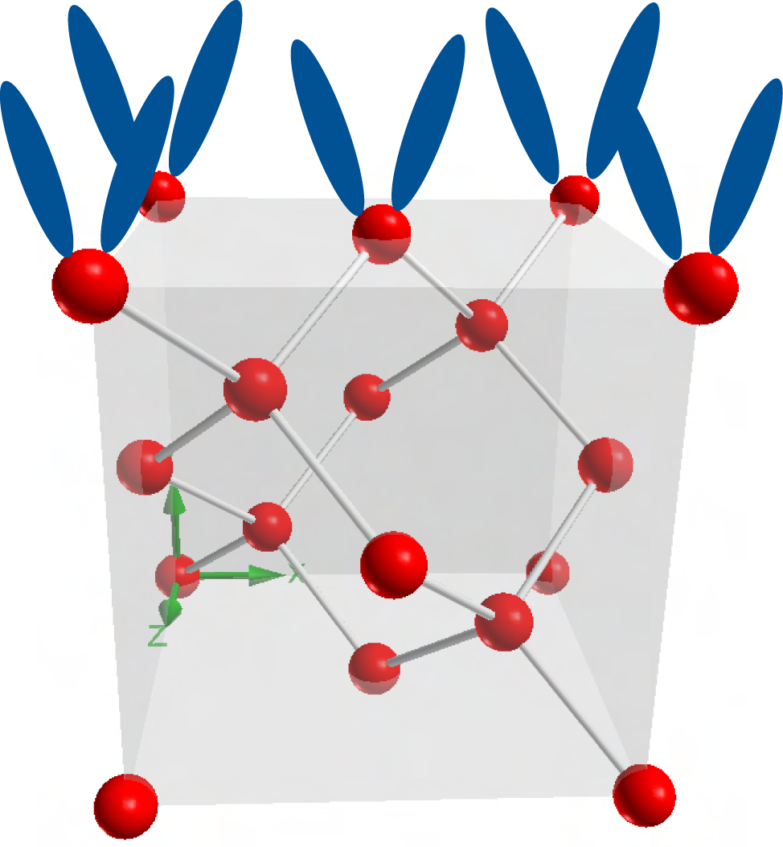
At the Interface between Si and SiO₂…
Lattice constants of Si and SiO₂ do not match
open bindings
highly electrically active

Slide 8
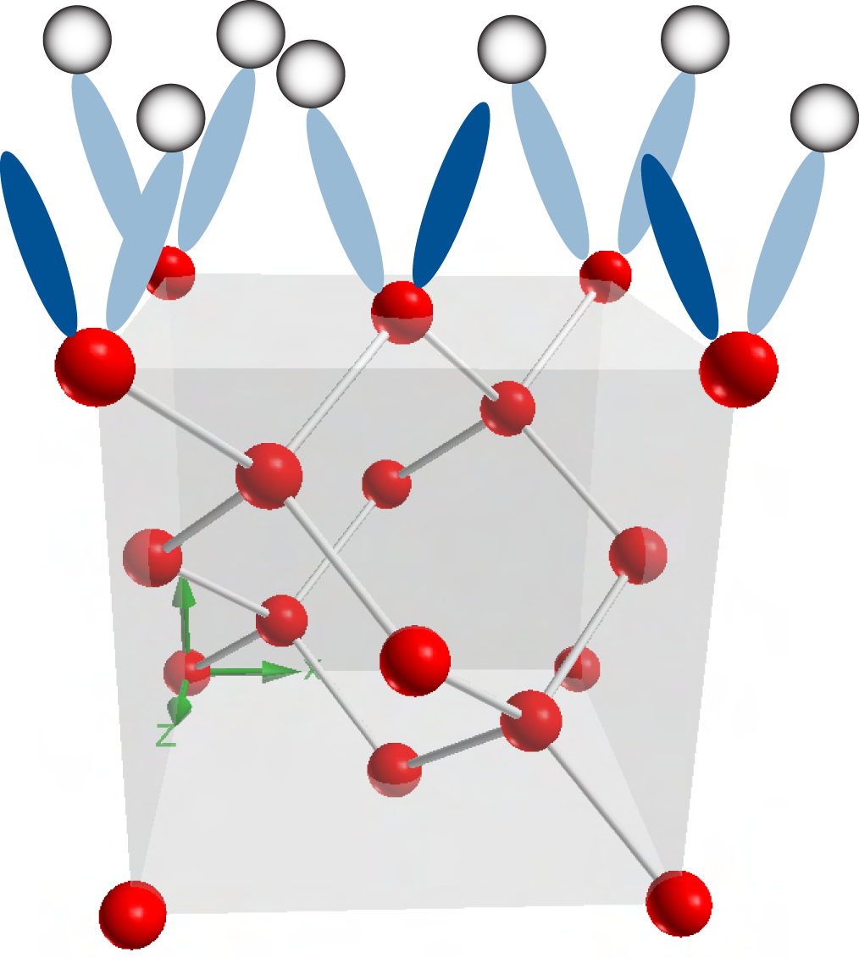
At the Interface between Si and SiO₂…
H2 diff zum Interface
passivation
Nicht alle getroffen
Paar übrig, liegen 0.2 eV
Von der andkante
Use Hydrogen (Forming Gas) to get rid of Interface Traps
Passivation

Slide 9
At the Interface between Si and SiO₂…
Ionizing radiation creates/frees protons somewhere in the device.
Via diffusion and drift Hydrogen nuclei get to the interface.
H⁺ + Si-H → Si⁺ + H₂

Slide 10
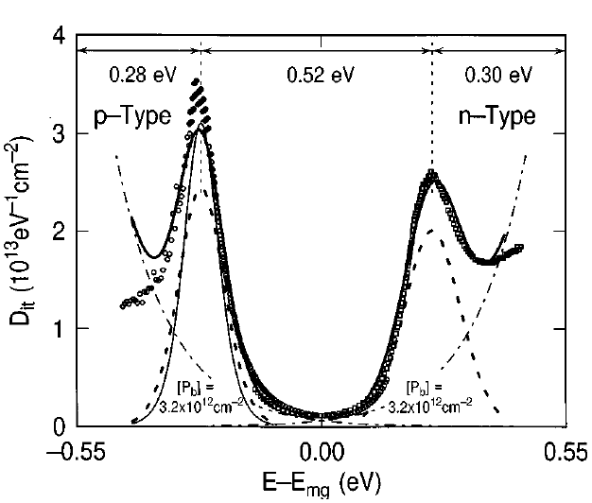
At the Interface between Si and SiO₂…
The most common interface trap is called Pb.
Interface trap is amphoteric = act as Donor or as Acceptor.
In lower Half Band Gap mostly acceptor type, in the upper half donor-type.
Hot-electron induced passivation of silicon dangling bonds
at the Si(111)/SiO2 interface
E. Cartier and J. H. Stathis from
Appl. Phys. Lett., Vol. 69, No. 1, 1 July 1996

Slide 11
Charge Pumping – Basic Working Principle

Slide 12
Measurement Setup
Pulse Generator drives Layer beneath the Gate into Inversion and Accumulation
Current Meter measures the net current I_{CP}
V_{rev} is set at a certain reverse Voltage – no influence on the charge pumping current I_{CP}

Slide 13
Working Principle – Strong Inversion
Transistor is in Strong Inversion
Most of Interface Traps occupied with holes

Slide 14
Working Principle
Transistor is in Strong Inversion
Most of Interface Traps occupied with holes

Slide 15
Working Principle
Transistor is going from Inversion to Accumulation
Emission of holes from Interface Traps too slowly – Traps remain occupied

Slide 16
Working Principle
Transistor in Accumulation
Occupied traps (with holes) are reloaded with electrons

Slide 17
Working Principle
Transistor in Accumulation
Traps are now occupied with electrons
Emission of electrons is too slowly – Circle starts again…

Slide 18
Working Principle
Transistor in Accumulation
Traps are now occupied with electrons
Emission of electrons is too slowly – Circle starts again…

Slide 19
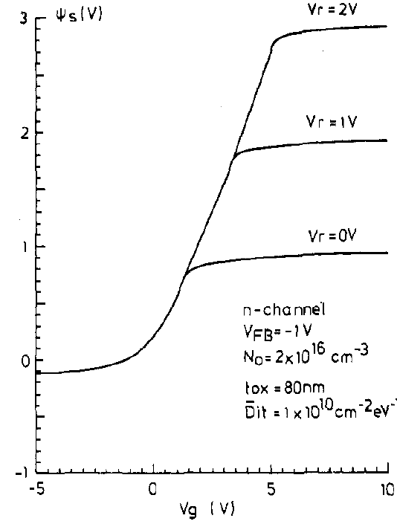
Measurement Data - Current
Charge in Interface Traps is
Assuming a mean surface trap density
and applying a frequency

Slide 20
Four Currents
During One Cycle there exist four currents:
I_{CP} due to hole emission
I_{CP} from electron neutralizing hole occupied traps
I_{CP} from electron emission
I_{CP} due to holes neutralizing electrons occupied traps
Net current flowing out to the bulk:
and through Source and Drain:

Slide 22
Four currents…One device

