Slide 1
Project 200
Technical Meeting
Overview
Dagmar Kreikemeyer
Jan 24th 2022

Slide 2
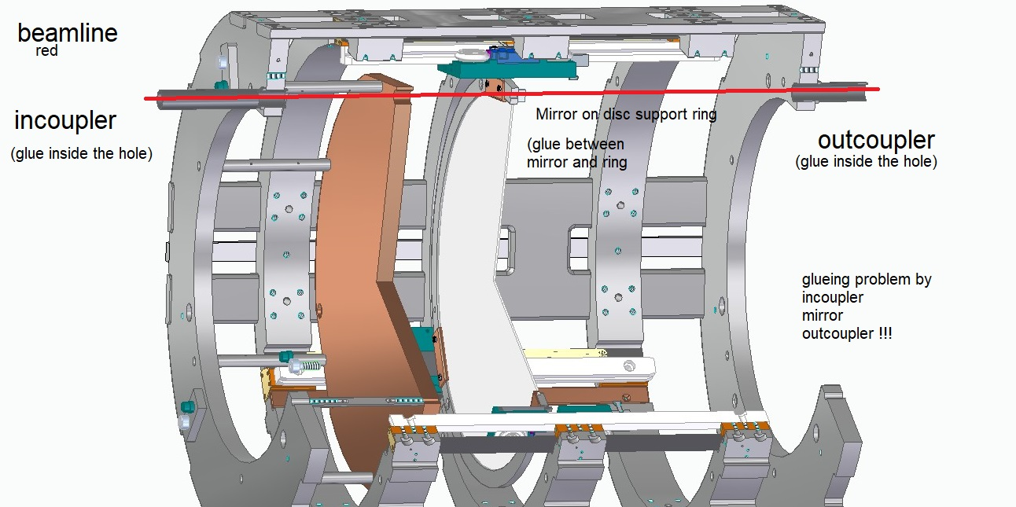
Mechanics Prototype: Project 200
Purpose: verifiy feasibility of 3 piezo motors moving one disk along a 200 mm rail at cryogenic temperatures in a vacuum volume. Study the temperature distribution along the hardware. First tests with absolute position interferometer.
3
4
5
6
Weight < 20 kg
1
1- Cu mirror (fix position)
2- Sapphire disk (adjustable position)
3- P200 backbone structure
4- (3x)piezo motors
5- interferometer incoupler
6- interferometer outcoupler
300 mm
2
530 mm

Slide 3
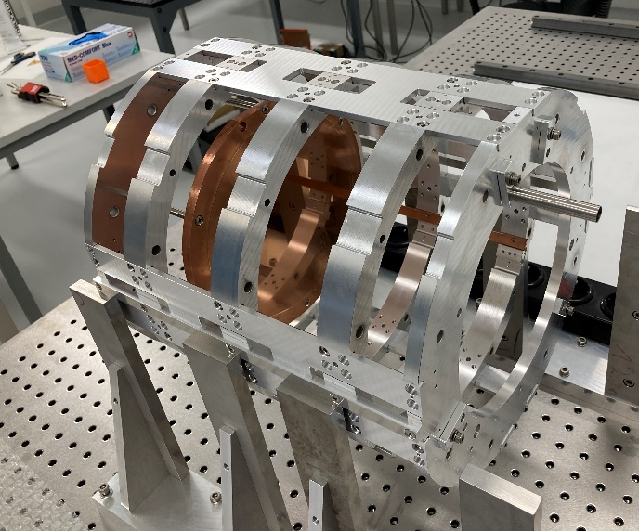
Timeline
Design → 2020
Production of the parts → June to September 2021
Assembly in Hamburg → September 2021
Purchase of Attocube interf. as back-up system → November 2021
Modifications → November/December 2021
First tests of the motors inside the setup → January 2022
Installation of Attocube Interferometer → January 2022
Programming of an interface between Attocube and JPE → Nov 2021 to Jan 2022
NEXT STEPS:
Tests of three motors together → January /February 2022
Test setup at 4 K (Cryolab, CERN) using Attocube interf. → Feb/March 2022
RF measurements with P200 (Antonios, Stefan) → Spring/Summer 2022
Test setup at 4 K (Cryolab, CERN) using HighFinesse interf. → Autumn 2022
Test setup in a B-field (MORPURGO) → March 2023

Slide 4
Meeting schedule
 |  | Topic | Speaker | Time
1 | 09:00 | Intro + Overview | Dagmar | 10‘
2 | 09:10 | Project 200 – Status | Christoph | 30‘
3 | 09:40 | Mechanical parts | Barthel | 15‘
4 | 09:55 | Disc support ring | Stephan | 5‘
5 | 10:00 | HighFinesse Interferometer | Christian | 15‘
10:15 |  | BREAK |  | 10‘
6 | 10:25 | Temperature simulations | Antonios | 5‘
7 | 10:30 | Tests in CERN cryostat | Dagmar | 40‘
8 | 11:10 | General discussion | all | 60‘
 | 12:10 | End of meeting

