Slide 1
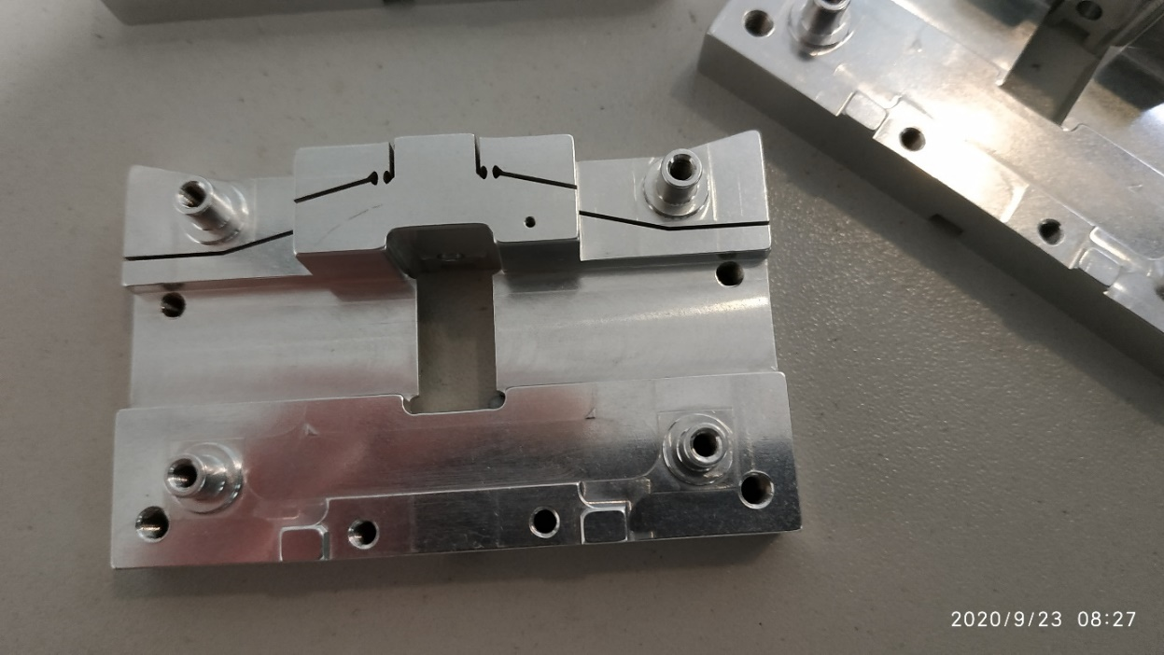
Summary Aachen Workshop January 2022
In Aachen we built 3 carriage frames
The design was adapted from the JPE drawing
Barthel Philipps RWTH Aachen

Slide 2
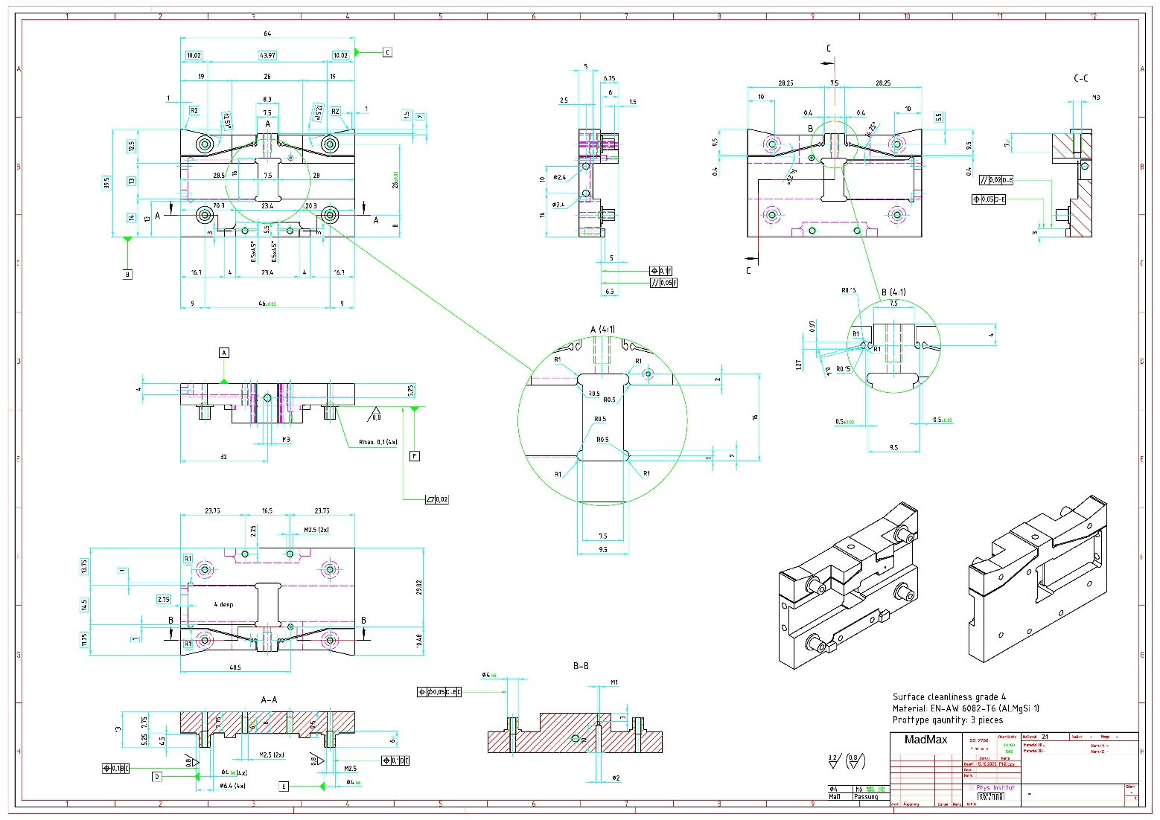
Summary Aachen Workshop January 2022
We changed the design to fulfil our needs
Barthel Philipps RWTH Aachen

Slide 3
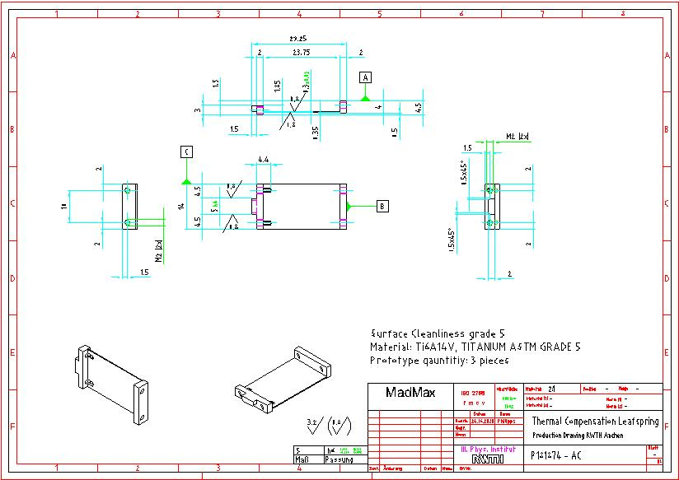
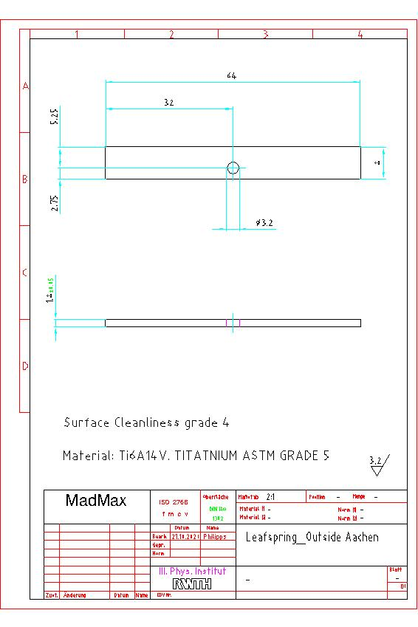
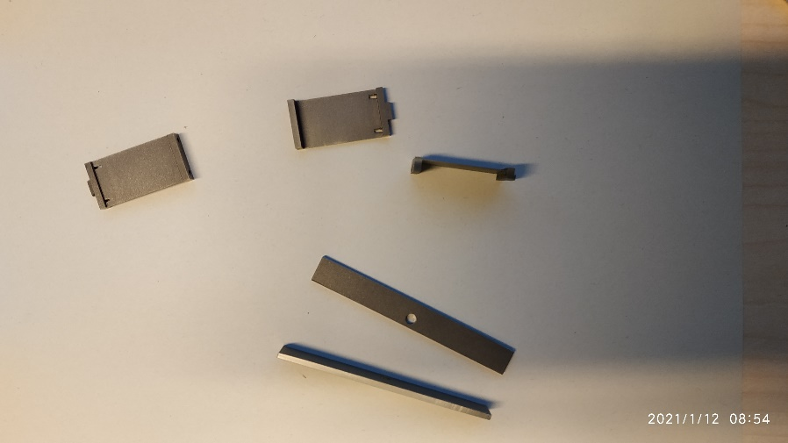
Summary Aachen Workshop January 2022
Further needed:
12pcs. Ceramic Bearing (send from JPE)
12pcs. Outer Rail-Ring (send from JPE, two times)
3pcs. Rail (send from JPE)
We ordered 3pcs. Leaf spring for thermal compensation
5) We ordered 3pcs. Leaf spring witch provide tension to the rail
Barthel Philipps RWTH Aachen

Slide 4
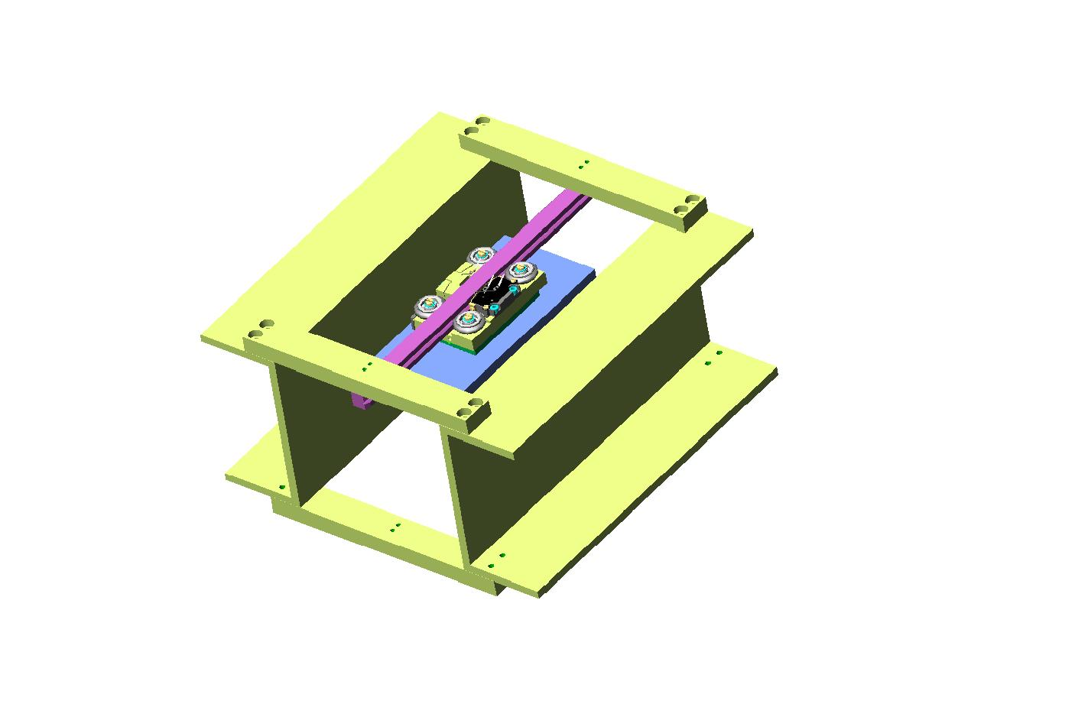
Summary Aachen Workshop January 2022
Test setup:
Goal was to test the behaviour between Rail /Bearings and Motor
Barthel Philipps RWTH Aachen

Slide 5
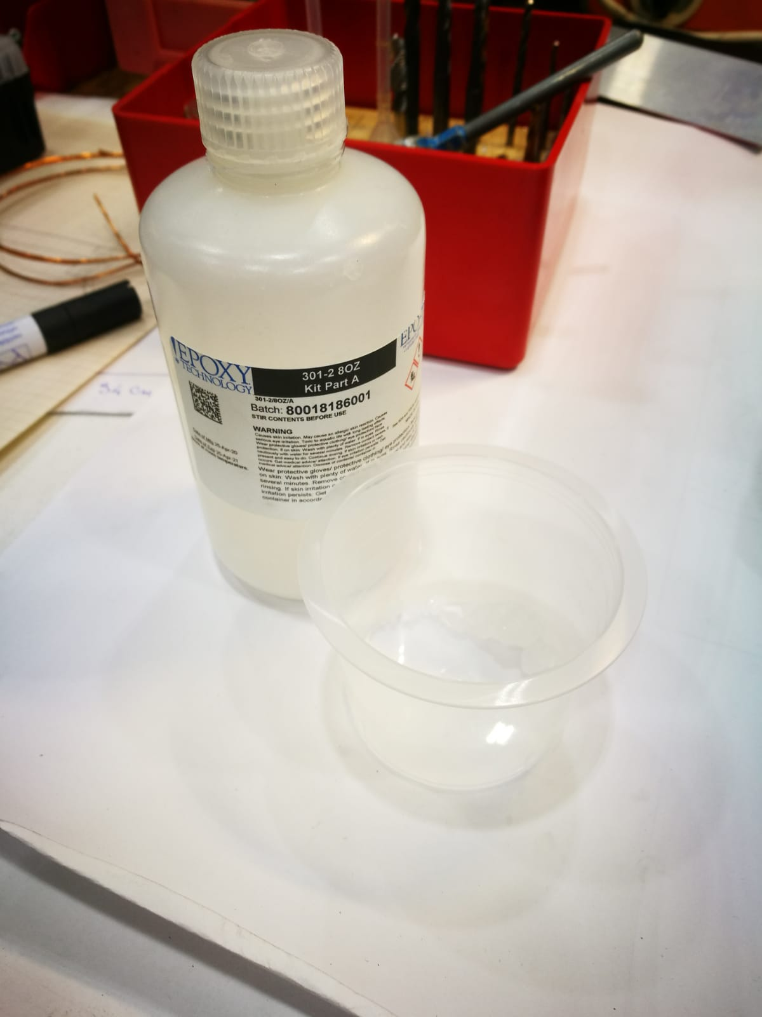
Summary Aachen Workshop January 2022
Before we have to glue the bearings
and the Outer-Rail-Ring
Glue: Epo-TEK 301-2
Recommended by JPE
Barthel Philipps RWTH Aachen

Slide 6
Summary Aachen Workshop Januar 2022
Measurement Bearings versus Outer-Rail-Ring height
Result: average deviation ca. 0,3mm
Lagerring | 1 | 2 | 3 | 4 | 5 | 6 | 7 | 8 | 9 | 10 | 11 | 12
 | 5,265 | 5,276 | 5,211 | 5,258 | 5,257 | 5,273 | 5,266 | 5,263 | 5,273 | 5,254 | 5,272 | 5,266
 | 5,261166667
Lager | 1 | 2 | 3 | 4 | 5 | 6 | 7 | 8 | 9 | 10 | 11 | 12
 | 4,965 | 4,974 | 4,95 | 4,974 | 4,971 | 4,977 | 4,971 | 4,971 | 4,976 | 4,947 | 4,947 | 4,94
 | 4,963583333
Poor geometry of the Outer-Rail-Ring in height and roundness !!!!
Barthel Philipps RWTH Aachen

Slide 7
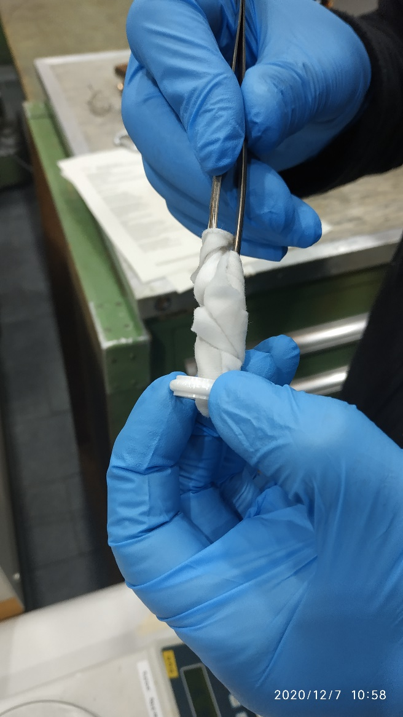
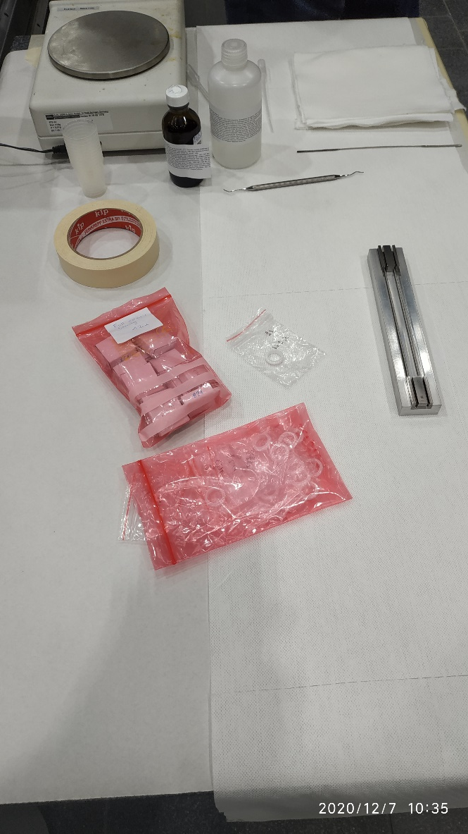
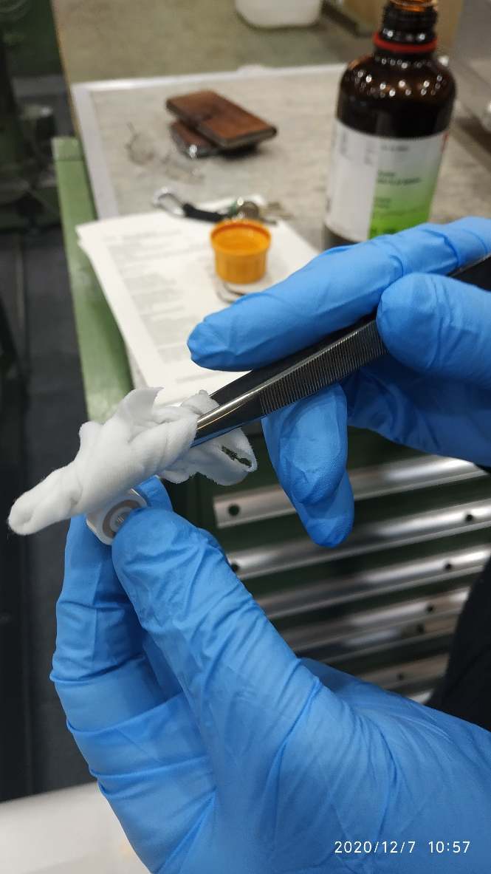
Summary Aachen Workshop Januar 2022
Gluing Process:
Barthel Philipps RWTH Aachen

Slide 8
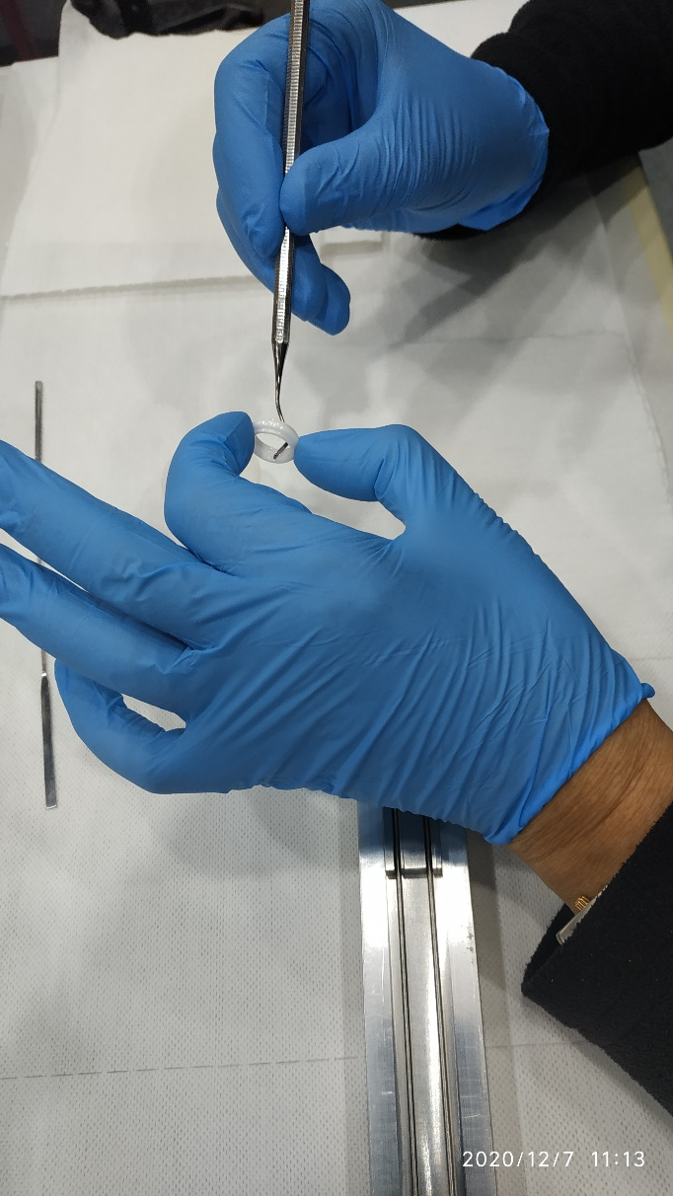
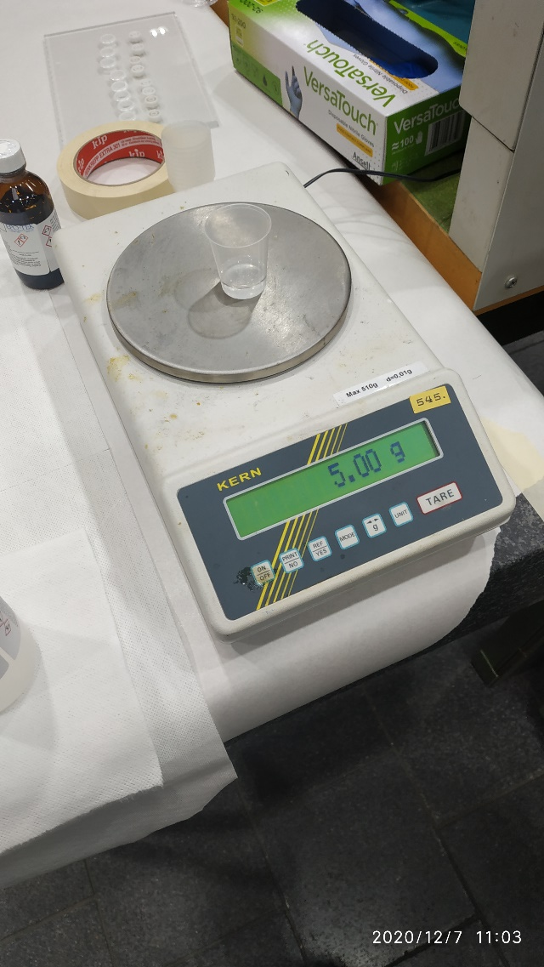
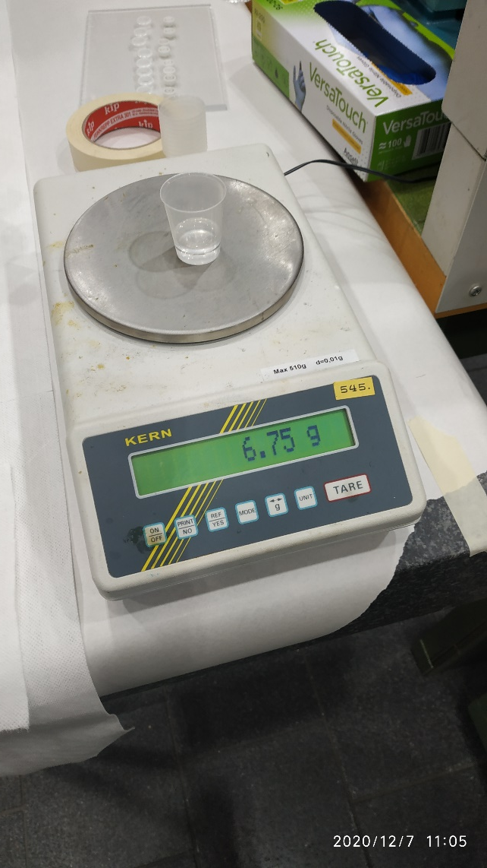
Summary Aachen Januar 2022
Gluing Process:
Barthel Philipps RWTH Aachen

Slide 9
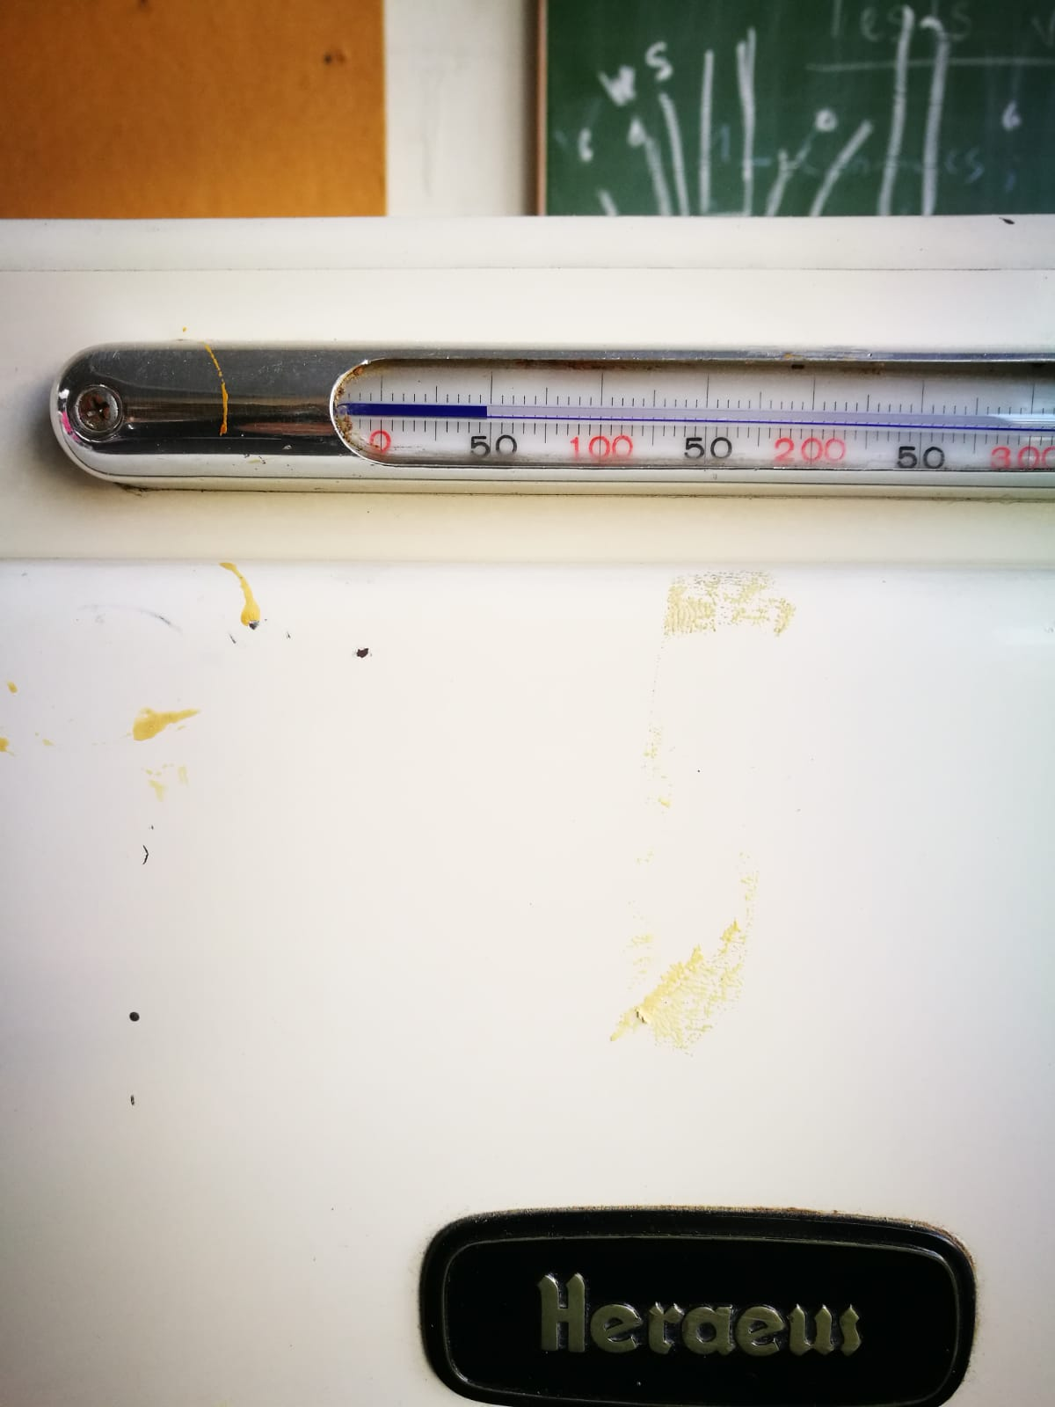
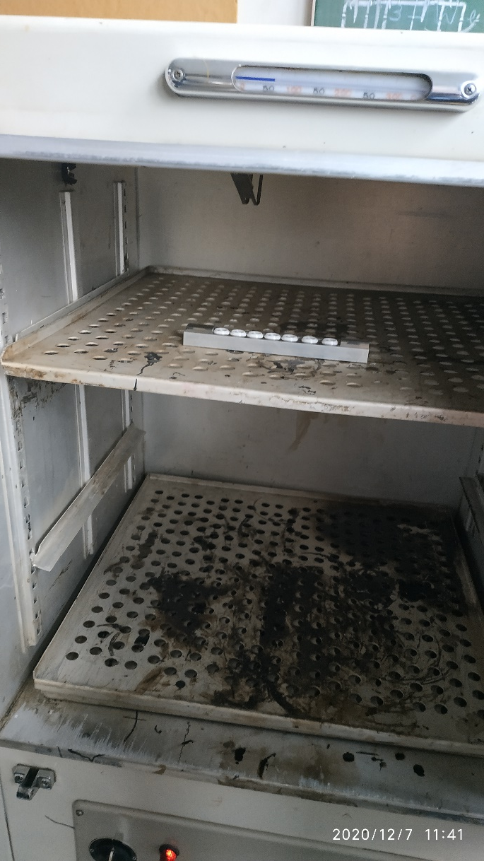
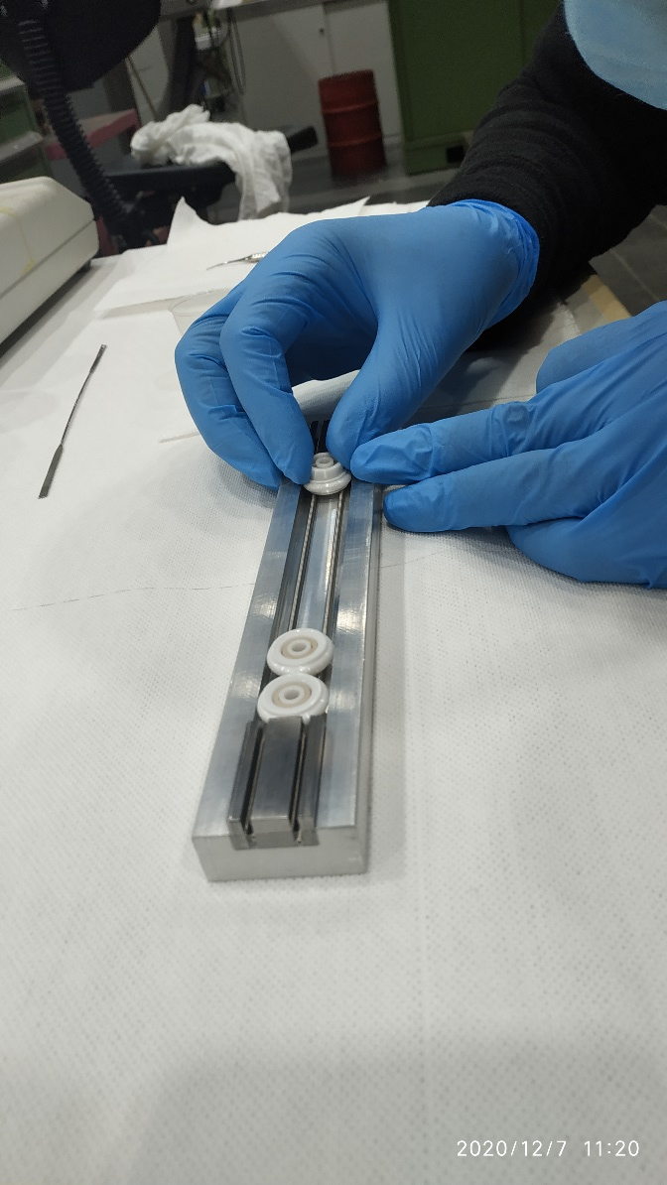
Summary Aachen Workshop Januar 2022
Gluing Process:
Barthel Philipps RWTH Aachen

Slide 10
This small video gives an impression of the poor appearance of the bearing assembly

Slide 11
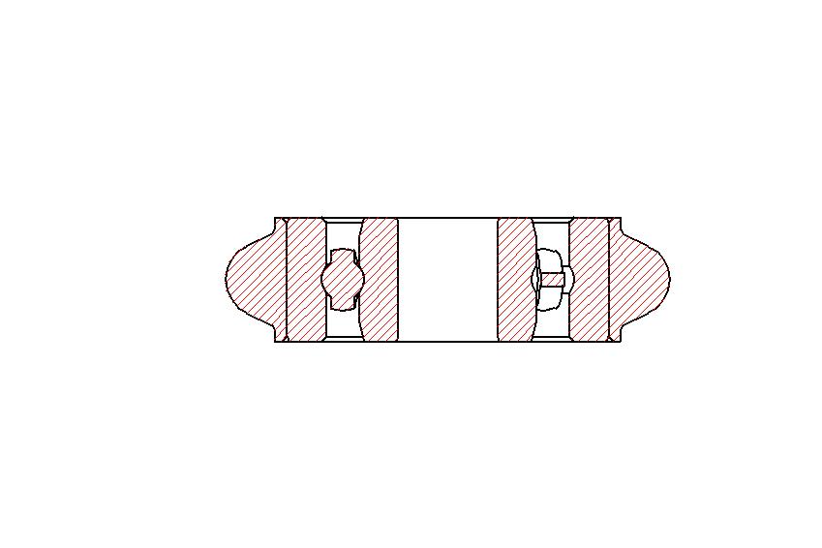
Summary Aachen Workshop January 2022
Concerns:
1)Very small slot for the Glue!!
2) Precision in height
roundness not good.
3) Circulation accuracy of
the outer ring very bad.
4) The small amount of glue
has to take all the forces
with load from all directions
Danger: We trust in Glue for years under very hard conditions!!!!!
Bearing
F
F
Outer – Rail -Ring
Barthel Philipps RWTH Aachen

Slide 12
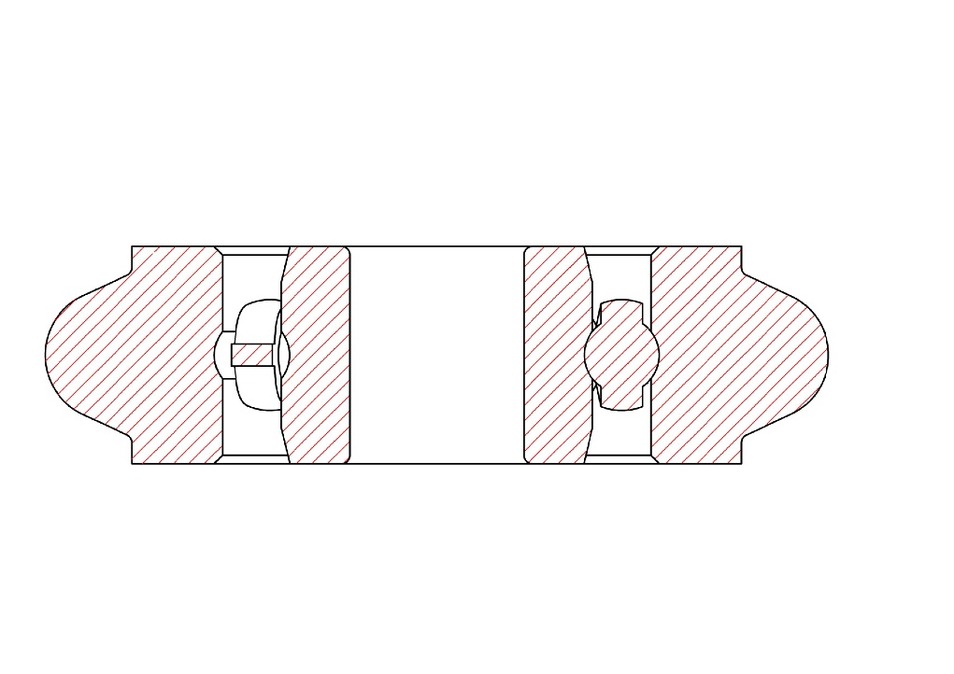
Summary Aachen Workshop January 2022
Proposal:
Make one part from Bearing and Outer-Rail-Ring
Advantage:
No more Glue !!!!
Higher Precision
More forces allowed
Assembly not needed
Gluing process not needed
Problems:
Not sure if supplier could make it
Higher costs?
Barthel Philipps RWTH Aachen

Slide 13
Summary Aachen Workshop January 2022
Michael made new drawings for this solution and get offers.
Aachen ordered them.
We replaced the old types!!!!
Barthel Philipps RWTH Aachen

Slide 14
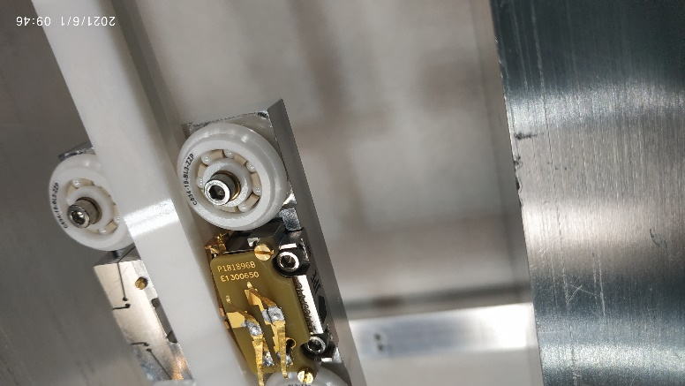
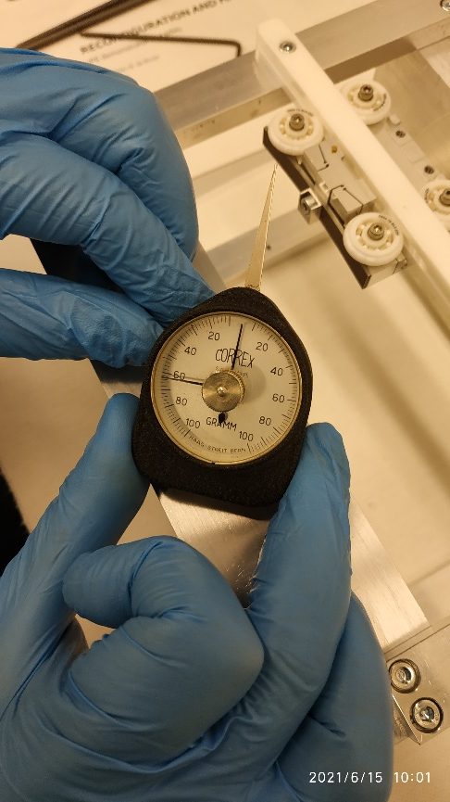
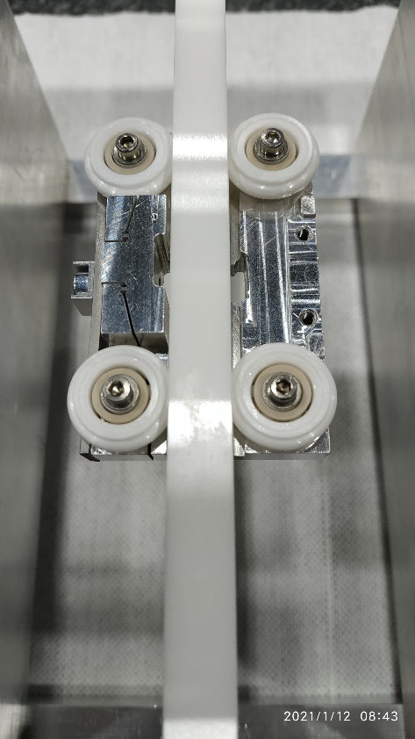
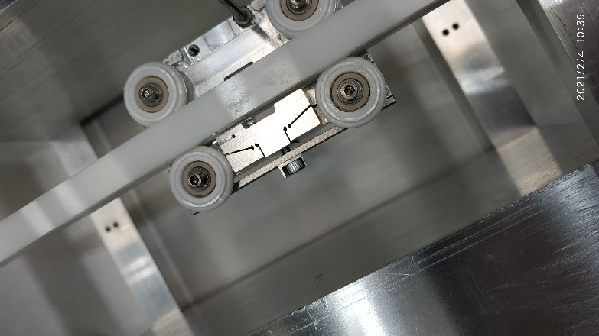
Summary Aachen Workshop January 2022
With the old bearings we did some tests to study the behaviour
between carriage / rail / and motor.
But those tests are not longer significand due to the new bearing design.
Barthel Philipps RWTH Aachen

Slide 15
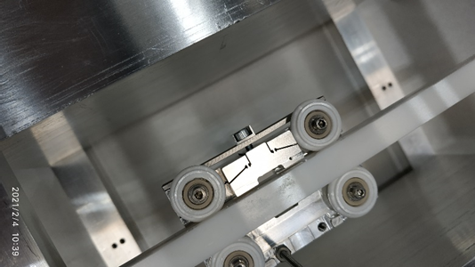
Summary Aachen Workshop January 2022
During these tests it became clear that the tension of the leaf spring design from JPE is much to high.
Barthel Philipps RWTH Aachen

Slide 16
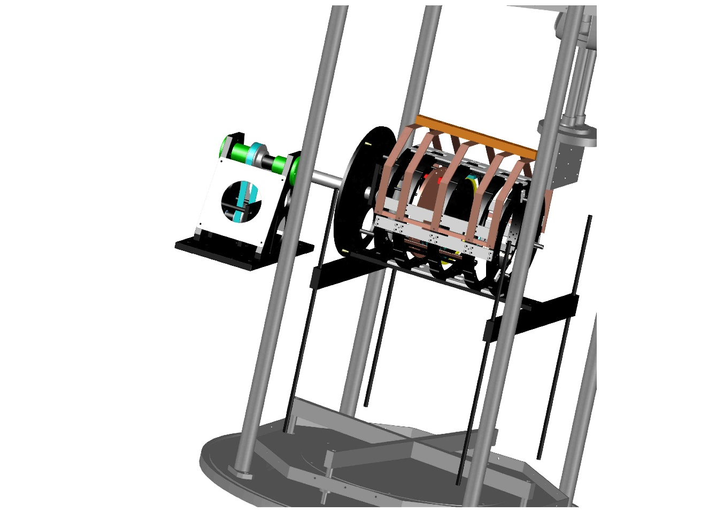
Summary Aachen Workshop January 2022
For the Project 200 , cryo test we did some part this January.
Michael designed it an we made the parts.
Barthel Philipps RWTH Aachen

Slide 17
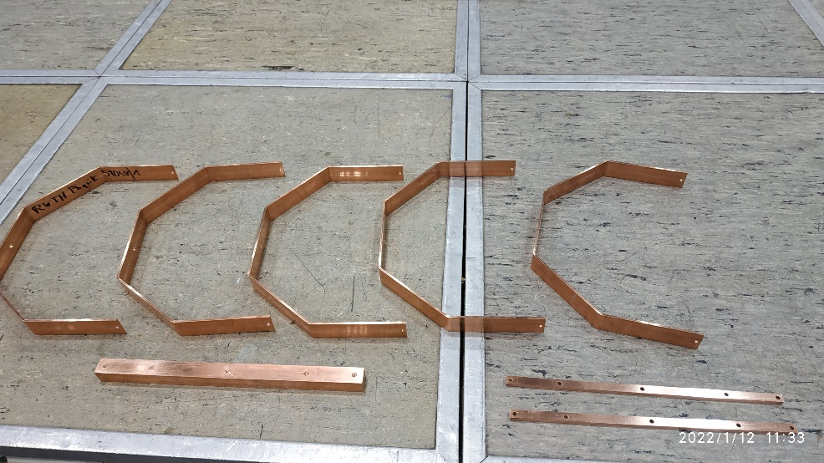
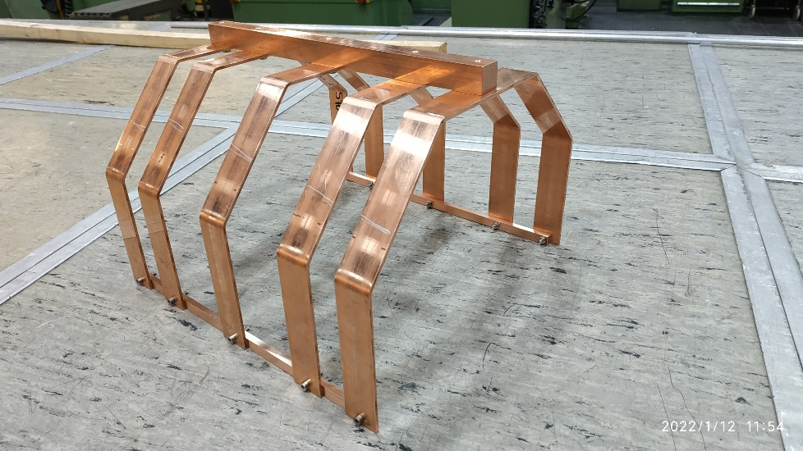
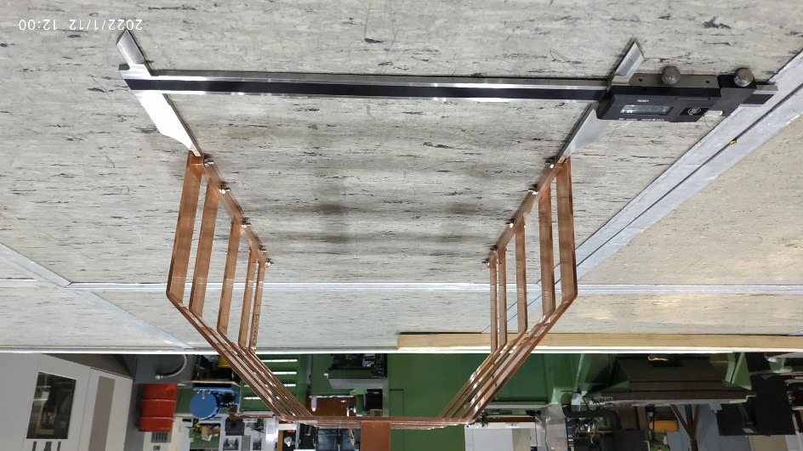
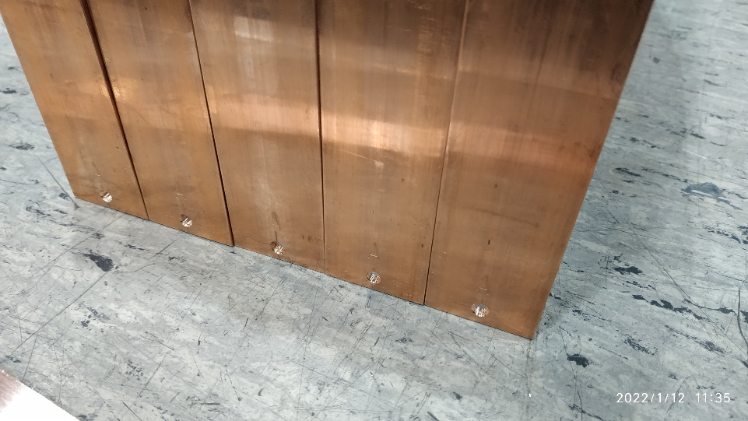
Summary Aachen Workshop January 2022
Barthel Philipps RWTH Aachen

Slide 18
Summary Aachen Worhshop January 2022
Further activities:
-Manufacturing of the new designed carriages (Prototypes).
-Order the new designed ceramic ball bearings.
Any questions ?
Thanks
Barthel Philipps RWTH Aachen

