Slide 1
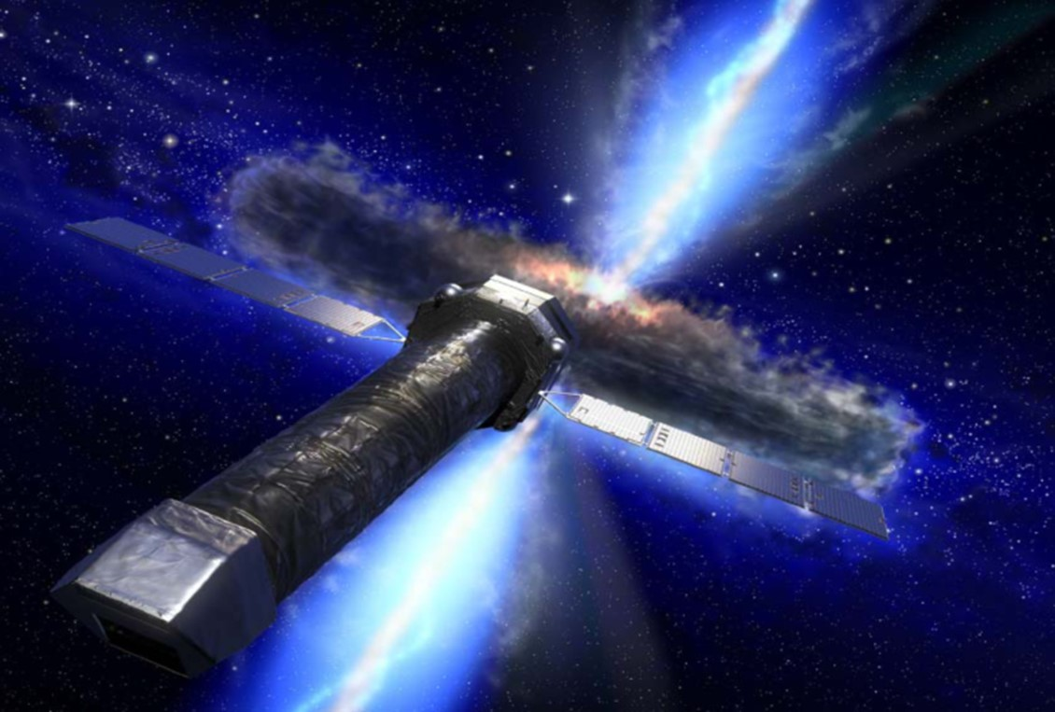
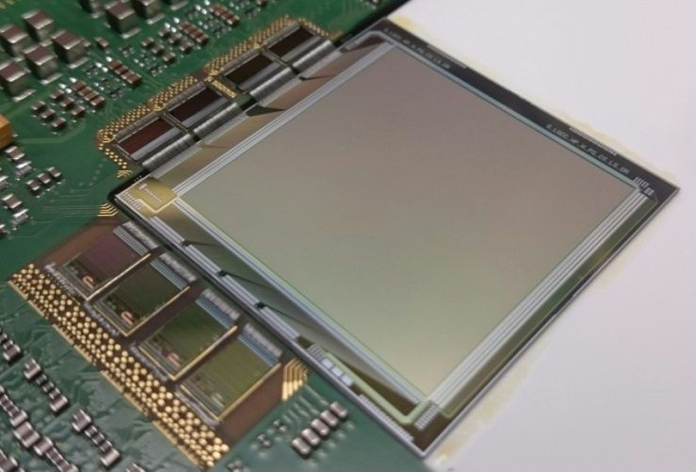
DePFET for the ATHENA Wide Field Imager DePFET Workshop München, 18.05.22
Alexander Bähr
MPG HLL
on behalf of the ATHENA WFI sensor teams

Slide 2
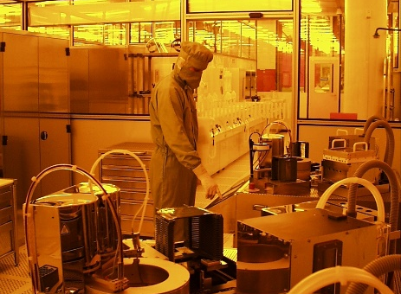
Contributors
Alexander Bähr
Peter Lechner
Raik Lehmann
Danilo Mießner
Jelena Ninković
Rainer Richter
Gerhard Schaller
Florian Schopper
Johannes Treis
Christian Zirr
WFI PI-ship
Annika Behrens
Michael Bonholzer
Valentin Emberger
Norbert Meidinger
Johannes Müller-Seidlitz
Kirpal Nandra (PI)
Wolfgang Treberspurg
Semiconductor Lab
of Max-Planck-Society
Munich, Germany
concept & layout
fabrication
wafer & die level test
assembly
Max-Planck-Institute for Extraterrstrial Physics
Garching, Germany
device test
readout & control electronics
data acquisition
focal plane architecture

Slide 3
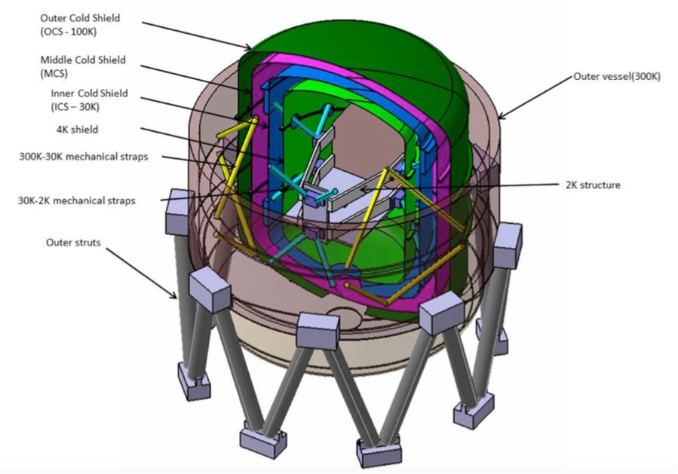
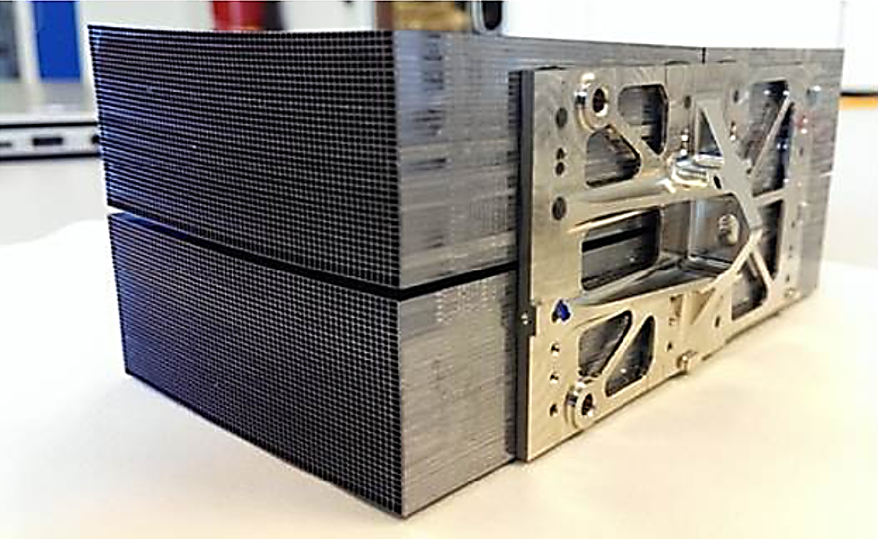
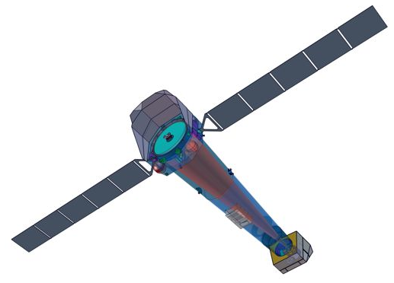
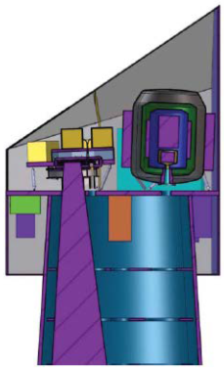
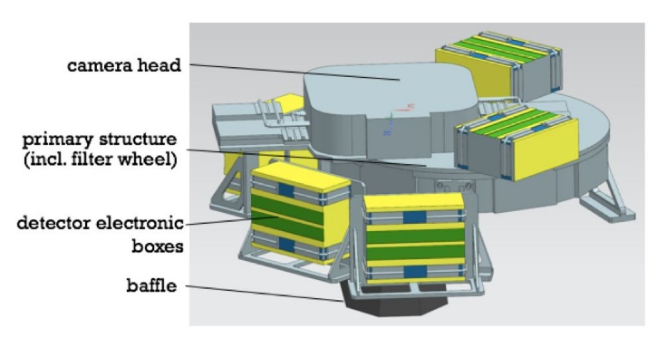
ATHENA Mission
(Advanced Telescope for High ENergy Astrophysics)
ESA's 2nd 'Cosmic Vision' L-class mission
next large X-ray observatory
launch ~ 2030, Ariane 6.4, life time > 4 y
halo orbit around Lagrange point L2
science theme: 'The Hot & Energetic Universe'
formation of large scale structures
evolution of black holes
instrumentation
movable mirror array
Si pore optics
effective area > 1.4 m² @ 1 keV
angular resolution 5 arcsec HEW
focal length 12 m
X-ray Integral Field Unit (X-IFU)
cryogenic transition edge sensor
highest resolution 2.5 eV @ 6 keV
field of view 5 arcmin
pixels 3840 (x 250 µm ◻)
temperature 50 mK
Wide Field Imager (WFI)
Si pore optics
modules
cosine/ESA
X-IFU
movable mirror array
science instrument module
WFI

Slide 4
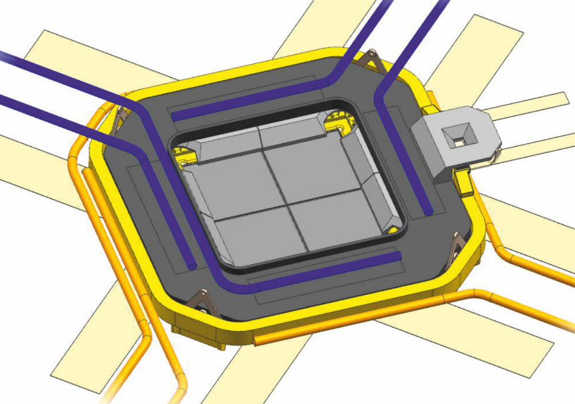
ATHENA Wide Field Imager
X-ray imaging spectrometer with spectral, position and time resolution
science drivers
specifications
WFI parameters
large-area detector, 'the' Wide Field Imager
4 identical tiles 512 x 512
gap compensation by dithering
point source
sensitivity
angular resolution
≤ 5 arcsec
< 0.3 mm
pixel size
130 µm □
> 2x oversampling
survey power
field of view
≥ 40 arcmin
≥ 14 cm Ø
pile-up limit
format
1024 x 1024 pixels
14 x 14 cm²
row / frame time
≤ 10 µsec / 5 msec
ATHENA WFI focal plane arrangement
Mo structure
thermal connection by heat pipes / thermal straps
structure: 0 °C, front-end: -20 °C, sensor: -60 … -80 °C
line spectroscopy
energy resolution
< 80 eV @ 1 keV
< 170 eV @ 7 keV
low electronic noise
≤ 10 el. ENC
quantum efficiency
energy range
0.1 … 15 keV
thin entrance window
thickness 450 µm
light-curve of bright point sources
transients
rate capability (1 Crab*)
throughput > 90 %
pile-up < 1 %
time resolution
position out of focus
~ 35 mm
4 mm PSF
frame time
≤ 80 µsec
high-rate detector
64 x 64 version of WFI
identical layout & technology
identical readout & control
out of focal plane, no imaging
* 1 Crab ≈ 10⁵ cps

Slide 5
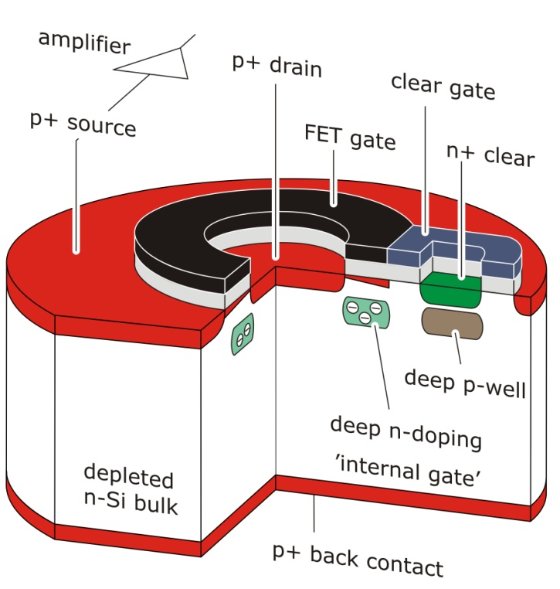
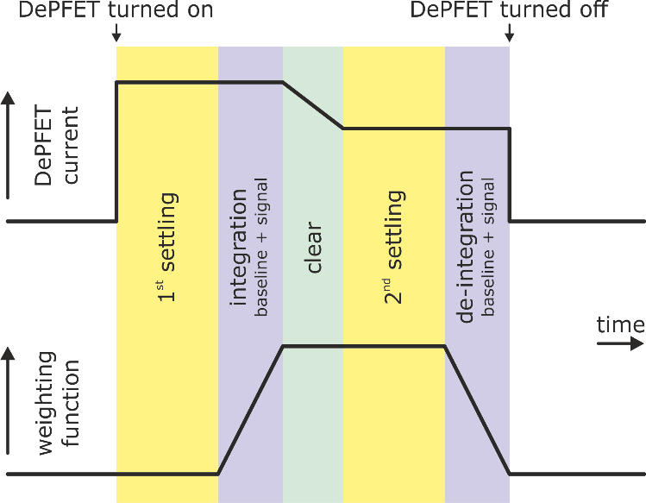
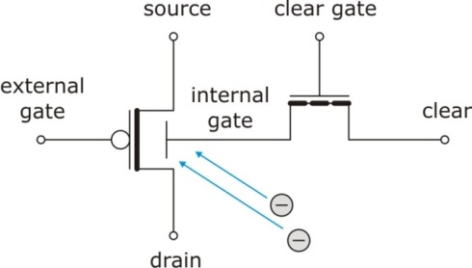
DePFET
(DEpleted P-channel Field Effect Transistor)
principle
p-FET on depleted n-bulk
signal charge collection in potential well below FET channel ('internal gate')
drain current modulation, Ơ(100 pA/el.)
combined sensor & amplifier
low capacitance (20 fF) and noise
 excellent spectroscopic performance
complete clearing of signal charge
 no reset noise
charge storage capability
 readout on demand
non-destructive readout
 potential of repetitive readout
backside illuminated, fully depleted
 quantum efficiency
readout sequence
1st measurement: signal + baseline
clear: removal of signal charges
2nd measurement: baseline
difference = signal
settling times after switch-on & clear
equivalent circuit
readout sequence

Slide 6
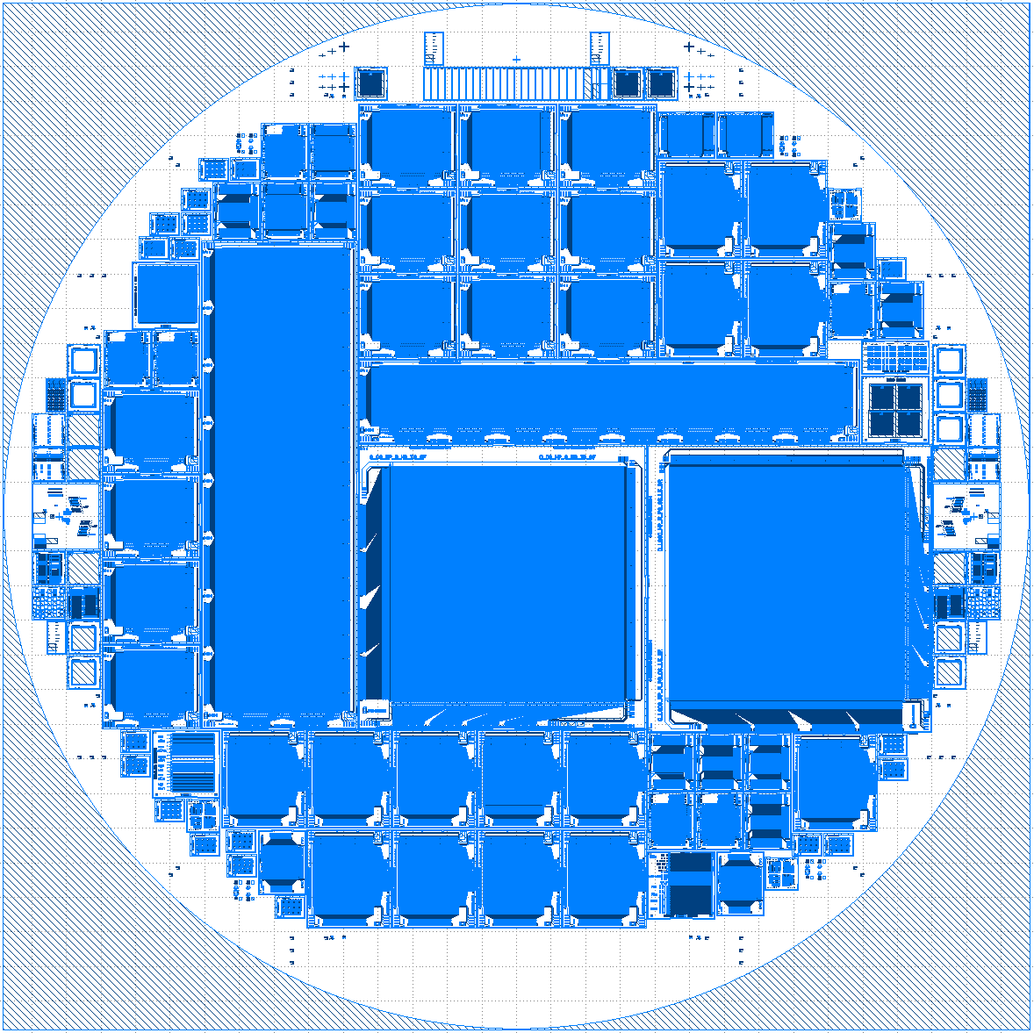
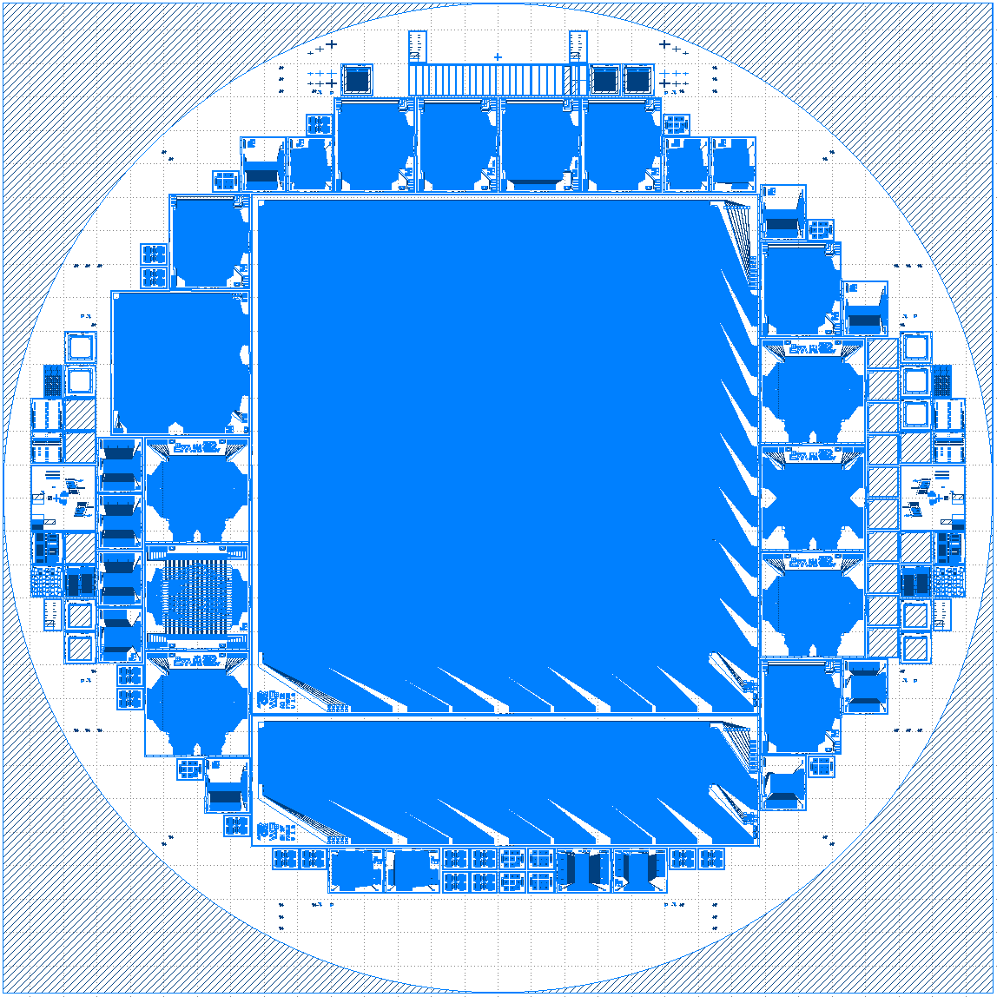
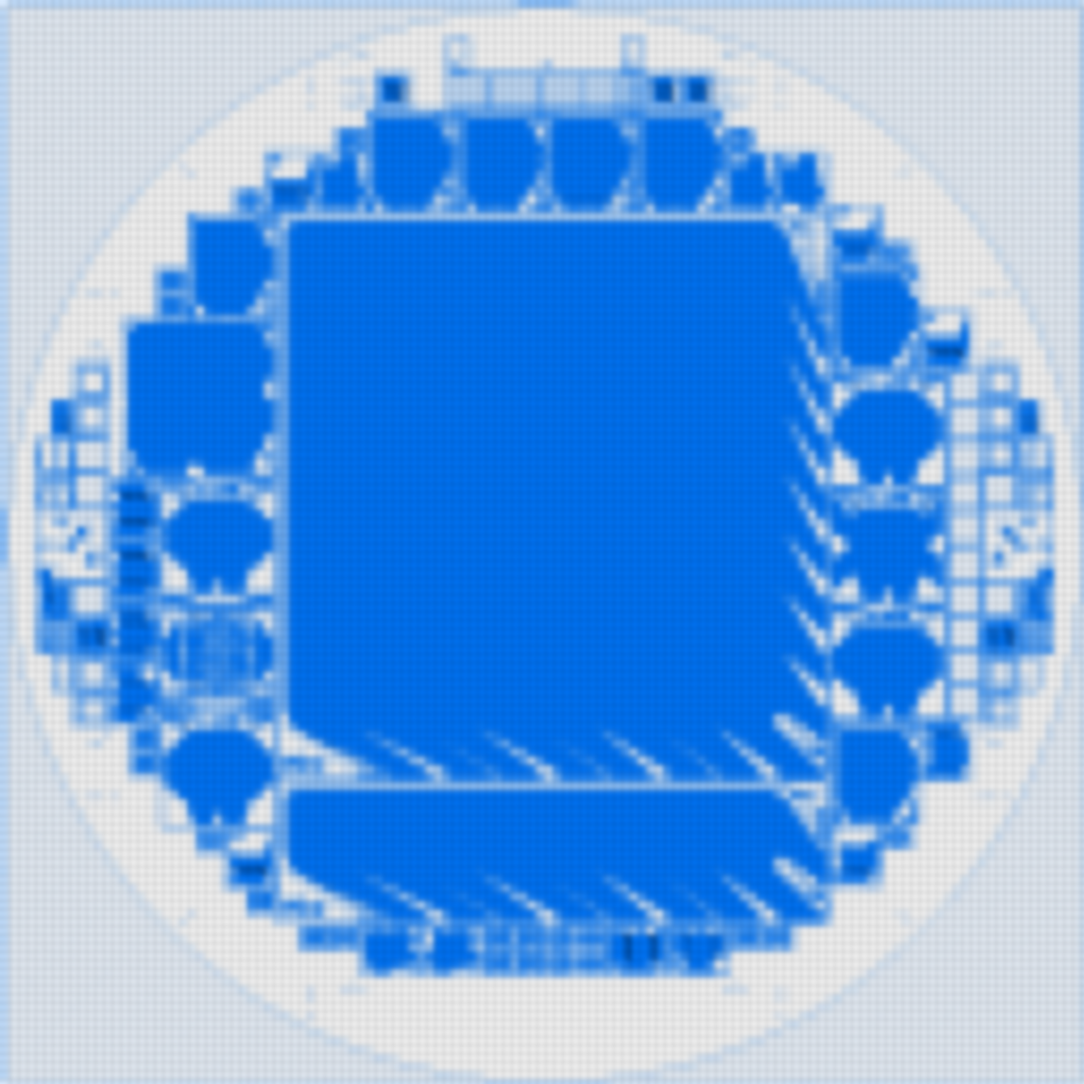
Production Overview
prototype production (PXD11)
may15 – nov16
many small devices
layout & technology variations
selection of best variant
pre-flight production (PXD12)
2 batches
oct17 – jun19, jan18 -
consolidated layout & technology
final device formats
quadrant 512 x 512
fast timing 64 x 64 split frame
flight production
mid2020 –
unchanged layout & technology
wafer number

Slide 7
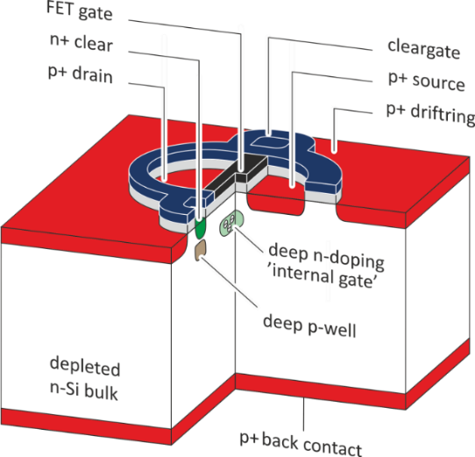
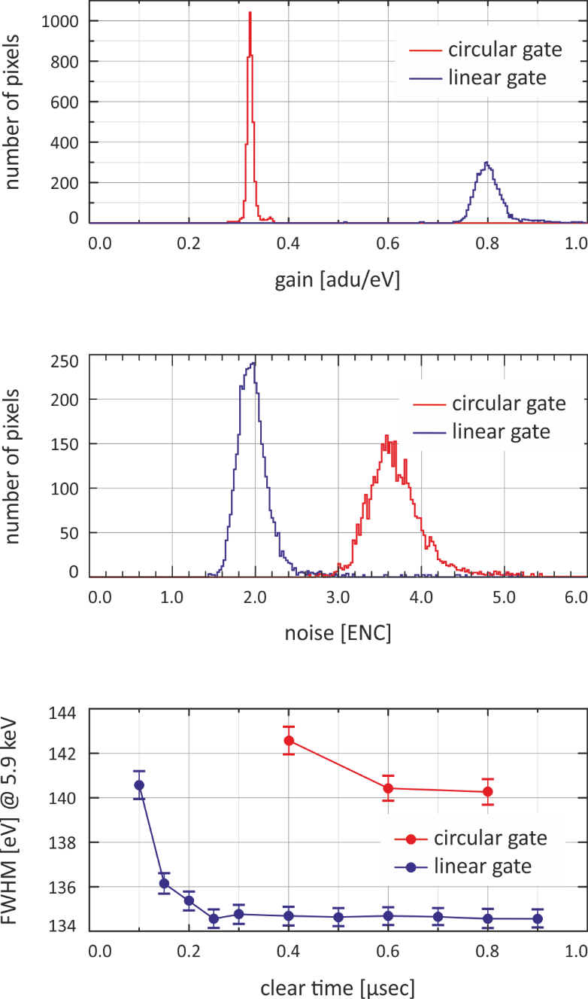
Prototype Production PXD11 - DePFET Layout
previous generations: circular gate
e.g. BepiColombo MIXS
analytical DePFET model
ATHENA WFI layout: linear gate
performance (64 x 64 prototypes)
gain
noise
timing
W/L = 45 µm / 5 µm
$$g_{q, sat}= \frac{∂I_{D}}{∂Q_{sig}} ≅ \sqrt{\frac{−2 μ_{p} I_{D, sat}}{W L^{3 }\acute{C_{ox}}}}$$
W/L = 25 µm / 3.5 µm

Slide 8
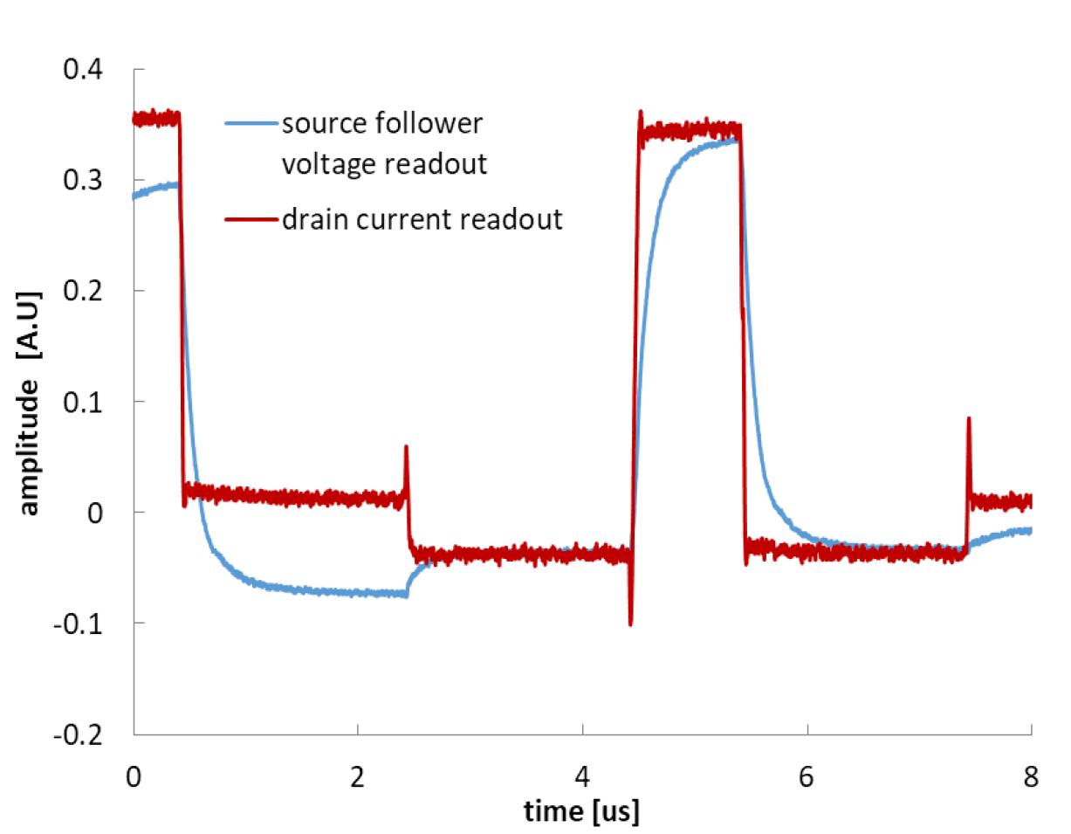
Prototype Production PXD11 - Readout Electronics
source follower
stable configuration
easy to operate
speed limitation by parasitic line capacitance
drain current readout
motivation: the need 4 speed
DePFET terminals at fixed potentials
requires homogeneity of DePFET characteristics
VERITAS redesign with reduced I2V gain to widen the input range
comparison
VERITAS 2.1 offers both input stages
drain current configuration can double the readout speed for large matrices, e.g. circular gate devices:
Sven Herrmann / SLAC, BNL
readout mode | source follower |  | drain current
time / row [µsec] | 9.8 | 13.8 | 2.5 | 5.0 | 8.7
FWHM [eV] @ 5.9 keV | 156 | 138 | 174 | 145 | 135
ENC [el. r.m.s.] | 4.98 | 2.85 | 7.70 | 4.95 | 3.93

Slide 9
Prototype Production PXD11
P-format 64 x 64
~ ATHENA WFI fast detector
spectroscopy performance
55Fe source, Mn-Ka line 5.9 keV
processing time per row 2.5 µsec
energy resolution FWHM 128 eV
mean pixel noise 2.3 el. ENC

Slide 10
Prototype Production PXD11
quarter format 256 x 256
~ ATHENA WFI large area detector
spectroscopy performance
55Fe source, Mn-Ka line 5.9 keV
processing time per row 9.8 µsec
energy resolution FWHM 128 eV
mean pixel noise 1.8 el. ENC

Slide 11
Prototype Production PXD11
quarter format 256 x 256
~ ATHENA WFI large area detector
spectroscopy performance
multi-target X-ray tube
processing time per row 9.8 µsec
energy resolution FWHM 50 eV @ 183 eV B
57 eV @ 525 eV O
69 eV @ 1.5 keV Al
128 eV @ 5.9 keV Mg
174 eV @ 11 keV Ge

Slide 12
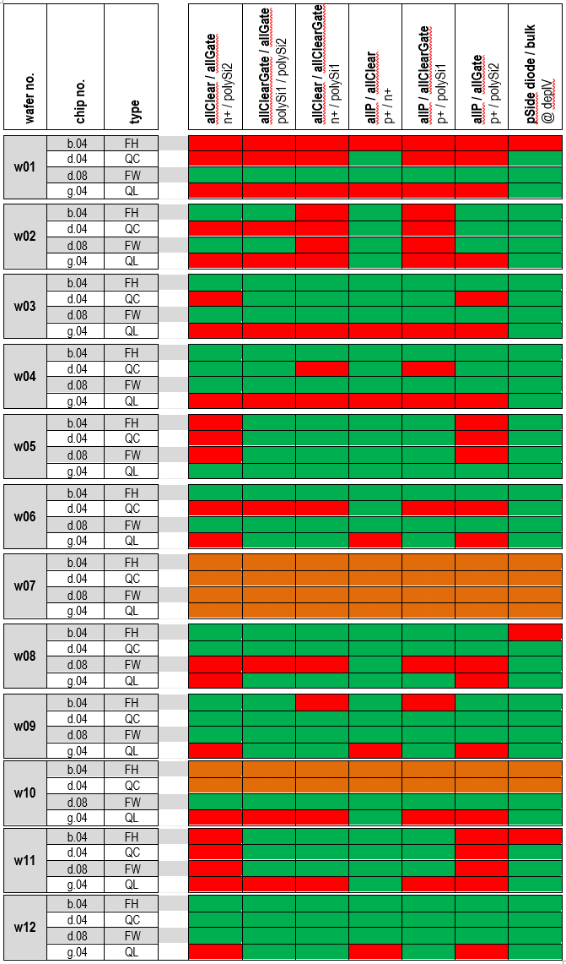
Prototype Production PXD11 – lessons learned
pxd11 - quarter devices
inline yield test
using global contacts
gate (polySi2)
cleargate (polySi1)
clear (n-implant)
ring2 (p-implant)
detectable
vertical shorts between layers
lateral shorts within layers
diode integrity
not detectable
defect number, nature & location
missing contacts
pass
fail
handling

Slide 13
Prototype Production PXD11 – lessons learned
lesson 1 learned from PXD11
random polySi etching imperfections
single, isolated defects polySi 1 & 2
not detected by µTEC inspection system
detected and identified by PHEMOS emission microscope
uneven edges of polySi structures, "nose"
→ short by touching neighbouring via
short cleargate - clear
tiled image of 256 x 256 quarter device by PHEMOS light-emission microscope
short gate - drain

Slide 14
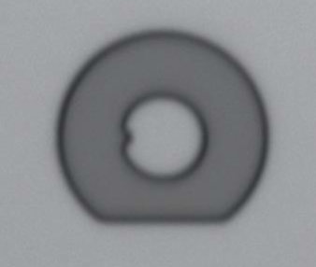
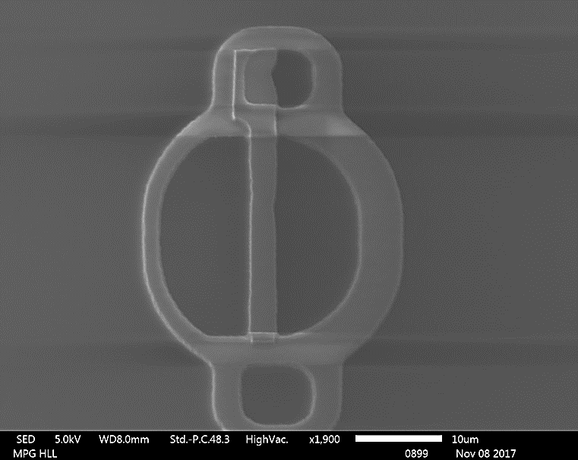
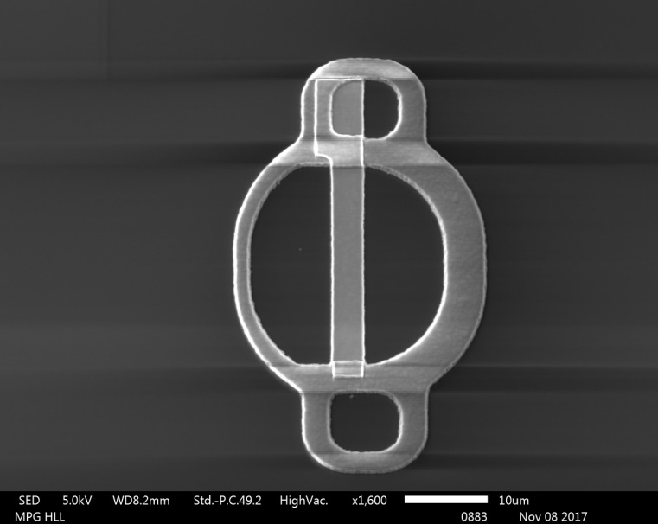
Prototype Production PXD11 – lessons learned
automatic inspection system
optics update: magnification x10 → x50
reliable detection of defects ≥ 500 nm
smaller defects irrelevant
virtual die-die comparison within a large format device
computation time ~ 5 h per wafer
polySi process optimisation
test project, ~ 50 wafers
ATHENA WFI representative layouts
optimisation of polySi lithography & etching
new development recipe
polySi patterning with photoresist, no LTO hardmask
smooth & straight edges
ideal climbing over polySi1 steps
x10
x50
artificial defect

Slide 15
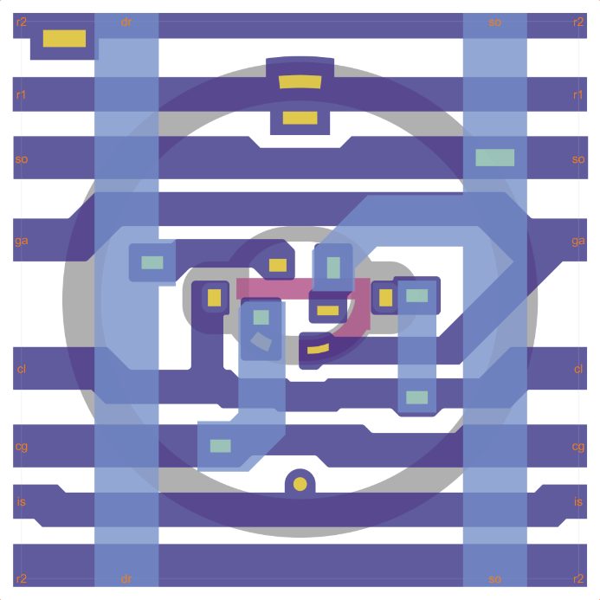
Prototype Production PXD11 – lessons learned
lesson 2 learned from PXD11
suspicion of metal shorts
related to device type
rework of pixel layout
PXD11 prototype
compact DePFET dimensions
gate extension for via placement
vertical polySi1 & 2 stack
frequent changes between metal layers 1 & 2
narrow gaps in metal layers
PXD12 pre-flight
relaxed DePFET layout
extended S & D regions, W & L unchanged
cleaned-up metal system
min. number of vias
full testability after metal 1
confirmed by 3D device simulation

Slide 16
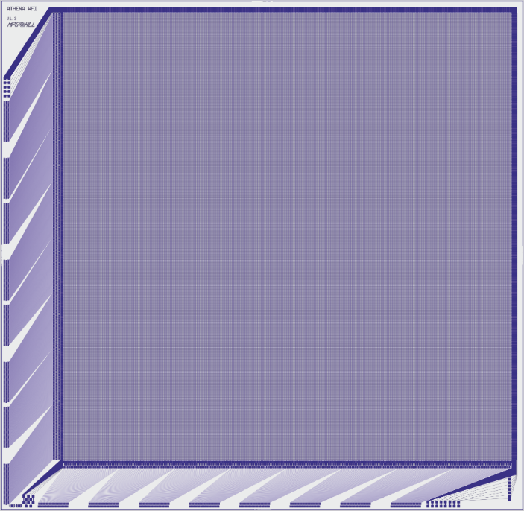
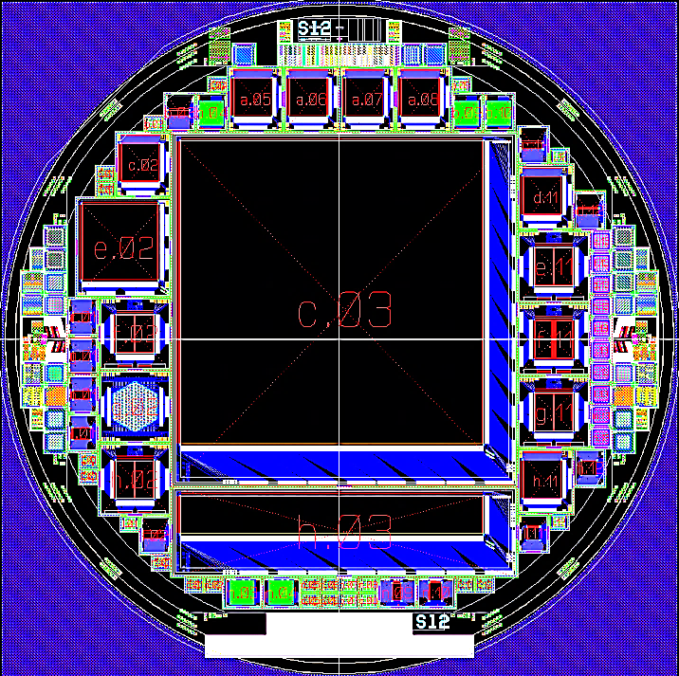
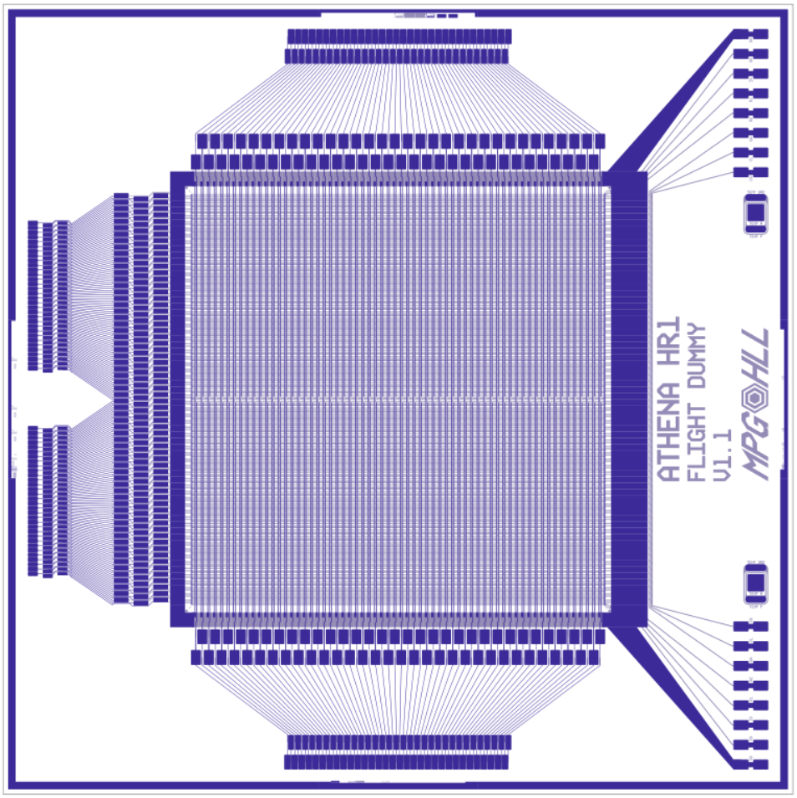
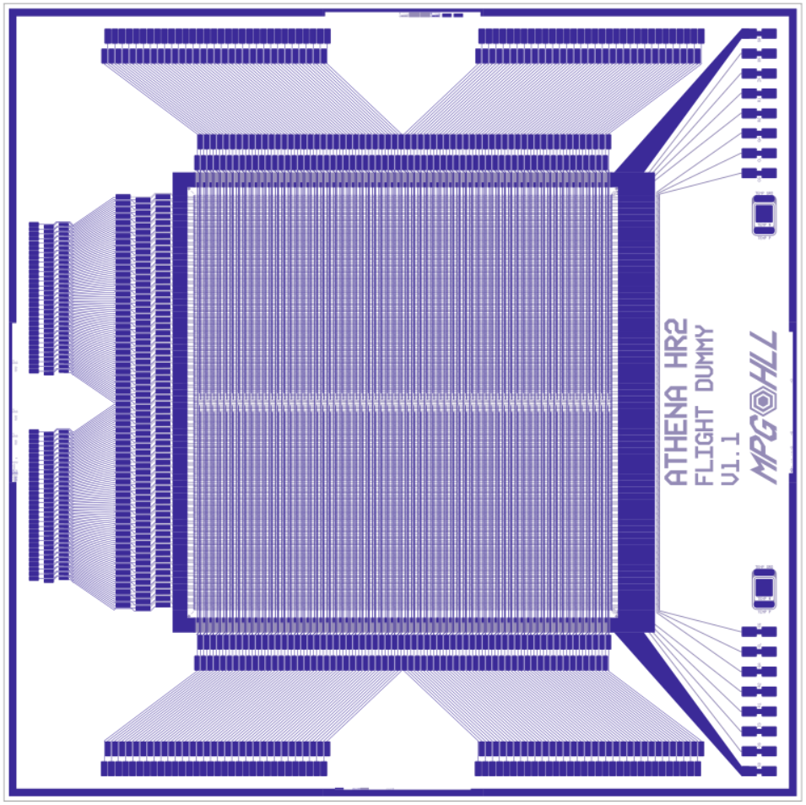
Pre-Flight Production PXD12
final layout & technology
large area imager quadrant
format 512 x 512
sensitive area 66.56 x 66.56 mm²
chip size 78.00 x 76.15 mm²
inner edges 2 mm
rolling shutter mode
displaced bond pads
high rate detector
format 64 x 64
chip size 16.00 x 16.00 mm²
split frame readout
one row per hemisphere → 2 r/o ASICs
two rows per hemisphere → 4 r/o ASICs
first devices available beginning 2019
ATHENA WFI quadrant
PXD12 wafer map
ATHENA WFI
fast detector
2 rows readout
ATHENA WFI
fast detector
4 rows readout

Slide 17
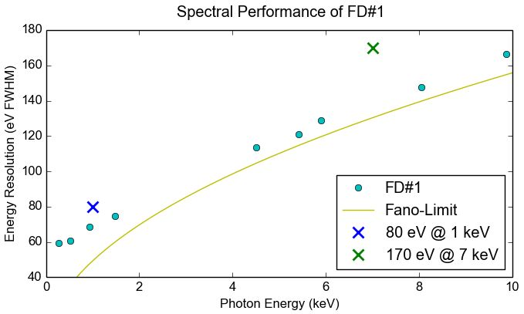
Pre-Flight Production PXD12 - Fast Detector (FD)
Excellent spectroscopic performance of the first fast detector was confirmed with the measurement of further emission lines (see below).
A second FD was mounted and investigated. FD#2 verified the performance of FD#1.
Fast Detector mounted in a vacuum chamber. An ⁵⁵Fe source is located in the holdfast on the left.
Spectral performance of the first Fast Detector for different emission lines. All measurements were done at the required readout speed of 80 µs per frame.

Slide 18
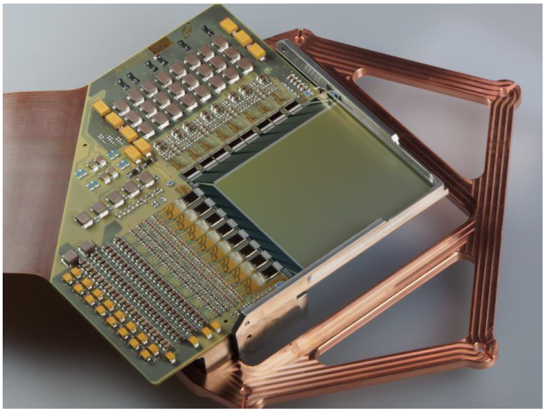
Pre-Flight Production PXD12
quadrant device
mounted at HLL
operated by MPE detector group
non-functioning
identified defect: short source – ring1
short in all large devices from PXD12-2

Slide 19
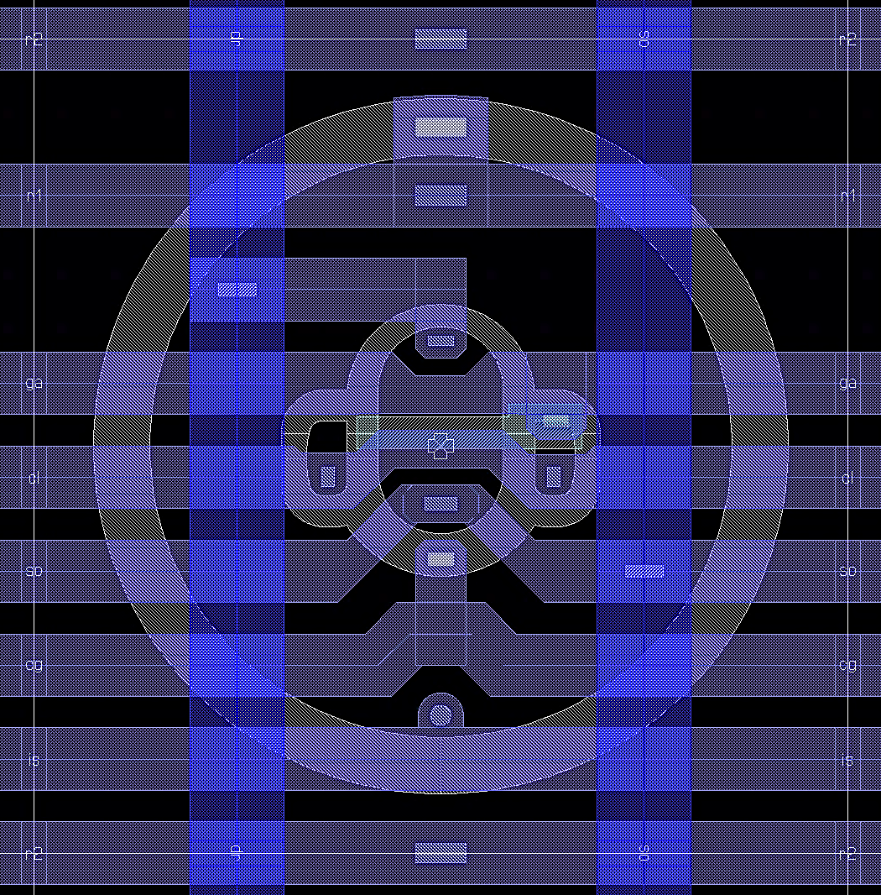
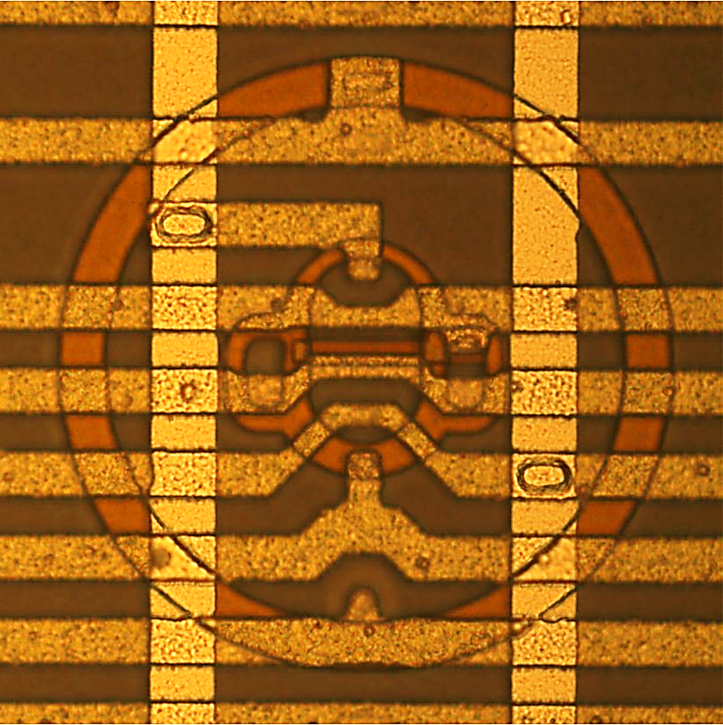
Pre-Flight Production PXD12
failure mechanism
intra-layer short within metal1
→ ruled out by layout
inter-layer short by insufficient insulation
→ triple stack polySi/metal1/metal2
not known from previous productions
no repair option for diced chips (PXD12.2)
source
ring1
source
PXD12 pixel layout
conductive layers
 metal1
 metal2
○ polySi
PXD12 pixel micro-photograph

Slide 20
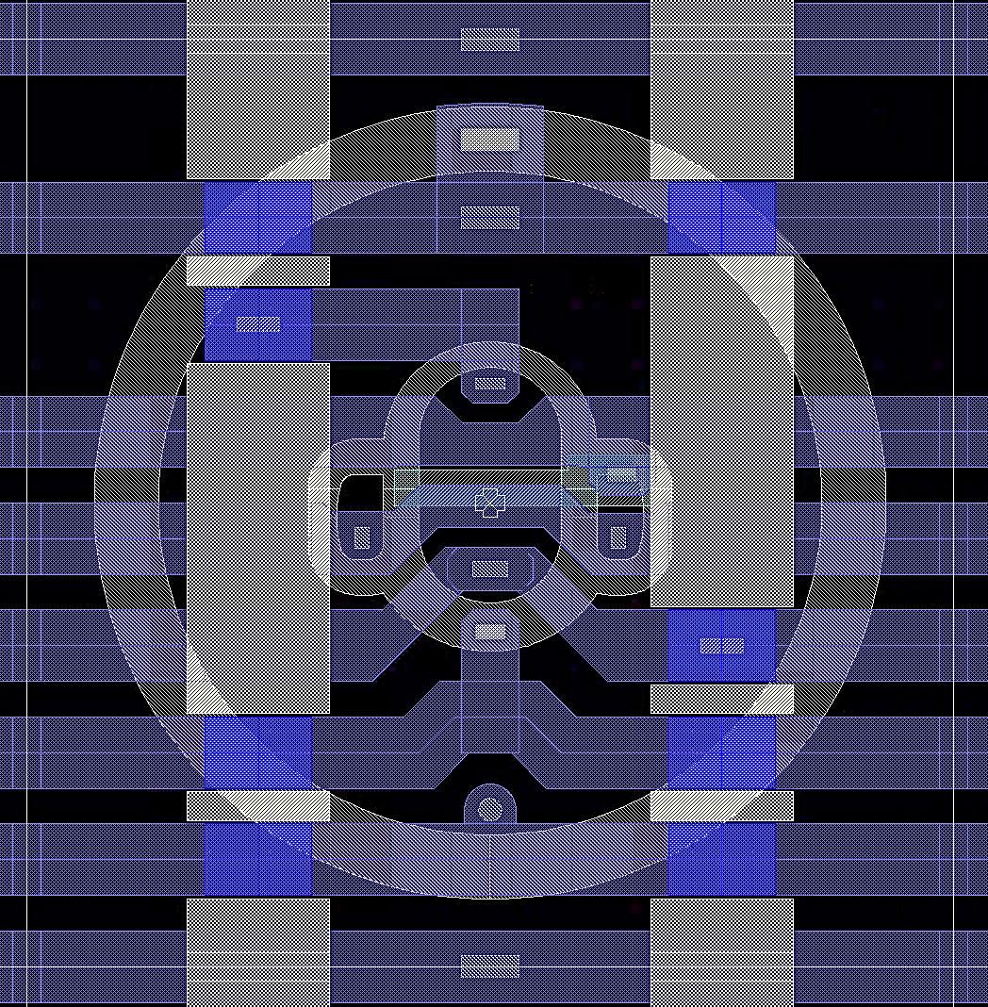
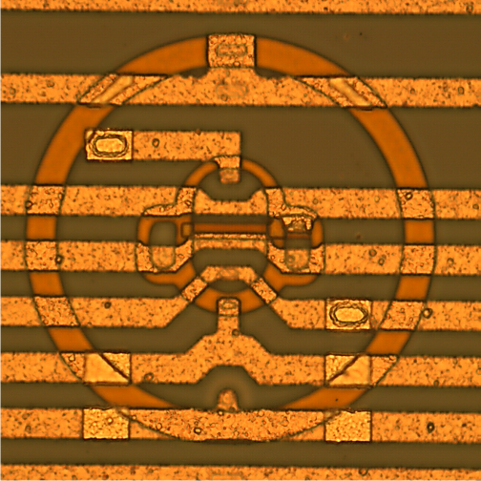
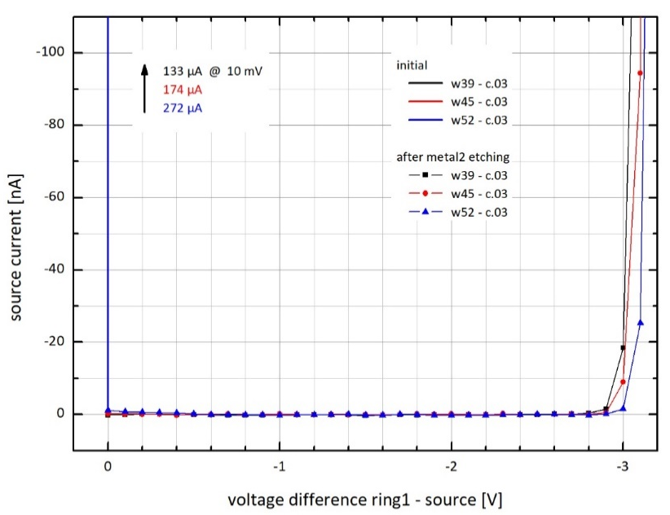
Pre-Flight Production PXD12
repair approach for wafers of PXD12.3
etching of metal2 lines
isolated metal2 islands
at critical triple stacks
at contact holes
only inside pixel, periphery unchanged
short circuit source/ring1 disappeared
new metal3 layer required
ring1
source
PXD12 pixel layout
conductive layers
metal 2 etching mask
after metal2 etching

Slide 21
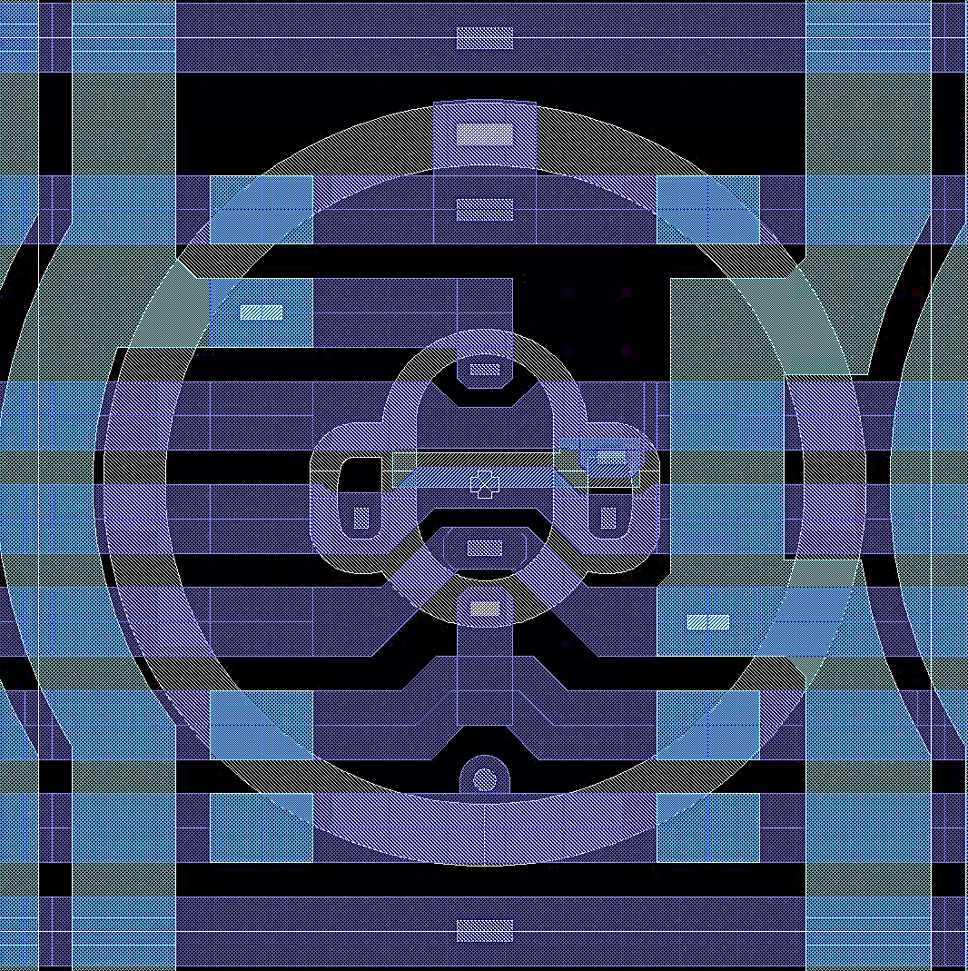
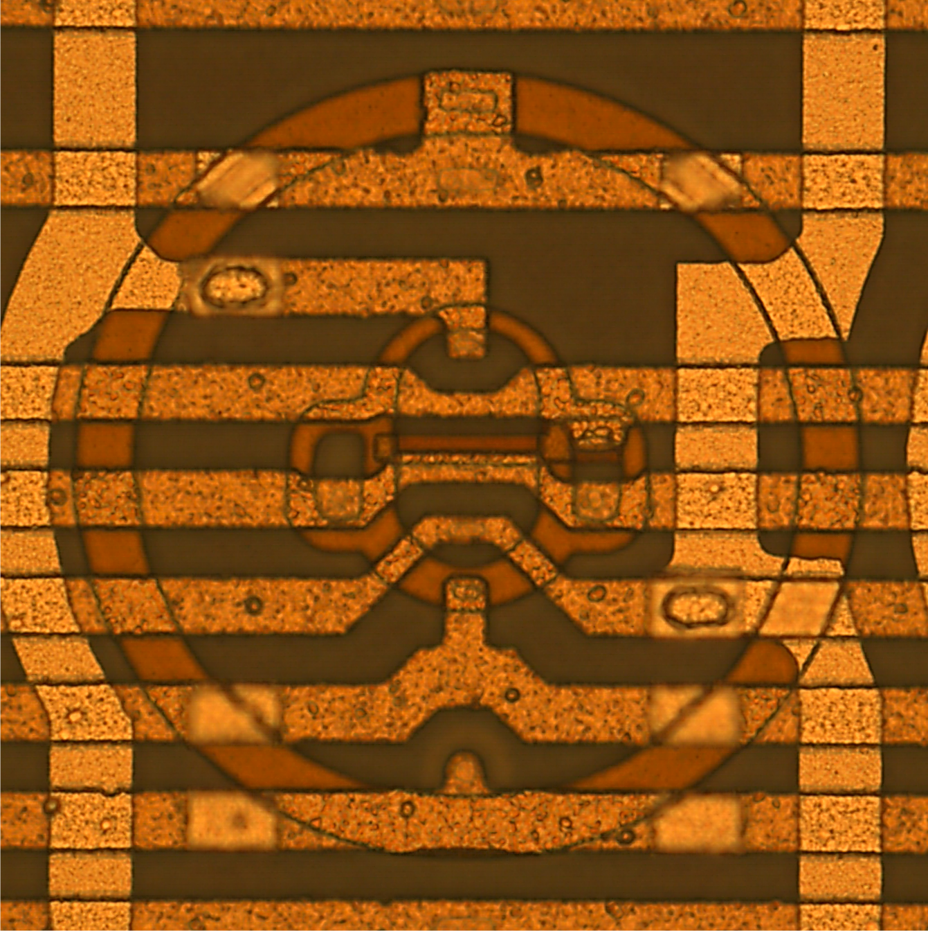
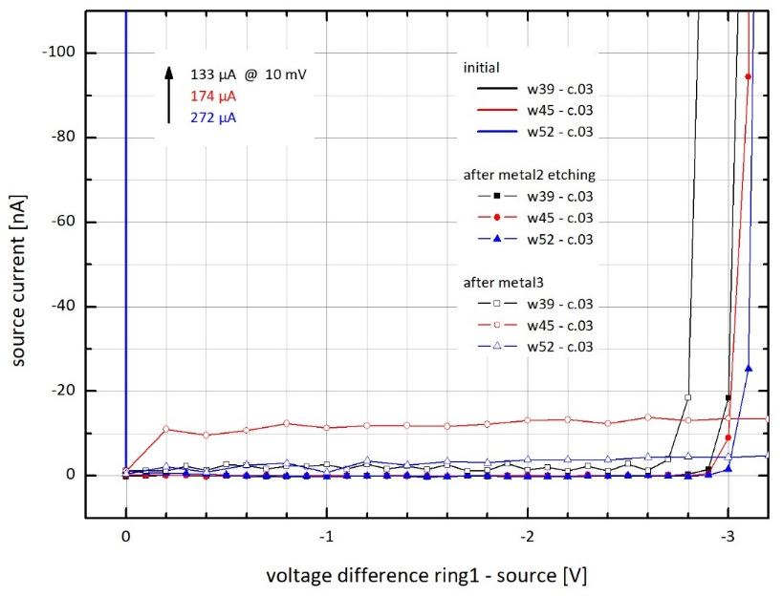
Pre-Flight Production PXD12
metal3 layer
replacement of metal2 lines
modified layout, avoidance of triple stacks
source/ring1 insulation still ok
other tests nominal, working device
PXD12 pixel layout
conductive layers
metal3 layer
after metal3 patterning

Slide 22
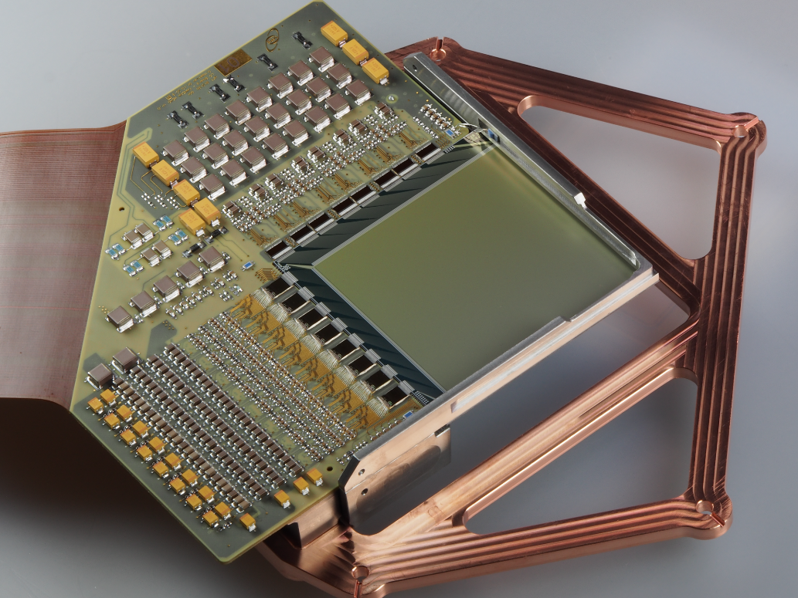
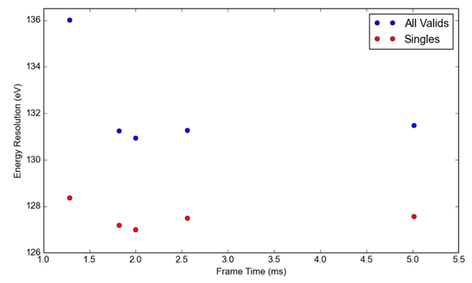
Pre-Flight Production PXD12 - Large Detector (LD)
Spectrum taken with a Large Detector and an ⁵⁵Fe source at a frame time of 2 ms. Due to the large fraction of readout to exposure time of a Large Detector, the detector-induced background is low and various fluorescence lines of elements used in the vacuum chamber are visible.
Spectroscopic performance of a Large Detector measured for different frame times. For all measurements with a frame time of > 1.5 ms the signal shaping time of the Veritas ASIC was kept constant. The increase of settling times does not improve the overall spectral performance.
Large Detector Module connected to its cooling interface used in the laboratory test setups.

Slide 23
Pre-Flight Production PXD12 - Large Detector (LD)
unexpected noise pattern
some pixels show factor 2-3 higher noise
can be reduced by data analysis
could limit low energy resolution
not observer for any device before
origin is still unknown

Slide 24
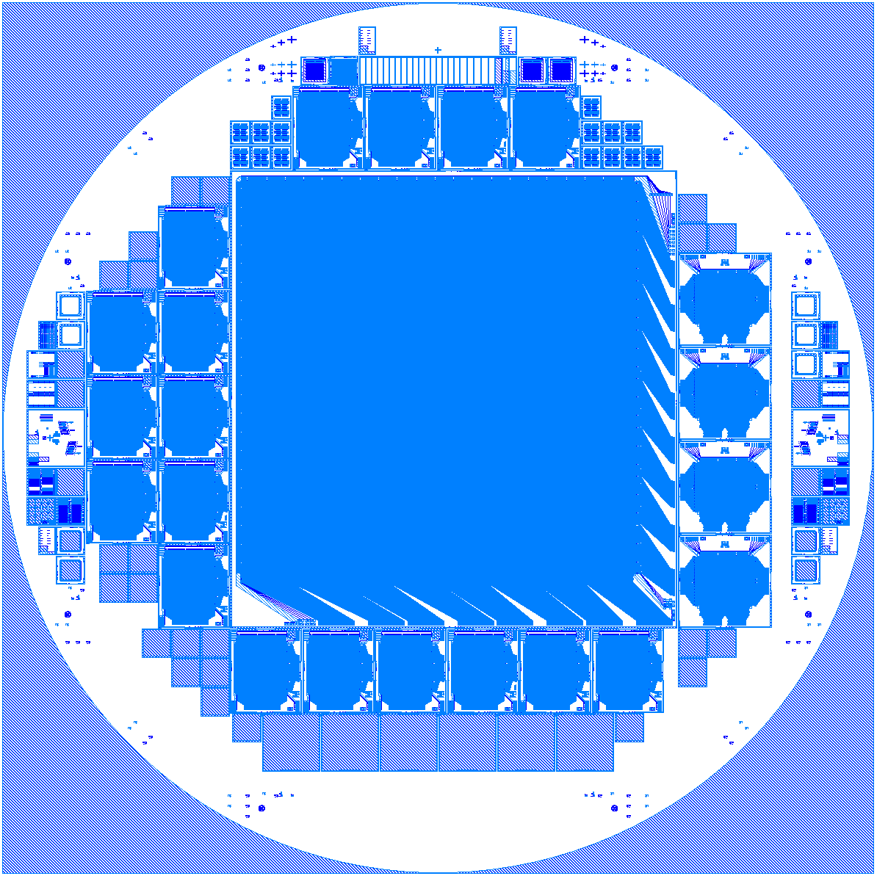
Flight Production (PXD14)
wafer layout
updated pixel layout
flight devices
1 x quadrant 512 x 512
4 x fast detector 64 x 64
others
18 x WFI-like 64 x 64
29 x diodes 10 mm², 64 mm² for qeff measurements
production
start Sep 20
volume: 36 wafers
sub-batches 3 x 12 wafers
1 batch before aluminum deposition
2 batches in poly process
PXD14 wafer layout

Slide 25
Summary
ATHENA
one of the biggest European science projects of the coming decades
DePFET-based Wide Field Imager
superior performance demonstrated by PXD11 prototypes
challenge of a large number of large format devices
positive results of pre-flight production PXD12
still open questions

Slide 26
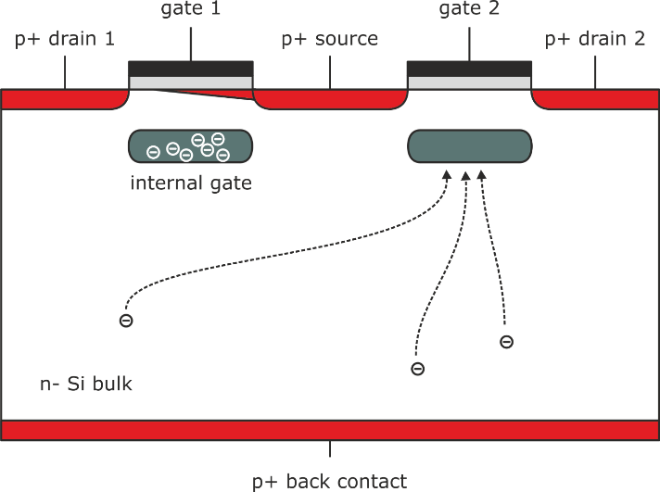
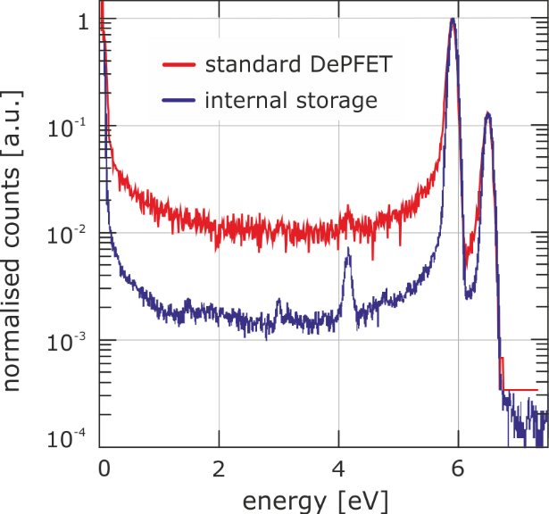
Full Frame Readout
parallel readout
increasing probability of photon events during readout sequence
false energy information-energy
internal storage DePFET
two DePFETs per pixel
alternating function
ON readout
OFF collection & storage
prototype demonstration
repetition rate 1/10 µsec
false event contribution to low-energy background reduced
full frame readout device
127 hexagonal pixels, Ø = 800 µm
X-ray spectroscopy (& imaging) at frame rate > 100 kHz
not baseline for ATHENA WFI

Slide 27
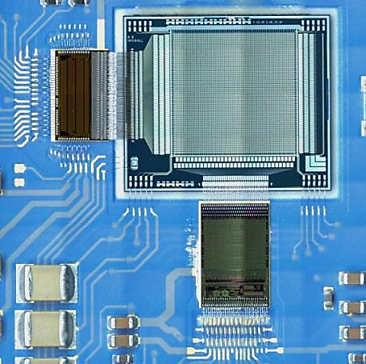
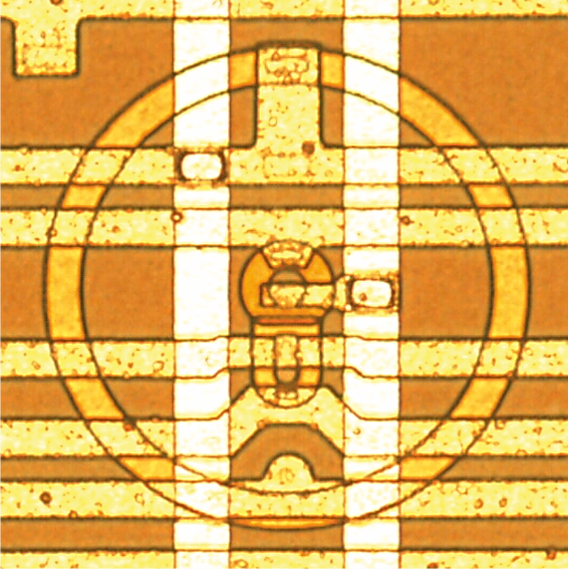
DePFET Active Pixel Sensor
matrix organisation
horizontal supply lines
clocked voltages connected to SWITCHER ASIC
global contacts connected to bond pads
vertical signal lines
connected to VERITAS readout ASIC
individually addressable pixels
optional windowing mode
rolling shutter mode operation
one active row
DePFETs on
read-clear-read sequence
column-parallel readout
other rows integrating signals
DePFETs off
front-end electronics
SWITCHER-A control ASIC
supply of clocked voltages
row selection & reset
64 channels, 3 ports each
daisy-chainable
row switching rate 10 MHz
rise time < 10 nsec @ 20 V
VERITAS 2.1 readout ASIC
64 channels
fully differential
selectable input stages
source follower
current readout
pre-amplifier
trapezoidal filter
64:1 multiplexer
ATHENA WFI prototype 64 x 64
ATHENA WFI pixel
130 µm x 130 µm
surrounding drift ring
scalable format

Slide 28
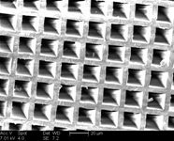
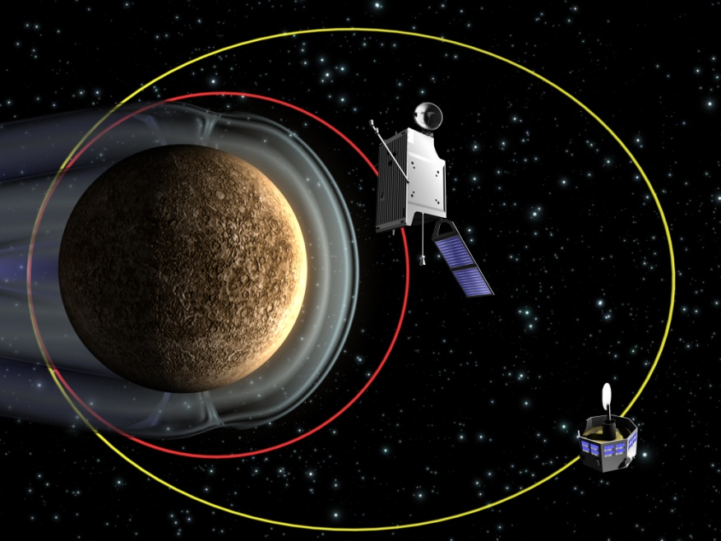
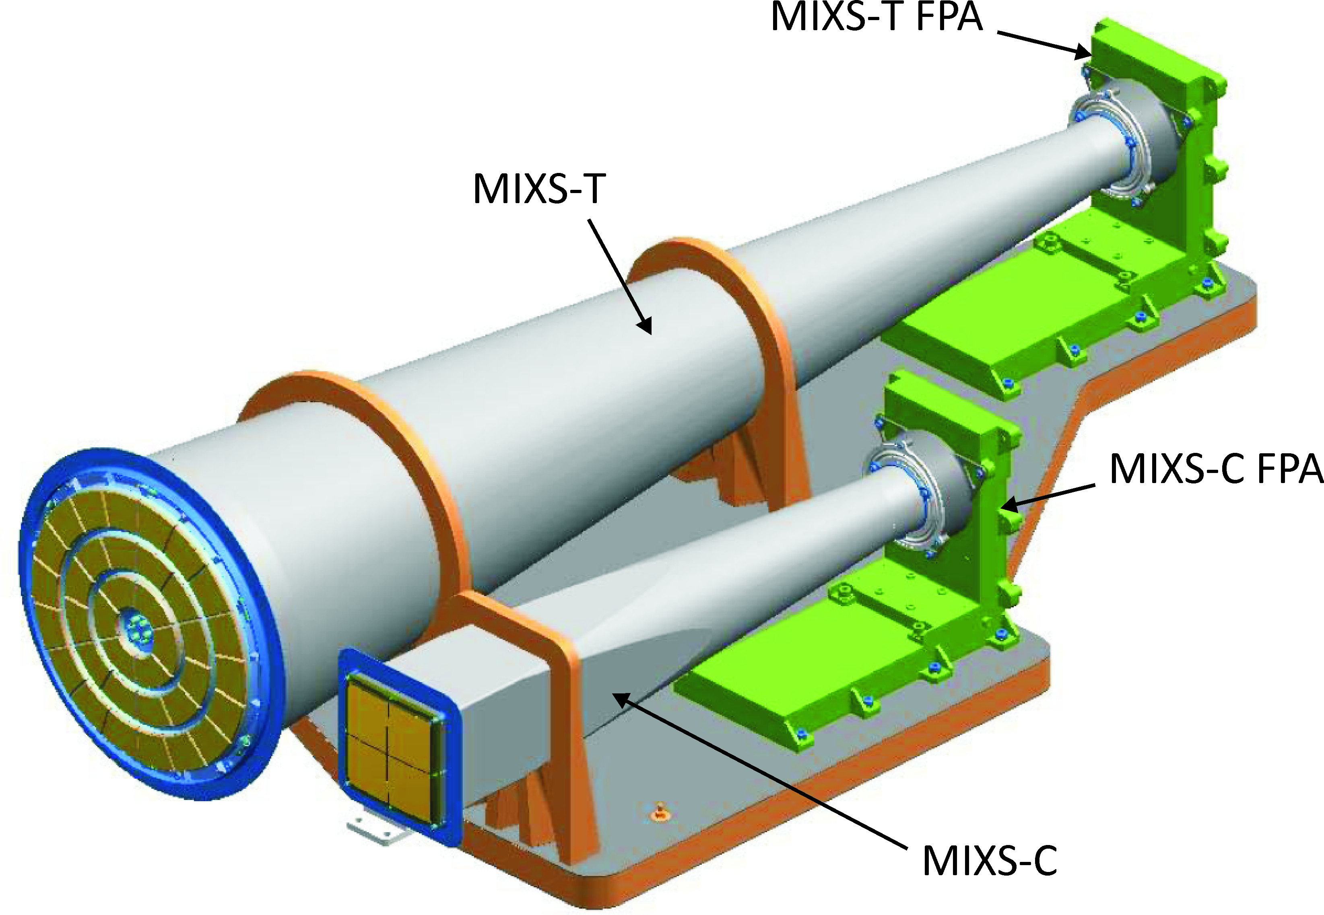
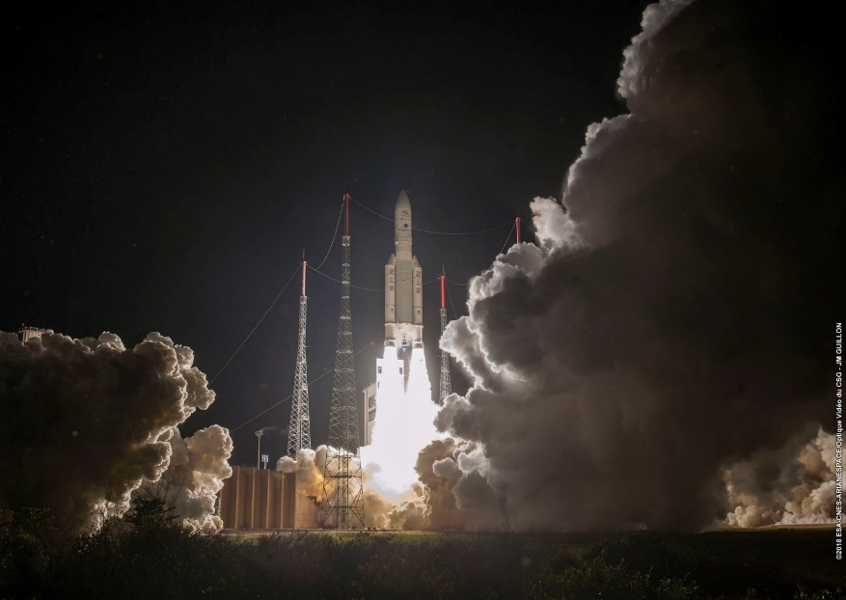
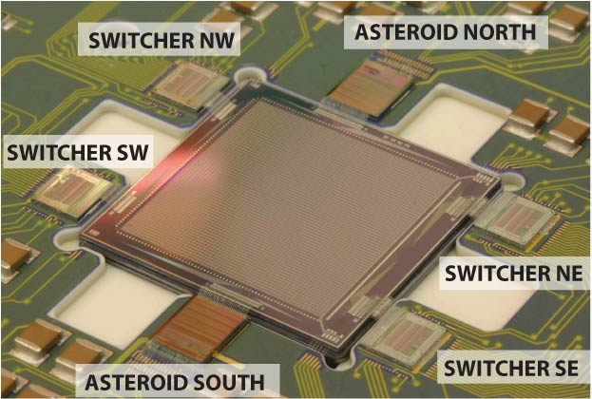
BepiColombo MIXS Heritage
(Mercury Imaging X-ray Spectrometer)
BepiColombo mission
magnetospheric & planetary orbiters
launch oct18, arrival in orbit dec25
MIXS instrument
Mercury surface elemental mapping
MIXS-C (collimator), MIXS-T (telescope)
DePFET Active Pixel Sensor
active area 1.92 x 1.92 cm²
format 64 x 64
pixel size 300 x 300 µm²
split frame readout 165 µsec
energy resolution 138 eV FWHM @6 keV
MPO
MMO
figure: ESA
Kourou, 19.10.2018
MIXS lab prototype detector

Slide 29
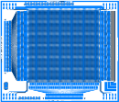
Prototype Production PXD11
prototype production
prototype 64 x 64 device flavour selection
quarter 256 x 256 large area
full width 512 x 64
full height 128 x 512
purpose
selection of technology variant
thin gate oxide
blanket deep n implanation
wet etching of polySi structures
selection of layout variant
linear gate
large clear
halo implantation
status
finished 2017
fully analised
64 x 64
long connection lines
full height
128 x 512
quarter
256 x 256
full width
512 x 64

Slide 30
Pre-Flight Production PXD12
inline yield test
using global contacts
gate (polySi2)
cleargate (polySi1)
clear (n-implant)
ring2 (p-implant)
detectable
vertical shorts between layers
lateral shorts within layers
diode integrity
not detectable
defect number, nature & location
missing contacts
pxd11 - quarter devices
pxd12, 1st sub-batch - quadrant devices
pixel count
x4
pass
fail
handling

Slide 31
Pre-Flight Production PXD12
entrance window diode
large area 44 cm²
reverse current @ depletion 2.83 nA
leakage current level 64 pA/cm²
best PXD value so far

Slide 32
Contents
ATHENA mission
Wide Field Imager
requirements & specifications
DePFET device
DePFET Active Pixel Sensor
prototype production PXD11
DePFET layout
readout electronics
pre-flight production PXD12
flight production PXD14

Slide 33
Pre-Flight Production PXD12
metal2 etching & metal3 deposition
applied to metal1/metal2 contact chains
contact between metal2 & metal3 ✓
climbing of metal3 ✓
metal2 etching
after metal2 etching
metal3 deposition & patterning
after metal3 deposition & patterning

Slide 34
Prototype Production PXD11
summary
linear gate layout DePFET
drain current readout
excellent noise < 3 el. ENC
fast readout 2.5 µsec / row
fully in ATHENA WFI specs

