Slide 1
EDET – Key Findings
EDET DH80k: Optimization, Calibration & Evaluation
Mai 17th 2022

Slide 2
SYSTEM OPTIMIZATION What to optimize?
Single Components: DCDE, DEPFET-Sensor, Power System, ...
Interchip Communication: Delay Scans, JTAG
Whole System: Offset Compression, Ghost Charge, Sampling Point Analysis, …
→ ULTIMATE GOAL: increase SNR

Slide 3
SYSTEM OPTIMIZATION Systematic Approach
WORK STEP | Example 1: DCDE | Example 2: Sensor Charge Collection
Define Objective Function | Missing Codes, INL, DNL, noise … → Hierarachy? | Maximize Charge Collection
Define Objective Parameters | Over 15 DCDE 7-bit DAC settings | DEPFET Voltages
Select Methods and suitable Instruments (sometimes have to be developed) | External current source →increasing signal injection | 2D-Voltage Sweeps + LED Charge Injection
Program necessary Algorithms
Output | Transfer Curves | 2-D Charge Collection Maps
Time Management: sweep step widths, selection of parameters, selection of favorable regions, …

Slide 4
E1_I_2 Can these Transfer Curves Improved?

Slide 5
E1_I_2 DCDE Optimized

Slide 6
GHOST CHARGE
Phenomenon of an additional measured pixel current without any external charge injection

Slide 7
GHOST CHARGE
Can not be calibrated away!

Slide 8
GHOST CHARGE detailed view

Slide 9
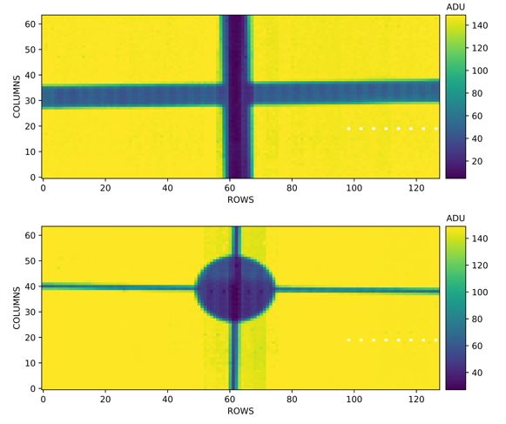
DIFFERENT MASKS – GHOST CHARGE REMAINS

Slide 10
ANOTHER EXAMPLE OF GHOST CHARGE

Slide 11
MITIGATING MEASURES …
Variation Switcher Parameters: extend clear period, increase clear voltage, different sampling points → no impact
Decrease Matrix Current: →no impact (corresponding adjustment VnSubIn)
Variate DCDE Parameters: set VTCSFN and VTCCASC to maximum → 😁

Slide 12
GHOST CHARGE after DCDE ADJUSTMENTS

Slide 13
Pixel Detectors need to be calibrated!
Despite "flat-field" LED-Illumination:
"mosaic" picture instead of homogeneous image

Slide 14
Cd¹⁰⁹ Source Pixel Histograms
For some pixels peak at 25 ADU for others at 45 ADU → need for Calibration

Slide 15
Cd¹⁰⁹ Source Calibration (I)

Slide 16
Cd¹⁰⁹ Source Calibration (II)

Slide 17
Cd¹⁰⁹ Source Calibration (III)

Slide 18
EDET SIGNAL COMPRESSION EDET Charge Handling Capacity significantly increased

Slide 19
Calibrate Basis-LED-Intensity with ¹⁰⁹Cd Source

Slide 20
LED allows to establish Charge Curves for all Pixels at once…

Slide 21
WHOLE SENSOR CALIBRATION

Slide 22
KNIFE EDGE MEASUREMENT
PHOTOGRAPHY: ISO 12233 (2017)

Slide 23
DETERMINE EXACT KNIFE EDGE ANGLE

Slide 24
SUPERSAMPLING & ESTABLISH ESF
$$\left(\begin{matrix}\vec{ADU} \\ \vec{z}\end{matrix}\right)$$
Binning

Slide 25
ESF & LSF

Slide 26
MODULATION TRANSFER FUNCTION – MTF
In analogy to audio signals where Fourier Transformation switches from time to frequency domain, an image's contrast is decomposed to its spatial frequencies → lp/mm

Slide 27
THANK YOU FOR YOUR ATTENTION

Slide 28
EDET HYBRID BOARD
Delay Scan, DCDE optimization, Sample Point Determination, Noise Analysis, Transfer Curves…

Slide 29
Laser Scan of one single EDET Pixel constant laser charge, 1 µm motorstage steps

Slide 30
Laser Scan 9 x 16 pixel array constant laser charge
3 µm step
highest pixel value
small tilt
thicker blue=drift line

