Slide 1
DHH architecture: outcome of DXP-DAQ workshop and few other topics
Igor Konorov
TUM Physics Department E18

Slide 2
DHH architecture
PXD-DAQ workshop : to choose one of two DHH architectures:
TUM proposal based on optical distribution system
KEK Trigger group proposal with direct Trigger interface to DHH module

Slide 3
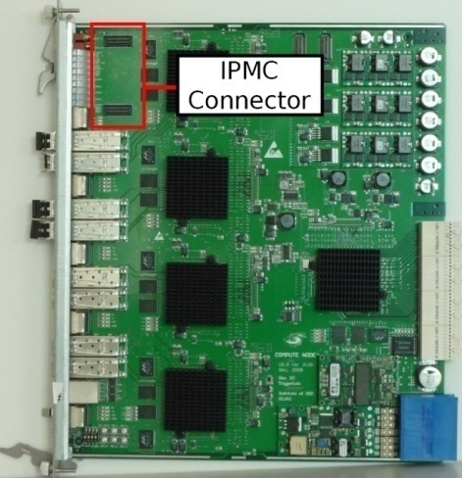
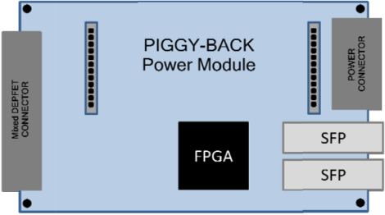
Proposal for DHH system architecture
DHH design :
FPGA(Lattice/Xilinx)
Optical transceivers
Power module
DHH functions:
Optical network: Trigger, DAQ, Control
Power
Power Supplies
Giessen Box
DH Hybrid
DHH Controller
RJ45
Belle II
Trigger
FPGA
USB ,
Ethernet

Slide 4
Alternative DHH architecture
Belle Trigger group(KEK) proposed:
trigger interface directly to DHH module
Possible scenario:
Belle II Trigger
Box
Copper
interfaces
PIGGY-BACK
Power Module
POWER
CONNECTOR
Ladder’s flat
cable connector
FPGA
SFP
DAQ
RJ45
JTAG
Slow Control
Slow Control
Box

Slide 5
New feature of Trigger Dist.System

Slide 7
Nakao-san’s proposal
RJ45, Trigger
RJ45, JTAG

Slide 8
DHH⬄DAQ links
1 x 6 Gb/s or 2 x 3 Gb/s
Agreed 2 x 3Gb/s !!!

Slide 9
CLOCK requirements
Belle II Trigger distribution provides:
127 MHz = 508.87 MHz/4
Clock for DHP serial links
101 MHz = 508.87 MHz/5
Can be asynchronous ?
Clock for Switchers: GCK = F0 · SW_channels/1280:
Virtex 5 DCM capability (Fclkfx):
Fout = Fin · M/D
M any integer : 2-33
D any integer : 1-32 To be tested
192/1280 = 3/20
224/1280 = 7/40
216/1280 = 27/160
210/1280 = 21/128
204/1280 = 51/320
168/1280 = 21/160

Slide 10
Starting prototype design
Specification to be defined
DHP ⬄ DHH interface
Power connectors
Internal features
Memory

Slide 11
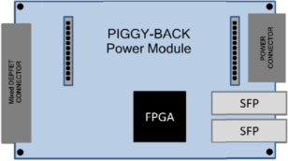
DHH location
First scenario:
2-3 m away
In Dock
Passive Patch Panel
High neutron flux
Too high SingleEventUpset rate
Loss of configuration information
Second(current) scenario
10 m away
No radiation
Patch panel
Passive ?
Active I: signal conditioner for Serial Links
Active II: radiation hard laser drivers and optical transceivers (GBT components)
30-50 cm
2 m
Kapton
Flat cable
Patch
Panel
30-50 cm
10 m
Kapton
Flat cable
Patch
Panel
1 Gb links just enough for 1% occupancy
Do we want to have more safety margin?
With passive patch panel it will not be possible

Slide 12
DHH ⬄ DHP
Probability for 10 triggers within 180us is 2.6% =>
Convert pulsed trigger signal to level trigger signal
Belle Trigger
one frame
DHP Trigger
HEADER
TRAILER

Slide 13
Questions: external memory for buffering
Does DHH needs memory ?
4x1 Gb/s incoming links
2x3 Gb/s outgoing links
No need memory
How to merge data ?
Sub frame wise
DHP
DAQ
DHP
DAQ

Slide 14
Prototype design
Flexible design compatible with optical, active and passive Patch panel
Objectives
Hardware for development internal DHH interfaces, firmwares for trigger distribution and clock synthesis
Provide more compact card for DHP readout
Provide card for evaluation DHP ⬄ DHH interfaces

Slide 15
Summary
DHH architecture
mixed , compatible with both proposals
Switcher frequency
no real limitations but still to be tested
options with odd multiplication coefficient > 21 to be excluded
Flexible prototype design

