Slide 1
Parameters
Number of lines: readout time/line > 100 ns
use switcher efficiently
stay with 32 channels/switcher
easy PLL clock synthesis
 | 1 | 2 | 3 | 4 | 5 | 6 | 7 | 8 | 9
active length (Ladder) | 90 | 90 | 90 | 90 | 90 | 90 | 90 | 90 | 90 | mm
gap at centre | 1 | 1 | 1 | 1 | 1 | 1 | 1 | 1 | 1 | mm
half length | 44.5 | 44.5 | 44.5 | 44.5 | 44.5 | 44.5 | 44.5 | 44.5 | 44.5 | mm
parallel | 4 | 4 | 4 | 4 | 4 | 4 | 4 | 4 | 4 | mm
switcher channels (chip) | 32 | 30 | 28 | 26 | 36 | 34 | 32 | 30 | 28
number of switchers (module) | 7 | 7 | 7 | 7 | 6 | 6 | 6 | 6 | 6
pitch in z | 49.67 | 52.98 | 56.76 | 61.13 | 51.50 | 54.53 | 57.94 | 61.81 | 66.22 | µm
switcher channels (module) | 224 | 210 | 196 | 182 | 216 | 204 | 192 | 180 | 168
lines/module | 896 | 840 | 784 | 728 | 864 | 816 | 768 | 720 | 672
time/line | 89.29 | 95.24 | 102.04 | 109.89 | 92.59 | 98.04 | 104.17 | 111.11 | 119.05 | ns
PPL : denominator | 40 | 128 | 320 | 640 | 160 | 320 | 20 | 64 | 160
PLL: nominator | 7 | 21 | 49 | 91 | 27 | 51 | 3 | 9 | 21
closest round | 224 | 200 | 192 | 160 | 200 | 200 | 192 | 160 | 160
PPL : denominator | 40 | 32 | 20 | 8 | 32 | 32 | 20 | 8 | 8
PLL: nominator | 7 | 5 | 3 | 1 | 5 | 5 | 3 | 1 | 1
lines/module | 896 | 800 | 768 | 640 | 800 | 800 | 768 | 640 | 640
time/line | 89.29 | 100.00 | 104.17 | 125.00 | 100.00 | 100.00 | 104.17 | 125.00 | 125.00 | ns
pitch/Z | 49.67 | 55.63 | 57.94 | 69.53 | 55.63 | 55.63 | 57.94 | 69.53 | 69.53 | µm
unused channels | 0 | 10 | 4 | 22 | 16 | 4 | 0 | 20 | 8
768 Lines 104 ns 58 µm pitch

Slide 2
Injection Noise

Slide 3
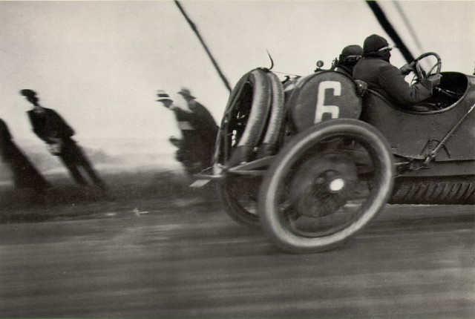
Rolling Shutter
Picture composed of consecutive stripes
Shutter slit
Jacques Henri Lartigue – Car Race, France 1912

Slide 4
Injection Veto
Data not read before next noise bunch
Read out every 5µs
Still no complete frame
without noise
z
T/2
T
t
Data spoiled by noise bunch
Injection noise
Injection noise
Data not read before next clear
Read out every 5µs
+ common clear
50% of frames ok
z
T/2
T
t
Data spoiled by noise bunch
Injection noise
+ clear
Injection noise
+ clear

Slide 5
Consequences
50 Hz Injection: 400 µs noisy out of 20ms (20%)
Ganging of 4 regions => 5µs frame rate
global clear in time with veto
50% efficient during injection veto cycles
10% overall inefficiency (gain 10%)
However: unganged readout: ½ % dynamic inefficiency (read/clear cycle)
4 regions ganged: 2% dynamic inefficiency
more power (4 times!)
larger pedestals (dynamic range)
mode switching (no global clear during normal cycles) (pedestals?)
(however injection noise disappears gradually)
quadruple effects of noisy/dead pixels
On the other hand: less bandwidth due to better trigger rejection (2x)
Recommendation: keep double ganging as option!

