Slide 1
Irradiations of thin oxides Status and plans
Peter Müller
Andreas Ritter
5th Int. Workshop on DEPFET Detectors
and Applications
Wednesday, September 22, 2010

Slide 2
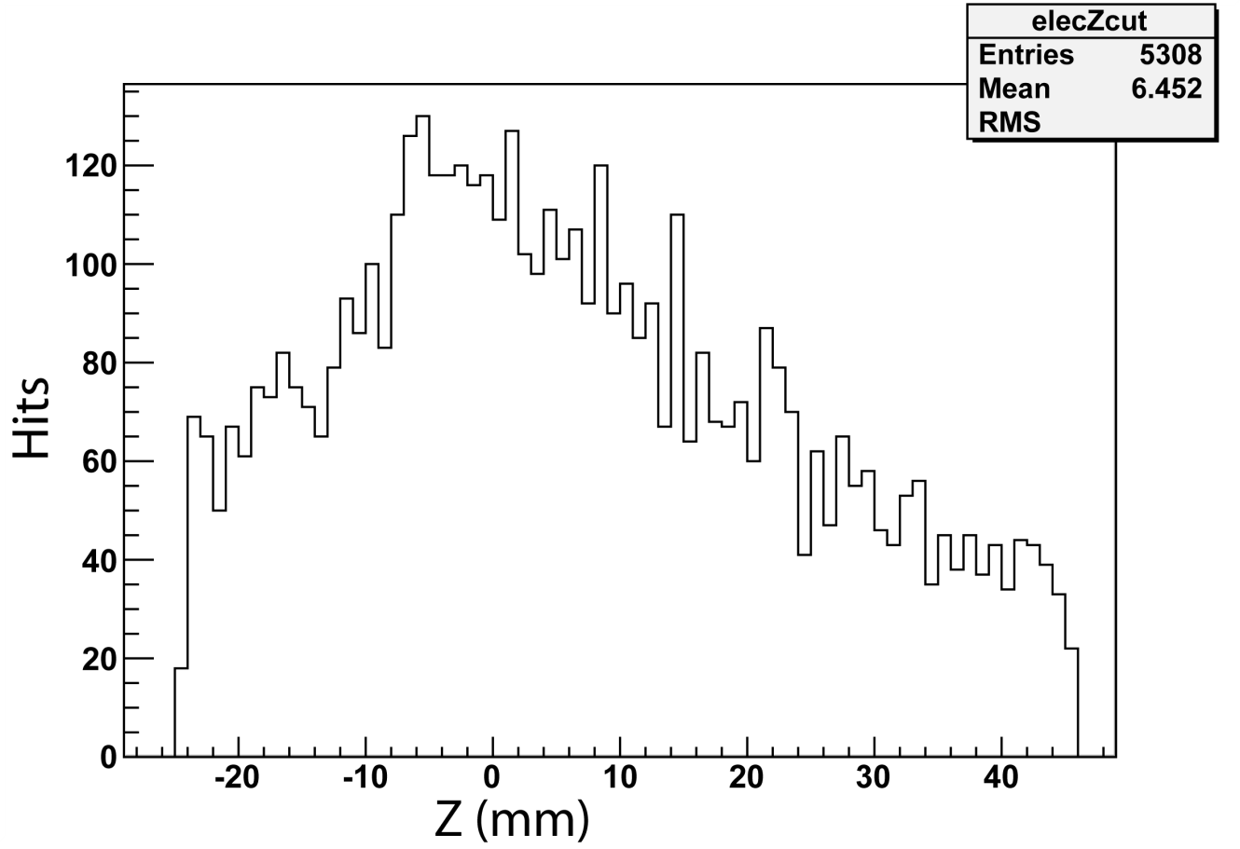
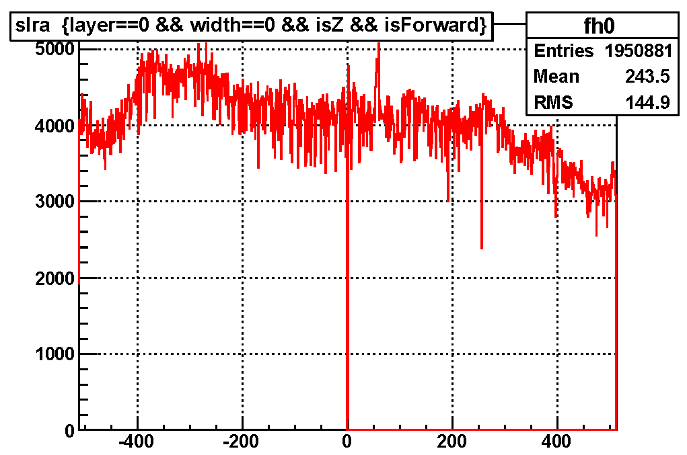
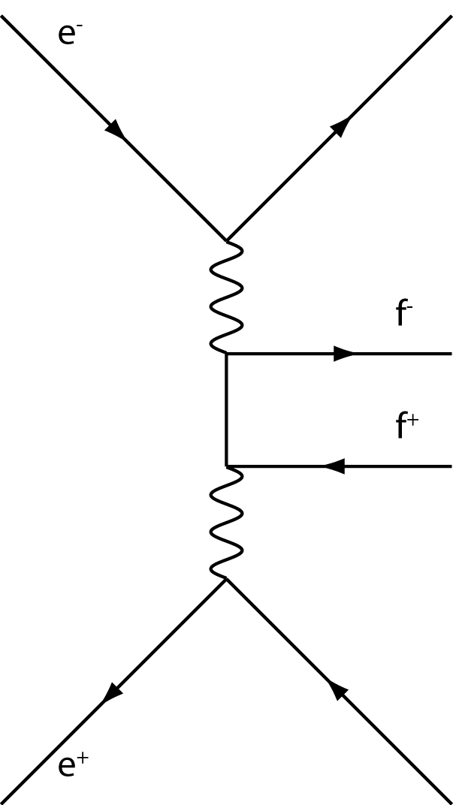
Radiation Sources in Belle II
We suffer from
different sources
QED related background, amount now smaller than anticipated
Touschek effect (may have a severe effect?)
Synchrotron, hits from backscattered events?
Beamgas interaction
M. Ritter
Background in SVD, Belle
Notes:
1. e+, e- QED process: Data from M. Ritter, applied cuts: 17°<Theta<150°, e+ and e- with E<5MeV ruled out;
2. Belle data: Layer 1 from SVD, comparable to Layer 2 of PXD

Slide 3
Old measurement from PXD 5
Thick Oxides
Irradiations done with PXD 5 structures (thick oxides)
X-ray irradiation in Karlsruhe
No long term annealing
Entire matrix (DEPFETs) biased during irradiation
→ Remedy: Thinner oxides
S. Rummel, old dosimetry, 8 Mrad ≈ 4 Mrad

Slide 4
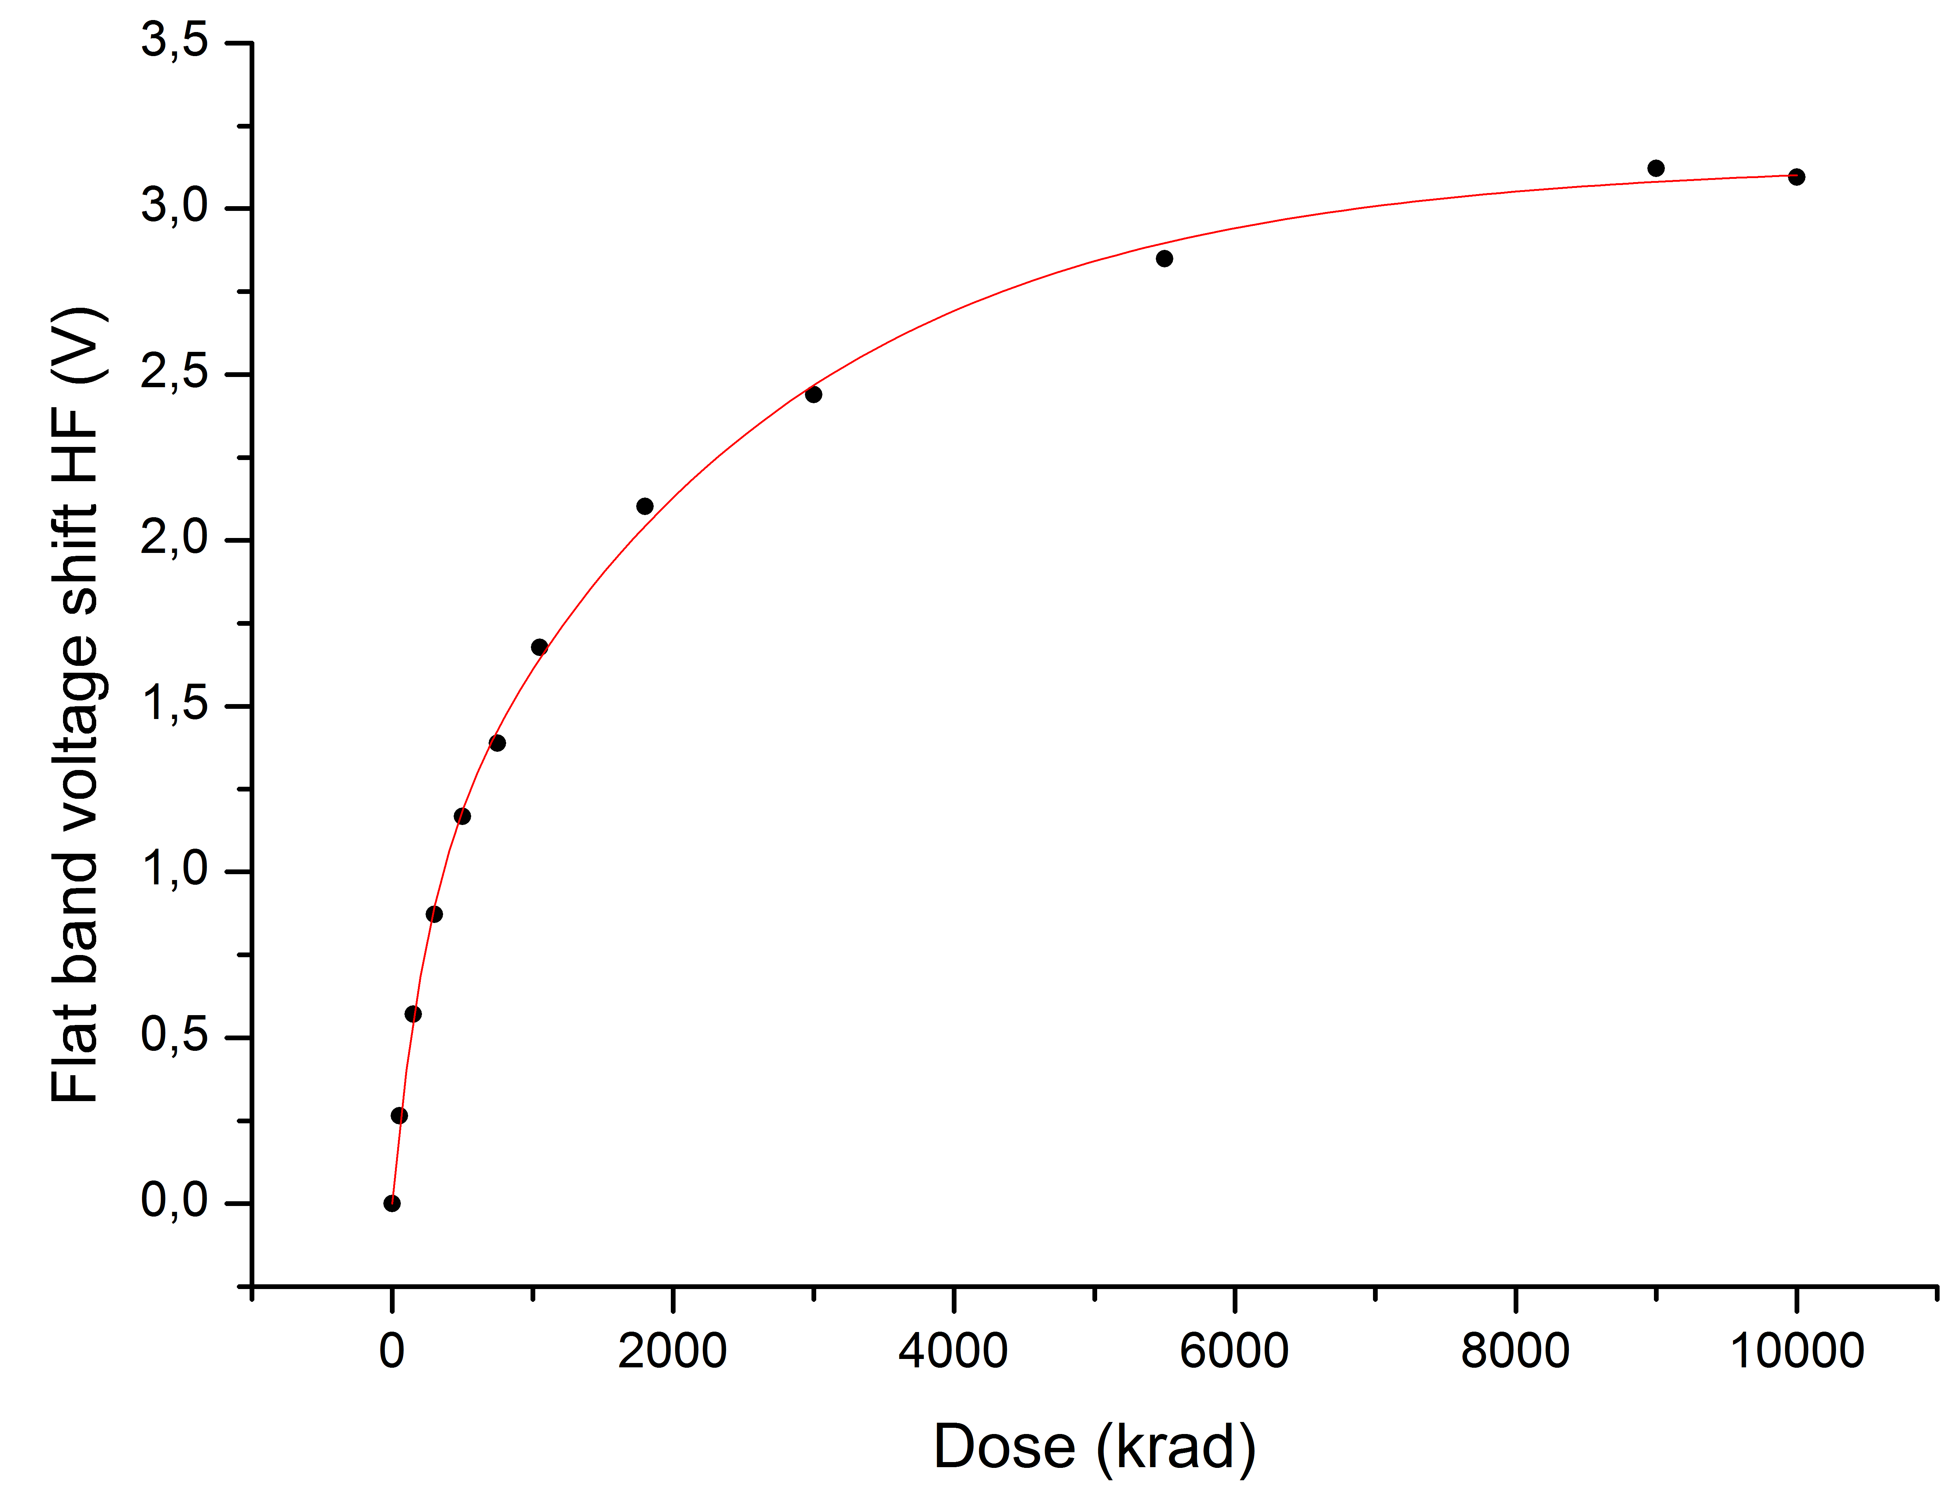
Why thinner?
Thinner oxides mean:
Dose = E/m, by reducing thickness → mass is reduced, but also absorption decreases → less charge in oxide, dose stays the same.
(approximated; valid until saturation has bigger effect; rho=density, sigma=absorption coefficient, d=thickness)
Threshold voltage depends on thickness:
Thin oxide, MOS Cap.

Slide 5
New devices
New devices (see also Jelenas Talk)
Wafer separated in 4 quadrants with different nitride thicknesses
Central device, e. g. gate-controlled-diode or MOS-Cap.
Surrounded by 14 Transistors with 7 different gate lengths
Different biasing in left and right hand side possible

Slide 6
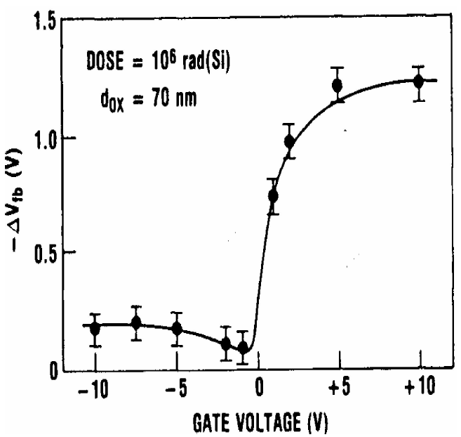
Irradiation Campaign in August
X-ray irradiation in Karlsruhe
4 devices under test (different nitride thickness, other parameters are the same)
Evaluation of transistors and capacitor
Dose rate of 325 krad/h for D≤1 Mrad, and 520 krad/h for D>1Mrad
Tube parameters: 60 kV, 33mA, Nickel filter
Biasing: Source = GND, Drain=floating, Bulk = 10V, Gate = +2 V

Slide 7
Threshold shift of thickest Si₃N₄ (#4)

Slide 8
Threshold shift of medium Si₃N₄ (#3)

Slide 9
Threshold shift of medium Si₃N₄ (#2)

Slide 10
Threshold shift of thinnest Si₃N₄ (#1)
Cap. measurement from thin DIO 3-18

Slide 11
Threshold shift of medium Si₃N₄ (#3), highly irradiated

Slide 12
Transconductance g_{m} of thinnest Si₃N₄ (#1)
Notes:
Q07

Slide 13
Inhomogeneous Irradiation
Inhomogeneous irradiation results in different pedestal currents.
Rough Values (for a g_{m} = 88 µS@I_{DS} = 80µA, thinnest Si₃N₄):
1 Mrad max. spread 20%
3 Mrad max. spread 50%

Slide 14
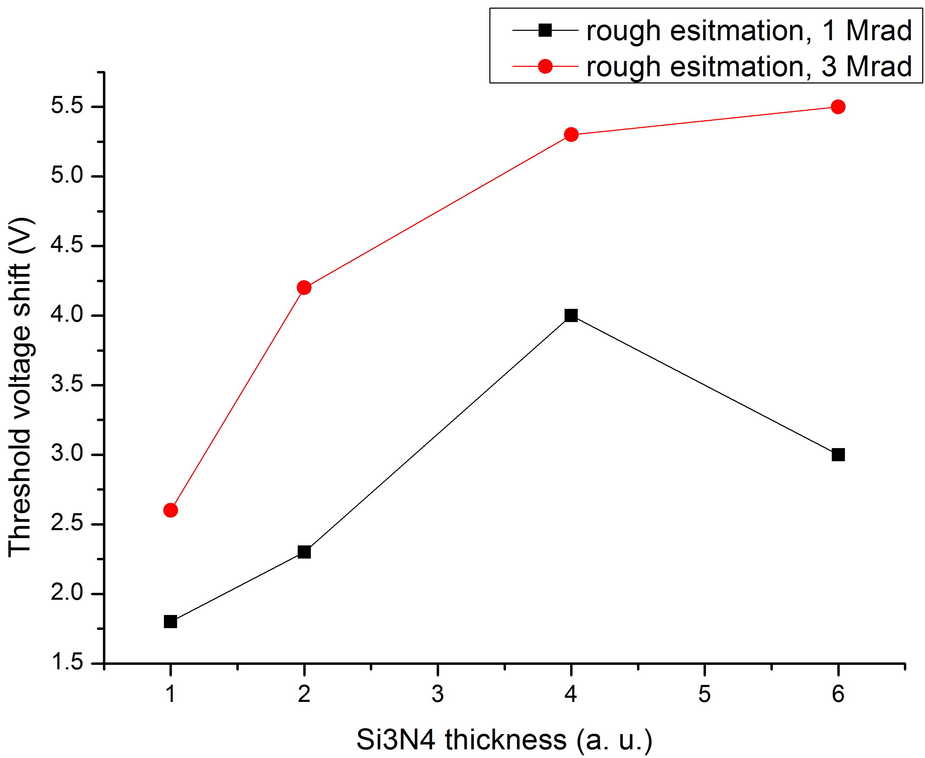
Summary and Plans
Summary
Measurements from DIO 3-18 could be confirmed
Thinnest Si₃N₄ shows promising results
Inhomogeneous irradiation could be a problem?
Plans
Perform gate voltage scans → effect of gate voltage on shift. Important for CG-structure
Irradiate gate-controlled-diodes → Build-up of Interface traps → g_{m}, Noise, Swing

Slide 15
Thank you

Slide 16
Backup Slides

Slide 17
Transconductance g_m of thickest Si₃N₄ (#4)
Notes:
B12

Slide 18
Transconductance g_m of medium Si₃N₄ (#3)
Notes:
Q12

Slide 19
Transconductance g_m of medium Si₃N₄ (#2)
Notes:
B07

Slide 20
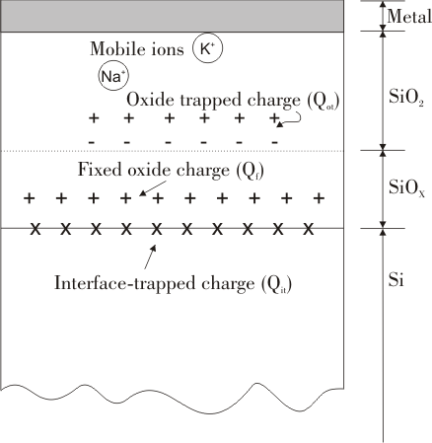
What happens in the oxide (1)
Oxide trapped charge
Particles loose energy in the silicon dioxide
For every 17 ± 1 eV one electron/hole pair is created
Electrons exhibit a high mobility and are swept out of the oxide, whereas holes get trapped at the Si-SiO2 interface (strained Si-Si bond, creation of E’ defects)
SiO₂ – Si interface

Slide 21
What happens in the oxide (2)
Interface trapped charge
Ionizing radiation frees hydrogen nuclei in the device
Drift and diffusion leads them to the interface
Hydrogen nuclei frees passivated bindings (Dangling bonds, Pb defect)

Slide 22
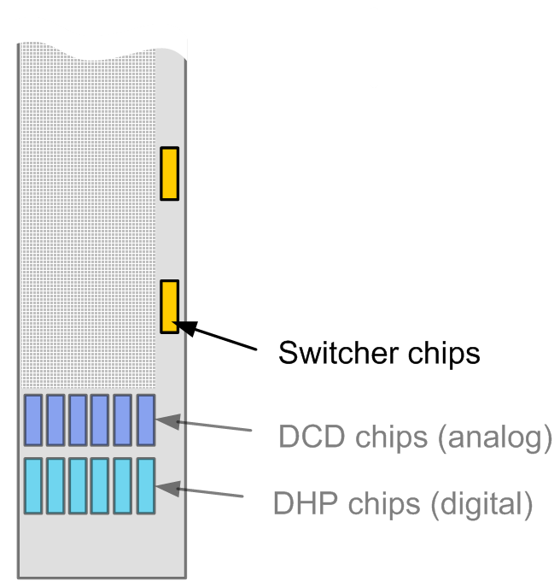
Impact on modules
Oxide trapped charge
Alters threshold voltage V_{th} of DEPFETs
Voltage for Switcher-chips needs to be adjusted during lifetime
Interface trapped charge
Charge can be trapped and emitted in the channel → increase of random signal telegraph noise
Overall current increase due to generation/recombination centers in the middle of the forbidden band gap
Reduction of transconductance g_{m}

Slide 23
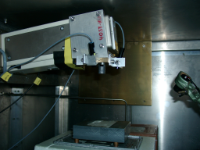
December 09: X-Ray Irradiations in Karlsruhe
DEPFET
2 Devices under Test
Irradiation scheme:
DUT 1: Zero Voltage at all contacts
DUT 2: Adaptive biasing from Off voltage (5V) to zero voltage at Gate contact (other contacts 0V)
Interest in input characteristics of devices
Threshold voltage V_{Th}
Transconductance g_{m}
Subthreshold Swing S
Mini matrices from PXD 5
V_{Th}
S
More neg.
Up: Typical extraction of threshold voltage from I_{DS} – V_{GS} data.
Bottom: X-ray tube at the Karlsruhe Irradiation center (from [http://www-ekp.physik.uni-karlsruhe.de/index.php?option=com_content&view=article&id=93&Itemid=12&lang=de] )

Slide 24
“Back on the envelope” calculation -From Occupancy to Radiation Damage-
“Scary” Version
Stopping power for 6 MeV electron in SiO₂: 1.65 MeV cm²/g (from NIST, http://physics.nist.gov/cgi-bin/Star/e_table.pl)
Density of SiO₂: 2.66 g/cm³
Pixel size: 50*50*0.13 µm³
Deposited energy in 130 nm SiO₂: 57eV
Mass of oxide layer⁺: 8.65*10⁻¹³ kg
Dose MIP= E/m= 1.05 * 10⁻⁵ Gy/pixel
Occupancy: 0.5% in 10µs → 100% in 2ms
Assumed duty cycle: 4 months≈10⁷ s
Cumulated dose: 0.525 * 10⁻⁵ Gy/ms *10³ * 10⁷s = 52.5 kGy/a
= 5.25Mrad/a
Preliminary:
Estimated Occupancy from Belle SVD2, Layer 1 transferred to PXD Layer 1:
0.05 % → “Normal” Version
Electron irradiations needed – Investigate Ionizing and NIEL damage
⁺In fact, gate oxide layer is much smaller, but anyway, the area cancels out

