Slide 1







Thermal jumble!
(Action list review)
C. Marinas
IFIC-Valencia
Valencia - 29.9.2010
1

Slide 2
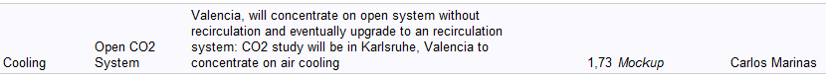
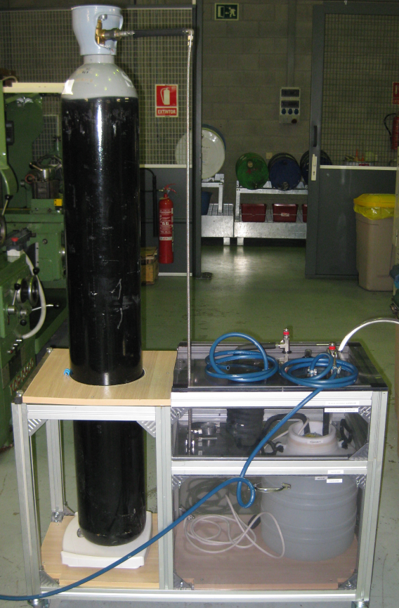
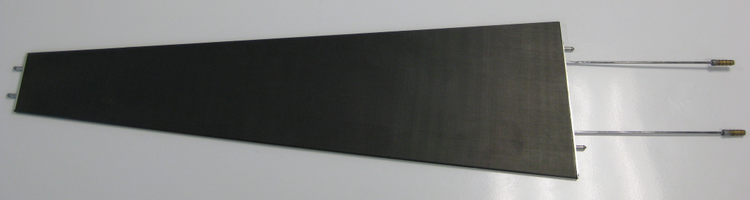
CO₂ cooling tests
Activities to be developed in Karlsruhe
Valencia developed a CO2 cooling plant for testing the ATLAS endcap upgrade
  → We can give support (if needed!)
Petal
2

Slide 3
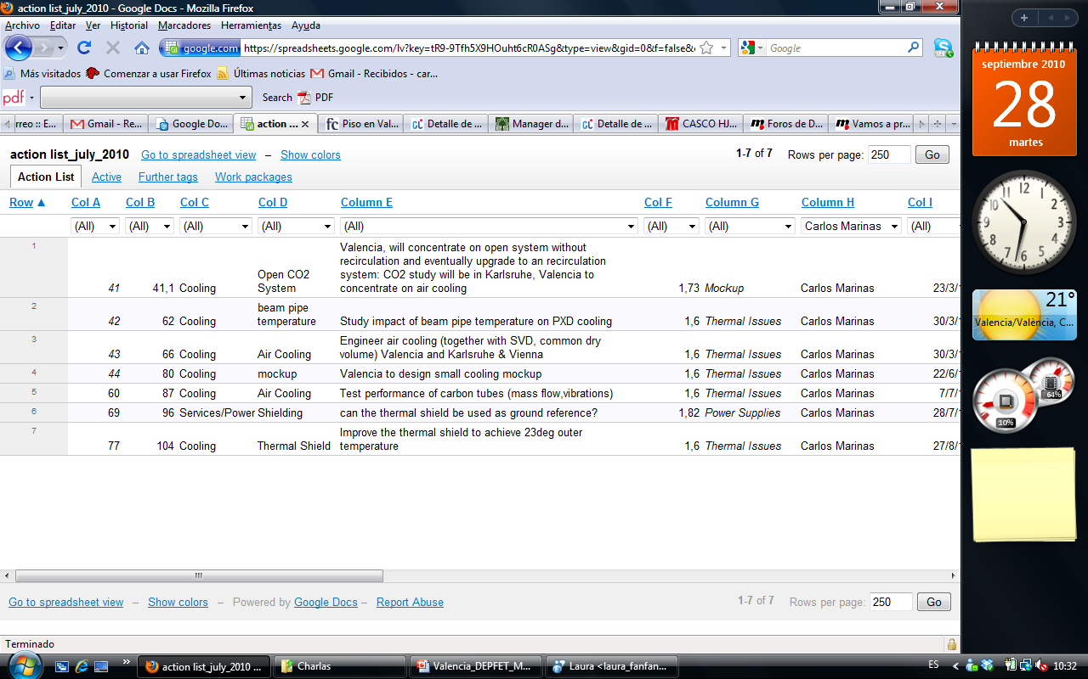
Mock-up: Air cooling
Working on a PXD mock-up inside a polycarbonate cylinder (thermal images)
Al-beam pipe with cooling (15ºC)
Dummy ladders in methacrylate to have access to the inner layer and study vibrations
Support structures similar to the final ones but with mono-phase cooling (CO₂ could be implemented if needed)
Carbon tubes can be added
Ladders: Samples with integrated resistors
3

Slide 4
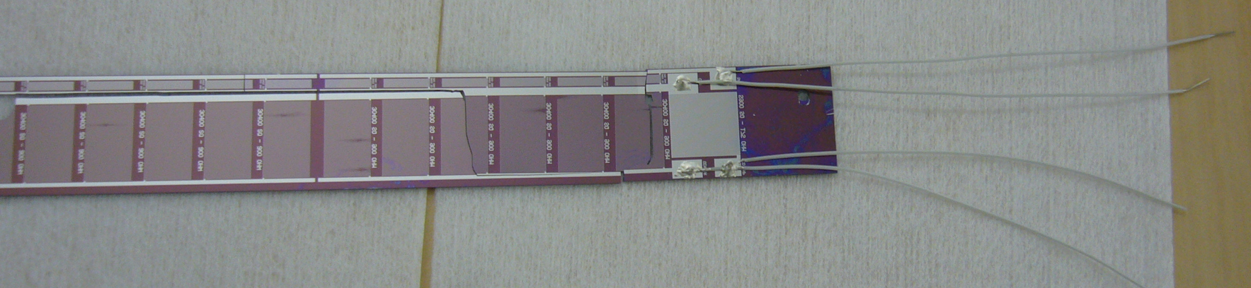
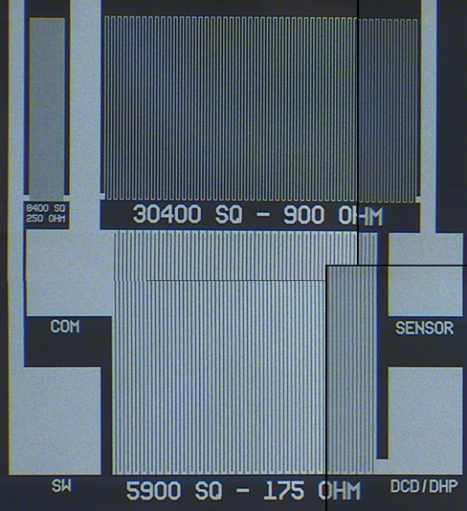
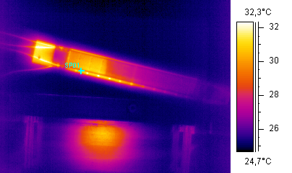
Samples with integrated resistors
Destructive test
Wires glued with silver conductive glue
Only 4 SWs on because of the crack
Thanks to Laci for the impressive job!
4

Slide 5
Thermal Enclosure (TE)
Mechanical protection
Thermal insulation between the PXD+SVD (-5ºC) and the CDC (23ºC)
Contains dry nitrogen atmosphere to avoid condensation
Moisture barrier
Electrical shielding (Faraday cage) and grounding
5

Slide 6

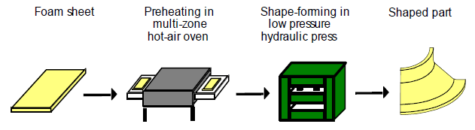
Option 1: Airex
Thermoformable → No frame needed!
ATLAS TE (Thermal Enclosure) → Airex R82 foam
Used in aerospace science: Cryogenic tanks, insulating panels
Operating temperature from -194°C to +160°C
Thermal conductivity: 0.036W/mK
Low moisture absorption (a few grammes per m² when in high humidity)
Low density (60 kg/m³)
6

Slide 7
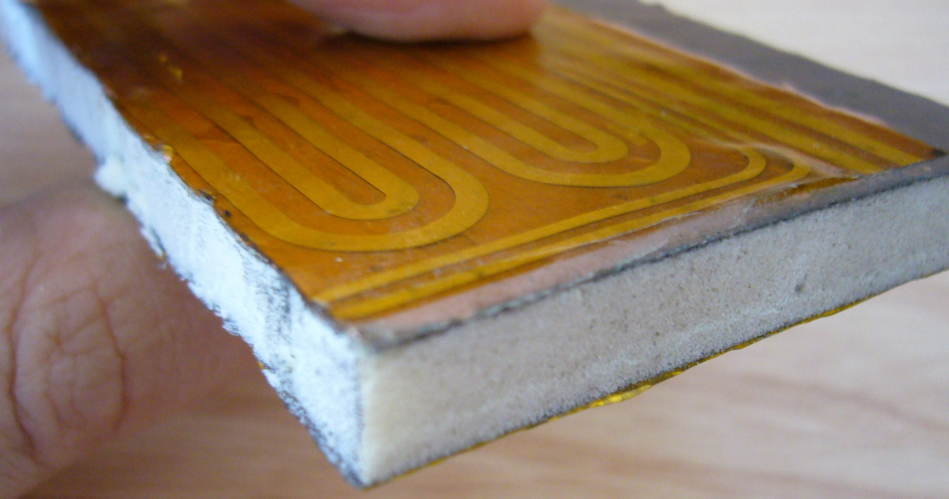
Option 1: Airex
ATLAS EndCap OTE sample (Made in Valencia)
Kapton: 0.017%X₀
Airex: 0.2%X₀
Al: 0.0002%X₀
Cu: 0.13%X₀
Araldite: 0.05%X₀
TOTAL: 0.397%X₀
100µm Araldite 2011 epoxy
Heater (Cu-polyimide)
Copper Kapton foil
8mm Foam Core (Airex)
Aluminised Kapton foil
Al-Kapton (<1µm Al; 25µm in total): Reduces the radiative heat transfer
Cu-Kapton (18µm Cu; 43µm in total): Electrical shielding
7

Slide 8
Option 1: Mini-Airex
100µm Araldite 2011 epoxy
Kapton: 0.017%X₀
Airex: 0.21%X₀
Al: 0.00045%X₀
Araldite: 0.05%X₀
TOTAL: 0.27%X₀
Heater (Cu-polyimide)
Aluminised Kapton foil
8mm Foam Core (Airex)
Aluminised Kapton foil
2 Al-Kapton (0.8 µmAl; 49.6µm in total): Reduces the radiative heat transfer
8

Slide 9
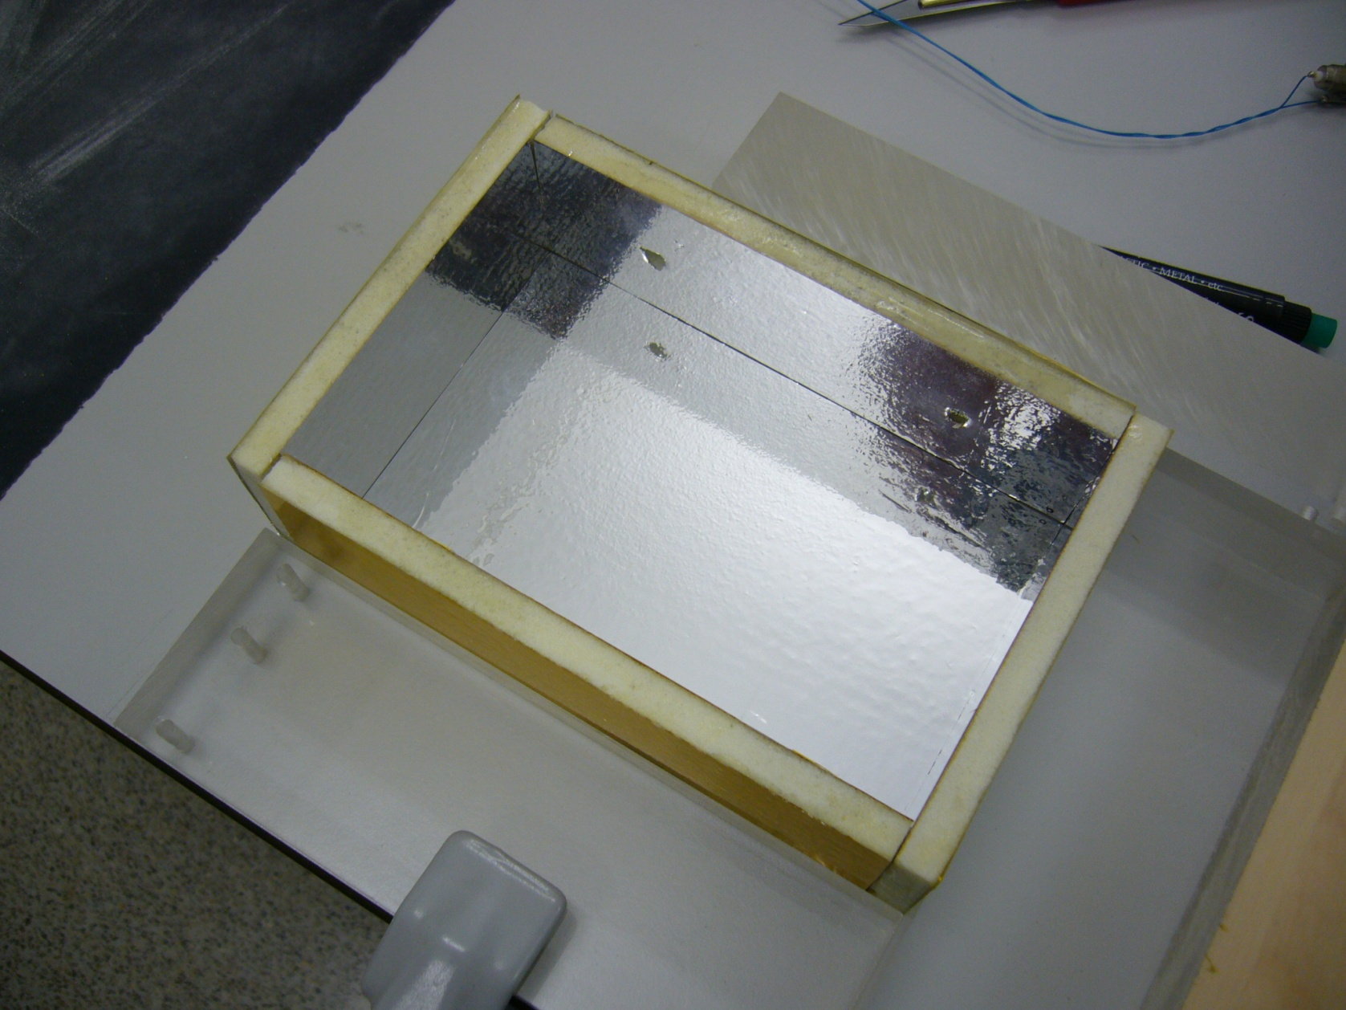
Dummy TE
Airex foam core
Al-Kapton
9

Slide 10
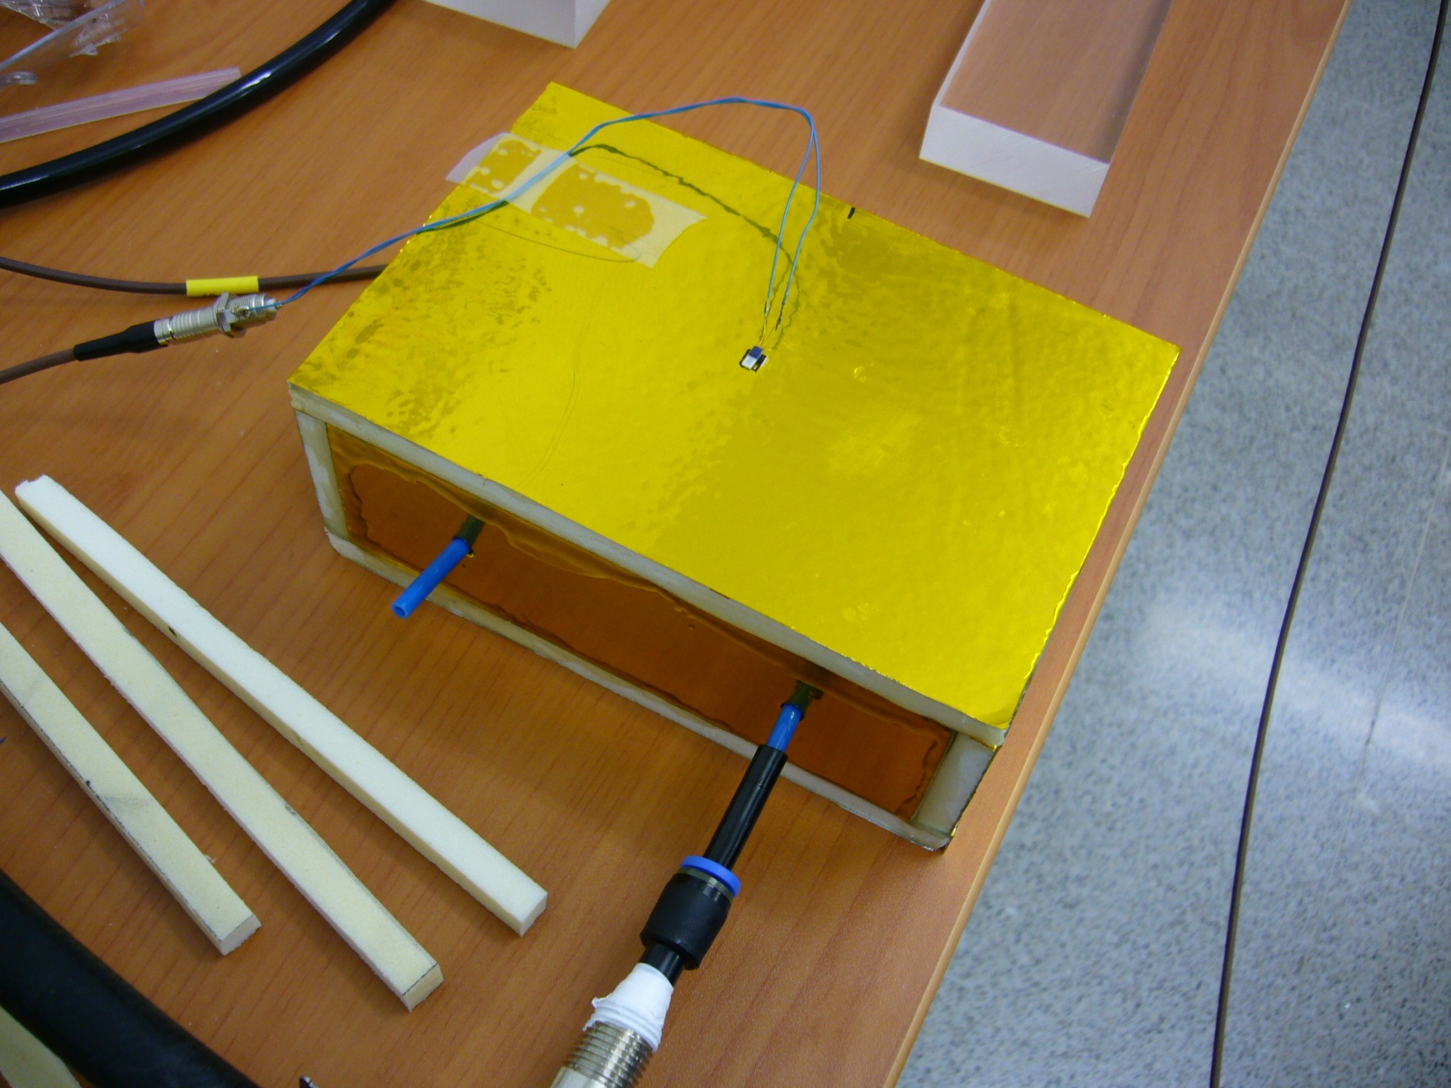
Dummy TE
ΔT
Cold air
10

Slide 11
Dummy TE (Single layer)
T_{out}=18.5ºC
The CDC needs 23ºC!
11

Slide 12
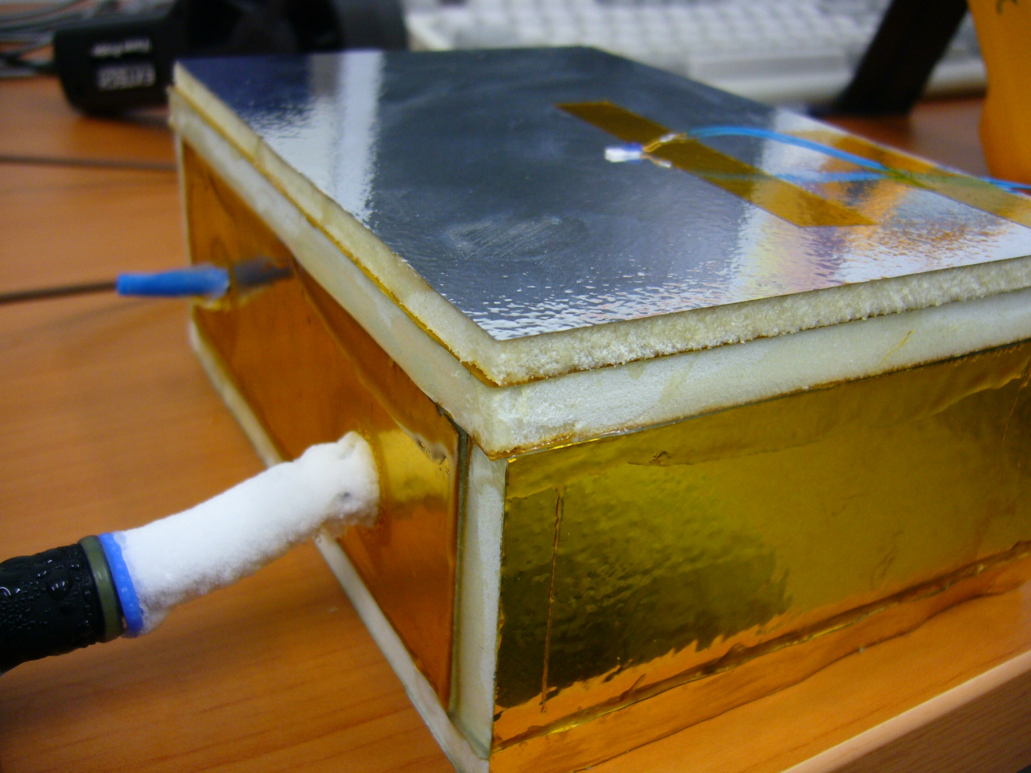
Strategies: Multilayer structure
Kapton: 0.025%X₀
Airex: 0.34%X₀
Al: 0.00067%X₀
Araldite: 0.075%X₀
TOTAL: ~0.4%X₀
5mm Airex
8mm Airex
The material budget is high but not using a heater, the system is simpler
12

Slide 13
Dummy TE (Double layer)
If T_{in}=-10ºC
T_{out}=19.7ºC
Not suficient once again…
T_{mid}=9.2ºC Where we had 18.5ºC !!
13

Slide 14
Comparison
Single layer
Multiple layer
T_{out}=19.7ºC
T_{out}=18.5ºC
T_{mid}=9.2ºC
5mm
8mm
8mm
T_{in}=-10ºC
T_{in}=-10ºC
The isolation comes not really from the Airex (that certainly helps), but from the infinite warm air outside…
If the material budget is not too much, the strategy to follow should be to heat the outer surface (heater) of a ‘thin’ Airex layer instead of trying to insulate it with a thick one
Let’s go back and try with an ‘a la ATLAS’ solution with thin AIREX+Heater
Will this heater influence the air inside?
  A big heater is ordered to study if the air inside will be heated
14

Slide 15
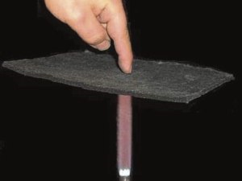
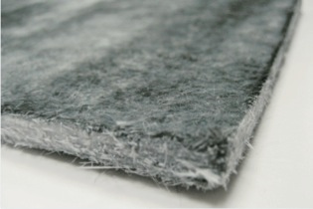
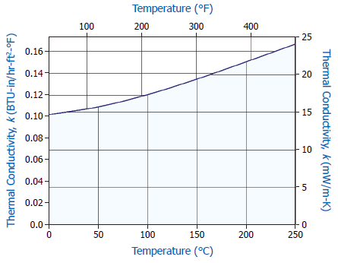
Option 2: Cryogel (High performance)
Encapsulation needed
Difficult to handle
Oxy-acetylene torch
ATLAS OTE (Outer Thermal Enclosure) → Pyrogel AR5401+Airex R82
Operating temperature from -200°C to +600°C
Thermal conductivity: <0.015W/mK (half of the previous one!)
15

Slide 16
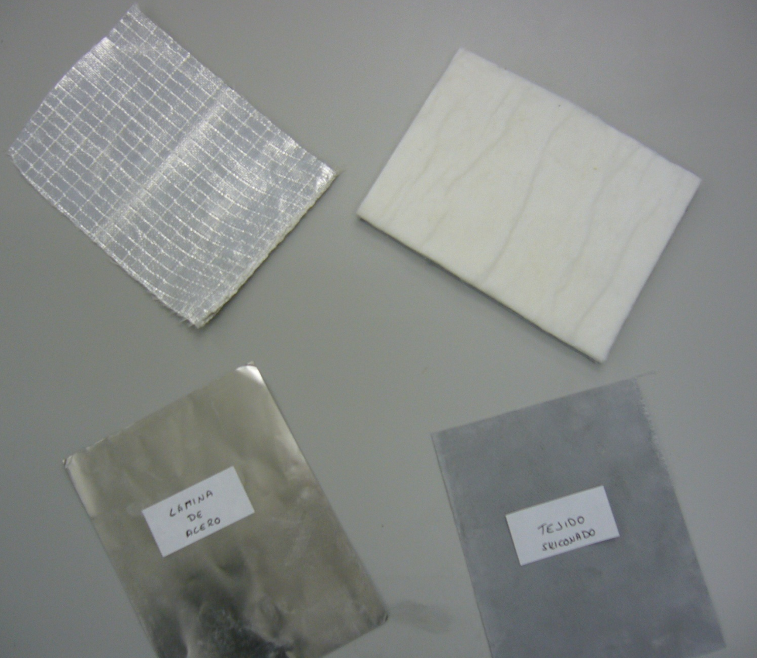
Samples (cryogel+encapsulation)
Textile+Al
Cryogel
Tests about to start
Steel
Textile
16

Slide 17
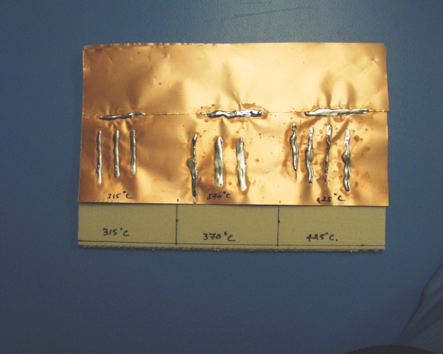
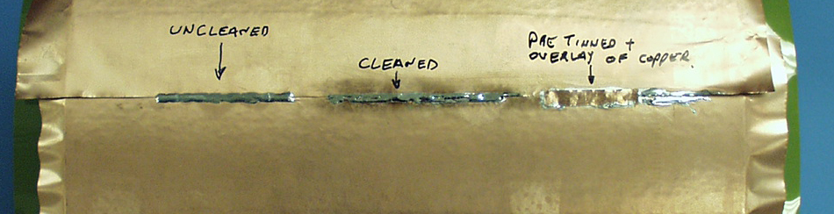
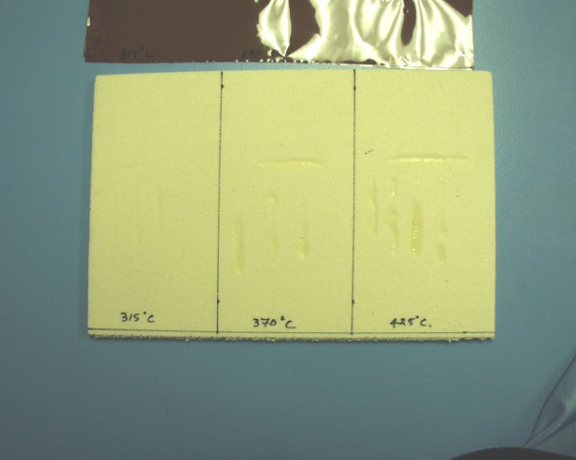
Grounding layer
A metal layer has to be implemented in the thermal enclosure barrel
Copper is the most suitable material (Al can not be soldered)
How much material is allowed?
To ensure a good conductivity and long term stability, both halves must be soldered
17

Slide 18
Summary
CO2 cooling plant is ready and can be used if needed
Detailed mock-up for air cooling studies is under construction
  Big progress expected within next few weeks
  Resistor samples work nice (even though destructive tests)
A conservative solution (ATLAS like) is proposed for the thermal enclosure
  Nevertheless, new options are under study (new materials)
A grounding layer can be implemented
  A trade-off between the material budget and feasibility has to be found
18

Slide 19
Thank you!
19

