Slide 1
Status of Cooling Development in Karlsruhe
Stefan Heindl, Thomas Müller, Hans Jürgen Simonis and Thomas Weiler 5th International Workshop on DEPFET Detectors, IFIC Valencia, 30.09.2010

Slide 2
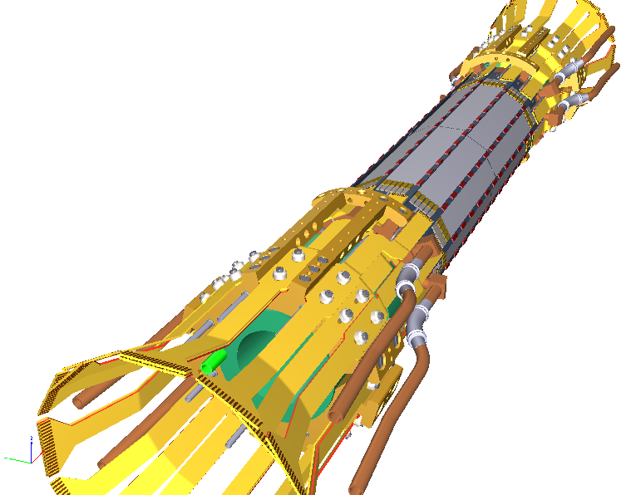
Overview
Cold air/nitrogen for PXD (and SVD) cooling
Open CO₂ system in Karlsruhe
Closed CO₂ system at CERN
Summary and Outlook
Belle II PXD (MPI)

Slide 3
1. Cold air for PXD cooling
Closed shared volume (~ 60l) containing PXD and SVD to be flushed with cold air
Inlet through dedicated channels in the PXD endflanges
SVD only asks for „parasitic cooling“
Continuous run time: some months (Does this exclude the use of liquid nitrogen as coolant?)
Thermal simulations shown in Ringberg require an air temperature of -10°C
Target: provide cold air with a selectable minimum temperature of -20°C at a rate of 10l per minute

Slide 4
1. Cold air for PXD cooling
First approach in Karlsruhe: boxed aluminum heat sink connected to peltier element, flush heat sink with compressed air and measure temperatures with Pt1000s
Not successful, temperature drop per unit of channel length too small

Slide 5
1. Cold air for PXD cooling
Second approach: heat exchanger (from VW Golf 2) in a box connected to water chiller, flush with compressed air and compare inlet/outlet air temperatures
Partly successful, temperature drop is measurable
Problems: - not designed to our needs (heater!) - box could not withstand high air pressure

Slide 6
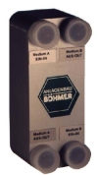
1. Cold air for PXD cooling
Third approach: buy a heat exchanger designed to our specifications
Small: 300 x 120 x 50 mm³, 3 kg
Delivered on Friday last week
Testing will begin after Valencia meeting
Anlagenbau Böhmer

Slide 7
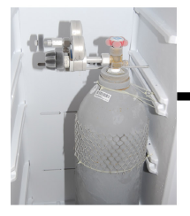
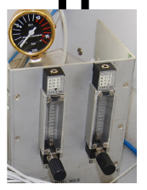
2. Open CO2 system in Karlsruhe
Built for CMS Upgrade testing
Manual operation → limited runtime
Lab window
Steel tube
CO2 bottle in freezer
Manual flowmeters at outlet
Endflange prototype with load resistors and Pt1000s

Slide 8
2. Open CO2 system in Karlsruhe
To Do: - make system work after 1.5 years of downtime - replace manual flowmeters at outlet with digital one at inlet → higher mass flow and more cooling power - prepare heat load resistors (from old copper mockup) - define quantity and positions of Pt1000s
Requirements: - 20 small silicon pieces (unthinned) with holes - screws (only if special)

Slide 9
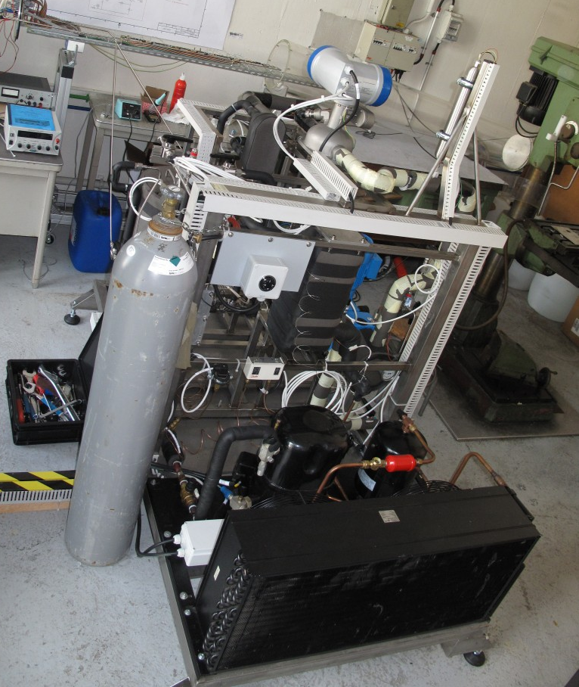
3. Closed CO2 system at CERN
Closed CO2 system built at CERN by the group of Hans Postema, also for CMS Upgrade testing
Finished in July
Available to IEKP Karlsruhe for tests
Same system is supposed to be used for Belle II PXD/SVD
CERN

Slide 10
4. Summary and Outlook
Providing cold air for PXD/SVD cooling for longer periods of time is not trivial
Testing of new heat exchanger will start next week
Preparation for CO2 cooling test of endflange prototypes has started
First test with open system in Karlsruhe
When successful: go to CERN and use closed system which is also foreseen for Belle II PXD/SVD

Slide 11
Thank you…

