Slide 1


Irradiation of DEPFET transistors with ⁶⁰CO up to 10 Mrad in Santiago
Pablo Vázquez, Eliseo Pérez, Pablo Rodríguez (IGFAE-USC)
5th International Workshop on DEPFET Detectors and Applications 29 Sep -1 Oct Valencia (Spain)

Slide 2
Irradiation procedure
We have used the USC Radiation Physics Laboratory
  http://www.usc.es/en/investigacion/riaidt/radiofisica/index.html
It houses a cobalt 60 radioactive source of 2080 Ci of activity (as for May 2009) emitting gamma photons of 1.17 and 1.33 MeV of energy
Dose: 11.5 Krad/h (June 2010) -> 11.3 Krad/h (August 2010)
  T_{1/2}(⁶⁰CO) = 2.57 years
Irradiation was made in 11 steps up to 10 Mrad + annealing @ room T
  0.1 -> 0.2 -> 0.43 -> 0.7 -> 0.97 -> 1.95 -> 2.95 -> 4 -> 5.55 –> 7.45 -> 10 -> annealing (28 days)
  IV curves was measured for each transistor after each step
To measure the variations on
  Vth
  Gain
  Subthreshold zone
To study dependence on
  Vgs biasing
  Dopping
  Width/Length ratio

Slide 3
Schedule (summer 2010)
Annealing of
8h (1 night) for step 0
60h (1 weedend) for step 1
2 power cuts on:
step 7 (2->3 Mrad)
step 12 (annealing)

Slide 4
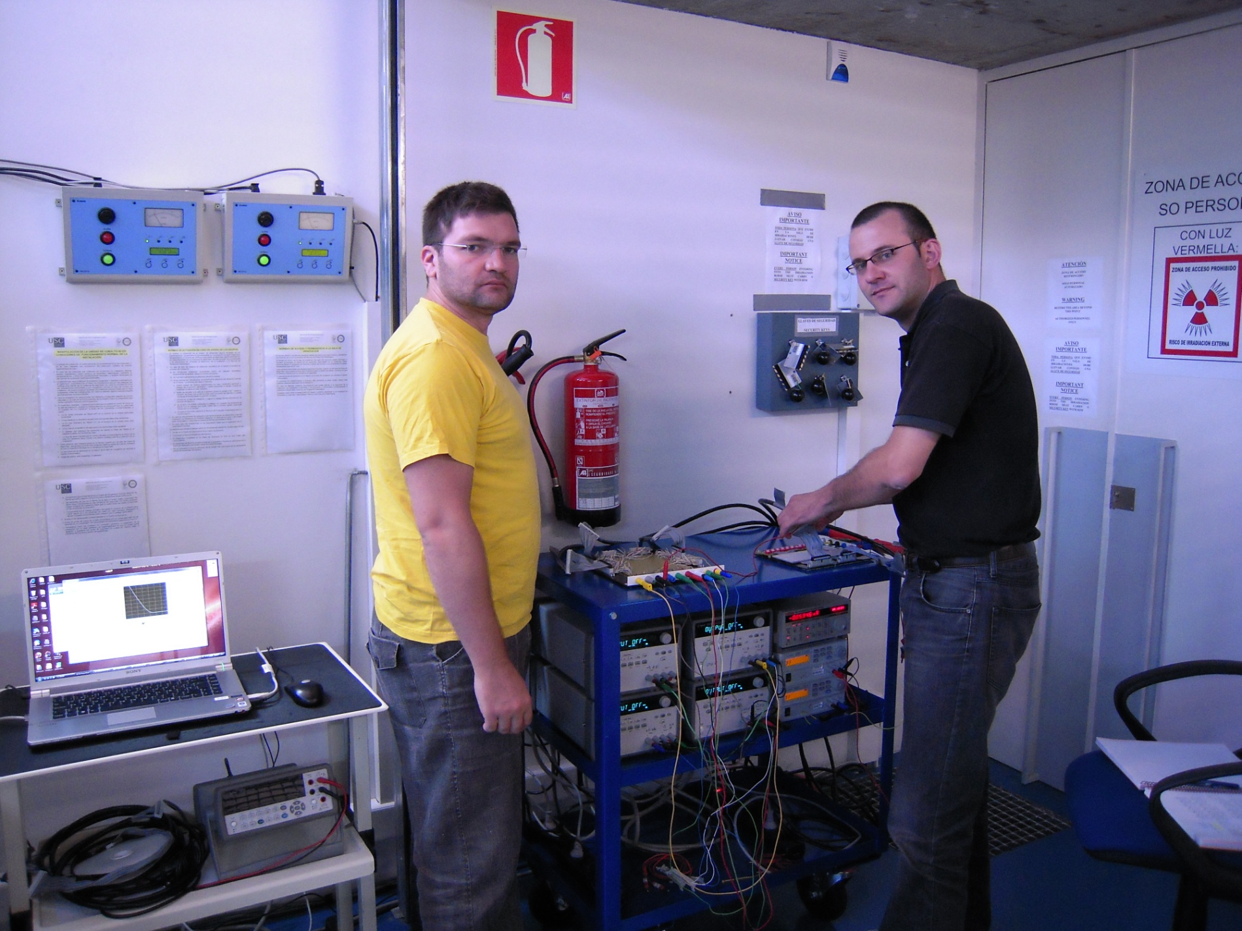
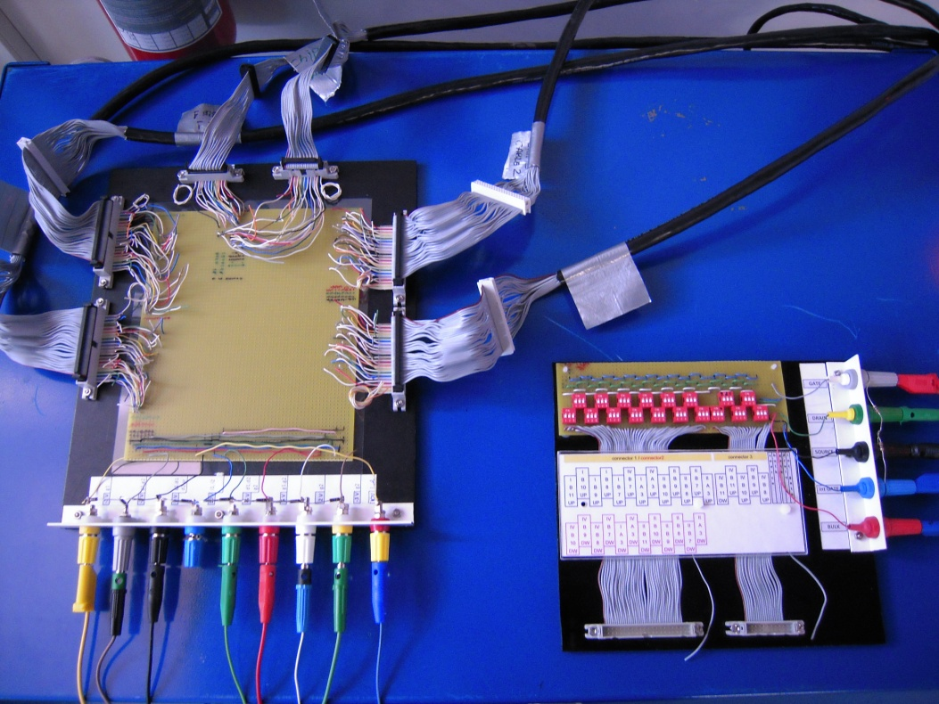
Setup (outside the bunker)
Irradiation Biasing
IV Test

Slide 5
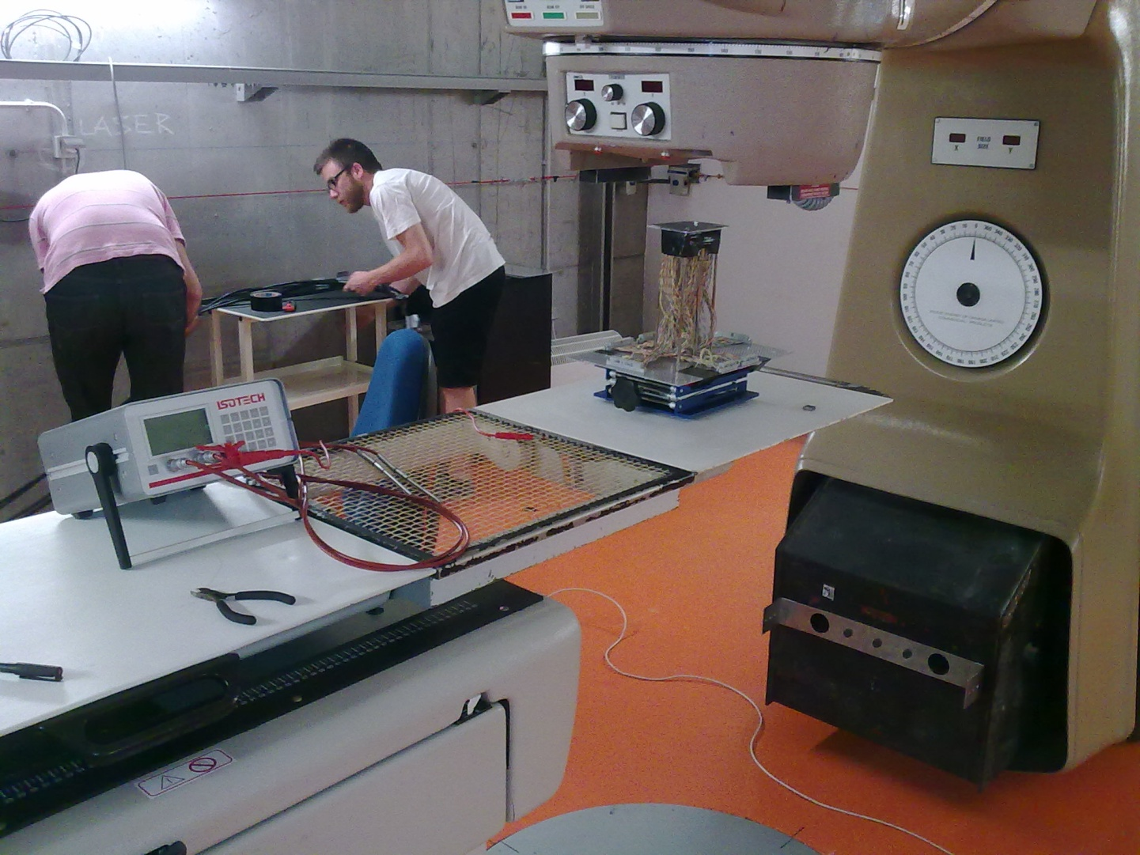
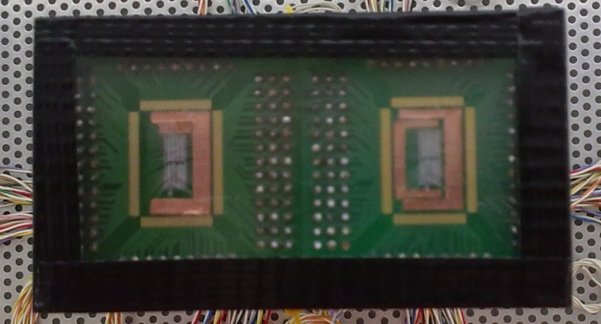
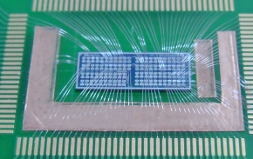
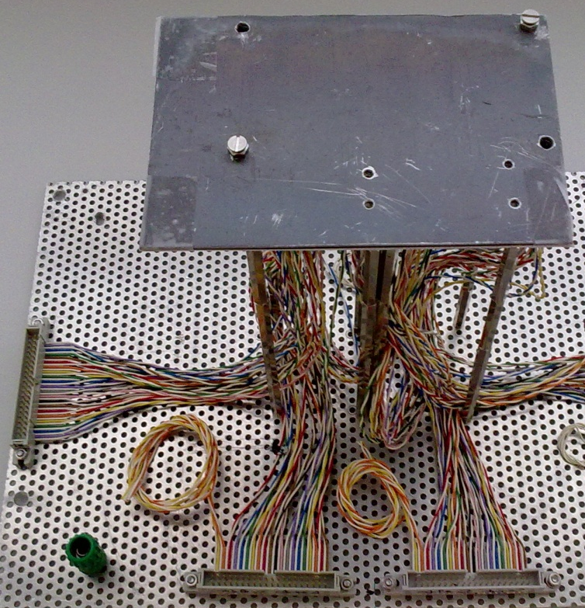
Setup (inside the bunker)
⁶⁰Co source
2mm Pb
1mm Al
Ionizing chamber (PTW 30013)
for dose measurement

Slide 6
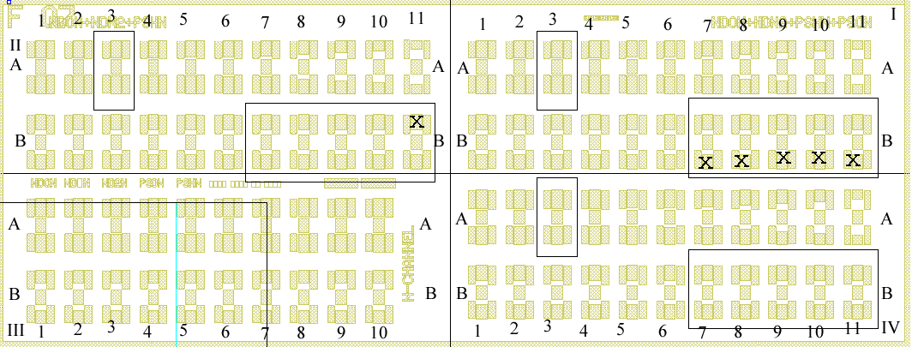
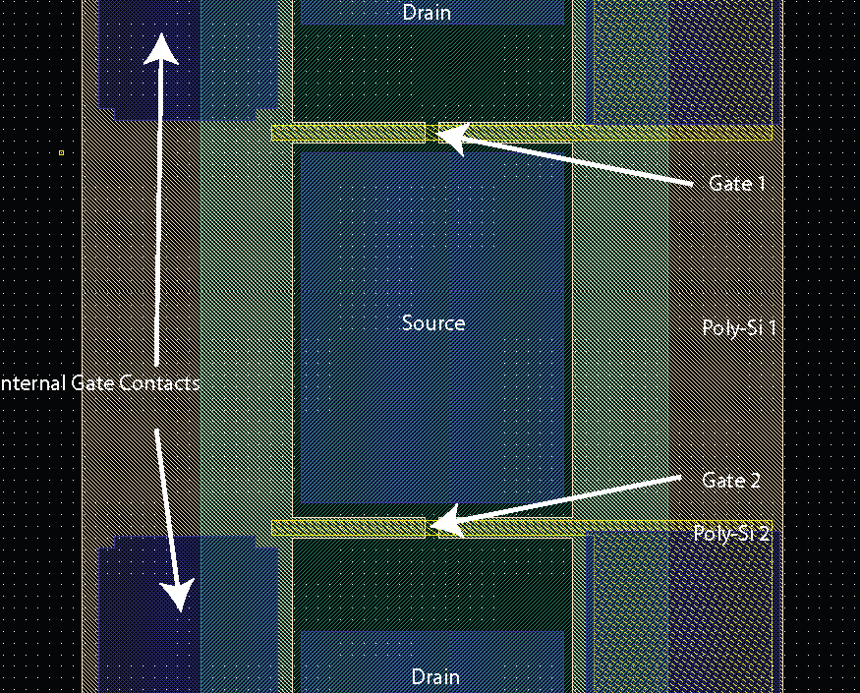
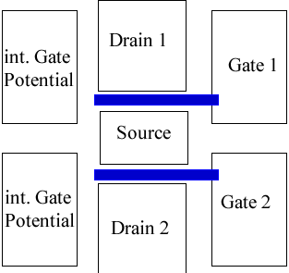
4-Quadrant 2-Transistor structures
Instrumentation limited to 30 transistors over 172
QI -> 7
QII -> 11
QIV - > 12

Slide 7
Transistor biasing during irradiation
Different biasing voltages were chosen to be applied during irradiation
Voltage | Value | Transistors
IG,bulk | 10 | all
Vs | 0 | all
Vd | -5 | 37
 | 0 | 23
Vgs | -5 | 6
 | -3 | 6
 | -2 | 6
 | -1 | 4
 | 0 | 24
 | 2 | 8
 | 5 | 6

Slide 8
Status of transistors during irradiation
OK =>
  IV curve fine, can connect InternalGate
notOK =>
  cannot connect IG (Gate-IG short), I=cte for just one irradiation step, double slope in IV curve, Igs = Overflow for certain Vgs values…
KO =>
  I=cte or Overflow (>2mA) for several steps, sinusoidal shape
Status before irradiation
  OK = 55%; notOK = 40%; KO = 5%
Status after irradiation + annealing
  OK = 37%; notOK = 27%; KO = 25%
Step | Mrad | InternalGate connected?
 |  | yes | no
S0 | 0 | 33 | 27
S1 | 0.1 | 28 | 32
S2 | 0.2 | 23 | 37
S3 | 0.43 | 23 | 37
S4 | 0.7 | 23 | 37
S5 | 1 | 23 | 37
S6 | 2 | 22 | 38
S7 | 3 | 21 | 39
S8 | 4 | 0 | 60
S9 | 5.5 | 0 | 60
S10 | 7.5 | 0 | 60
S11 | 10 | 0 | 60
S12 | anneal | 0 | 60
status | chip |  | column |  |  |  |  |  | Vgs |  |  |  |  |  |  | Shorts
 | 1 | 3 | 3 | 7 | 8 | 9 | 10 | 11 | -5 | -3 | -2 | -1 | 0 | 2 | 5 | Rgs | Rgig
OK | 11 | 11 | 6 | 4 | 6 | 2 | 5 | 1 | 3 | 3 | 2 | 3 | 6 | 2 | 3 | 50 | 27
notOK | 12 | 11 | 4 | 3 | 3 | 1 | 5 | 5 | 2 | 3 | 2 | 0 | 10 | 3 | 3 | 10 | 33
KO | 7 | 8 | 2 | 3 | 1 | 7 | 0 | 2 | 1 | 0 | 2 | 1 | 8 | 3 | 0
Total | 30 | 30 | 12 | 10 | 10 | 10 | 10 | 8 | 6 | 6 | 6 | 4 | 24 | 8 | 6 | 60 | 60

Slide 9
The analysis (Gm, Vth)
Ids is made positive to be able to calculate the square root
  Ids = Ids - Ids_{min} in case Ids_{min} < 0
The linear trend of the curve sqrt(Ids) vs Vgs is searched
  A loop selects groups of 10 points and fit them to a straight line. The fit with the highest slope is selected and it gives:
  Gm: the slope (which is proportional to the transconductance gm)
    Gm = ∂(√Ids)/∂Vgs ; gm = ∂(Ids)/∂Vgs
    gm = 2 Gm (Vgs - Vth)
  Vth: the cross with the X-axis

Slide 10
Ids vs Vgs, Vth, Gm for a good transistor

Slide 11
Ids vs Vgs, Vth, Gm for a bad transistor
Behaves as a column 3
(full width) transistor
Behaves as a column 11
transistor

Slide 12
Ids vs Vgs, Vth, Gm for a bad transistor
Double slope

Slide 13
Ids vs Vgs, Vth, Gm for a bad transistor
Igs=cte for S4
Igs overflow

Slide 14
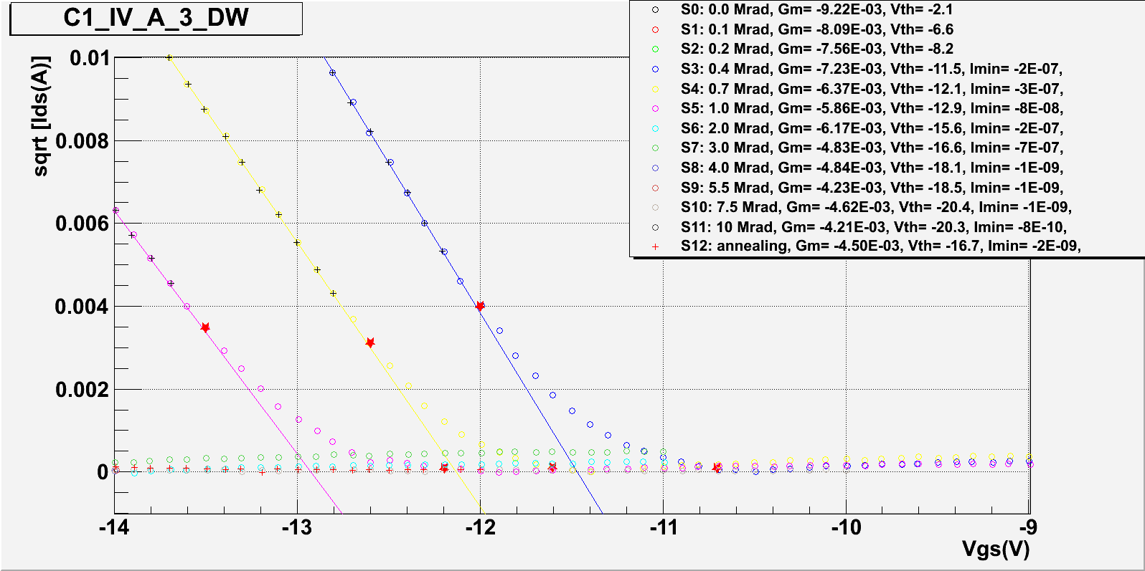
The analysis (Subthreshold zone)
The Subthreshold zone is calcucated as the subtraction of the Vgs of the two points which determine the begining of conduction zone and the end of the cut zone
  Those points are the first ones with a distance to their fit > 10⁻⁴
1.3V
Distance to the conduction fit
Distance to the cut fit

Slide 15
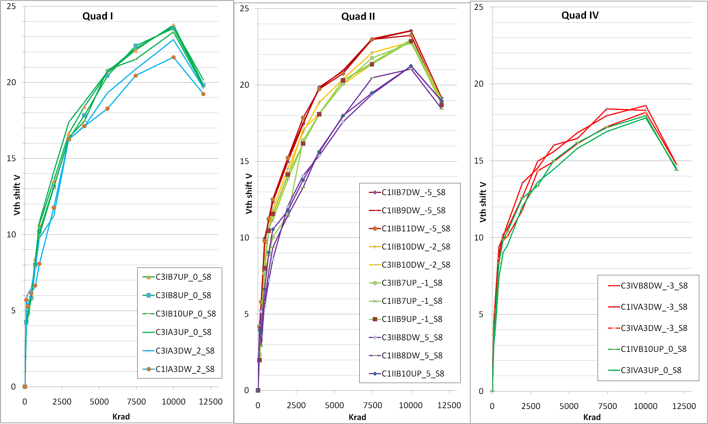
Vth shift vs dose (by quadrants & Vgs)
Vgs
0
2
Vgs
-5
-2
-1
+5
Vgs
-3
0
QIV has no IG
implemented
Points on 12 Mrad
mean annealing

Slide 16
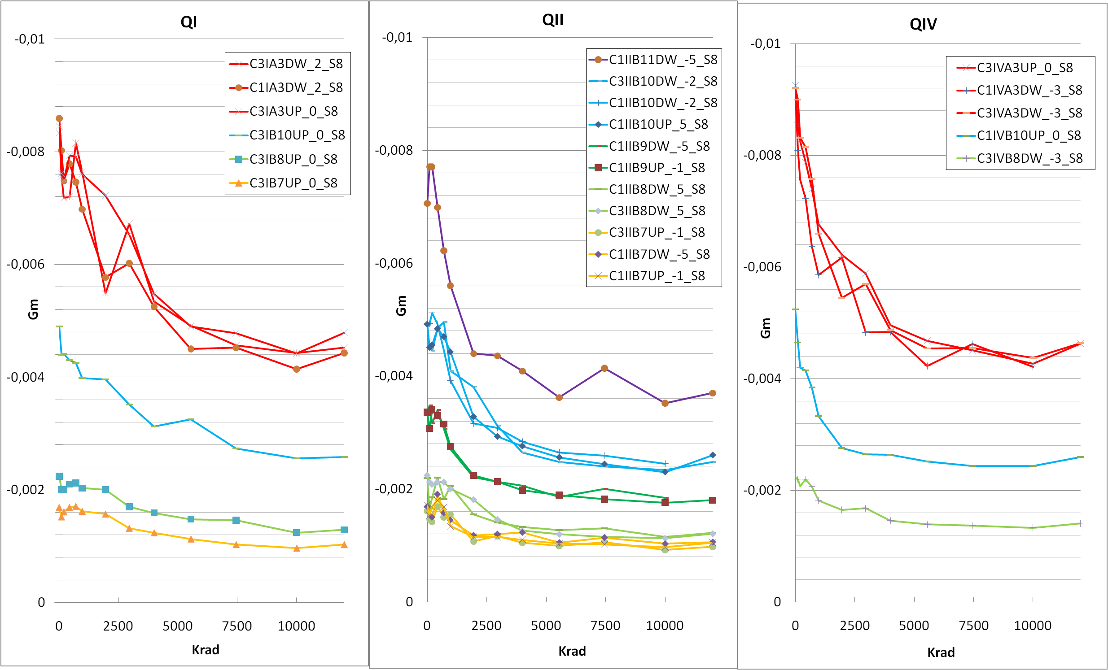
Gm vs dose (by quadrants & columns W/L)
W/L
20
6.7
1.7
1
W/L
13
6.7
3.3
1.7
1
W/L
20
6.7
W/L
20
6.7
1.7

Slide 17
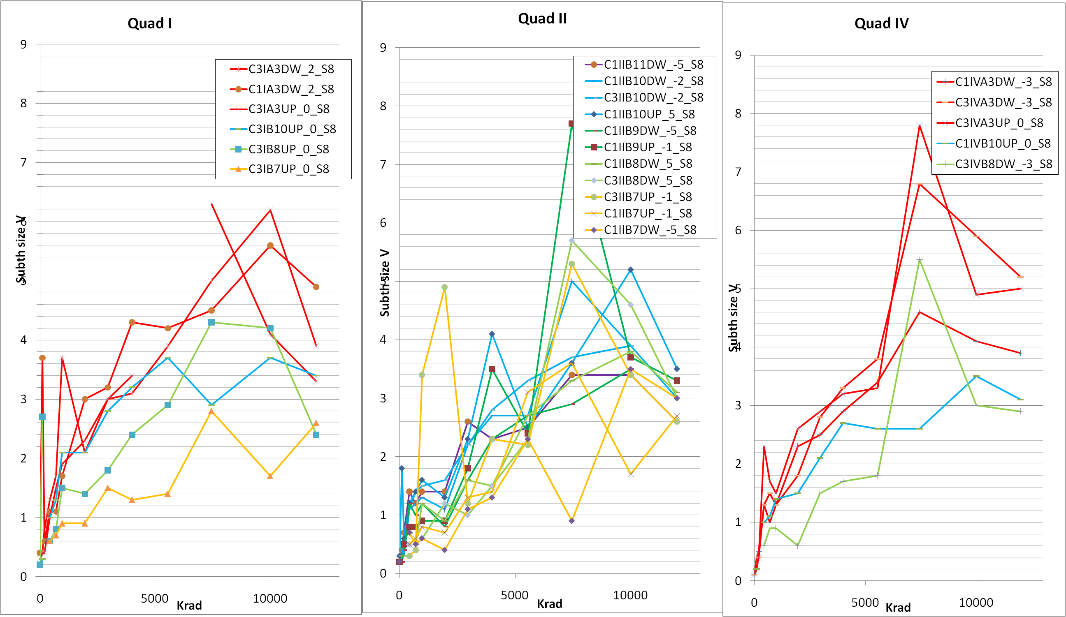
Subthreshold zone vs dose (by quadrants & W/L)
W/L
20
6.7
1.7
1
W/L
13
6.7
3.3
1.7
1
W/L
20
6.7
1.7

Slide 18
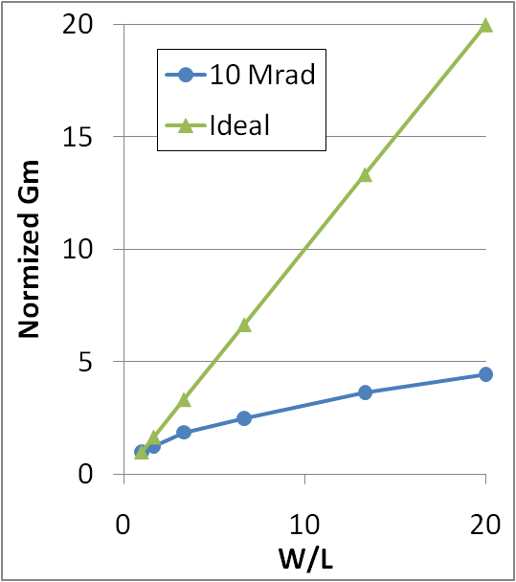
Results
Vth shift after 10 Mrad ~23 V for transistors of QI,II and ~18 V in QIV
Vth shift decreases by 3.5 V after 28 deays of annealing
Vth shift decrease ~3.5 V changing Vgs from -5 V to 5V
Gm is a factor 4 below what spected from W/L ratio
Gm is reduced 40% after 10 Mrad and slightly recovers after the anealling
Subthreshold zone increases up to 4±2 V after 10 Mrad (the method is still not well tuned)
W/L | <Gm> 10Mrad
1 | -9.7E-04
1.7 | -1.2E-03
3.3 | -1.8E-03
6.7 | -2.4E-03
13 | -3.5E-03
20 | -4.3E-03

Slide 19
Back up slides

Slide 20
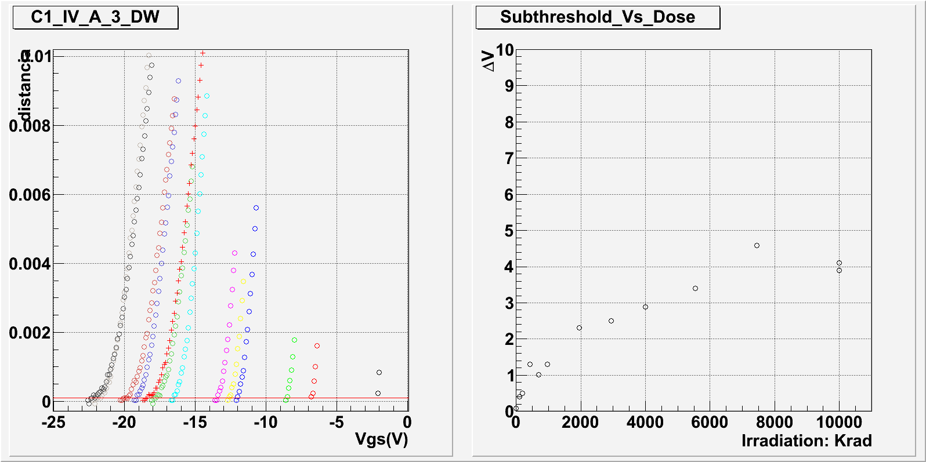
Distance to the conduction linear fit
Distance = 10⁻⁴

Slide 21
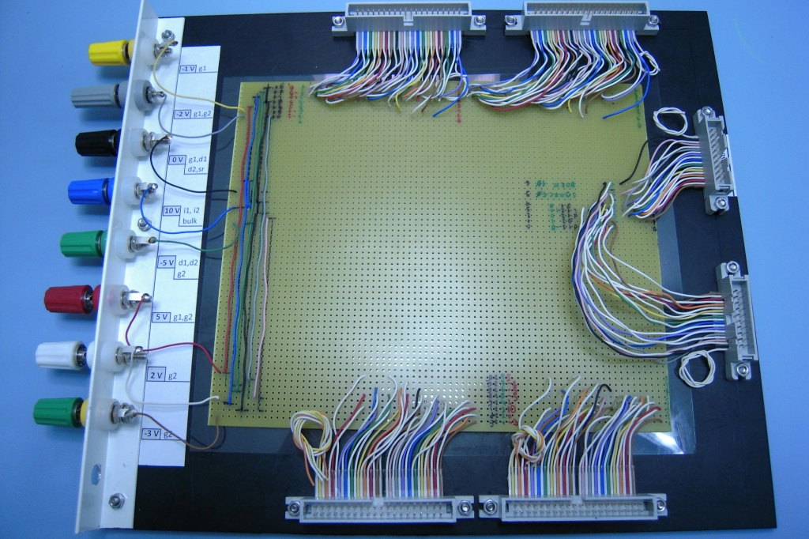
Irradiation Board

Slide 22
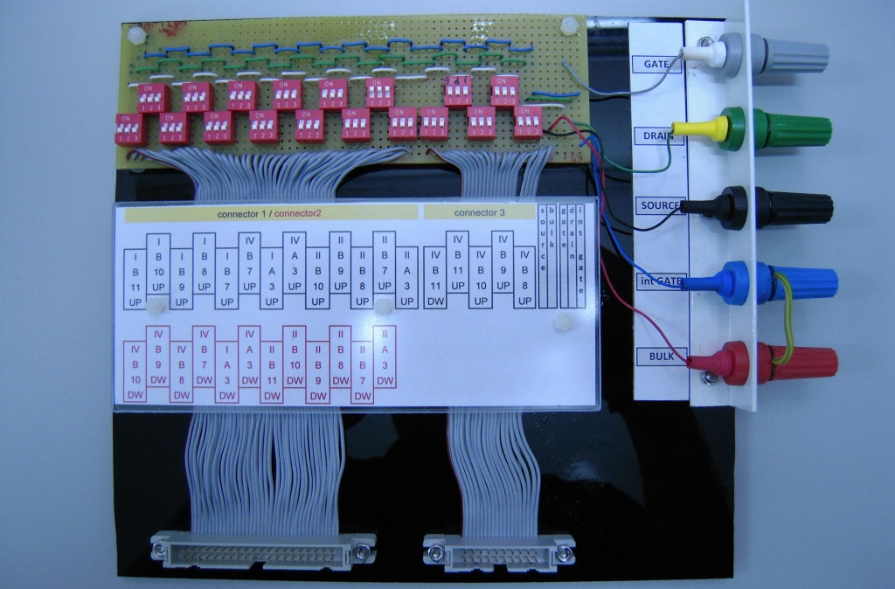
IV test board

Slide 23
Irradiation housing board scheme
2 mm Pb
1mm Al
Ionizing
chamber
depfet
depfet
adaptor
adaptor
connector
connector
45mm
45mm
15mm
Patch panel pcb

