Slide 1


Applications of Plasma-Wave Acceleration Techniques to Particle Colliders
Science and Applications of Plasma‐Based Accelerators
HERAEUS-767
Brian Foster (Oxford)
16/5/22

Slide 2
Outline of Talk
Introduction
Injectors
Booster/afterburner for pre-existing machine
Stand-alone colliders
Summary

Slide 3
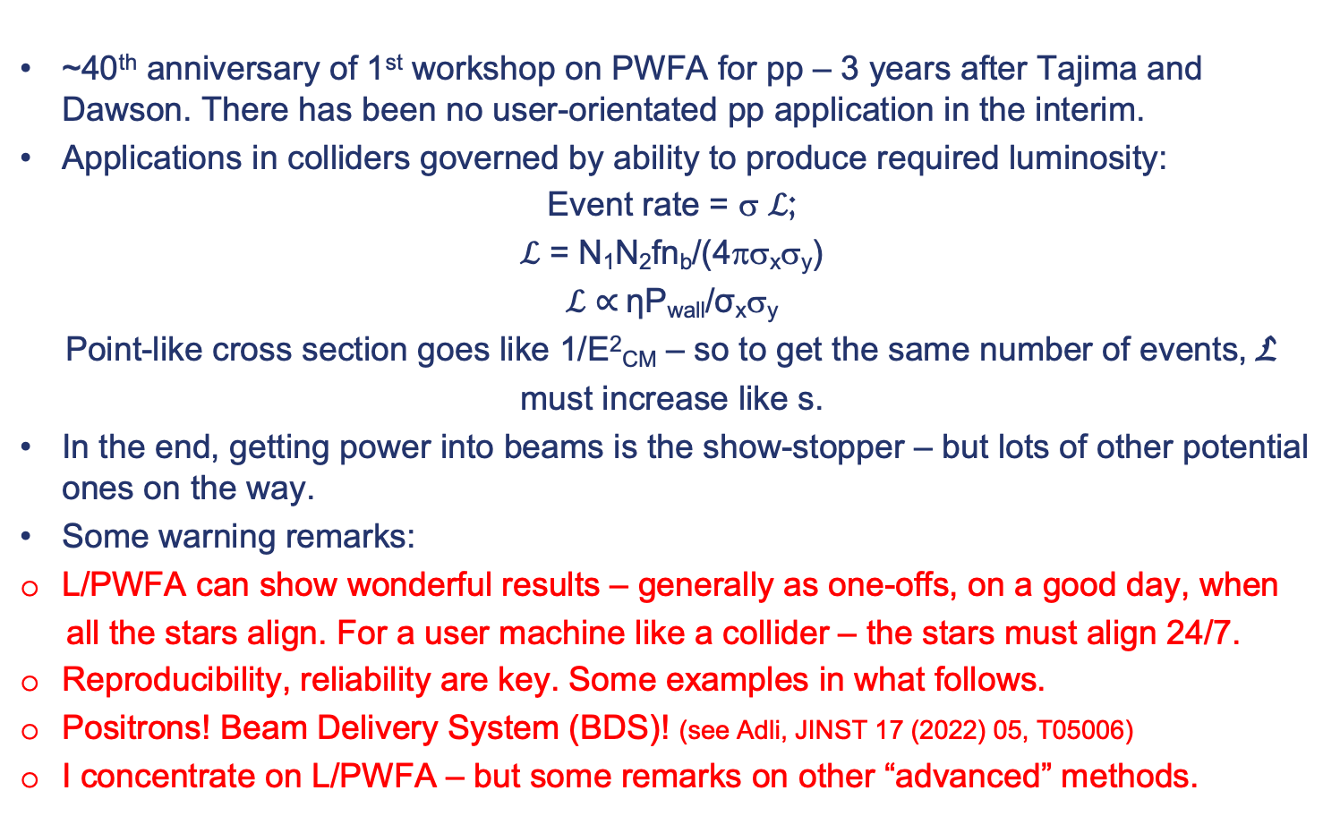
Introduction
~40th anniversary of 1st workshop on PWFA for pp – 3 years after Tajima and Dawson. There has been no user-orientated pp application in the interim.
Applications in colliders governed by ability to produce required luminosity:
Event rate = σ ℒ;
ℒ = N₁N₂fn_{b}/(4πσ_{x}σ_{y})
ℒ $∝$ηP_{wall}/σ_{x}σ_{y}
Point-like cross section goes like 1/E²_{CM} – so to get the same number of events, L
must increase like s.
In the end, getting power into beams is the show-stopper – but lots of other potential ones on the way.
Some warning remarks:
L/PWFA can show wonderful results – generally as one-offs, on a good day, when
all the stars align. For a user machine like a collider – the stars must align 24/7.
Reproducibility, reliability are key. Some examples in what follows.
Positrons! Beam Delivery System (BDS)! (see Adli, JINST 17 (2022) 05, T05006)
I concentrate on L/PWFA – but some remarks on other “advanced” methods.

Slide 4
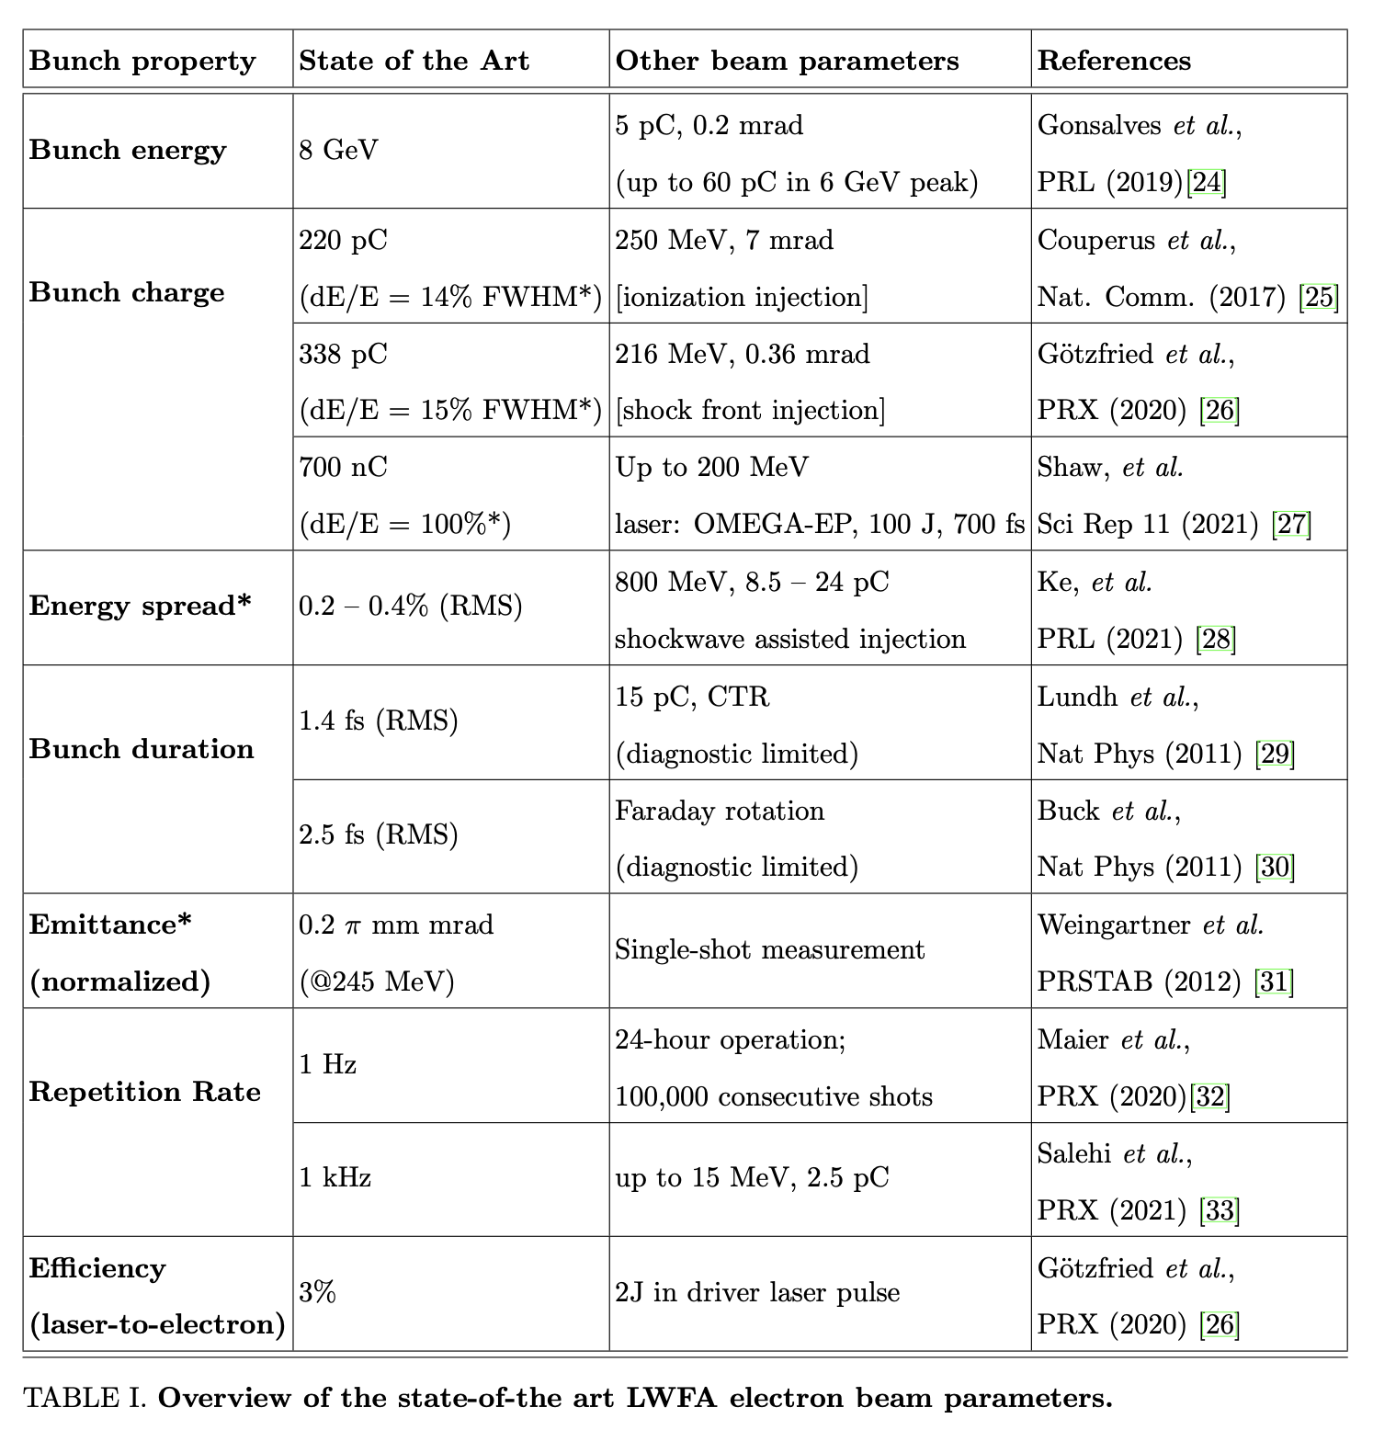
Injectors
An obvious use of L/PWFA – intrinsically tiny “feature-size” promises intrinsically excellent 6D emittance – low energy, no staging required. But archetypically the area where reliability crucial. Some applications need low rep. rate.
What is state of art?
Plasma-Based Particle Sources,
Fuchs et al., Snowmass2021,
arXiv:2203.08379
Notes:
Andi’s results at LUX

Slide 5
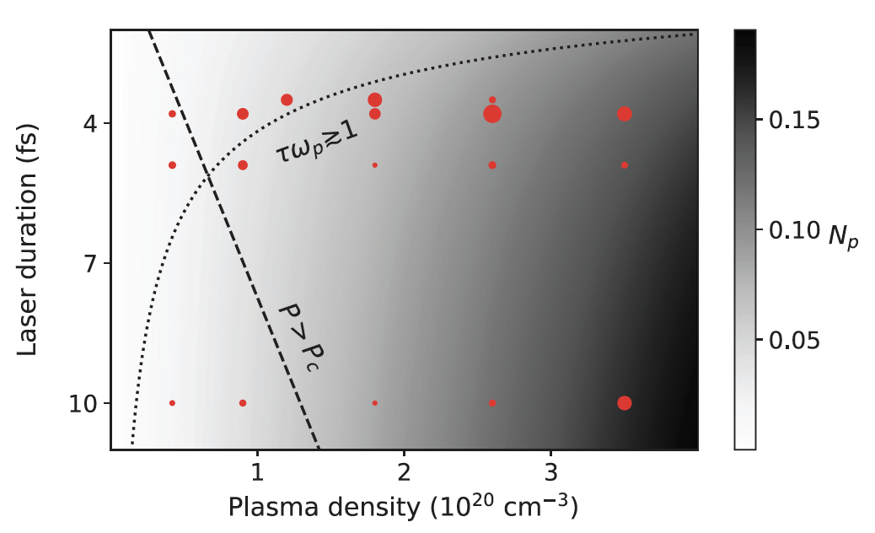
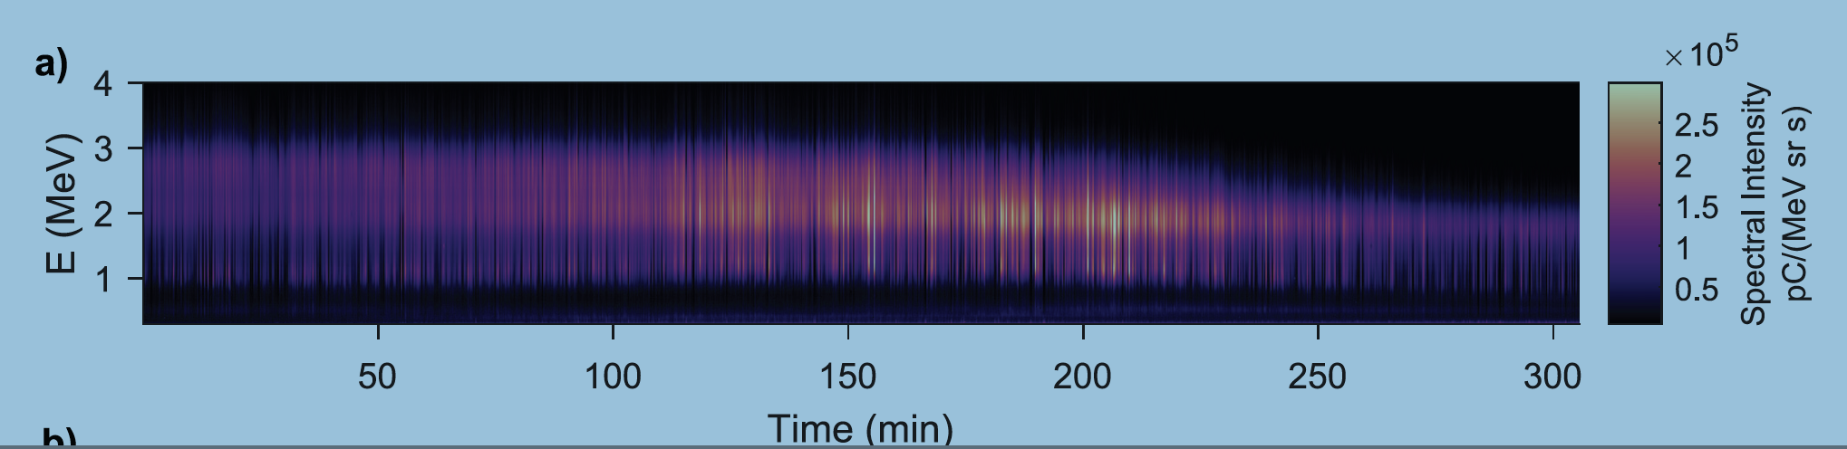
Injectors
Perhaps most obvious use of L/PWFA – intrinsically tiny “feature-size” promises intrinsically excellent 6D emittance – low energy, no staging required. But archetypically the area where reliability crucial.
What is state of art?
L. Rovige et al., Phys. Plasmas 28, 033105 (2021)
Notes:
Size of red dots proportional to charge – comes from self-injection. Bunch charges between 2 and 5 pC. Done at Salle Noire kilohertz laser system at Laboratoire d’Optique Appliqu ee (LOA – Ecole Poly.
Faure’s group – France-Japan-Lithuania.

Slide 6
CEPC Accelerator
Notes:
Convergence with FCCee due to Katsunobu Oide

Slide 7
CEPC
20
m tunnel
/
BUT – Linacs are
very expensive –
this is essentially 1*XFEL.
Injecting into Booster at
such low energy is a pain!
Notes:
New linac C-band – magnets could need to run at 30 Gauss.

Slide 8
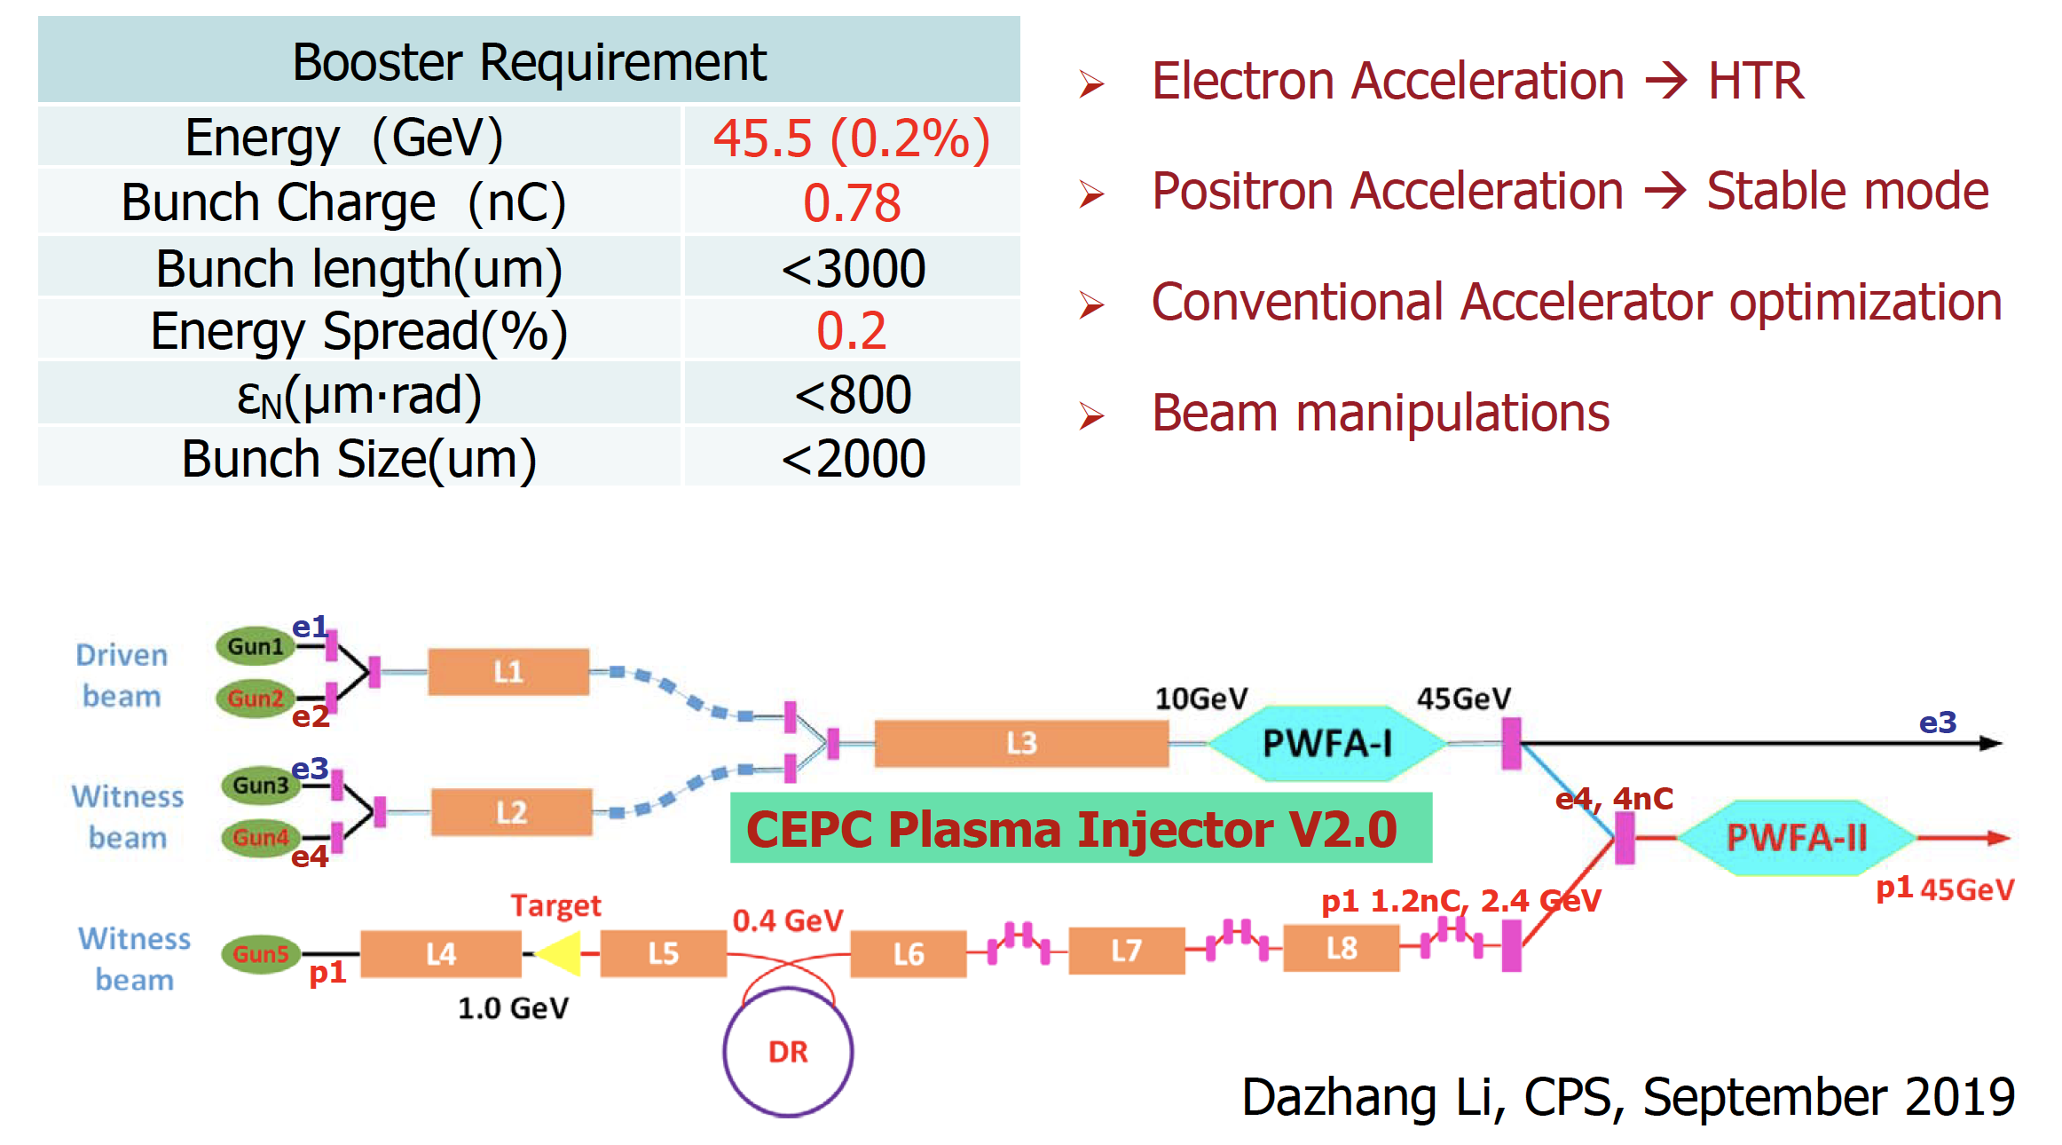
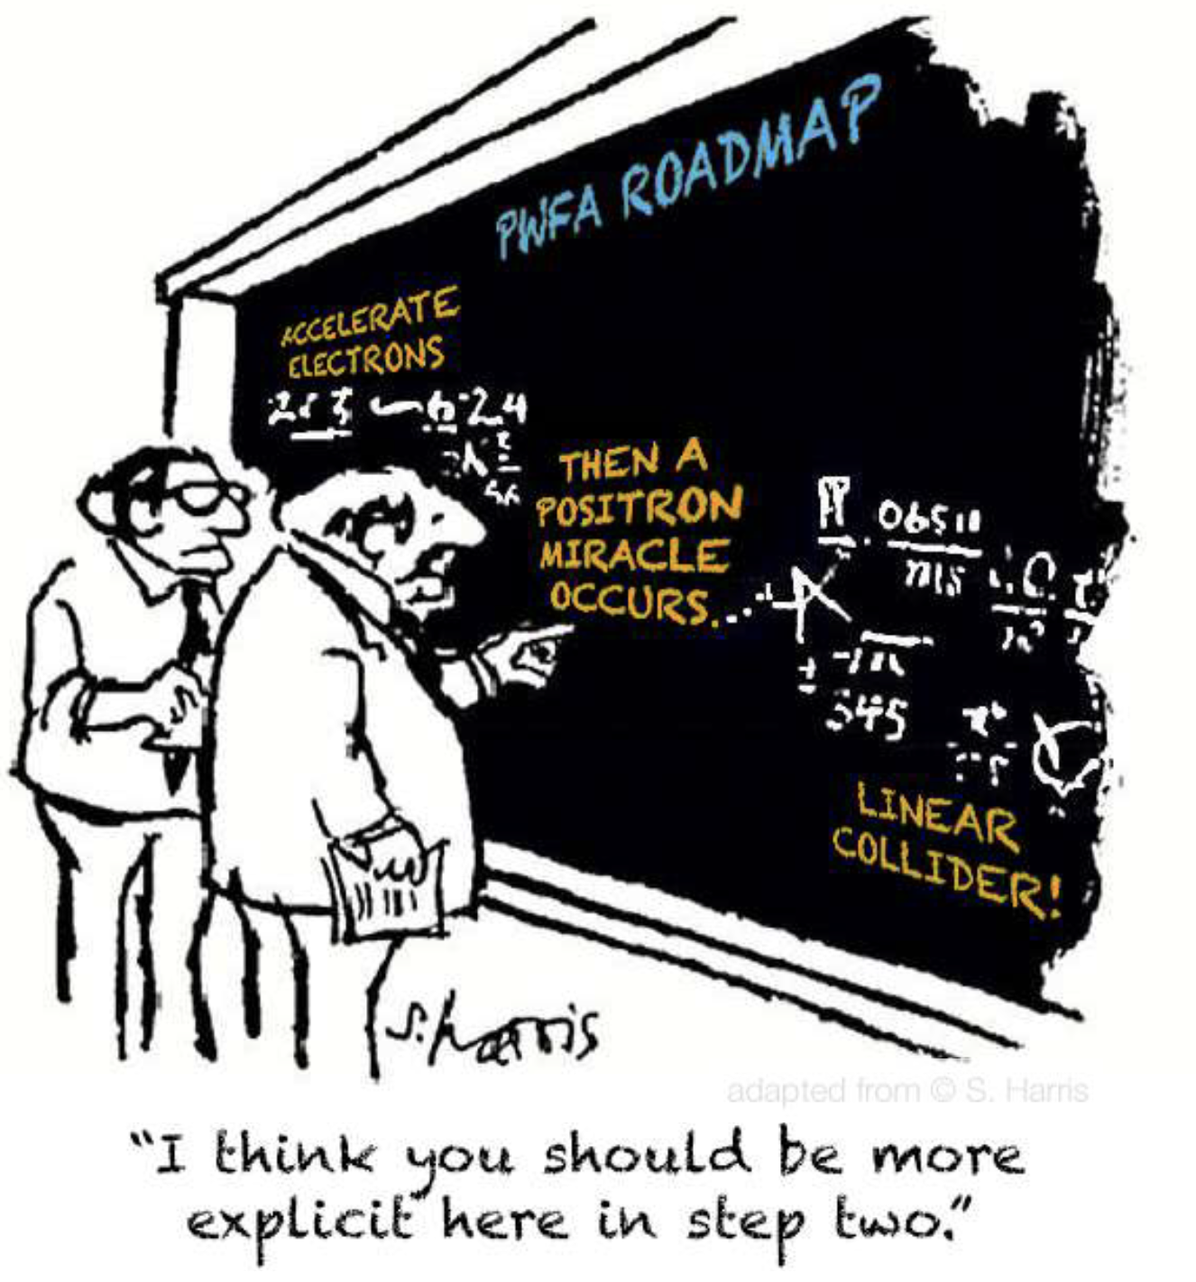
CEPC PWFA Linac
e⁻ run at low Transformer ratio 1 – 1.5 –
some concern that beams unstable to small
offsets and enhanced hosing instability
– under study.
Uniquely useful for green-field site – FCCee? No.
But e⁺? Linear wakes can symmetrise e⁺/e⁻ but only
with low efficiency, high emittance, low gradient. Non-linear?
Notes:
Carl recovery

Slide 9
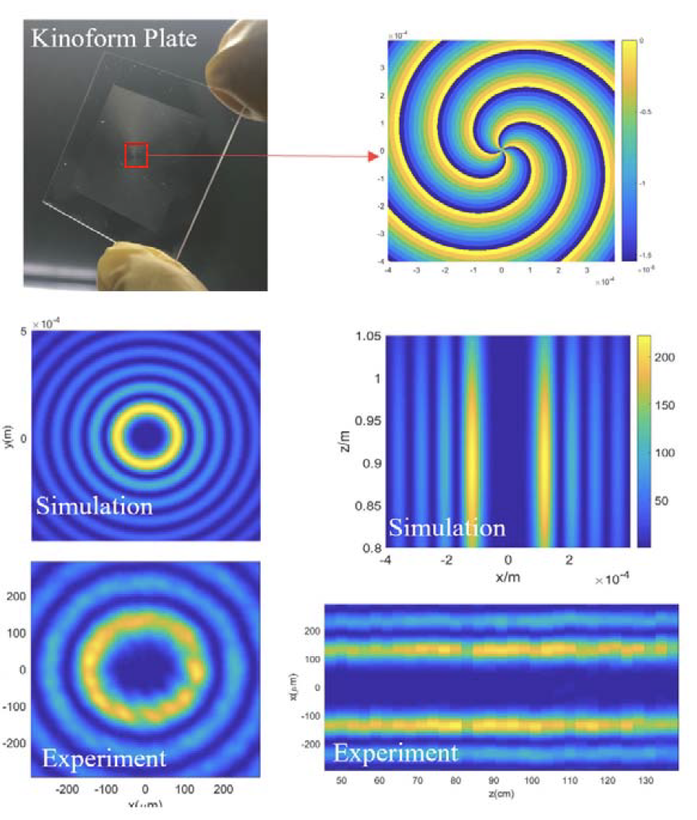
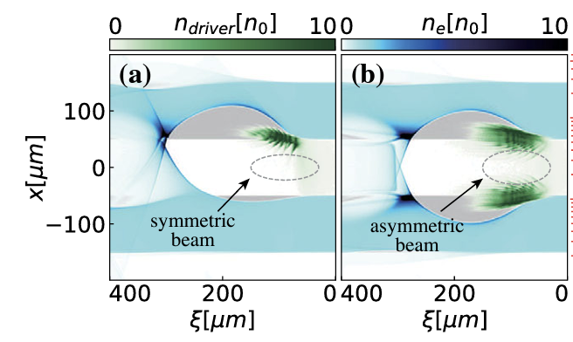
Positron acceleration
Asymmetric (eliptical) drive beam forms stable configuration at the edge of the plasma after a few cm of propagation – focus and accelerate positrons. Hollow channel means no ions to defocus e⁺. positrons.
Zhou et al., Phys, Rev. Lett. 127,174801 (2021)
The offset for the asymmetric beam is
100nm. Elliptical beam stable in simulation but needs verification at FACET-II.
Notes:
Carl recovery

Slide 10
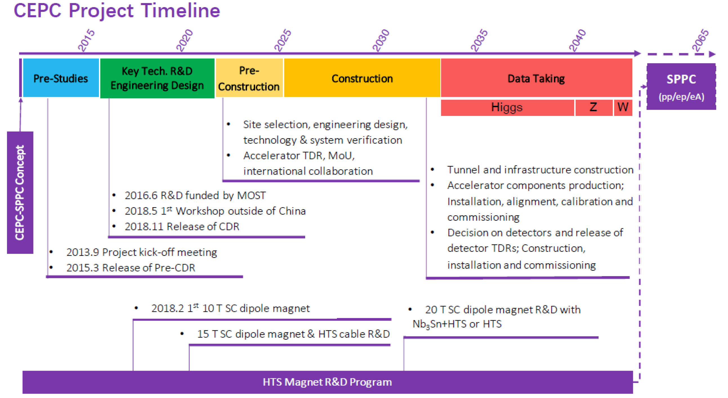
CEPC Timeline
Notes:
Carl recovery

Slide 11
Outline of Talk
Introduction
Injectors
Booster/afterburner for pre-existing machine
Stand-alone colliders
Summary

Slide 12
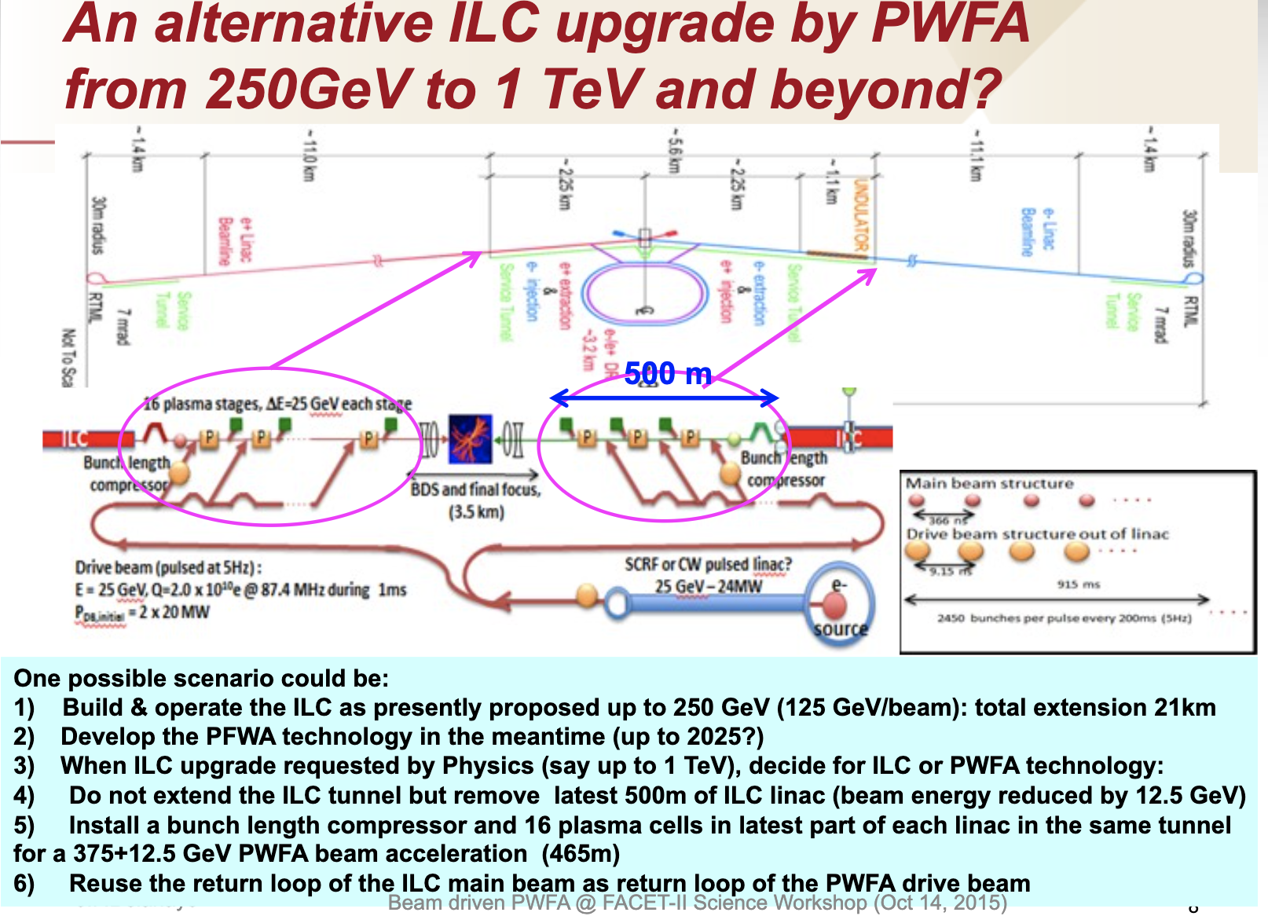
Booster/afterburner
Need to match beam delivered to L/PWFA to give optimum results. Because it sits inside conventional accelerator, many problems such as staging amenable to conventional solutions – easier? More difficult than boosting XFEL because staging, positrons required in addition to rep. rate.
Again, reliability/reproducibility at a premium.
E.g. add plasma stages to boost ILC from Higgs Factory to 500 GeV/1 TeV

Slide 13
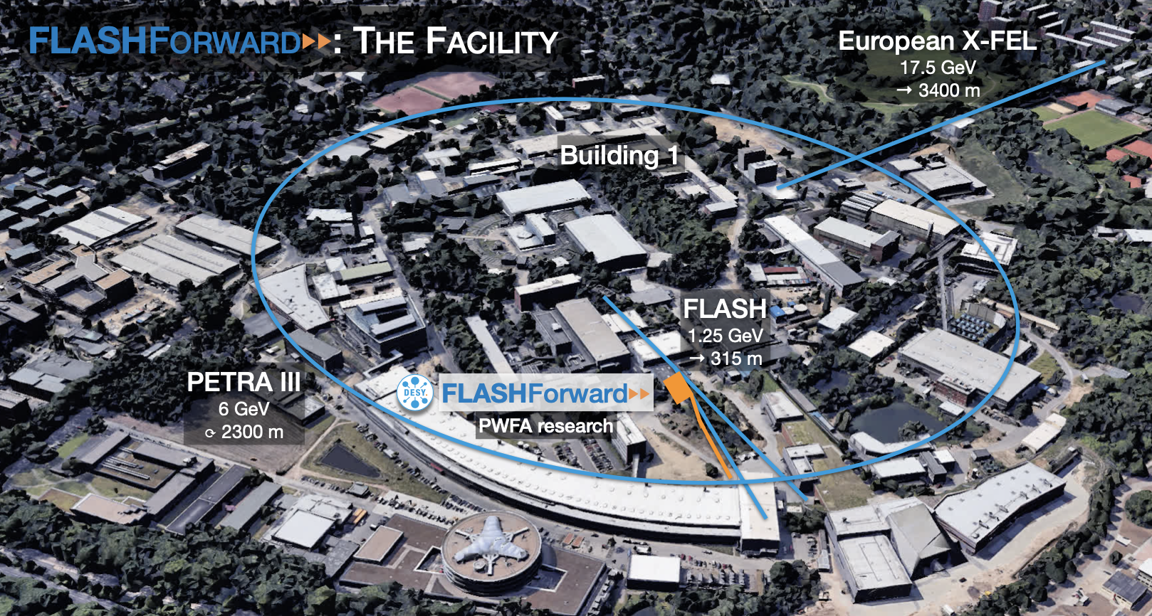
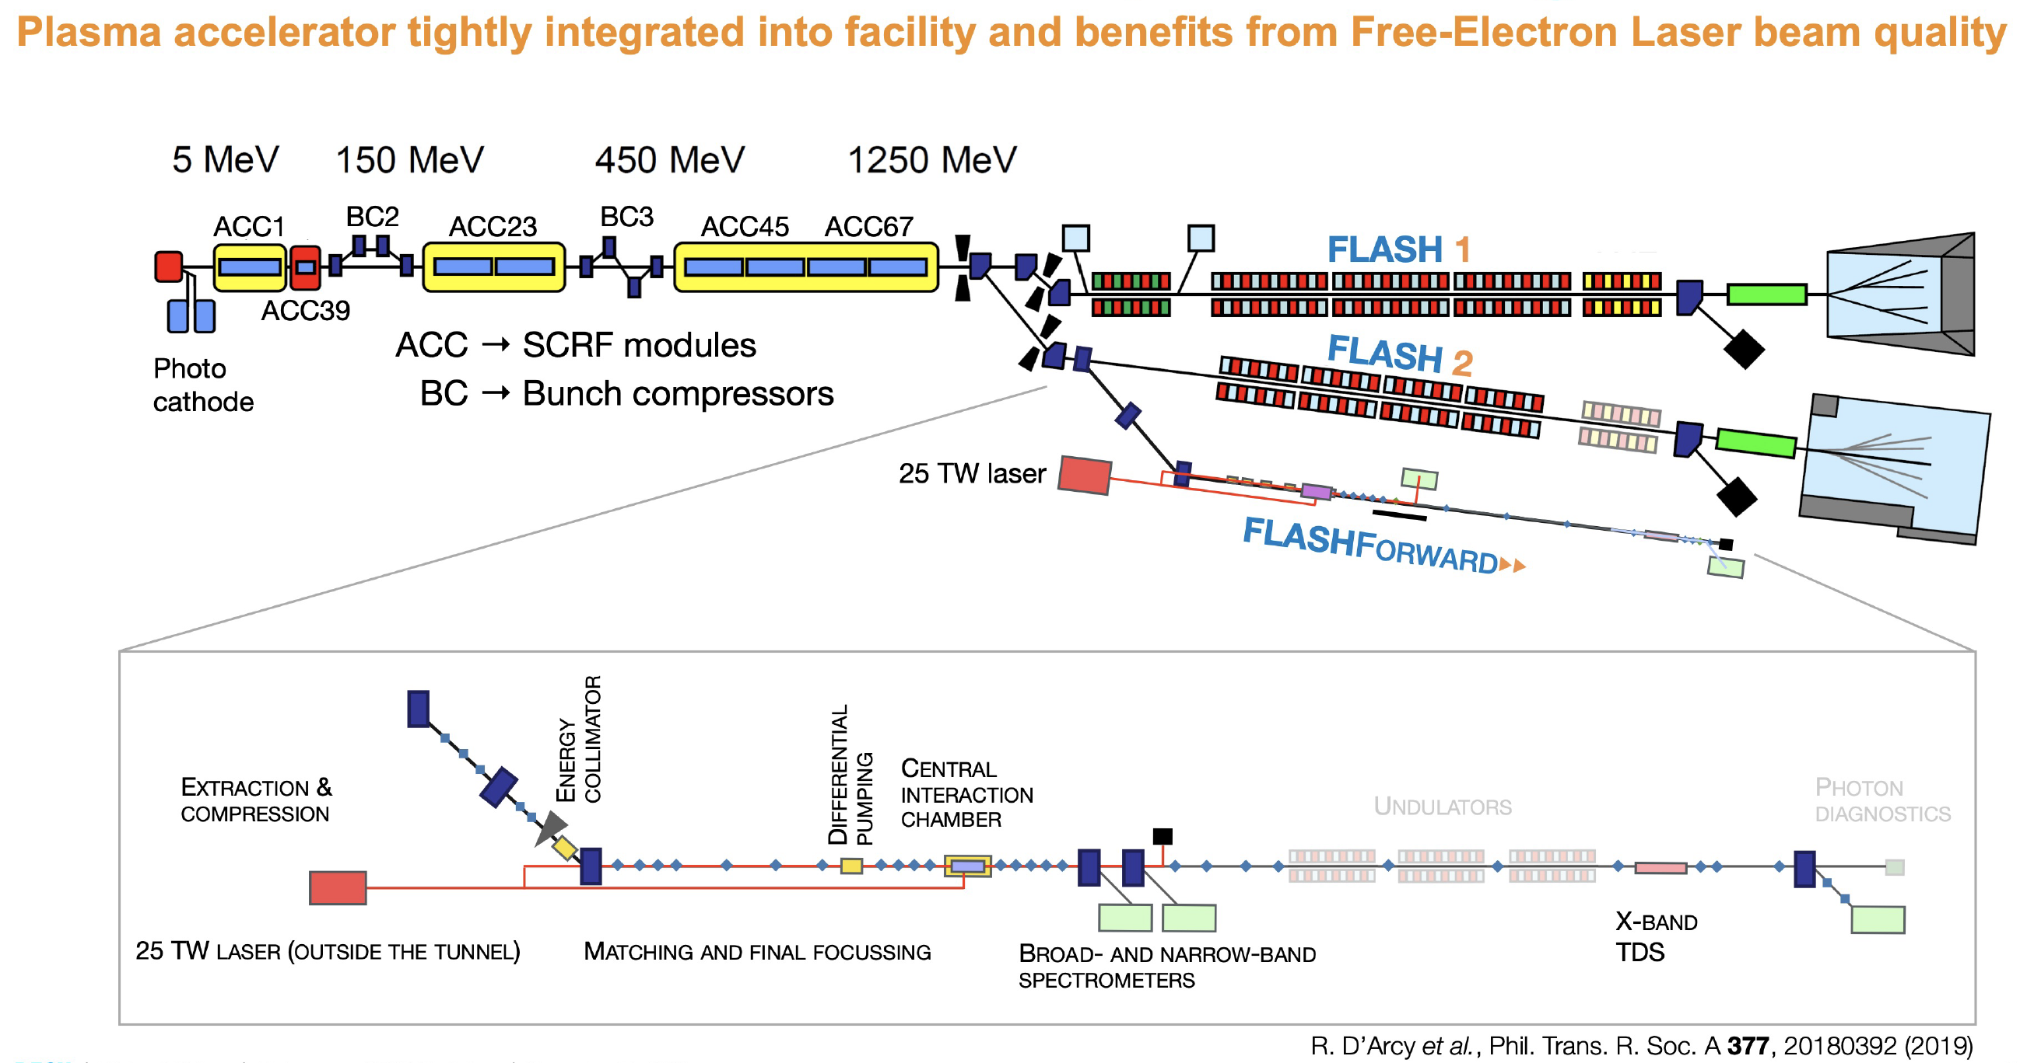
Basic L/PWFA limits - Rates
Need to understand how plasma reacts to beam structure of “conventional” accelerators – what are the limits and are they compatible with afterburner requirements?
FLASHForward results on maximum repetition rate from basic plasma relaxation.

Slide 14
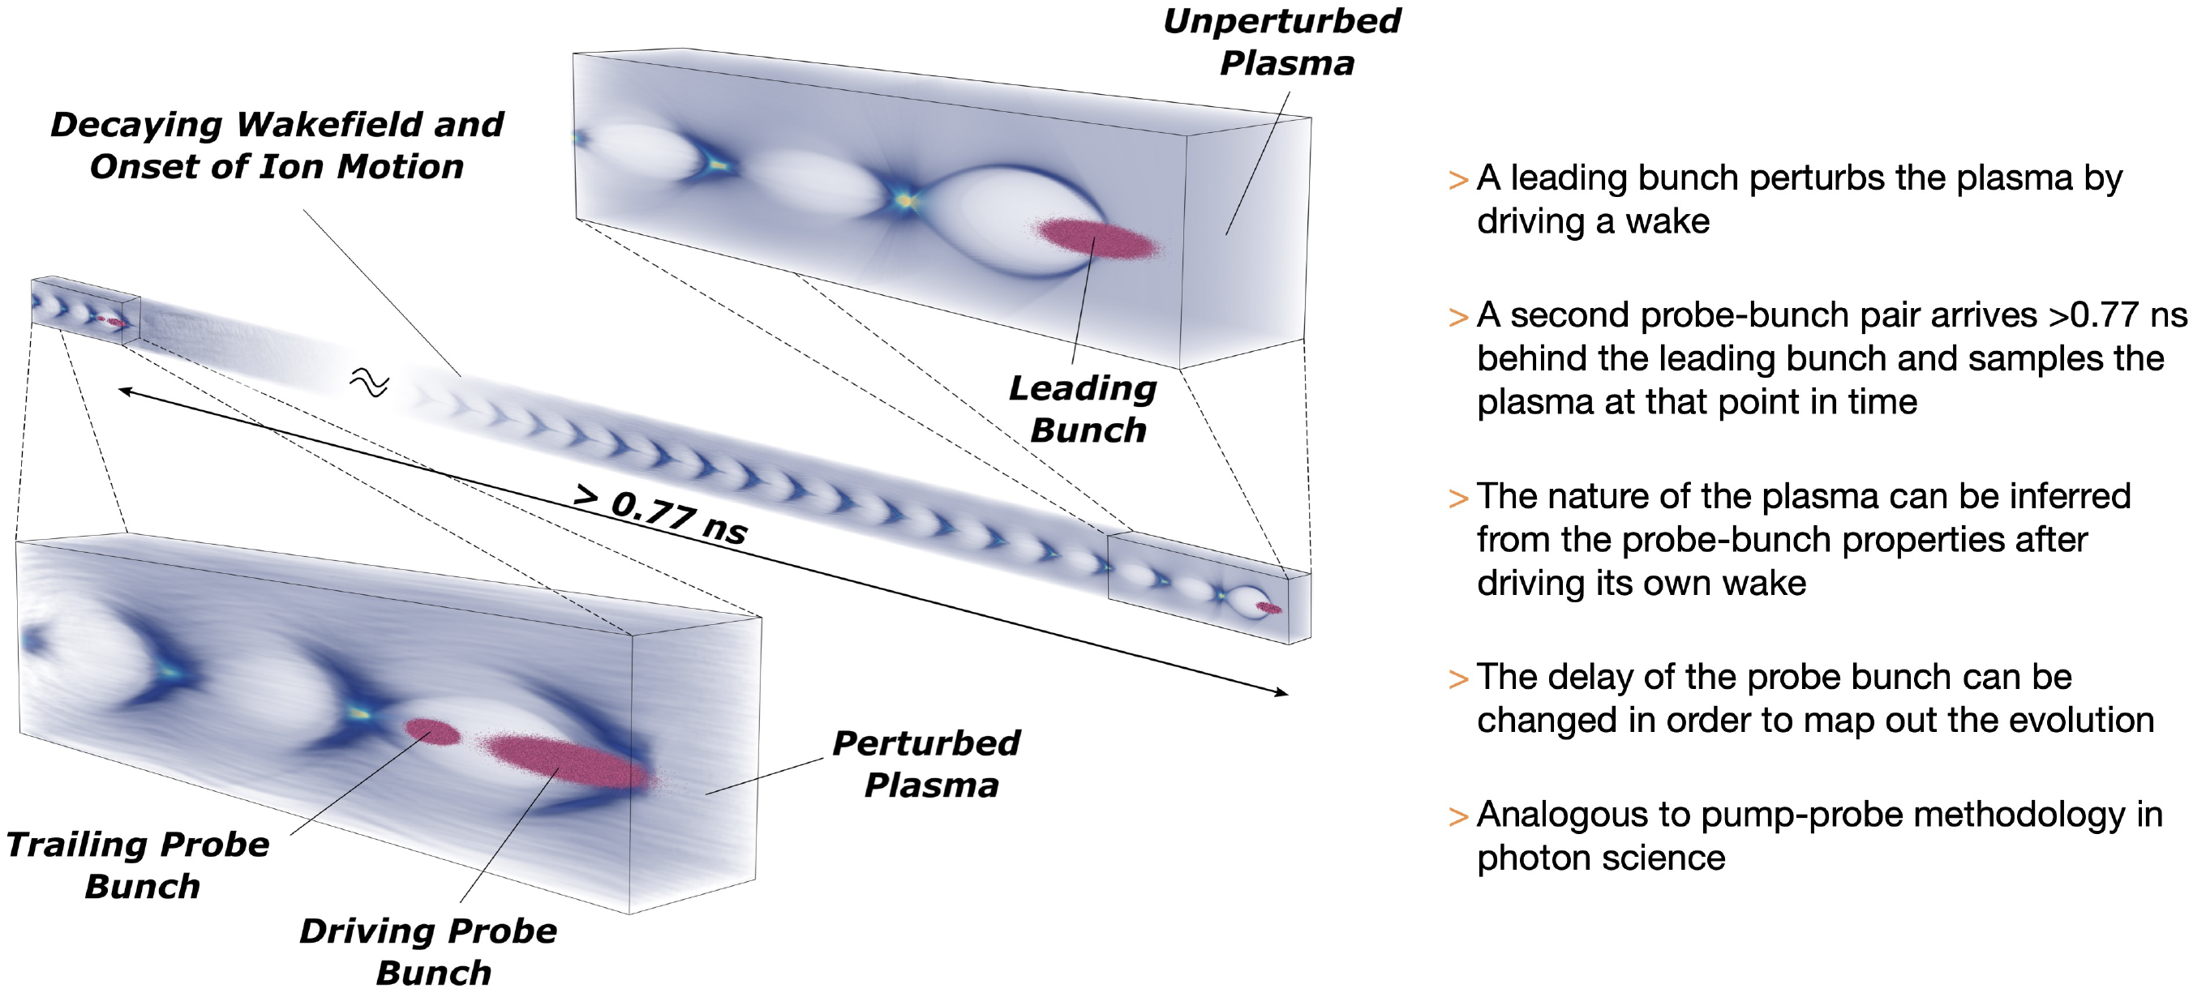
Basic L/PWFA limits - Rates
D’Arcy et al., Nature 603, 58–62 (2022)

Slide 15
Basic L/PWFA limits - Rates
D’Arcy et al., Nature 603, 58–62 (2022)
Corresponds to rate limit ~ 16 MHz. NB – intrinsic limit due to physics processes – in practice, limit set by engineering issues, e.g. cell cooling, plasma generation…

Slide 16
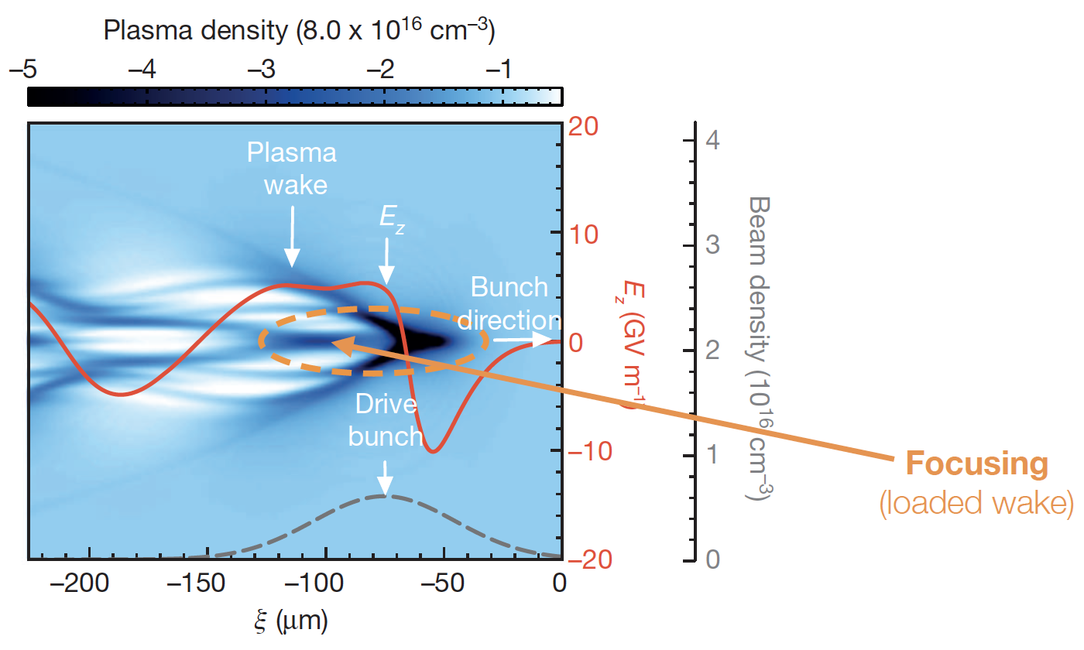
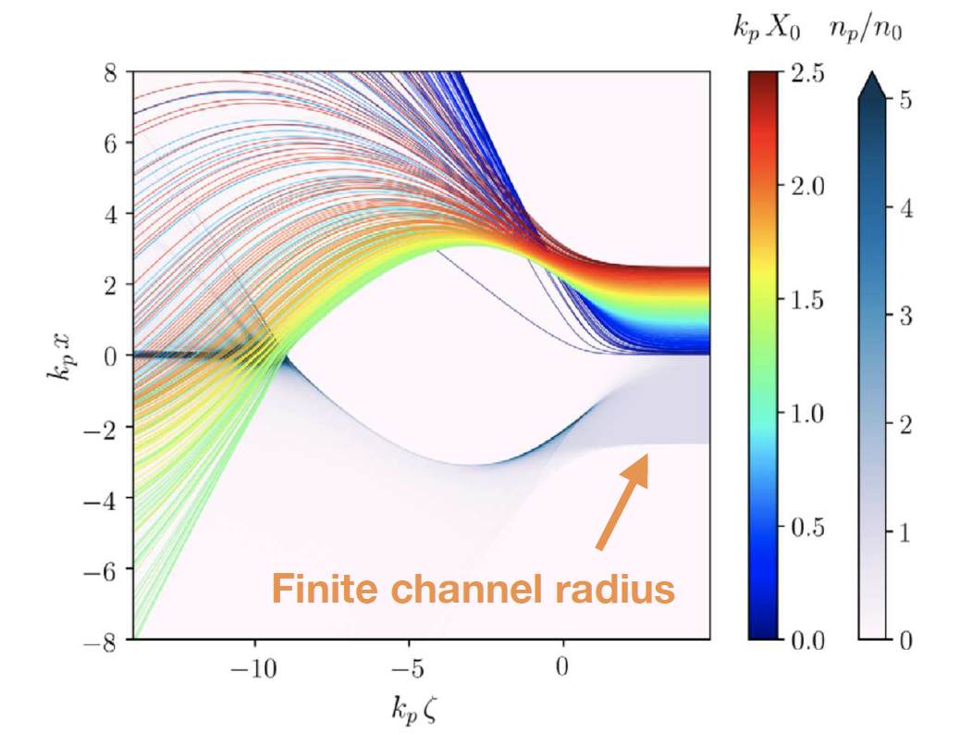
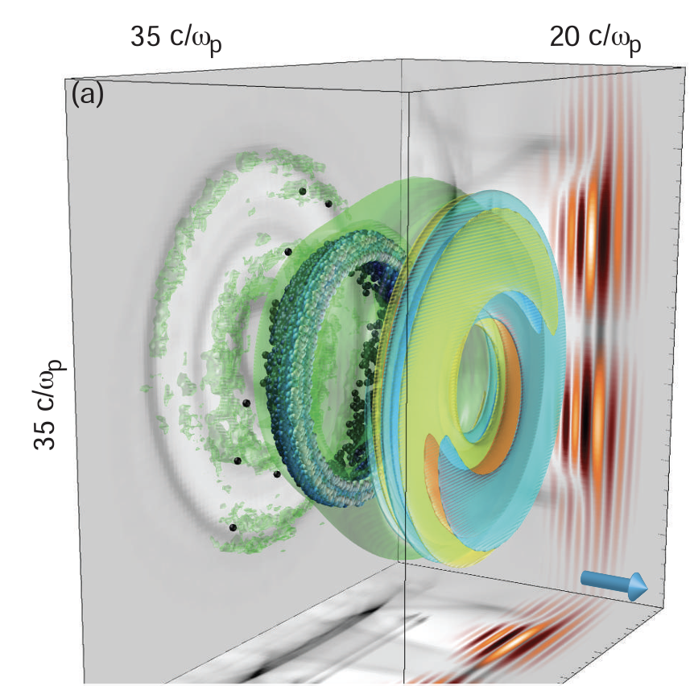
Basic Limits - Positron acceleration
The asymmetric scheme of Zhou et al. mentioned in CEPC only one of many approaches to e⁺ acceleration:
Linear wakefields: original observation of e⁺ acceleration – but cannot escape from low efficiency, high emittance and low gradient;
Non-linear wakefields – blow-out accelerating regime is naturally defocusing – basically need to manipulate beam or plasma:
  “self-loading” regime may work – but bunch
  shape distorts in equilibrium – likely to give
  high emittance;
  Limit the diameter of the plasma cylinder –
  can give region of both acceleration & focusing.
  Promising, but potential sources of emittance
  growth need further investigation;
  Wake inversion – tailor the beam shape e.g.
  torus can engineer blow-out – but beam loading
  gives non-linear focusing;
  Hollow Channel – conjugate of WI – tailor
  plasma so no ions on axis to defocus e+ -
  but stability issues - may require strong focusing.
Corde et al., Nature 524, 442 (2015)
Doche et al., Sci. Rep. 7, 14180 (2017
Diederichs et al., PRAB 22, 081301 (2019)
Viera & Mendonca, Phys.Rev. Lett 112 215001 (2014)
Vier et al., AIP Conf. Proc. 1777, 070112(2016)
Tajima, Proc. HEACC1983, 470 (1983)
Lee et al., Phys. Rev. E 64, 045501 (2001)

Slide 17
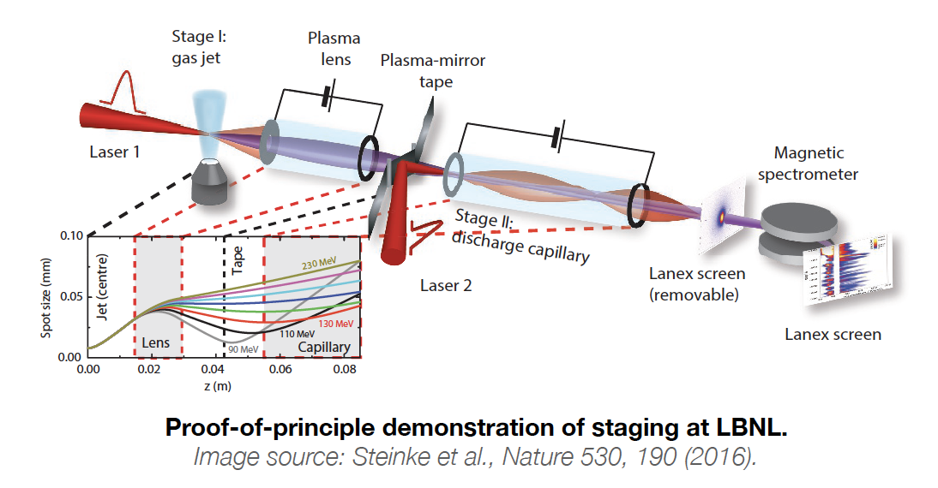
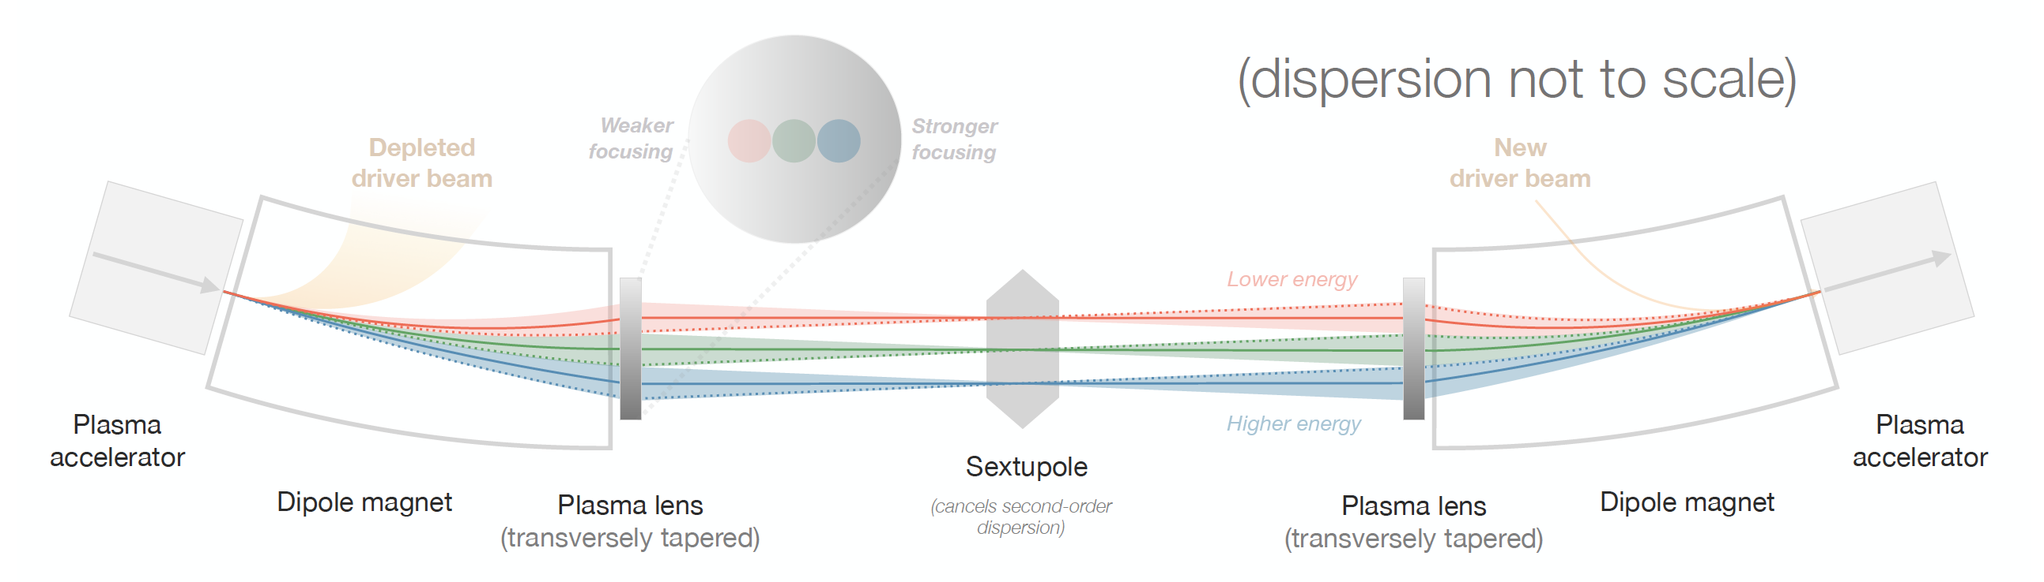
Basic limits - Staging
Staging demonstrated – but as yet no scheme that preserves emittance & charge.
Several new ideas, e.g. achromatic staging with non-linear plasma lenses
Lindstrøm:
Phys. Rev. Accel. Beams 24, 014801 (2021)

Slide 18
Outline of Talk
Introduction
Injectors
Booster/afterburner for pre-existing machine
Stand-alone colliders (def: at least one colliding beam does not originate from a conventional machine)
Summary

Slide 19
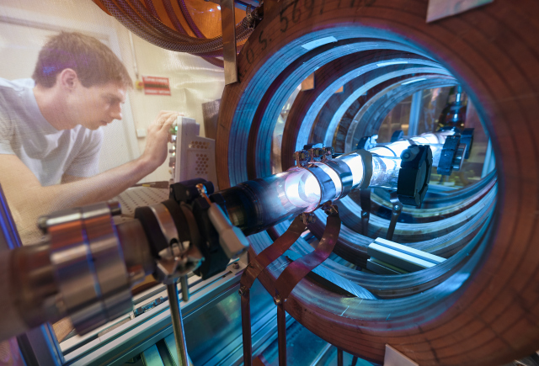
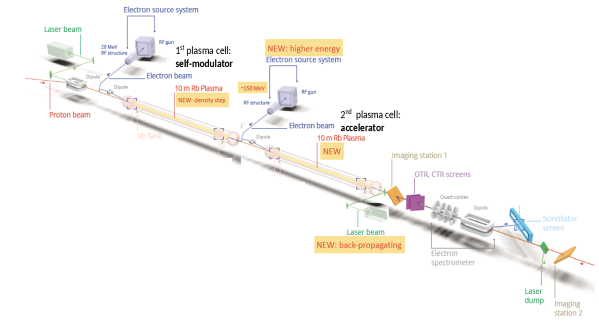
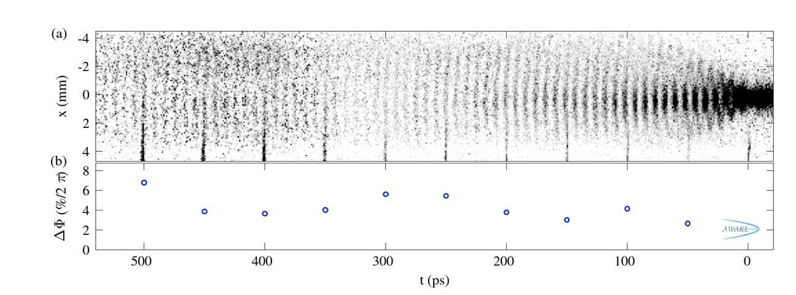
No Staging - AWAKE
Proton-beam-driven facilitates long plasma cells and reduces/removes need for staging.
Plasma source 10m long, 4cm diameter, density 10¹⁴ – 10¹⁵cm⁻³

Slide 20
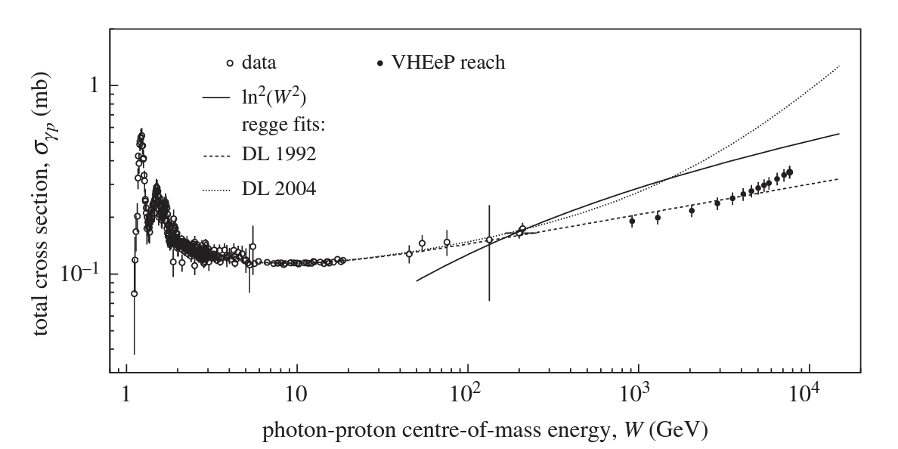
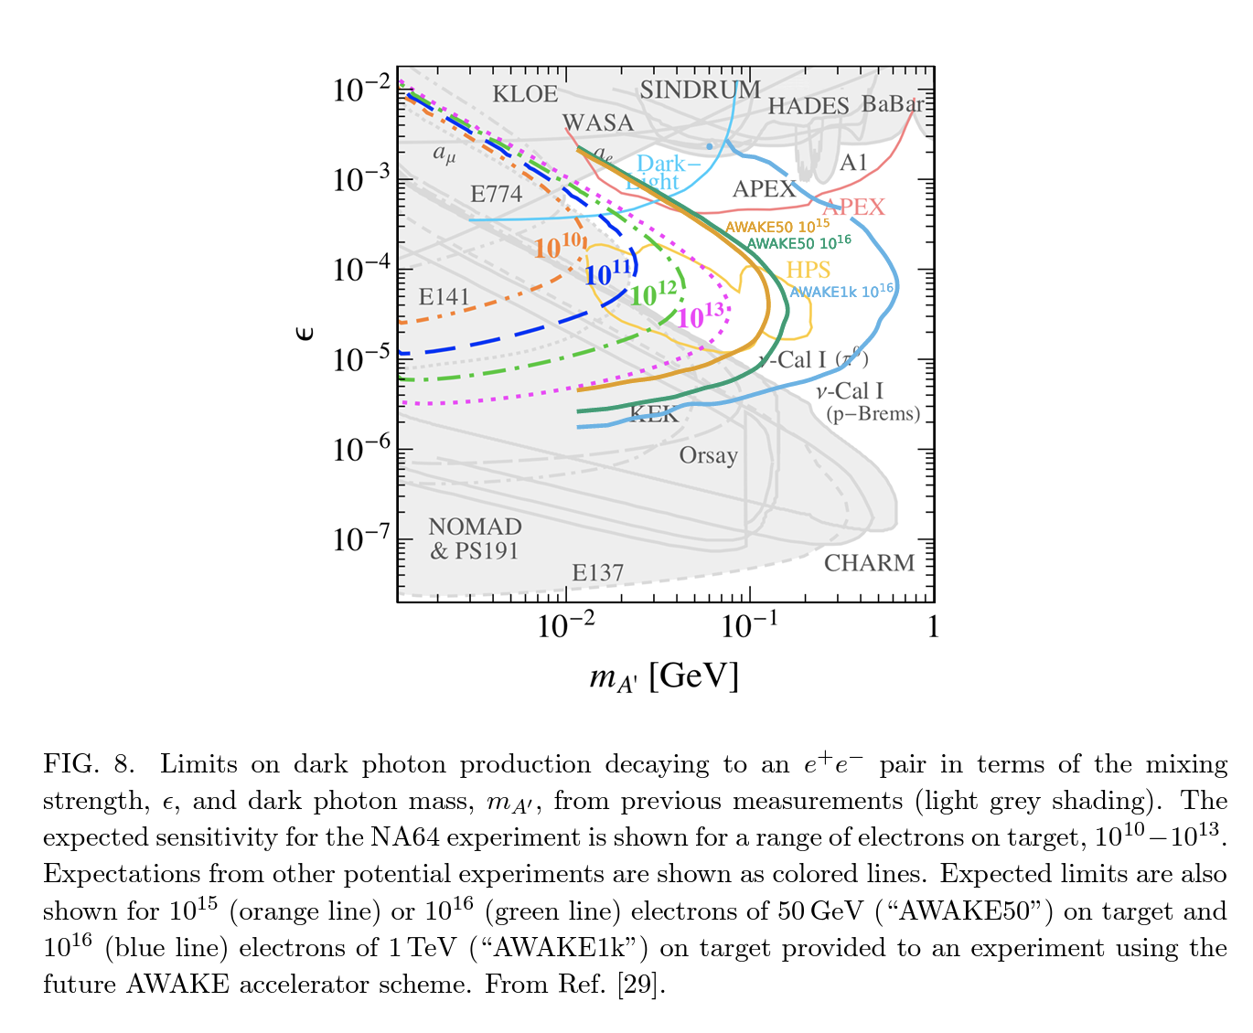
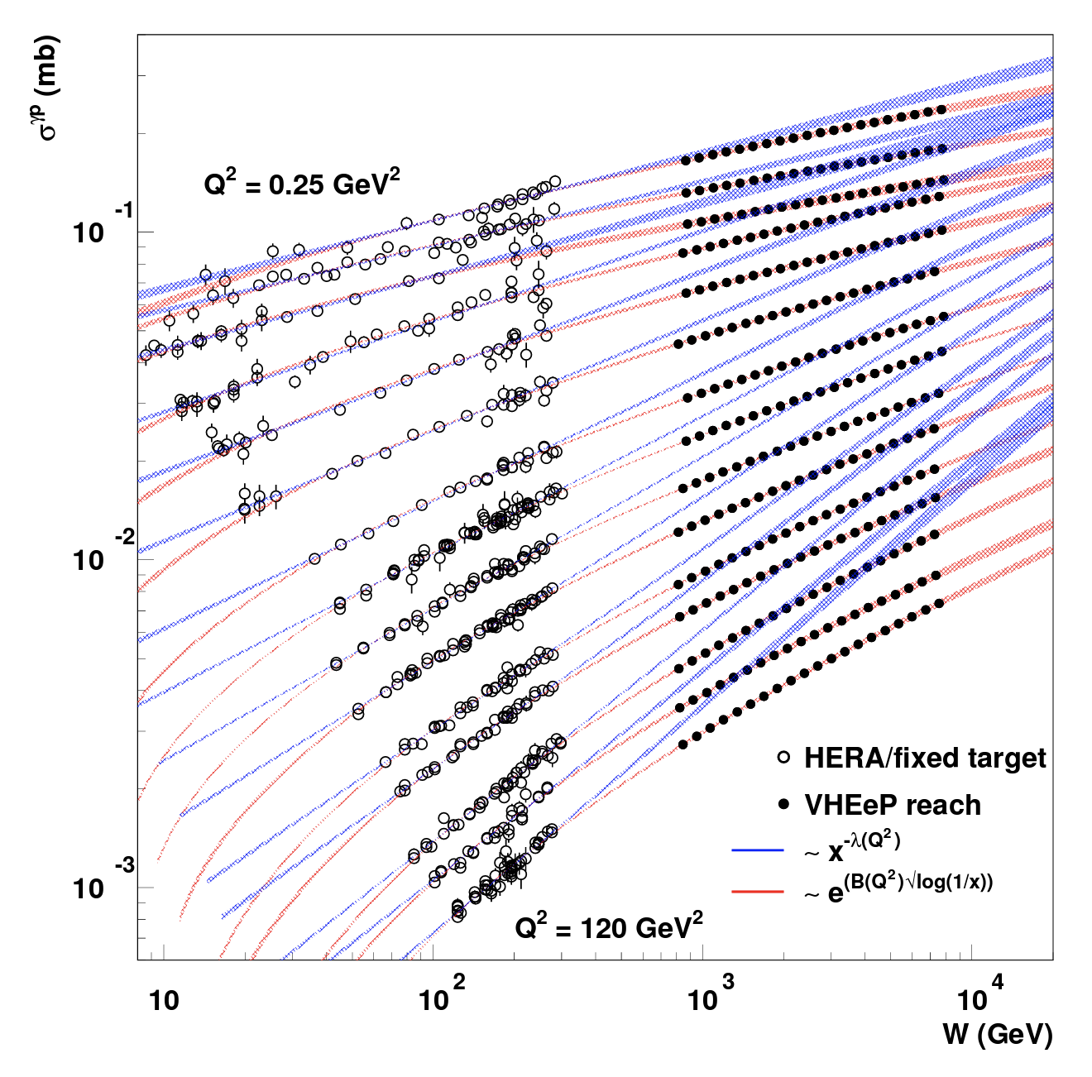
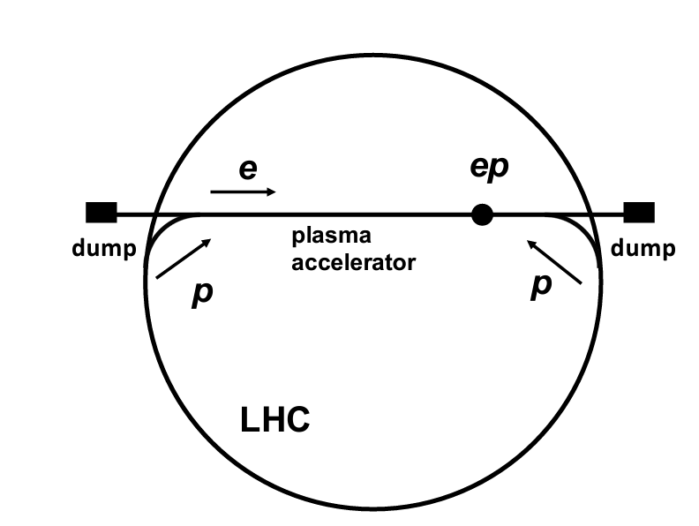
AWAKE Physics
ℒ Limited by p accelerator repetition rate – look for high-cross-section processes to compensate.

Slide 21
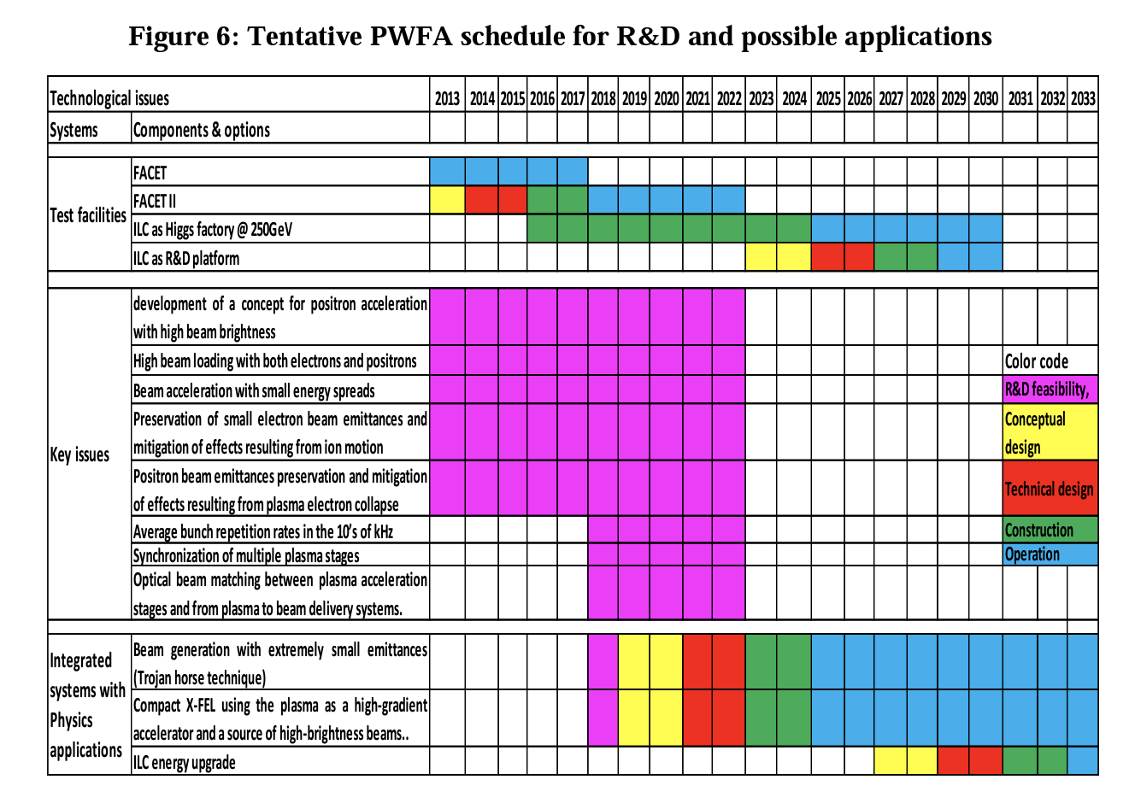
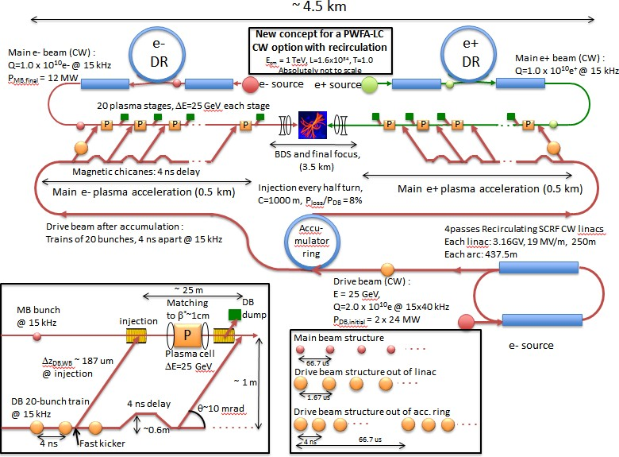
L/PWFA Colliders
Ideas around now for a long time.
Adli et al.,
arXiv: 1308.1145
Notes:
Adli is 2013

Slide 22
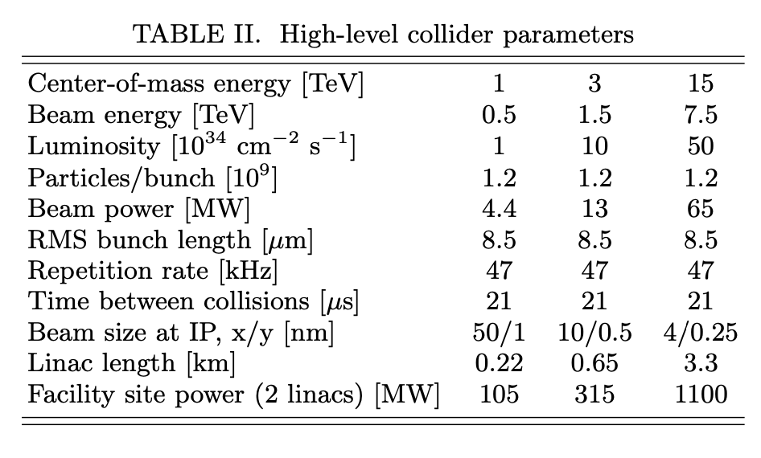
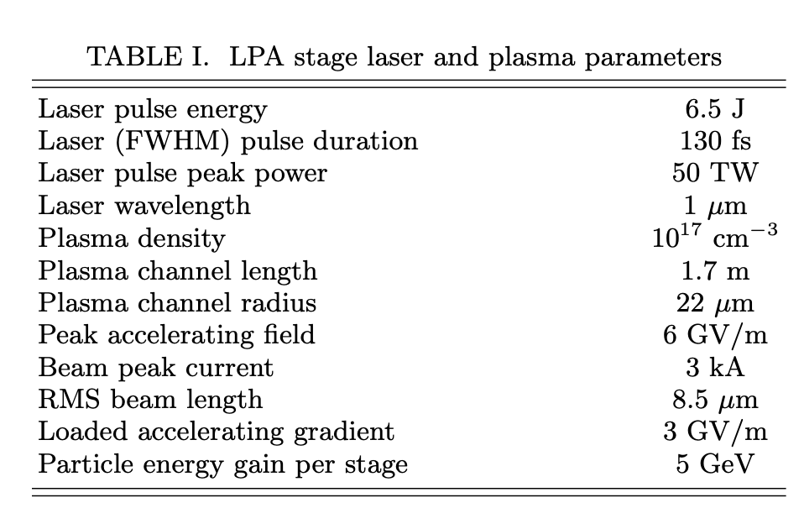
LWFA Colliders
Final Recommendations:
1. Vigorous research on LPAs in the (DoE) GARD program
2. Enhanced R&D on laser drivers
3. Near term LPA capability extensions
4. Integrated design study of a high energy (1–15 TeV) LPA collider
5. Study of a collider demonstration facility at intermediate energy
6. DOE-HEP workshop on advanced accelerator strategy
Benedetti et al.,
arXiv:2203.08366 –
Snowmass21 contribution

Slide 23
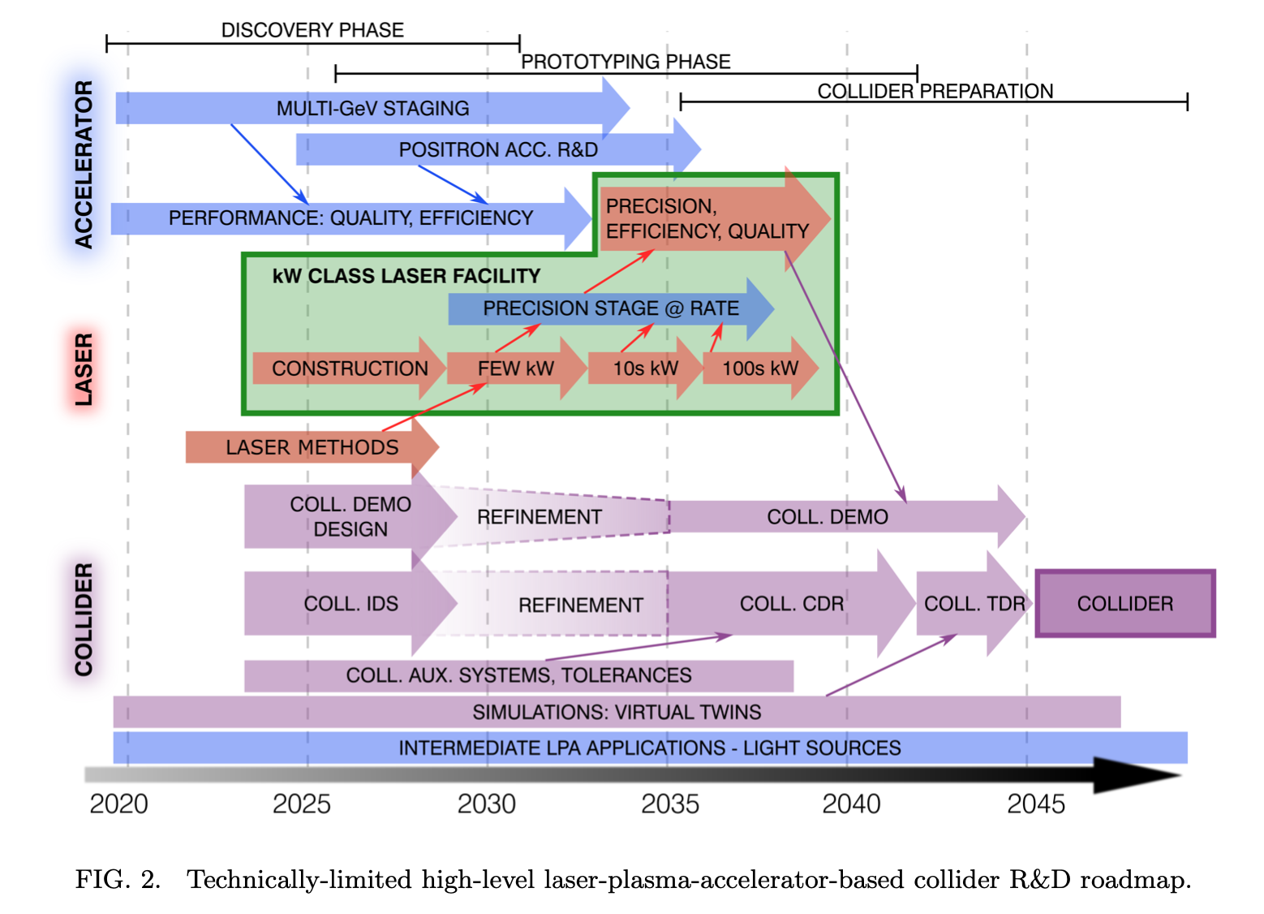
LWFA Colliders
Benedetti et al.,
arXiv:2203.08366 –
Snowmass21 contribution

Slide 24
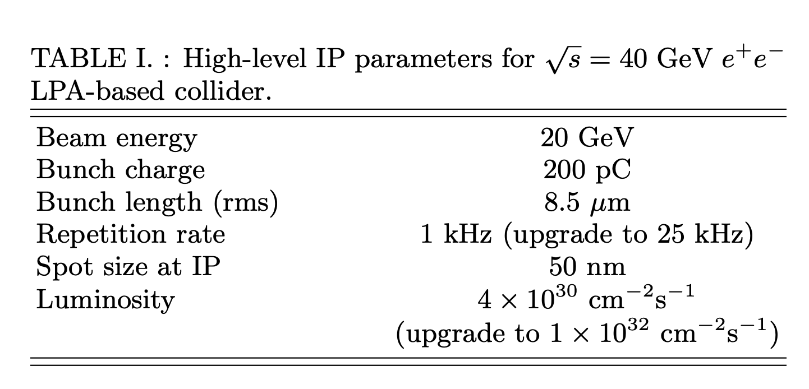
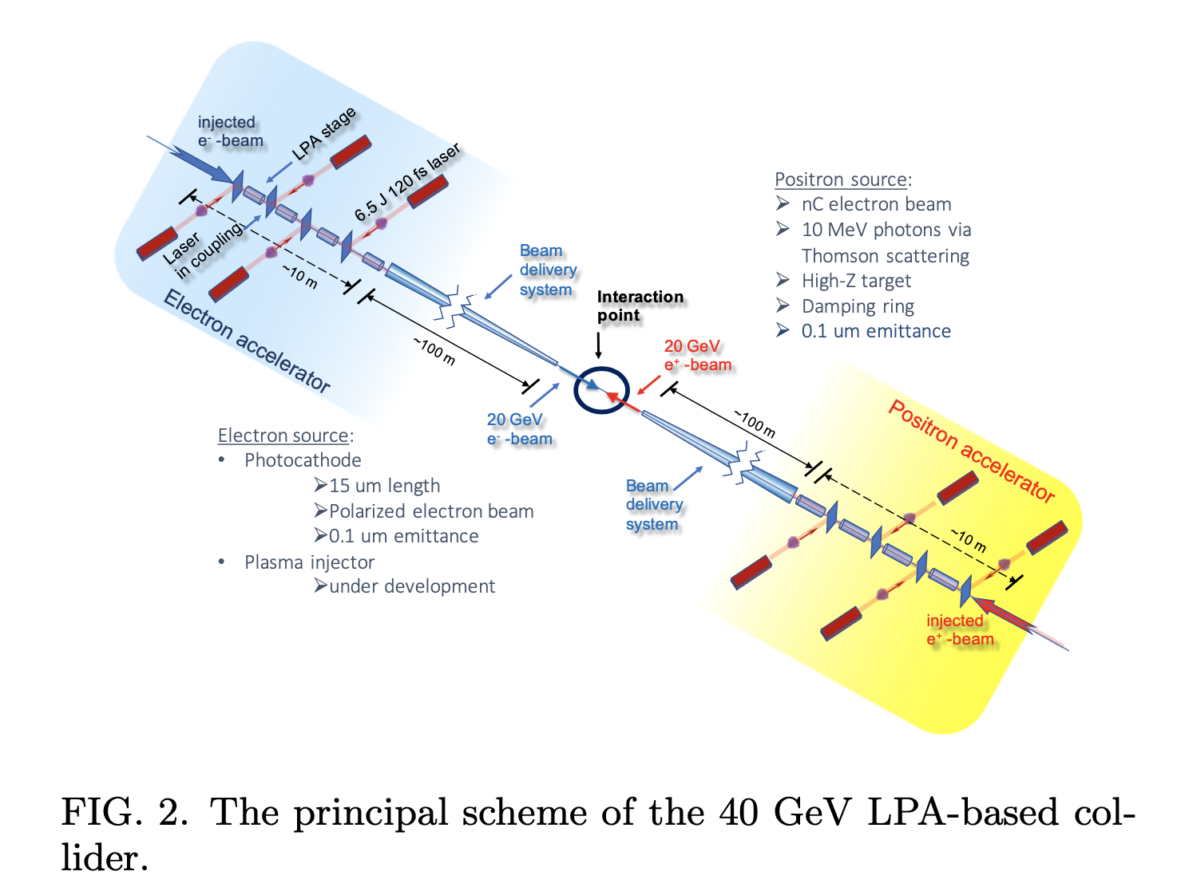
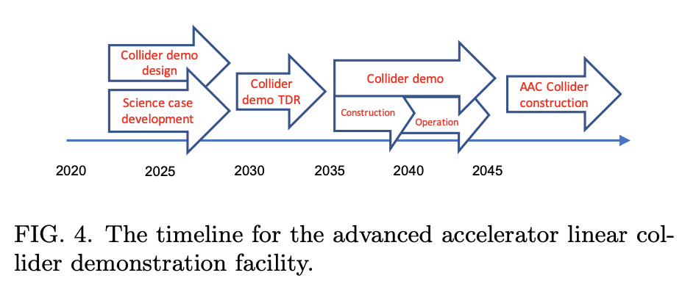
LWFA Demo Facility
Benedetti et al.,
arXiv:2203.08425
Snowmass21 contribution
Notes:
Remark on 40 GeV – TRISTAN valley of despair – get at least to Z0

Slide 25
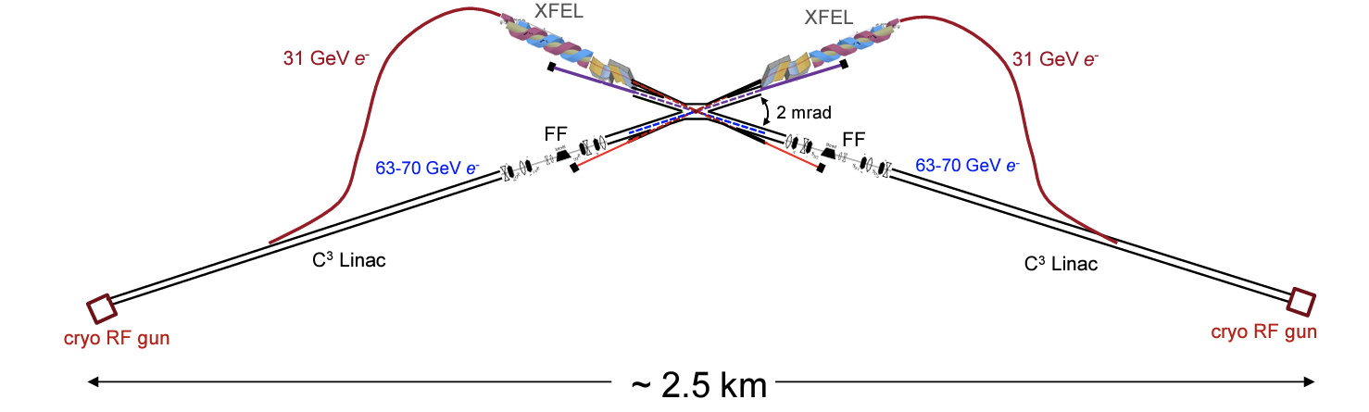
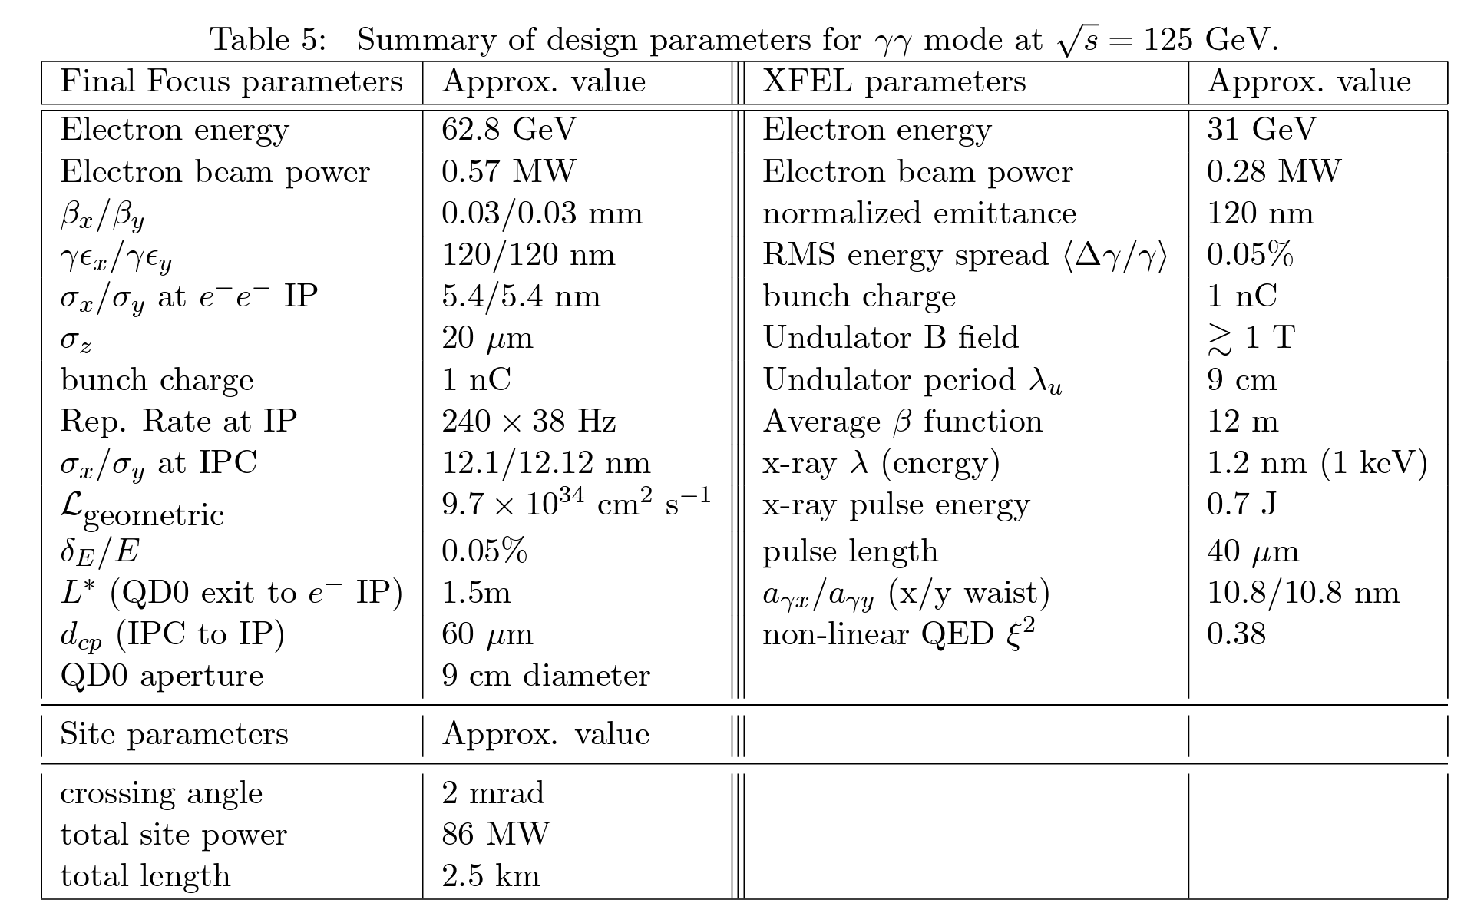
X-ray FEL-based γγ Collider
Higgs Factory
Technology is C³ @ 70 MV/m
Barklow et al,
arXiv:2203.08484
Snowmass21
See also
Barzi et al,
arXiv:2203.08353
Snowmass21;
Adli, JINST 17 (2022) 05,
T05006
Round beams may increase experimental backgrounds;
Beta functions highly challenging –
- tolerances!
But “easy” to imagine replacing
with PWFA –
Notes:
One way to avoid the positron problem is gamma-gamma – and cross section goes up like log s – also different sensitivity to various SM processes.

Slide 26
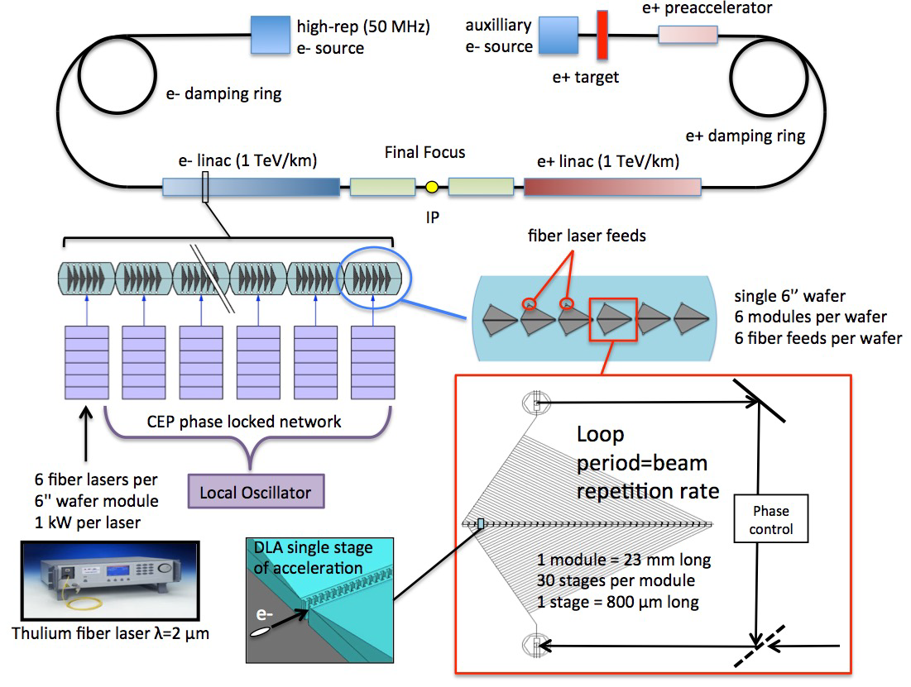
Structure-based acceleration
England et al,
arXiv:2203.08981
Snowmass21
Notes:
Also dielectric structures – plasmonics - get around positron problem – continuity of Maxwell’s Eqns charge blind – but smaller gradient. Assumption here is 1 GV/m.

Slide 27
Structure-based acceleration
Strawperson parameter table
Parameter | Units | 250 GeV | 3 TeV | 30 TeV
Center of Mass Energy | GeV | 250 | 3000 | 30000
Bunch charge | e | 3.8e4 | 3.0e4 | 3.0e4
# Bunches/train | # | 159 | 159 | 159
# Parallel Beamlines | # | 1 | 1 | 10
Train Repetition Rate | MHz | 20 | 20 | 20
Final Bunch Train Length | ps | 1.06 | 1.06 | 1.06
Single Bunch Length | µm | 2.8e-3 | 2.8e-3 | 2.8e-3
Drive Wavelength | µm | 2 | 2 | 2
IP X Emittance (Norm) | nm | 0.1 | 0.1 | 1
IP Y Emittance (Norm) | nm | 0.1 | 0.1 | 1
IP X Spot Size | nm | 2 | 1 | 1
IP Y Spot Size | nm | 2 | 1 | 1
Beamstrahlung Energy Loss | % | 0.6 | 1.0 | 2.6
Length of Beam Delivery | m | 2321 | 2304 | 2304
Effective L* | m | 5 | 5 | 5
Total Length | km | 5.0 | 8.4 | 42.1
Geometric Luminosity Enhanced Luminosity
_{cm}−2_{s}−1 _{cm}−2_{s}−1
1.46e33 | 3.63e33 | 3.63e35
1.84e34 | 3.19e34 | 3.19e36
Beam Power (per beam) | MW | 2.4 | 22.9 | 2292.5
Total Wallplug Power | MW | 88.1 | 360.3 | 30487.4
Wallplug Efficiency | % | 5.5 | 12.7 | 15.0
England et al,
arXiv:2203.08981
Snowmass21

Slide 28
Technological Readiness
Technology issue | LWFA | PWFA | DWFA | DLA | NCRF
Gradient limit | 100 GV/m | 100 GV/m | 10 GV/m | 1 GV/m | ½ GV/m
Wallplug efficiency | Mid term | Near term | Near term | Mid term | Done
Transformer ratio | - | Near term | Near term | - | -
Average power | Near term | Near term | Ready | Near term | Ready
Energy spread | Near term | Near term | Near term | Near term | Done
Emittance and transport | Near term | Near term | Near term | Mid term | Done
Positron | Long-term | Long-term | Ready | Ready | Done
Staging | Ongoing | Ready | Ongoing | Long-term | Done
Carlston et al,
J. Phys.1596 (2020) 012063
Notes:
DLA – Direct Laser Acceleration – NCRF – Normal Conducting RF

Slide 29
Application Readiness
Application | LWFA | PWFA | DWFA | DLA | Cyro NCRF
Light sources | Near to mid | Near to mid | Near | Mid to long | Near
HEP add-ons | Near to mid | Near to mid | Near | Unknown | Near
e- only HEP | Mid to long | Mid to long | Near to mid | Unknown | Near
Multi-TeV ALIC | Long | Long | Mid | Unknown | Near to Mid
10-TeV ALIC | Longer | Longer | Not suitable | Unknown | Not suitable
Carlston et al,
J. Phys.1596 (2020) 012063

Slide 30
Asymmetric Hybrid Higgs Factory
Another way to avoid the e⁺ problem - use conventional technology and
reduce cost by reducing energy. Obviously, this boosts the collision frame.
Some simple relativistic kinematics:
E_{cm}= 2sqrt(E₁E₂); gamma = (E₁+E₂)/E_{cm}
For HERA, γ of CM was (27.5+920)/318 = ~3
For an e⁺e⁻ Higgs factory assume E_{cm} =125 GeV; for same γ as Hera,
E₁E₂ = 125*125/4 and E₁+E₂ = 3*125, which has solution for roughly
E₁ ~ 10.7 GeV, E₂ ~ 364.3 GeV.
Notes:
Local correcting BDS can shorten to ~500m/arm but has drawbacks. Garcia Morales and Tomás García
Phys. Rev. ST Accel. Beams 17, 101001 (2014)

Slide 31
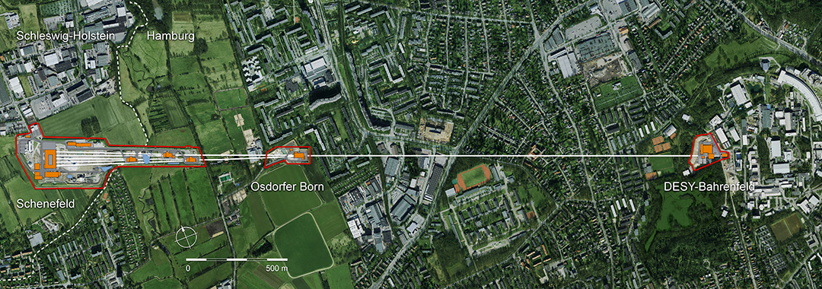

Asymmetric Hybrid Higgs Factory
A HH Factory
Why not use E-XFEL, with added e⁺ source @ 17.5 GeV? For E_{cm} =125 GeV, E_{e-} ~223 GeV => γ ~ 2. Assuming 1 GV/m PWFA then:
2 km
e-
e⁺
BUT BDS!
e-
e⁺
2 km
Notes:
Local correcting BDS can shorten to ~500m/arm but has drawbacks. Garcia Morales and Tomás García Phys. Rev. ST Accel. Beams 17, 101001 (2014). Problems: ZEUS no longer exists; beam-beam worse & low-energy beam disruption – someone has to tell EXFEL people that we need their machine. Wim & Beate?

Slide 32
Final Remarks
We have promised a lot on the applications of L/PWFA to pp. Progress but so far no application in the real world. Credibility not helped by propagating unrealistic timescales.
3T & 7.6m
Afterburners etc. have to accept beam parameters from conventional machines. Proper proposal for PWFA collider needs to start from tabula rasa to optimise bunch numbers & structure, currents etc. Shorten BDS – plasma lenses?
24/7 reliability! Long periods – weeks - of stable operation!
High power/repetition rate/efficiency!
Positrons! Some distance from a solution that could be applied to a real machine. FACET-II!
Maybe hybrid solutions – either with conventional or structure acceleration – or γγ - are the way forward?
For e⁺e⁻ particle physicists – boosted systems don’t bite!

Slide 33
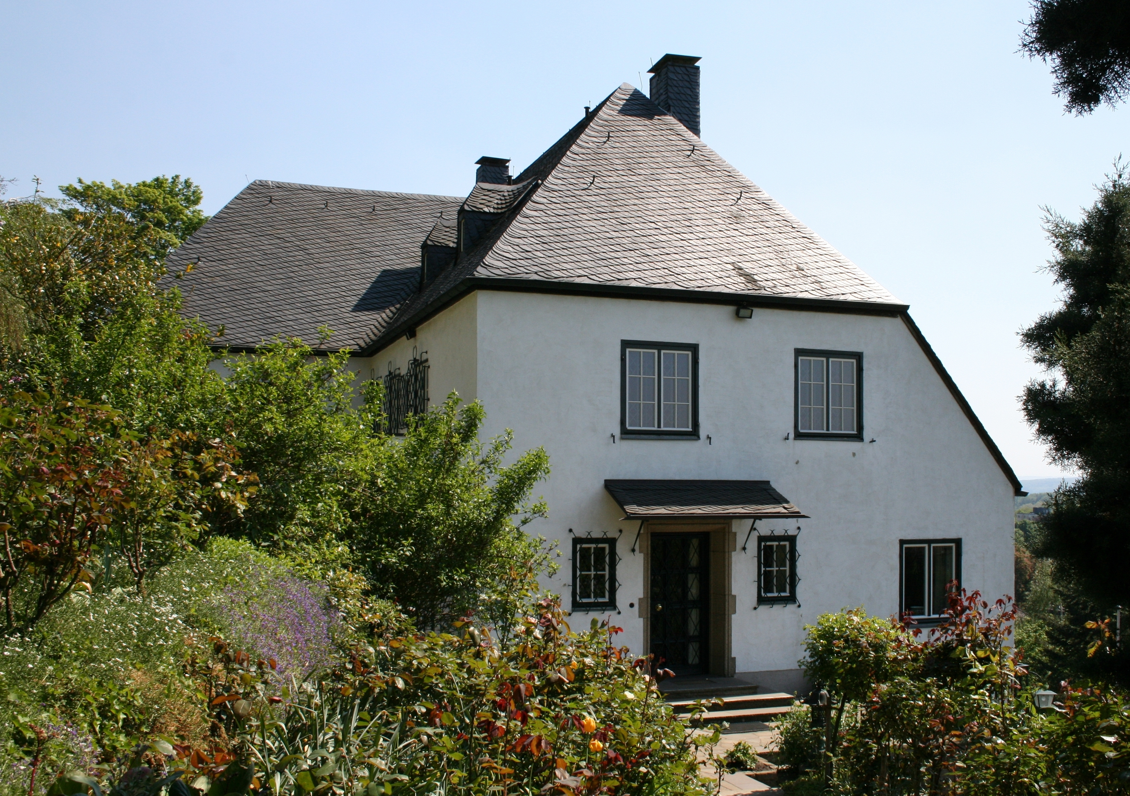
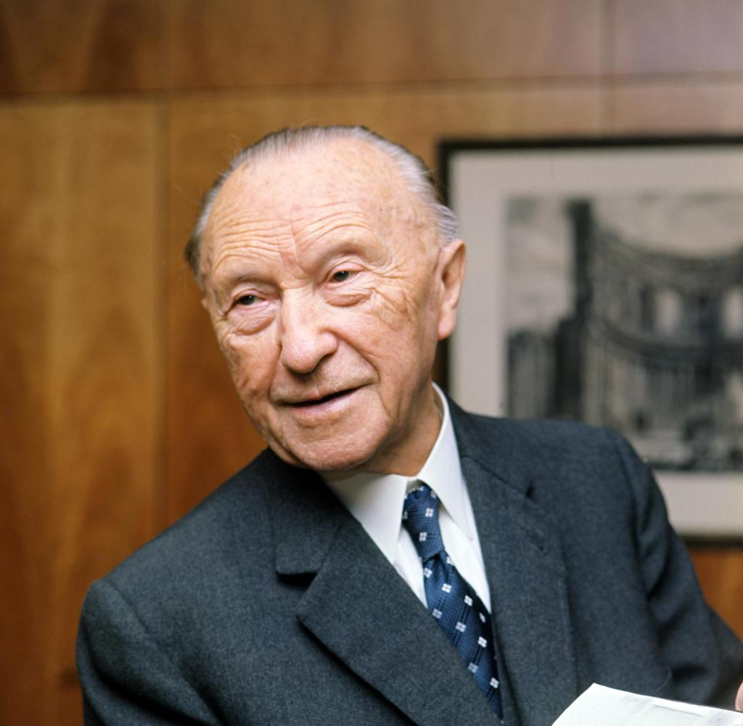
A Final Thought
Konrad Adenauer: “When everybody else thinks it is the end, we have to begin.”
Acknowledgements & thanks: R. D’Arcy, C. Lindstrøm, J. Osterhoff.
Notes:
Local correcting BDS can shorten to ~500m/arm but has drawbacks. Garcia Morales and Tomás García
Phys. Rev. ST Accel. Beams 17, 101001 (2014)

