Slide 1
Laser technology for Accelerators
Dr. Laura Corner
laura.corner@liverpool.ac.uk
University of Liverpool, Cockcroft Institute for Accelerator Science

Slide 2
Applications for particle accelerators
LWFA is a promising technology for high gradient particle acceleration - source of compact, perhaps cheaper accelerators.
But only with high efficiency drive systems – rf klystrons 40 – 50%, prototypes up to 80 or 90%.
What’s a perfect laser driver?
High peak power
High average power
High rep rate
Short pulse length
High efficiency
Excellent beam quality
800 nm? I μm? CO₂ @ 10μm?
How short?
Wavelength?
Multipulse? Modulation of ps pulses? Extermal injection? MOPA? Different injection & acceleration stage lasers?
kHz? 100s kHz? MHz?
Lasing medium?
How high rep rate?
One that works!!
What’s out there?

Slide 3
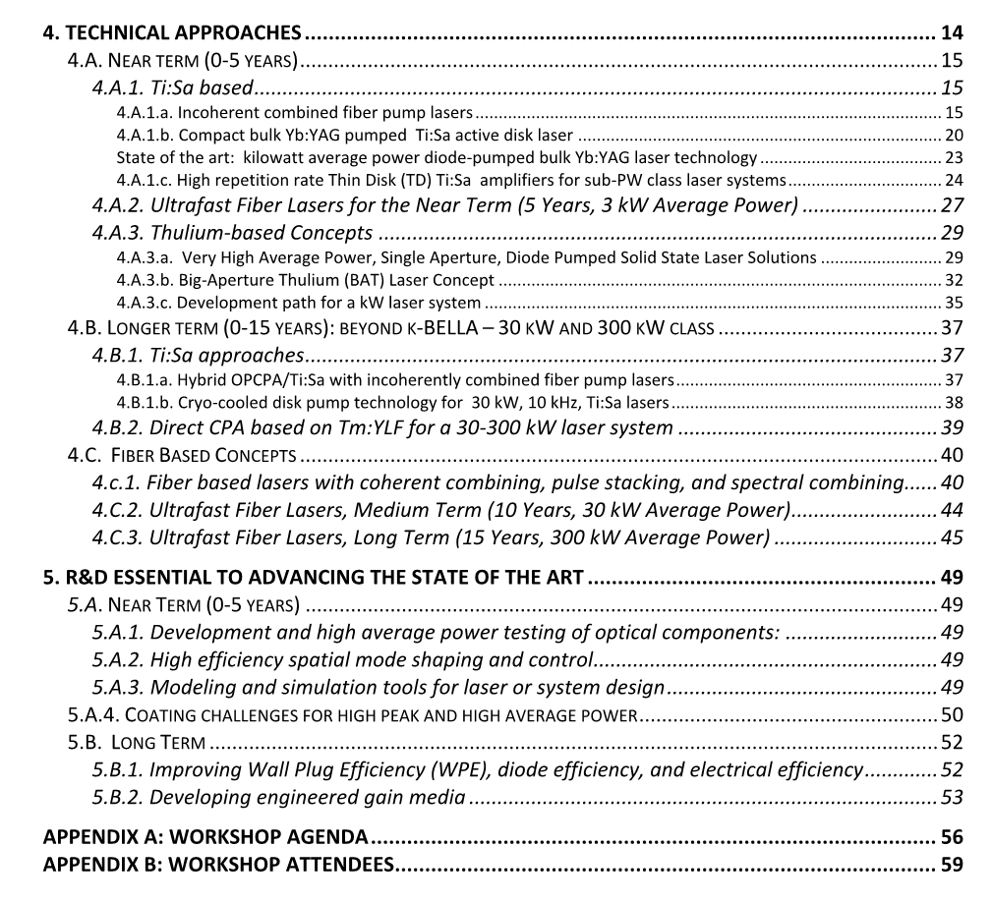
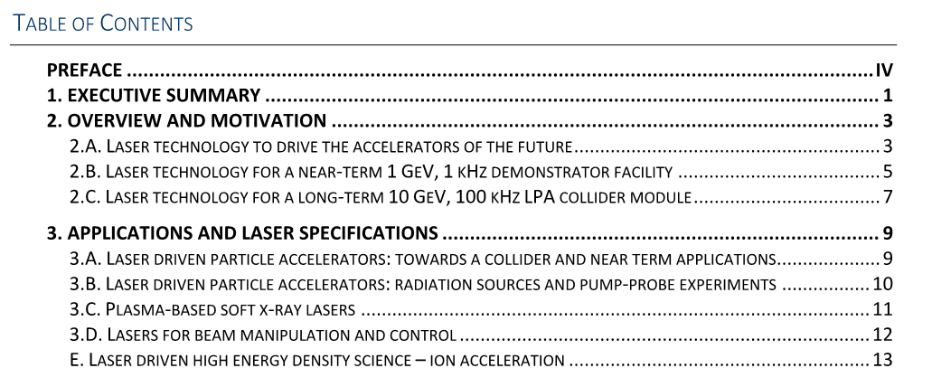
Technology Options
3

Slide 4
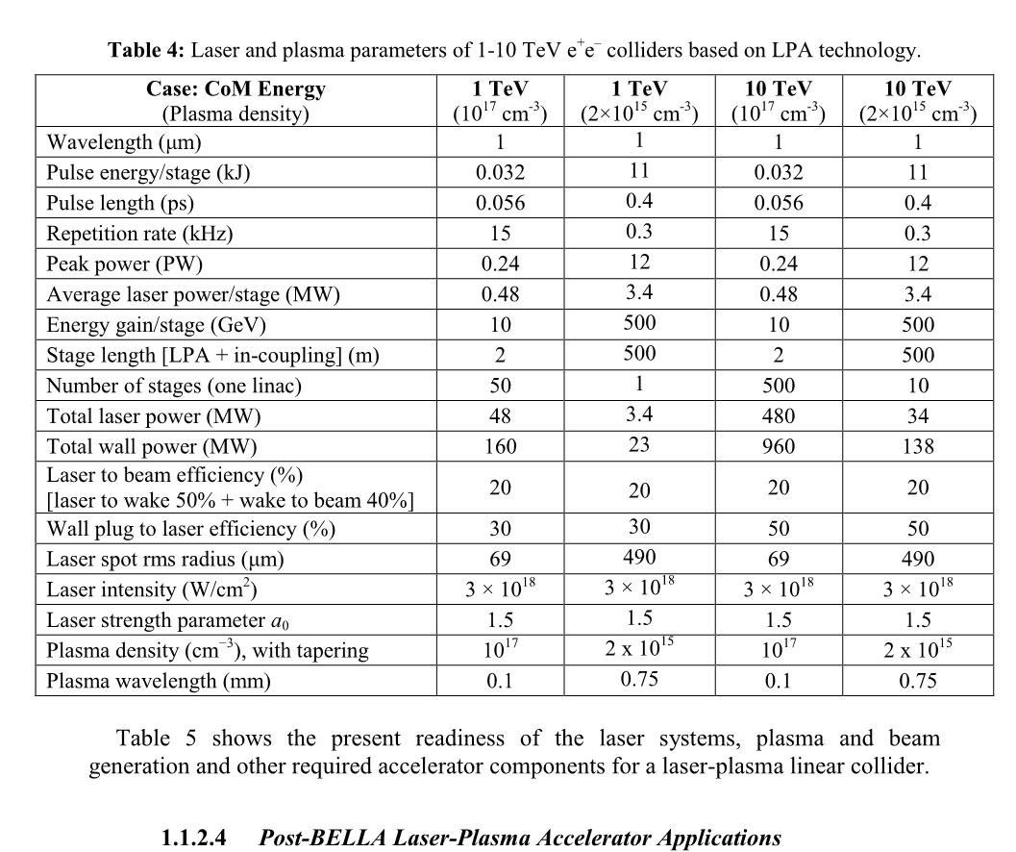
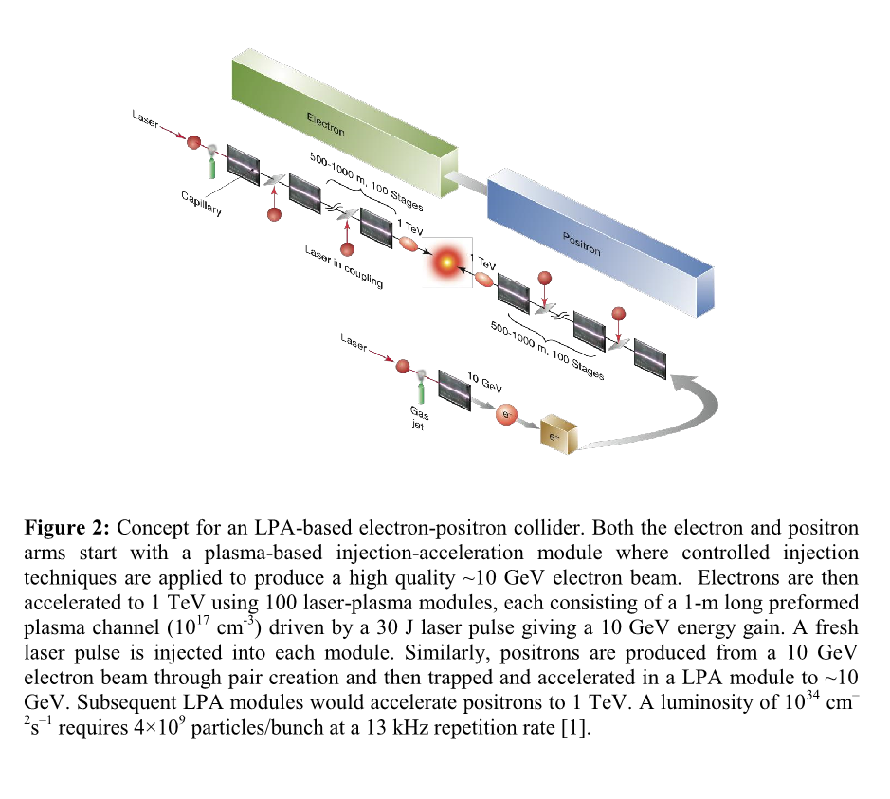
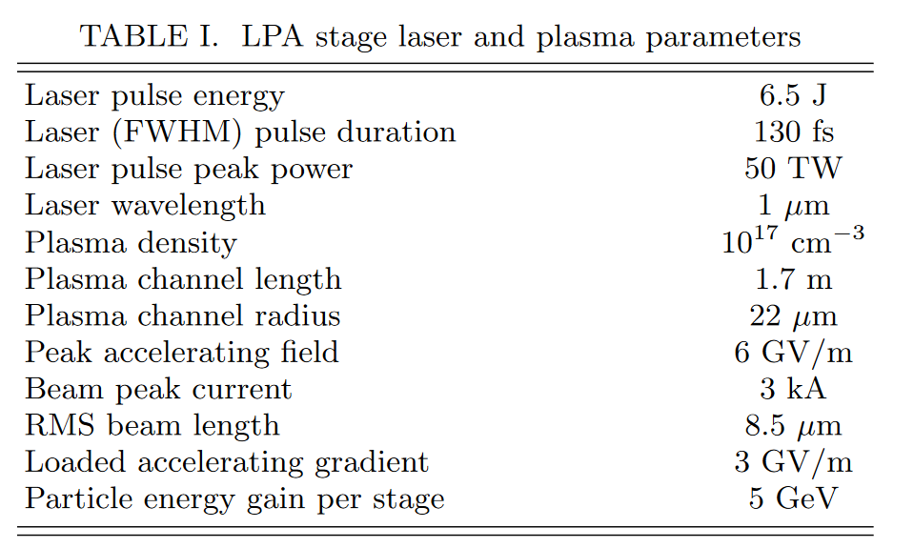
Laser requirements
Benedetti et al.
arXiv:2203.08366
https://www-bd.fnal.gov/icfabd/WhitePaper_final.pdf
4

Slide 5
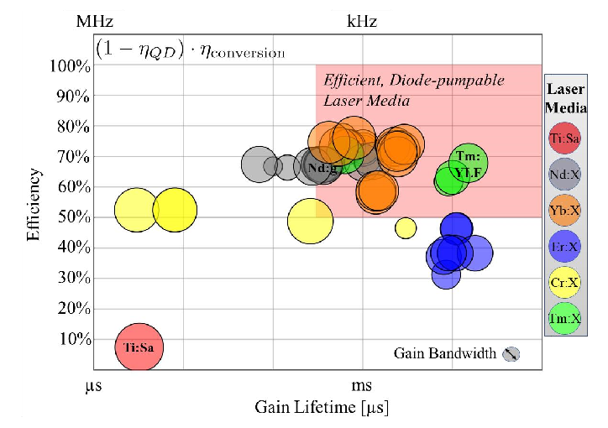
Laser Medium Options
5

Slide 6
Thulium Lasers
Imperial College, 30th Oct 2019
6

Slide 7
7

Slide 8
Fibre lasers
Optical waveguides.
Light guided and amplified in core doped with lasing ions.
Er ~ 1.5μm, Yb ~ 1μm, Tm ~ 2μm.
Efficient – core (or inner cladding) pumping.
High average power – 10s – 100s kW.
Excellent single mode quality – intensity/modelling/efficiency.
Core – ion doped,
~ few μm diameter
Cladding – few
100 μm diameter
8

Slide 9
Fibre lasers and amplifiers
9

Slide 10
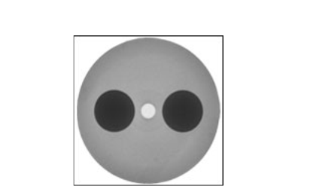
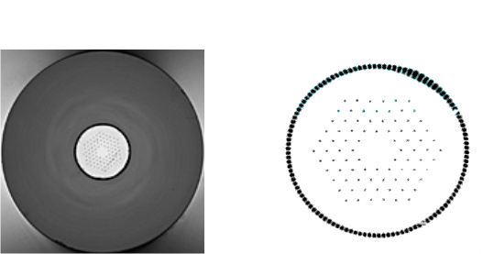
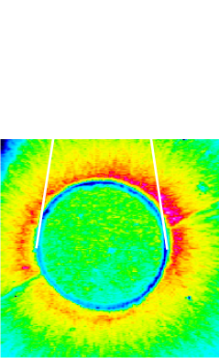
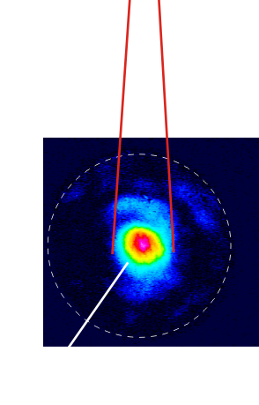
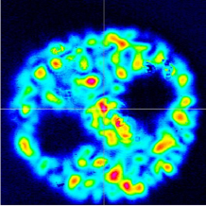
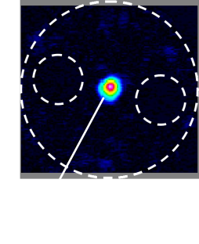
10

Slide 11
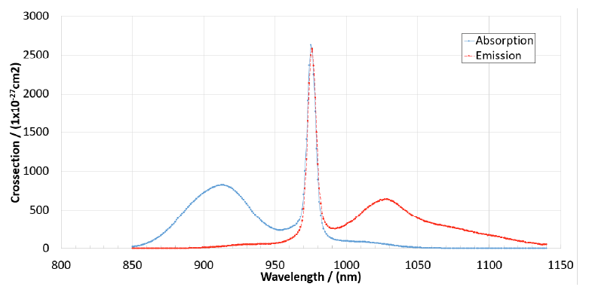
Efficiency
quantum
defect
Fibre lasers:
Yb – low quantum defect.
Direct diode pumping nir (@976nm).
Optical-optical 80%.
WPE 40%.
Single mode – efficiency at focus.
Air/water cooled.
Yb:glass
Current laser drivers for LWFA:
High peak power (100s TW/PW systems, J, <100 fs)
Low repetition rates ~ 1Hz (low average power)
Inefficient – expensive to run
Fibre lasers:
High repetition rates (> kHz)
Low pulse energy (~ mJ)
Single fibres considered limited to < 10GW peak power (Schimpf et al. J. Opt. Soc. Am. B. 27 20151 (2010))
Can we use this technology to make both high peak and average power lasers?
Make many low energy pulses into one high energy pulse – coherent combination
11

Slide 12
Coherent combination
Tiled aperture v. filled aperture
Tiled aperture:
Beams placed alongside each other.
Combined in the far field.
No beam combination element.
Inherent < 100% combination.
Energy in side lobes.
Phase control.
Filled aperture:
Beams combined in near and far field.
Beam combination element(s) required.
Scaling with channel number?
Phase control.
Review: Fathi et al., Photonics 8, 566 (2021)
12

Slide 13
Tiled aperture

Slide 14
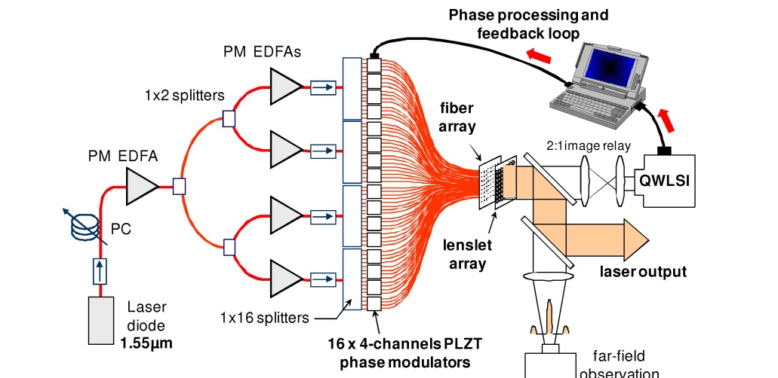
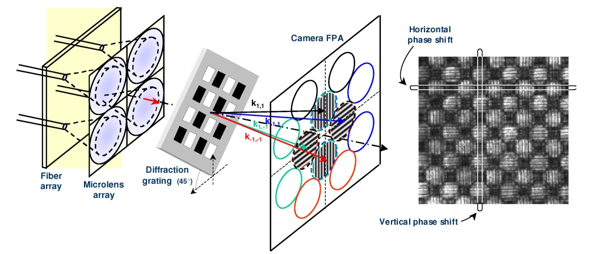
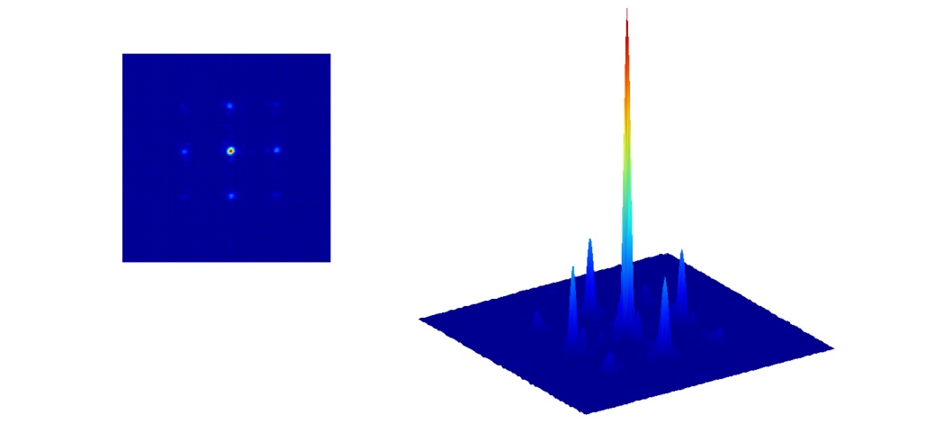
Tiled aperture combination
Bourderionnet et al.,
Op Exp 19, 17053 (2011)
Signal split and amplified in 64 cw fibres with integrated phase modulators.
Light collected in microlens array.
Phase between adjacent fibres analysed in quadriwave lateral shearing interferometer.
34% beam in central lobe (cf 44% theoretical).

Slide 15
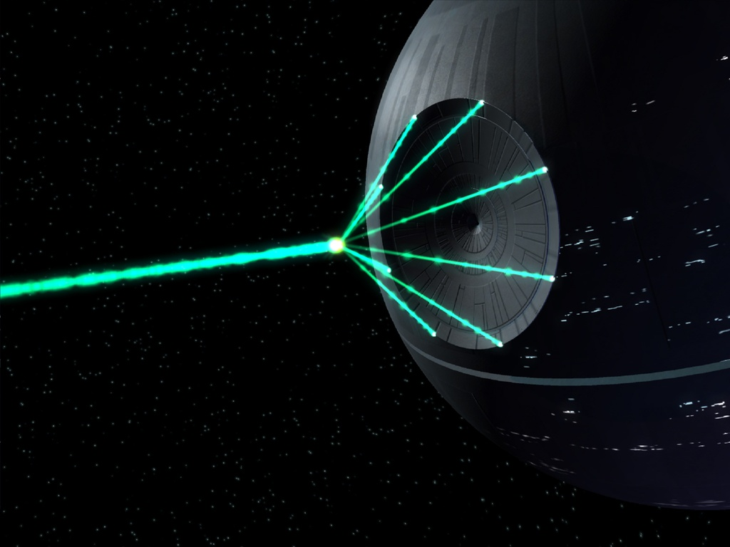
Filled aperture combination
Binary tree example – polarisation combination and locking
Limits of beam splitter based combining:
Müller et al., Opt. Exp. 29, 27900 (2021)
15

Slide 16
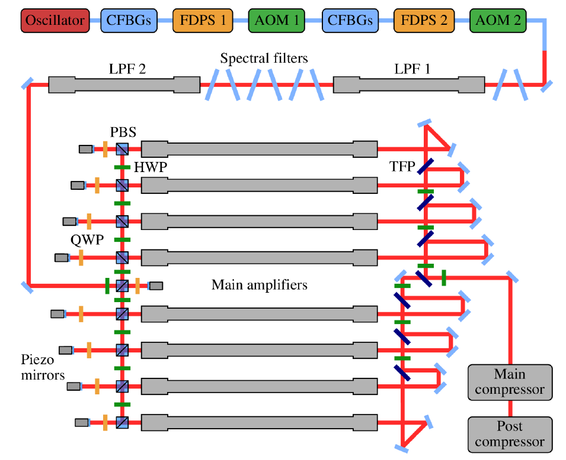
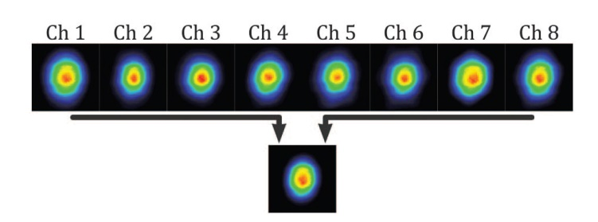
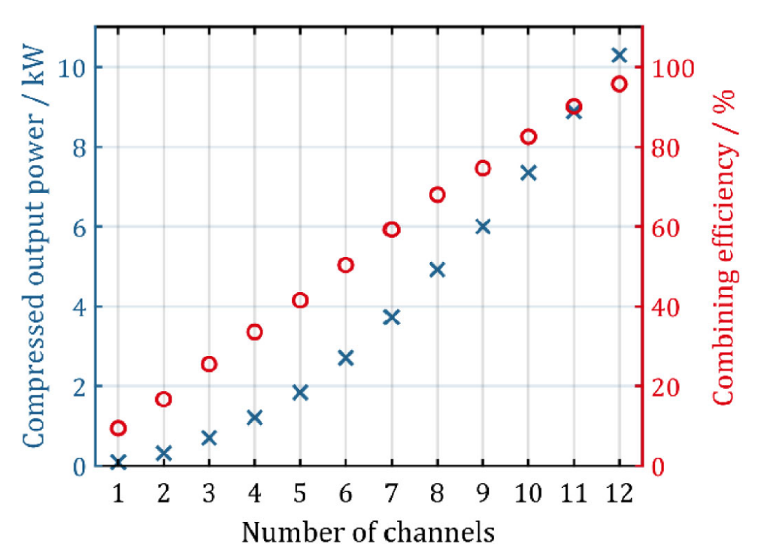
Polarisation combination
Müller et al., Opt. Letts. 41, 3439 (2016)
Stark et al.,
Opt. Letts. 46, 969 (2021)
Müller et al., Opt. Letts. 45, 3083 (2020)
Seed split and amplified in large pitch photonic crystal fibres.
Polarisation – piezo mirror phase control.
1 MHz, 1.1mJ, 1kW, 8 fibres (2016).
80MHz, >10kW, 254fs, 12 fibres (2020).
100kHz, 10mJ, 1kW, 120fs, 16 fibres (2021).
Does not scale gracefully to > 1000 fibres.

Slide 17
Commercial systems
17

Slide 18
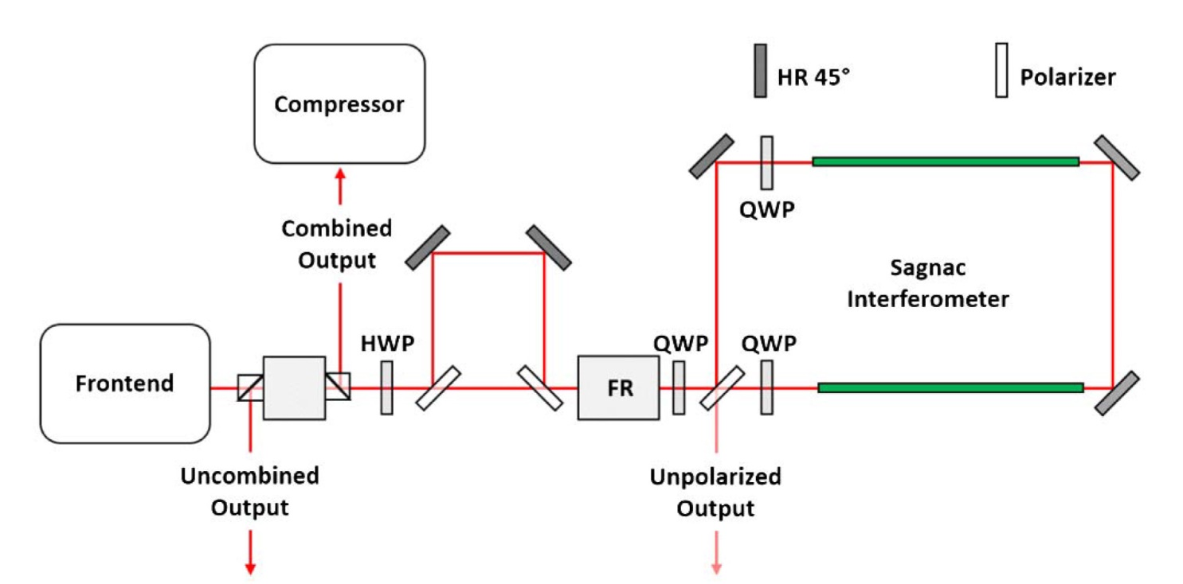
Passive combination
Guichard et al.,
Opt. Letts. 40, 89 (2015)
Passive set up – no stabilisation.
Uses divided pulse amplification as well as spatial combination.
Seed split into train of 2 pulses, then split spatially and directed oppositely.
Train split into 2 pairs and sent in opposite directions around Sagnac interferometer.
Interferometer has 2 photonic crystal fibres for amplification.
Recombined beam extracted and compressed.
18

Slide 19
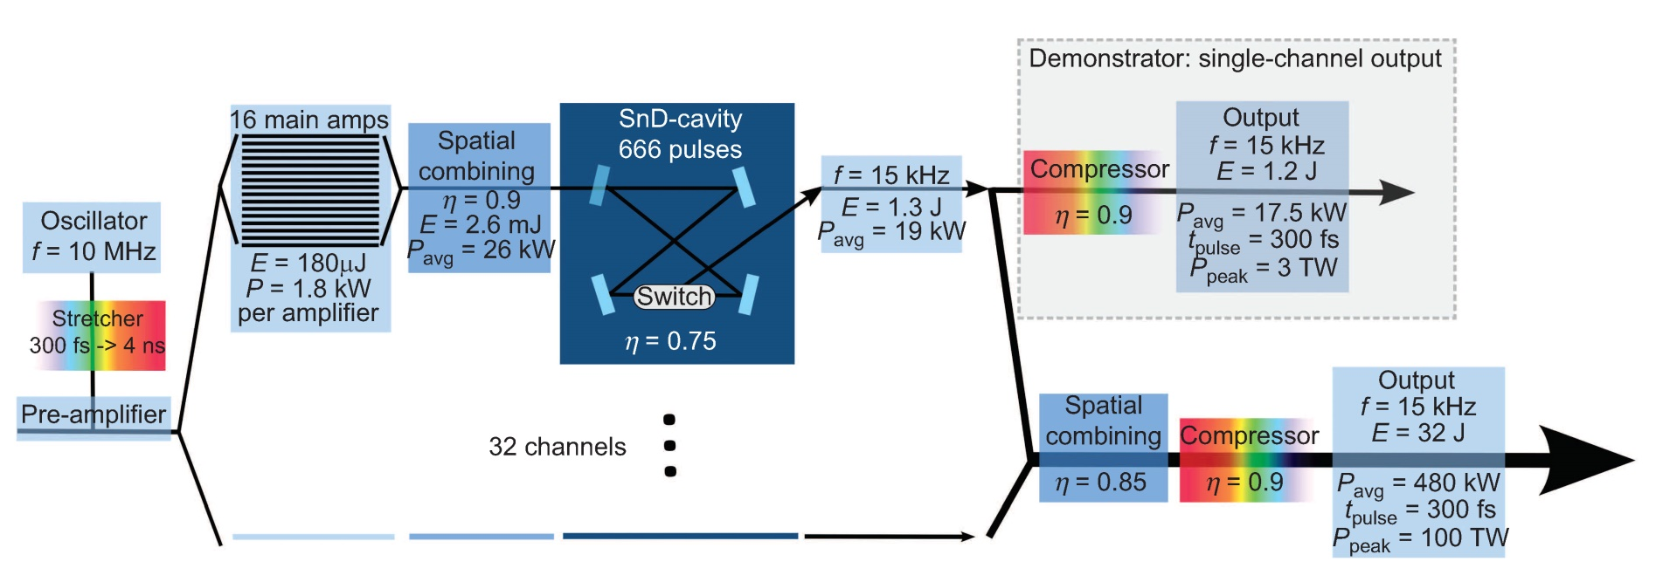
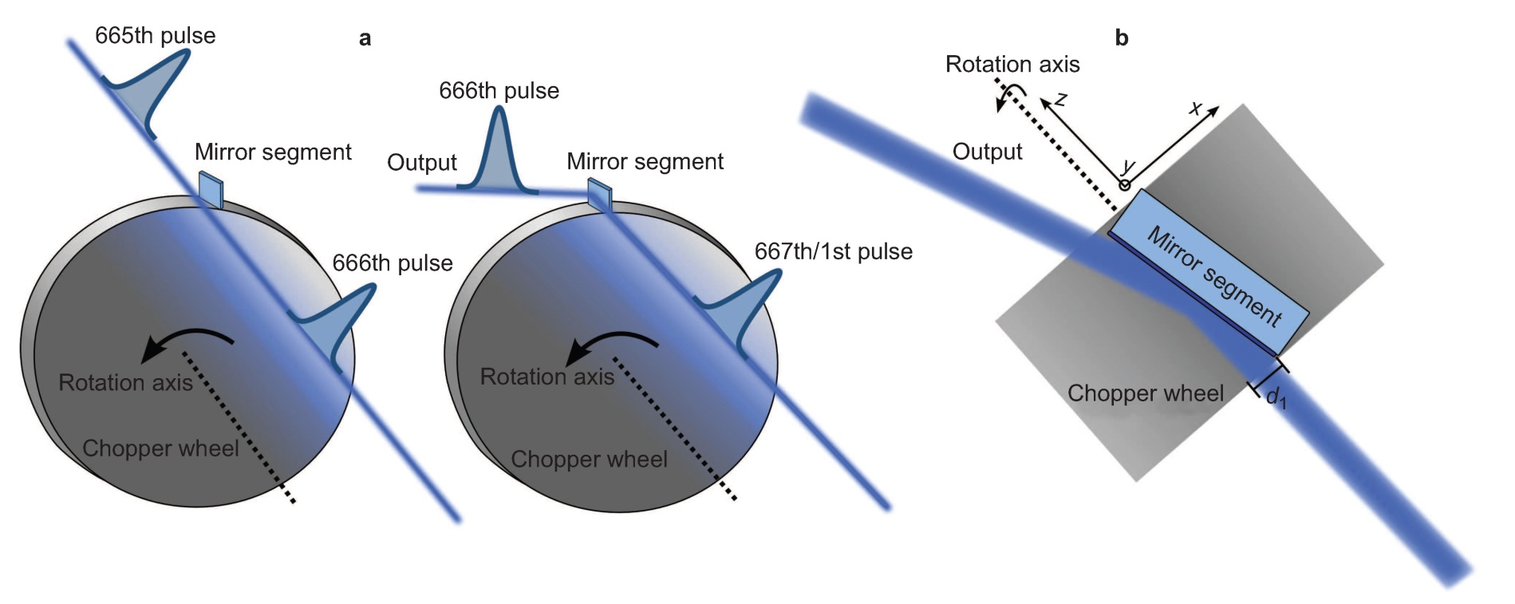
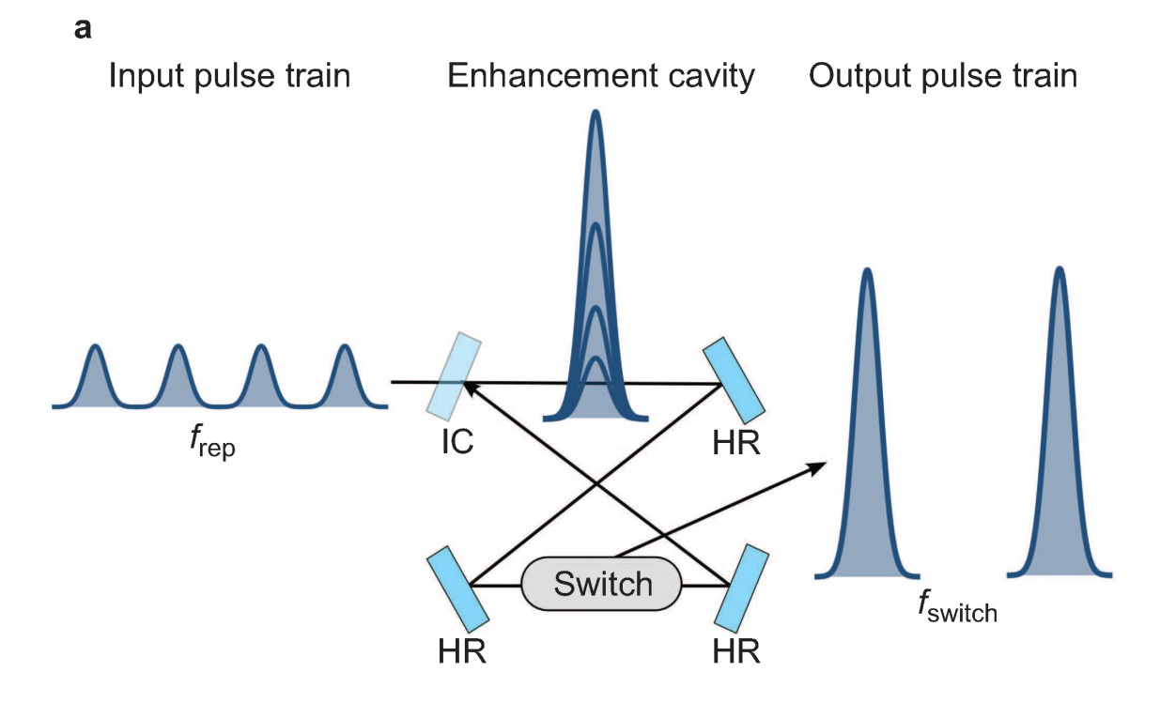
Enhancement cavities
Breitkopf et al., Light Sci. Appl. 3, e211 (2014)
Breitkopf et al. Appl. Phys. B 122, 297 (2016)
19

Slide 20
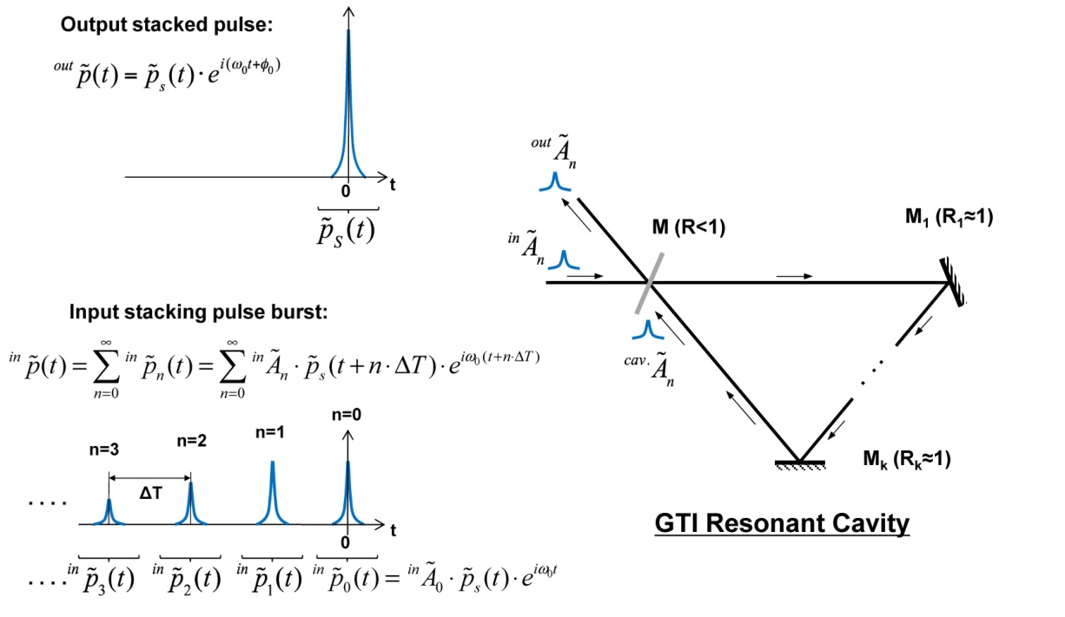
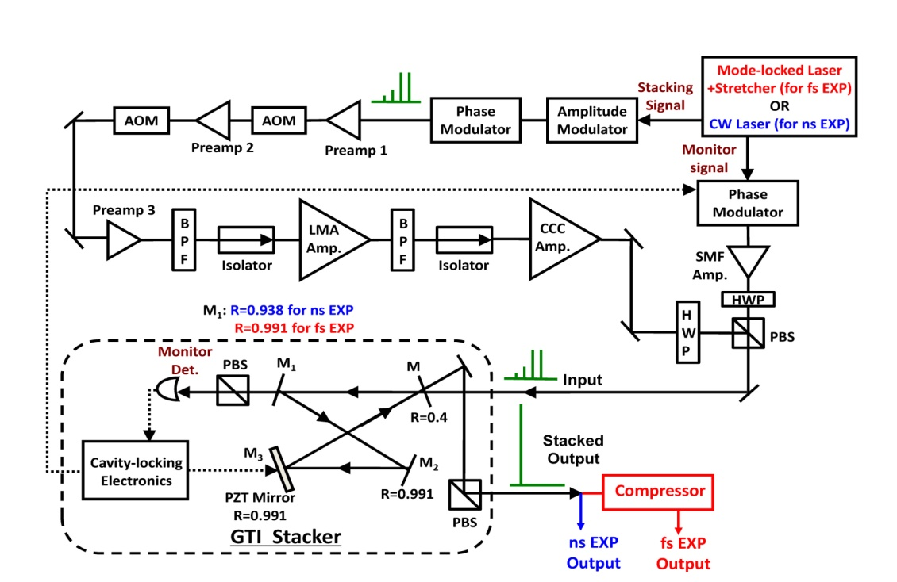
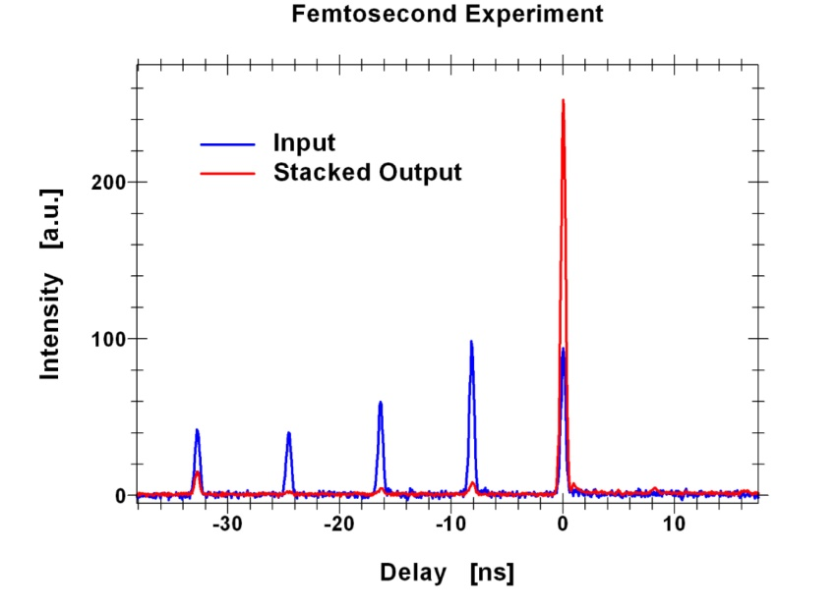
Enhancement cavities
Zhou et al., Opt. Exp. 23, 7442 (2015)
20

Slide 21
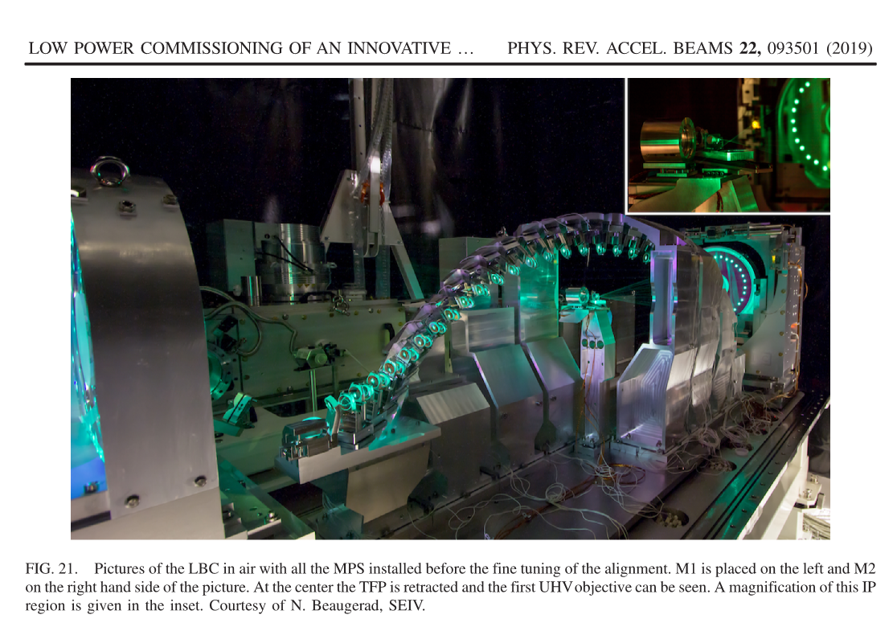
Optical cavities
Optical cavities
Laser Beam Circulator for γ source, ELI-NP, Romania

Slide 22
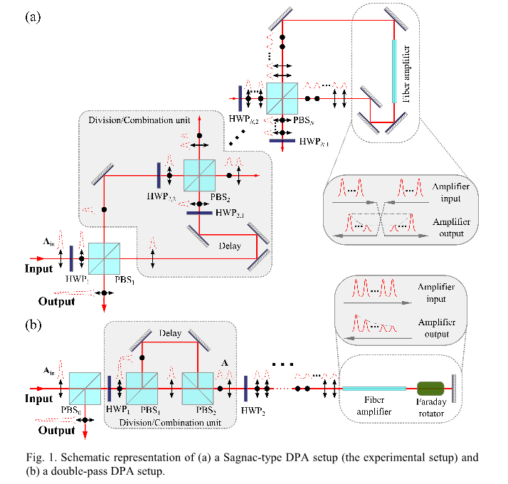
Divided pulse amplification
Split single pulse in time.
Effectively artificially stretch pulse duration.
More efficient extraction of stored energy.
Reduces nonlinear phase for recombination.
M. Kienel et. al., Opt. Exp. 21, 29031 (2013)
22

Slide 23
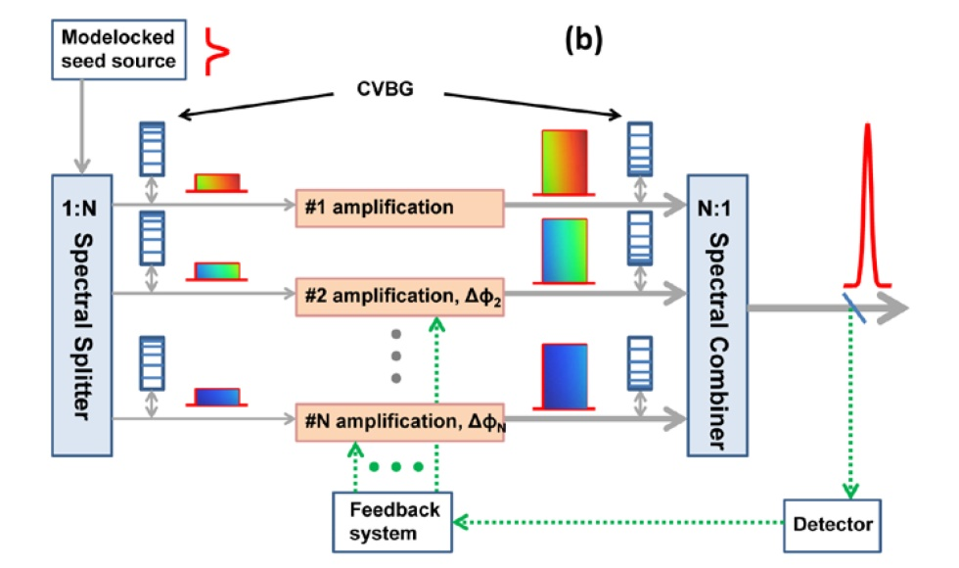
Spectral combination
Chang et al., Opt. Exp. 21, 3897 (2013)
Seed split spectrally with filters and amplified in different fibre channels.
Amplified pulses combined on spectral filters and compressed.
Feedback from TPA detector.
23

Slide 24
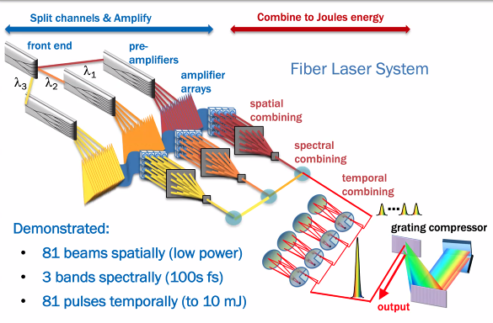
Do everything!
Concept: R. Wilcox, A. Galvanauskas, W. Leemans
https://www2.lbl.gov/LBL-Programs/atap/Report_Workshop_k-BELLA_laser_tech_final.pdf
24

Slide 25
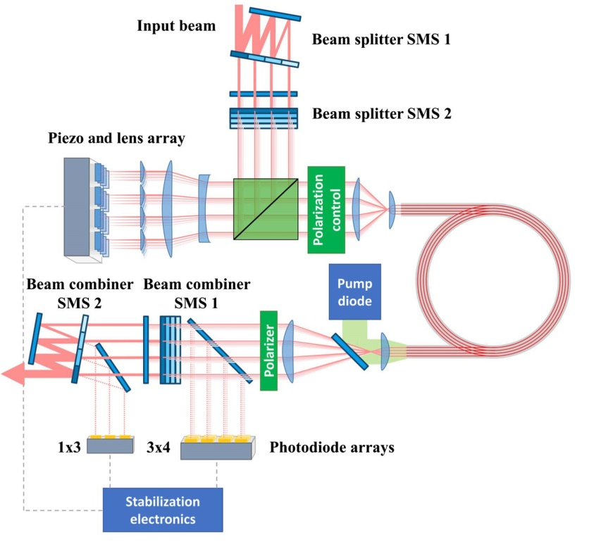
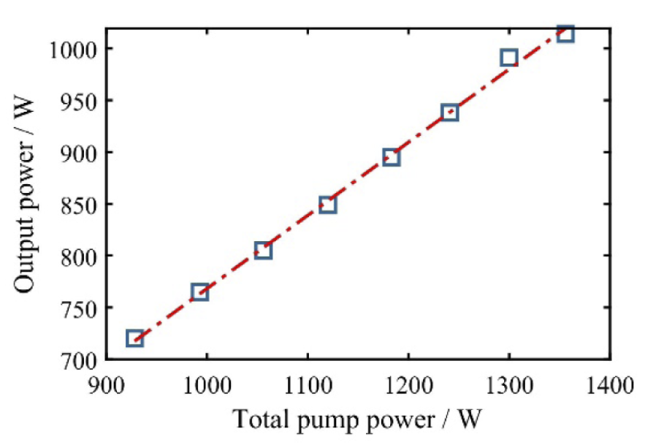
Multicore fibres
Klenke et al.,
Opt. Letts. 43, 1519 (2018)
Efficiency!
Use multicore fibre.
Less phase difference to correct.
Fewer channels.
ps pulses – 70W, 40ps.
fs pulses – 500W & 600mJ, 500fs.
Klenke et al., Opt. Letts. 47, 345 (2021)
25

Slide 26
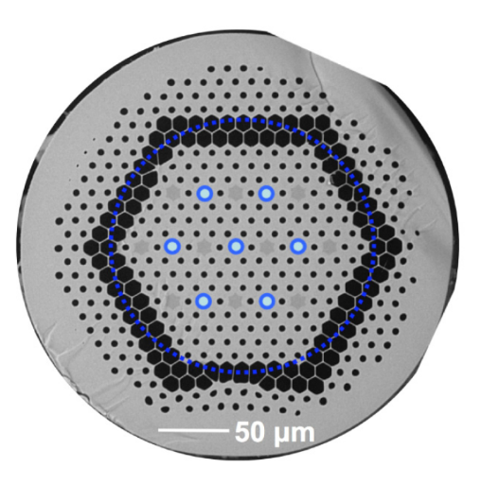
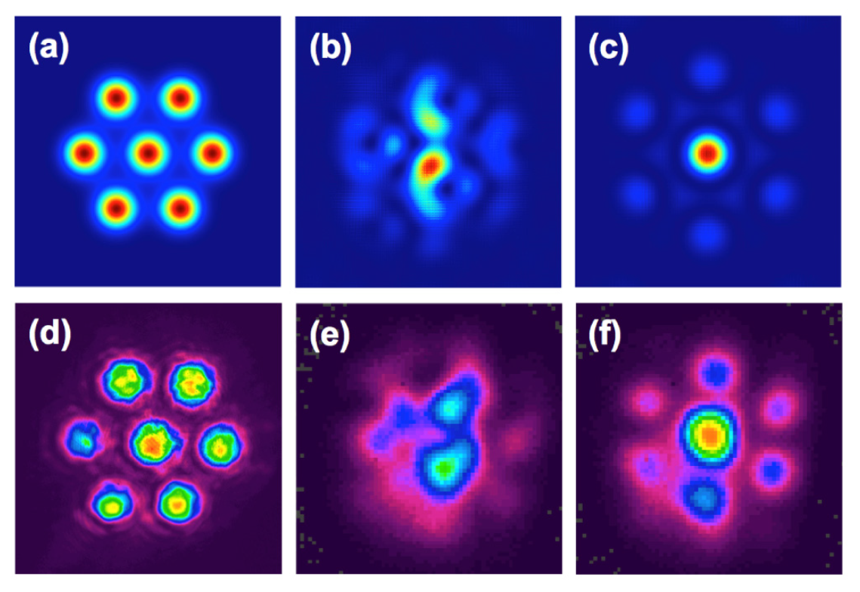
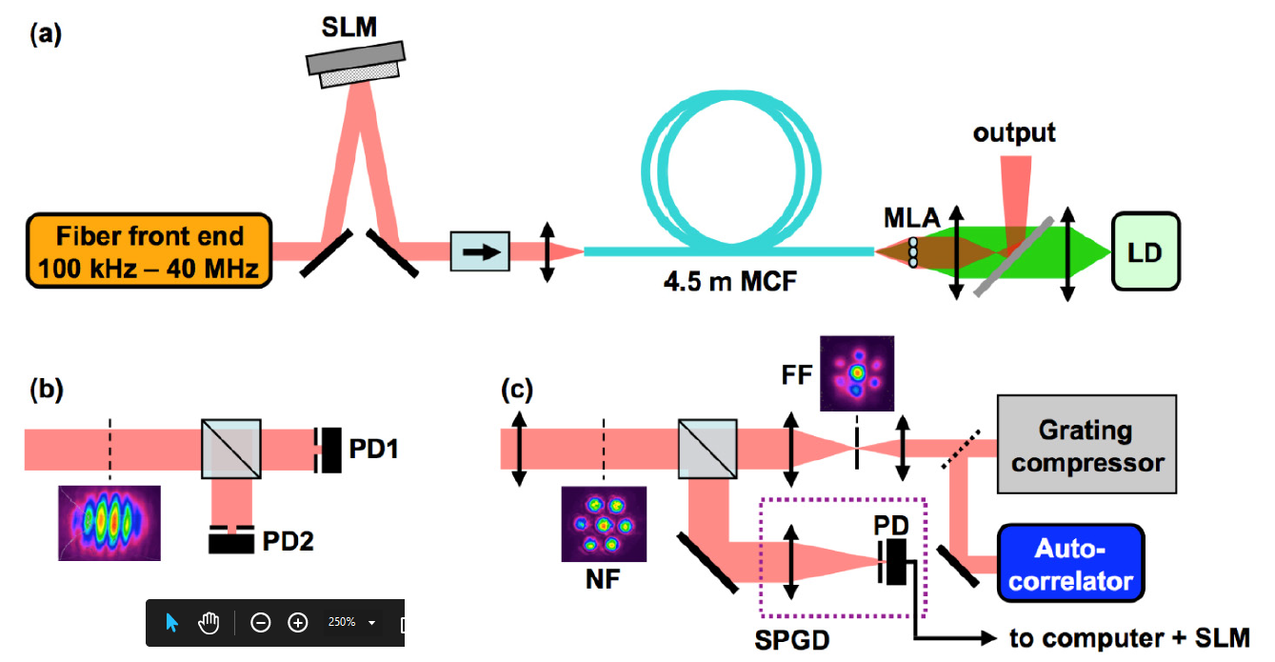
Tiled aperture multicore fibre combination
Rameriz et al., Opt. Exp. 23, 5407 (2015)
7 core Yb fibre
690fs (a/c), 2.6W
49% coupling (76% theoretical max.)
26

Slide 27
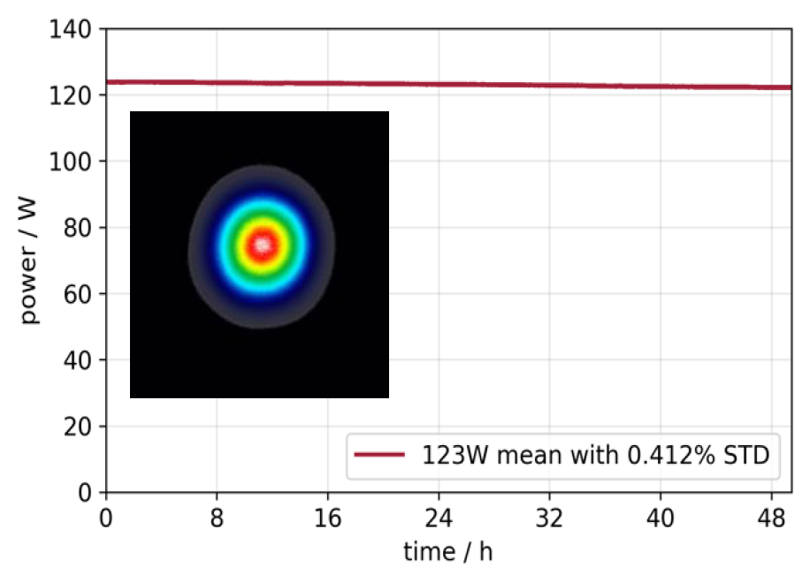
Thulium fibres and combination
Not just Yb doped fibres!
Tm cw systems combined:
Zhou et al., Proc. SPIE 7843, High-Power Lasers and Applications V, 784307(2010)
P Honzatko et al., Laser Physics Letters 10, 095104 (2013)
Coherent combination of pulsed Tm doped fibres:
120fs, 228μJ, > 120W.
Stable > 48hr operation.
C. Gaida et al., proc. CLEO/Europe-EQEC, 1 (2021)
27

Slide 28
Coherent combination of fibre lasers
Highly successful technology:
16 pulsed fibre lasers combined – 100kHz, 10mJ, 1kW, 120fs.
Müller et al., Opt. Letts. 45, 3083 (2020)
64 continuous wave fibre lasers combined.
Bourderionnet et al., Opt. Exp. 19, 17053 (2011)
8 channels combined with spatial and temporal division – 12mJ, 56kHz, 260fs.
Kienel et al., Opt. Letts. 41, 3343 (2016)
2 fibre lasers combined passively in Sagnac interferometer – 1.1mJ, 50kHz, 300fs.
Guichard et al., Opt. Letts. 40, 89 (2015)
All experiments carried out with identical fibre amplifiers
How does this scale to > 1000 fibres?
28

Slide 29
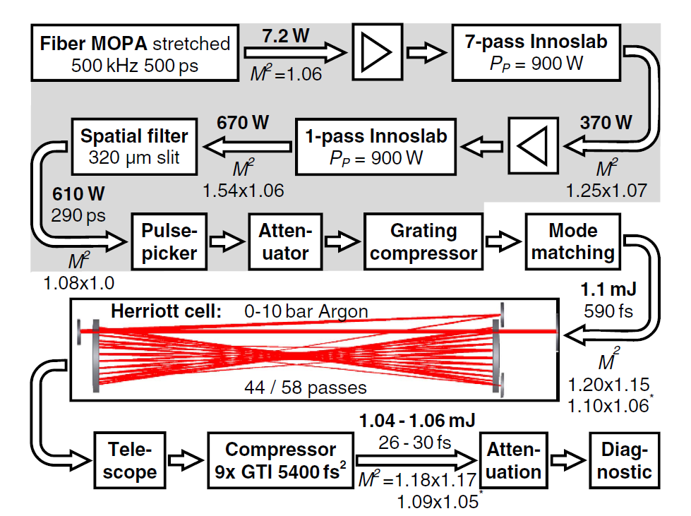
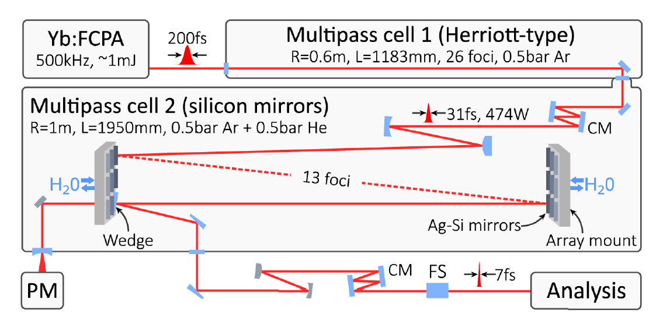
Multipass cells for pulse shortening
Russbueldt et al., Opt. Letts. 44, 5222 (2019)
600fs to 30fs
96% transmission
> 500W, > 1mJ, Yb:fibre
Müller et al., Opt. Letts. 46, 2678 (2021)
200fs to 7fs
82% transmission
> 380W, > 700μJ, Yb:fibre
29

Slide 30
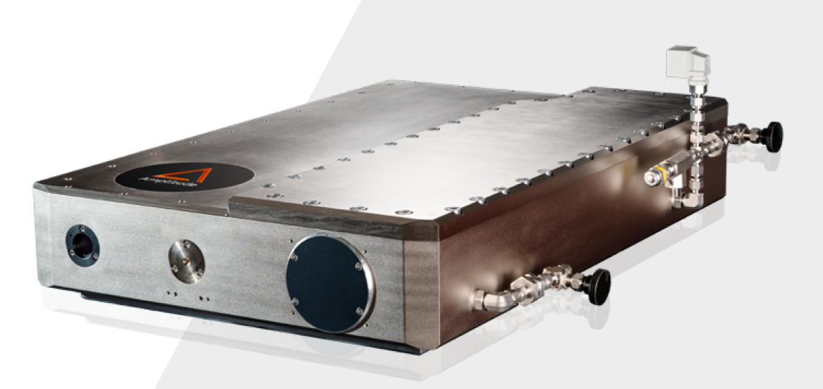
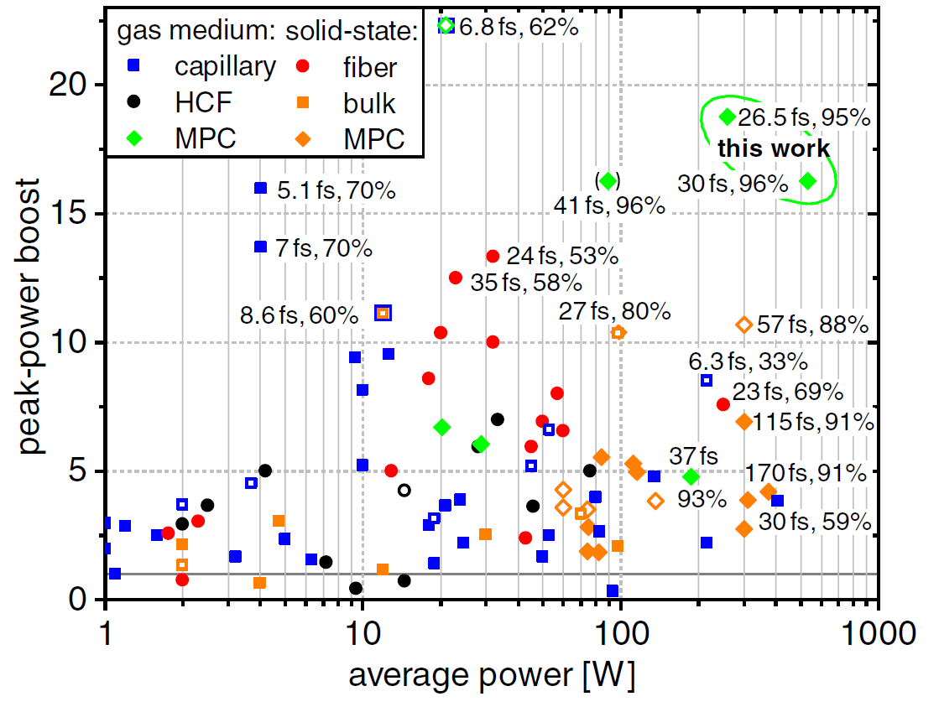
Pulse broadening
Russbueldt et al.,
Opt. Letts. 44, 5222 (2019)
30

Slide 31
Summary
Presented technology options for laser driven plasma wakefield acceleration:
Different laser media?
Coherent combination: Tiled aperture or filled aperture.
Binary combination.
Enhancement cavities – stack and dump, interferometric extraction.
Passive locking.
Divided pulse amplification.
Multicore fibres.
But what do we really need?
31

Slide 32
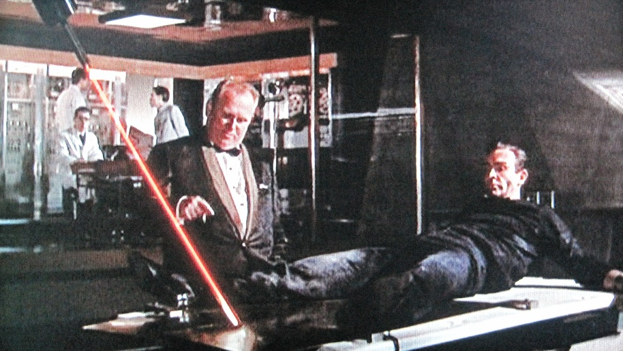
Always design the right laser for your application
Reviewer 2

