Slide 1

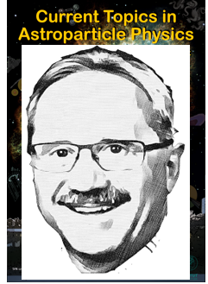
CAST and after-CAST
Konstantin Zioutas
University of Patras/ Greece
October 1999:
With Frank Avignone, Georg + Juan Collar
we defended the CAST proposal to CERN.
23 years later we celebrate Georg’s super
presence in astroparticle physics >>>
U N B E L I E V A B L E!!
Zwicky
Why solar axions?
➔ this talk ⬅
Munich, 10th November 2022
1

Slide 2
CAST: physics achievements
+
young people ‘start-ups’, promotions, …
education in astrophysics & cosmology …
EU: ILIAS network ➔ Patras workshop
2

Slide 3
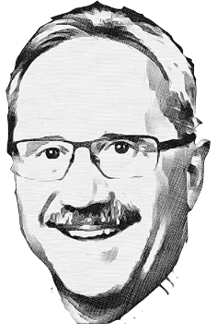
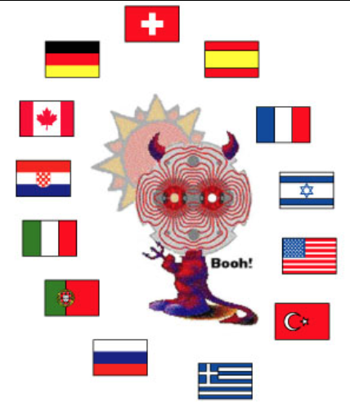
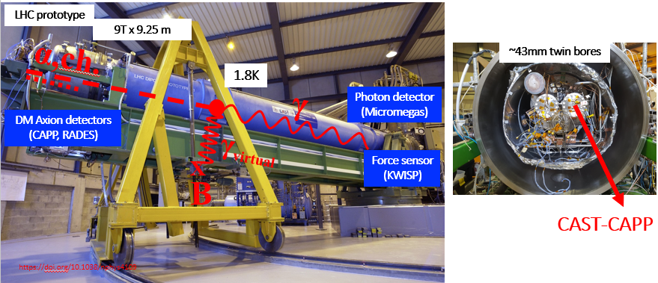
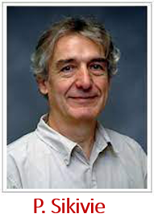
Axion Helioscope
Solar Axions
2019
Axion Haloscope
DM Axions
⬅ Vater unser
1983
3

Slide 4
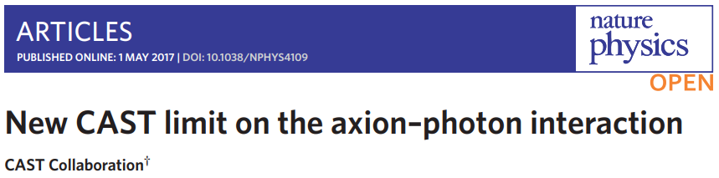
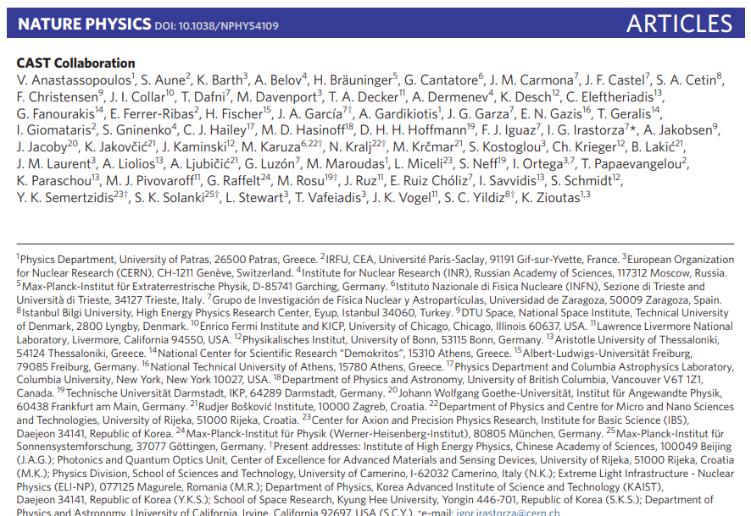
2017
66 CASTers
https://www.nature.com/articles/nphys4109
4

Slide 5
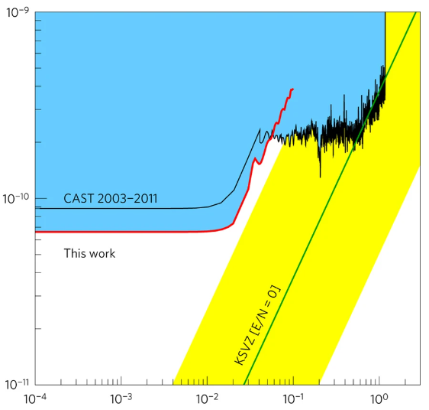
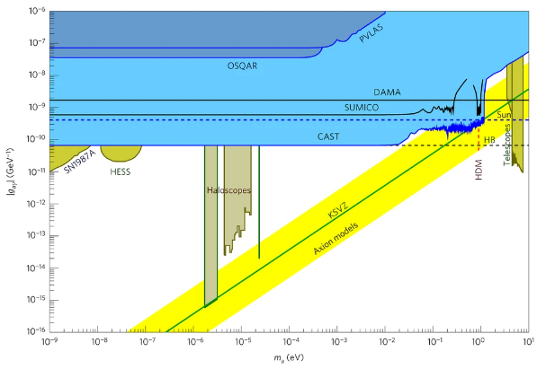
2017
Constraints on the two-photon coupling g_{a γ} of axions
and similar particles depending on their mass m_{a}.
New CAST limit on the axion–photon interaction
?
WHY?
we look(ed) into the Sun?
++++++++++++++++++++++++++++++++++++++++++++
My arguments:
+++++++++++++++++++++++++++++++++++++++++++++++++
a priori ≠ a posteriori
1999 2022
Best g_{aγγ} - limit
This talk
https://www.nature.com/articles/nphys4109
5

Slide 6
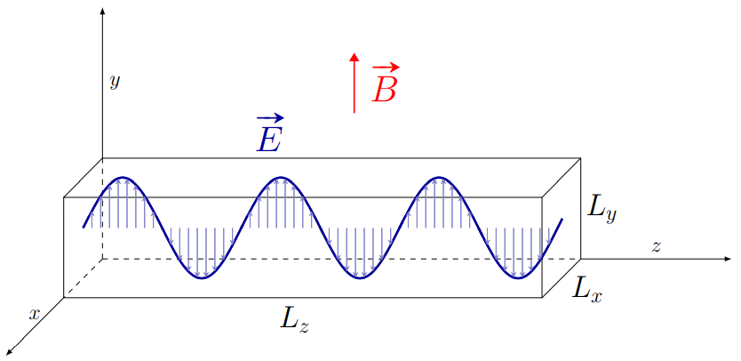
AXION HALOSCOPE à la Sikivie
The on-resonance axion conversion power in a microwave cavity is:
Rectangular Cavities
Mode frequency:
γ
Higher frequencies
α
smaller cavities
B_{ext}
X
For CAST-CAPP:
6

Slide 7
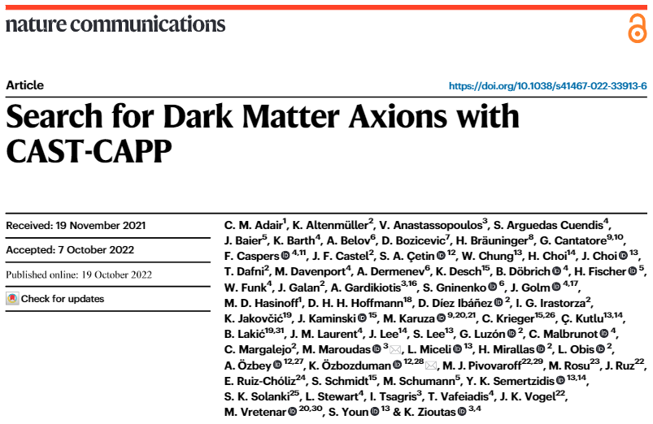
https://arxiv.org/abs/2211.02902
So far: CAST-CAPP => SHM
OCTOBER 2022
64 CASTers
PRD – Proposal (2011)
9 authors from 7 affiliations
7

Slide 8

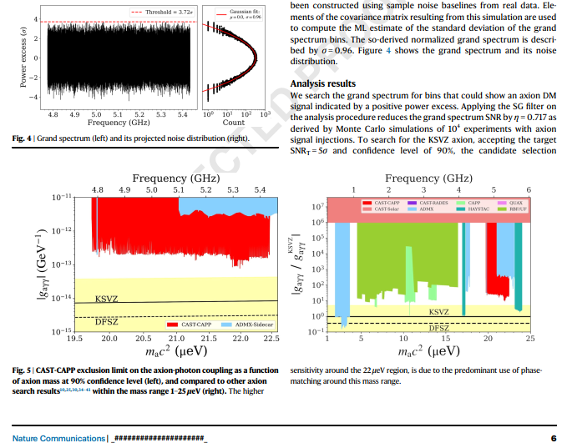
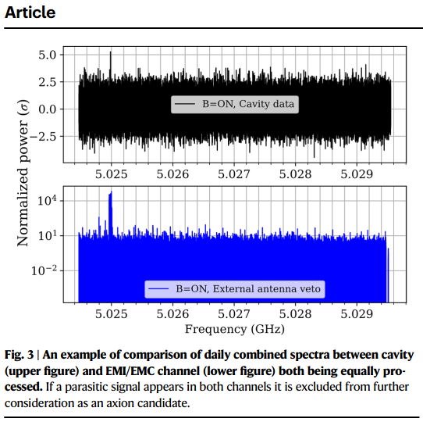
=> October 2022 =>
https://arxiv.org/abs/2211.02902
ADMX
CAST
8

Slide 9
Streaming dark matter
Cosmological fine grained streams:
Mark Vogelsberger and Simon D. M. White,
Mon. Not. R. Astron. Soc. 413 (2011) 1419
DM could be a superposition of many fine-grained streams.
Consequence from the collisionless character and the coldness of CDM.
Each such stream has a very small velocity dispersion.
~10¹⁴ streams in the solar neighborhood.
Half of the local DM density is comprised of the 10⁶ most massive streams.
The most massive individual stream contributing a 0.1% to the local DM density.
9

Slide 10
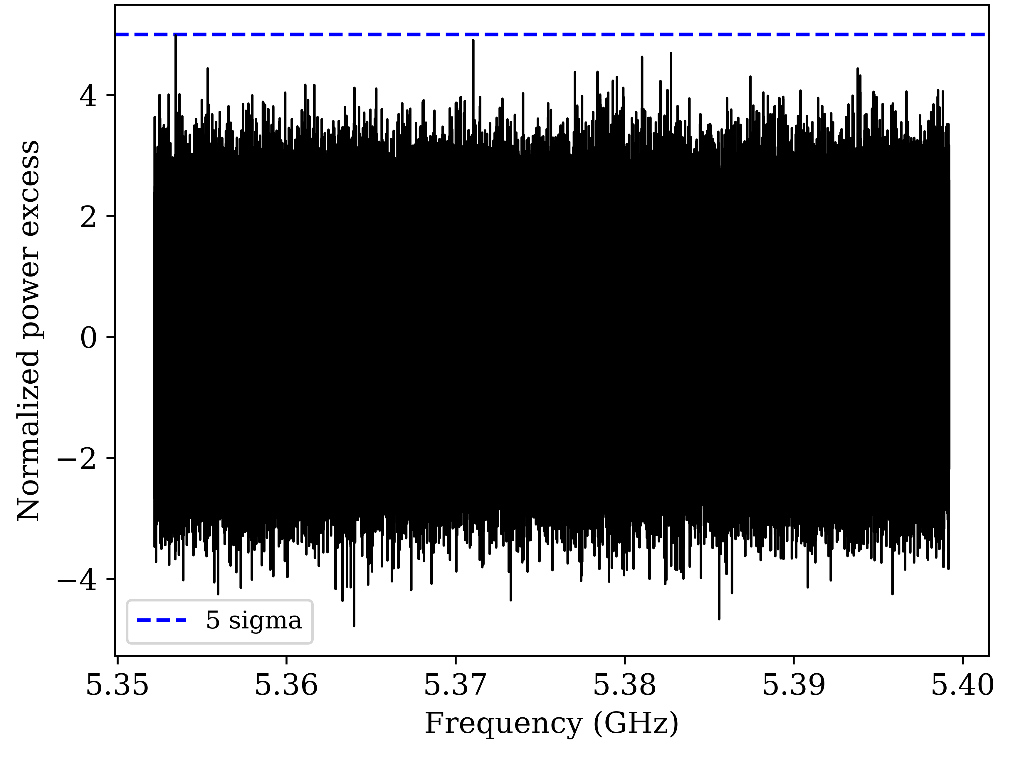
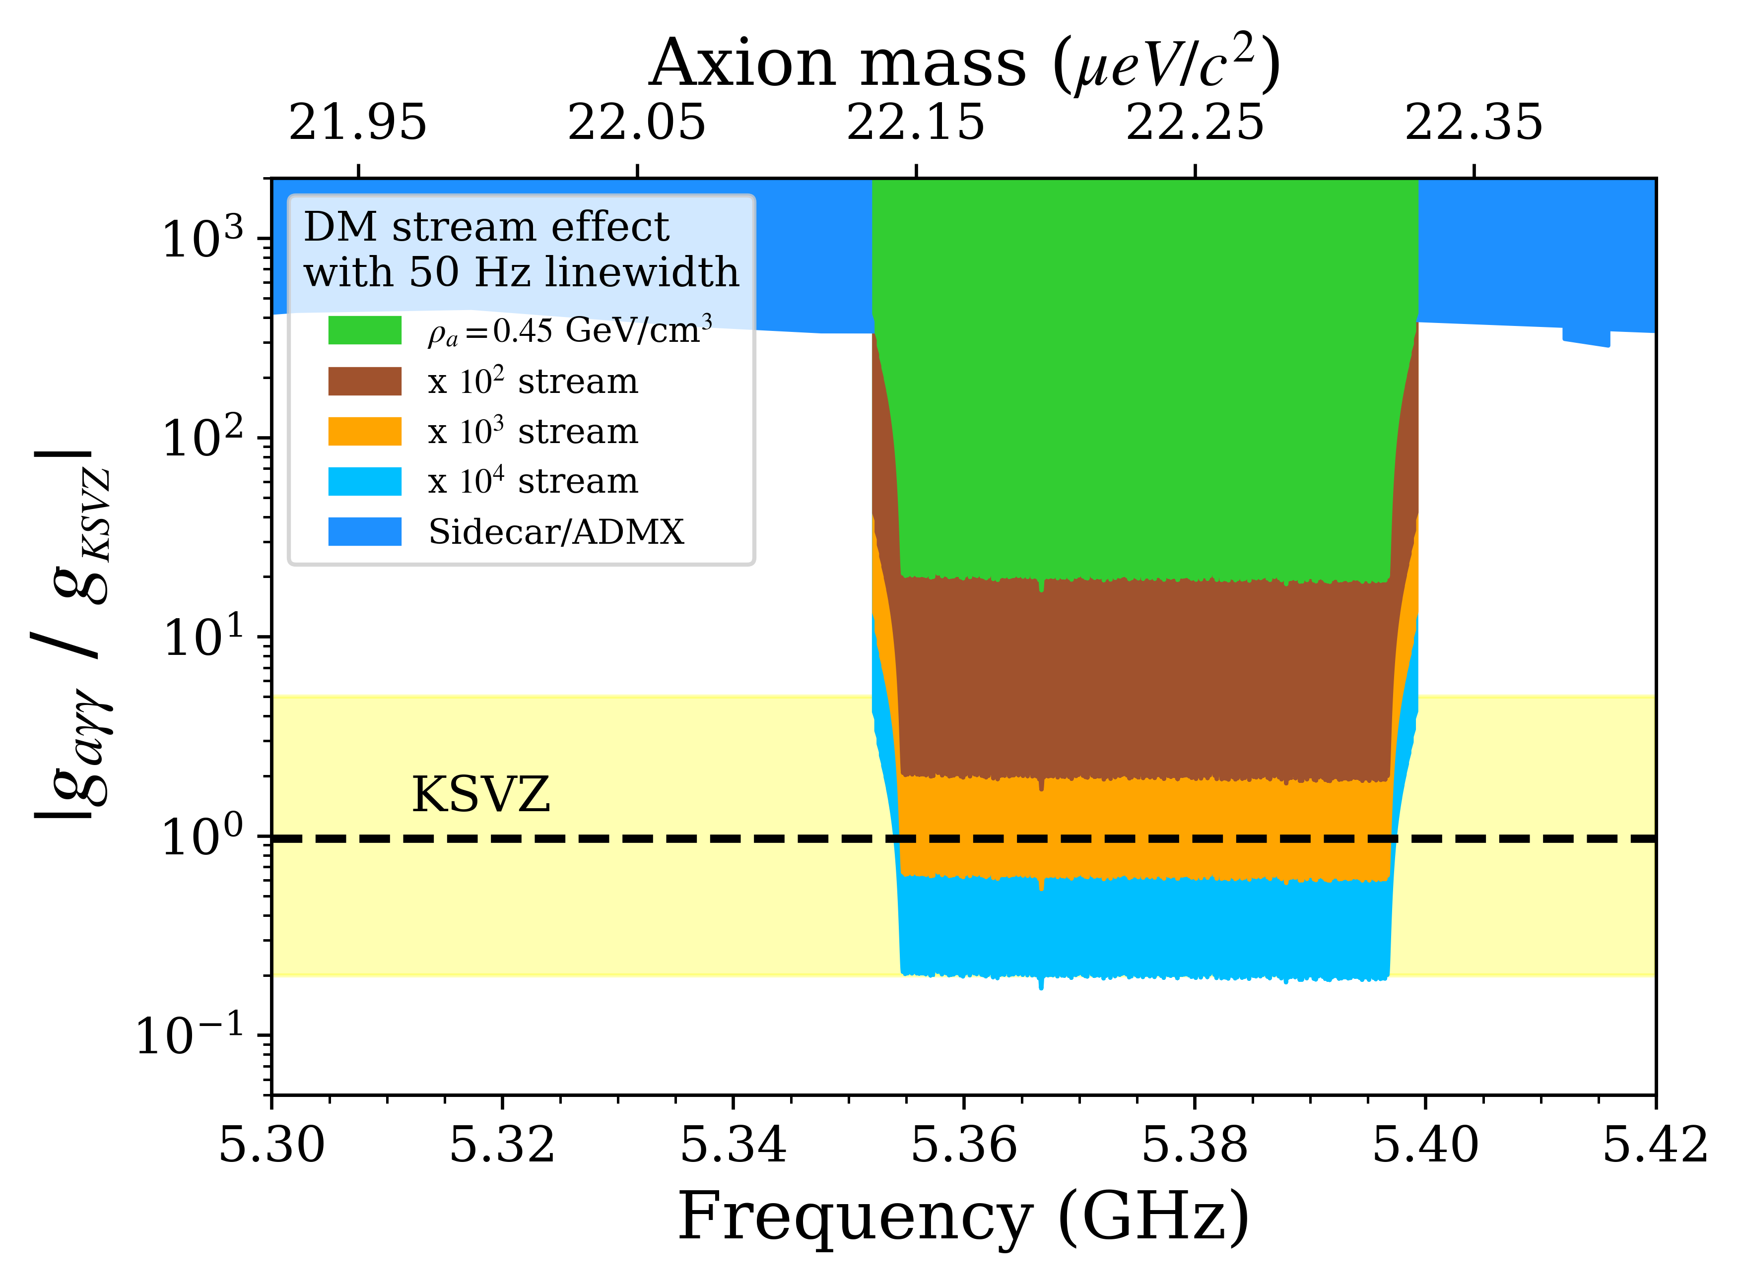
Streaming dark matter
New procedure for transient events such as axion streams or axion-mini clusters.
Second measurement channel is decisive for such searches.
Example measurement for 4.5h on 24/11/2020 (19:19 – 23:53 local time).
Fast scanning method over 42 MHz (5.3547 GHz – 5.3967 GHz).
Combined spectrum (RBW = 50Hz) shows no lines above 5σ threshold.
”Local” exclusion plot assuming axion streams with modest flux enhancement 10² – 10⁴.
Future tests with even smaller RBW including also raw IQ data in time-domain.
WORK TBD
!!
10

Slide 11
DATA taking Results
RESULTS:
Data-taking time: 4124 h (172 d)
Frequency range: 660.15 MHz
‘Axion Masses’: 4.77 - 5.43 GHz
Data size: ~ 650 TB
QUALITY CHECKS:
Total discarded Files: (~4.4%)
Phase-matching of all four cavities.
Fast resonance scanning.
Unexplored parameter space.
⬅ FUTURE UPGRADES
Data Processing: FFT
Time domain
I(t), Q(t)
Frequency domain
I(f), Q(f)
RBW = 50 Hz
11

Slide 12
Fine-Grained Streams from Cosmological Simulations
The cold nature of dark matter yields particles with nearly zero dispersions
( ~10⁻¹⁰ c for WIMPs and 10⁻¹⁷ c for Axions) at the last scattering
➔ ECHO idea
Mark Vogelsberger and Simon D. M. White used N-body equations of motion:
The DM distribution at a typical point in the halo is described as
a superposition of many fine-grained streams with discrete
velocity distributions, each of which has a very small velocity dispersion.
Mark Vogelsberger and Simon D. M. White,
Mon. Not. R. Astron. Soc. 413 (2011) 1419
12

Slide 13

WHY solar axions?
Axion theory
Sun
From the Sun ~grav. focusing
a permanent big bang~16MK
➔ exo-solar origin ⬅
DM velocities ➔ GF within solar system => STREAMS Dieter Hoffmann, Joachim Jacoby, K.Z,
Astroparticle Phys. 20 (2003) 73; https://www.sciencedirect.com/science/article/pii/S0927650503001385
13

Slide 14
CAST in time
From solar axions
  H.E. solar Axions
  Solar Chameleons
  DM axions
Beyond initial proposal
Also:
XRTelescope from DE astrophysics ➔ astropart. Phys.
Phase matched 4 cavities ➔ ~∞ [F. Caspers]
~fast scanning ~10 MHz / min (single cavity)
14

Slide 15

Sun’s dynamical behaviour
=> a multiple mystery <=
p.t.o. ➔
Frank Wilczek (CERN seminar):
“~focus on anomalies / mysteries”
➔
15

Slide 16
SUN:
Plenty of mysteries + anomalies
1 example: corona heating & its temperature inversion
1939 -
unnatural
16

Slide 17
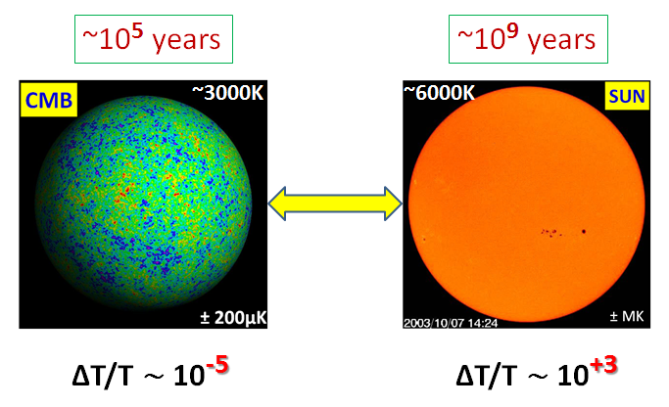

UNIVERSE SUN
~3000K
~6000K
SUN:
not thermalized after 4.5 Gyrs => WHY NOT?
17

Slide 18
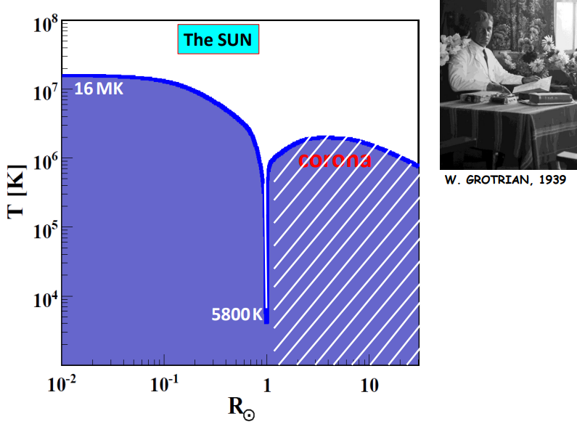
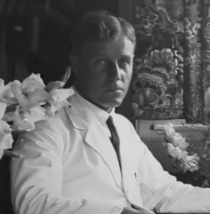
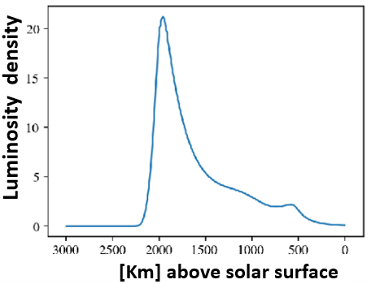
A mysterious solar observation: T_{SUN} = ƒ(R)
AQNs
~10-100 km
W. Grotrian 1939
N. Raza, L. van Waerbeke, A. Zhitnitsky, Solar Corona Heating by the AQN DM, arXiv:1805.01897(2018)
Surface
18

Slide 19
“Spacecraft Makes Progress on
Solar Heating Mystery”
October 2022• Physics 15, 157 Parker Solar Probe confirms a long-suspected heat source for the Sun’s …
surprisingly hot corona, but there may be others. https://physics.aps.org/articles/v15/157
See also https://journals.aps.org/prl/abstract/10.1103/PhysRevLett.129.165101?utm_source=email&utm_medium=email&utm_campaign=prl-alert
A long lasting mystery
It is extremely difficult to simulate the details of coronal heating … Thus,
testing realistic models with observations is a major challenge.
JA. Klimchuk et al., ApJ (2022) accepted 2nd Nov. 2022
➔ remember:
19

Slide 20
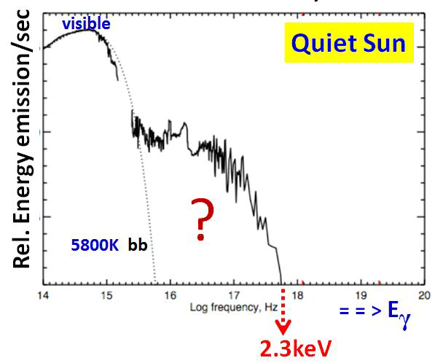
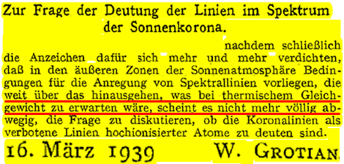
Solar Corona 1939->>> observational mystery.
Sun's upper atmosphere much hotter than its surface=>why?
• ”a major open issue in astrophysics” 2015
• ”one of the fundamental outstanding problems in solar physics” 2015
•“for 83 years…one of the outstanding unsolved problems in astrophysics” 2015
[ http://arxiv.org/abs/1502.07401; http://arxiv.org/abs/1508.05354; DOI: 10.1098/rsta.2014.0269]
The strikingEUV excessof the
quiet Sun is the manifestation
of the solar corona problem.
http://dx.doi.org/doi:10.1007/BF01488890
H.S. Hudson
20

Slide 21
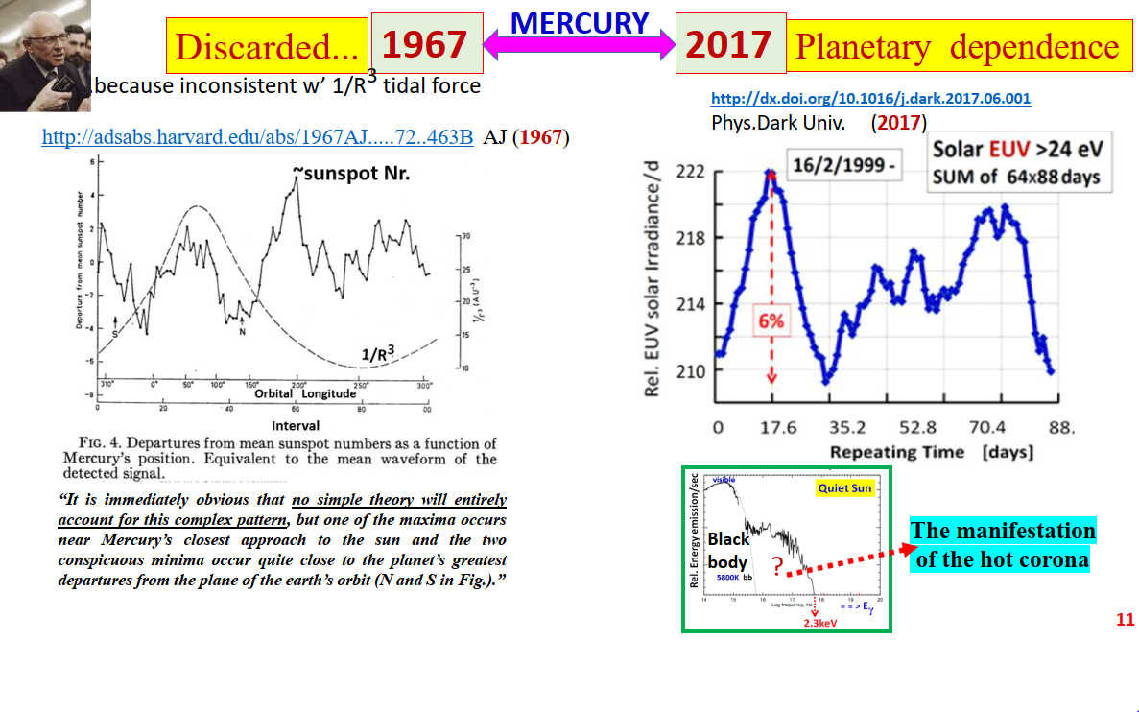
S. Bertolucci,
K.Z., S. Hoffman,
M. Maroudas
Phys. Dark U.
17(2017) 13
21

Slide 22
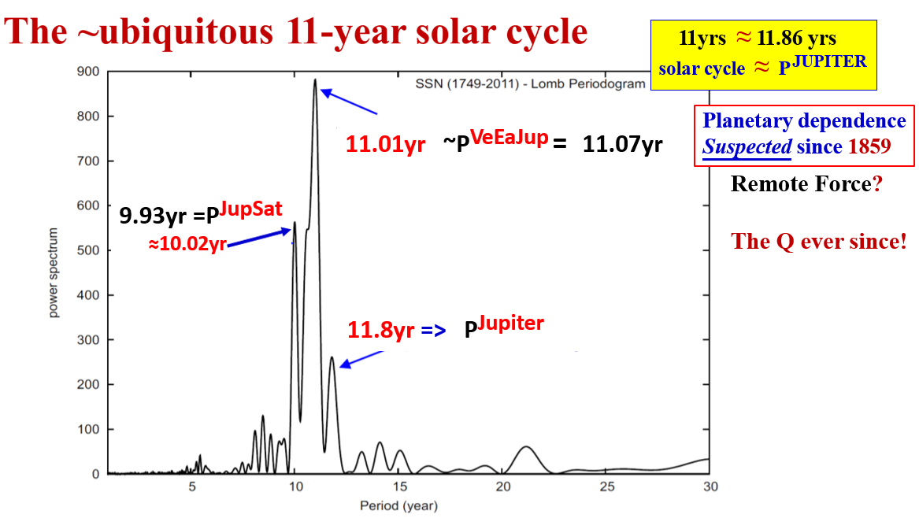
SUNSPOTS: Fourier analysis
https://arxiv.org/abs/1309.4021
22

Slide 23
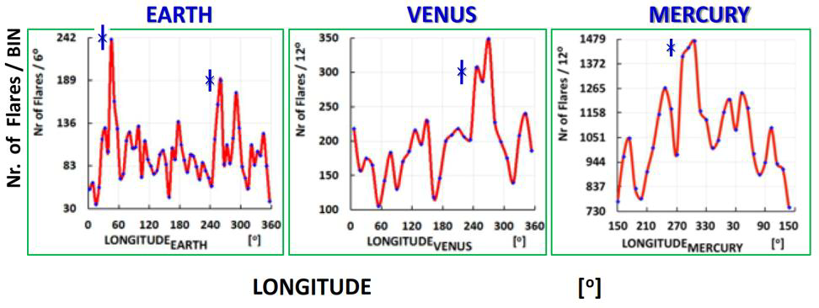
Solar Flares
Peaking planetary relationship,
Biggest and unpredictable “explosions”
@ solar system
excludes remote planetary interaction, e.g., tidal forces
Search during peaks!
Data from M.J. Aschwanden
23

Slide 24
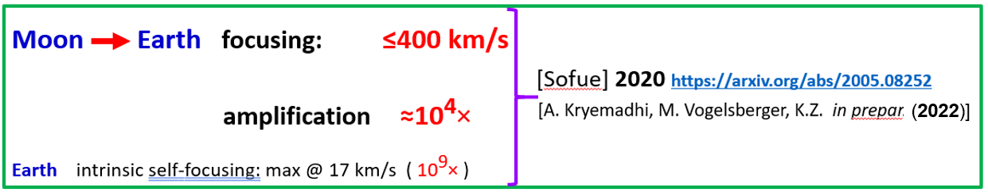
[A. Kryemadhi, M. Maroudas, A. Mastronikolis,
K. Z. (2022) https://arxiv.org/abs/2210.07367
Overlooked in DM research
!
Prezeau
!
Also: planetary grav. self-focusing: Streams ➔ “hairs”
Flux enhancements : > 10⁵×
24

Slide 25
The dynamical solar behaviour remains a mystery! + inspiring
11 years cycle, Corona anomaly, sunspots, flares, EUV, solar radius variation
… F10.7 radio line (=solar proxy) ➔
All show planetary dependencies! HOW?
25

Slide 26
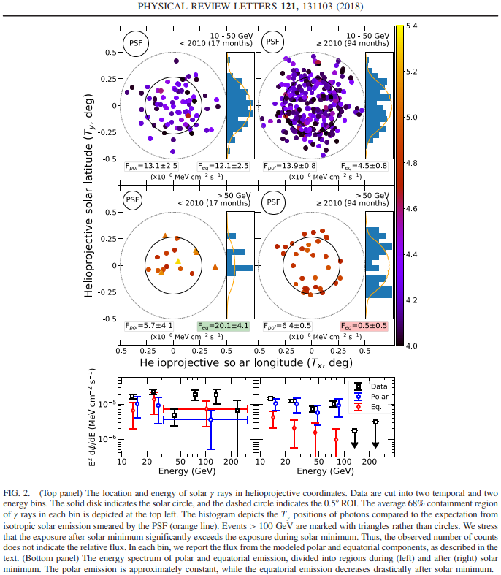



Evidence for a New Component
of HE Solar γ-Ray Production
Fermi-LAT
2008-2017
Theobservedmulti-GeVγ-rayemissionfromthesolardisk—
sourcedbyhadroniccosmicraysinteractingwithgasand
affectedbycomplexmagneticfields—isnotunderstood
...Moststrikingly,althoughsixγraysabove100GeVwere
observedduringthe1.4yrofsolarminimum,nonewere
observedduringthenext7.8yr.Thesefeatures,alongwitha
30–50GeVdip…werenotanticipatedbytheory.
? ?
Tounderstandtheunderlyingphysics,Fermi-LAT+HAWC
obs’softheimminent…solarMinimumarecrucial.
Our work:
>>>search for planetary dependence!
T.Linden,B Zhou, JF Beacom,AHG Peter, KCY Ng,
Q-W Tang, Phys. Rev. Lett. 121 (2018) 131103
https://doi.org/10.1103/PhysRevLett.121.131103
26

Slide 27
Searching for neutrinos from solar flares …
with Super-Kamiokande
No significant solar-flare ν signal
above background rate was observed.
https://arxiv.org/abs/2210.12948 2022
Search for Solar Flare Neutrinos
with KamLAND.
found no statistical excess of
ν’s and established upper limits
https://iopscience.iop.org/article/10.3847/1538-4357/ac35d1 2022
27

Slide 28
a posteriori
CONCLUSION:
The Sun is a set of anomalies / mysteries
Look at e.g.: w. an XRT
or, w. DM equipment!
Unexpected.…
…potential discovery!
!Surprise!?
28

Slide 29
Therefore:
➔ Look @ (towards) the Sun!
29

Slide 30
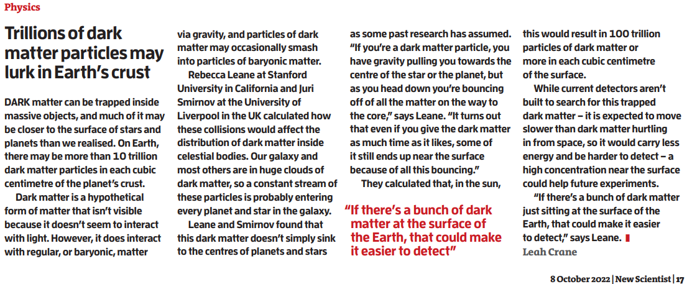
Trillions of DM
Particles may lurk
in Earth’s crust
Trillions of dark matter particles may lurk in Earth's crust - ScienceDirect (cern.ch)
https://doi-org.ezproxy.cern.ch/10.1016/S0262-4079(22)01808-5
The original work:
. arXiv:2209.09834 [pdf, other]
Floating Dark Matter in Celestial Bodies
Rebecca K. Leane, Juri Smirnov
Comments: 20 pages, 6 figures, 100000000000000+ dark matter particles per cm^3 at Earth's surface
30

Slide 31
TheDarkWorldisnotdark!
THANK YOU

Slide 32
Welcome to the club GOOD LUCK for
your 2nd T_{1/2}

Slide 33
Additional
slides
31

Slide 34
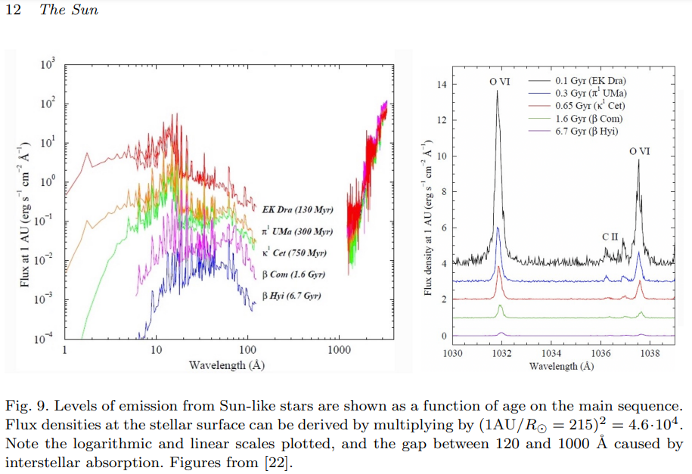
https://arxiv.org/abs/2205.03498
32

Slide 35
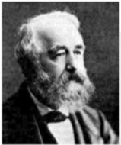

R. WOLF
The 11-year solar cycle
P^{JUPITER} = 11.86 years ≈ 11 years
1859- Suspected planetary dependence
The only remote tidal planetary force => too weak!
missing factor ~10¹¹
Following
known
physics
follow-up!
…. more quantitatively ➔
33

Slide 36
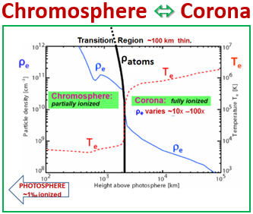
AQNs
~10 - 100 km
AQNs: ♦the only solar atmospheric model reproducing
the ~100 km thin Transition Region
♦planetary dependence of the flaring Sun
♦more?>>> unexplained obs’?!
N. Raza, L. van Waerbeke, A. Zhitnitsky, Solar Corona Heating by the AQN DM, arXiv:1805.01897(2018)
34

Slide 37
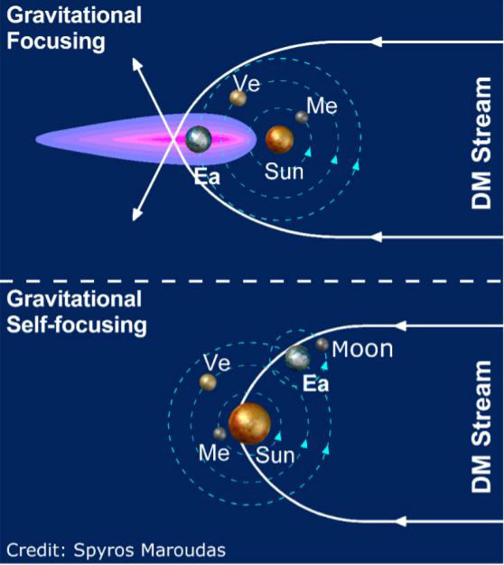
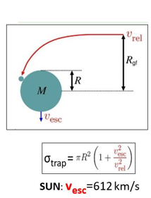
[10,19]
~18thDecember
❶
Gal.center
Coincides with ionospheric anomaly
+
planetary dependence
✓
Free fall
➔ exo-solar ✓
❷
2 peaks 180º apart
[Adrien Leleu]
Cartoonillustrationofgravitational
focusingof low speed streams.
35

Slide 38
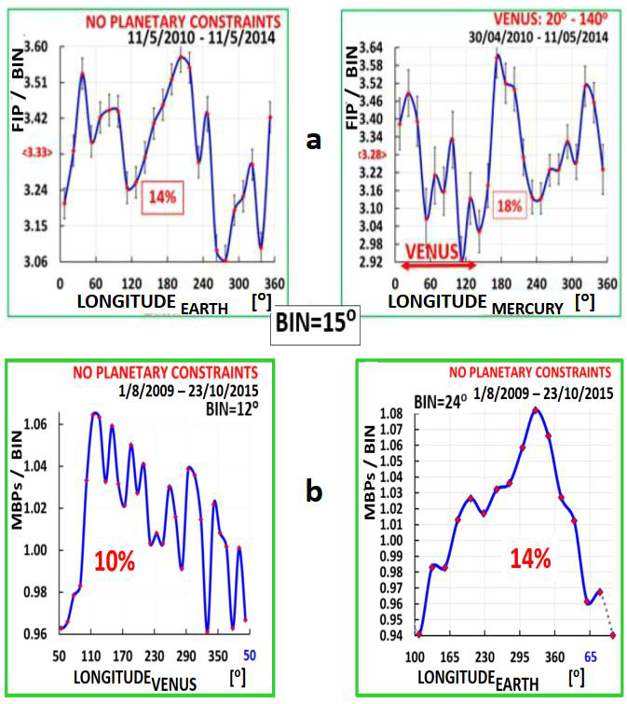
Elemental
Composition ➔
Planetary relations:
how to reconcile w.
conventional picture?
Magnetic
Bright points ➔
(a)https://www.nature.com/articles/s41467-017-00328-7NATURE Comm. 2017
(b) https://arxiv.org/abs/1710.01678 PASJ 2017
36
M. Maroudas and D. Utz, work in preparation 2021

Slide 39
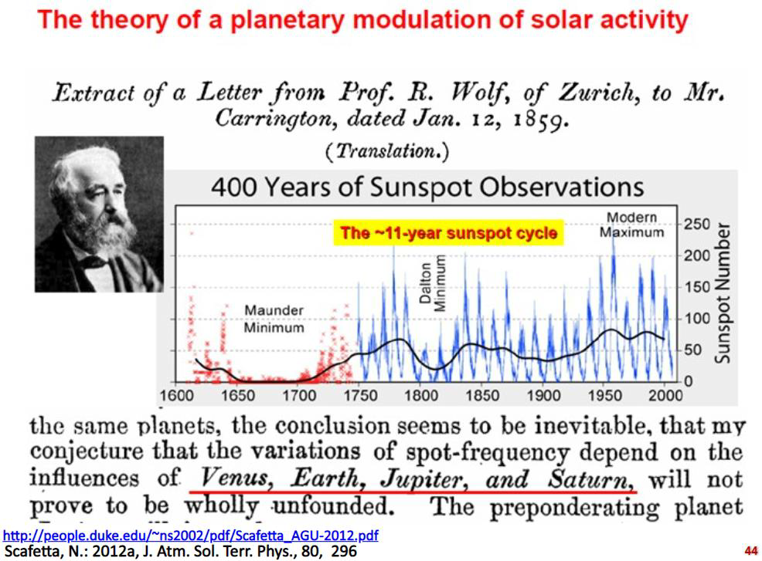
Overlooked!
Too weak within
known physics
therefore abandoned!
The variations of sunspot
Periodicity depend on influences
Of Venus, Earth, Jupiter & Saturn
https://slideplayer.gr/slide/7988163/
37

Slide 40
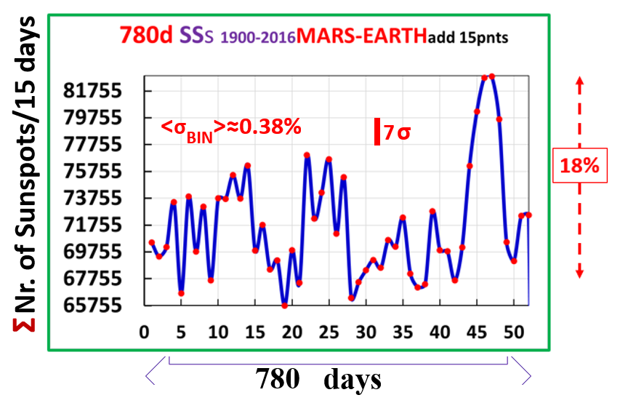

Sunspots1900-2016>>MARS-EARTH synod = 54×780 days
substructure!
=>
Combined
planetary
relationship
ΣNr. of Sunspots/15 days
Synod
Simplest FOURIER
analysis with more
information.
54×
38

Slide 41
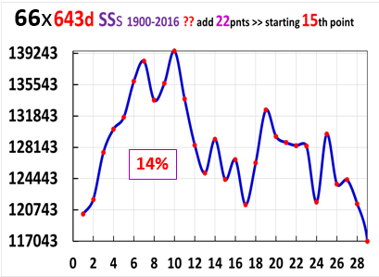
NO synod
ΣNr. of Sunspots/22 days
66×643 days
39

Slide 42

…. NOT from mc²
⬅ [6,7]
Gravitational deflection ΔΦ ∝ 1/v²
Deflection (v~1‰ c) ➔ 10⁻⁶ × Deflection (v=c)
planetary lensing within inner solar system ✓
+ Moon => Earth!
[6,7,10]
⬅ 2003
2014
⬅ 2017
40

Slide 43
DM presence is known through its gravitational pull on visible matter in space.
➔ DM remains elusive
DM does not emit, absorb, or, reflect light.
.
Therefore, dark matter remains as elusive as Alice in Wonderland's Cheshire Cat – where you only see its grin (in the form of gravity) but not the animal itself.
https://www.nasa.gov/feature/goddard/2020/hubble-observations-suggest-a-missing-ingredient-in-dark-matter-theories
Misleading? => counter examples => this work. E.g.:
various energetic events of unknown origin, like
Flares, Solar EUV, and terrestrial obs’s, etc…
This work: DM => “Invisible matter”
41

Slide 44
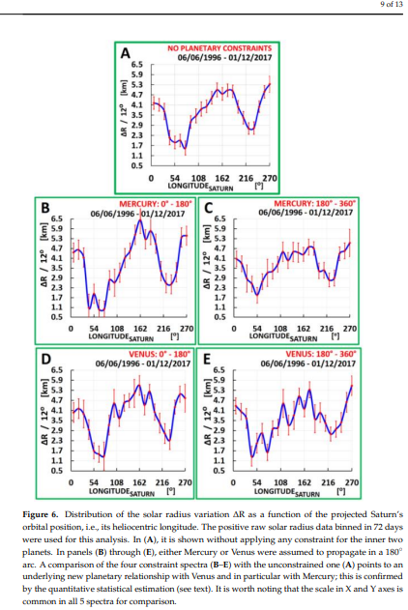

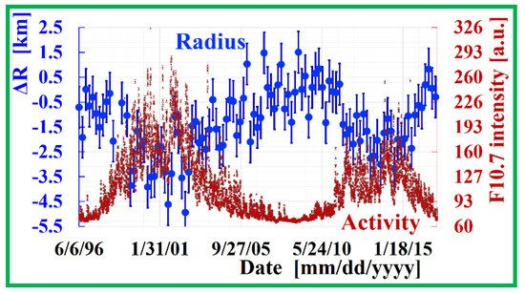
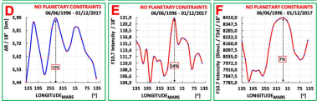
Solar radius variation:
from helioseismology
- minimum BIN=72 days
Planetary relationship✓
ΔR [km]
⬅Mercury
⊗
0-180º 180º-360º
OR
ΔR [km]
⬅ Venus
0-180º 180º-360º
LONGITUDE-SATURN
ΔR [km]
Lift 1km photosphere by 1km:
required ~ 10³⁰ erg.
LONGITUDE-MARS
42

Slide 45

AntiQuarkNuggets (AQNs):
dark matter +missing antimatter +(much) more?
https://indico.desy.de/indico/event/20012/session/19/contribution/54/material/slides/0.pdf
N. Raza, L. van Waerbeke, A. Zhitnitsky,
Solar Corona Heating by the AQN Dark
Matter,arXiv:1805.01897(2018),
Phys. Rev. D 98 (2018)103527 ^{Candidates:}
1. - AQNs
- Pearls
Pearls
>> see Holger Nielsen’ talk, this workshop
2. Magnetic monopoles
Dark photons
Or,a combination from + more?
https://inspirehep.net/record/1235677/plots
43

Slide 46
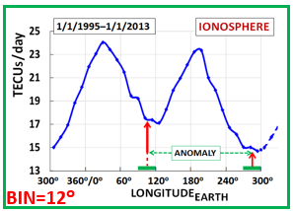
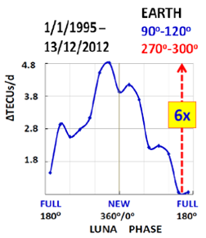
EARTH ^{EARTH⊗MOON}PHASE
Stream(s) from G.C. mega-BlackHole?
Longitude ≈266º+TOF (Earth => Sun)
➔18thDecember
Longitude ≈85º+ TOF (Moon => Earth)
➔17thJune, ..?..
44

Slide 47

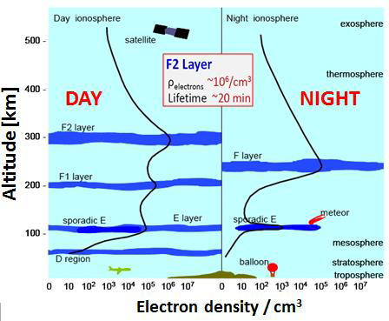
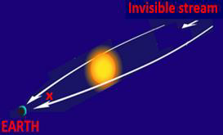
EARTH’s IONOSPHERE
Anomalies lasting for some decades
>>>First obs’1937/1938
45

Slide 48
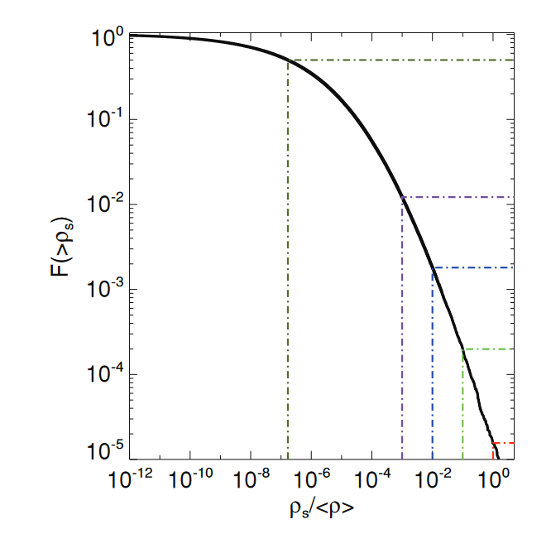
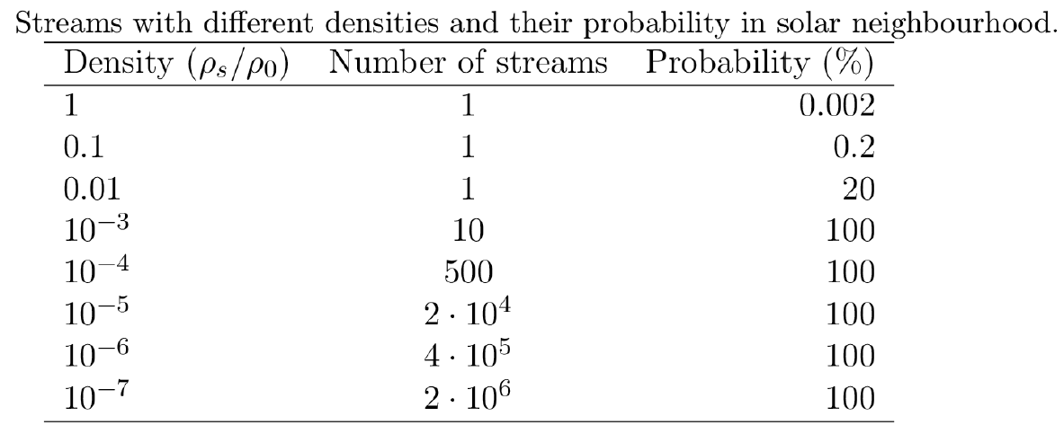
Fine-Grained Stream Abundance
Mark Vogelsberger and Simon D. M. White,
Mon. Not. R. Astron. Soc. 413 (2011) 1419
2 million streams with density 10⁻⁷ ρ₀
46

