Slide 1
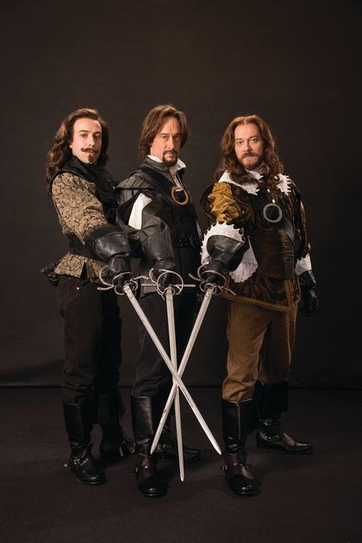
Earth for Neutrinos,
Neutrinos for Earth
Amol Dighe
TIFR Mumbai
Current Topics in Astroparticle Physics
Munich, Nov 2022

Slide 2
Earth for supernova neutrinos
(Some of my first work with Georg)

Slide 3
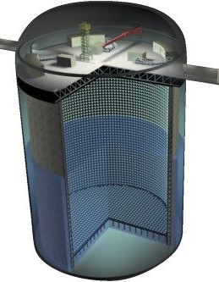
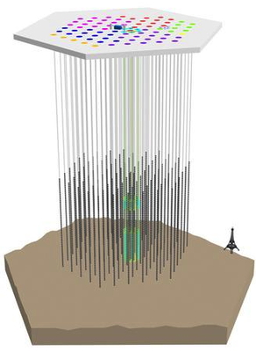
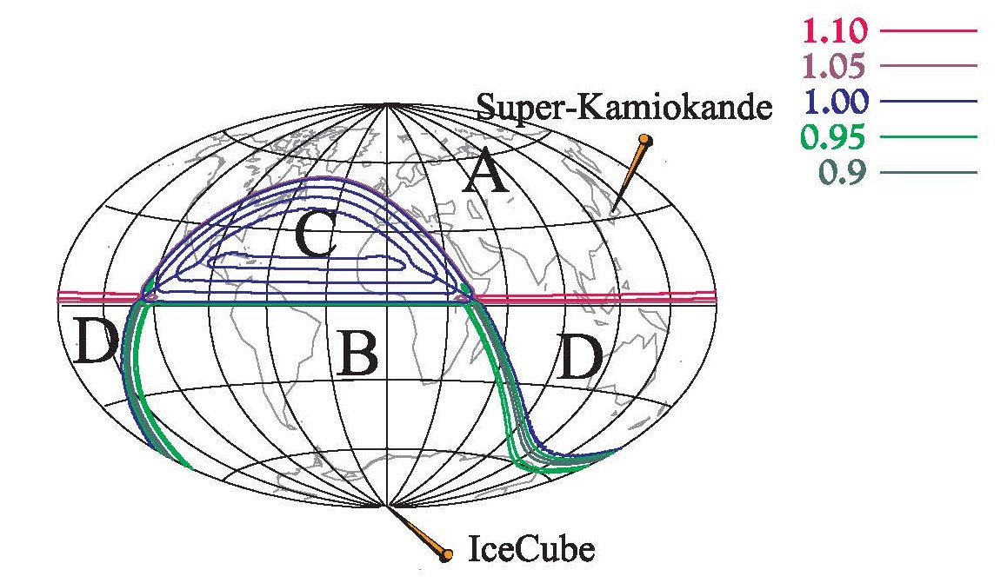
Comparing SN signals at SK and IceCube
IceCube cannot detect individual MeV neutrinos, but can measure the total luminosity to more than a per cent precision.
When compared to the time progression of neutrino signal at SK, Earth matter effects possible if the arriving fluxes are not depolarized.
AD, M. Keil, G. Raffelt, hep-ph/0303210

Slide 4
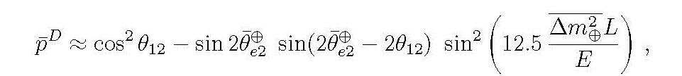
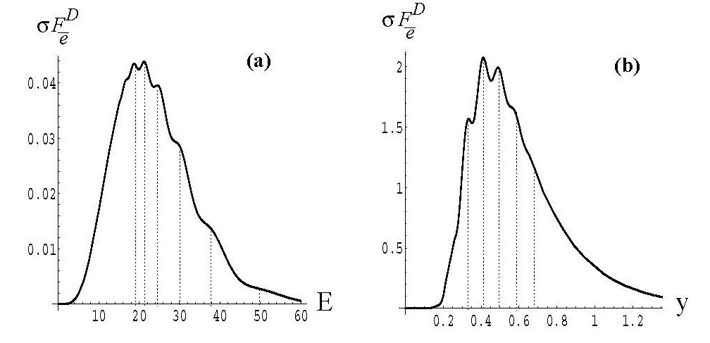
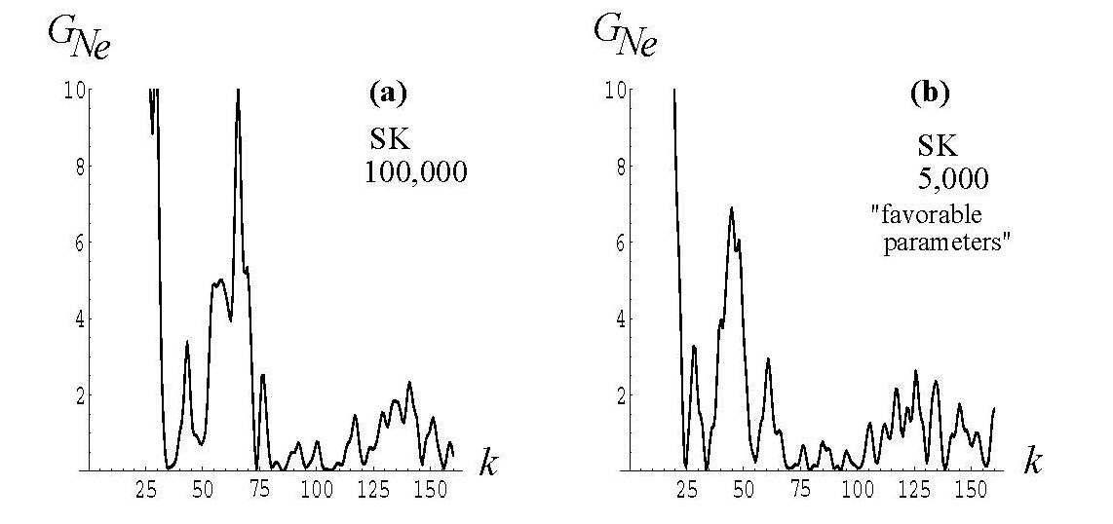

Earth effects at a single detector
Earth effects introduce a fixed frequency in $y≡1/E$ in the neutrino event spectrum (at constant density)
Fourier transform in $y$ can identify Earth effects at a single detector
Detector resolution and number of events play a major role in feasibility, in addition to the difference in flavour fluxes
AD, M. Keil, G. Raffelt, hep-ph/0304150

Slide 5
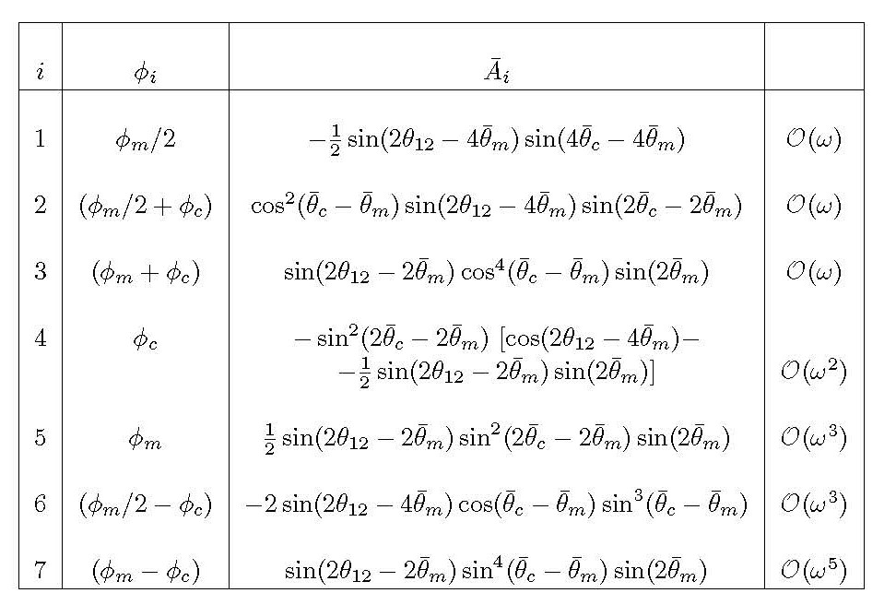
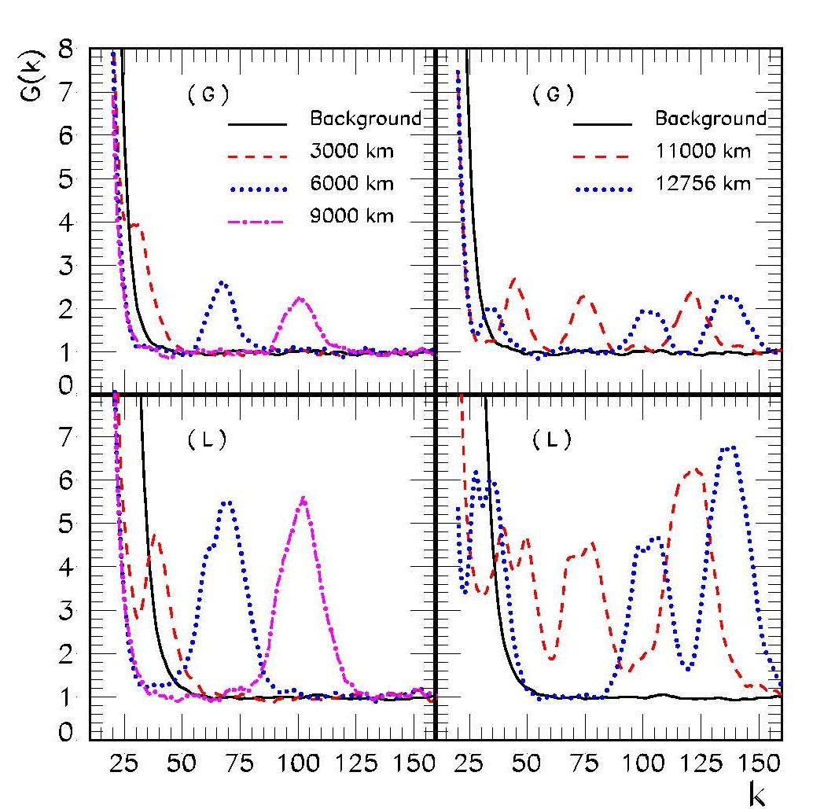
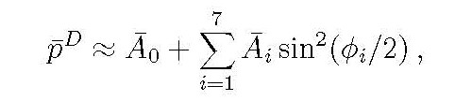

Earth frequencies in core and mantle
If neutrinos pass through the Earth core, 7 frequencies appear, out of which 3 can give significant contributions
Can be identified by FT in $y$ , but energy resolution of detector crucial
50 kt
sciltillator
AD, M. Kachelriess, G. Raffelt, R. Tomas, hep-ph/0311172

Slide 6
Back to the present
Back to the Earth

Slide 7
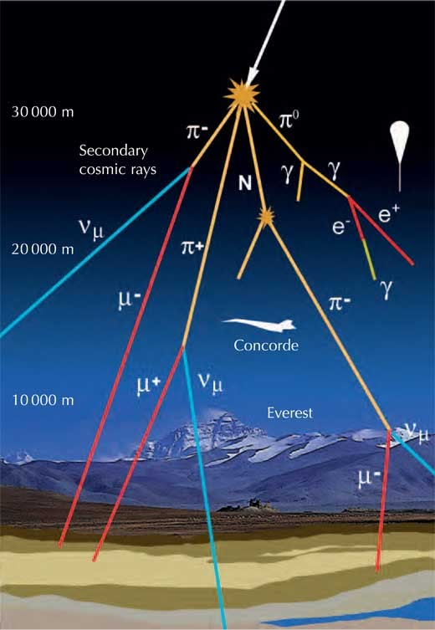
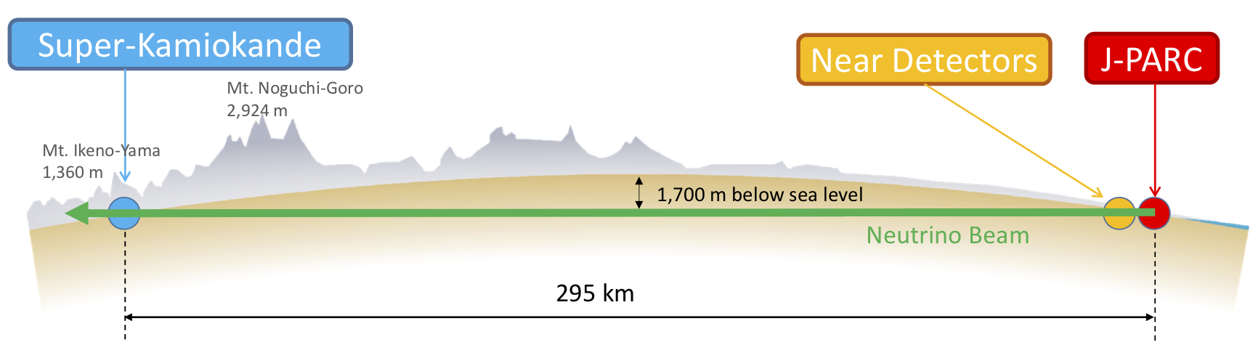
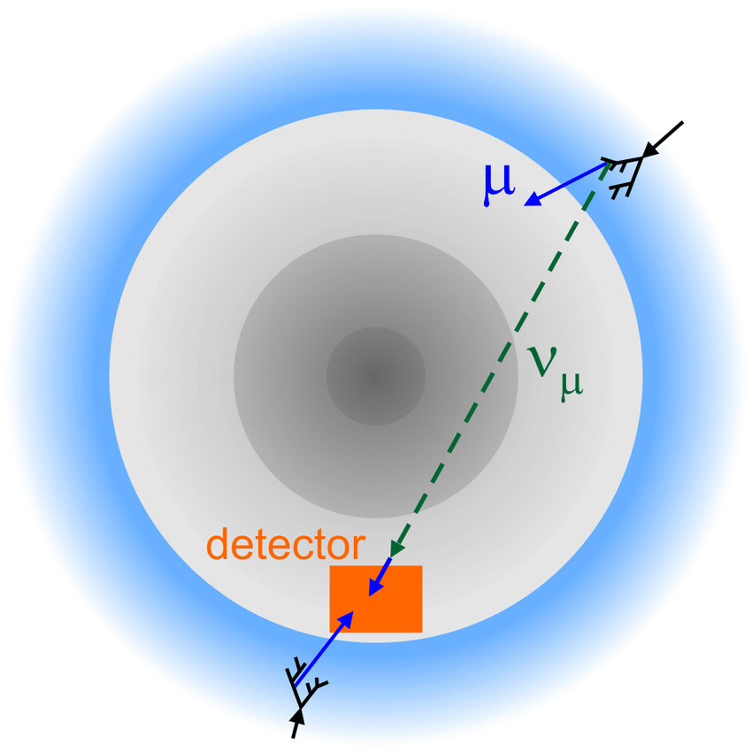
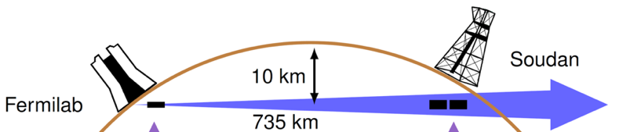
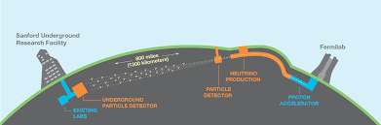
Matter effects at $ν$oscillation experiments
Fixed-baseline experiments
Atmospheric neutrino experiments
Controlled fluxes, Higher luminosity
vs.
Larger coverage of L and E

Slide 8
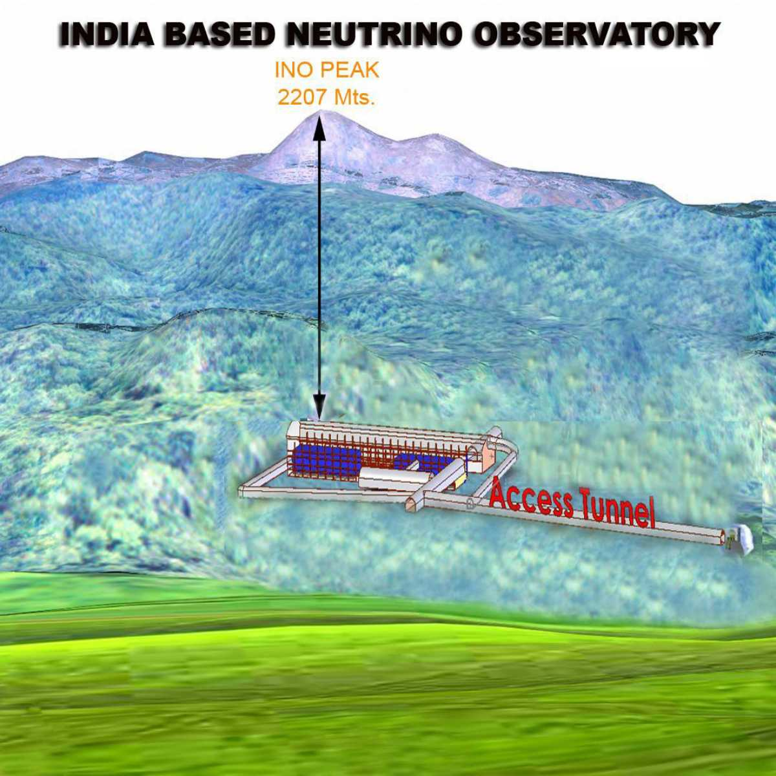
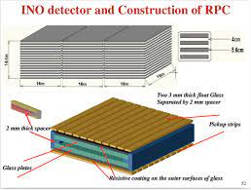
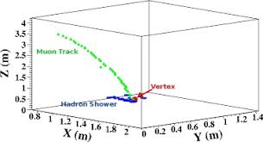
ICAL@INO : Iron CALorimeter tracker
Distinguishing neutrinos and antineutrinos using magnetic field
Muon tracks and hadron showers
Excellent energy and angular resolution for muons

Slide 9
What can atmospheric neutrino experiments do that Long-baseline experiments cannot ?

Slide 10
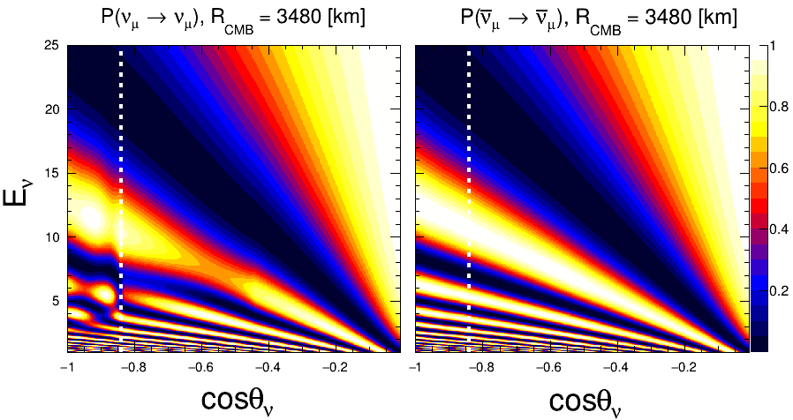
Oscillograms for muon neutrino survival
Neutrinos experience (more) matter effect for NO
Antineutrinos experience (more) matter effect for IO
Parametric resonance /
Neutrino Oscillation length resonance
MSW Resonance Region
- 0.8 < cosθ_{𝜈} < - 0.5
6 GeV < E_{𝜈} < 10 GeV
S. K. Agarwalla,
Talk at MMTE 2022
cosθ_{𝜈} < - 0.8
3 GeV < E_{𝜈} < 6 GeV

Slide 11

Parametric resonance for core-passing $ν$
For specific matching of oscillation phases gained by neutrinos while passing though the mantle and the core, oscillation probabilities undergo substantial changes
Akhmedov 1998
Petcov 1998
Akhmedov, AD, Lipari, Smirnov, 1998
Long baseline experiments have no access
To the paramtric resonance !
S. K. Agarwalla,
Talk at MMTE 2022

Slide 12
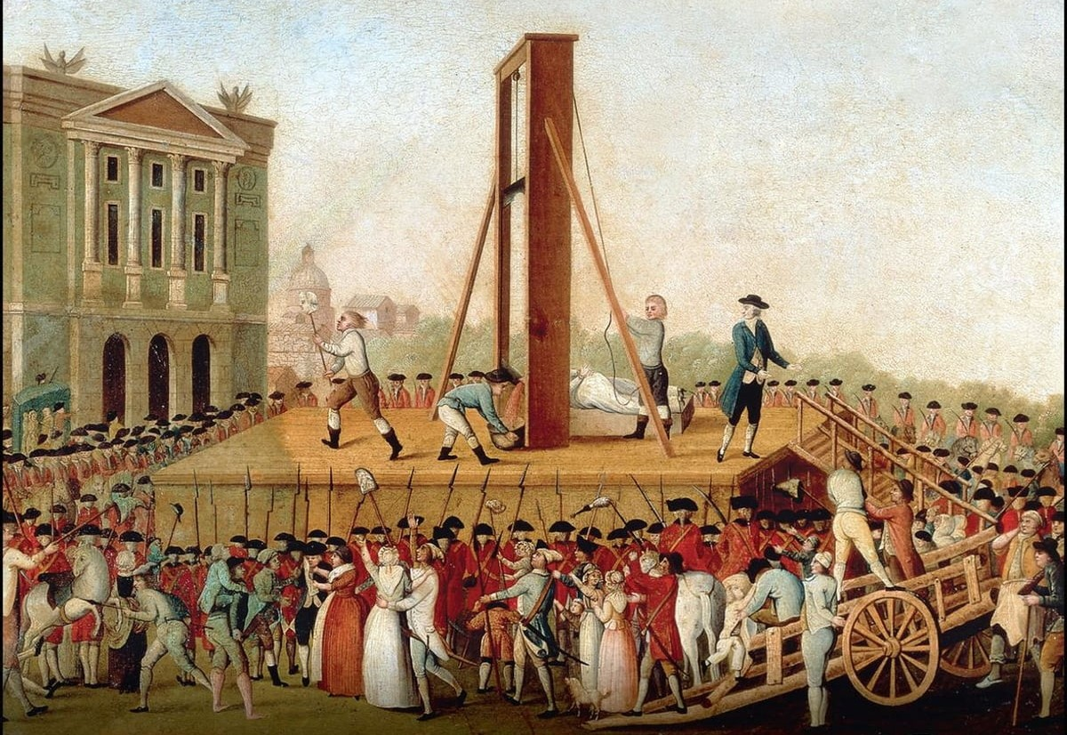
A tale of two Hamiltonians
Cover page of “A tale of two cities”,
By Charles Dickens

Slide 13
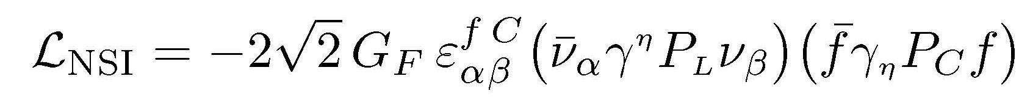
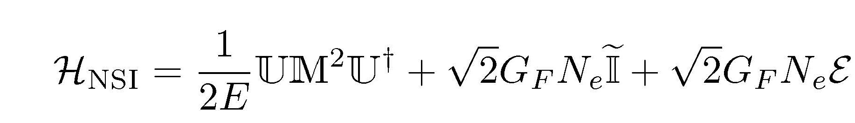

Non-standard neutrino interactions
Neutral-current non-standard interactions (NSI):
Effective Hamiltonian in 3-neutrino flavour basis:
$Ɛ$ = $\left(\begin{matrix}ε_{ee} & ε_{eμ} & ε_{eτ} \\ ε_{μe} & ε_{μμ} & ε_{μτ} \\ ε_{τe} & ε_{τμ} & ε_{ττ}\end{matrix}\right)$

Slide 14

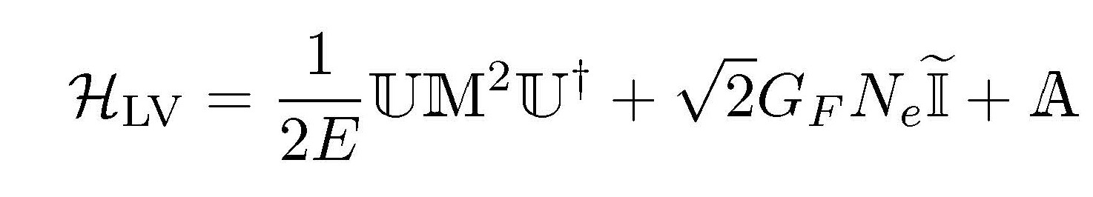


Violation of CPT and Lorentz symmetry
Spontaneous breaking of Lorentz symmetry
(e.g. vev to a 4-vector $V^{λ}$that has flavour-dependent couplings to neutrinos)
Magnitudes of $a_{αβ}^{λ}$ expected to be suppressed by Planck scale
Since Lorentz symmetry is broken by a vector, CPT also broken automatically.
When only timelike component of $V^{λ}$ is nonzero (i.e. $a_{αβ}^{0} ≠0$ )
Effective Hamiltonian in 3-neutrino flavour basis:
$A$ = $\left(\begin{matrix}a_{ee} & a_{eμ} & a_{eτ} \\ a_{μe} & a_{μμ} & a_{μτ} \\ a_{τe} & a_{τμ} & a_{ττ}\end{matrix}\right)$

Slide 15
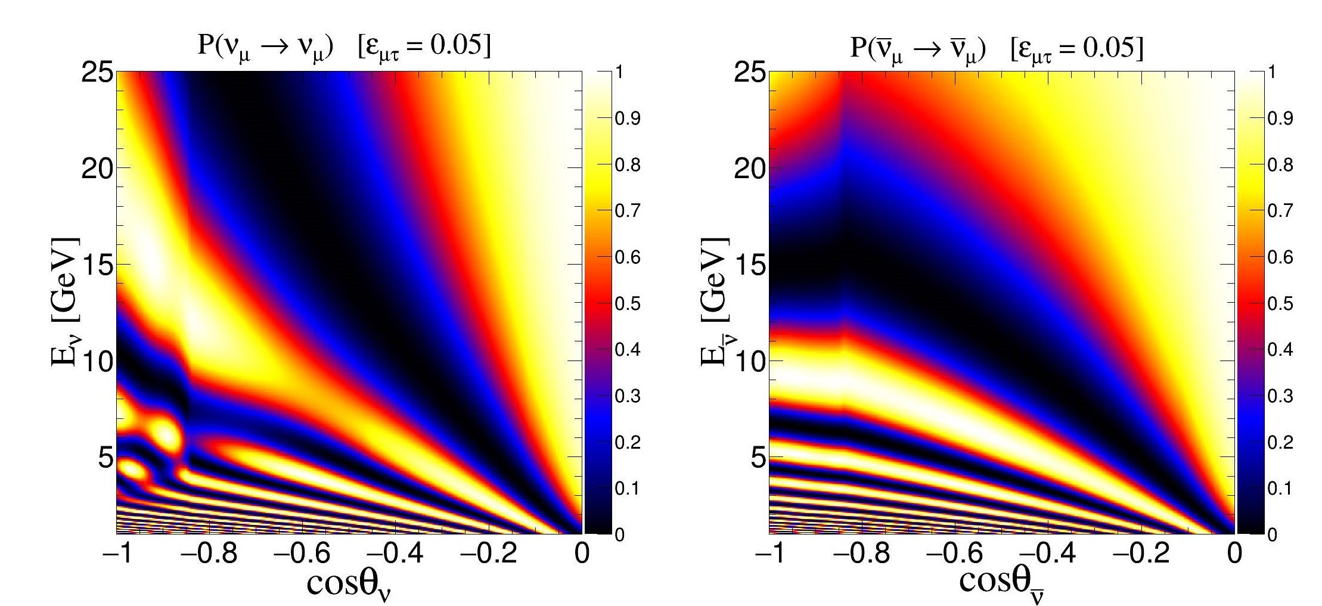
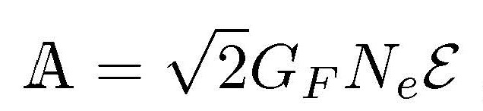
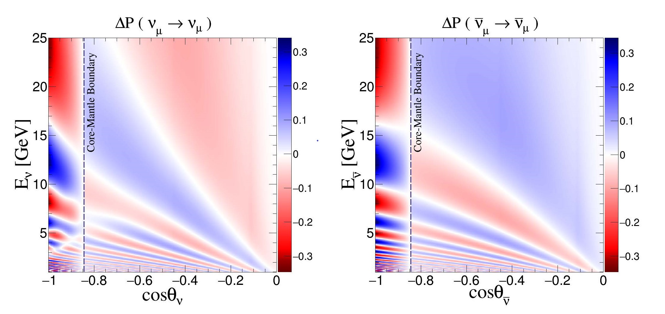
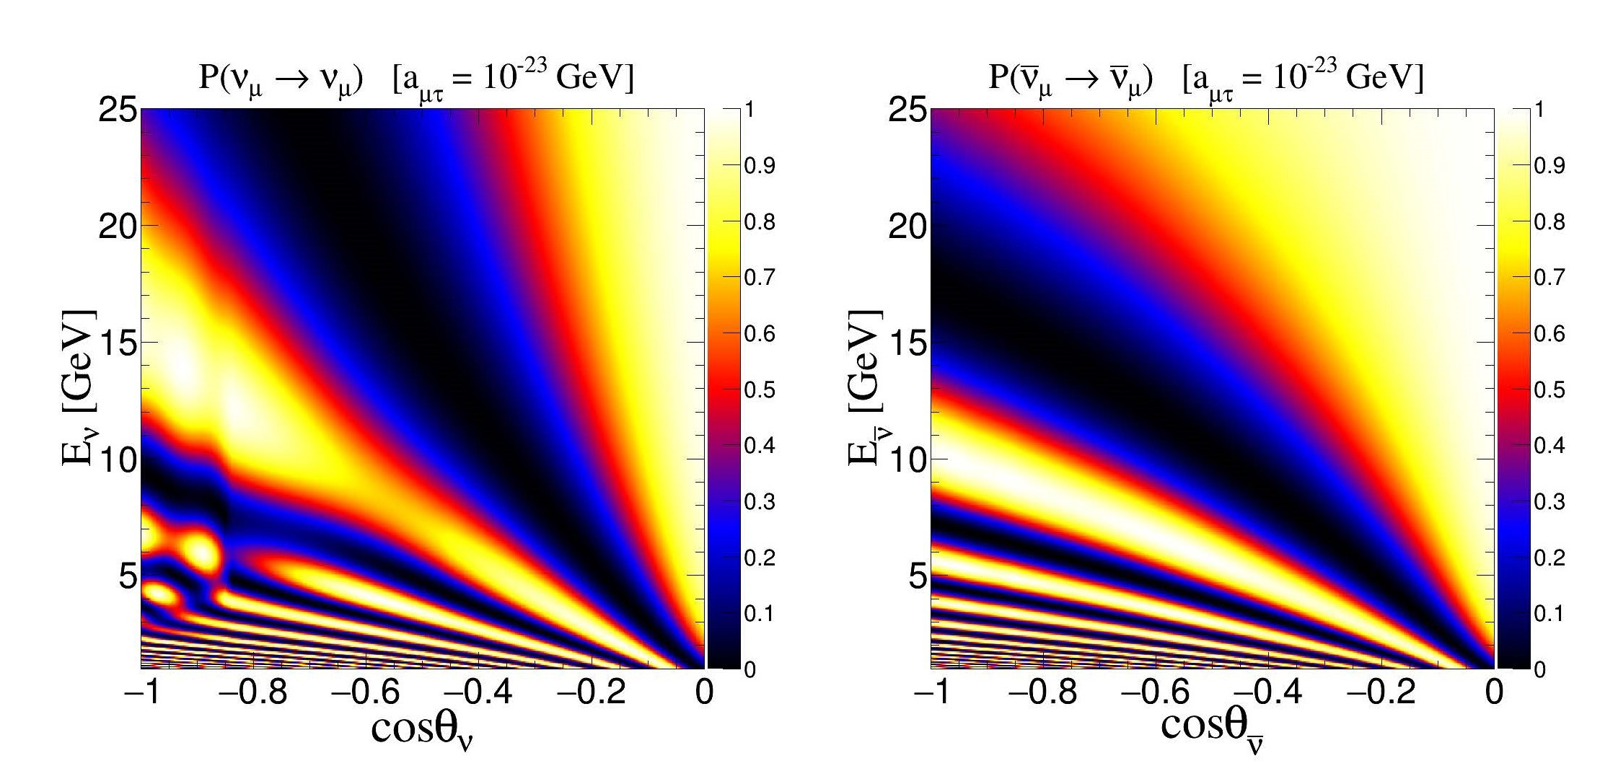




Identical oscillograms in LBL region
NSI, $ε_{μτ}=0.05$
Not surprising, since Hamiltonians identical when
As long as constant-$N_{e}$ approximation works,
any $A$ can be mimicked by $ε$ and vice versa
Difference in ``mimicking’’ region
LIV, $a_{μτ}={10}^{−23}$ GeV
$|ΔP|$ (DUNE) < 0.0012

Slide 16
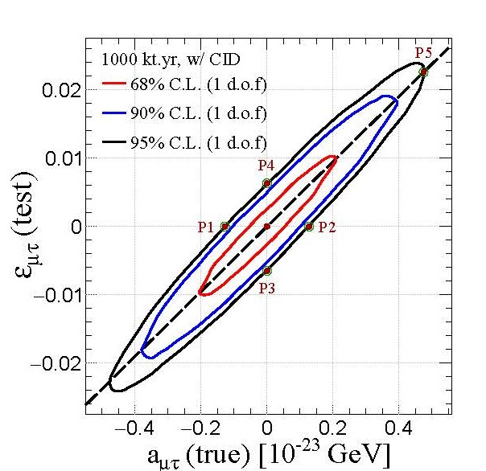
Atmospheric neutrinos to the rescue
Core-passing neutrinos do not obey the “average linear density along the path” approximation
(remember the parametric resonance)
It is possible to distinguish between these two (NSI vs LV) scenarios at any atmospheric neutrino experiment
Simulation study for ICAL@INO has been performed, still to be done for other detectors.
(Study for ICAL@INO)
Sadashiv Sahoo, Anil Kumar, S.K.Agarwalla, AD, 2205.05134

Slide 17
Neutrinos for Earth

Slide 18
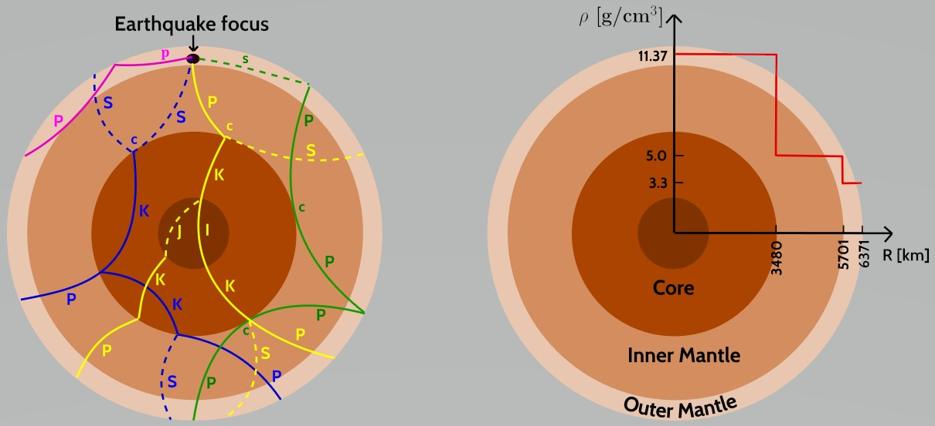
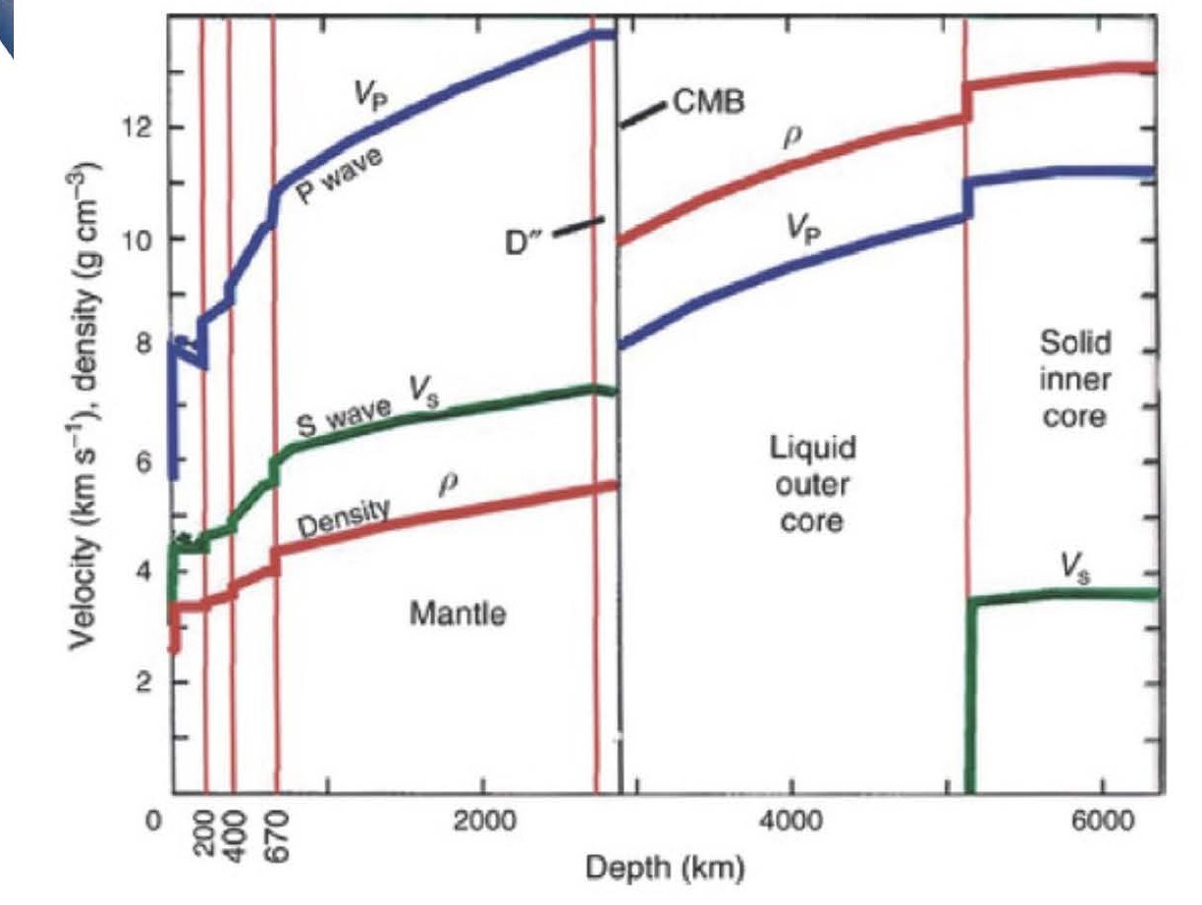
Multi-messenger tomography of Earth
Propagation of earthquakes
F. McDonough. Talk at MMTE 2022
Multi-messenger Tomography of Earth
A new workshop series bringing geophysicists and neutrino physicists together
What can neutrino propagation tell ?

Slide 19
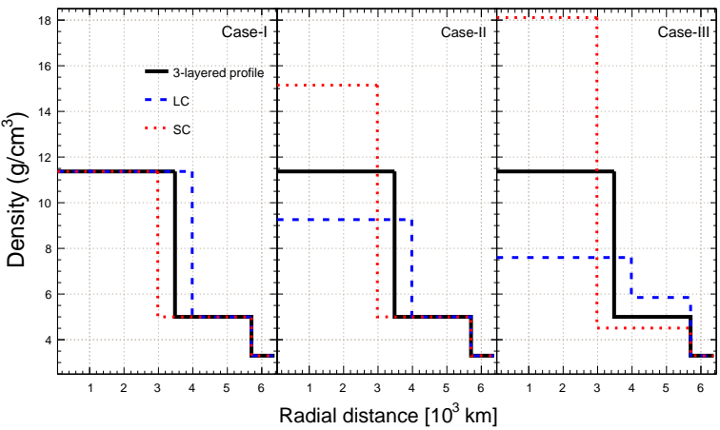
How well can the core-mantle boundary be identified ?
Preliminary
Three sample ways of implementing change in Core-Mantle-Boundary (CMB):
Case-I: density of each layer is kept fixed. The total mass of Earth is not constant.
Case-II: density of core modified such that the total mass of Earth remain constant. (Closer to reality)
Case-III: densities of core and inner mantle modify such that the individual masses of core and mantle remain constant.
Standard Core: 3480 km
Larger Core (LC): 3480 + 500 km
Smaller Core (SC): 3480 – 500 km
Anuj K. Upadhyay, Anil Kumar, Sanjib K. Agarwalla, AD, 2211.xxxxx

Slide 20
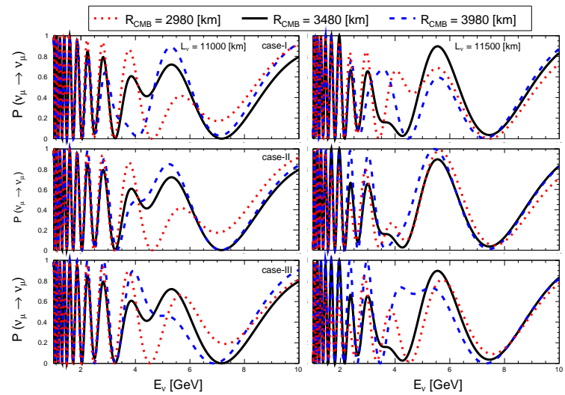

Effect of CMB change on Oscillation Probability
CMB variation significantly affects oscillation probability $P(ν_{μ}→ ν_{μ})$ at 2-5 GeV
This is the parametric resonance / NOLR region !
Preliminary
Anuj K. Upadhyay et al, 2211.xxxxx

Slide 21
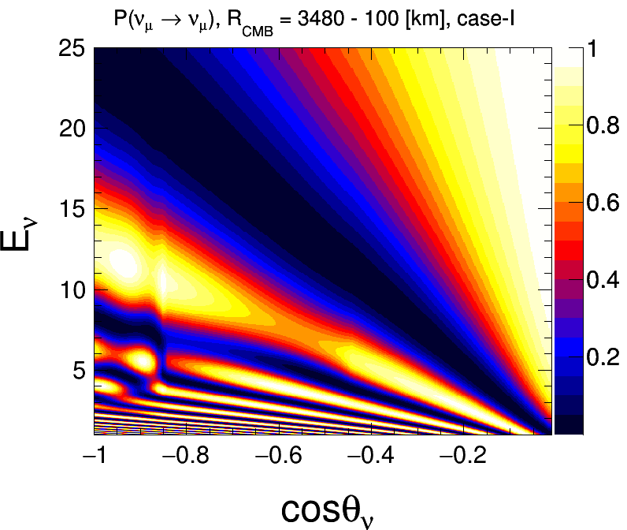





Effect of CMB Variation on Oscillograms
For decreasing core size, parametric resonance / NOLR region shrinks towards left
For increasing core size, parametric resonance / NOLR the NOLR/PR expands towards right.
Preliminary
Animation thanks to
Anil Kumar,
Talk at MMTE 2022

Slide 22
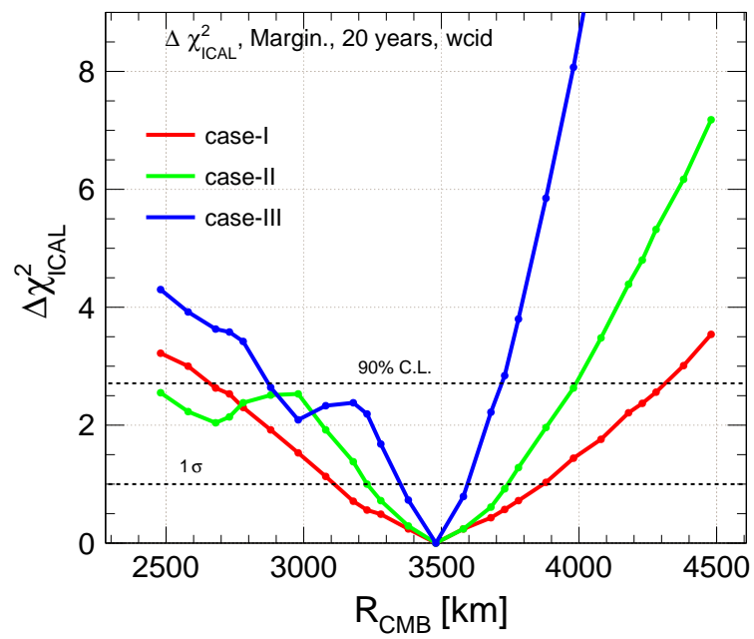

Sensitivity for Locating Core-Mantle Boundary
For realistic case-II, core radius can be determined to $±250$ km with 1 Mt-yr exposure at ICAL@INO
Study for other atmospheric neutrino experiments to be done.
With large detectors like HK, neutrinos may be able to offer competitive, and definitely complementary, bounds.
Preliminary
(Study for ICAL@INO, Anuj K. Upadhyay et al, 2211.xxxxx)

Slide 23
Is there DM inside the core ?
Strong bounds for scenarios where DM accumulates around a baryonic matter core
Scenarios where a DM ball is trapped around the Sun and accumulated visible matter ?
Anyway it may be worthwhile to put these limits by completely independent means

Slide 24
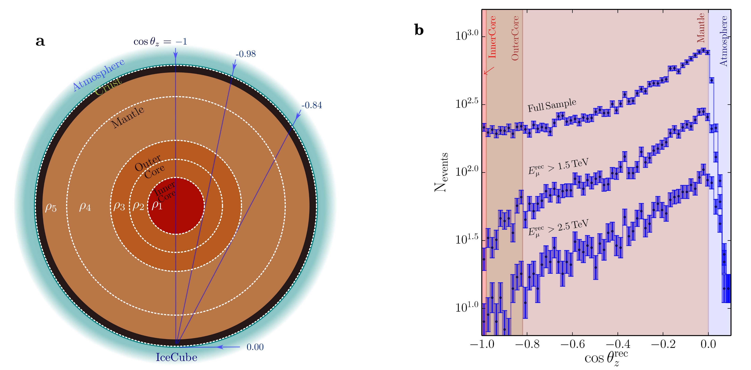
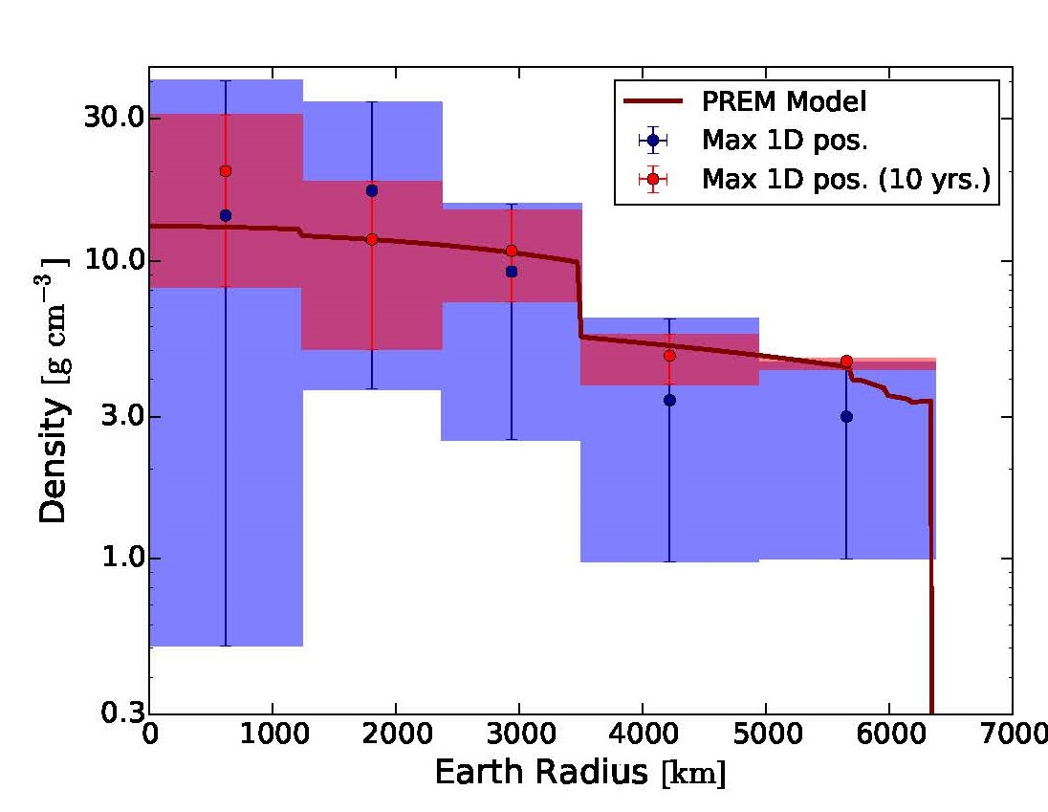


Neutrino Absorption Tomography
High-energy neutrinos ($E>$TeV) start getting scattered in Earth
The extent of scattering measures the matter content of earth using weak interactions [as opposed to gravitation/ EM (seismology)]
IceCube results indicate that the mass of Earth measured from weak interactions is consistent to the gravitational mass to within error bars ($∼30 \%$ )
A. Donini, S. Palomares-Ruiz, J. Salvado, 1803.05901 (Nature Physics)
But absoption can only measure path-integrated density!
Cannot exploit oscillation phase information !

Slide 25
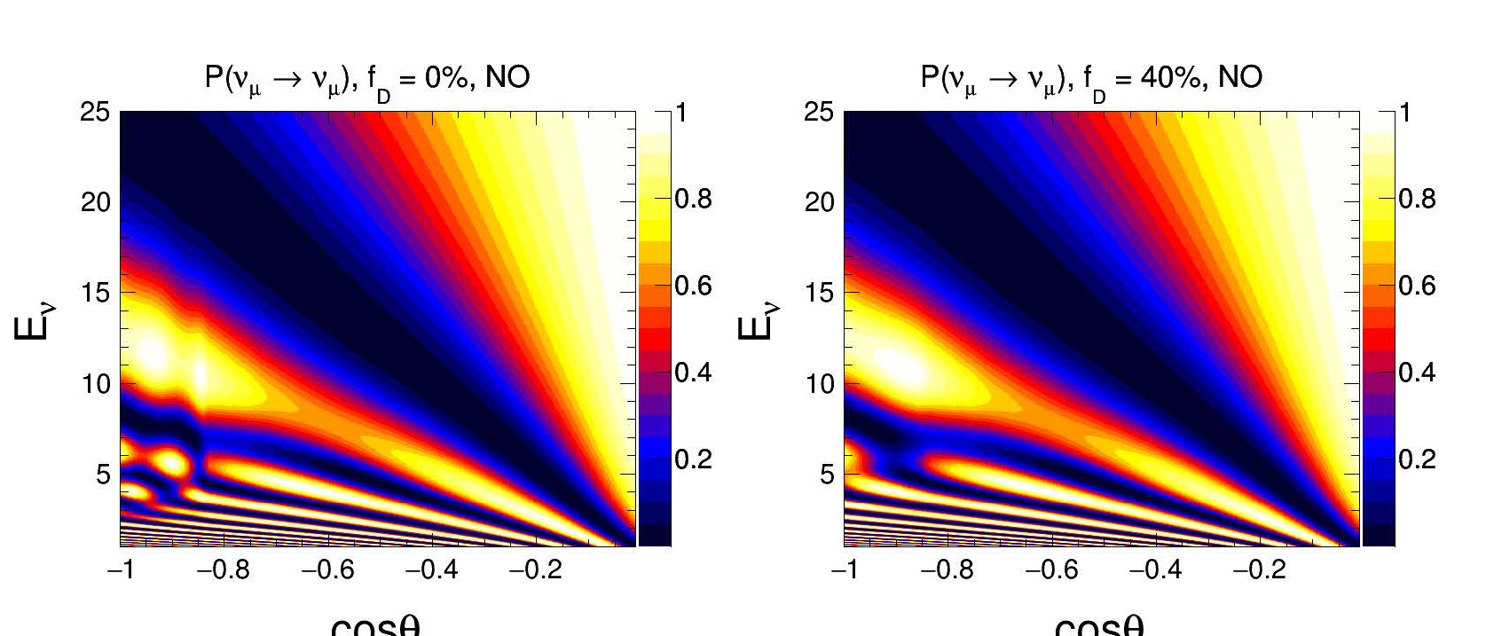
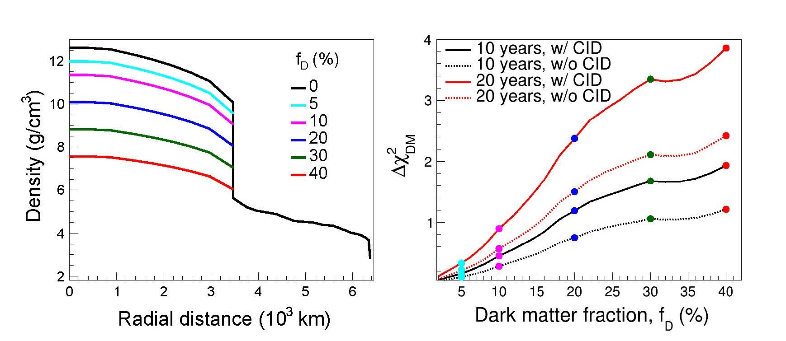

Neutrino Oscillation Tomography
Take the mass of mantle to be known to a good accuracy (1% – 5%)
Scale down the matter profile inside the core by a fraction, assuming that the remaining will be accounted for by DM
Study for INO@ICAL suggests sensitivity to DM fraction of $∼30\%−40\%$ of the core, i.e. about 10% of total earth mass.
Study for other atmospheric neutrino experiments to be done.
Anuj K. Upadhyay, Anil Kumar,
Sanjib K. Agarwalla, AD, 2112.14201

Slide 26
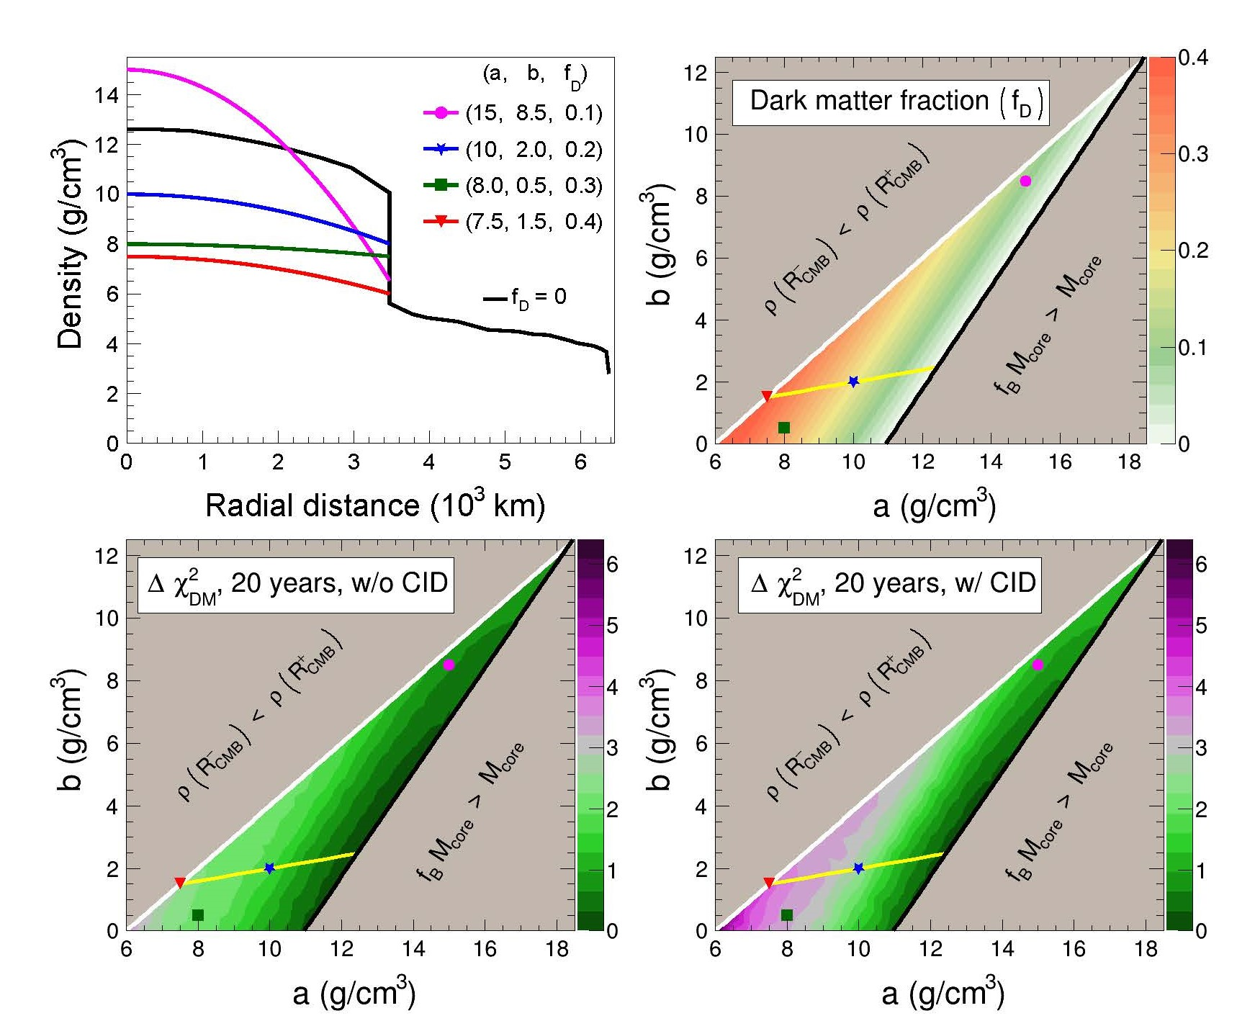

Sensitivity to density profile in the core
Baryonic density profile
$ρ_{B}=a+b {\left(\frac{r}{R_{CMB}}\right)}^{2}$
Parameters $a$ and $b$ can be bounded
$⇒$ sensitivity to the profile shape of baryonic density
This is independent of the presence of DM
Anuj K. Upadhyay, Anil Kumar,
Sanjib K. Agarwalla, AD, 2112.14201

Slide 27
Final remarks
Earth matter effects on supernova neutrinos may be observable if the fluxes have not depolarized
Earth matter effects crucial for measuring neutrino properties
Measurement of neutrino propagation through Earth can give information about Earth itself
Atmospheric neutrinos can probe the core of the Earth, allows distinction between scenarios that are virtually degenerate at long baseline experiments
After all, it is the combination of multiple experiments that increases our strength

Slide 28
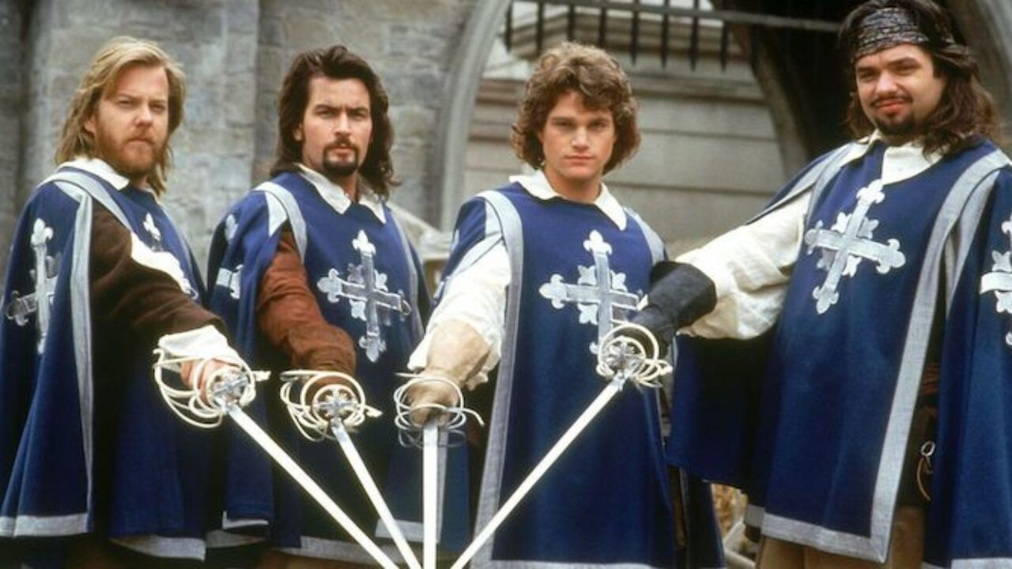




Astro $ν$
Solar $ν$
Atm $ν$
LBL $ν$

