Slide 1
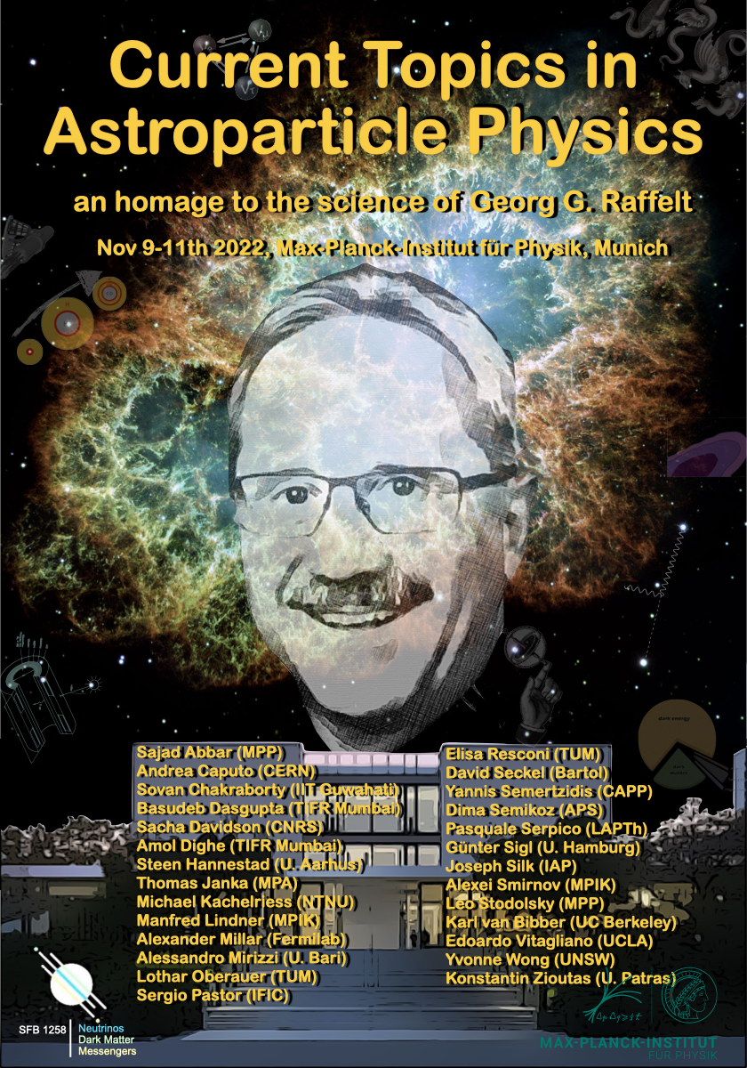
Low energy neutrino physics
Georg Raffelt Symposium
Munich – MPP
Nov. 2022

Slide 2
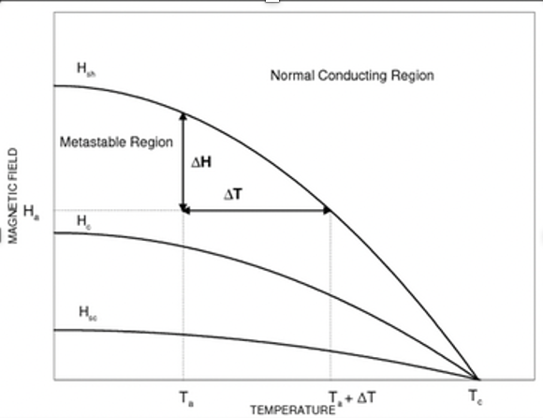
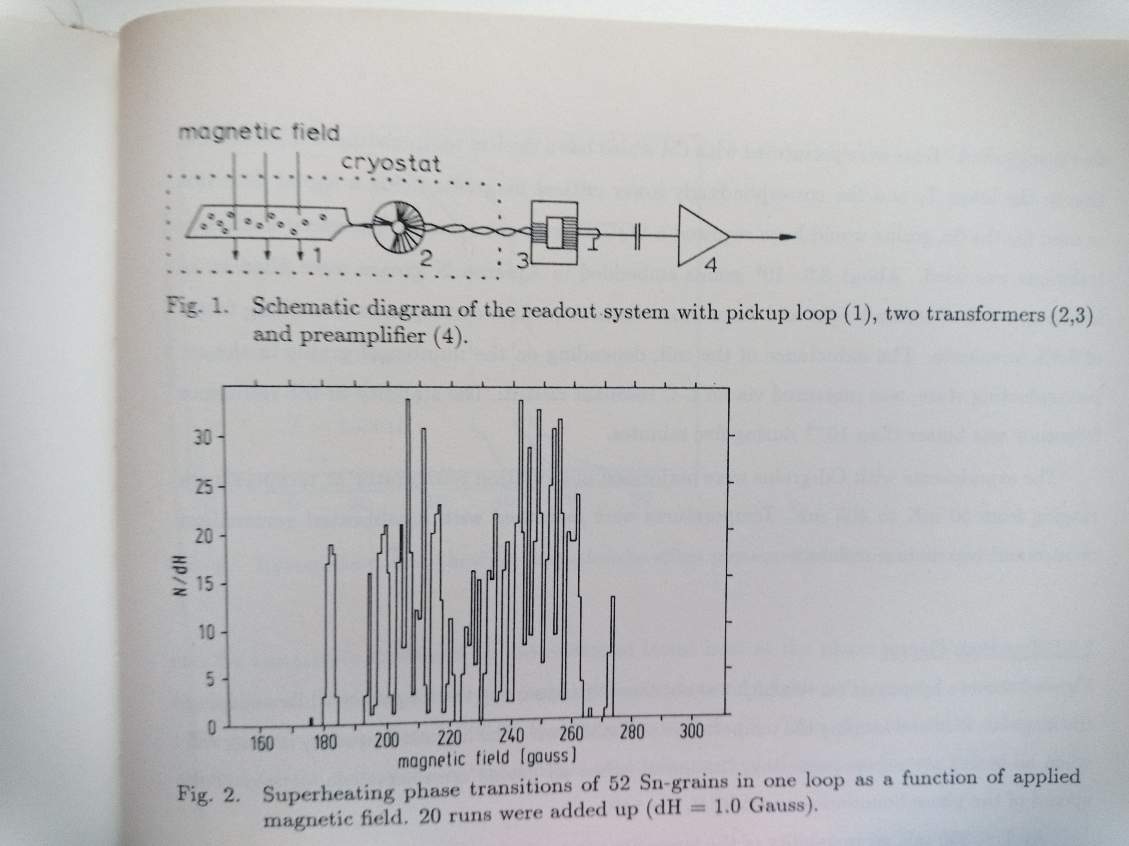
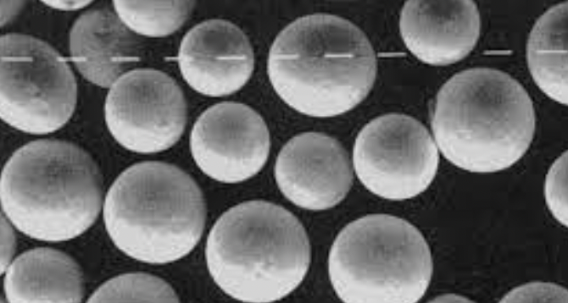
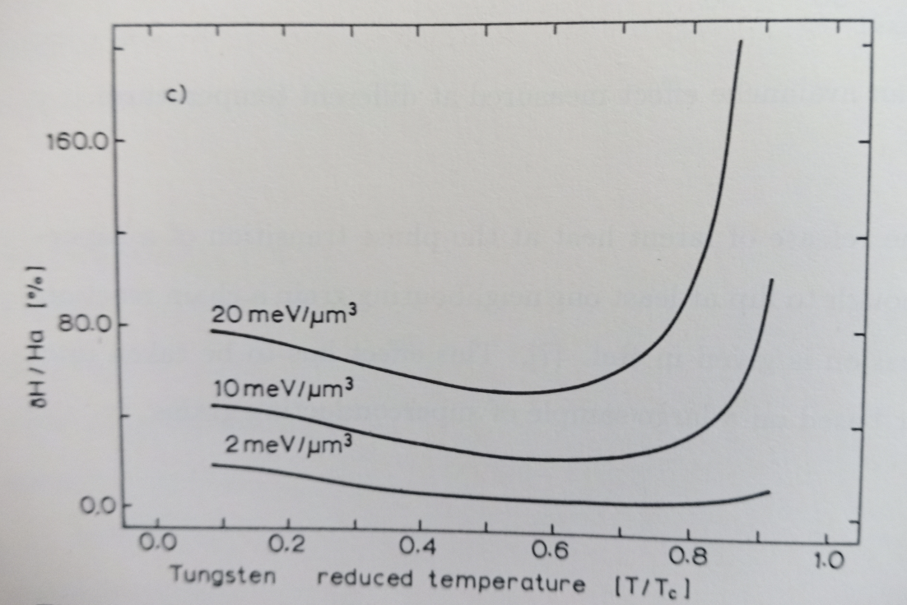
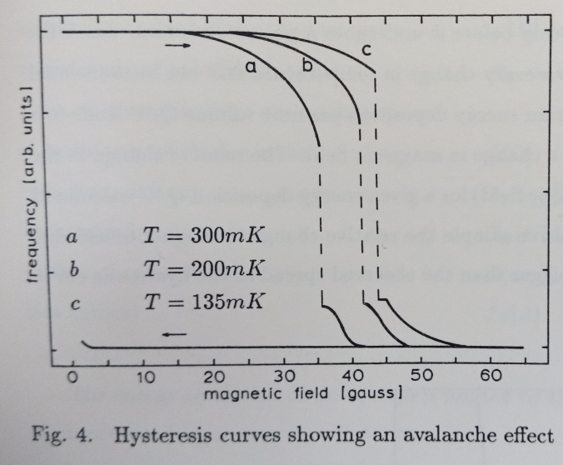
Coherent neutrino nucleus scattering
Ca. 1983 – 1985
Superheated superconducting grains (≈ 10μm) in external B-field
Rudolf Mößbauer
Franz von Feilitzsch
Leo Stodolsky
Andrej Drukier
Wolfgang Seidel
Georg Raffelt
LO
Transition curves of superheated, supercooled superconducting grains
Measured flips of 52 Sn grains (superheated) in 20 cycles
Irradiation with 93 keV gammas: 90% flipping rate
Threshold ΔE/V = 12 eV/μm³
Grains (Sn, Cd)
Hysteresis curve (Cd) and avalanche effects as function of T
Extracted sensitivity curves for W-grains

Slide 3
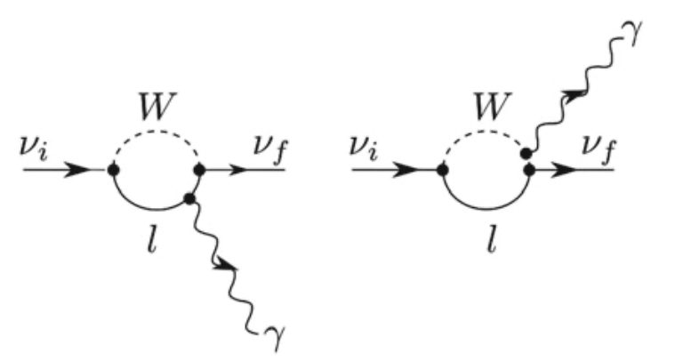
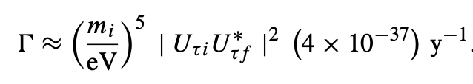
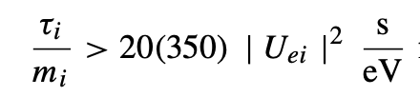
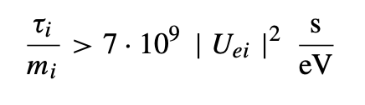
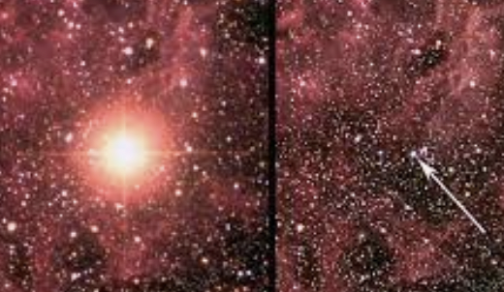
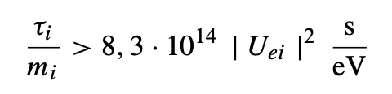
Neutrino decay
Experimental limits:
Reactor Gösgen
Solar x-rays
SN1987a
(1995 – 1993)
Rudolf Mößbauer
Franz von Feilitzsch
Caren Hagner
Michael Altmann
Yves Declais
Stefan Schönert
…
Georg Raffelt
LO
Radiative neutrino decays
LO, R. Mössbauer, F. von Feilitzsch, Phys. Lett. B 198, 113 (1987)
G. Raffelt, Phys. Rev. D 31, 3002 (1985)
F. von Feilitzsch and LO, Phys. Lett. B 200, 580 (1988)
Supernova SN1987a

Slide 4
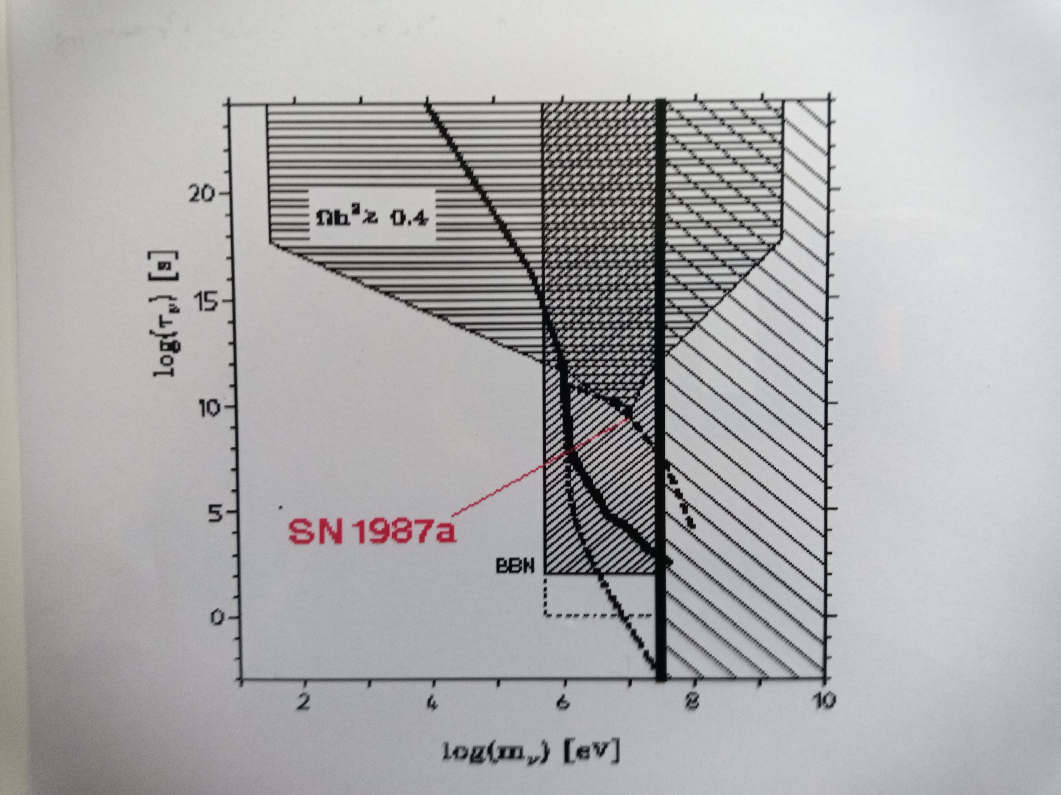
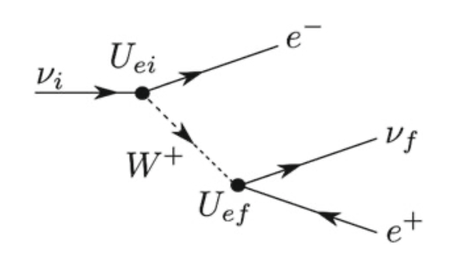
Neutrino decay
For masses > 1 MeV
Associated with Bremsstrahlung
Lower limits from SN1987a
Upper limits from cosmology: exclusion of heavy (> MeV) neutrino states
LO, G. Raffelt et al., Astropart. Phys. 1, 377 (1993)

Slide 5
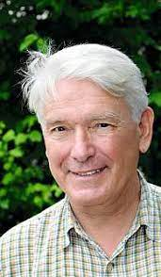

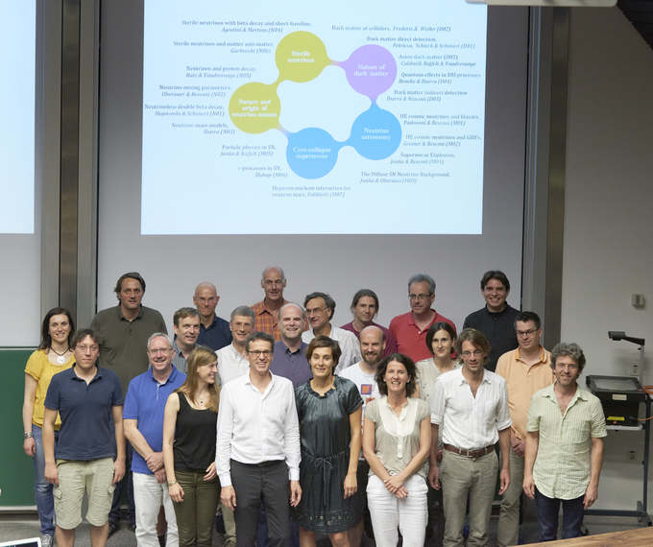
SFBs
SFB „Astroteilchenphysik“
1994 – 2006
Speaker: Franz von Feilitzsch
TR 27 „Neutrinos and Beyond“
2007 – 2011
Speaker: LO
SFB „NDM“
Since 2017
Speaker: Elisa Resconi

Slide 6
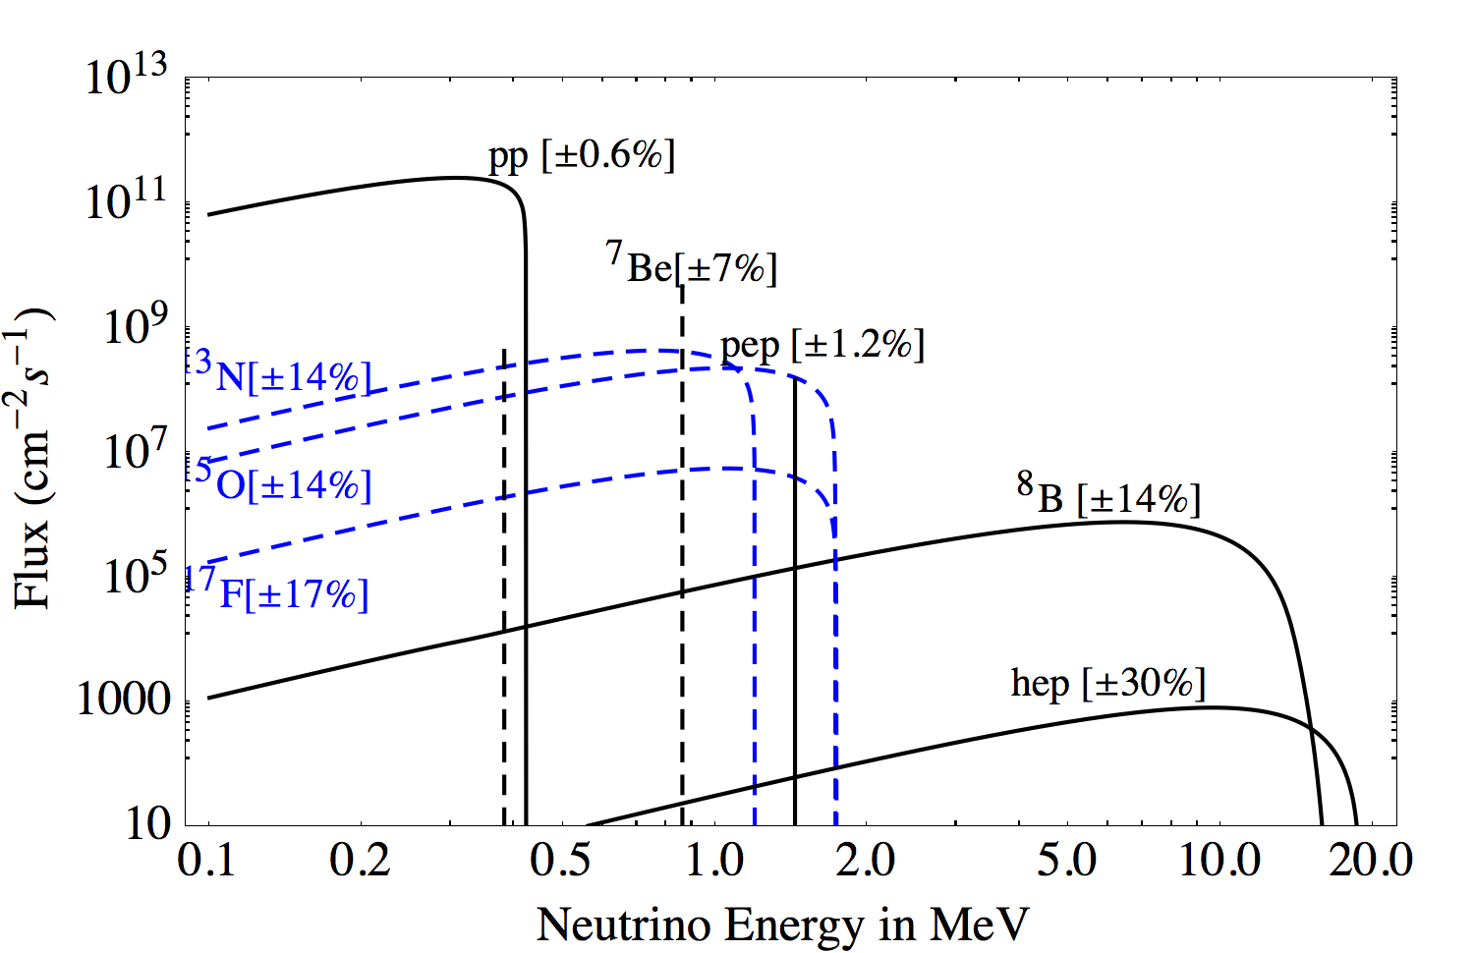
Solar Neutrino Spectrum
BOREXINO
Borexino

Slide 7
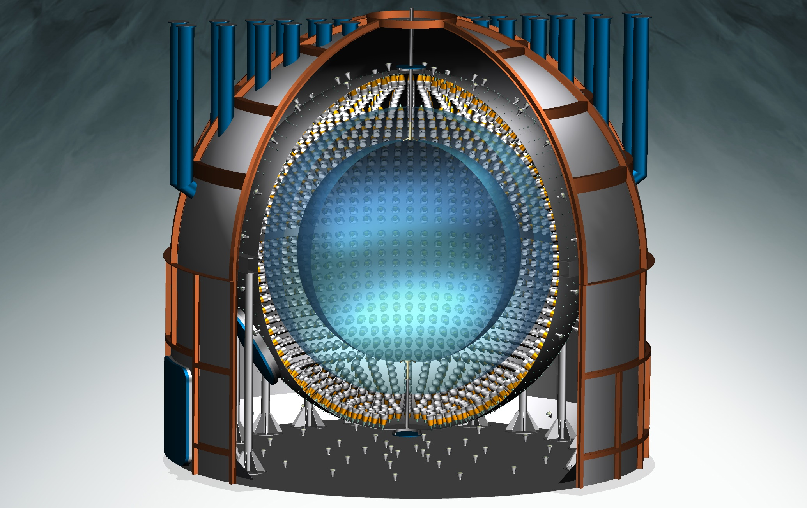
Borexino detector layout
Scintillator sphere (~270t PC, PPO)
Nylon membranes (0.15mm)
Buffer PC
Sphere (13m diameter)
2212 PMs plus light concentrators
Water shield and Cherencov detector (208 PMs)
Outer steel tank (~18m height, ~18m diameter)

Slide 8
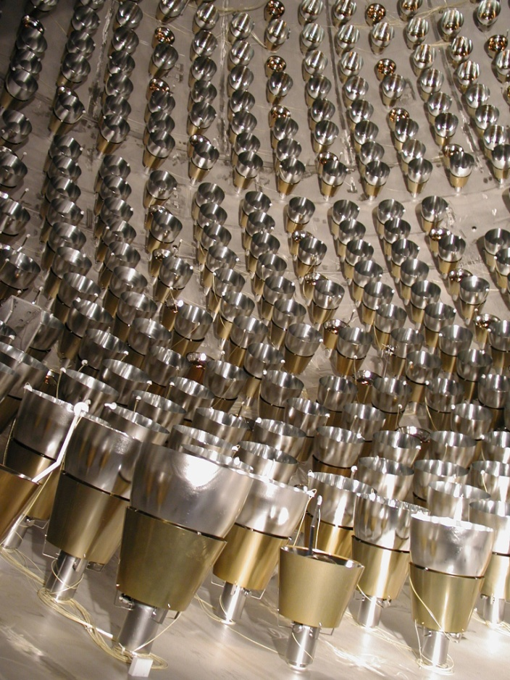
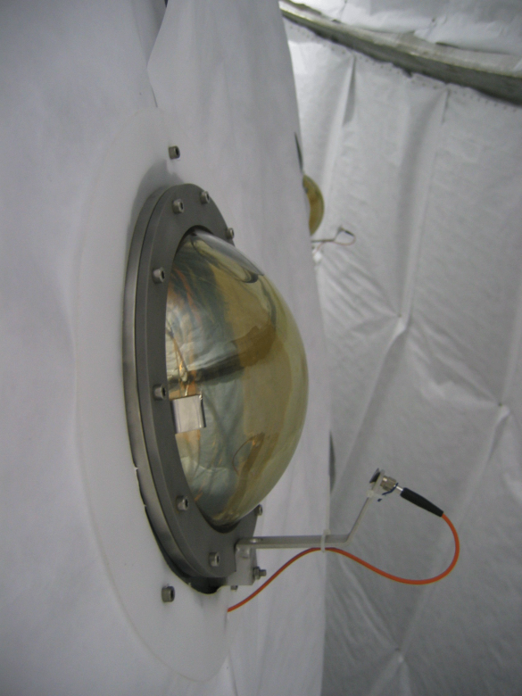
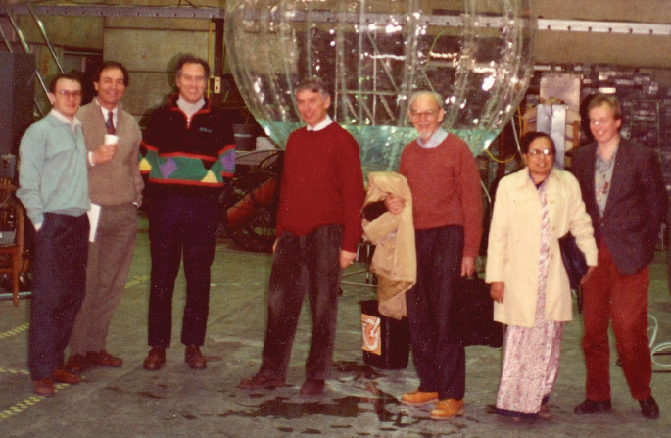
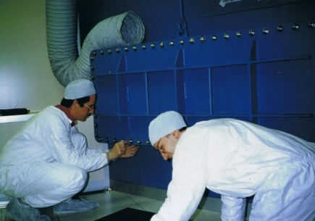
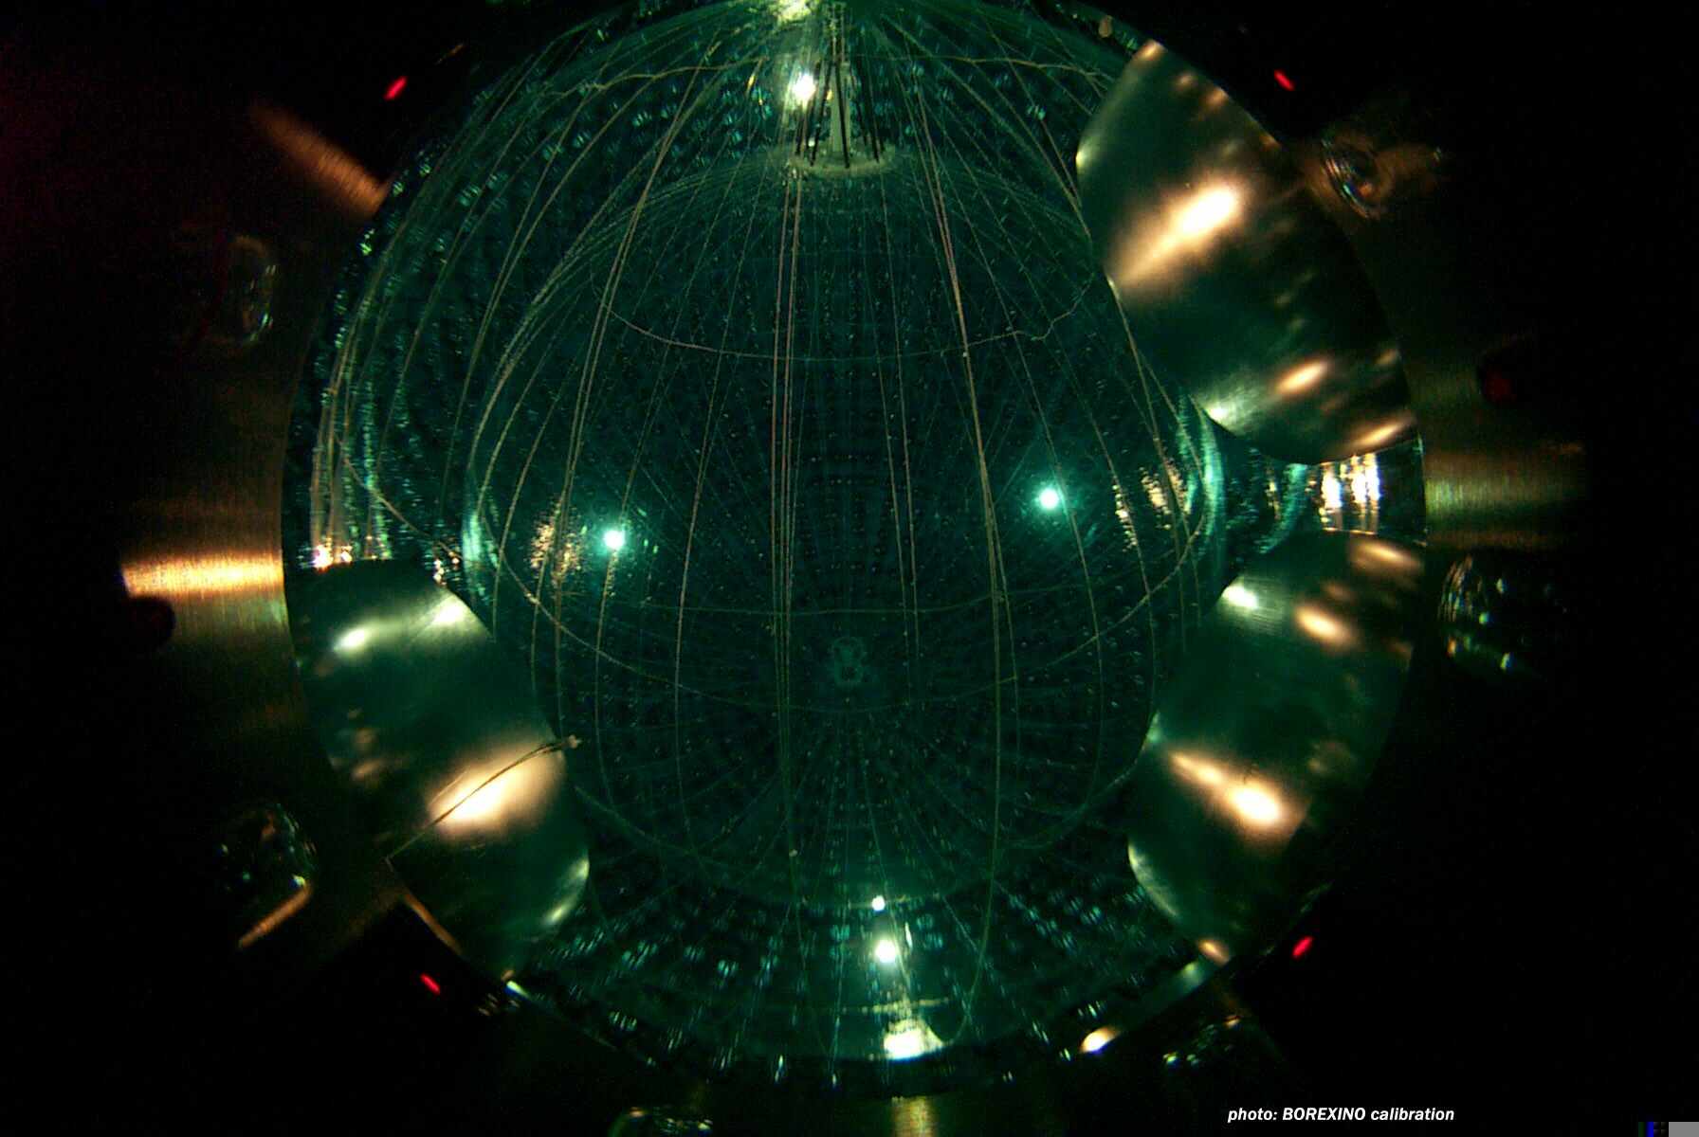
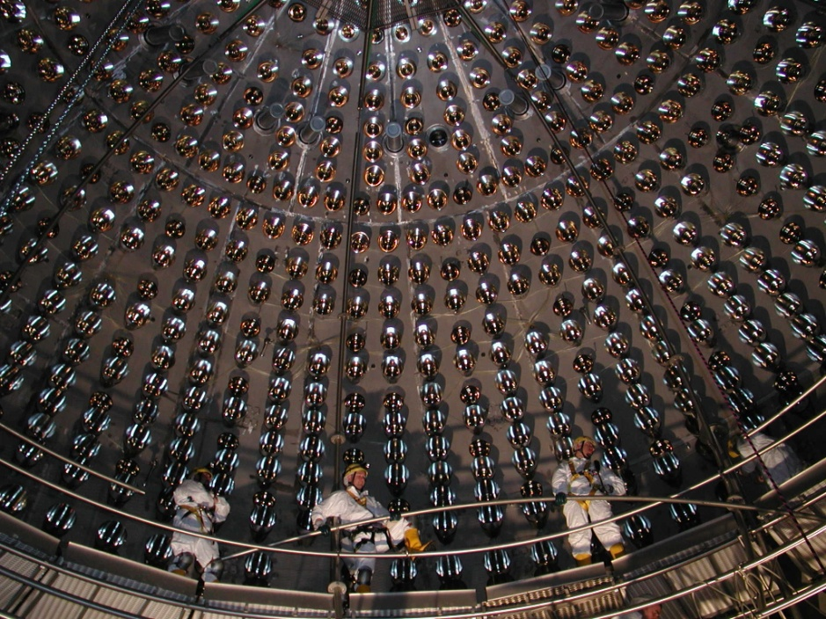

Slide 9
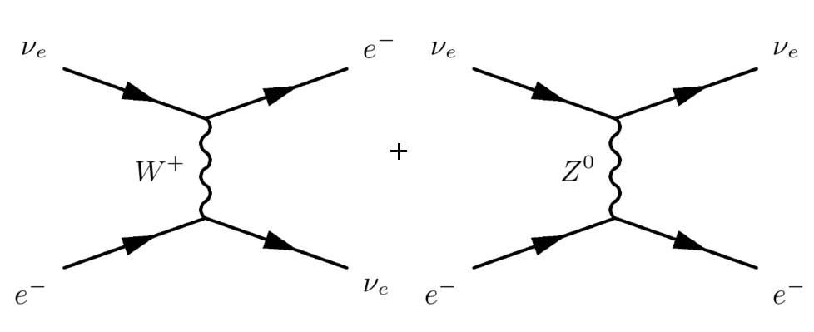
Solar neutrino detection in Borexino
Solar neutrinos are detected via elastic scattering off electrons ν + e -> ν + e
Spectroscopy of the recoil electrons in the liquid scintillator
Low energy threshold (∼ 60 keV), no directional information
Cross section for ν_{e} larger (factor ∼ 6) as for ν_{μ,τ}
ν_{μ,τ}
ν_{μ,τ}
forbidden for ν_{μ}, ν_{τ}

Slide 10
Solar neutrino detection in Borexino
ν
ν
e⁻
measurement of electron recoil energies
=> spectroscopy (σ/E ∼ 5% at 1 MeV)
measurement of neutrino interaction vertex
position resolution ∼ 10 cm (each direction)
=> definition of an inner, fiducial volume
Borexino event display

Slide 11
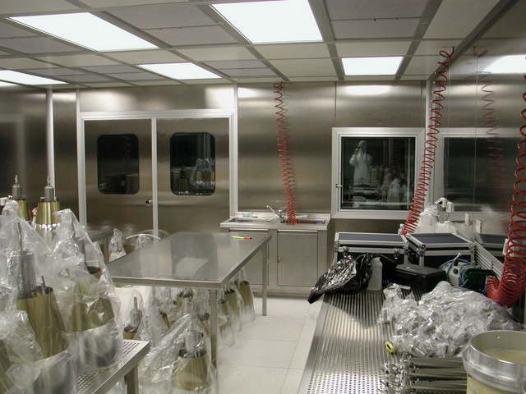
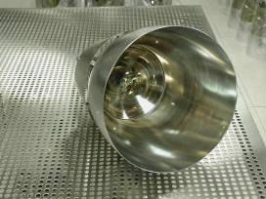
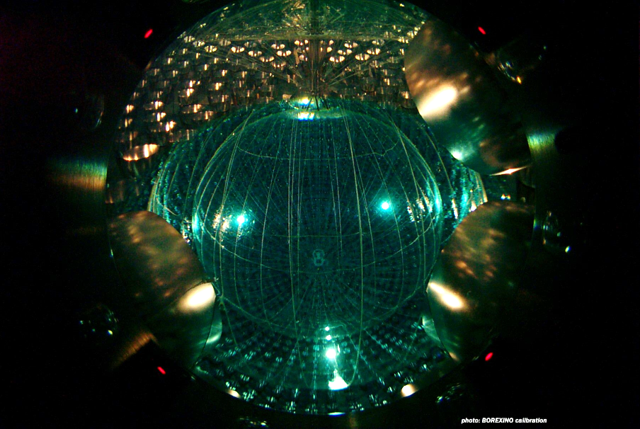
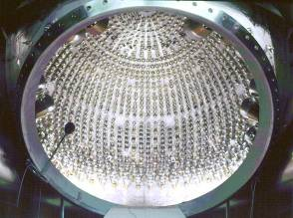
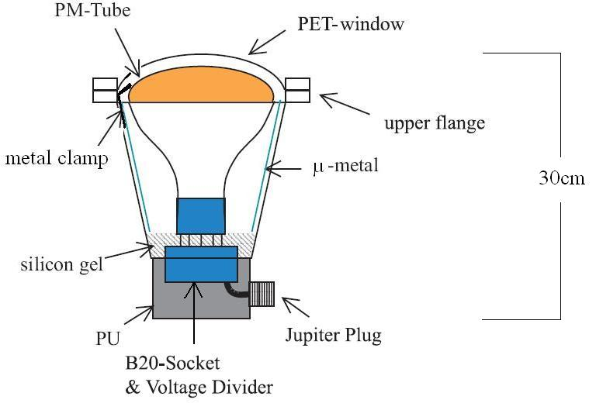
Borexino
Technical developments towards an unique low energy, high purity ν−detector
developments of new techniques and purification methods
careful selection of detector materials
installation under cleanroom condintions

Slide 12
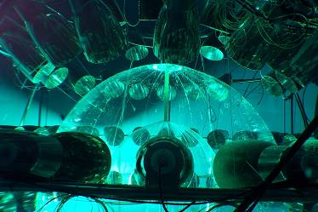
Borexino Counting-Test-Facility (CTF)
The reduction of radioactive elements in the scintillator was key for the big success of Borexino
Beta- and gamma-events in the fiducial volume are irreducible background events
e.g.:
Uranium-, thorium-concentrations in…
crust of the Earth ca. 10⁻⁶
scintillator oil ca. 10⁻¹³
specs Borexino ca. 10⁻¹⁷
Measured in Borexino (> 2012) ca. 10⁻¹⁹
CTF was a ca. 5 t prototyp detector of Borexino
Its results (e.g. on 14C, U, Th, K, cosmic-μ interactions etc.) and developments
pathed the way for Borexino

Slide 13
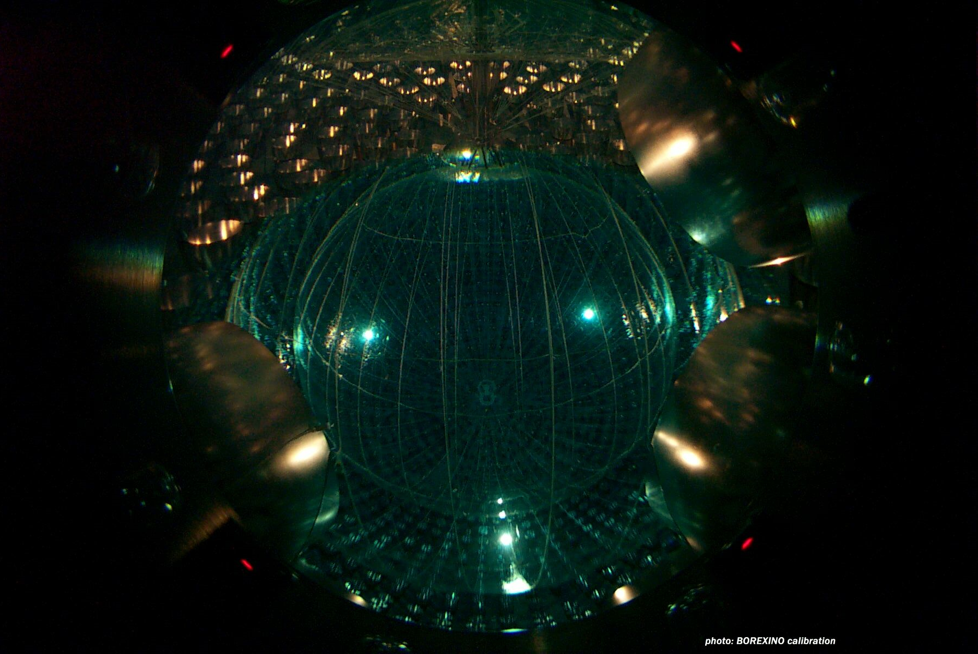
Borexino scientific highlights
1st result on 7-Be neutrinos (2007)
8-B neutrino measurement at E > 3 MeV (2010)
Geo-neutrino detection (2010)
Long-baseline reactor neutrino detection (2010)
High precision 7-Be measurement
(2011)
1st direct pep-neutrino measurement (2012)
1st direct pp-neutrino measurement (2014)
Update geo-neutrinos (2016)
Update solar neutrinos (2017)
1st measurement of CNO-neutrinos (2020)
=> complete measurement of all relevant neutrino branches
Borexino inner detector

Slide 14
Borexino-results
…out of 2 x 10²⁰ neutrinos /day about 50 interact n the target…
solar ⁷Be-Neutrinos
rate: 48.3 ± 1.3 / (day x 100 t)
solar pep-neutrinos
rate: 2.4 ± 0.4 /(day x 100 t)
solar pp-neutrinos
rate: 134 ± 14 /(day x 100 t)
solar ⁸B-Neutrinos
rate: 0.220 ± 0.017 /(day x 100 t)
energy distribution of events after muon veto within the FV

Slide 15
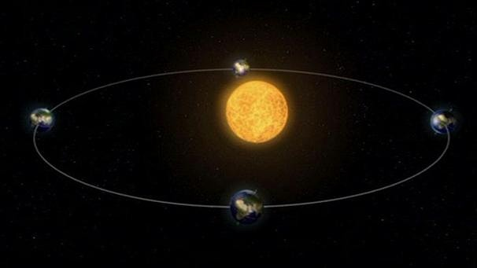
Eccentricity
Seasonal variation of the 7Be-ν signal
Eccentricity of Earth‘s orbit introduces a ca. 7% flux variation.
observed by Borexino
Quelle: Die Umlaufbahn der Erde um die Sonne | Bild: BR

Slide 16
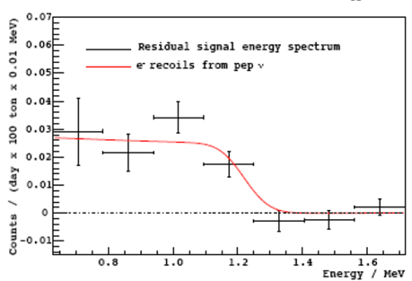
Borexino-results
solar pep-neutrinos
rate: 2.4 ± 0.4 /(day x 100 t)
Elaborate analysis required:
ID of muon induced ¹¹C-(beta+)-events via 3-fold coincidence
Pulse shape discrimination (ortho-positronium formation in the scintillator)
p
e
p
+
ν
n
p
²H

Slide 17
Borexino-results
solar pp-neutrinos
rate: 134 ± 14 /(day x 100 t)
elaborate analysis required:
ID of background events at extremely low energies
good knowledge of the visible ¹⁴C-beta spectrum
Analysis of pile-up effects in the relevant low-E window
p
p
+
e⁺
+
ν
n
p
²H

Slide 18
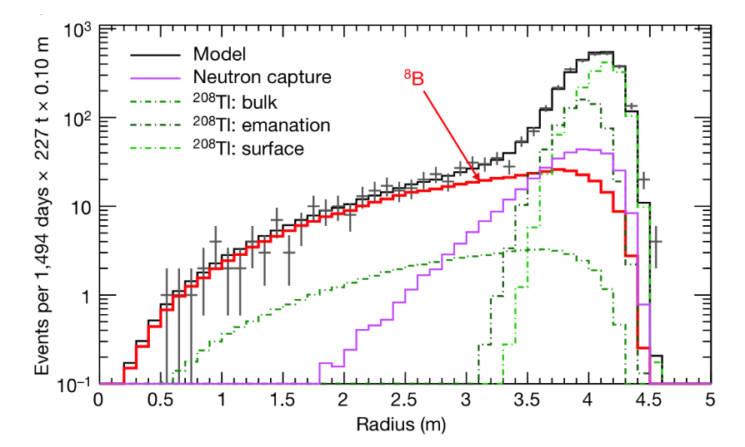
Borexino-results
solar ⁸B-Neutrinos
rate: 0.220 ± 0.017 /(day x 100 t)
analysis challenge:
extension to larger volume
precise understanding of external & internal bg
precise understanding of cosmic muon induced bg
⁴He
⁸B
−>
+
ν
e⁺
⁴He

Slide 19
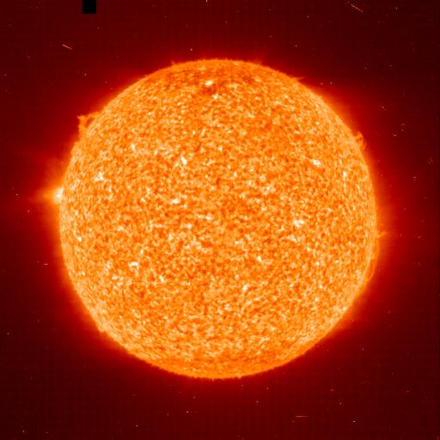
Neutrino luminosity
Result on pp – Neutrinos
Measurement of the actual nuclear solar power
One may compare this to the electromagnetic solar luminosity (radiation from ist surface)
Both are in good agreement
=> Sun ist stable in ist energy generation for more than about 10⁵ years

Slide 20
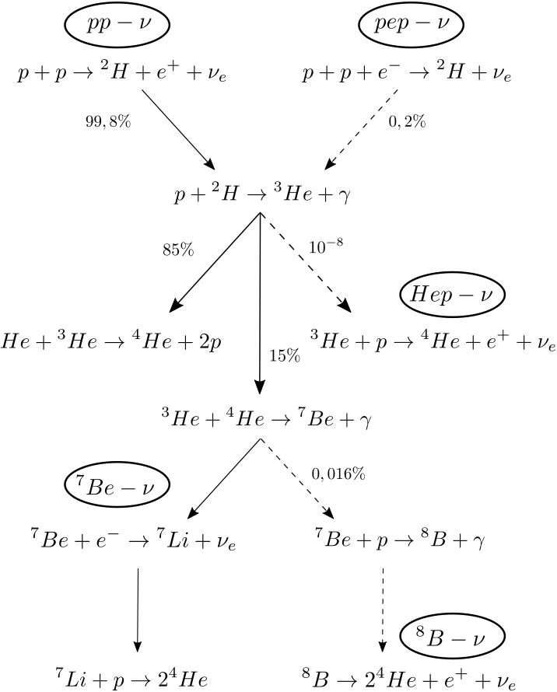
pp-branching ratio
Borexino can measure the solar branching ratio
R = ³He + ⁴He / ³He + ³He
by comparing pp-, pep-, and ⁷Be-neutrino fluxes

Slide 21
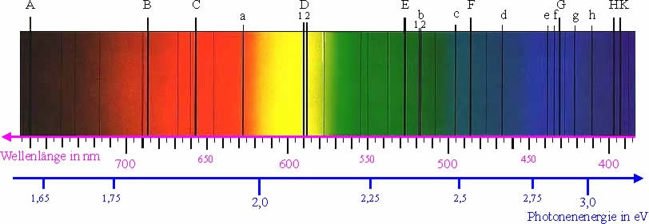
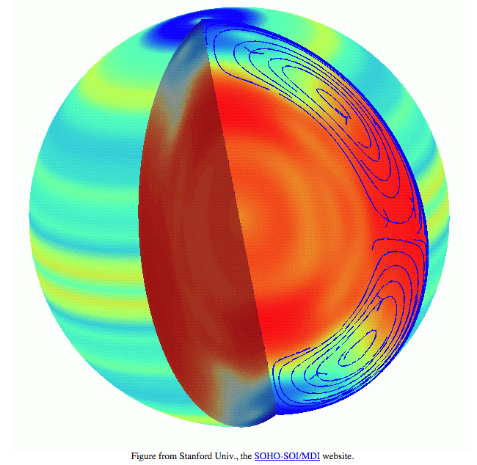
Solar metallicity
Actual issue of solar physics:
Low vs. high-value metallicity !
Physics of the solar surface prefers low metallicity
https://www.leifiphysik.de/atomphysik/atomarer-energieaustausch/geschichte/joseph-von-fraunhofer-1787-1826
Helio-seismology: high metallicity
…and solar Neutrinos ?

Slide 22
Solar metallicity
Analysis ⁸B- and ⁷Be-neutrino fluxes
prediction (blue = low metallicity, red = high metallicity)
Borexino: indication for high metallicity
Low metallicity is excluded by 96.6%
No ultimative answer yet posssible

Slide 23
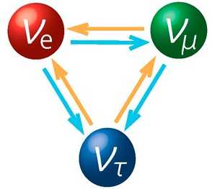
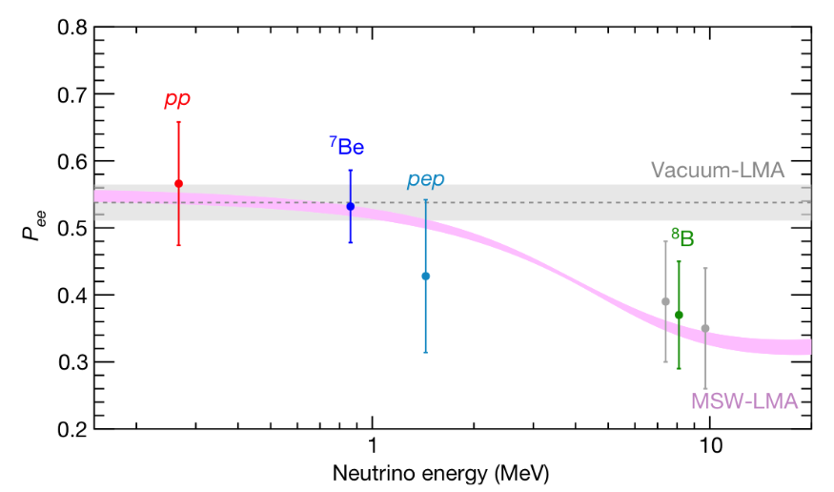
MSW effect
Probing solar matter effects with Borexino
Comparison rates of different branches (i.e. different energies) with astrophysical predictions
Survival probability P_{ee} (ν_{e} -> ν_{e} )
Proof of ν−oscillations
Good agreement with prediction of MSW-effect with large-mixing solution
Solar ν_{e} survival probability as function of its energy, measured in Borexino

Slide 24
CNO-Neutrinos
CNO-ν window in the lower part of the energy spectrum
CNO-ν detection extremely difficult
⁷Be- and pep-ν form background
Beta-decay ²¹⁰Bi forms irreducible background
²¹⁰Bi decays to ²¹⁰Po (alpha-decay)
Idea: use radioactive equilibrium between ²¹⁰Po- and ²¹⁰Bi-rates
=> determine ²¹⁰Bi-decay rates
²¹⁰Pb −> ²¹⁰Bi (beta) −> ²¹⁰Po (alpha) −> ²¹⁰Pb
T_{1/2}: 22.3y 5.01d 138.4d stable

Slide 25
CNO-Neutrinos
Low ²¹⁰Po – region (black)
inner part of Borexino-FV
fiducial Volume (white)
minimum of ²¹⁰Po
upper limit on ²¹⁰Bi
proof of ²¹⁰Bi uniformity in FV
²¹⁰Po – Rate in 2020

Slide 26
CNO-Neutrinos
Fit including systematic uncertainties
best fit value (per day in 100 t):
CNO-ν flux:
blue region: prediction with low metallicity
purple: prediction with high metallicity

Slide 27
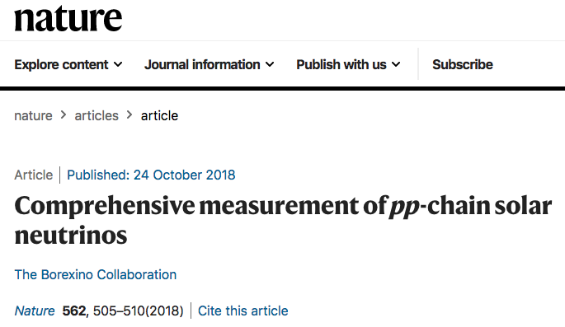
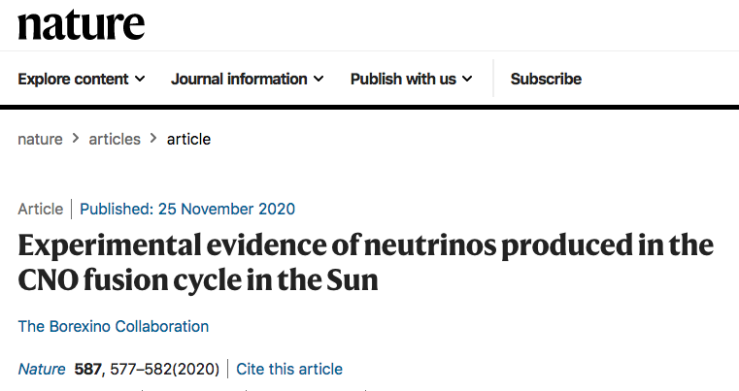
Further readings

Slide 28
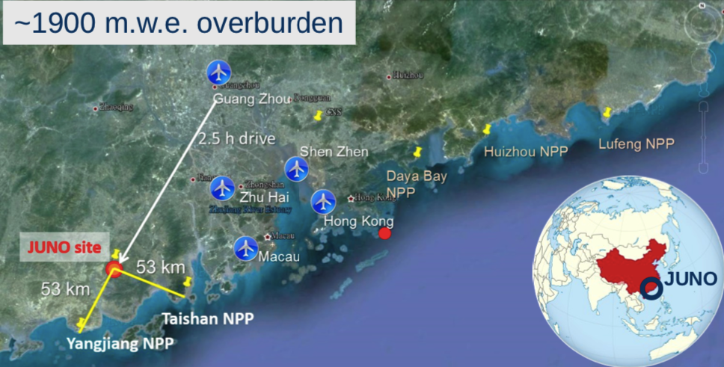
Physics of JUNO
Jiangmen Underground Neutrino Observatory
Neutrinos from two Nuclear Power Plants
26.6 GW_{th} power by 2020 (35.8 GW_{th} final)
JUNO Central Detector
20 kt Liquid Scintillator Target

Slide 29
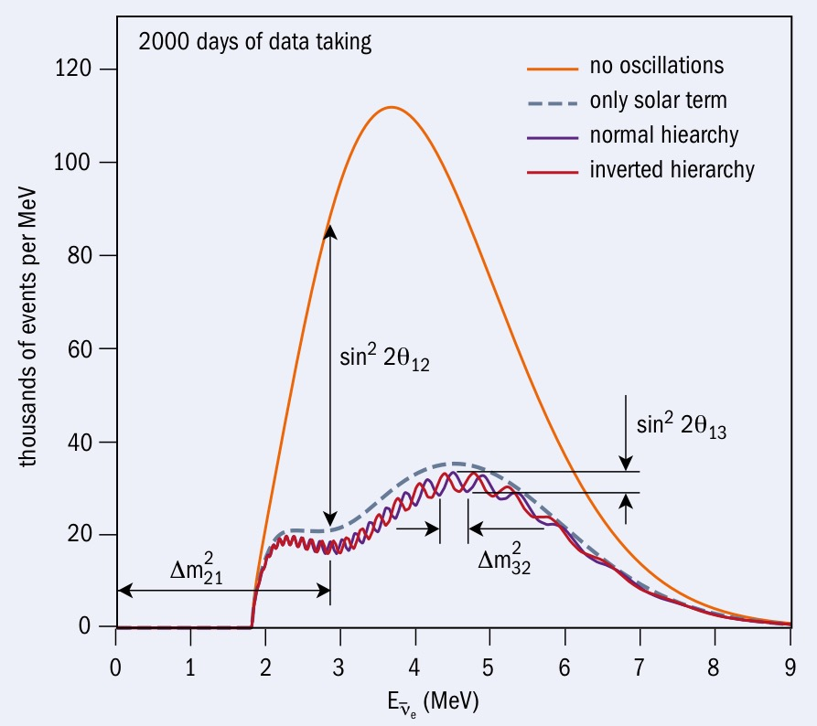
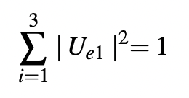
Oscillation physics
High precision measurements all inclusive (one spectrum):
Mass ordering
Θ₁₂
Θ₁₃
Δm²₂₁
Δm²₃₁
Test on unitarity of PMNS-matrix
Precision after 6 years of data taking:
sin²Θ₁₂ 0.5%
sin²Θ₁₃ 12.1%
Δm²₂₁ 0.3%
Δm²₃₁. 0.2%
arXiv: 2204.13249
Δm²₃₁
1%

Slide 30
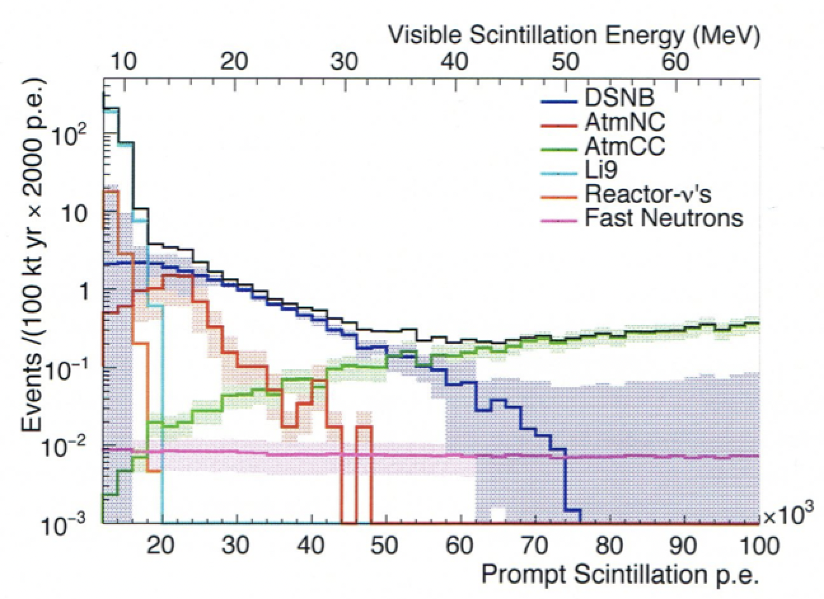

DSNB
DSNB not detected yet
Search via
Best limits from SuperK
Is it around the corner?
SuperK now filled with Gd-doped water, JUNO liquid scintillator
Rare rate experiment (< 10 / year)
Bg due to nc-atmosph. neutrino events
Remedy: PSD techniques

Slide 31

JUNO goals
source | Event rate | topic
reactor | ∼ 60 /day | Oscillation physics
DSNB | < 10 / year | Astrophysics
Supernova burst | ∼ 5 x 10³ / 10 s (at 10 kpc) | Astrophysics
Atmospheric neutrinos | ∼ 10 / day | Oscillation physics
Terrestrial neutrinos | ∼ 1 / day | Geophysics
Solar neutrinos | ∼ 10⁴ / day | MSW-effect/Astrophysics
Proton decay | < 1 / year | B-violation

Slide 32
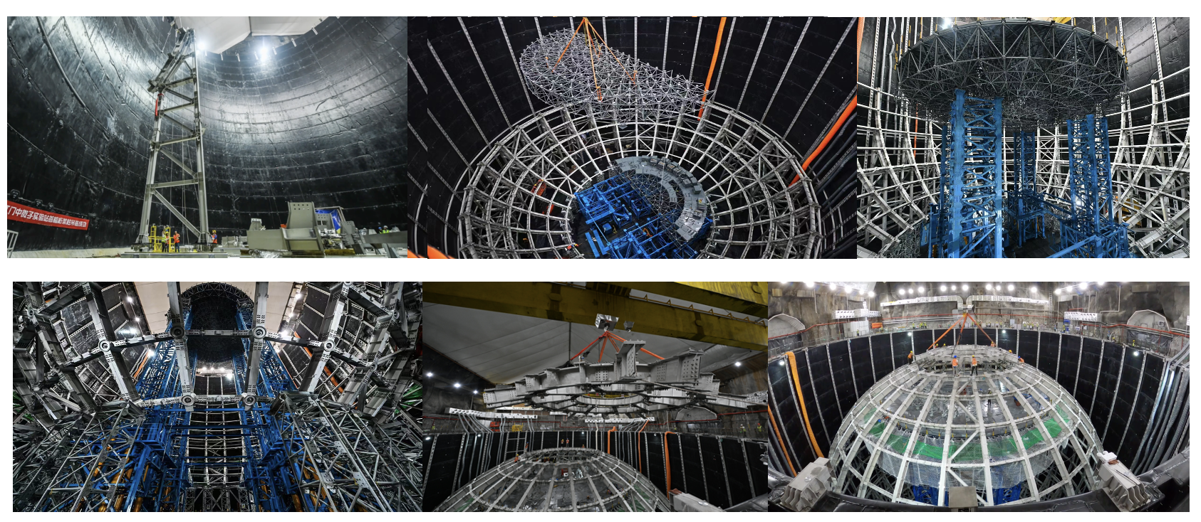
Status of JUNO
Completion of CD stainless steel truss (June 2022)

Slide 33
Status of JUNO
Construction of liquid scintillator purification systems ongoning

Slide 34
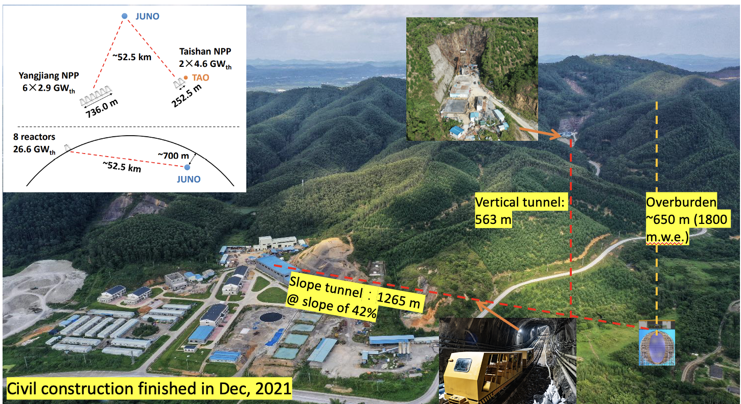
Status of JUNO

Slide 35
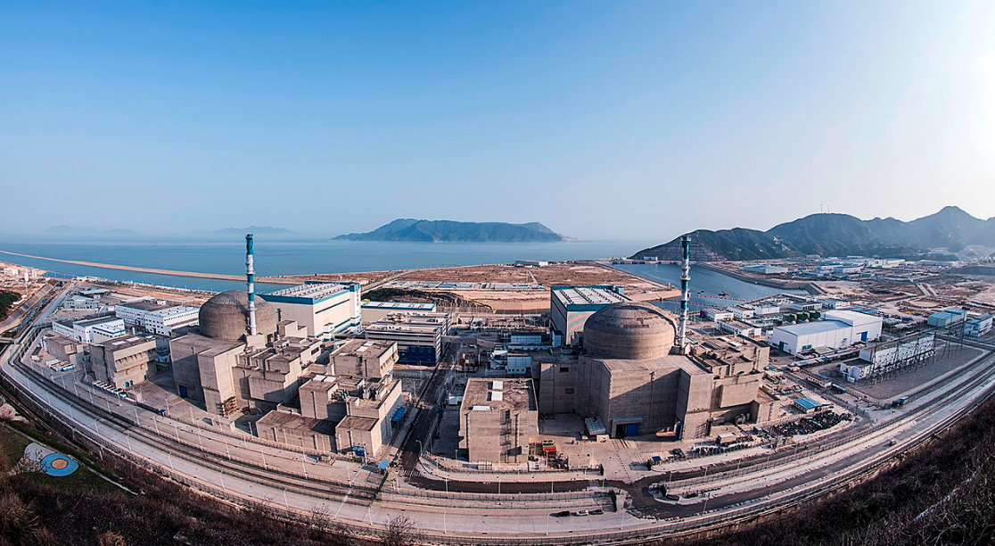

TAO (satellite experiment of JUNO)
JUNO:
Neutrinos from two Nuclear Power Plants
26.6 GW_{th} power by 2020 (35.8 GW_{th} final)
JUNO-TAO:
Located at Taishan 1 reactor core (4590 MW_{th})
New EPR
Taishan 1
∼ 30 m distance to the core
∼ 36 × JUNO statistics
∼ 4500 p.e. / MeV (better resolution as JUNO)
∼ 10% background-to-signal ratio
Short baseline reactor experiment
Precise determination of reactor spectrum vs. time
Provide model independent reference for JUNO
Search for sterile neutrino oscillations

Slide 36

Time schedule & milestones

Slide 37
Conclusion
Dear Georg,
thanks a lot for the common work in astroparticle physics!
It was and it is a great pleasure!
Best wishes to you!

