Slide 1





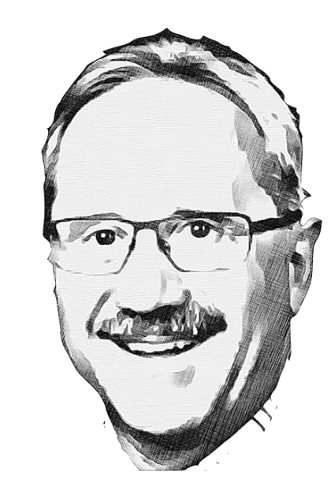
The incredible journey of IBS-CAPP to DFSZ sensitivity since its establishment on October 16, 2013
Yannis K. Semertzidis, IBS/CAPP & KAIST
Georg Raffelt celebration, MPP, November 10, 2022
I know Georg’s name since I got involved with axions in 1987. His papers are a reference for us all and I’m honored to be here to celebrate with him and colleagues.
All the interesting axion frequencies will be probed globally in the next 10-20 years

Slide 2
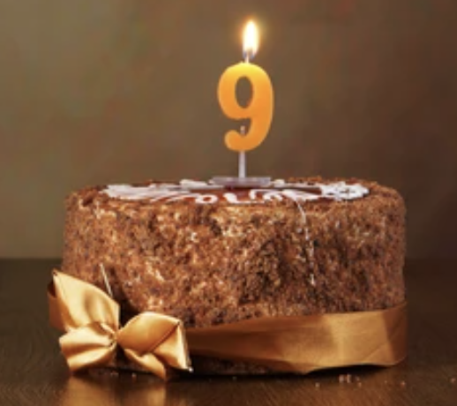
CAPP-Physics: strong CP-problem and axion dark matter
Dark Matter is one of the top ten most important Particle Physics questions
The coupling is feeble, it requires the effective application of latest state of the art technology and lots of ingenuity (high-risk, high-physics-potential)
CAPP (est. October 16, 2013) has acquired the equipment and has developed the technology, know-how, and infra-structure to effectively probe the 1-8 GHz in the next five years at DFSZ sensitivity.
Strong CP-problem: why
Strong interactions don’t
violate CP-symmetry?

Slide 3
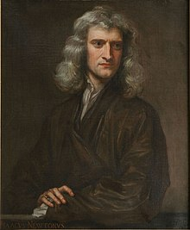

Dark Matter and Isaac Newton (1642-1726)
Isaac Newton unified the Physics phenomena:
falling of an apple with the planet, moon, star, sattelite, comet motions, under Gravity!
He clarified the view of Heavens for Humanity!
He also gave us the ability to see what cannot be seen with ordinary methods. Looking from deviations from his rules we are able to sense the presence of Dark Matter.

Slide 4
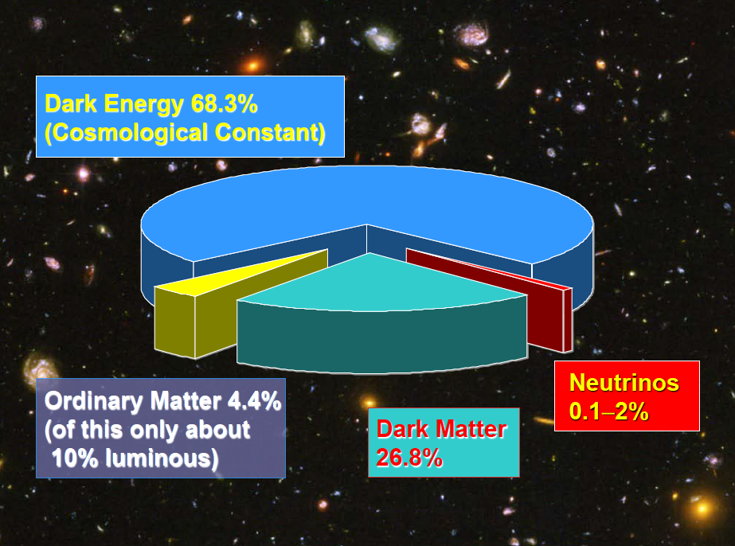
Cosmological inventory

Slide 5

Axions: A leading Dark Matter Candidate

Slide 6
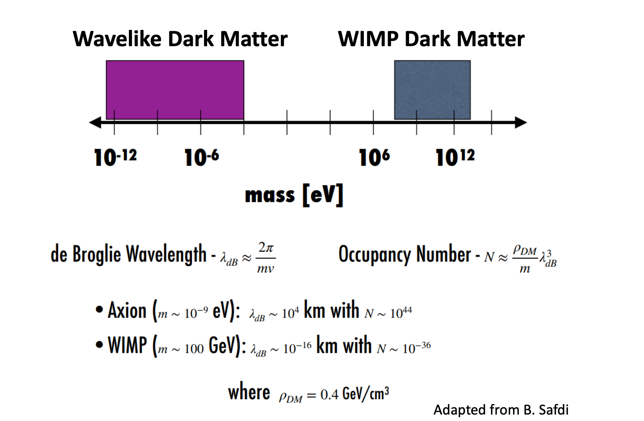
Dark matter candidates

Slide 7
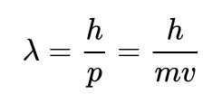
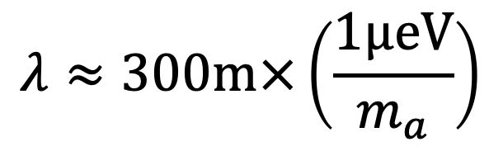
Axion Dark Matter: a Cosmic MASER
De Broglie wavelength of axions
$$λ≈300m×\left(\frac{1μeV}{m_{a}}\right)$$

Slide 8
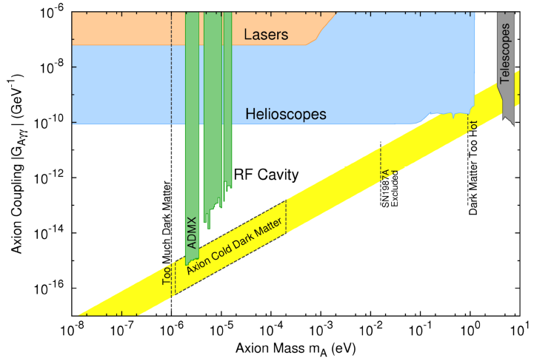
Axion coupling vs. axion mass
ALPs:
Axion
Like
Particles
A unique feature: There’s a bottom line
Axions here solve the
Strong CP-problem

Slide 9
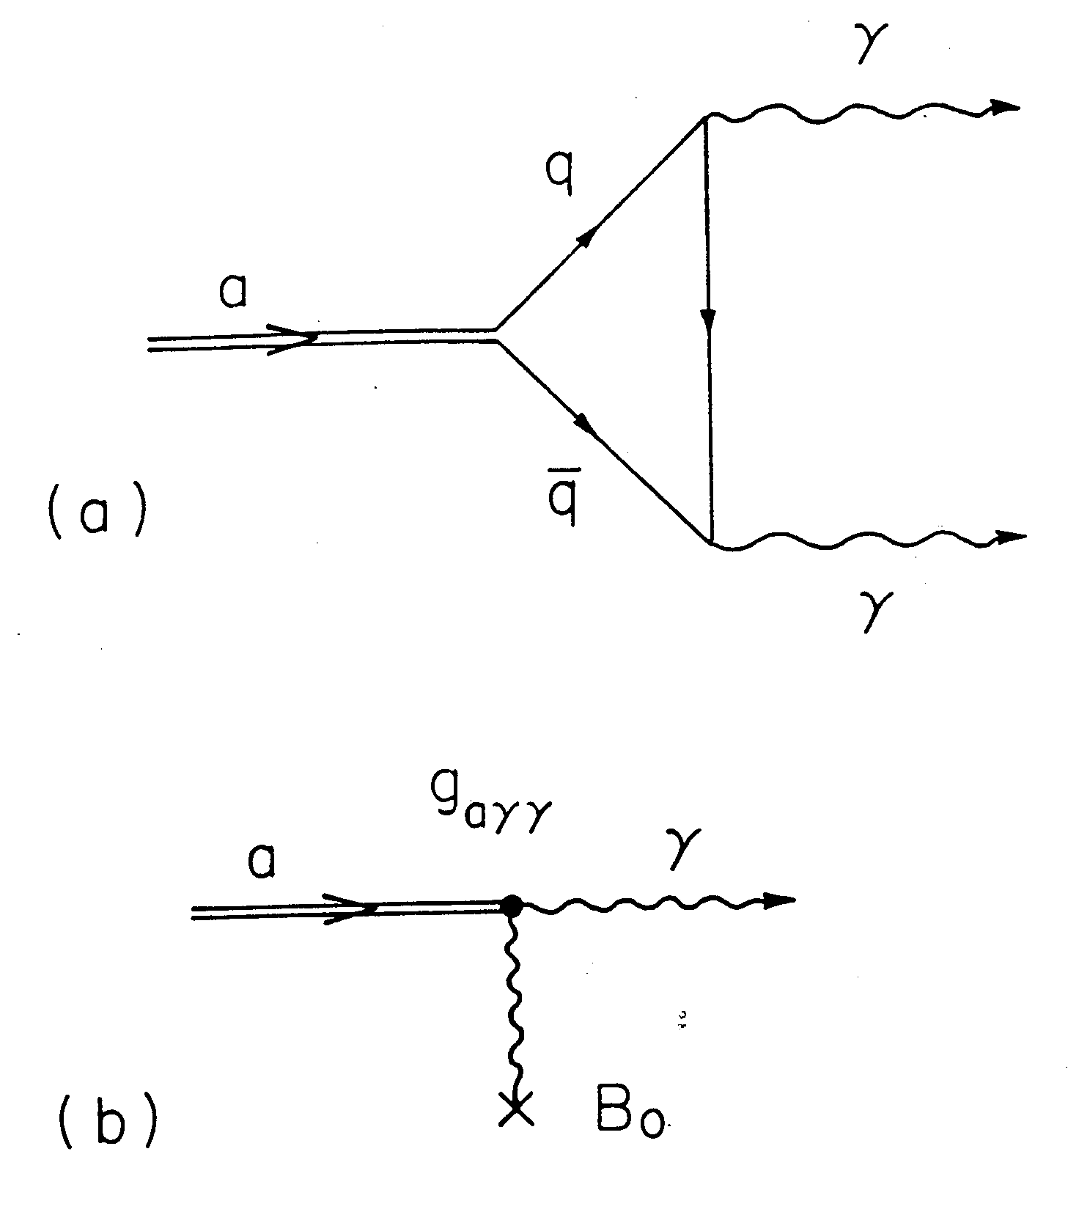
Axion Couplings
Gauge fields:
  Electromagnetic fields
  Gluon Fields (Oscillating EDM,…)
Fermions (coupling with axion field gradient, pseudomagnetic field)

Slide 10
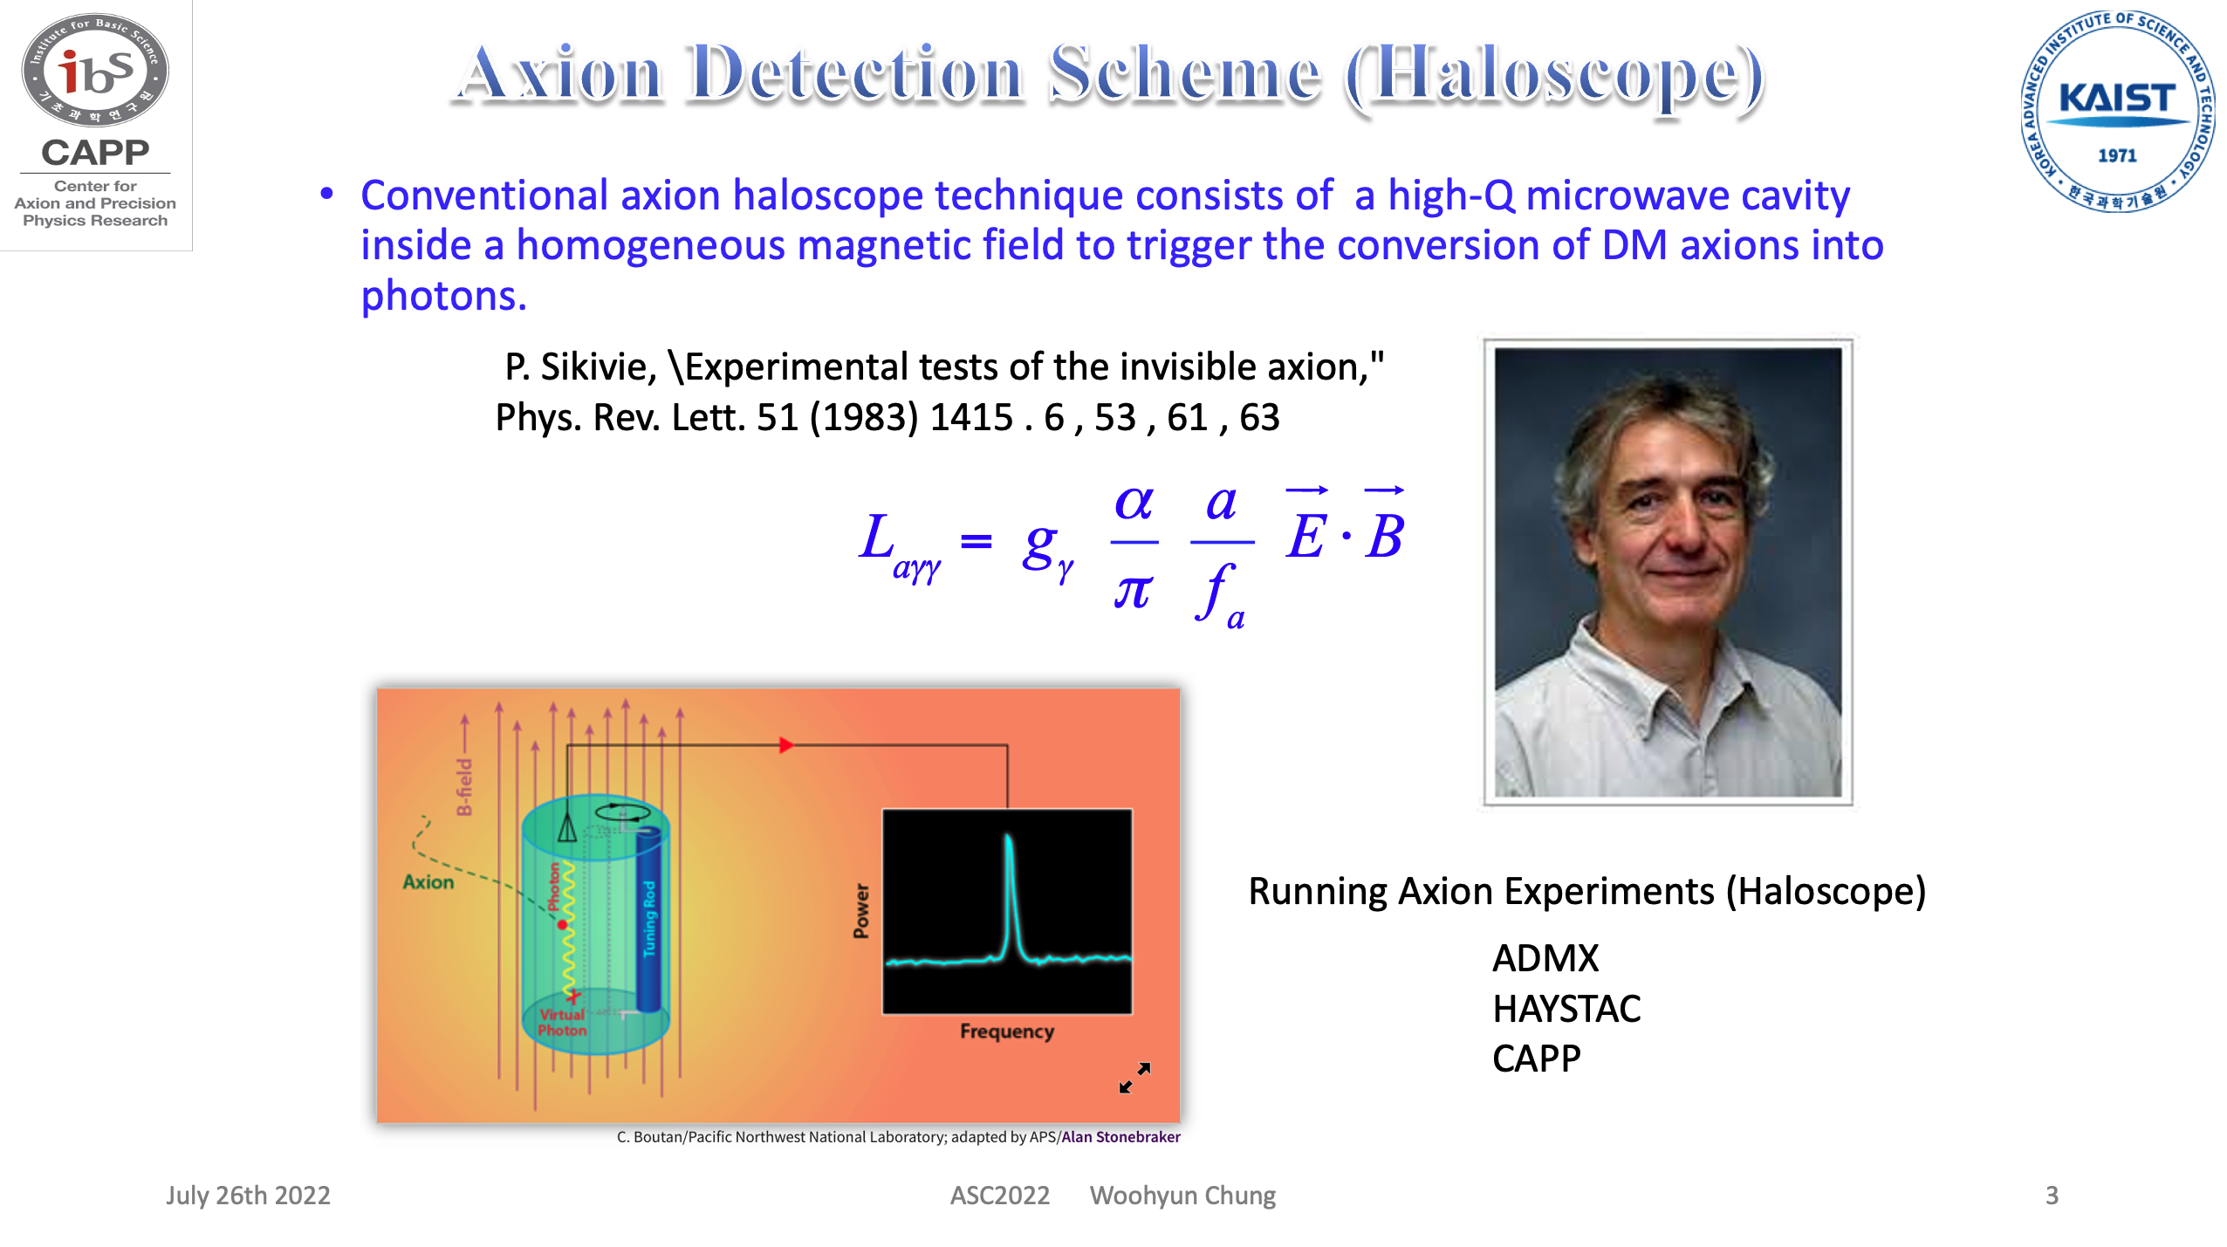
Woohyun Chung’s slide

Slide 11
Axion haloscope method by Pierre Sikivie
The ability to scan fast depends on B-field, Volume, Temperature, and Q₀
Most sensitive method
Running Haloscope
Experiments:
CAPP
ADMX
HAYSTAC

Slide 12
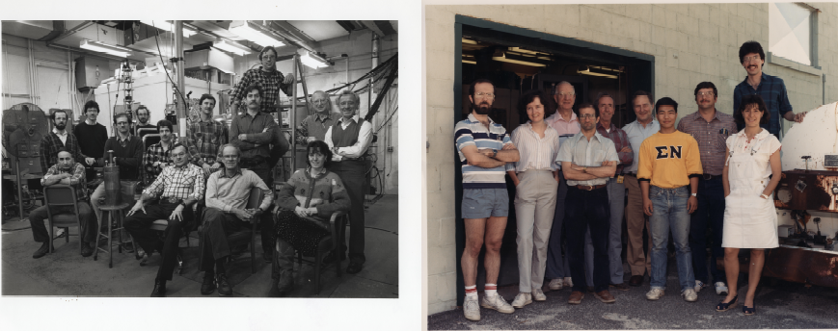
Rochester Brookhaven Fermilab axion dark matter search
The RBF-dark matter axion group, circa 1990
Under the leadership of Adrian C. Melissinos (Rochester), 1929-2022, a daring pioneer, full of energy, great teacher.

Slide 13
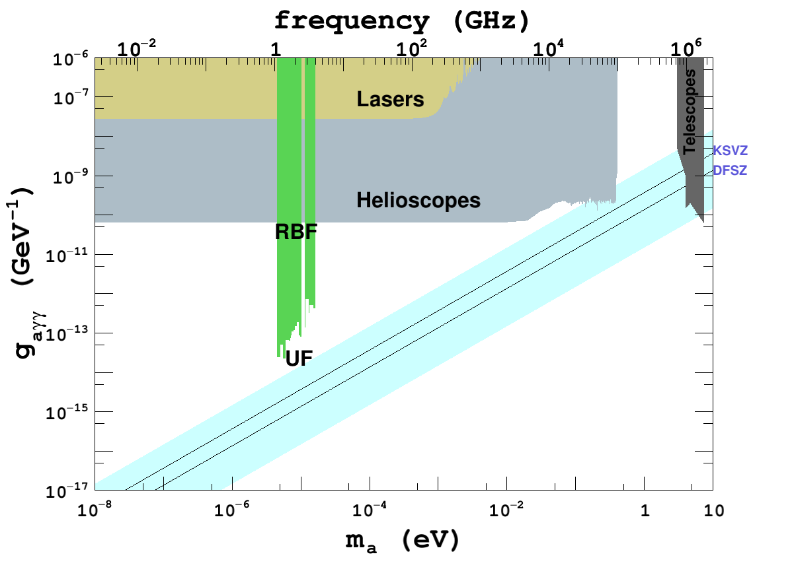
First haloscope limits:
Rochester, Brookhaven, Fermilab.
Then
University of
Florida

Slide 14
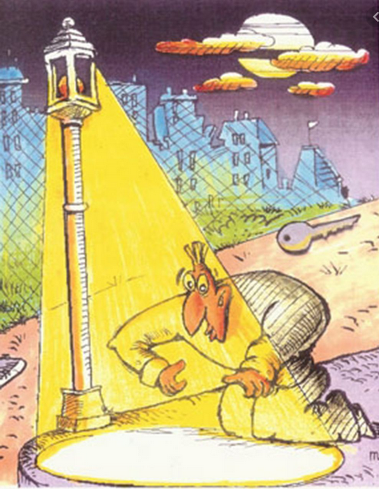
Where to look? ADMX established in 1990.
Below 1 GHz there is a “sweet” spot chosen by ADMX:
Large volume, with large B²V including a low-cost low temperature superconducting (LTS) magnet.
Low noise Microstrip SQUID Amplifier (MSA)
Dilution refrigerators became readily available (reducing labor cost)
Key to Dark Matter

Slide 15
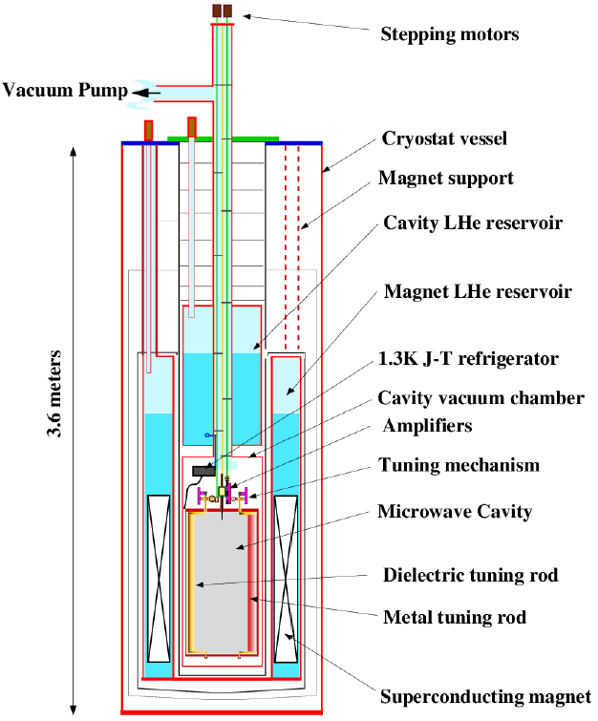
Axion Dark Matter eXperiment
Cryogenics (0.1K)
Superconducting magnet (>7.5 T)
Large volume cavity (140l)
Low noise amplifiers
  From 12K to 1K
  Currently SQUID and JPA (<1K)

Slide 16


ADMX reached KSVZ sensitivity in 2010; DFSZ in 2018.
Patience paid off

Slide 17
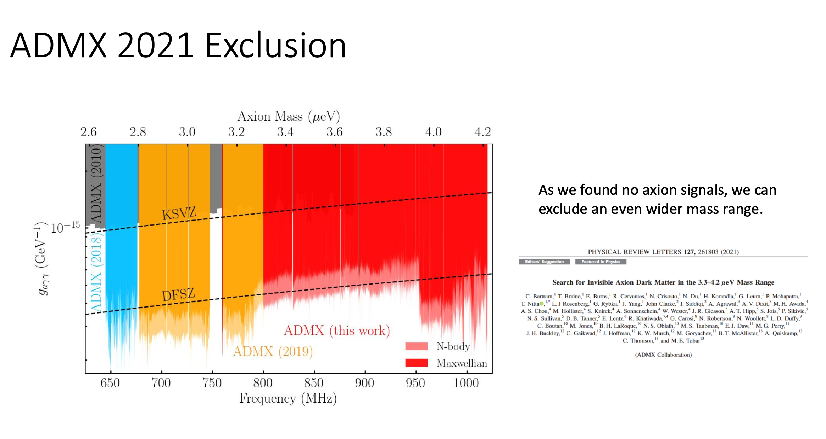
Gray Rybka’s slide
(ADMX)

Slide 18
David Tanner, Univ. of Florida

Slide 19
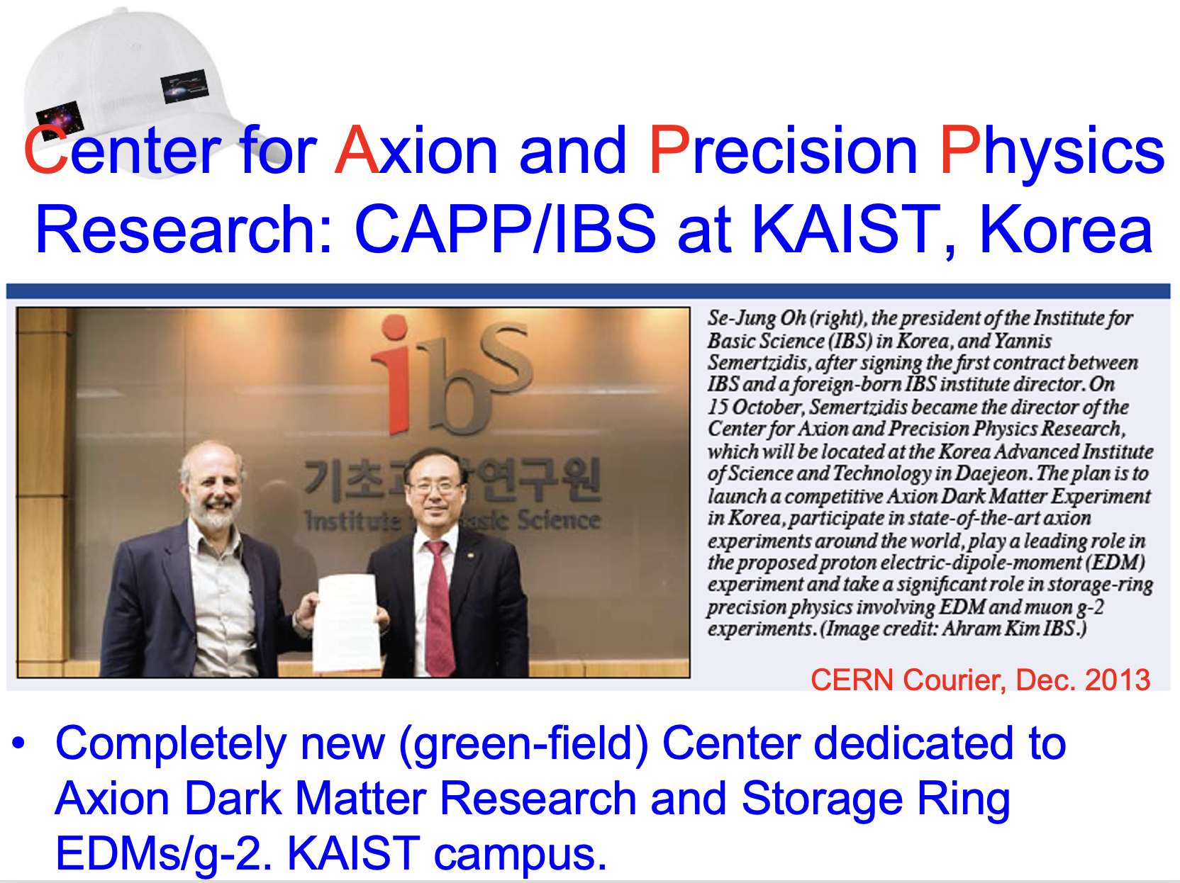
IBS-CAPP recruitment time, making clear: Axion research is like a Marathon, not a short-term effort
IBS President Oh, Se Jeong at my recruitment time (I was the first foreign-born IBS-Director): “Just show promise…” when I stated 10-years as too short for axion dark matter research to leave my Senior-Scientist-Tenured position at BNL for it. He gave me a very supportive contract to enable the effective operation of the Center. CAPP was established October 16, 2013.

Slide 20
Landscape
October 16, 2013 CAPP is established. No particle or nuclear exp. physics present at KAIST
2014-2017. Setting up infrastructure, purchasing expensive equipment. Started hiring "high-energy", dynamic people.
2017-2020. Set R&D goals, work in parallel to achieve results fast. First setup and runs of prototype experiments.
2020-present. Combine achievements to create competitive axion dark matter experiments
Some points to consider:
No axion dark matter experimental activity in Korea prior to CAPP.
The prospects of reaching theoretically interesting sensitivities above 1 GHz seemed remote.
IBS was a newly established institution. Not long Basic Science tradition in Korea. Nonetheless, it was possible to make it happen since Korea learns fast.

Slide 21
IBS-CAPP period timeline, established Oct. 16, 2013
2013-2015, exhausting recruitment effort, not a single “axion expert” came to Korea. We needed to develop all expertise in-house. A time of great growth and infra-structure setup.
2016-2019, turbulent period for IBS, budget was drastically reduced. All my contract provisions were fully ignored by the second IBS administration. Building up of CAPP prototype experiments and developing know-how.
2020-May 2022, returned to stability with thriving innovation period. Breakthrough results from CAPP pouring out. Most budget cuts remained.

Slide 22
BNL 25T/10cm, HTS magnet review
October 22, 2018
Magnet construction plan with single layer is sound
Magnet design with No Insulation making it safe from quenches and structural integrity
>50% margins in critical current and stresses
16 out of 28 pancakes constructed and tested.
Canceled by IBS-HQ when IBS’s budget was reduced

Slide 23
Strategy at CAPP: best infra-structure and know-how
Under (a brighter) lamp-post with microwave resonators
  LTS-12T/320mm, Nb₃Sn magnet: for 1-8 GHz
  12T for large volume 37 liters
Powerful dilution refrigerator: ~5mK base temp.
  25mK for the top plate of the 37 liter cavity
State of the art quantum amplifiers (JPAs)
  Best noise for wide frequencies: 1-6 GHz
High-frequency, efficient, high-Q microwave cavities (best in the world)
Key to Dark Matter

Slide 24
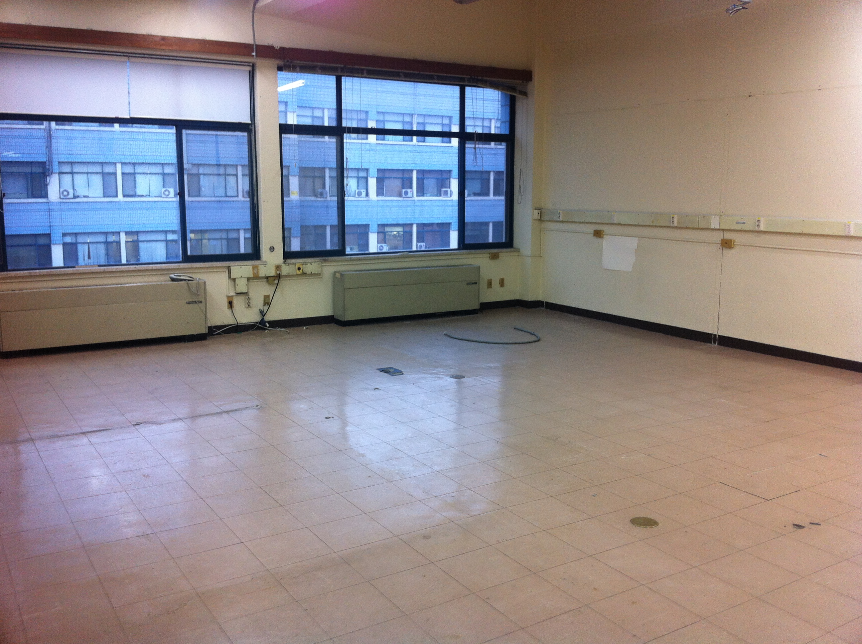
CAPP started from scratch in 2013.
Lab space at KAIST, 2014

Slide 25
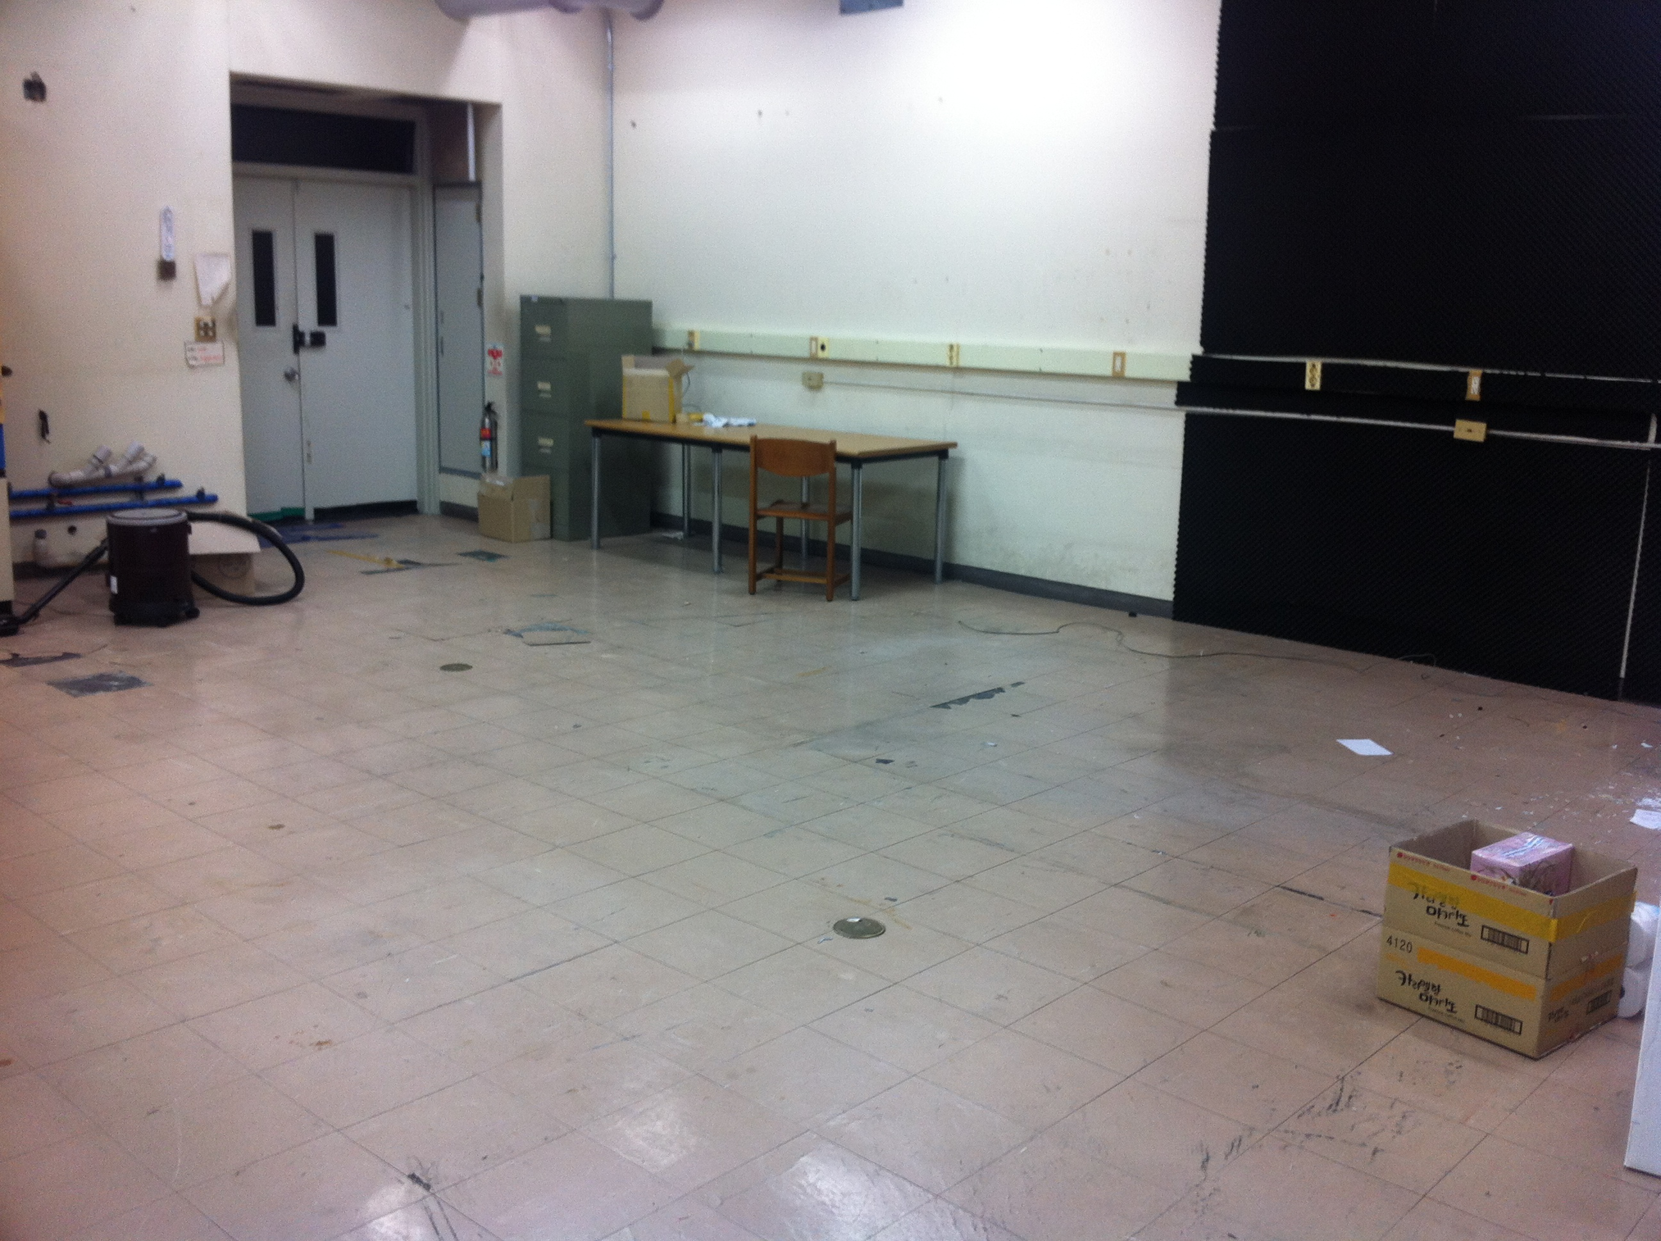
Another room at KAIST.
We had to buy even screwdrivers.

Slide 26

CAPP had to create a miracle
Had to change everything:
Several parallel R&D efforts
High-risk projects with high-potential payout
Developing state of the art infrastracture at the same time.

Slide 27
Main CAPP tactics, targeting axions of 1-10 GHz
Develop infra-structure
Develop in-house expertise
Collaborate with the best around the world on amplifiers (long lead-time) and others as needed

Slide 28
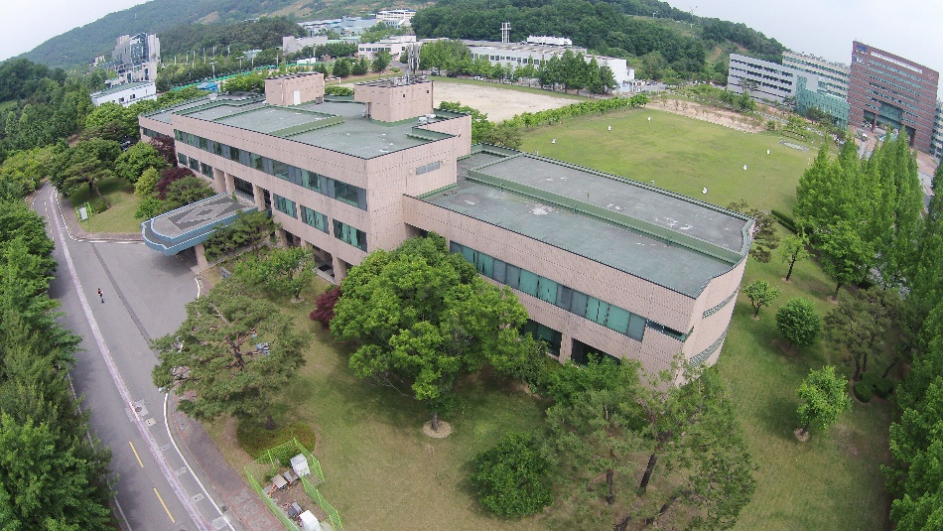
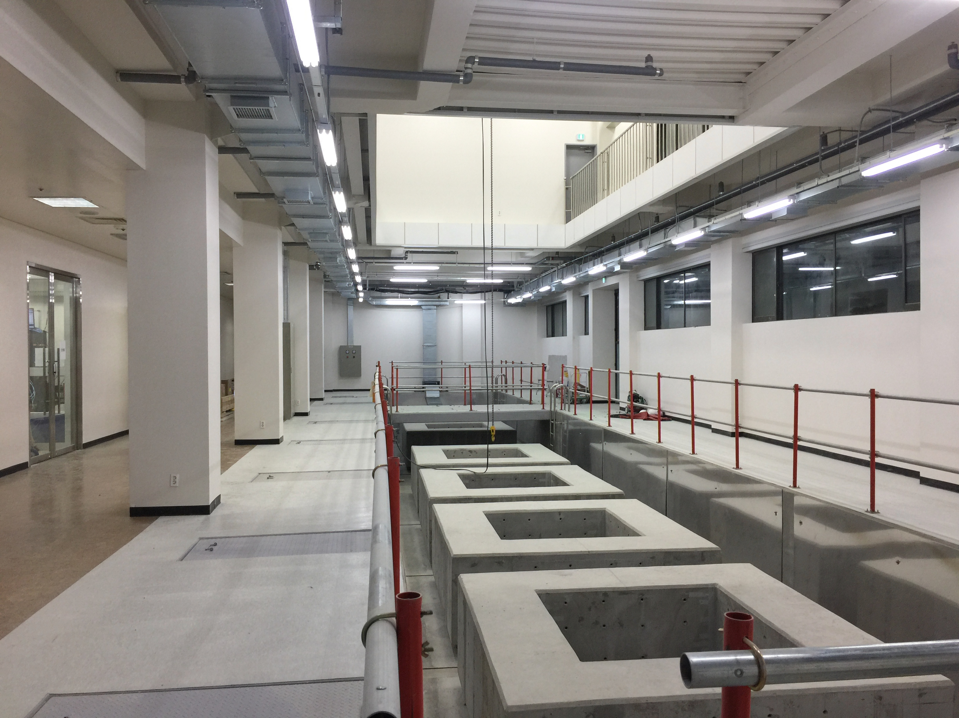
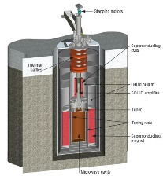
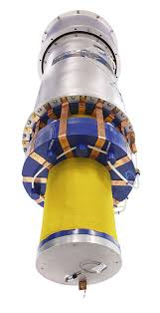
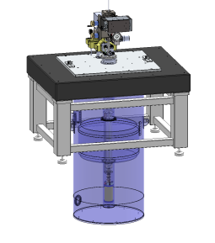
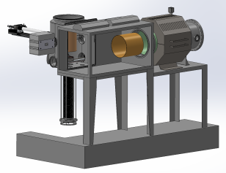
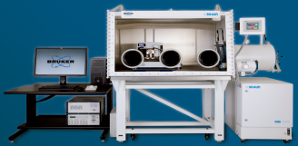
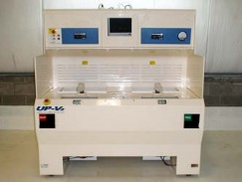
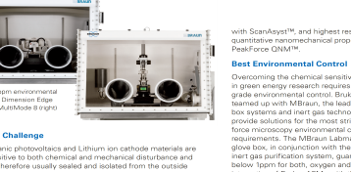
Center for Axion and Precision Physics Research (IBS-CAPP) at KAIST
CAPP of Institute for Basic Science (IBS) at KAIST in Korea since October 2013.
Projects : Axion dark matter, Storage ring proton EDM, Axion mediated long range forces
Created a state-of-the-art RF-lab at an existing bldg. (Creation Hall at Munji Campus of KAIST)
Operation model:
Reward risk taking with high-physics potential R&D efforts
Created a can-do environment with competent and confident scientists.
Fast pace, the Korean clock running three times faster than regular clocks!
State of the art infra-structure: 7 low vibration pads for parallel experiments; 6 cryo or dilution refrigerators;
high B-field, high volume magnet: 12T, 5.6MJ. Flagship exp.

Slide 29
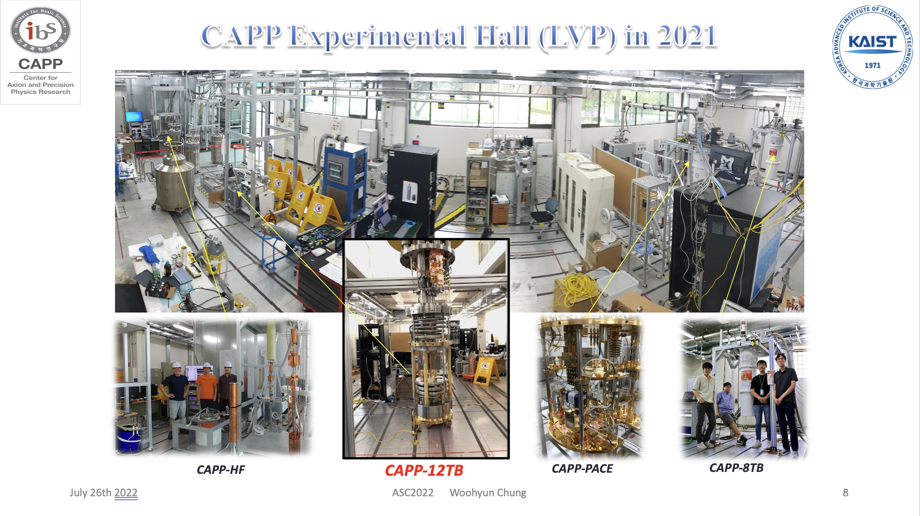

Slide 30


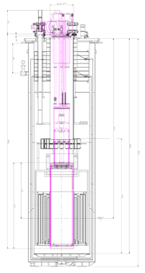
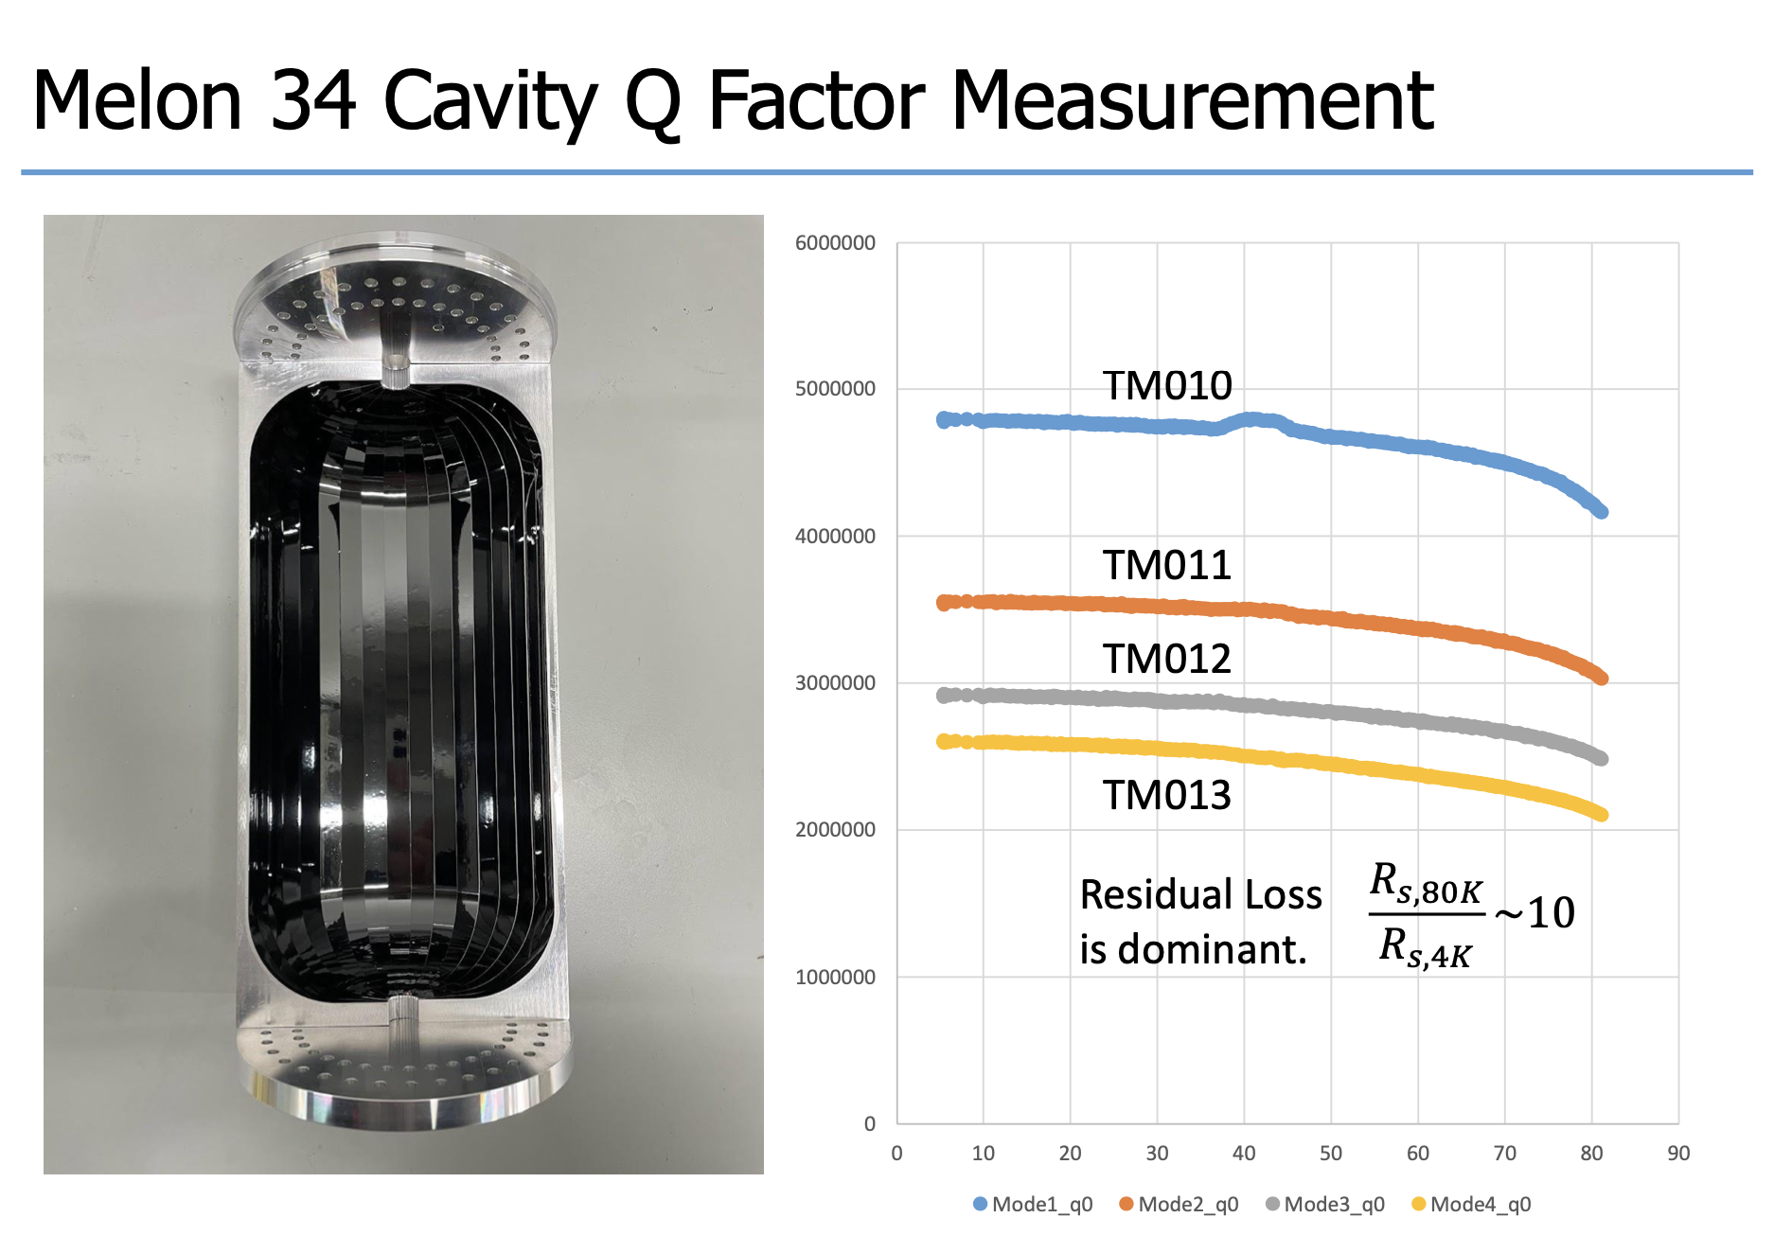
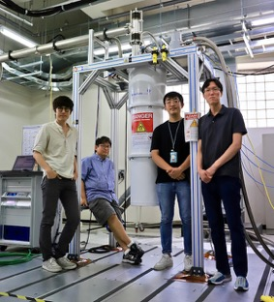
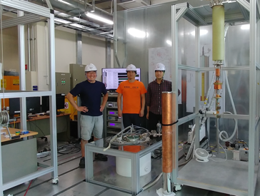

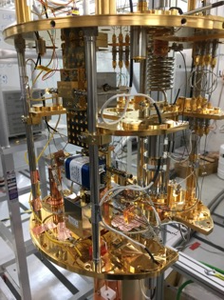

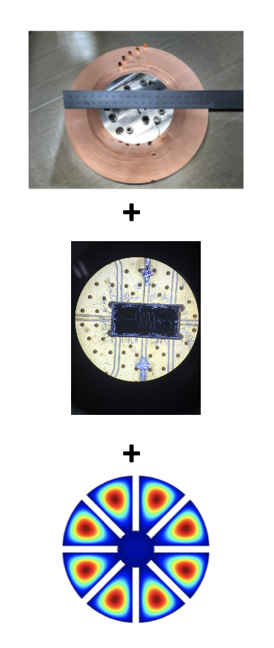
IBS-CAPP at eight-years and beyond
O. Kwon et al., Phys. Rev. Lett. 126, 191802 (2021)
1 K pot
9T SC magnet
He-3 pot
Pizza cavity
CAPP-PACE
CAPP-8TB
CAPP-9T MC
CAPP-12TB
TM₀₁₀ quality factor: Q=4.7 M
CAPP-25T
By 2020
2023 and beyond
Cu cavities are assumed
W/ SC cavities, down to 10% of axion dark matter content can be probed
We have succeeded in all our R&D goals. We expect to reach DFSZ sensitivity even for a fraction of axion content in the local dark matter halo. Target sensitivity: 10% axions in DM halo!

Slide 31
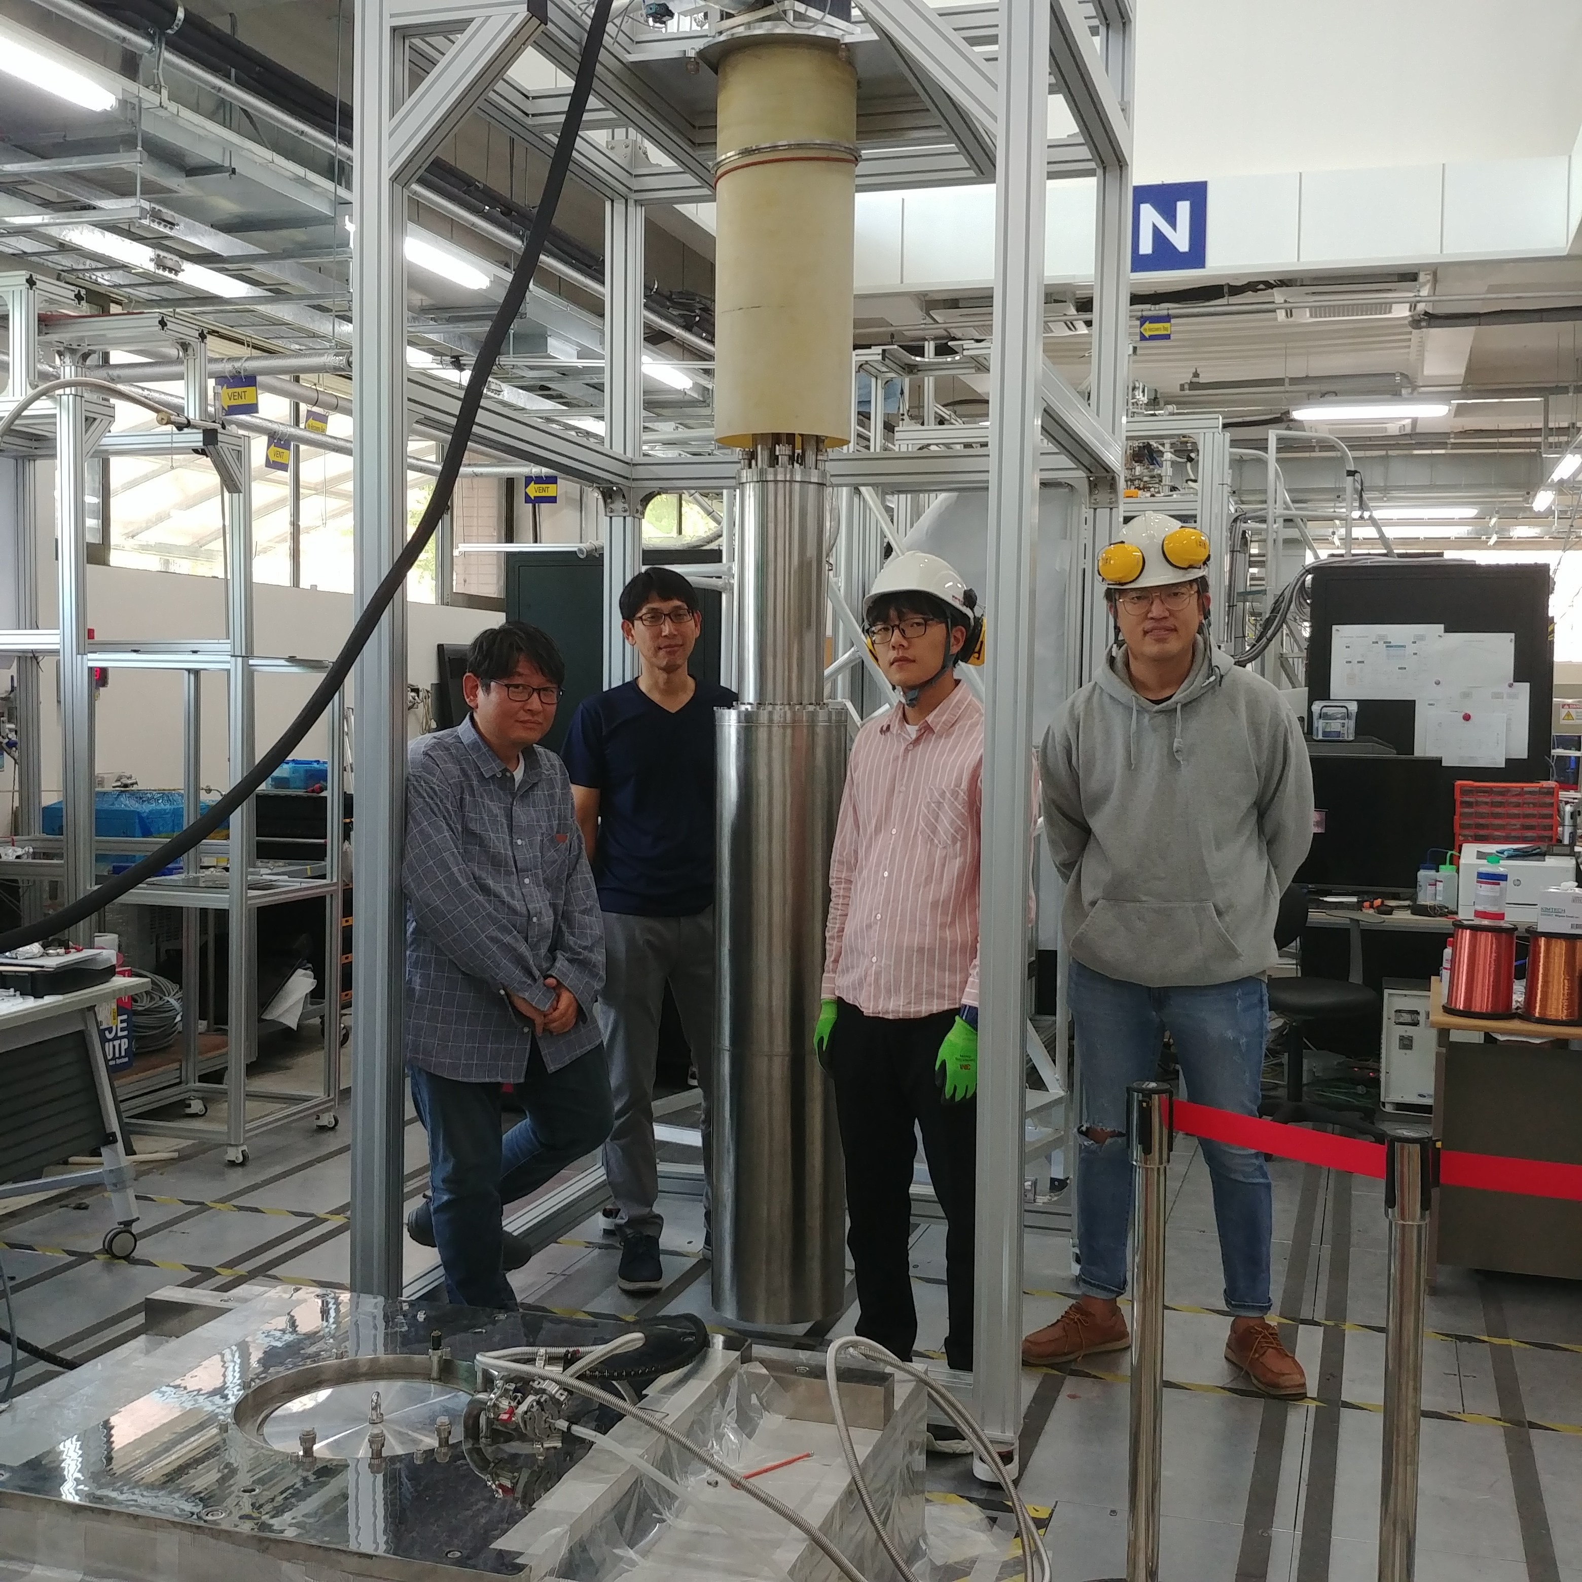
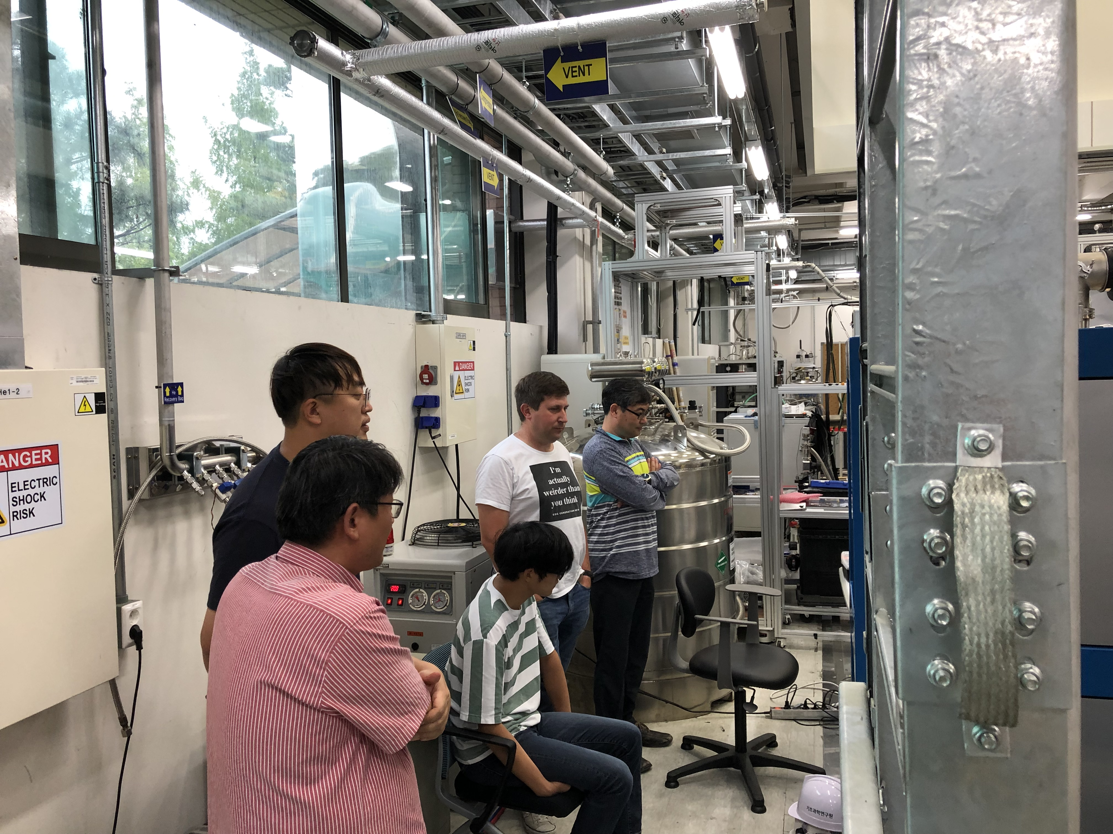
LTS-12T/320mm from Oxford Instruments
ByeongRok Ko, Team leader of CAPP-12TB including the Nb₃Sn, LTS-12T/320mm magnet. Here, with his team testing the Leiden system.
Sat., September 21, 2019

Slide 32
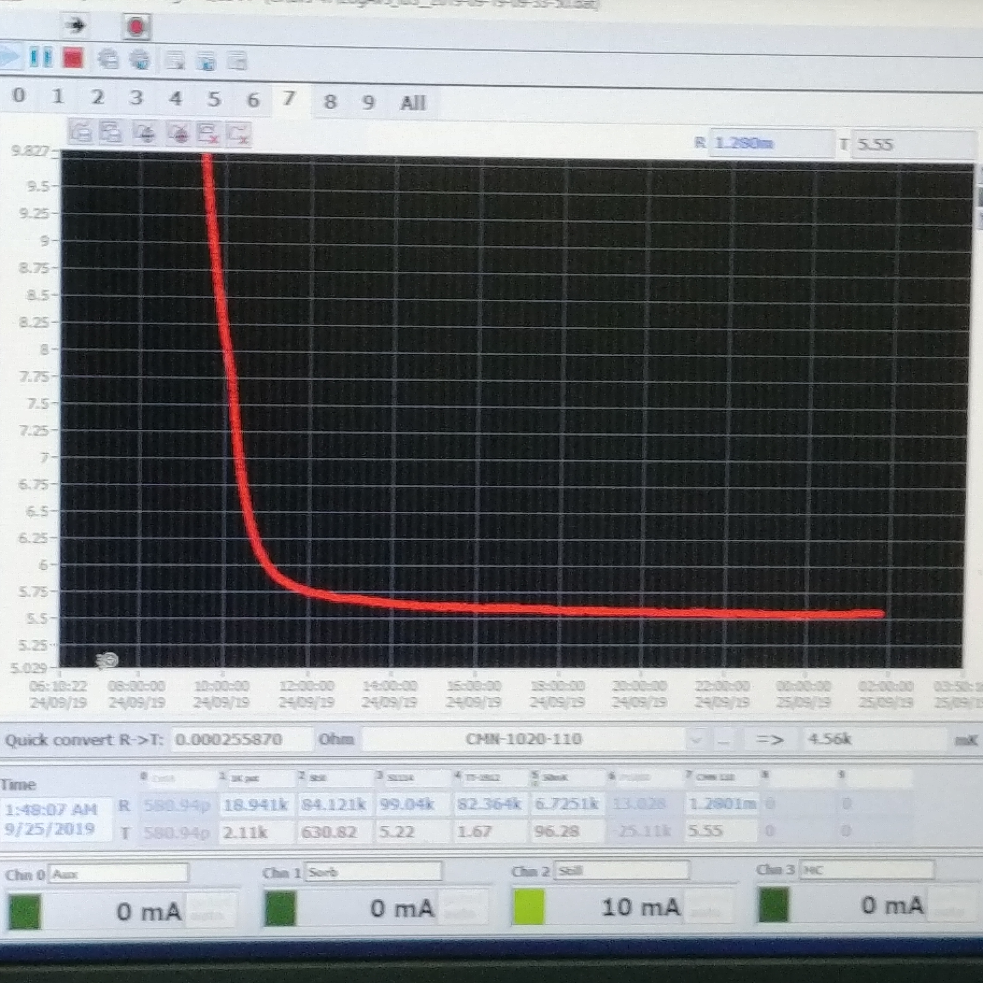
LTS-12T/320mm magnet (12TB experiment)
Nb₃Sn + NbTi, LTS-12T/320mm from Oxford Instr., delivered March 2020, commissioned in August-December 2020.
This system can reach DFSZ level sensitivity in the 1-8 GHz, with present technology. Using SC cavities probe more…
Wet system,
Leiden dilution system:
1.3mW at 120mK,
achieved 5.6mK.

Slide 33
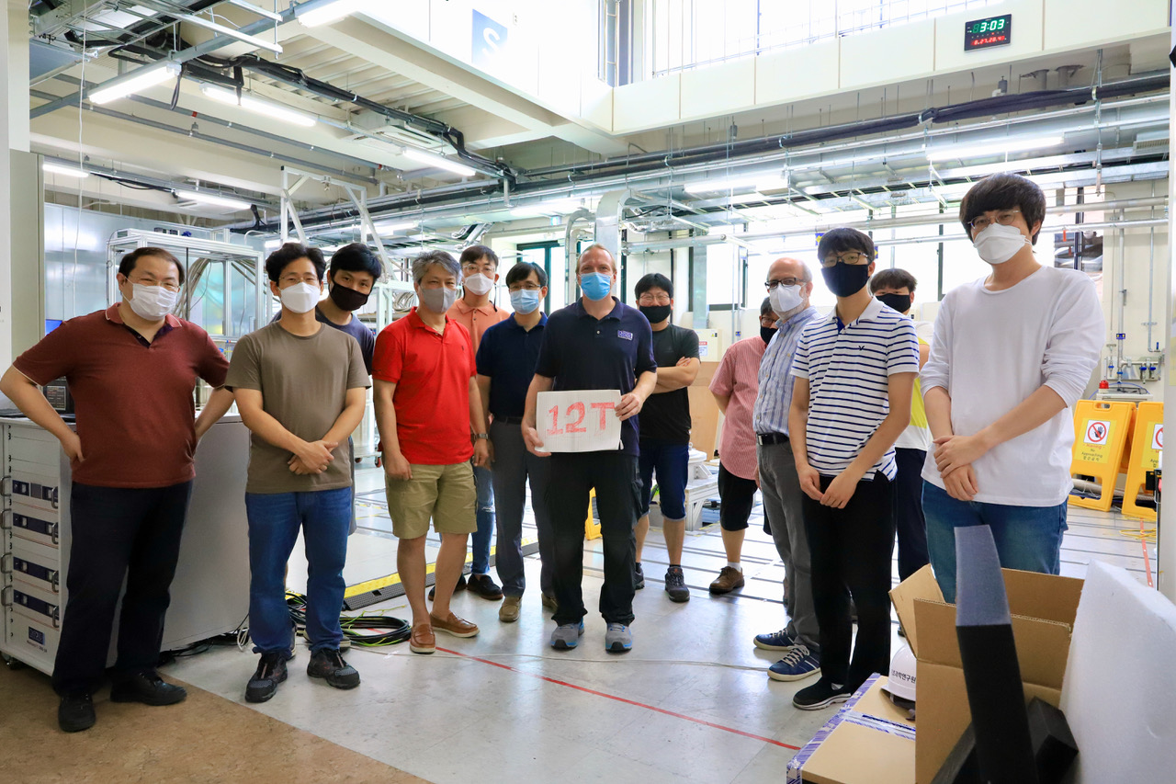
LTS-12T/320mm from Oxfrod Instruments
Fully commissioned end of 2020 delivering 12T max field (5.6MJ)

Slide 34
LTS-12T/320mm from
Oxfrod Instruments
Based on Nb₃Sn and NbTi, new challenging technology, 12T. Persistent mode switch
Project delayed by a year due to COVID-19
The largest Nb₃Sn magnet system in axion dark matter search.
Cavity: ~37 liter, ultra-light cavity, 25mK
The main activity at IBS-CAPP, integrating all experience from small experiments

Slide 35


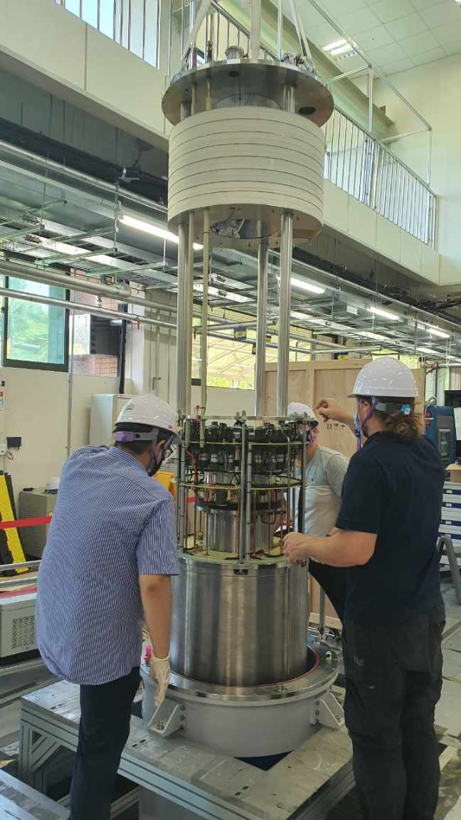
The CAPP-12TB, our flagship experiment based on the LTS-12T/320mm magnet
Axion to photon conversion power at 1.15 GHz
  KSVZ: 6.2×10⁻²² W or ~10³ photons/s generated
  DFSZ: 0.9×10⁻²² W or ~10² photons/s generated
With total system noise of 300mK, Q₀=10⁵, eff. = 0.80
  KSVZ: 25 GHz/year
  DFSZ: 0.5 GHz/year
With total system noise of 200mK (250mK), Q₀=10⁵
  KSVZ: 50 GHz/year (35 GHz/year)
  DFSZ: 1 GHz/year (0.64 GHz/year)
With total system noise of 100mK (150mK), Q₀=10⁵
  KSVZ: 200 GHz/year (90 GHz/year)
  DFSZ: 4 GHz/year (1.7 GHz/year)

Slide 36
The CAPP-12TB, our flagship experiment based on the LTS-12T/320mm magnet
Axion to photon conversion power at 1.15 GHz
  KSVZ: 6.2×10⁻²² W or ~10³ photons/s generated
  DFSZ: 0.9×10⁻²² W or ~10² photons/s generated
With total system noise of 300mK, Q₀=10⁵, eff. = 0.80
  KSVZ: 25 GHz/year
  DFSZ: 0.5 GHz/year
With total system noise of 200mK (250mK), Q₀=10⁵
  KSVZ: 50 GHz/year (35 GHz/year)
  DFSZ: 1 GHz/year (0.64 GHz/year)
With total system noise of 100mK, Q₀=2×10⁶
  DFSZ: 2 GHz/year for 20% of dark matter as axions

Slide 37
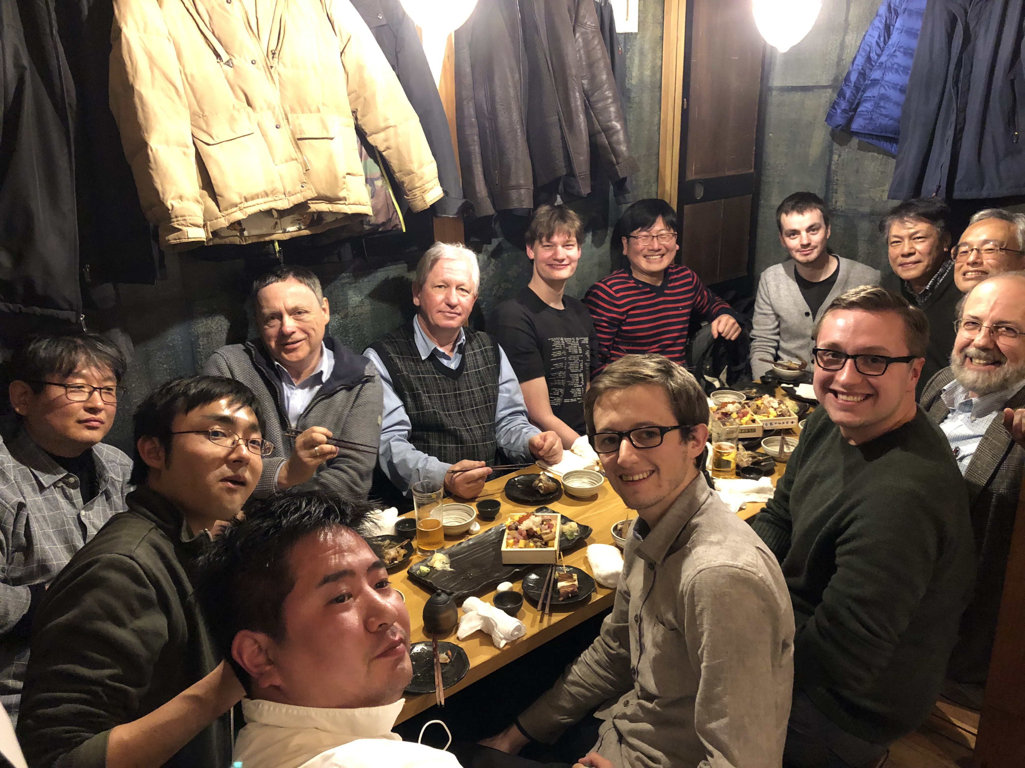
The Josephson parametric amplifiers (JPA) from Tokyo/RIKEN are quantum-noise limited. Best integrated system in the world.
Collaboration with University of Tokyo/RIKEN, providing us with the chips, while we provide feedback for noise improvement.
Currently we have the lowest noise temperature JPAs in the world at:
1GHz, 2 GHz, and 6 GHz.
CAPP delegation visiting
Prof. Nakamura’s Lab in Tokyo. Jan. 8, 2019

Slide 38
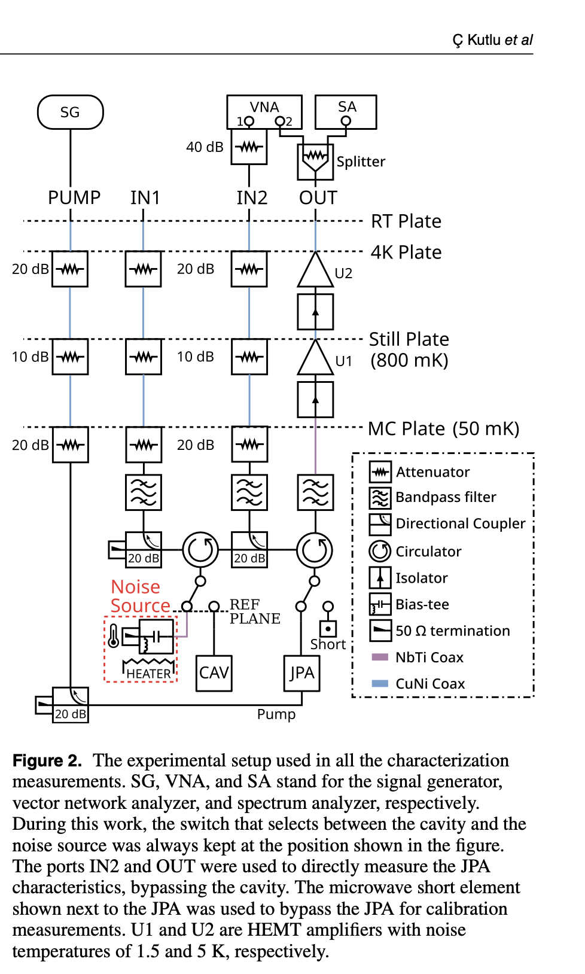
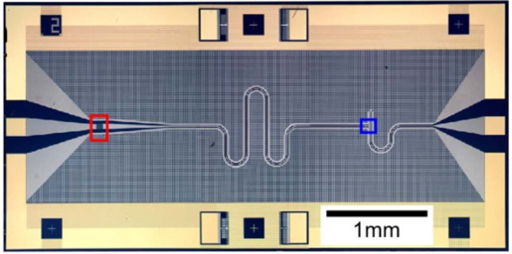
Cryogenics, RF-chain & JPAs
Caglar Kutlu, JinMyeong Kim, Saebyeok Ahn, Andrew Yi, … KAIST graduate students under the leadership of Sergey Uchaikin on JPAs created the best performing quantum-noise-limited amplifiers. Chips/expertise from RIKEN/Univ. of Tokyo, Prof. Y. Nakamura, Arjan F van Loo.
Ultra-light-cavity (37 liter) and cryogenics, OhJoon Kwon, Woohyun Chang, Heesu Byun, Sergey Uchaikin, Boris Ivanov achieved 25mK cavity physical temperature. The best in the world.
Total system noise <200mK, measured with Noise Source at 1 GHz. Best in the world.

Slide 39
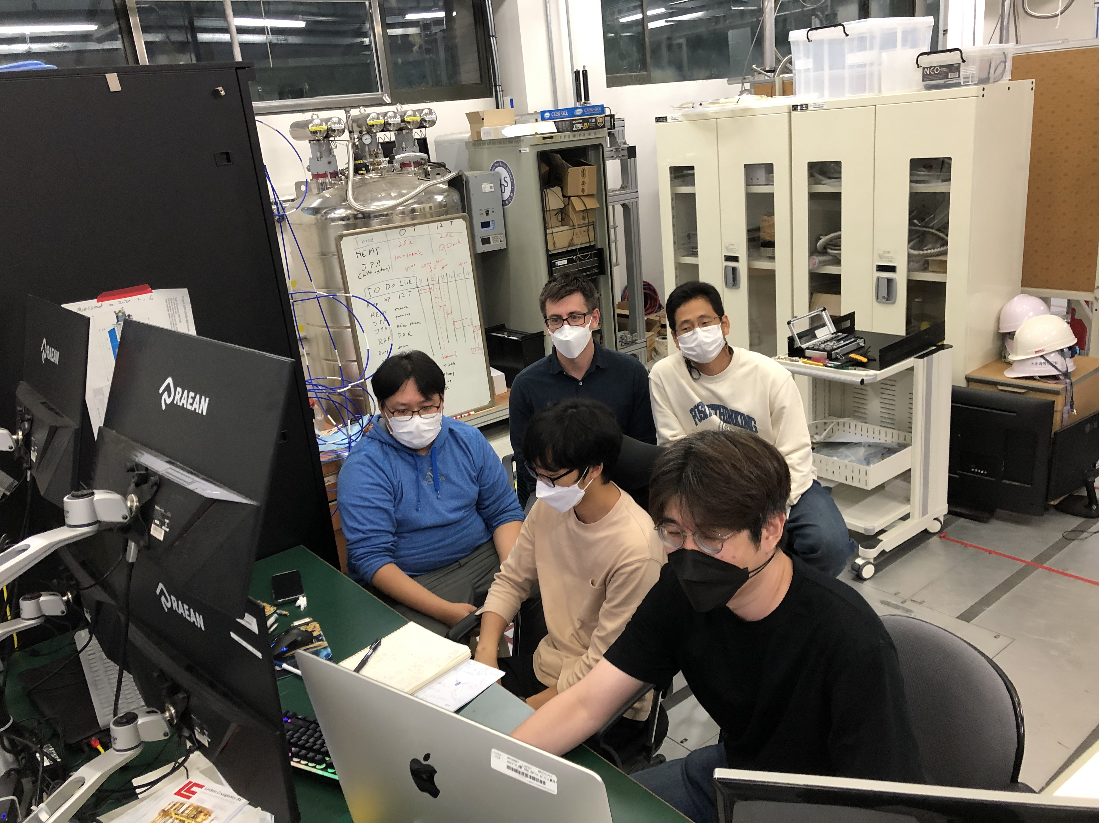
CAPP status in spring 2022
We have two small systems taking data at KSVZ sensitivity:
  BF6: Around 5.8 GHz, ~1 MHz/day, scanned: ~100 MHz, “Pizza” cavity, first and still best in the world
  BF5: Around 2.3 GHz, ~1 MHz/day, first goal: 25 MHz, superconducting cavity, first and still best in the world
LTS-12T/320mm, after the heroic job by so many.
  Taking axion dark matter data at DFSZ sensitivity
  at 1.1 GHz with ~1.4 MHz/day
In preparation:
HTS-18T/70mm, with SC cavity, 6 GHz
BF3, at 7 GHz
JANIS high Freq. at ~10 GHz

Slide 40
CAPP-12TB RUN4, engineering run, spring 2022
Goal : axion search around 4.55 μeV (1.09 – 1.11 GHz) with DFSZ sensitivity, scanning at 1.4MHz/day
Andrew. Y. et al, submitted to PRL

Slide 41
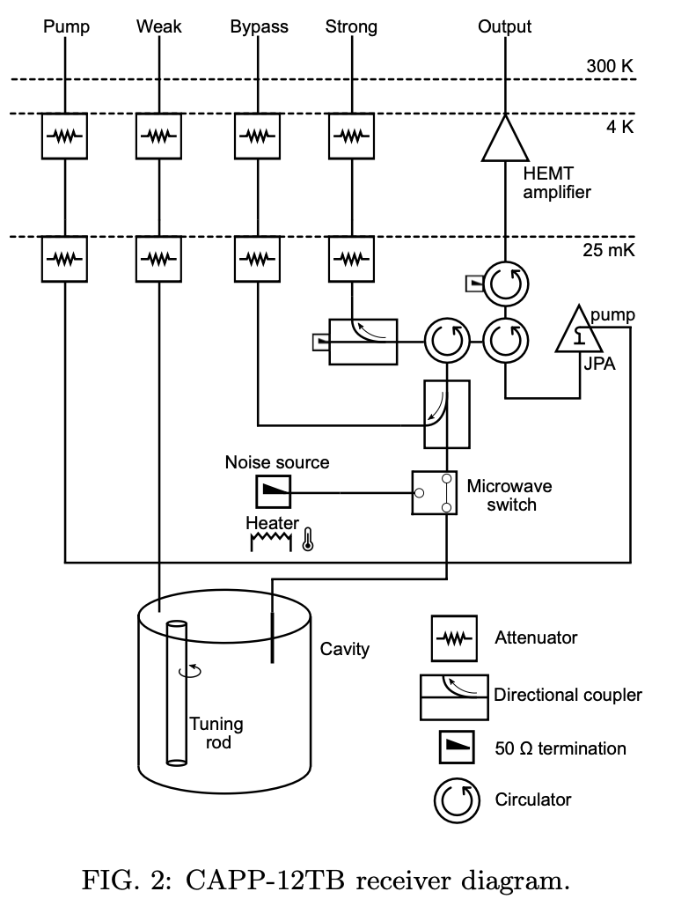
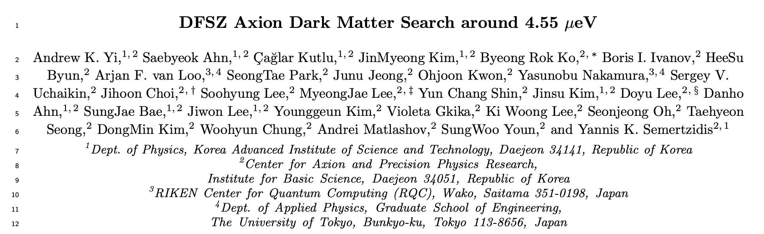
CAPP-12TB RUN4, engineering run, spring 2022
Andrew. Y. et al, submitted to PRL

Slide 42
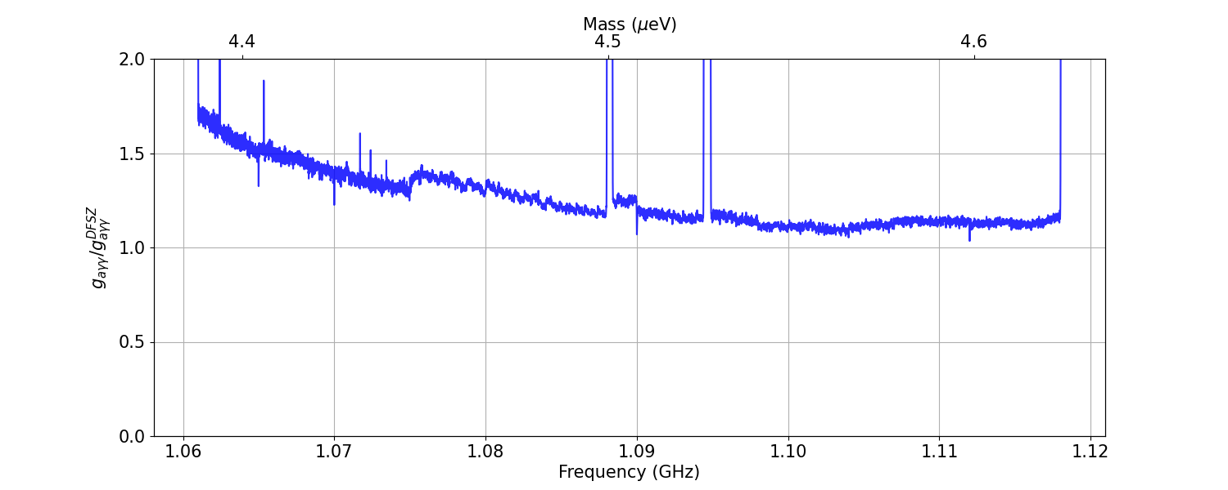
New data: CAPP-12TB RUN5C, since September 2022
Achieved already sensitivity (preliminary), scanning at 4MHz/day
Expect to reach ~150 MHz at DFSZ sensitivity by end of 2022
From 22 candidate groups,
22 groups rejected
0 group under further checking
PRELIMINARY
60 MHz

Slide 43
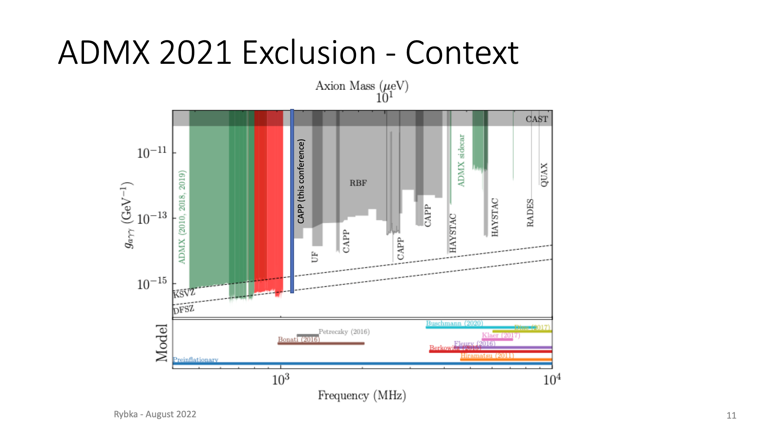
Rybka’s slide from Patras, August 2022
He welcomed CAPP to the DFSZ club!

Slide 44
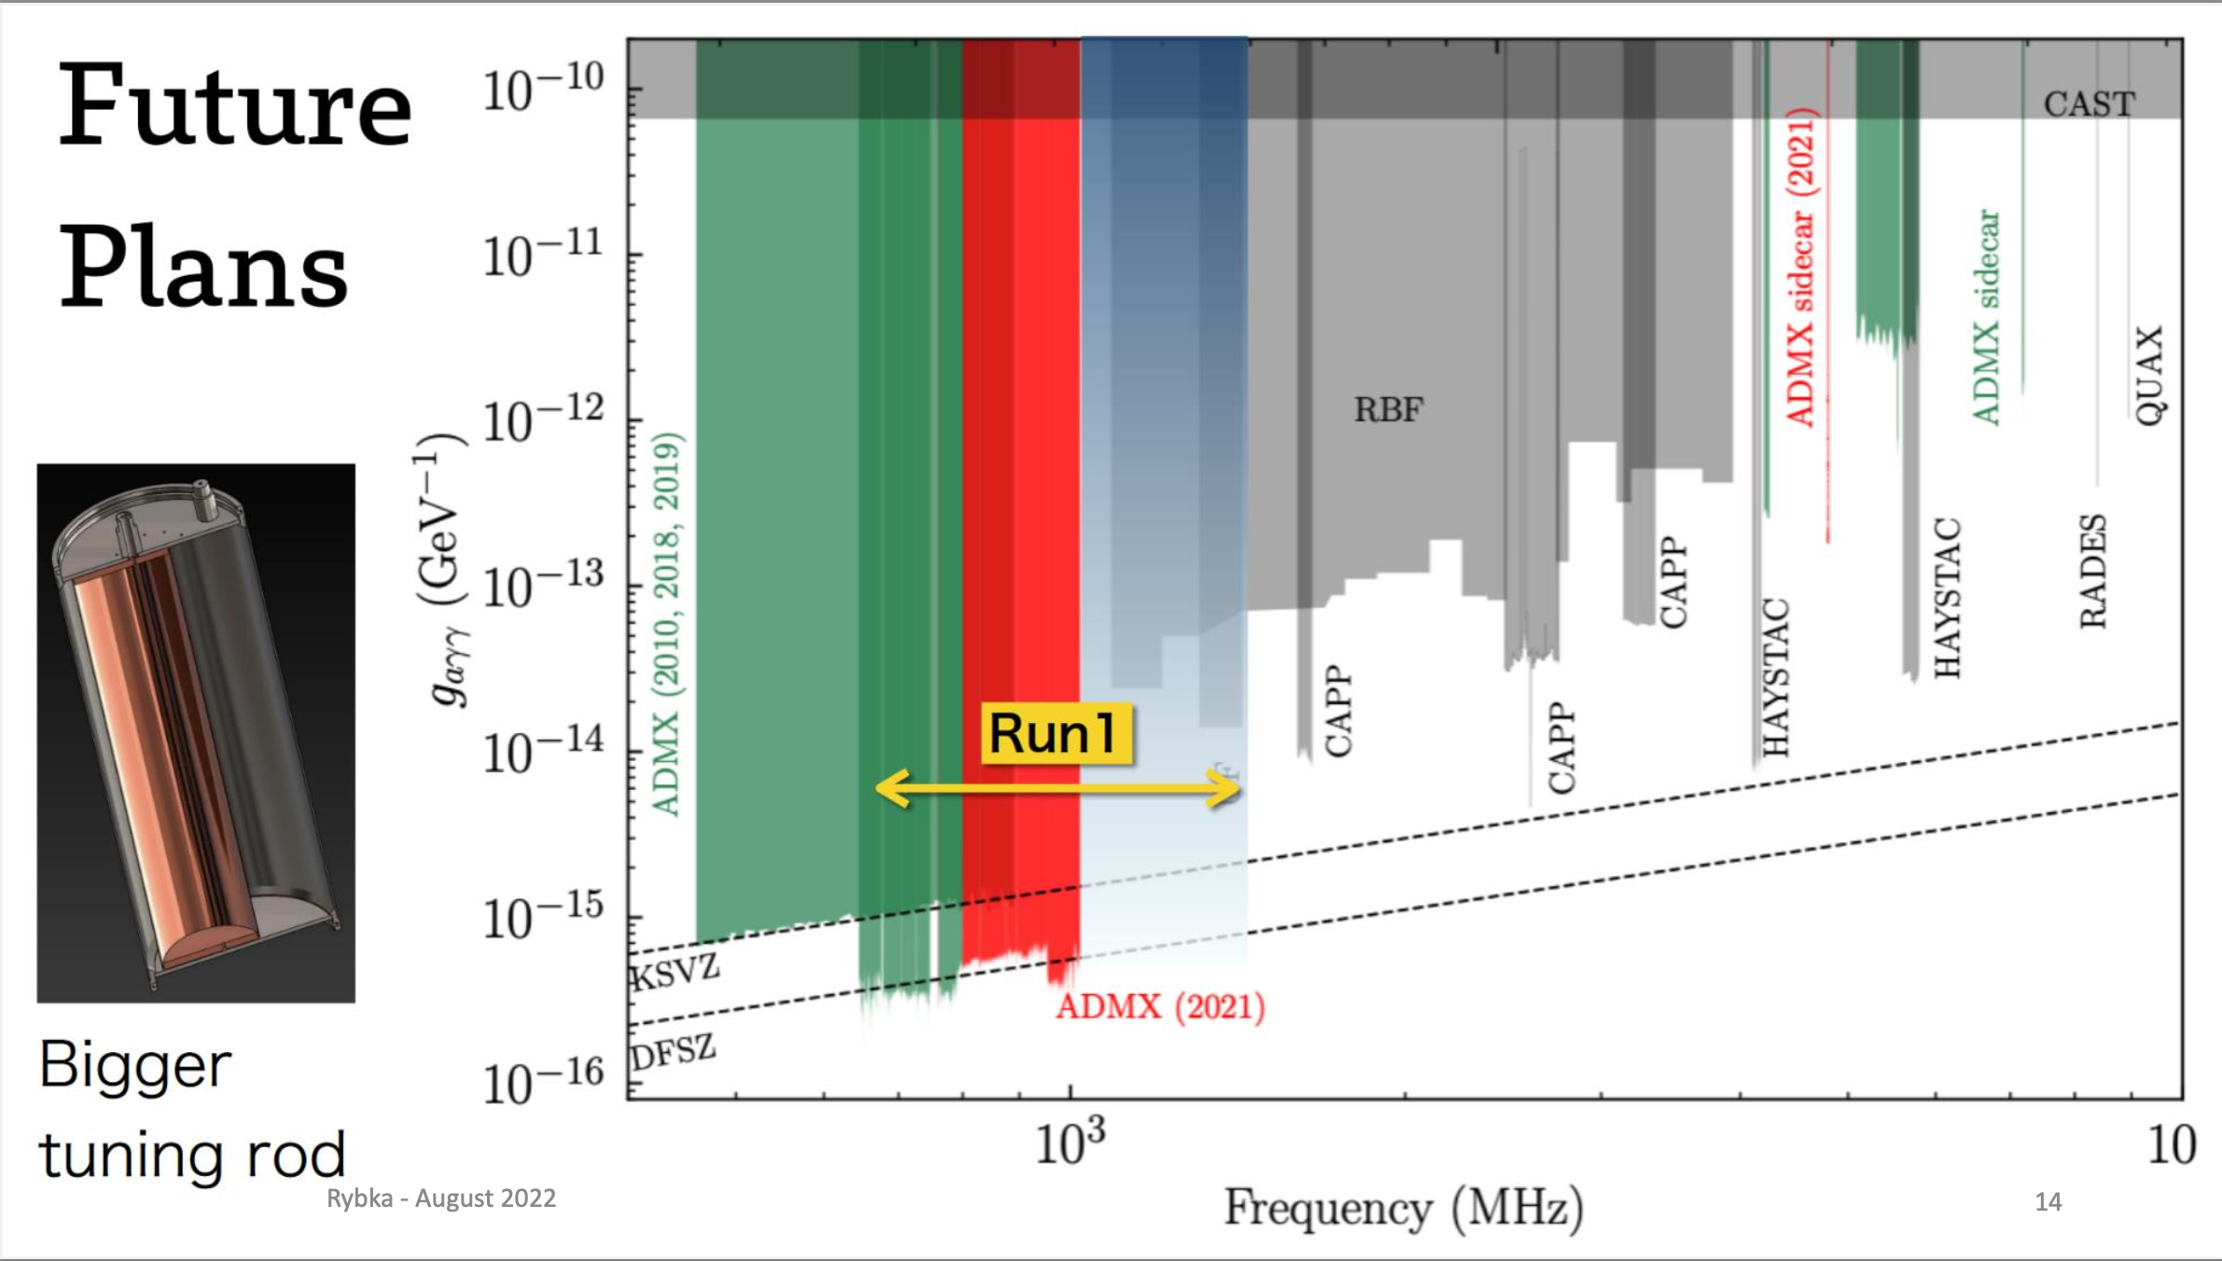
Rybka’s slide from Patras, August 2022

Slide 45
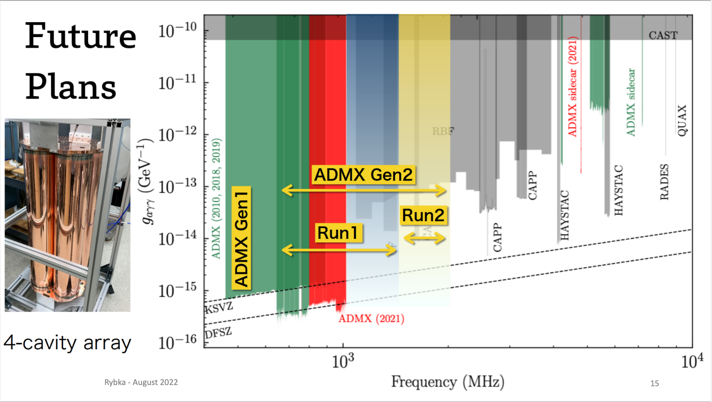
Rybka’s slide from Patras, August 2022

Slide 46
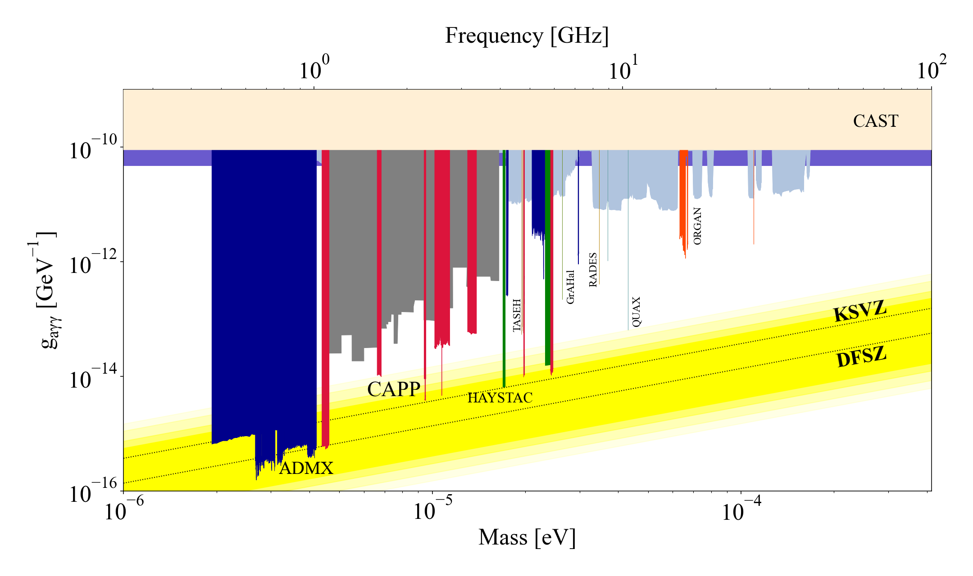
Our place in the world, CAPP in red, now

Slide 47

Our place in the world, CAPP in red, now

Slide 48

CAPP’s target for 2023, 1-10 GHz
CAPP’s scans in solid red
Hashed areas within 2023
CAPP by end of 2024

Slide 49

Superconducting cavity in large B-field!
YBCO tapes on cavity walls
TM₀₁₀ mode

Slide 50
Superconducting cavity in large B-field!
Best in the world!
Phys. Rev. Applied 17, L061005

Slide 51

Superconducting cavities in large B-field!
Great interest from CERN and FNAL on our results.
@ CAPP

Slide 52

Superconducting cavity in large B-field!
CAPP plans to make
a 36-liter HTS cavity
for CAPP-12TB

Slide 53
CAPP’s flagship experiment status and plans
In spring 2022, covered 20MHz at DFSZ sensitivity, scanning rate at 1.4 MHz/day @ 1.1 GHz with our LTS-12T/320mm magnet from Oxford Instr.
Covered ~60MHz near DFSZ sensitivity in September 2022, at 4 MHz/day
Target 100 MHz by the end of 2022 at 4 MHz/day and 1 GHz by end of 2023.
Target to cover 1-4 GHz within the next two years at DFSZ sensitivity.

Slide 54
CAPP’s smaller experiments
Covered 20 MHz near 2.3 GHz at KSVZ sensitivity using an HTS superconducting cavity (Q₀~0.5M) and low-noise JPA, scanning at ~1 MHz/day.
Covered 100 MHz at KSVZ sensitivity at 5.8 GHz with ~1MHz/day
Target 0.4-1 GHz/year at KSVZ sensitivity between 4-8 GHz
Develop prototype experiments for the 8-25 GHz range.

Slide 55
Actively planned axion exps.
Irastorza, Redondo 1801.08127v2

Slide 56

>>100 participants, 12th Patras Workshop on AXIONs, WIMPs, and WISPs, Jeju Island/Korea, 20-24 June 2016.

Slide 57

>150 participants, 17th Patras Workshop on AXIONs, WIMPs, and WISPs, Mainz, Germany, 8-12 August 2022.

Slide 58




Axion dark matter results using an LHC dipole magnet at CERN

Slide 59
Summary
IBS-CAPP has achieved all its R&D goals and now it’s covering
  1-4 GHz axion freq. in the next 2-years (DFSZ)
  4-8 GHz within the next 5-years (DFSZ)
  8-25 GHz within the next 10 years
IBS-CAPP proved the original IBS idea correct! The human capacity for innovation is amazing and it is possible to achieve it. We have achieved all our R&D goals!
The international effort is intensified, promising to cover all the available axion dark matter parameter space within the next 10-20 years.
Georg, have a great retirement and enjoy life!

Slide 60
Extra slides

Slide 61

Rybka’s slide from Patras, August 2022
Proposal to DOE

Slide 62
Is the axion quality factor (10⁶) the limit?
It depends on the noise temperature. For high-frequency, single photon detection is everything!

Slide 63
Is the axion quality factor (10⁶) the limit?

Slide 64

HTS results from CERN:

Slide 65

JPA Principle
(Caglar Kutlu’s slide)

Slide 66


Newton’s laws: “observing” the unseen
Gravitational law applied to the planets: by measuring the planet velocity and its distance from the center, we can estimate the enclosed mass.
1915, Einstein’s General Relativity
Resolved the issue with Mercury’s precession
1846, Adams and Le Verrier suggested the existence of Neptune: First discovery of “Dark Matter”

Slide 67




18 T no insulation magnet
SuNAM
BNL
1st coil
for 25 T magnet
1/28
B²V=0.6T²m³
B²V=1.3T²m³
44 double pancake coils

Slide 68

Dark matter candidates

Slide 69

Dark matter: the Bullet Cluster
Comments by J.O. Bennett (U. of Colorado, Boulder), M.O. Donahue (Michigan State U.), N. Schneider (U. of Colorado, Boulder), and M. Voit (Space Telescope Science Institute)

Slide 70
Part of review presentations

Slide 71
Punishing tests

Slide 72
Axion dark matter HTS magnet specs
No Insulation quenches the magnet fast!
Quenches safely. (Further tests with 3DP, 7DP, 14DP)
What’s next? Material strength…

Slide 73
>50% margins

Slide 74
HTS magnet future
With the new administration at IBS/HQ we need to come up with a plan to finish the project.
We need support from the community to do this.

