Slide 1
Simulation of a DEPFET Pixel Detector IMPRS Young Scientist Workshop July, 26 – 30, 2010
Christian Koffmane^{1,2}
¹Max-Planck-Institut für Physik, München
²TU Berlin, Faculty IV of Electrical Engineering & Computer Science, Chair of Sensor and Actuator Systems
Notes:
Welcome ….

Slide 2
Overview
Motivation
DEPFET Readout Schemes
DEPFET Parameter Model
Extraction of Parasitic Capacitance
DEPFET Simulations using Cadence Spectre Simulator
Summary & Outlook

Slide 3
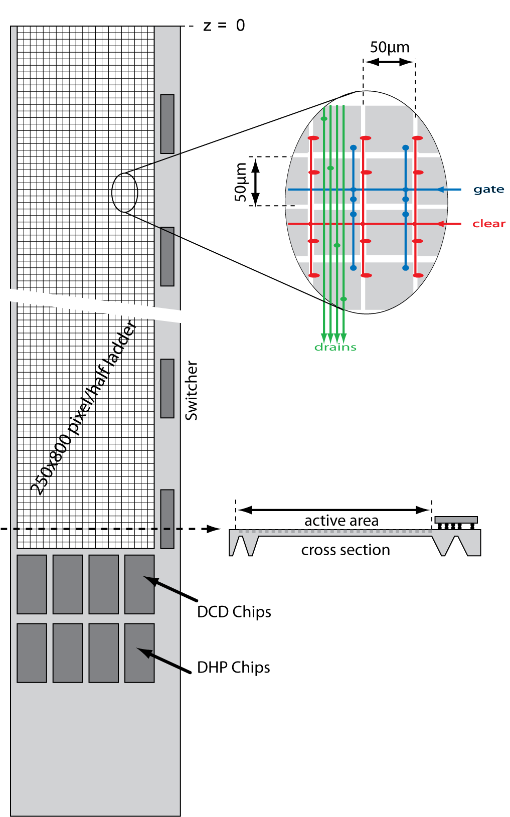
Why is there the Need for electr. Simulations?
Belle II detector requires a pixel detector (PXD) to achieve the aimed vertex resolution
8M pixel of the PXD have to be read out in 20µs
1k pixel have to be readout in parallel within 100ns (for each of the 40 half ladders)
Electrical Simulation of the DEPFET Pixel Detector is necessary

Slide 4
DEPFET Readout
U
t
Average
Pedestal Current ~50 µA
Pedestal Fluctuation ~10 µA
Signal ~ 0.5nA/e
= 2-3 uA (75µm Si)
2 possible readout schemes….

Slide 5
Readout Scheme 1: Double Sampling
Clear Pulse
Store
-
ADC
Large Range, good use of ADC
Faster shaping → higher noise

Slide 6
Readout Scheme 2: Single Sampling
Clear Pulse
DAC
-
ADC
Slow shaping, no signal subtraction → low noise
Need DAC Data (here: 2 bits, from DHP → extra pins)

Slide 7
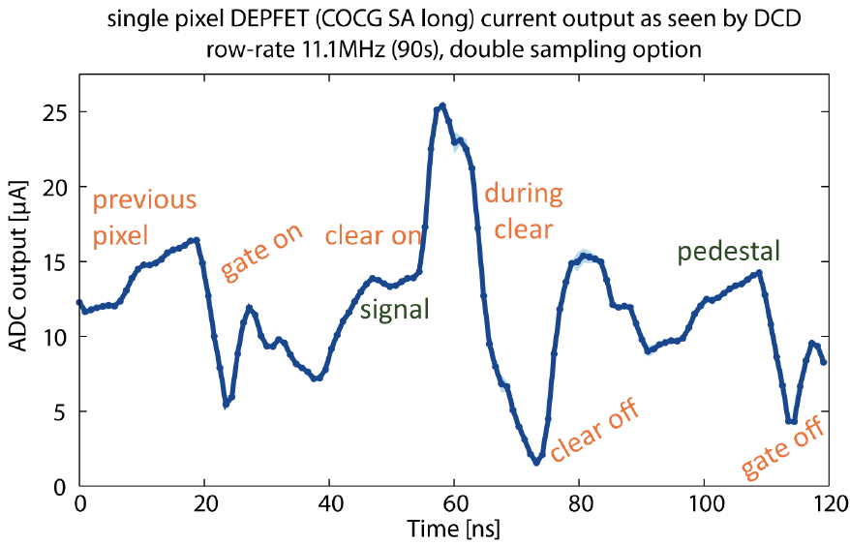
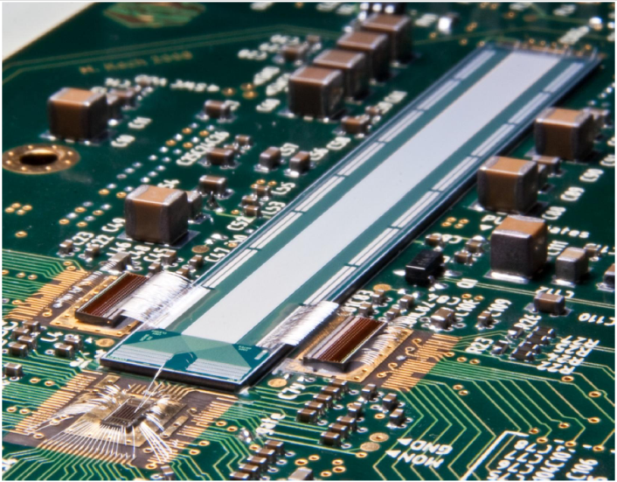
Measurements of PXD-5 Matrices
Measurements of a DEPFET matrix by Manuel Koch – University of Bonn

Slide 8
PXD Electrical Simulation
Aim: test the electrical behavior of the PXD before it’s physical implementation
Simulation of integrated circuits is state of the art:
Models for Switcher and DCD ready (since standard technologies are used)
for a DEPFET matrix a new model has to be implemented

Slide 9
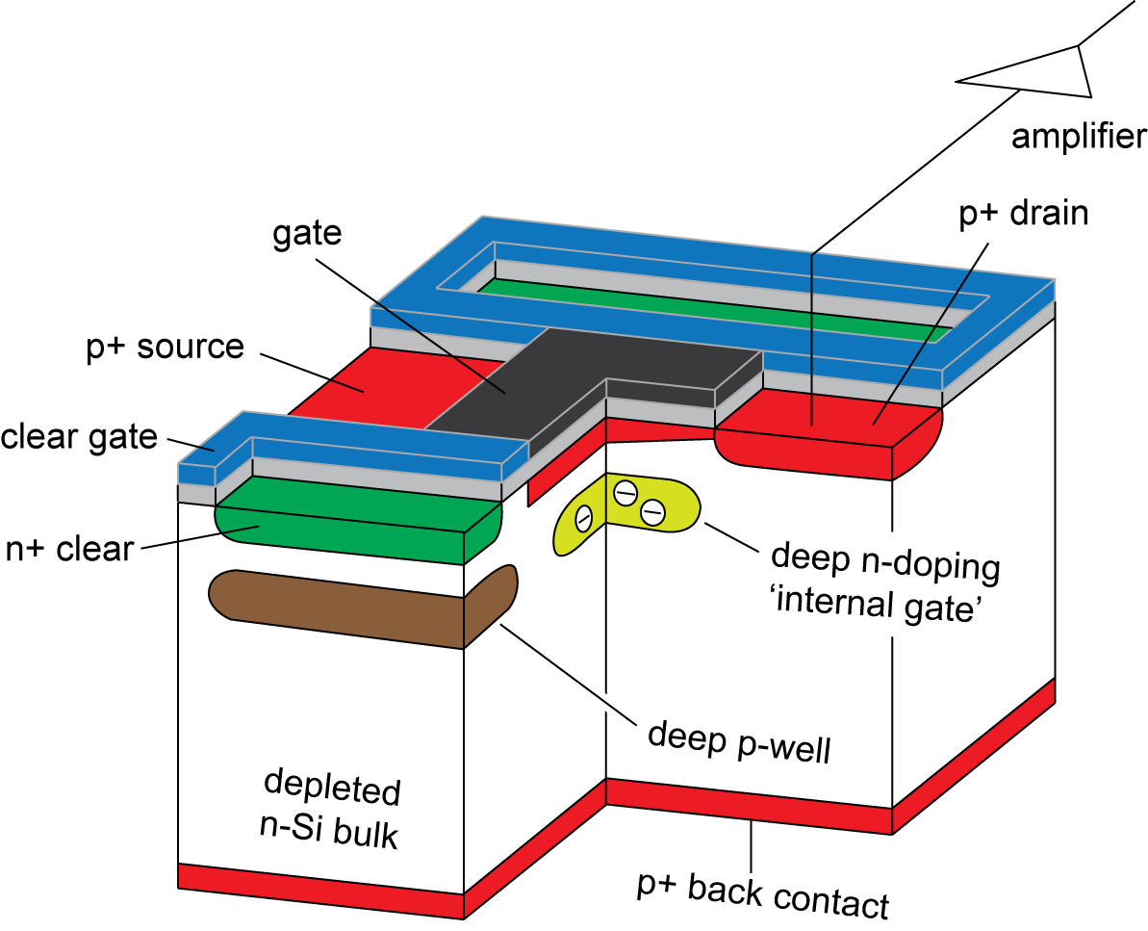
Specific DEPFET Model
Influence of the internal gate on the drain current
Transconductance of the clear and clear-gate electrode on the drain current
Clear mechanism
For an array of DEPFET pixels the line resistance and the capacitive coupling to neighboring lines are also important.
Notes:
Compared with a standard MOSFET the DEPFET model has to take the following properties into account:

Slide 10
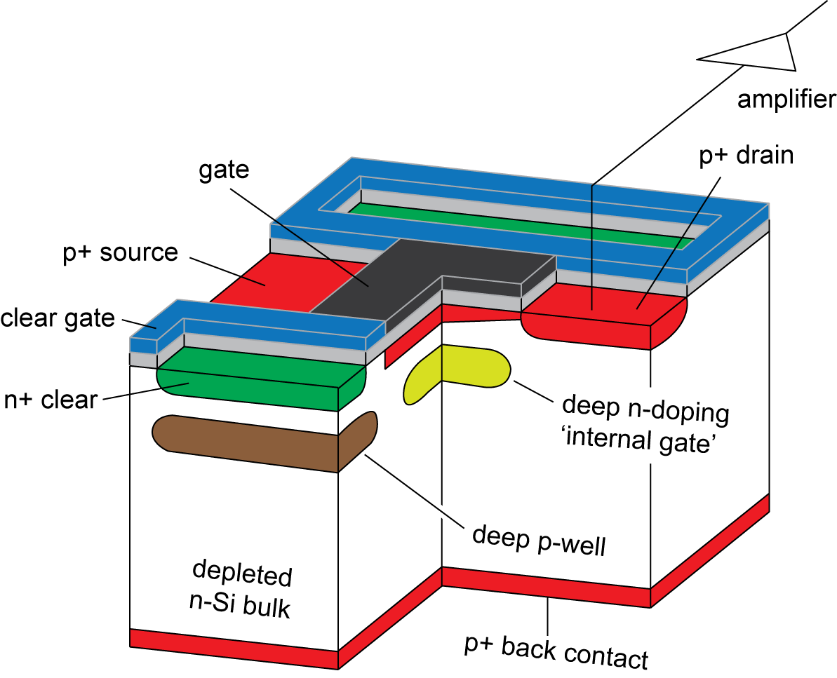
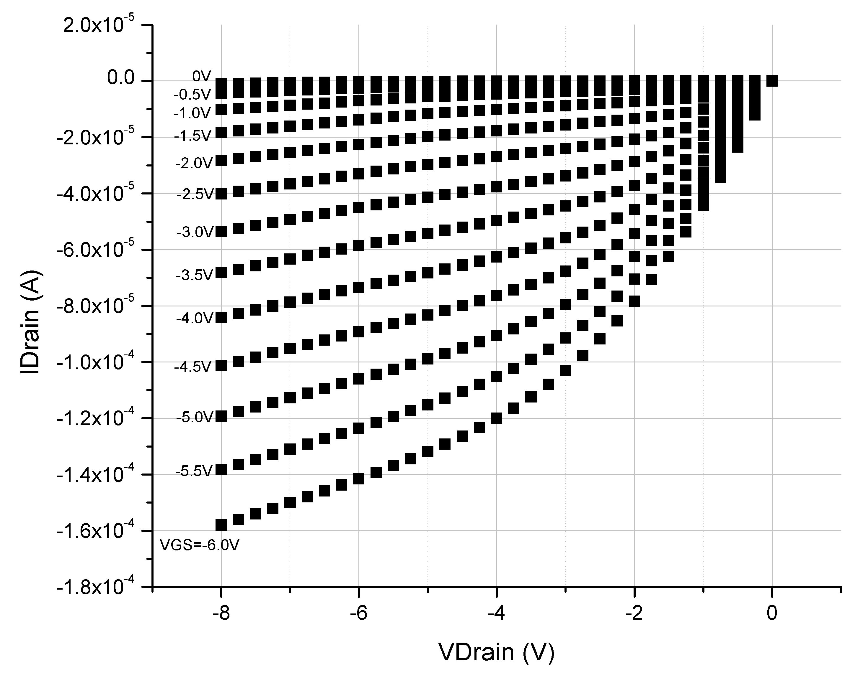
DEPFET Tabular Model
Model uses look-up table with I_{DS} measurements for different bias voltages (V_{GS} and V_{DS})
Only quasi stable condition if the internal gate is empty → I_{DS} measured @ V_{cl high} = 10V
For DEPFET read mode (V_{cl low}) correction of I_{DS} is needed
Spline interpolation for the values which are not in the table
Notes:
In general there are three different kind of large signal transistor (or non-linear) models:
1) Physical models – based upon the deivce physics
based upon approximate modeling of physical phenomena within a transistor.
such as oxide thicknesses, substrate doping concentrations, carrier mobility, etc.
2) Empirical models
This type of model is entirely based upon curve fitting, using whatever functions and parameter values most adequately fit measured data to enable simulation of transistor operation. Unlike a physical model, the parameters in an empirical model need have no fundamental basis, and will depend on the fitting procedure used to find them. The fitting procedure is key to success of these models if they are to be used to extrapolate to designs lying outside the range of data to which the models were originally fitted. Such extrapolation is a hope of such models, but is not fully realized so far.
3)Tabular Models – in form of a look-up table containing large numbers of values for common device parameters such as drain current and device parasitics.
These values are indexed in reference to their corresponding bias voltage combinations. Thus, model accuracy is increased by inclusion of additional data points within the table. The chief advantage of this type of model is decreased simulation time (see article look-up table for discussion of the computational advantages of look-up tables). A limitation of these models is that they work best for designs that use devices within the table (interpolation) and are unreliable for devices outside the table (extrapolation).

Slide 11
DEPFET Specific Properties
DEPFET specific properties can be described by following equations:
internal amplification
Influence of the internal gate on the drain current
Transconductance of the clear and clear-gate electrode on the drain current
Clear mechanism
number of signal electrons

Slide 12
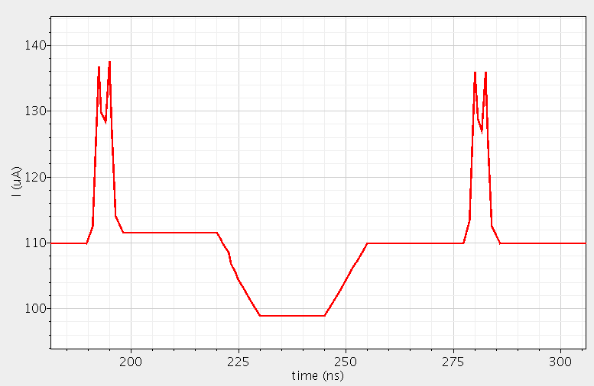
DEPFET Model without parasitic RCs
Simulation of the drain current of a DEPFET Pixel matrix without parasitic RCs.
gate on
gate off
signal
ΔI=1.6µA
pedestal
clear on
clear off
Simulation tool: Cadence SpectreCMI, T Gate on = 90ns

Slide 13
DEPFET Model without parasitic RCs
gate on
gate off
signal
ΔI=1.6µA
pedestal
clear on
clear off
Simulation tool: Cadence SpectreCMI, T Gate on = 90ns

Slide 14
Specific Parameters of a DEPFET Model
Influence of the internal gate on the drain current
Transconductance of the clear and clear-gate electrode on the drain current
Clear mechanism
Capacitive coupling and line resistivity is missing
using Cadence Spectre
Compiled Model Interface
RC extraction based on layout and technology
Notes:
Compared with a standard MOSFET the DEPFET model has to take the following properties into account:

Slide 15
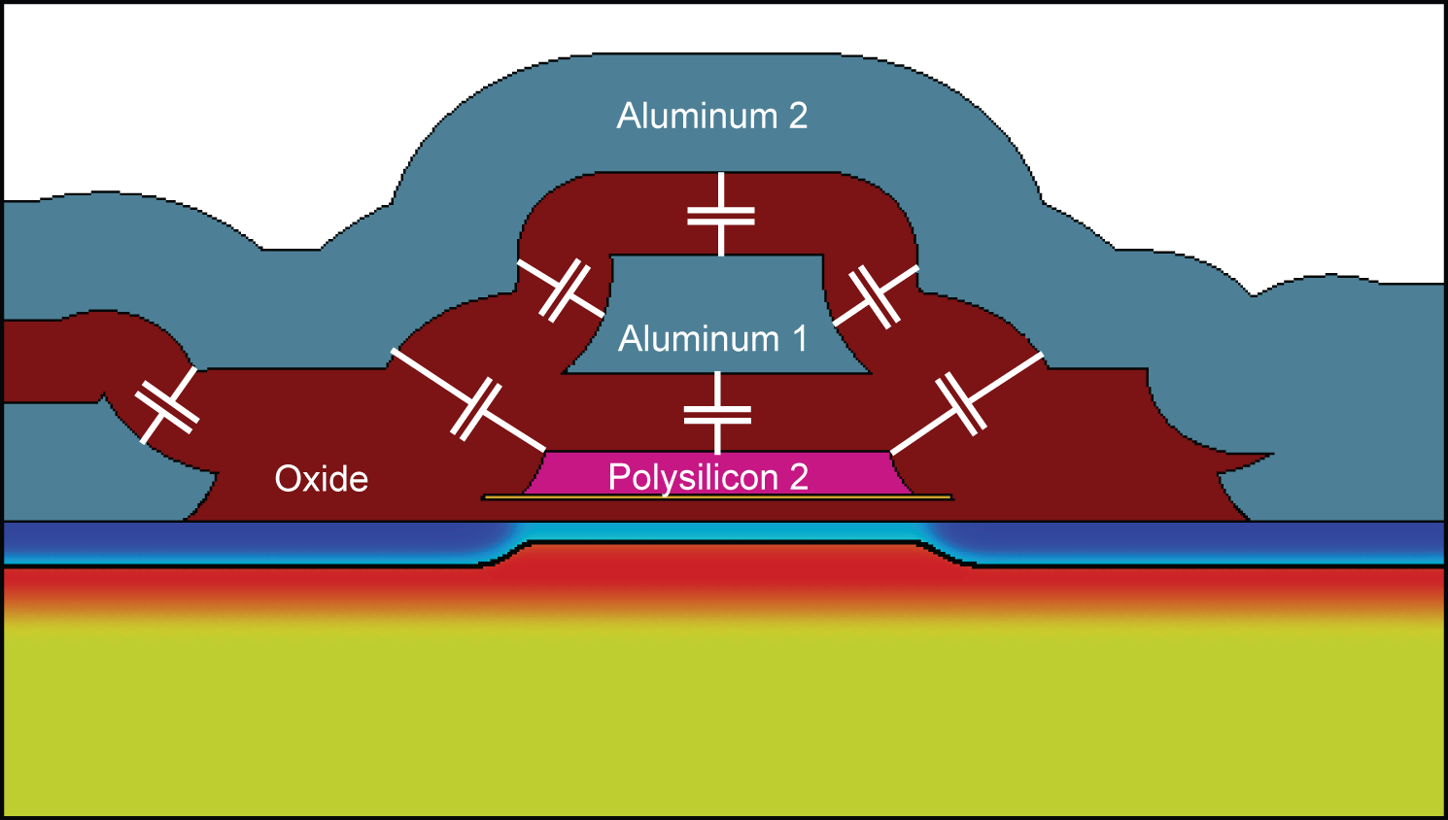
DEPFET Cross Section incl. Parasitic Capacitances
Drain
Source
Gate

Slide 16
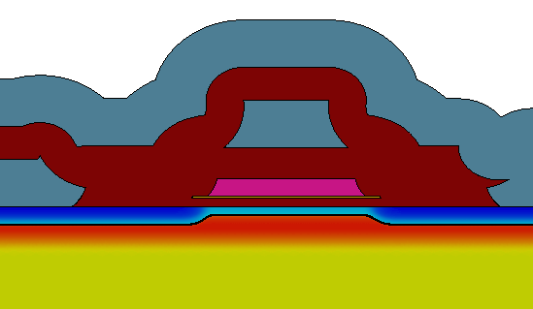
Synopsys Raphael RCV + Sentaurus Structure Editor
Non-planar technology
GDS II
Along P-Channel
Perpendicular to Channel
Drain
Gate
Source
n+ Clear
Clear Gate
DEPOSITION THICKNESS=0.2 MATERIAL=Oxide TYPE=iso
ETCH THICKNESS=0.2 MATERIAL=Oxide TYPE=iso MASK=via1 POLARITY=NEGATIVE
DEPOSITION THICKNESS=0.4 MATERIAL=Metal TYPE=patterned MASK=poly1 POLARITY=POSITIVE
Synopsys Tools
3D Model
MESH
Generator
Capacitance
Report
SPICE net list
Charge Calculation

Slide 17
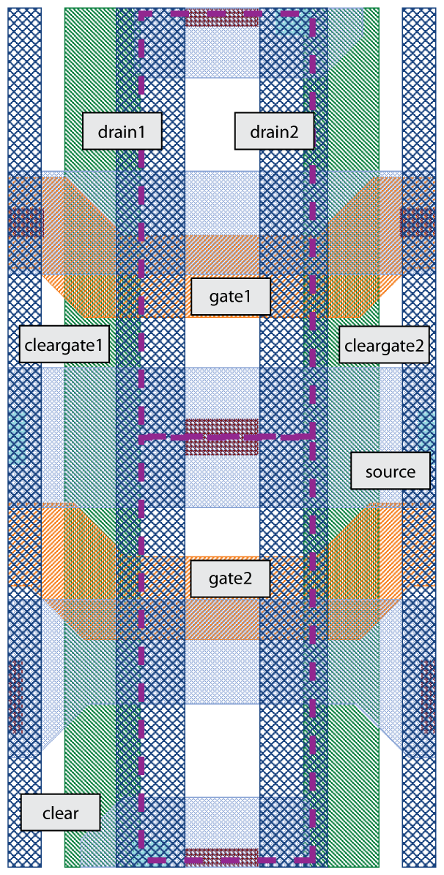
PXD5 Long Matrix (ILC –like)

Slide 18
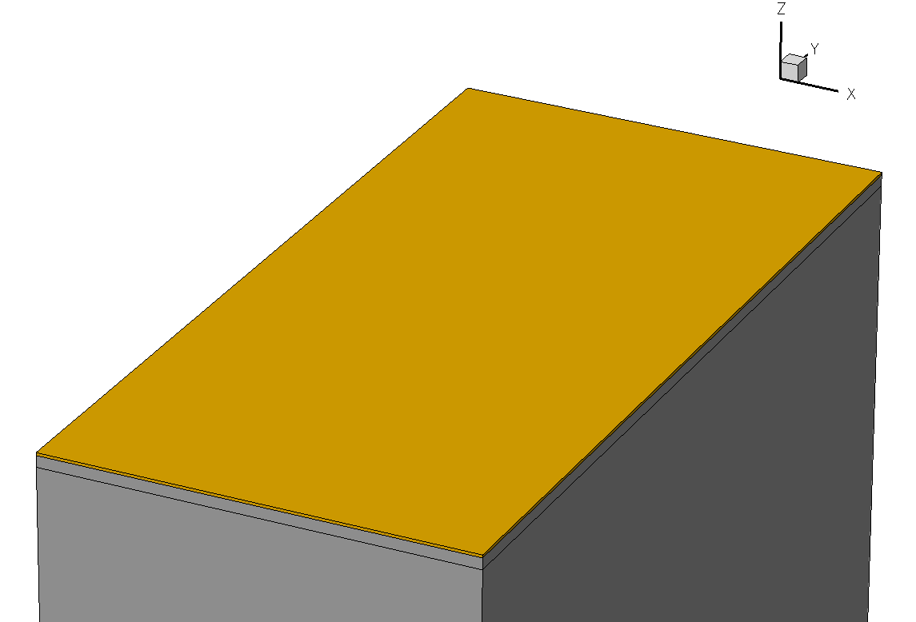
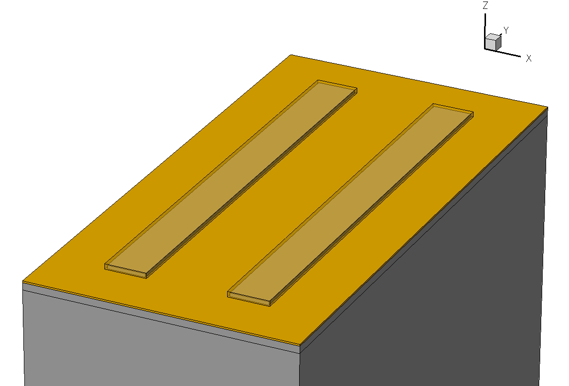
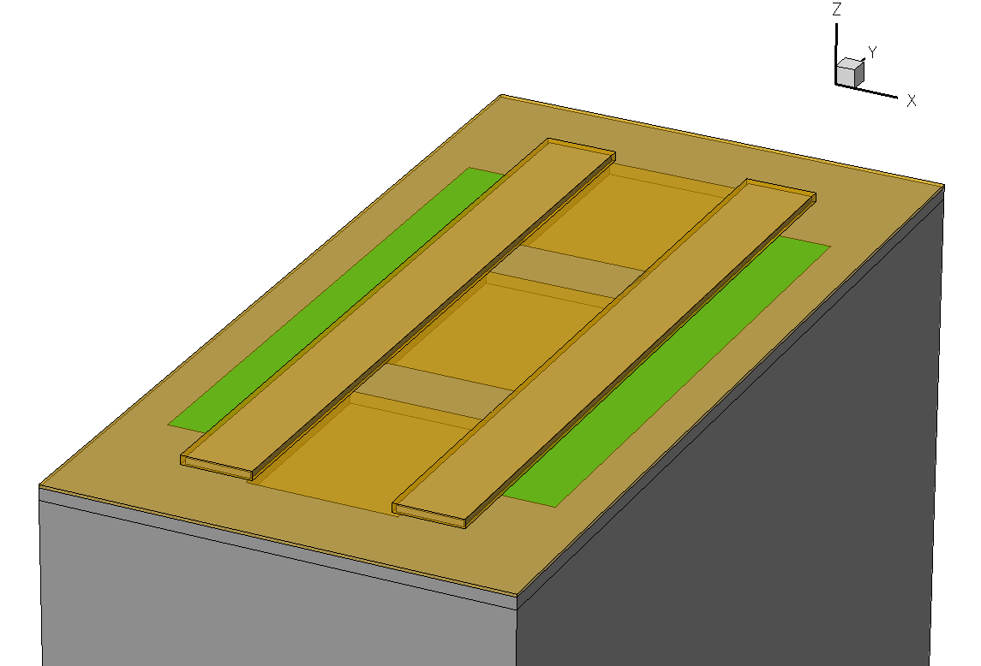
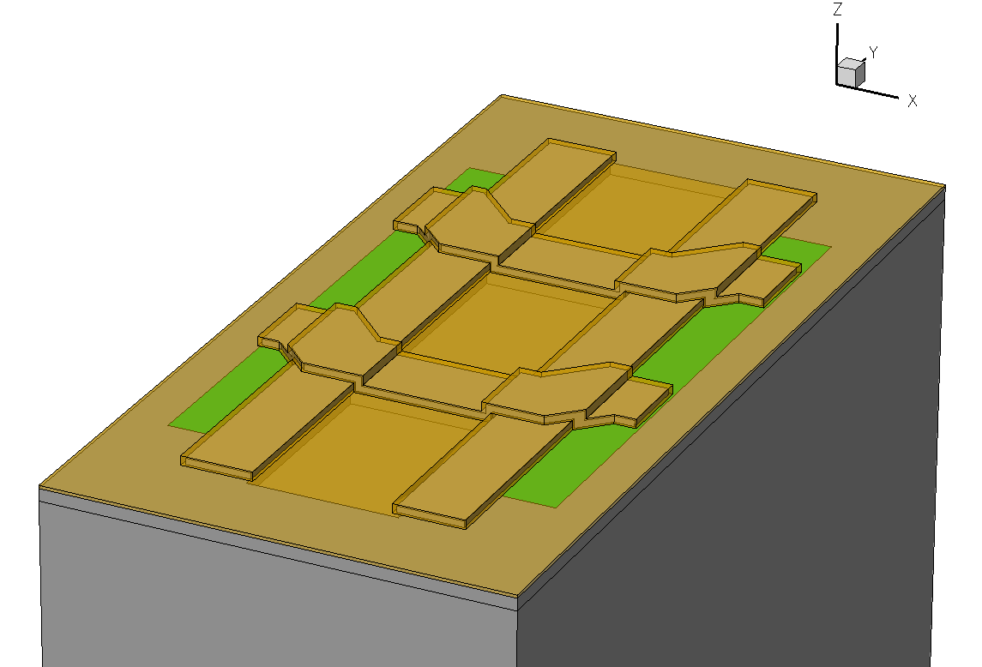
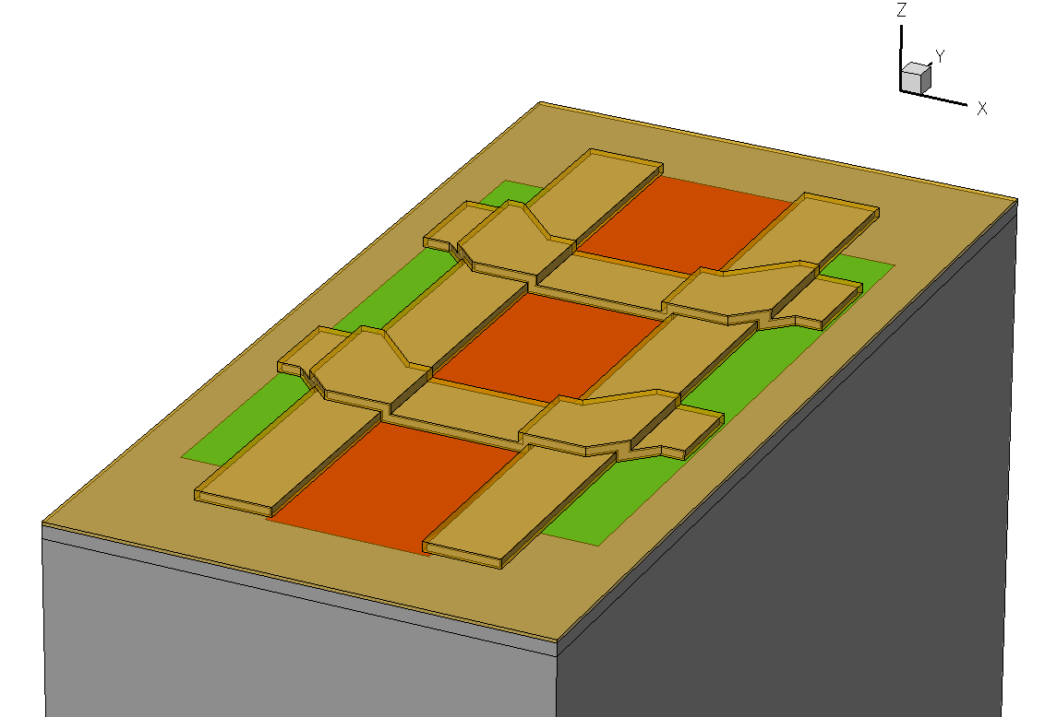
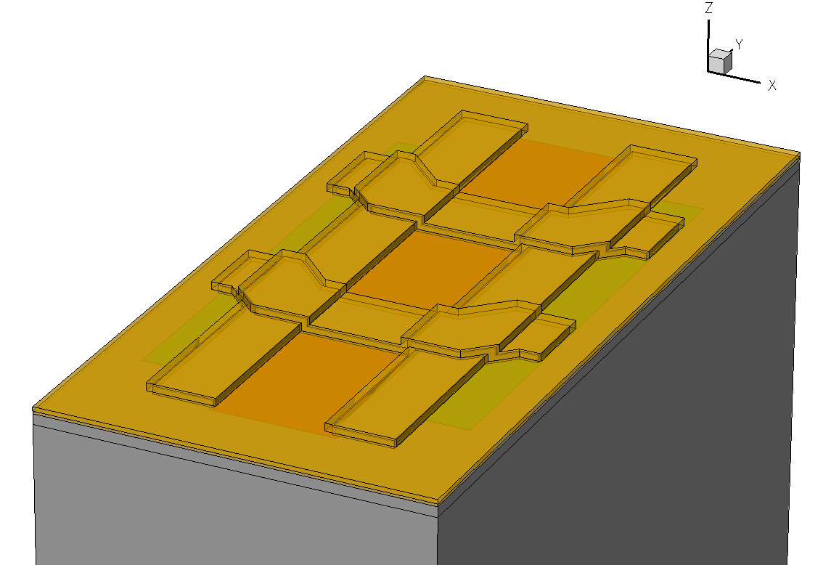
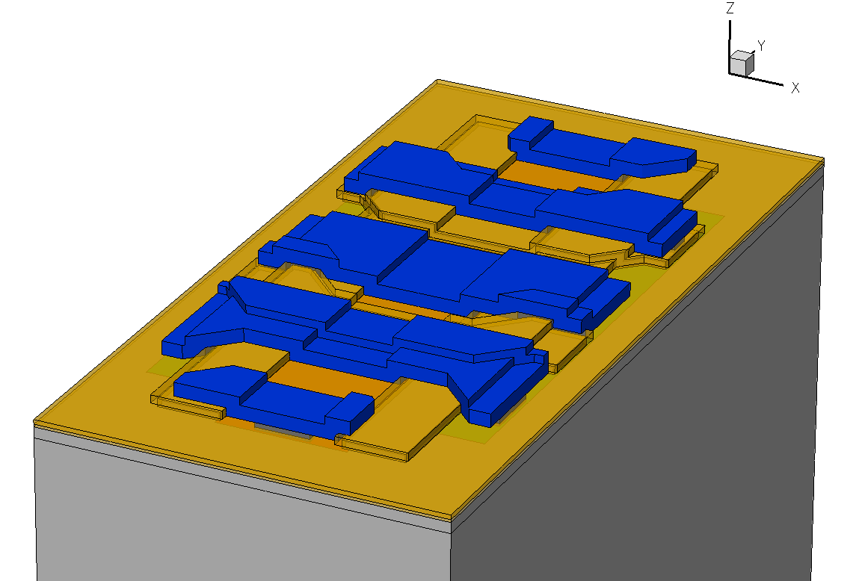
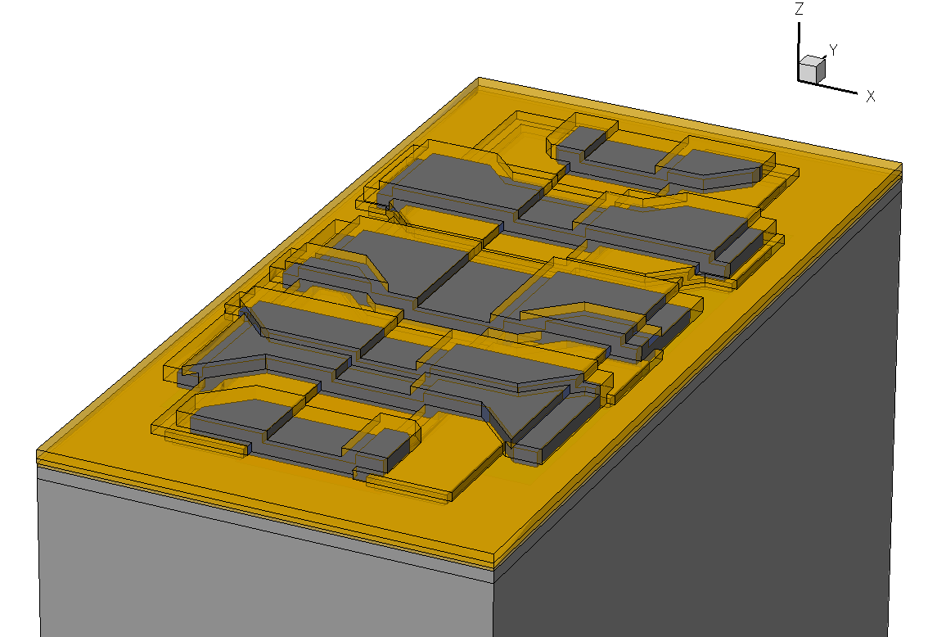
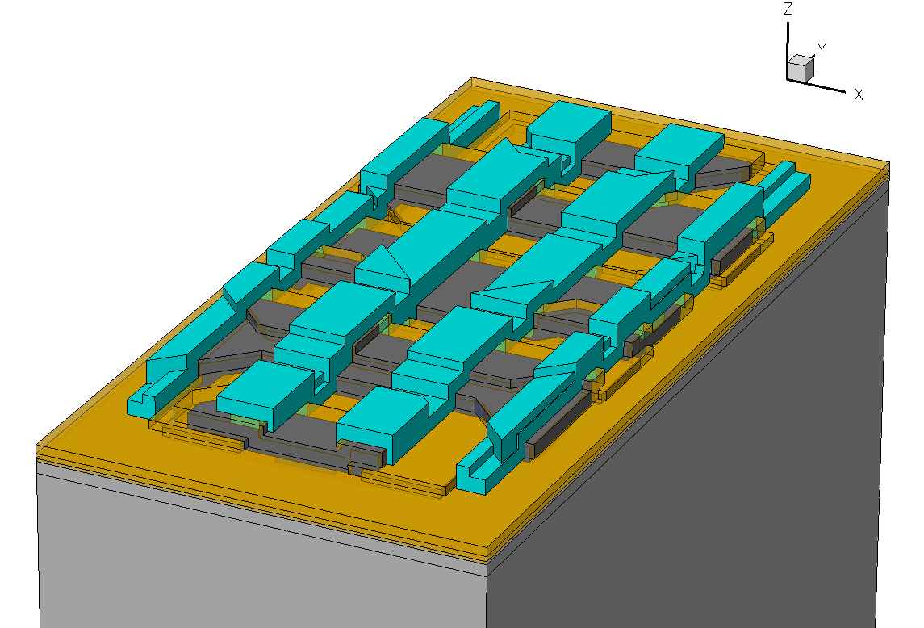
3D Model of PXD5 ILC-like Cell

Slide 19
Capacitance Extraction
C Drain | 51 fF
C Gate | 102 fF
C Cleargate | 248 fF
C Clear | 213 fF
For a pixel array 1024x128:
C Drain_Array = 1024 * 51fF = 52pF

Slide 20
Example: Worst Case Pixel
Each line is a distributed RC line
of 50 segments
worst case pixel
Control lines
Gate line: R = 40 Ohm, C = 13pF
Clear line: R = 40 Ohm, C = 27pF
Readout (drain) line
R = 215 Ohm, C_DrainArray = 52pF

Slide 21
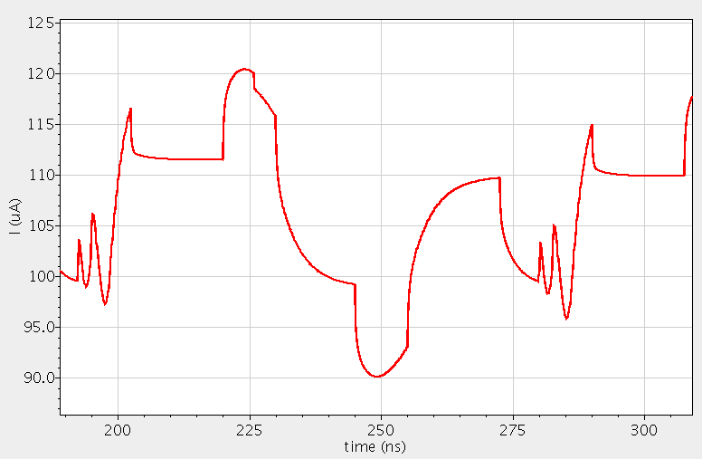
Simulation PXD5 COCG - Double Sampling
Simulation of I_{DS}
gate on
clear on
Next pixel
gate on
Next pixel
clear on
signal
pedestal
signal
gate off
gate off
Measurement
clear off
clear off

Slide 22
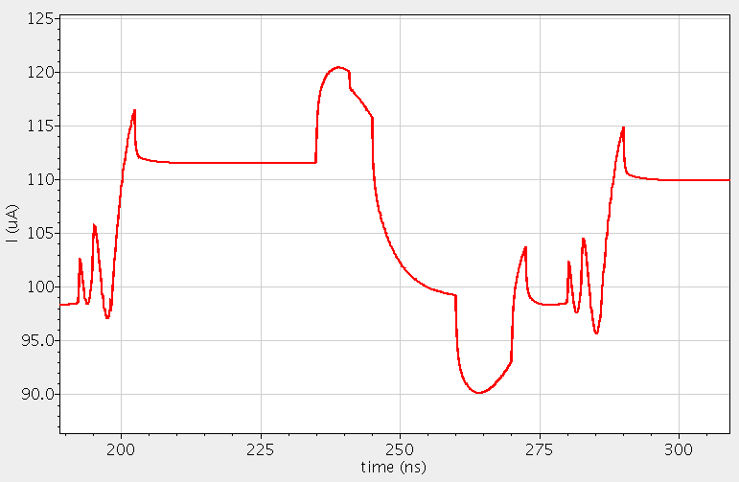
Simulation PXD5 COCG - Single Sampling
Simulation of I_{DS}
clear on
gate on
Next pixel
signal
gate off
clear off
Measurement

Slide 23
Summary and Outlook
DEPFET Parameter Model describes the unique DEPFET specific properties and includes parasitic RC values (based on layout and technology)
Enables the investigation of fundamental speed limits and optimization by changes in design or technology
Simulation environment including the full-chip models of the Switcher-B and DCD-B is available at the University of Heidelberg (Prof. Fischer‘s group)
Next steps are the simulations of the current PXD6 designs and the setup of the full-chip models of Switcher-B and DCD-B at MPI Munich

Slide 24
Thank you!

Slide 25
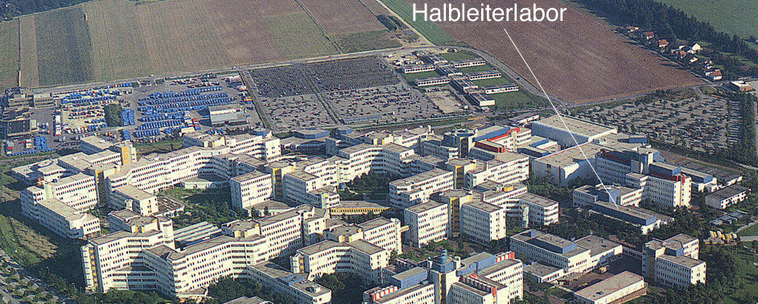
MPI Semiconductor Laboratory
Common project of the:
Max-Planck-Institut für Physik (Werner Heisenberg Institut), Munich
Max-Planck-Institut für extraterrestrische Physik, Garching
Founded in 1992, since 2000 located in the Siemens plant in Neu-Perlach,
Munich

Slide 26
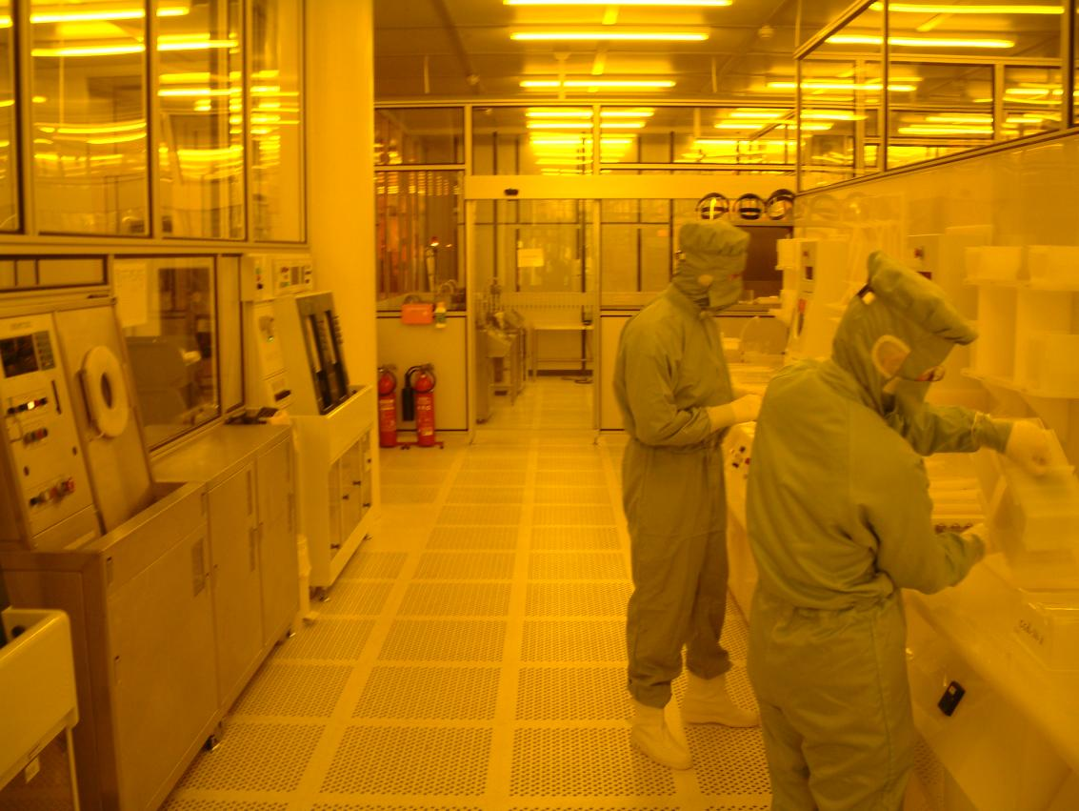
MPI Semiconductor Laboratory
800 m² cleanroom, up to class 1 in critical areas
particle removal by a continuous filtered air stream (from ceiling to bottom, 40.000 m³/h)
clean processing by handling, clothing and separation from outside world
clean process gases and chemicals
supply of ultra-clean water

