Slide 1
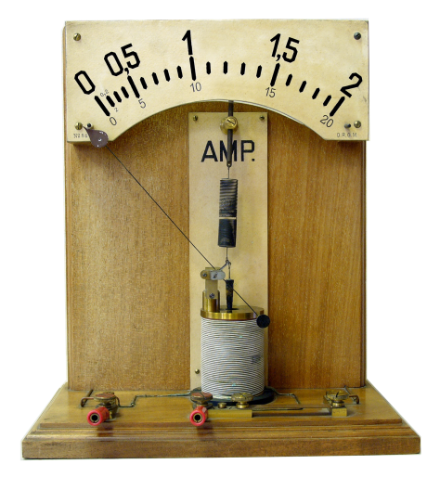
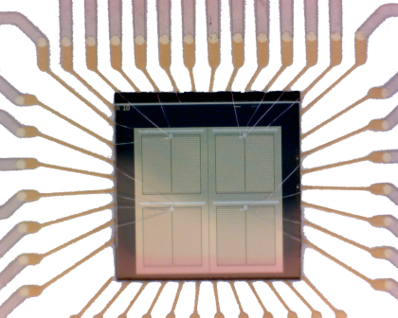
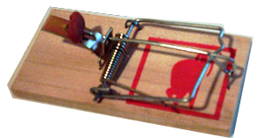
Radiation Hardness of DEPFET Pixel Sensors
Andreas Ritter
IMPRS - Young Scientist Workshop 2010, Ringberg

Slide 2
Outline
Motivation
DEPFET
Defects
Measurement
Outlook

Slide 3
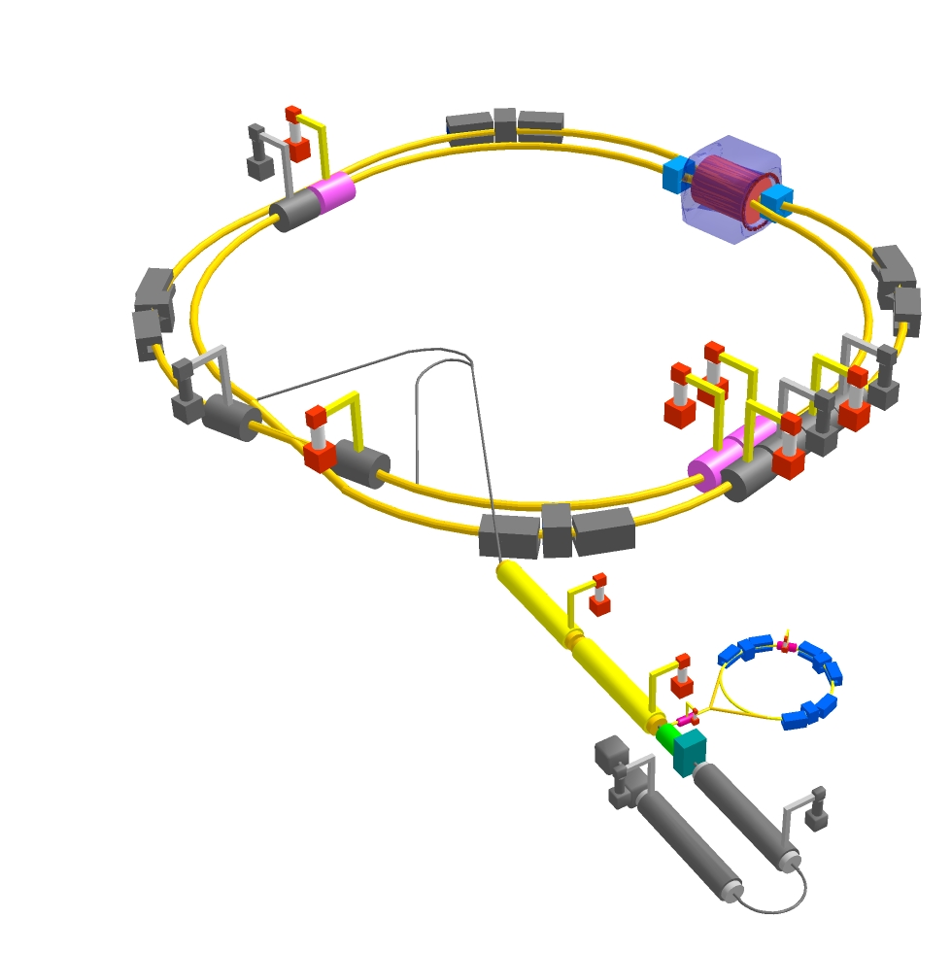
Motivation – SuperKEKB and the Belle II Experiment
Accelerator KEKB (now SuperKEKB), experiment Belle (now Belle II)
e+ / e- collider
4 GeV / 7 GeV Energy
Operated at the Y(4S) resonance (10.58 GeV)

Slide 4
Motivation – The Belle II Experiment (II)
Location in Japan, Tsukuba
Only experiment at Super-KEKB, control of Beam
Upgrade, of accelerator KEKB -> SuberKEKB
Belle -> Belle II
1 Mrad(yr)

Slide 5
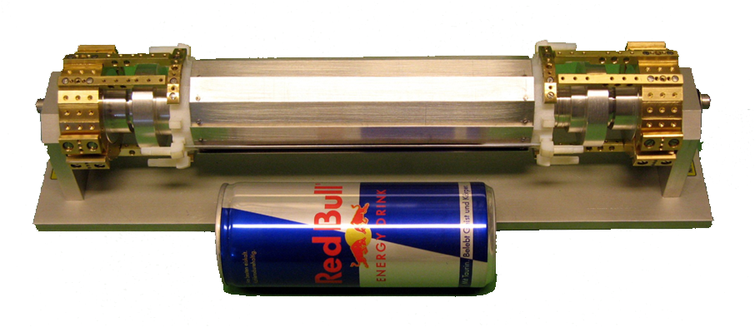
The PX Detector
New pixel Detector at Belle II
Part of Vertex detector, innermost 2 layer
Detector resolution ≈ 1.3 µm ¹
Close to IP for good resolutions of reconstruction
Consists of DEPFETs, developed at the MPI Semiconductor Laboratory
¹ DEPFET Vertex Detectors: Status and Plans, Frank Simon, LCWS Proceedings

Slide 6
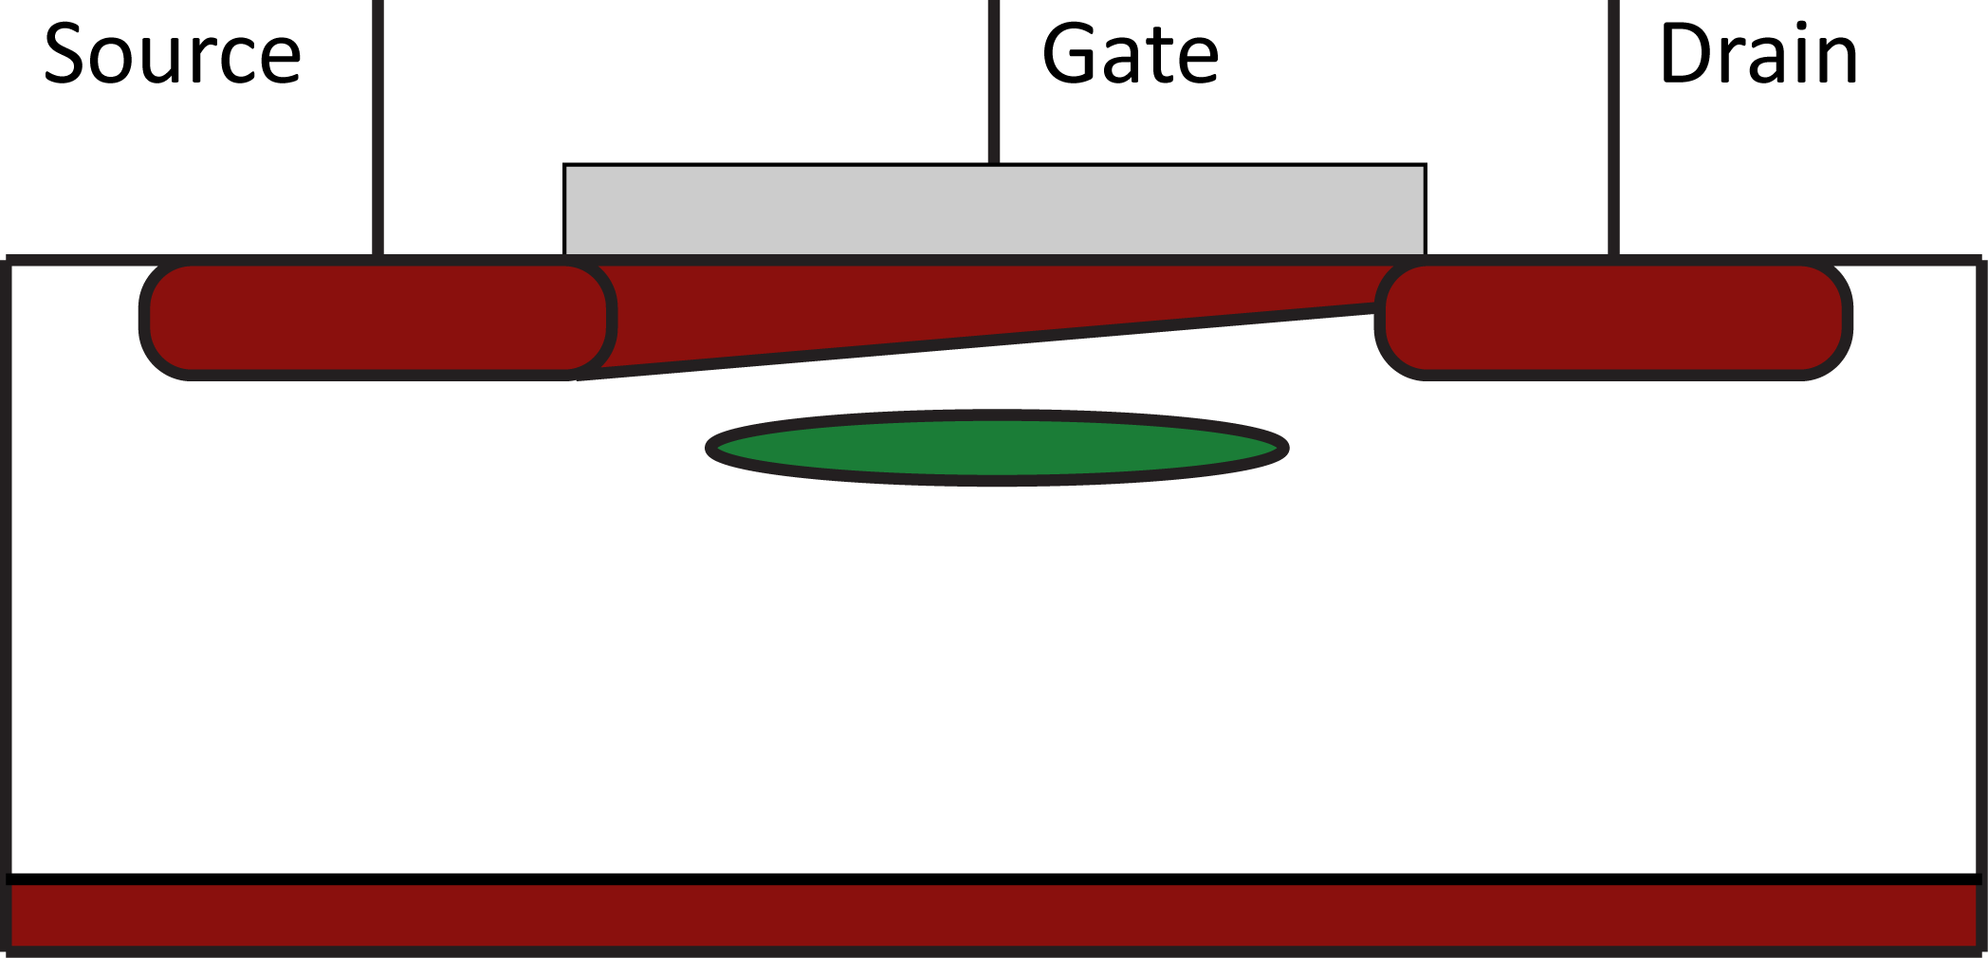
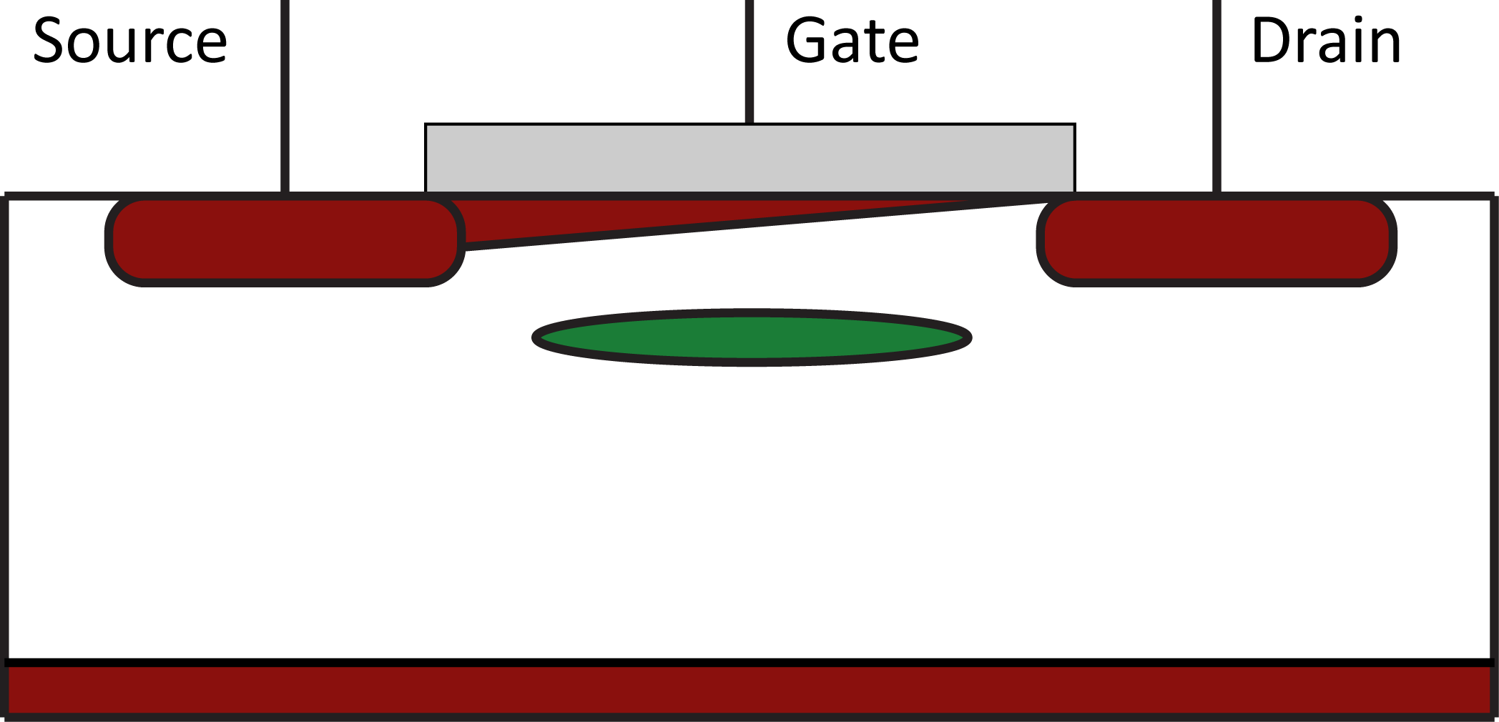
DEPFET - Charge Collection and Signal
Charge generation in DEPFET
Sideward depletion --> internal Gate
Current Modulation by collected Charge
-High Voltage

Slide 7
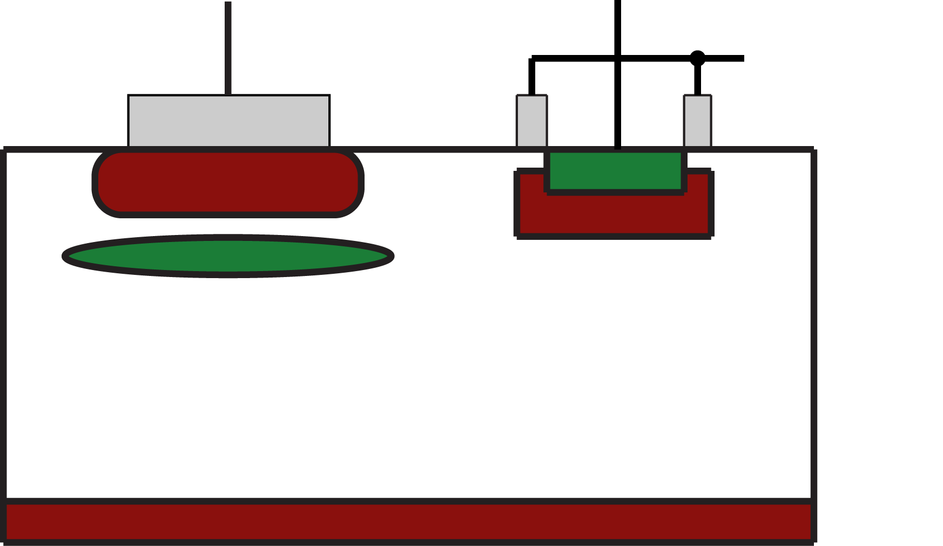
DEPFET – Clear mechanism
+
Measure Current1 with charged internal Gate
Then charge has to be removed of the internal Gate → Clear Contact (pos. Bias)
Measure Current2
Difference of currents = Signal
Channel
Clear
Clear Insulator (p+)

Slide 8
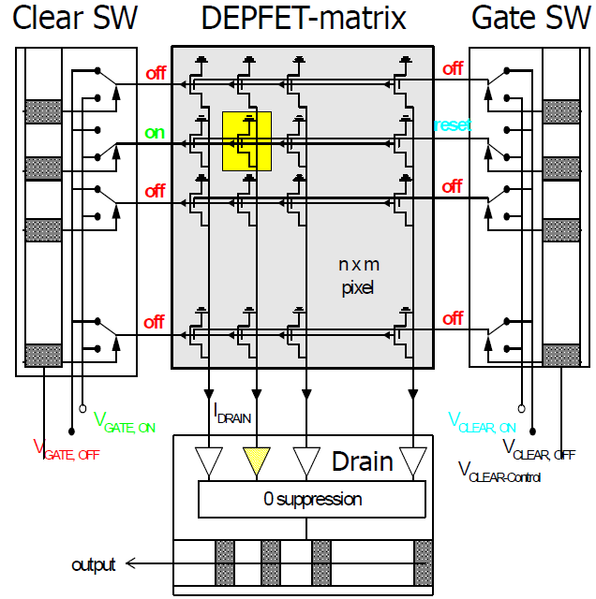
Matrix Operation
Matrix Operations need 2 Switcher (Gate and Clear)
Also Current read-out required
Read out in rolling shutter mode

Slide 9
Radiation sources
Luminosity related QED process
--> Creation of electron/positron pairs
--> Ionizing as well as Bulk Damage
Synchrotron Radiation
Beamgas interactions
--> Belle II will have a bad vacuum in the Interaction Region of the beampipe
Touschek effect

Slide 10
Damage to Device
Bulk Damage = Lattice Displacements in Silicon
Vacancies
Interstitials
Substitials
Clusters
Oxide Damage
Build up of Oxide Charge
Generation of Interface Traps

Slide 11
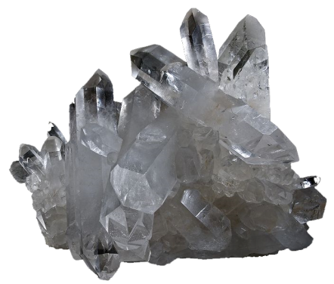
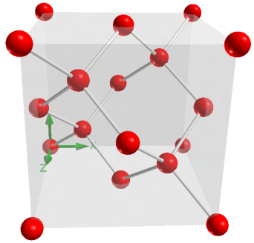
Oxide Charge and Interface Traps – Origin and Generation

Slide 12
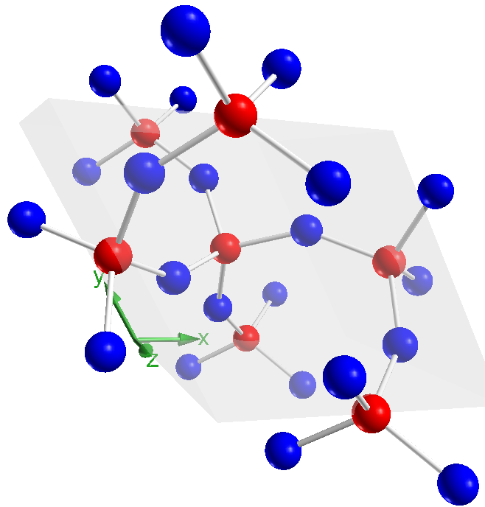
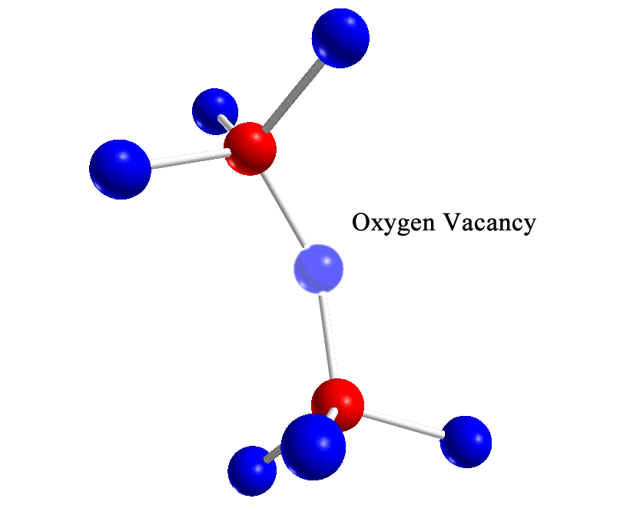
Defects – Creation of Oxide Charge (I)
SiO₂ Crystal structure
Interface between Si and SiO₂: Lattice mismatch → Bond from Si to Si
Strained Bond can be broken…

Slide 13
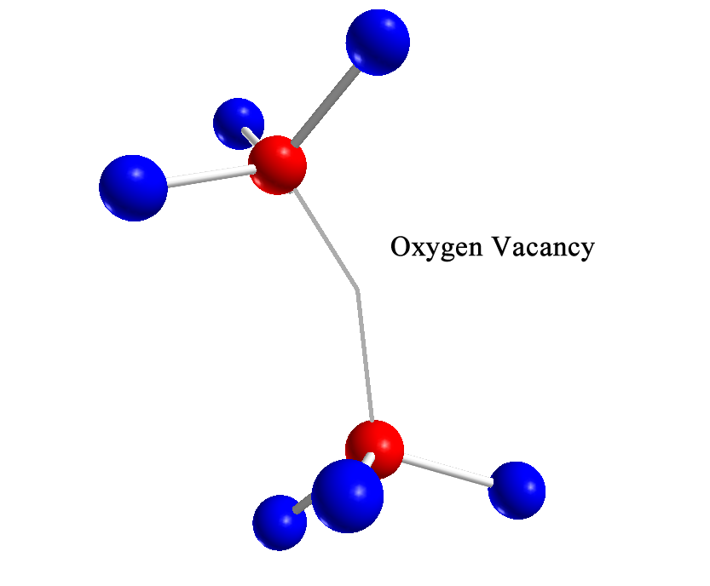
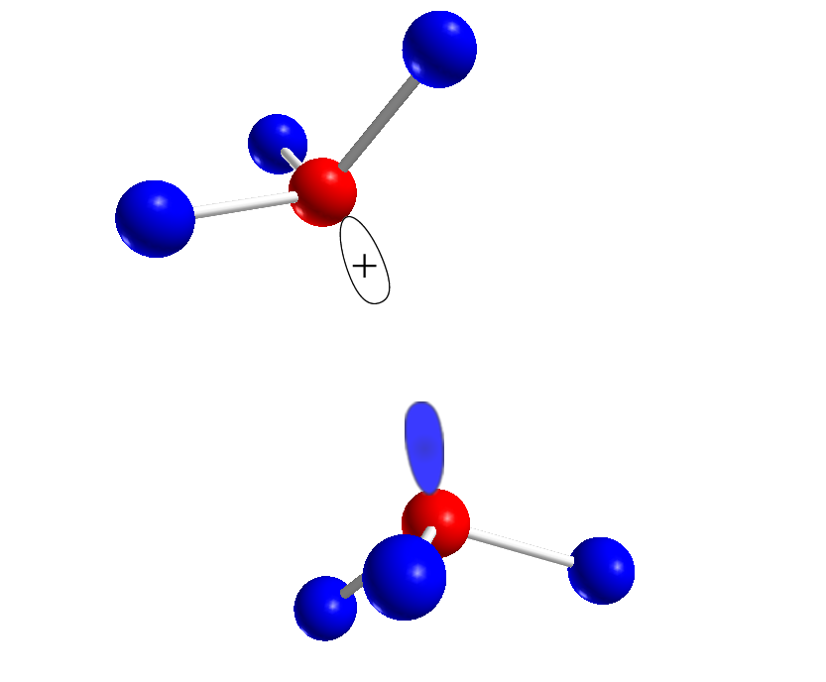
Defects – Creation of Oxide Charge (II)
Oxygen Vacancy
Electron-hole-pair generation by ionizing radiation
Hole meets vacancy
Formation of trapped hole

Slide 14
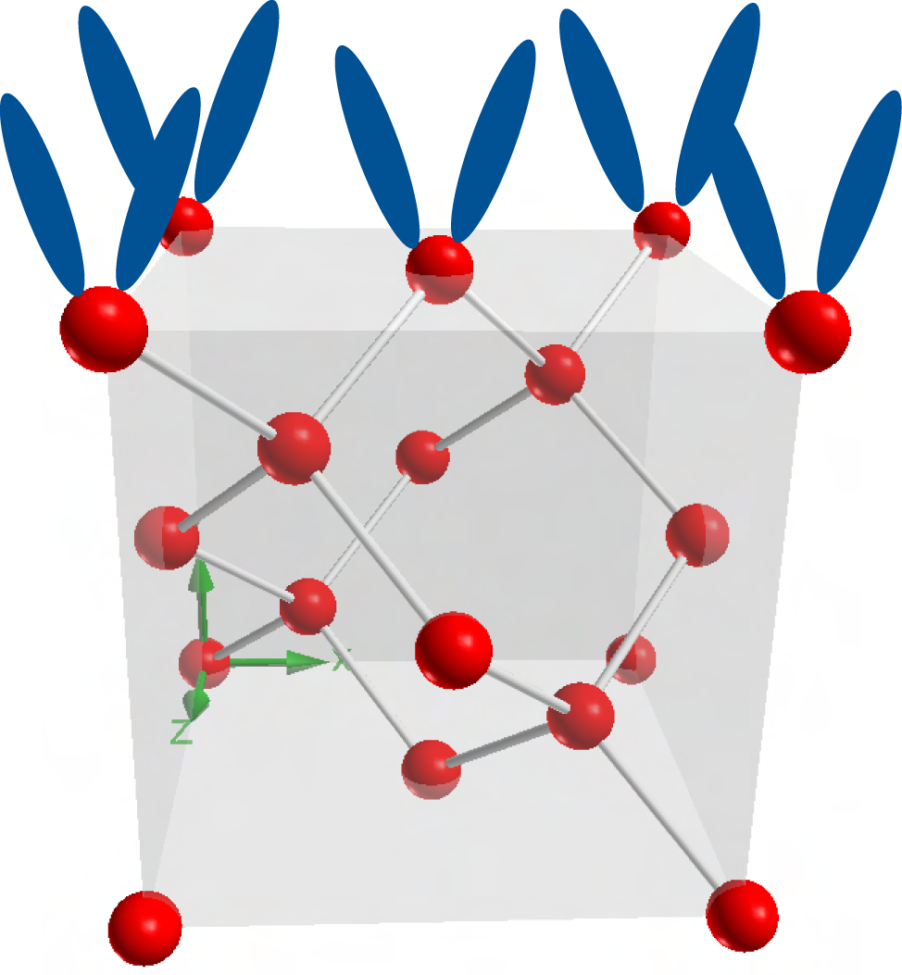
At the Interface between Si and SiO₂…
Lattice constants of Si and SiO₂ do not match
open bindings
highly electrically active

Slide 15
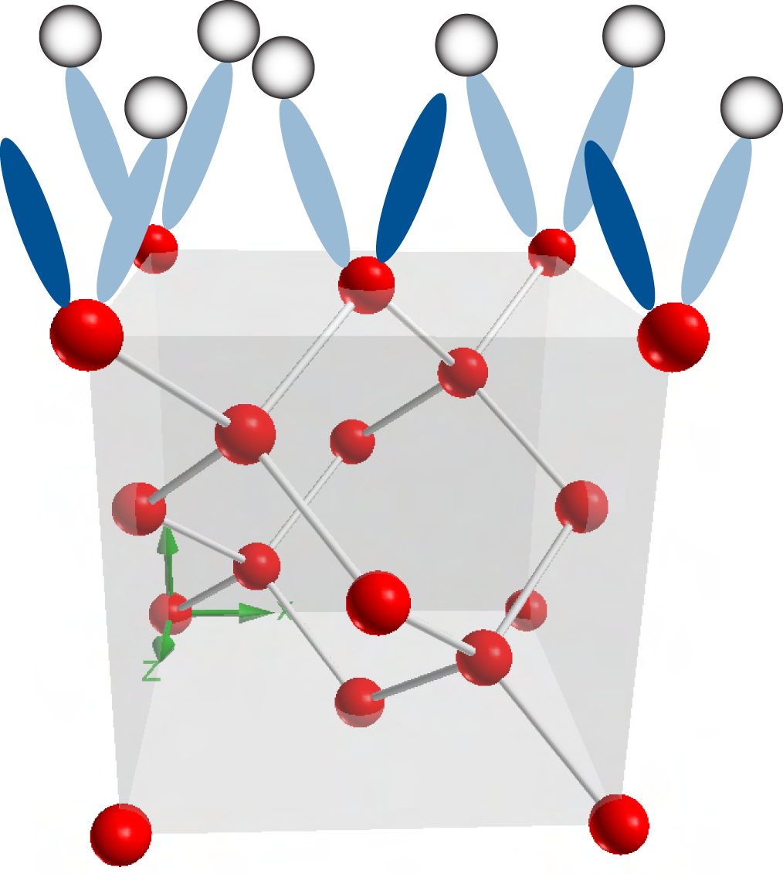
At the Interface between Si and SiO₂…
H2 diff zum Interface
passivation
Nicht alle getroffen
Paar übrig, liegen 0.2 eV
Von der andkante
Use Hydrogen (Forming Gas) to get rid of Interface Traps
Passivation

Slide 16
At the Interface between Si and SiO₂…
Ionizing radiation creates/frees protons somewhere in the device.
Via diffusion and drift Hydrogen nuclei get to the interface.
H⁺ + Si-H → Si⁺ + H₂

Slide 17
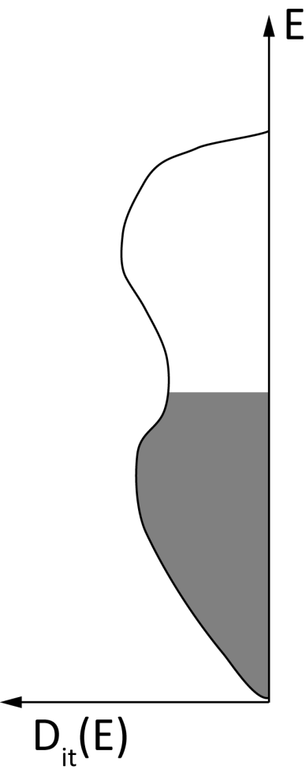
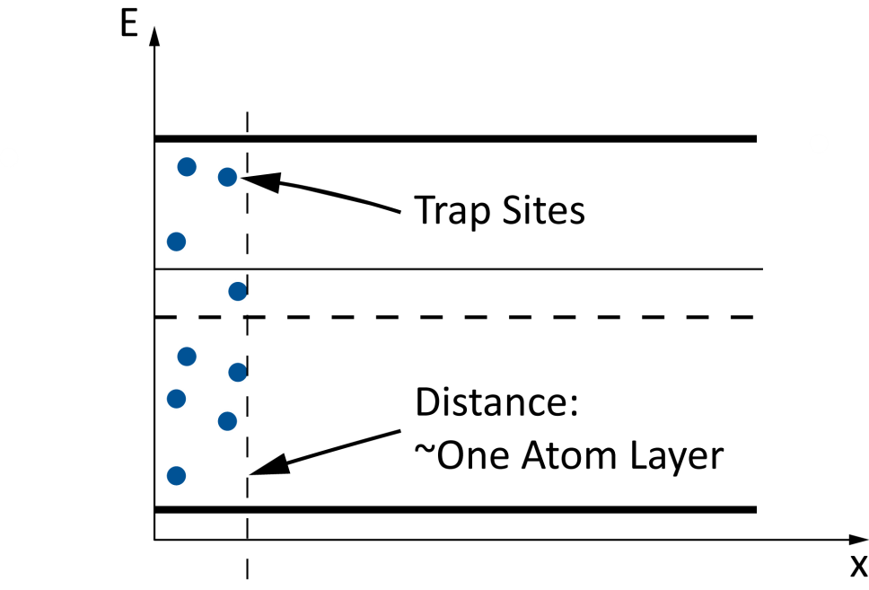
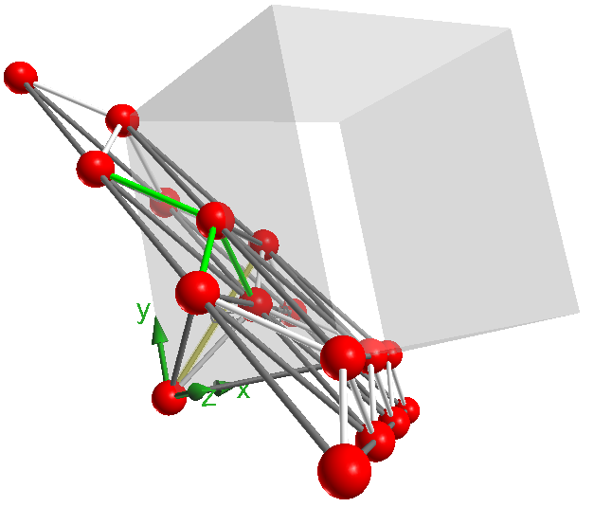
Interface Traps depend on: Density
[111]
[100]
…and Location

Slide 18
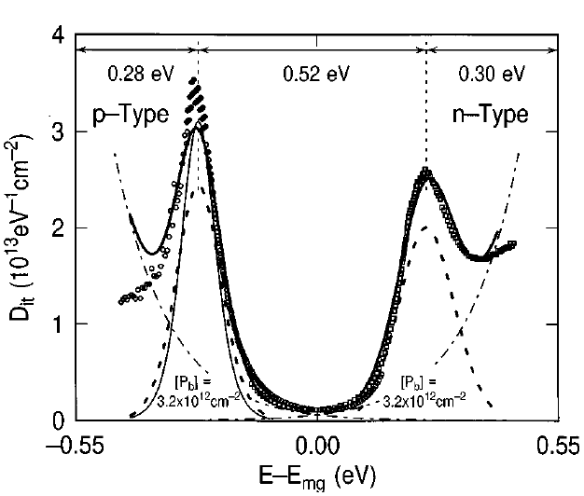
At the Interface between Si and SiO₂…
The most common interface trap is called Pb.
Interface trap is amphoteric = act as Donor or as Acceptor.
In lower Half Band Gap mostly acceptor type, in the upper half donor-type.
Hot-electron induced passivation of silicon dangling bonds
at the Si(111)/SiO₂ interface
E. Cartier and J. H. Stathis from
Appl. Phys. Lett., Vol. 69, No. 1, 1 July 1996

Slide 19
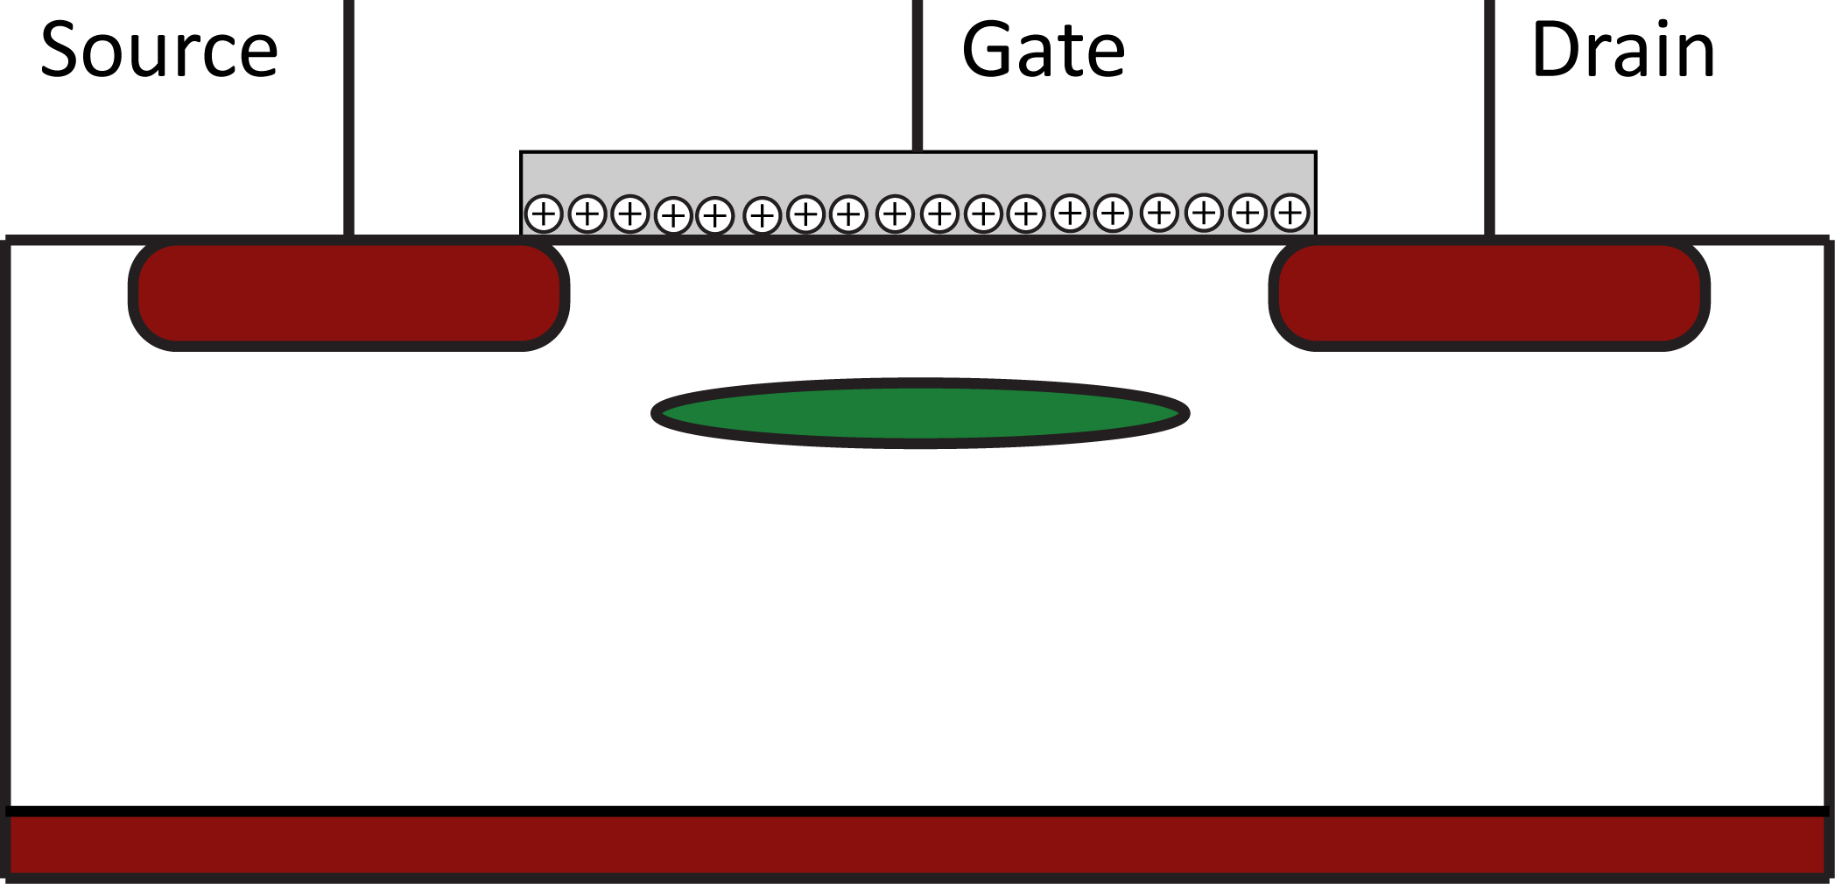
Impact of Oxide Charge on the DEPFET
Oxide charges are trapped holes in the oxide
Change threshold voltage and may create parasitic channels

Slide 20
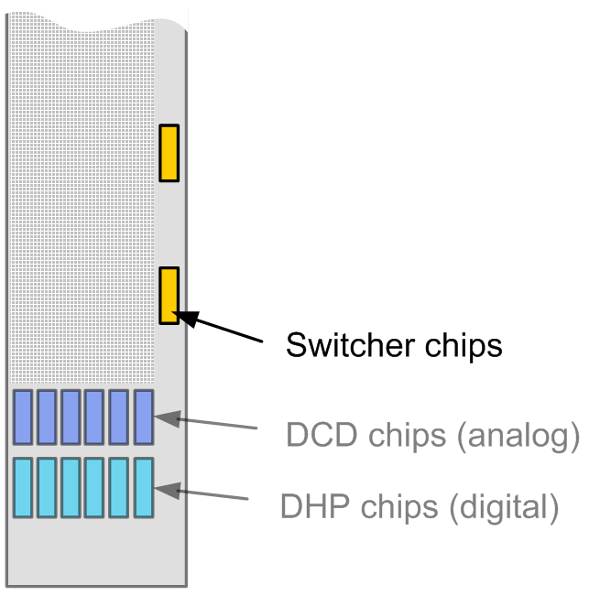
Impact of Oxide Charge on the ladder
Voltages for DEPFET ON/OFF are supplied via Switcher-Chips. Adjustments necessary
DEPFETs may receive different amounts of radiation
No Space for so many voltage lines
Necessary: Reduce threshold voltage change

Slide 21
Impact of Interface Traps on the DEPFET
Interface traps are located near the Si-SiO₂ Interface → Charge in channel is influenced
Interface traps trap charge in the channel and emits them after some time → 1/f Noise increase
In general: Traps reduce the mobility of the charge in the channel → transconductance (amplification) is reduced

Slide 22
Measurements - DEPFETs and MOS Capacitors

Slide 23
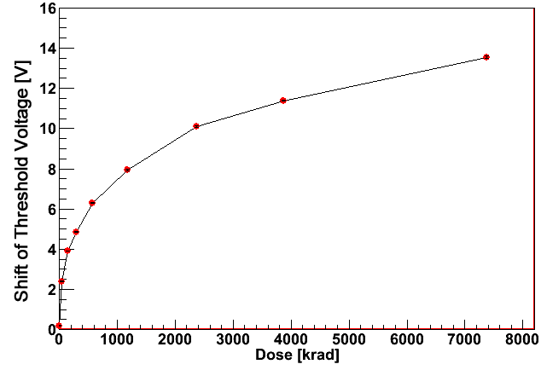
X-ray irradiations – DEPFETs with thick oxides
Irradiation with 60 keV X-ray. DEPFETs with thick Oxides
Zero Gate Voltage during Irradiation
13 V shift in ideal case
To much shift → Remedy thin oxides:
Lower voltage needed to steer DEPFET
and deposited dose only half as much as with ½ thick oxides
1 Gy = 1 J/kg = 100 rad
Measurements by Peter Müller

Slide 24
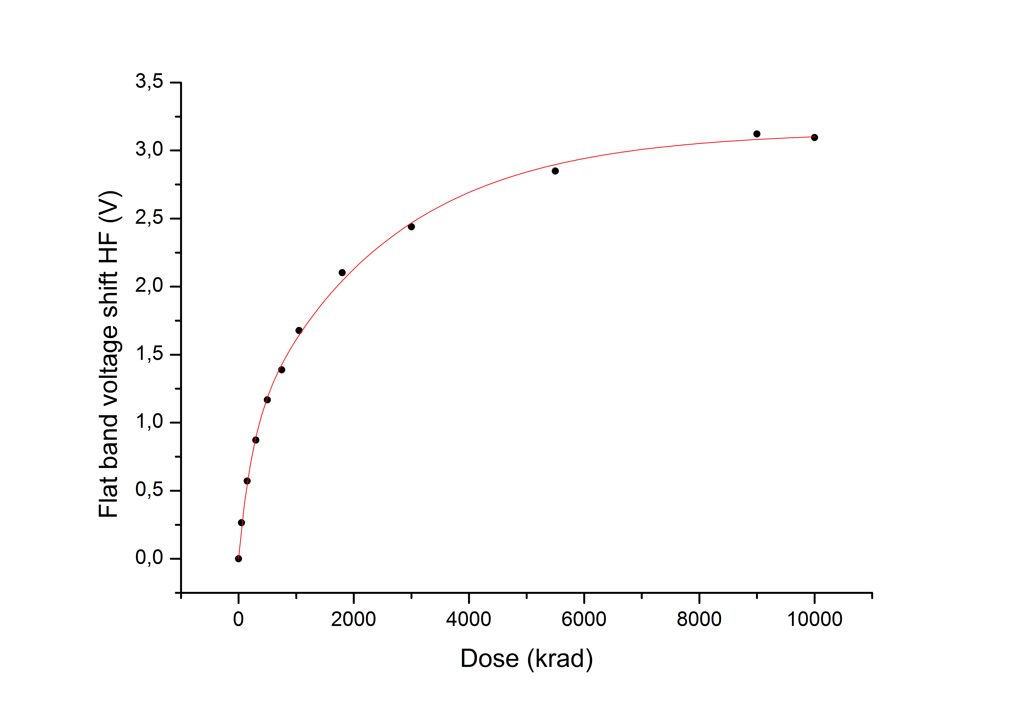
X-ray irradiations – MOS Capacitors with thin oxides
Capacitors react in the same way as DEPFETs (flat band voltage = threshold voltage)
No Gate Voltage
No Annealing

Slide 25
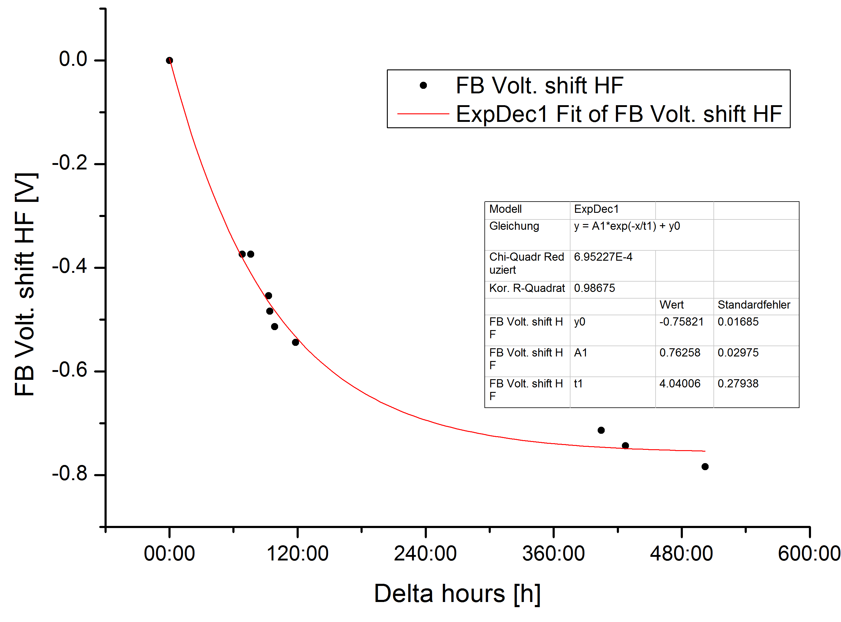
Annealing
Tunneling from electrons into SiO₂ (trapped holes) →neutralizes traps
More electrons by temperature and light
Annealing was done at room temperature
~3V after 10 Mrad was set to “0”

Slide 26
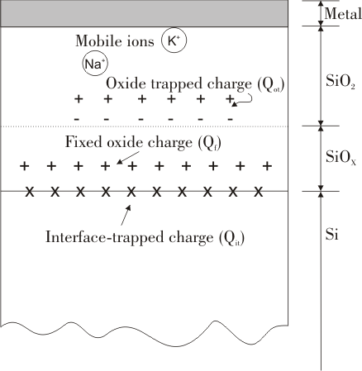
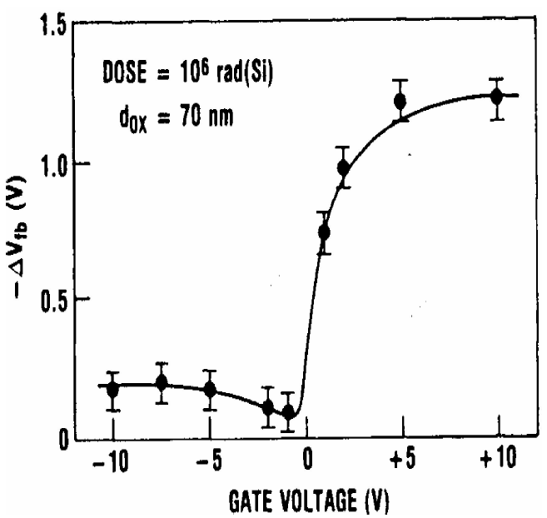
Influence of Gate Voltage
Ideal case (≈0V) means no electric field in the oxide → Recombination is enhanced

Slide 27
Outlook
ELSA – simulate damage of electrons via electron irradiation
Prague Minimatrix Board – Noise studies on DEPFET matrices
Study thin oxide in different design variations

