Slide 1
Fast Small Pixel -
The next Generation
(FSP TNG)

Slide 2
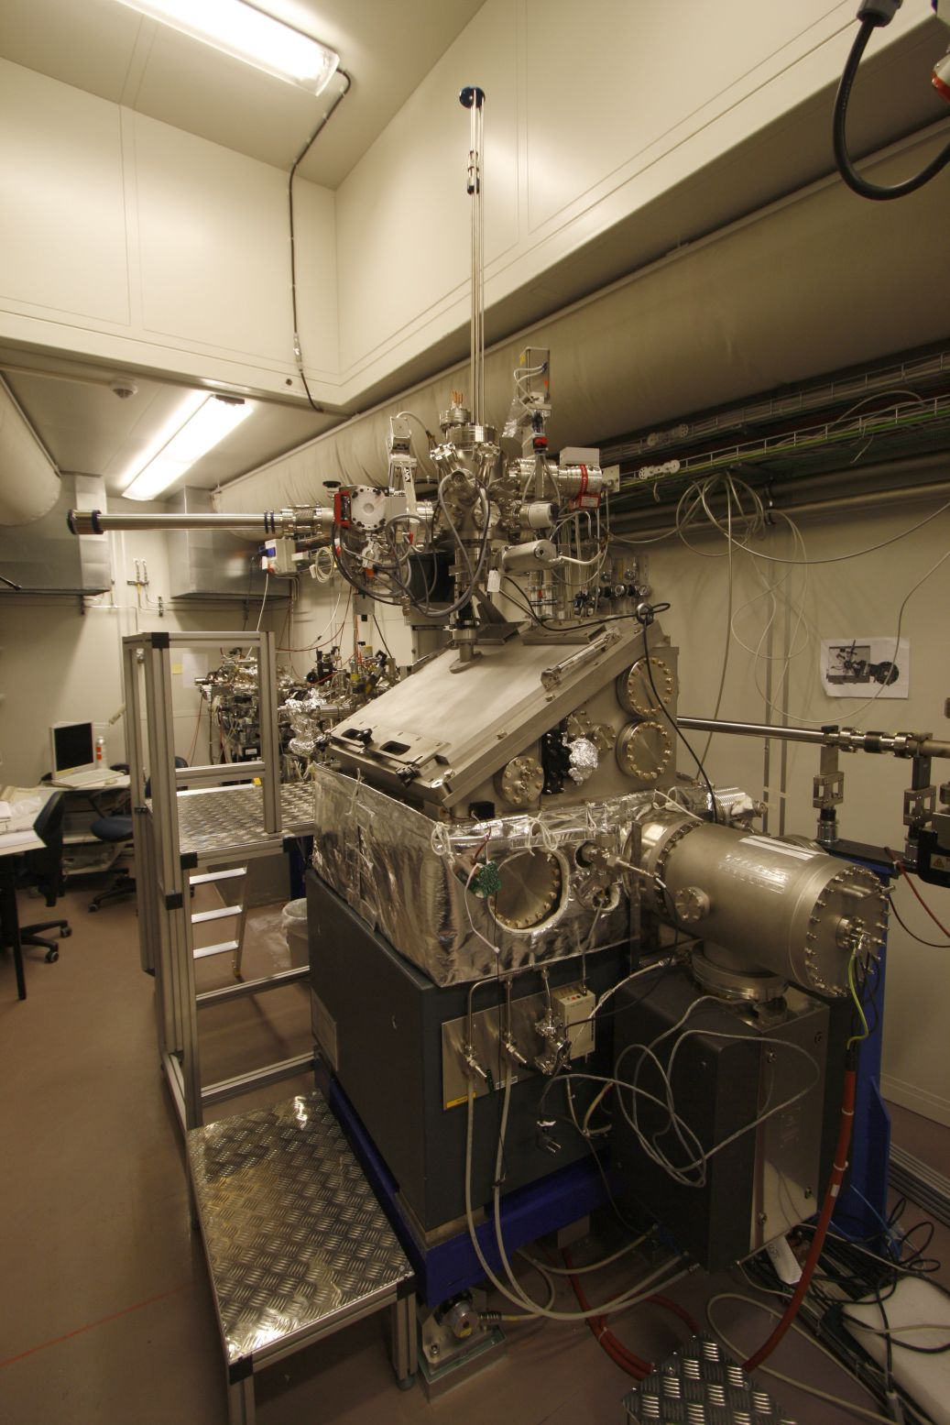
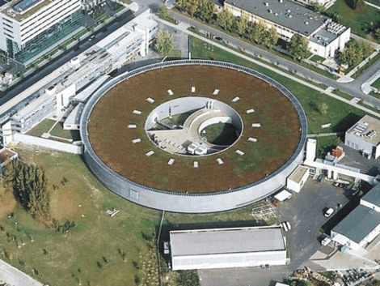
MAXYMUS/MYSTIIC @ Bessy II
BESSY II, Helmholtz-Zentrum, Berlin
*MAgnetic X-raY Microscope
with UHV Spectroscopy

Slide 3
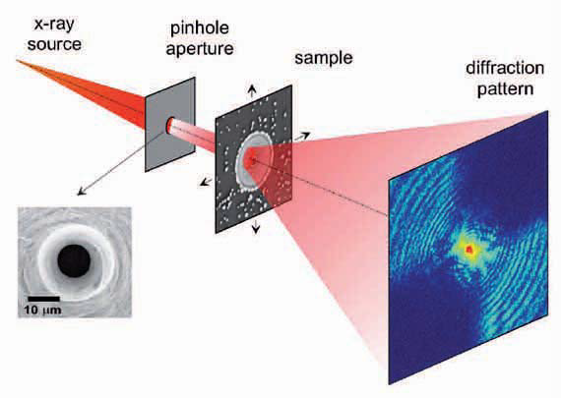
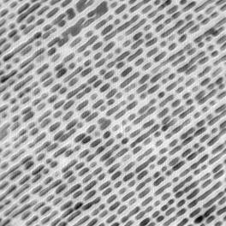
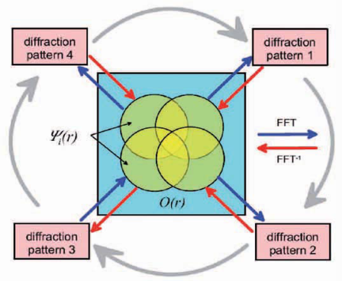
Ptychography
Ptychographic reconstrution of
commercial Fresnel Zone Plate
200 nm
5 nm half-pitch
resolution aperture limited
record n pictures
move sample in x and y
do this for m positions
reconstruct sample from m x n pictures

Slide 4
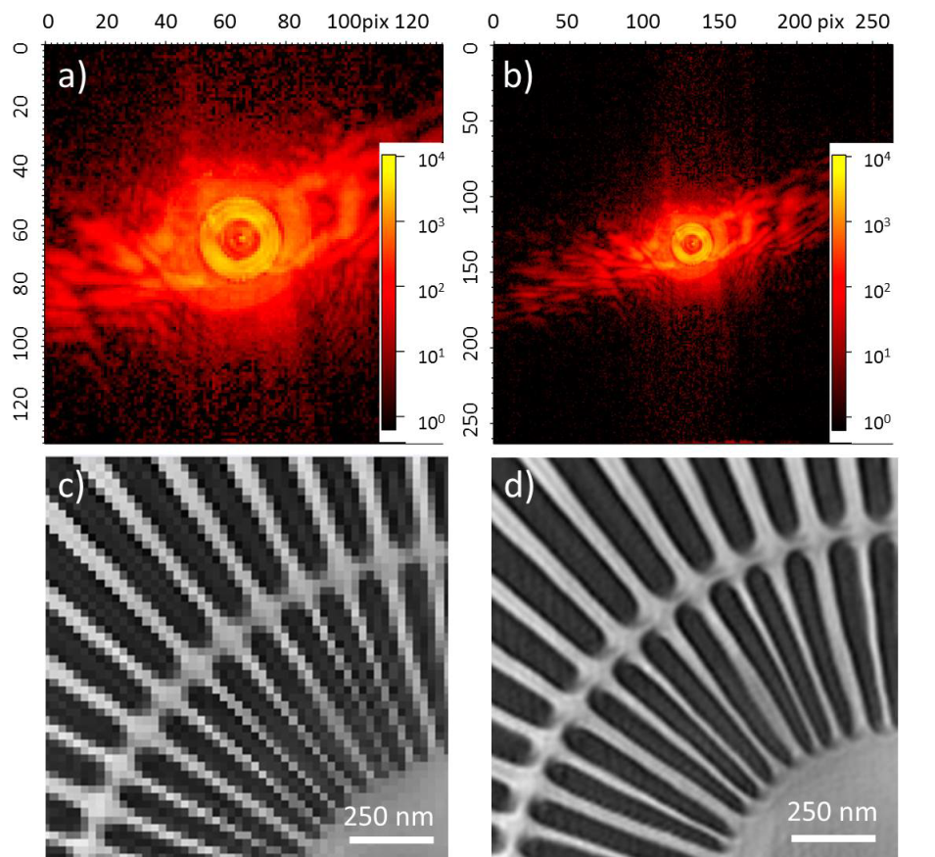
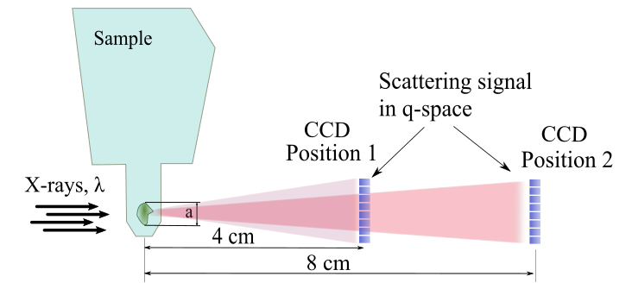
ptychography
Reconstractions with different NA
Numerical aperture (NA)

Slide 5
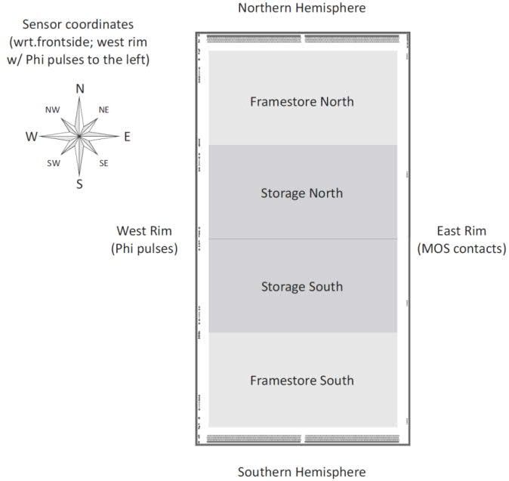
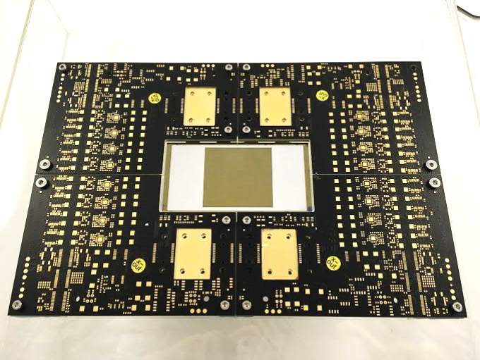
FSP TNG
build a camera around an availabe
  1 MPix pnCCD
  36 x 36 µm² Pixels
  framestore area
  split frame readout
utilizing available components
Sensor + Hybrid PCBs
develop:
thermo-mechanics
electronics
soft-and firmware for operation

Slide 6
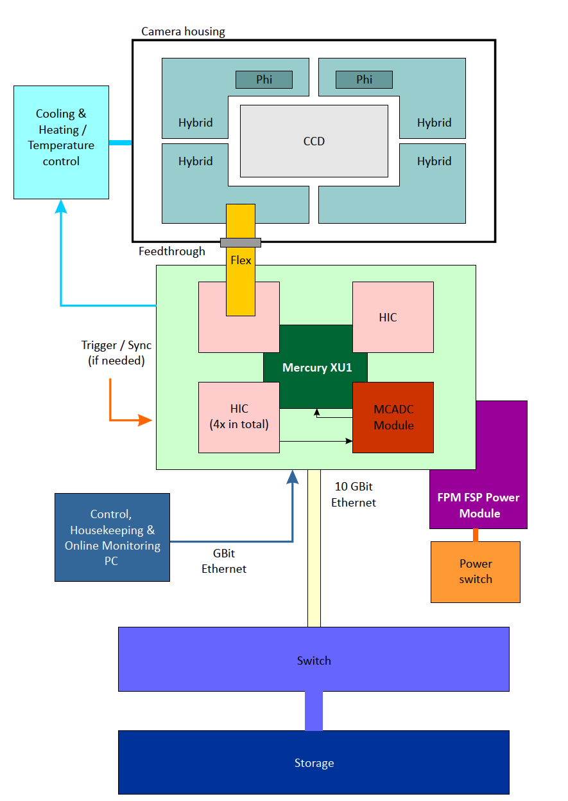
FSP TNG - concept
sensor + hybrids inside vacuum
IIC + mezanine cards outside vacuum
  Control over Mercury XU1
  1 GB – slow control from PC
  10 GB Ethernet – datatransfer XU1 to Storage

Slide 7
FSP TNG - IIC
  “Mainboard”
  voltage generation
  current/voltage monitoring
  mounts
          HIC (Hybrid Interface Card)
          XU1 (SoC)
          MCADC
          FPB (FSP Power Board)
  provides physical connection between components
  Hybrids connected via HIC
serious issue with availability of ICs
took several month to get all components
Layout for PCBs finished
IC stock for PCB population available

Slide 8
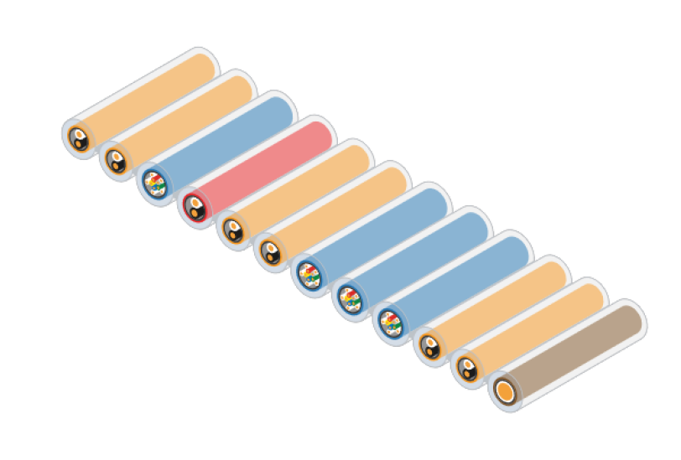
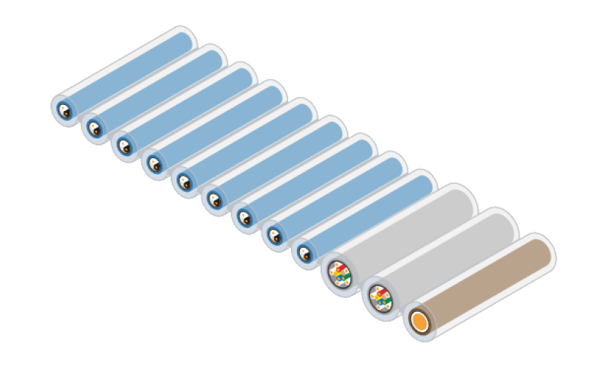
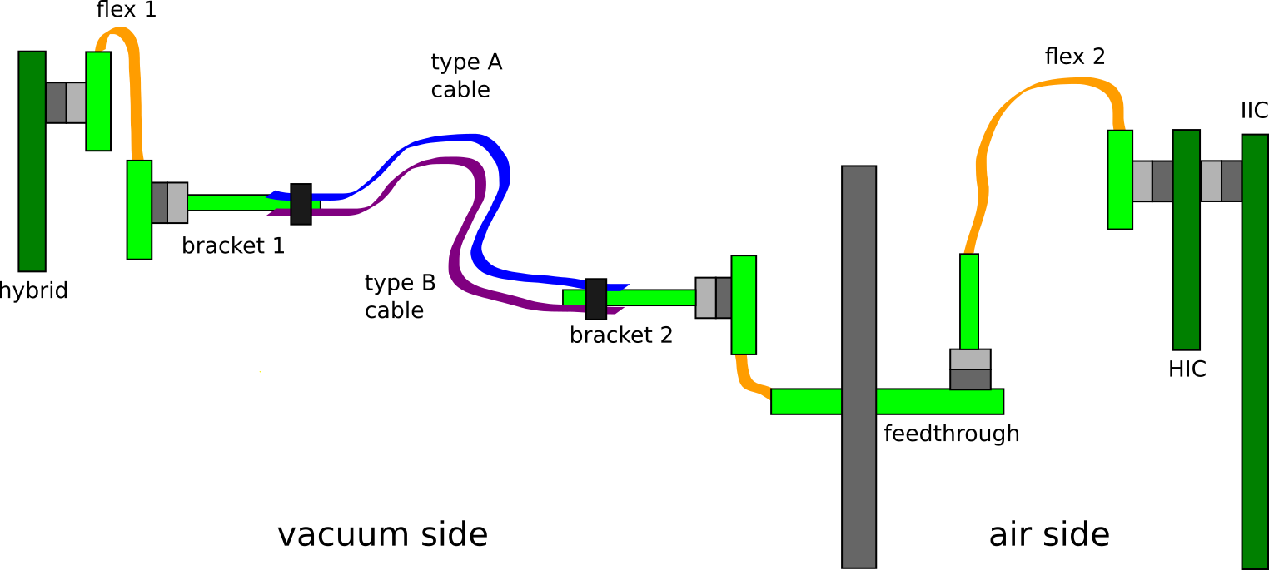
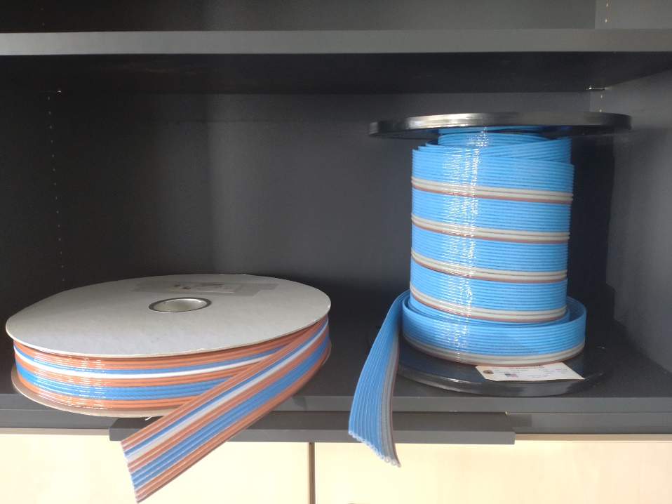
connection hybrid/IIC
cable + vacuum feedthrough
concept for connection (still subject to changes)

Slide 9
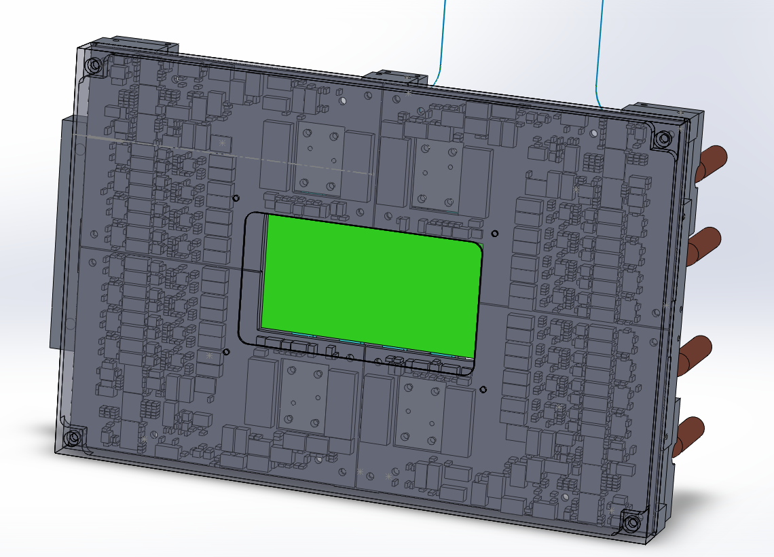
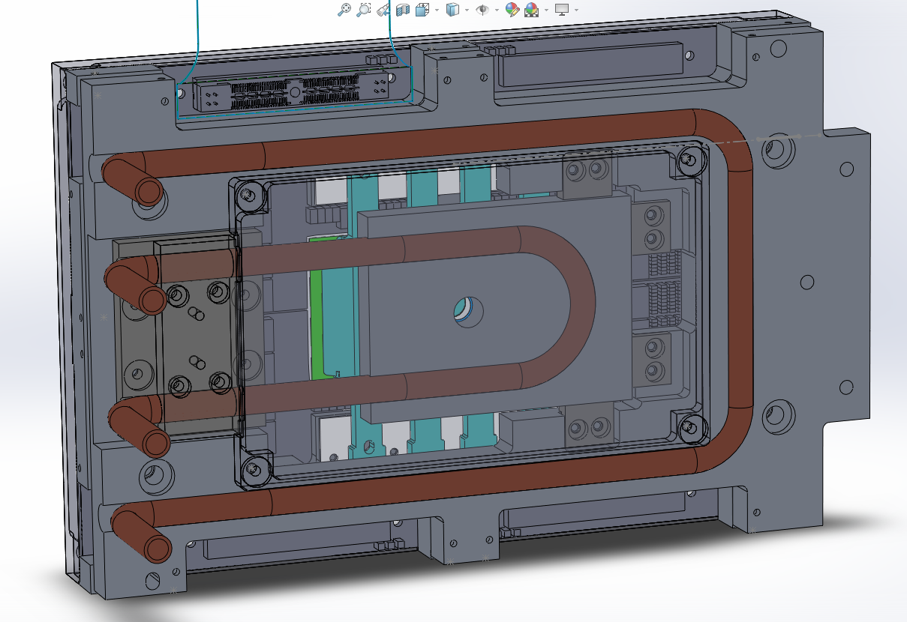
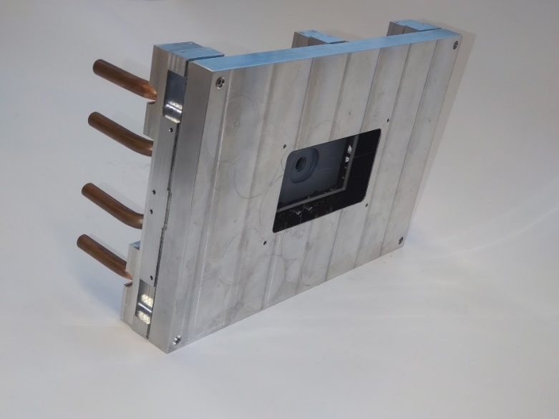
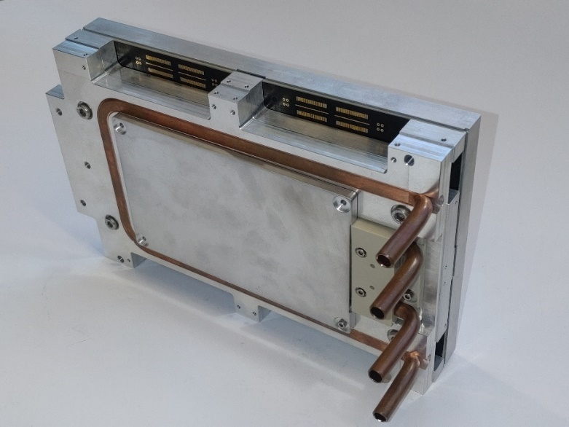
mechanics and cooling
Mechanics to fit inside experimental chamber
incorporates sensor+hybrids
sensor thermally decoupled from frame
cooling loop for sensor and hybrids
TEC to cool sensor to -20°C
arrived completely
minor adjustments riquired
fits as intended otherwise

Slide 10
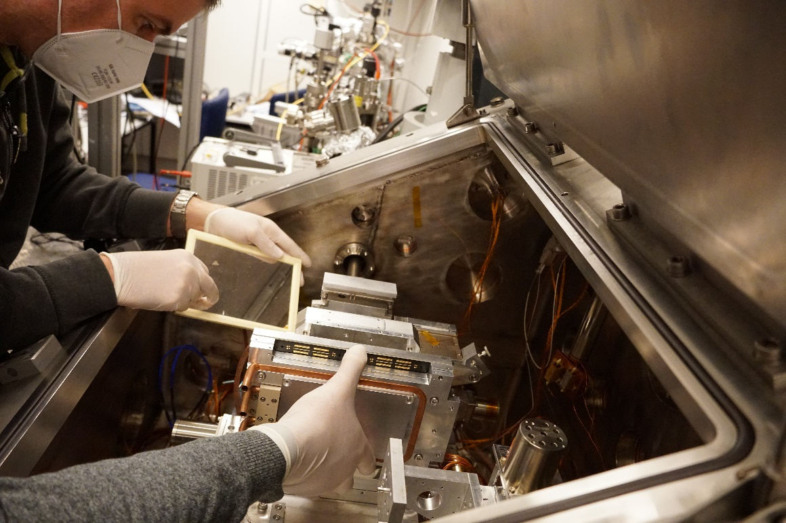
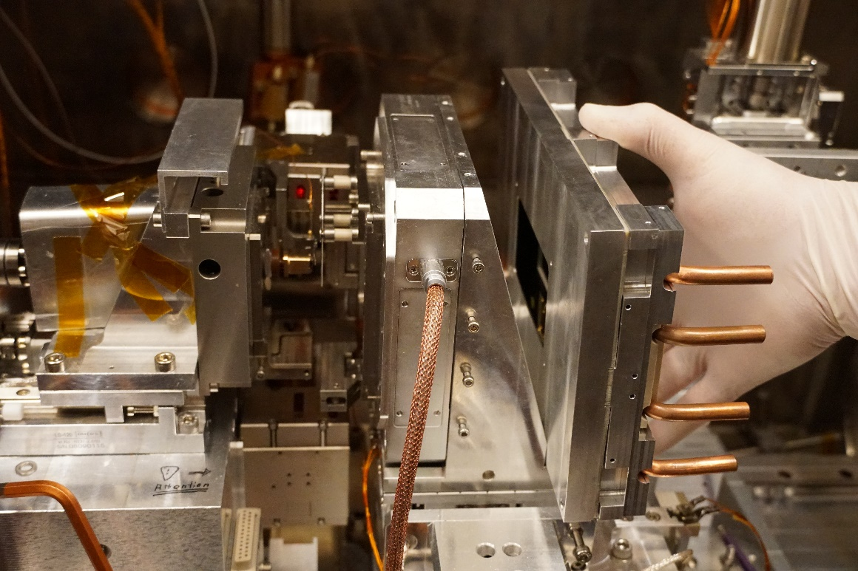
mechanics and cooling
Meeting at BESSY

Slide 11
Soc Firmware
S7 Sequencer
1 GB/10 GB Ethernet connection (slow control/fast datatransfer)
I2C interface (programming/readout of ASICs)
SPI interface (ASIC programming)
JESD-B connection (communication ADC-SoC)
ADC Programming
Metadata generation
Data reduction

Slide 12
ADC (Firmware) development
communication ADC-SoC-PC implemented
test- and analogue data can be recorded
still required
synchronization of ADC and SoC/sequencer
analogue performance
integration with SoC firmware

Slide 13
Software
System & Housekeeping Software
I2C commands for different Ics
voltage settings
automated current monitoring
automated startup/shutdown
emergency shutdown
receive and store data
online monitoring

Slide 14
Status
SoC programming
Sequencer S7
  migration to XU1 +
  additions -
    clock adjustment
    sample point adjustment
    additional user registers
JESD-B +
Clock Management +
Online Monitoring -
Watchdog for digital signals -
ADC Konfiguration -
Veritas Configuration +
Sequencer Configuration +
I2C interface +
1GB/10GB Ethernet +
Metadata Generation/ -
Data Processing/ -
Data Reduction -
Software
Adaption of VI Client/Server -
  Online Monitoring
  Houskeeping
Data analysis ~
Sensor +
Electronics
Hybrids available +
HIC available +
IIC ordered +
Phi-driver available +
XU1 available +
MC-ADC Layout done -
  analogue test of EM ongoing
FPM -
  Concept work done
  Schematic in progress
  Layout missing
Vacuum Interconnect -
  progressing
Mechanics
Design of new mechanics
Coupling of TEC to water cooling
Optimization TEC to Sensor

Slide 15
Thanks for listening

