Slide 1

Fast Small Pixel
The next Generation

Slide 2
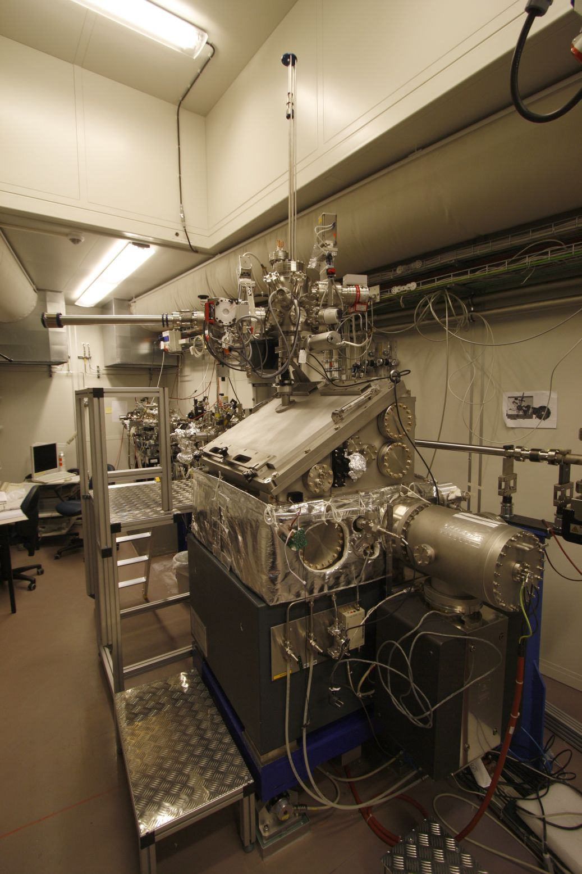
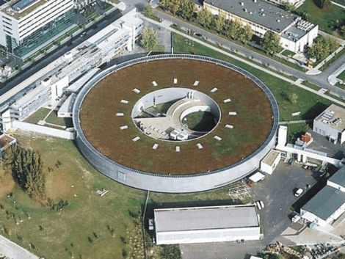
MAXYMUS/MYSTIIC @ Bessy II
BESSY II, Helmholtz-Zentrum, Berlin
*MAgnetic X-raY Microscope
with UHV Spectroscopy

Slide 3
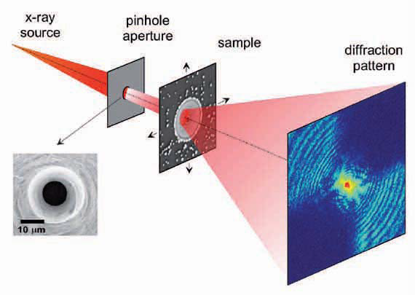
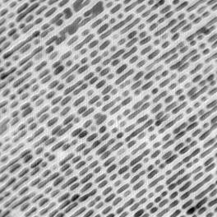
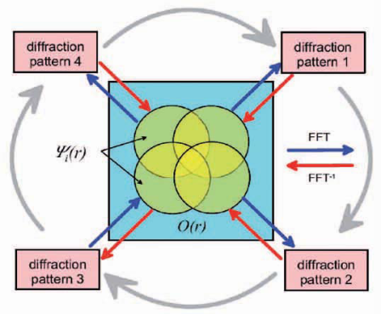
Ptychography
Ptychographic reconstrution of
commercial Fresnel Zone Plate
200 nm
5 nm half-pitch
resolution aperture limited
record n pictures
move sample in x and y
do this for m positions
reconstruct sample from m x n pictures

Slide 4
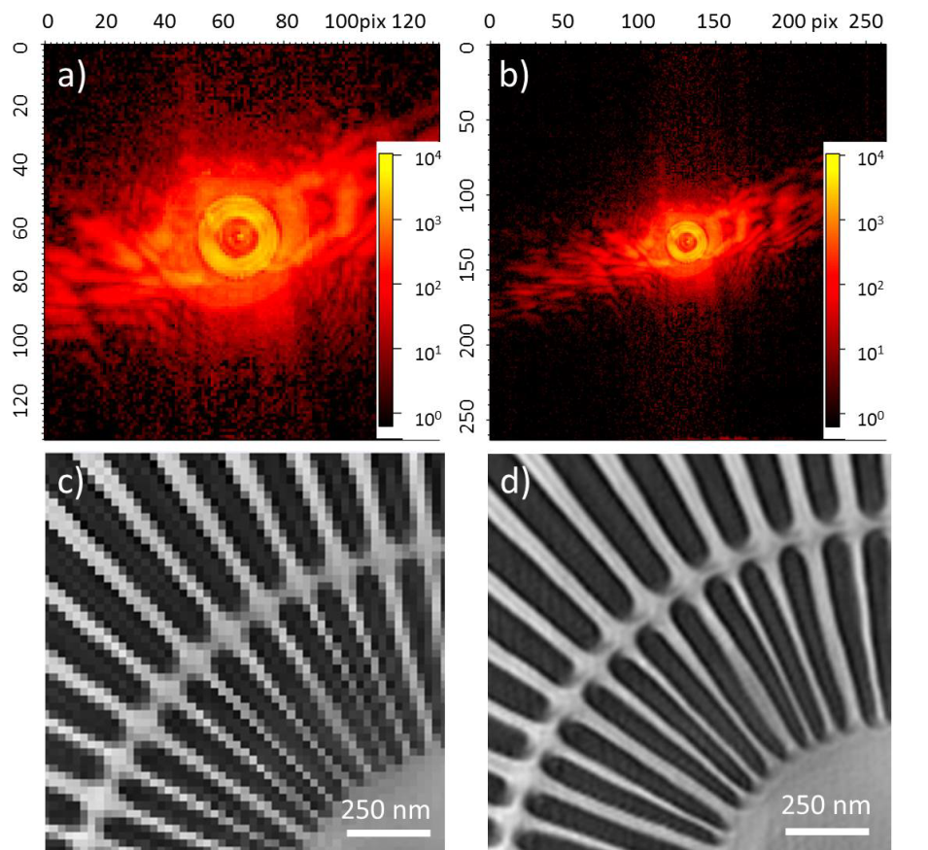
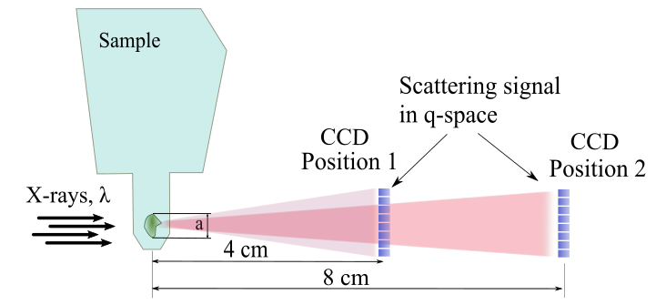
ptychography
Reconstractions with different NA
Numerical aperture (NA)

Slide 5
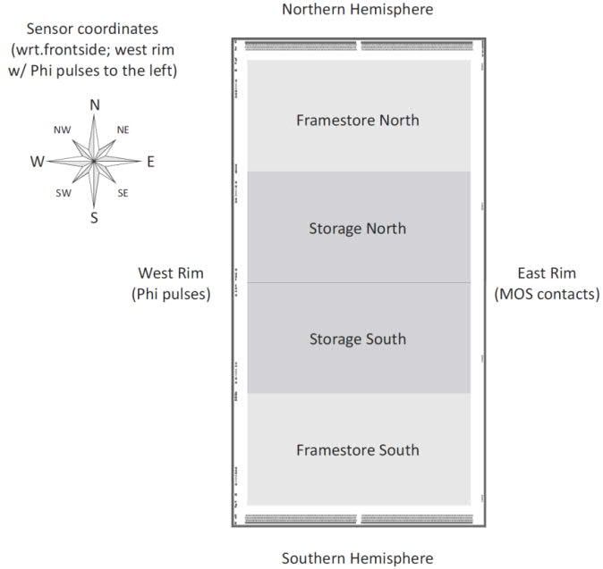
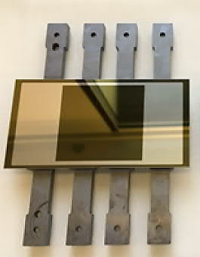
FSP TNG
development of a camera around a
  1MPix pnCCD
  36x36µm² Pixels
  framestore area
  read out from two sides by Veritas-ASIC
thermo-mechanics
electronics
soft-and firmware for operation
project runtime of 2 years

Slide 6
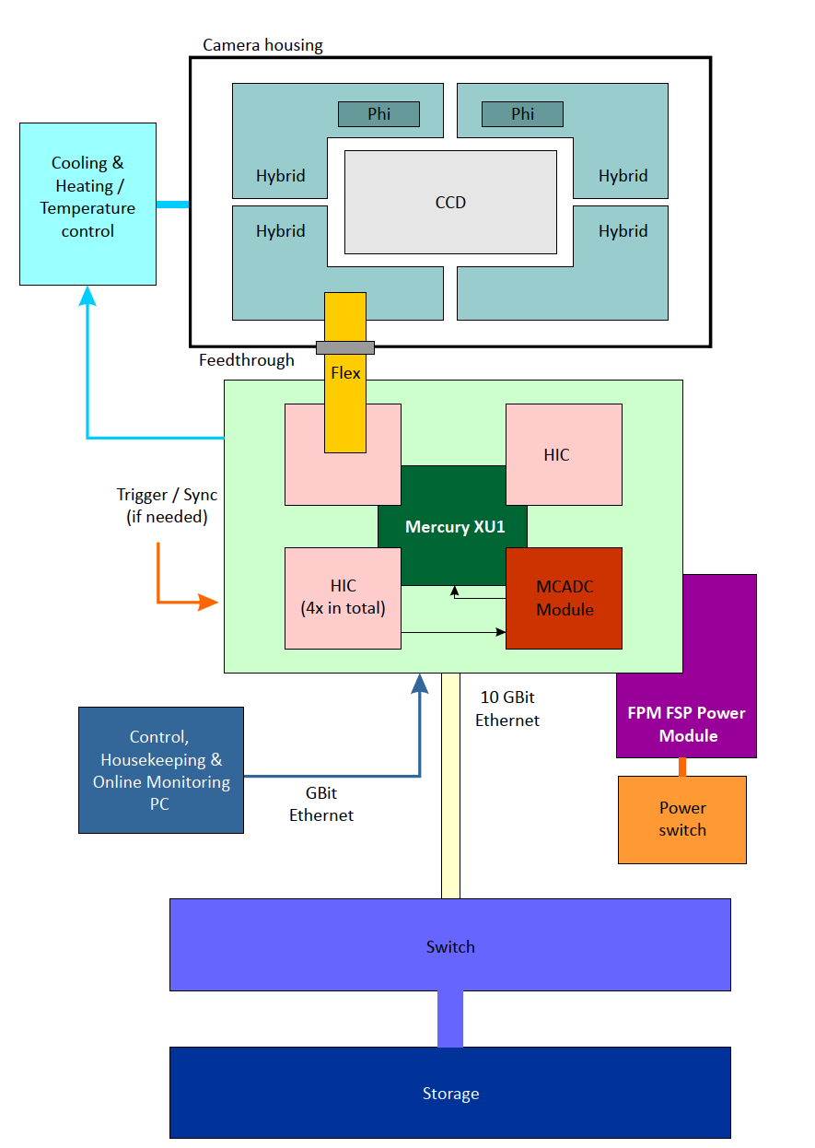
FSP TNG - concept
sensor + hybrids inside vacuum
IIC + mezanine cards outside vacuum

Slide 7
FSP TNG - concept
  Control over Mercury XU1
  1 GB – slow control from PC
  10 GB Ethernet – datatransfer XU1 to Storage
  MCADC for data aquisiton
    JESD - ADC to XU1

Slide 8
Electronics
layout for PCBs finished
apart from MCADC all PCBs ordered or already available
shortage in component supply caused quite some delays
Layout for PCBs finished
Stock for PCB population available
Full test requires all components
limited test done
  I2C components
  ASICs

Slide 9
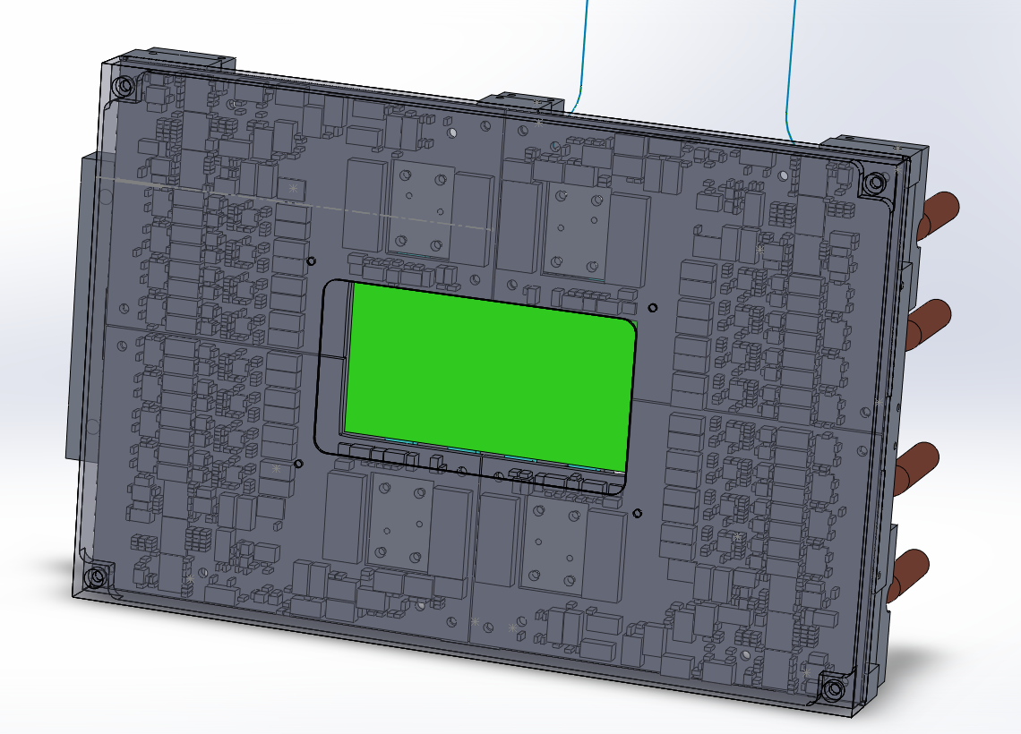
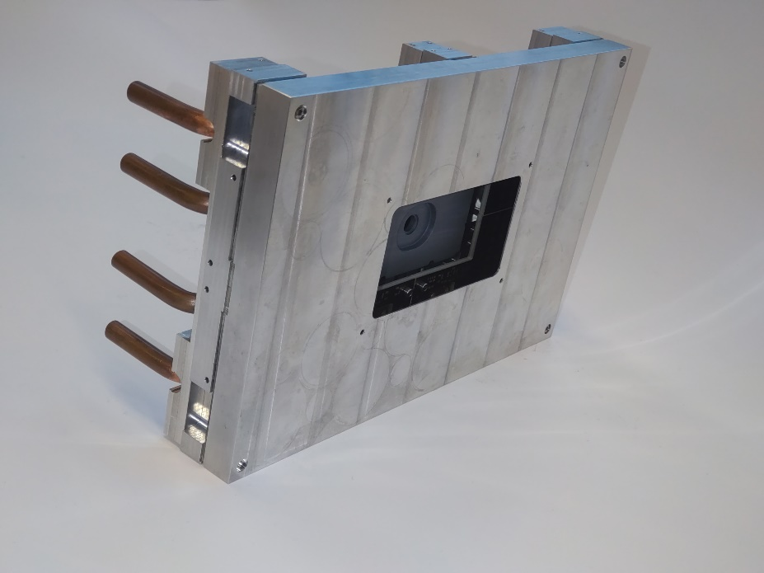
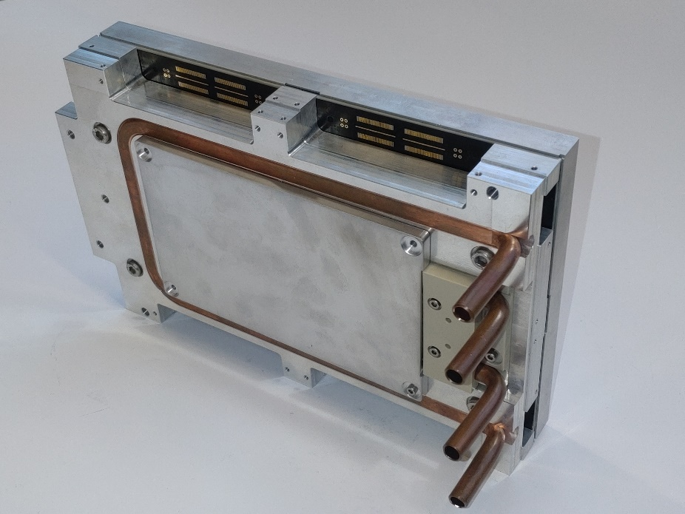
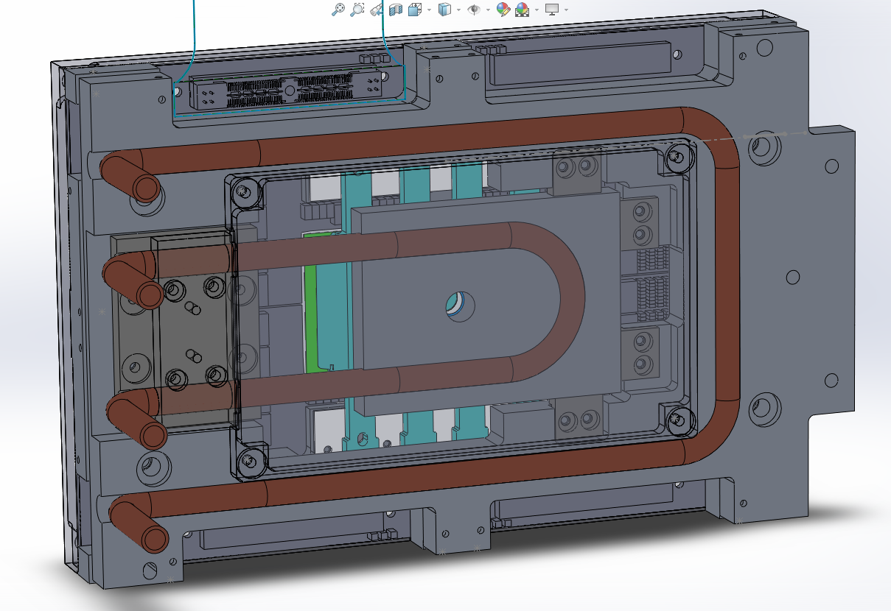
mechanics and cooling

Slide 10
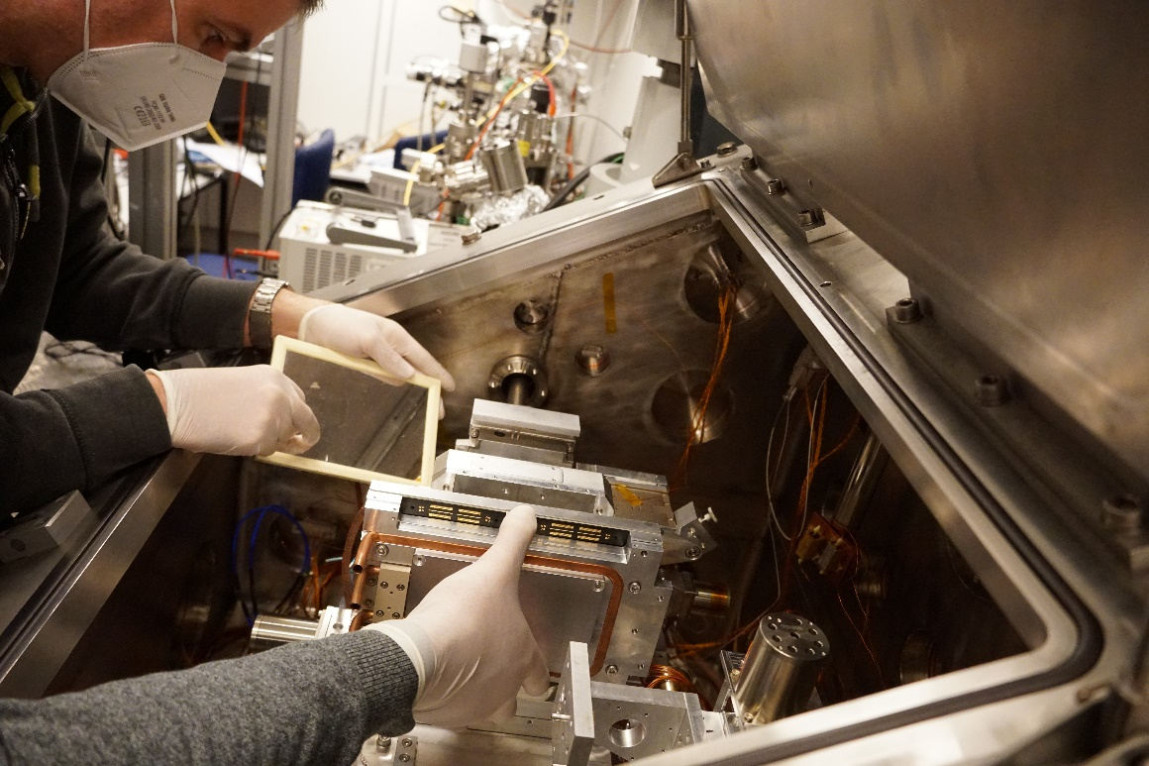
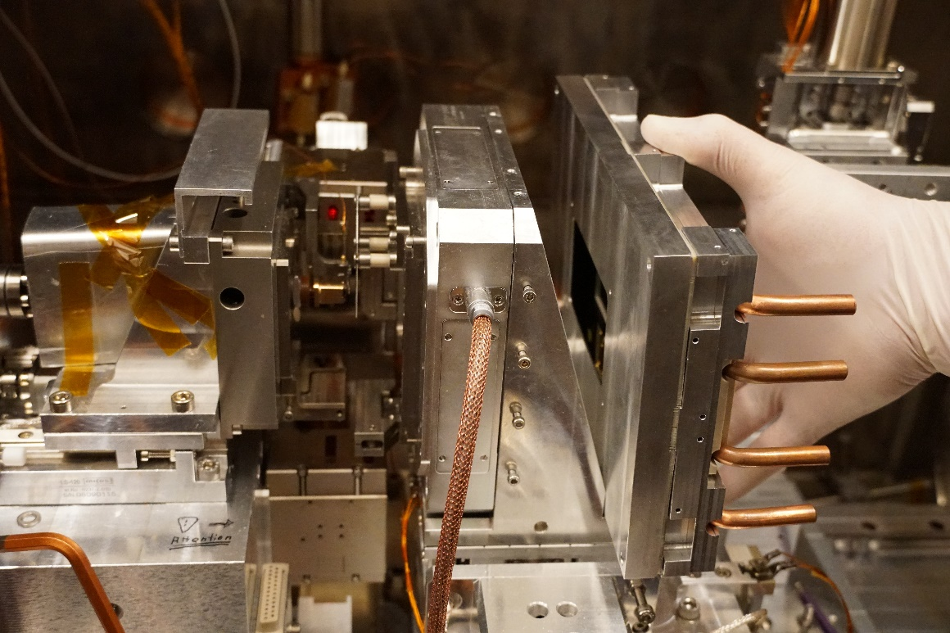
mechanics and cooling

Slide 11

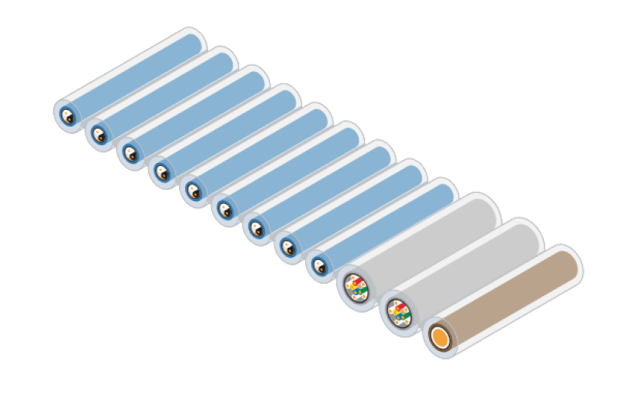
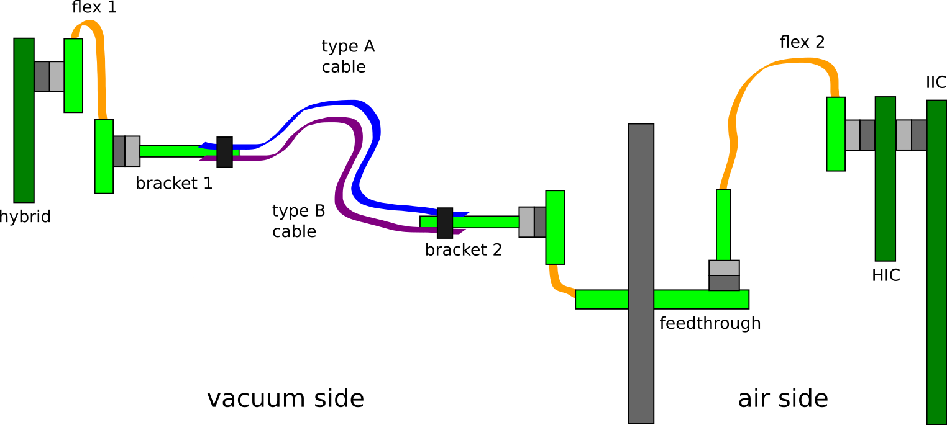
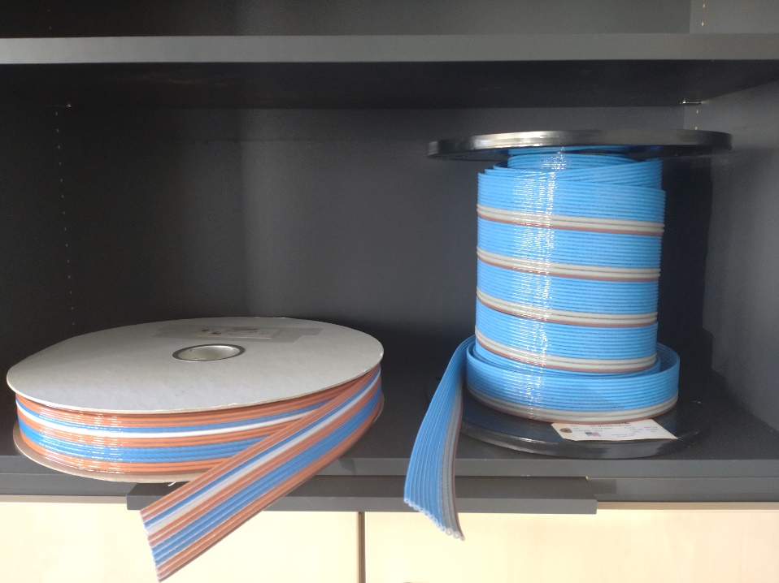
connection hybrid/IIC
cable + vacuum feedthrough
concept for connection (still subject to changes)

Slide 12
Firmware
S7 Sequencer
1 GB/10 GB Ethernet connection (slow control/fast datatransfer)
I2C interface (programming/readout of ASICs)
SPI interface (ASIC programming)
JESD-B connection (communication ADC-SoC)
ADC Programming
Metadata generation
Data reduction
Talk of Mikhail

Slide 13
ADC development
communication ADC-SoC-PC implemented
test- and analogue data can be recorded
still required
synchronization of ADC and SoC/sequencer
analogue performance
integration with SoC firmware

Slide 14
Software
System & Housekeeping Software
I2C commands for different Ics
voltage settings
automated current monitoring
automated startup/shutdown
emergency shutdown
etc.
Talk of Martin

Slide 15
Data acquisition
receive and store data
  (data format coordination with MPI IS)
provide online monitor
“Online” post-processing for development?
Talk of Andrey

Slide 16
development blocks
Electronics
Hybrids available +
HIC available +
IIC ordered -
Phi-driver available +
XU1 available +
MC-ADC Layout done -
  analogue test of EM ongoing
FPM -
  Concept work done
  Schematic in progress
  Layout missing
Vacuum Interconnect -
  progressing
SoC programming
Sequencer S7
  migration to XU1 +
  additions -
    clock adjustment
    sample point adjustment
    additional user registers
JESD-B +
Clock Management +
Online Monitoring -
Watchdog for digital signals -
ADC Konfiguration -
Veritas Configuration +
Sequencer Configuration +
I2C interface +
1GB/10GB Ethernet +
Metadata Generation/ -
Data Processing/ -
Data Reduction -
Software
Adaption of VI Client/Server -
  Online Monitoring
  Houskeeping
Data analysis ~
Mechanics
Design of new mechanics
Coupling of TEC to water cooling
Optimization TEC to Sensor
realistic date for first prototype (minimum functionality)?

Slide 17
Thanks for listening

Slide 18
FSP TNG - concept
IIC
  “Mainboard”
  voltage generation
  current/voltage monitoring
  mounts
          HIC (Hybrid Interface Card)
          XU1 (SoC)
          MCADC
          FPB (FSP Power Board)
  provides physical connection between components
  Hybrids connected via HIC

Slide 19
Summary
mechanical components available
minor changes required
vacuum feedthrough in development
IIC ordered, population of PCBs
ADC EM testing ongoing
electronic test ongoing (without IIC yet)
meeting at BESSY?
Mechanical design fits
have to see about vacuum feedthrough

