Slide 1
New DePFET technology
Alexander Bähr

Slide 2
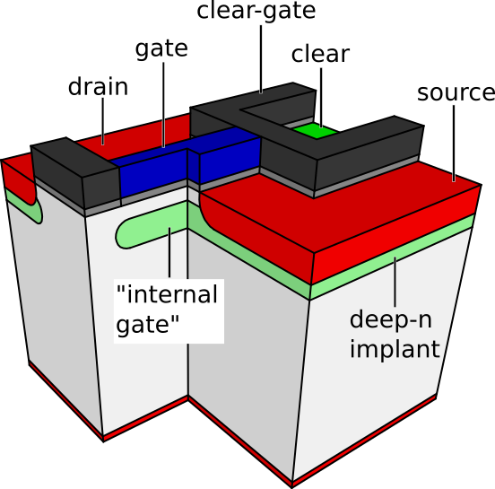
The DePFET
MOSFET on n-substrate
deep-n implant below gate
potential minimum for electrons
„internal gate“ (IG)
conductivity modulated by electrons
Source Follower
Drain Current Readout
reset via clear and clear gate
good signal to noise
unobstructed backside contact
typical charge gain values ~420 pA/e⁻
source
clear gate
gate
Q(t)
signal(t)
drain
Applications:
Belle II, BepiColombo, Athena, EDET, etc.

Slide 3
can we improve the depfet?
increase signal to noise minimize impact ionization reduce voltage variations reduce clear voltages

Slide 4
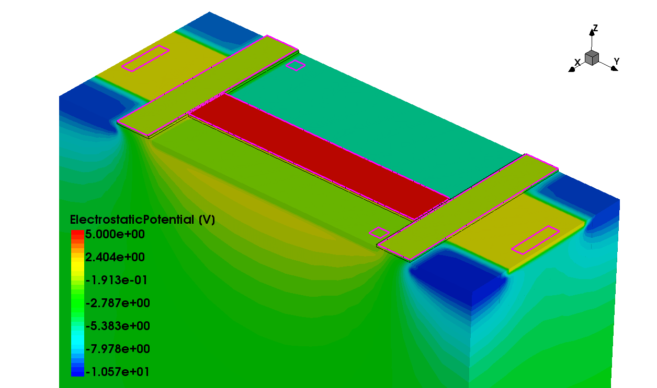
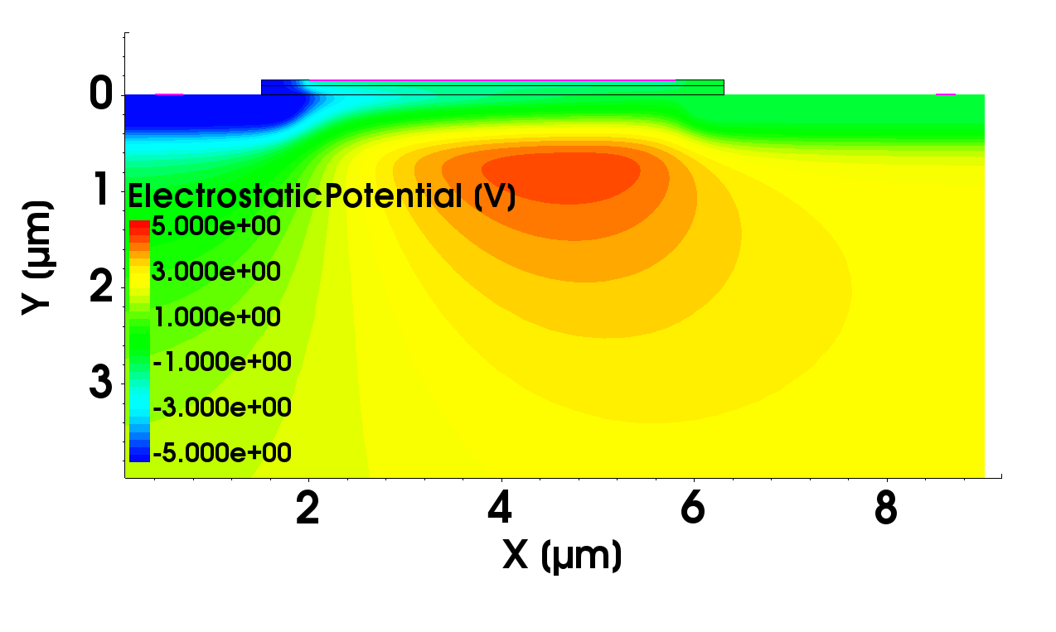
Device Simulations
gate
gate
drain
source
drain
source
clear gate
clear
internal gate
3D device simulation - study complex geometries
charge collection, clear, etc
2D device simulation – DePFET transistor properties
charge gain, noise, impact ionization, etc

Slide 5
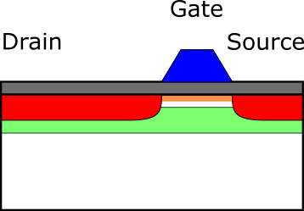
Simulation – 2D scaling

Slide 6
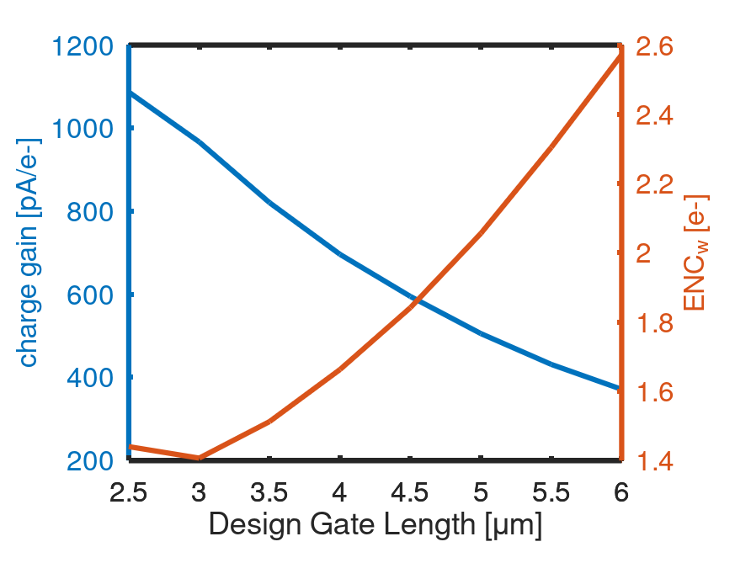
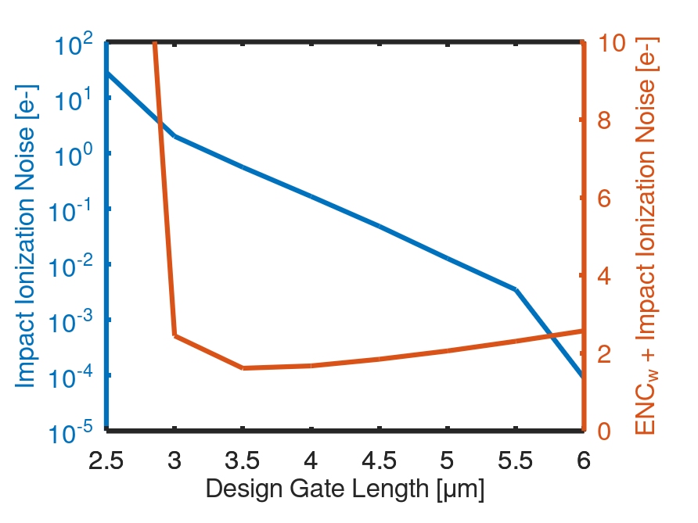
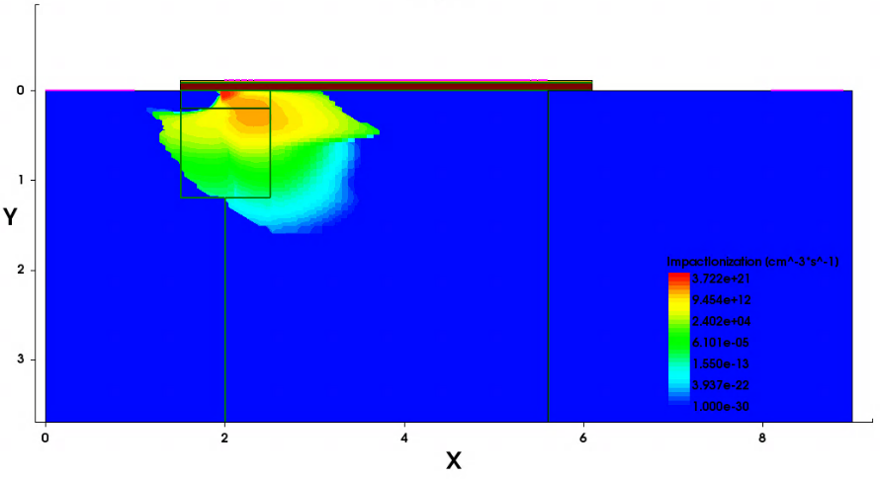
Simulation – 2D scaling
Electric Field
impact ionization
charge gain
gate
drain
source

Slide 7
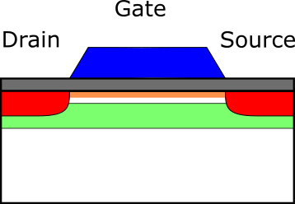
Standard DePFET
implants of DEPFET (without clear):
p+ source/drain
deep-n (internal gate)
channel implant (threshold adjustment)

Slide 8
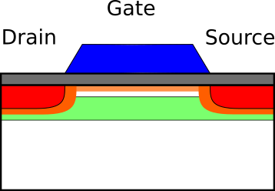
1) DePfet with halo implant
tested in context of the ATHENA WFI (W. Treberspurg et al 2018 JINST 13 P09014)
reduces impact ionization (allows for example for up to 0.5 V more negative V_{d})
increases charge gain by ~10% (460 pA/e⁻)
Reference technology

Slide 9
2) optimized “standard” technology
vary all standard implants (dose and energy)
keep halo as is
charge gain increasy by ~10% (500 pA/e⁻)

Slide 10
2 b ) vary halo implant
higher dose, higher energy, steeper angle
further reduction of impact ionization
further increase of charge gain by ~10% (540 pA/e⁻)
higher possibility for parasitic channel below clear-gate

Slide 11
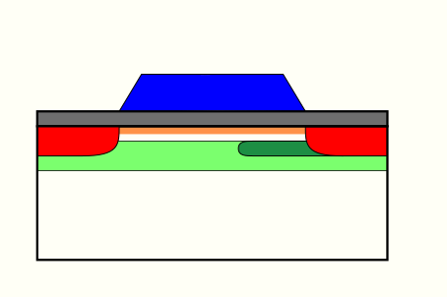
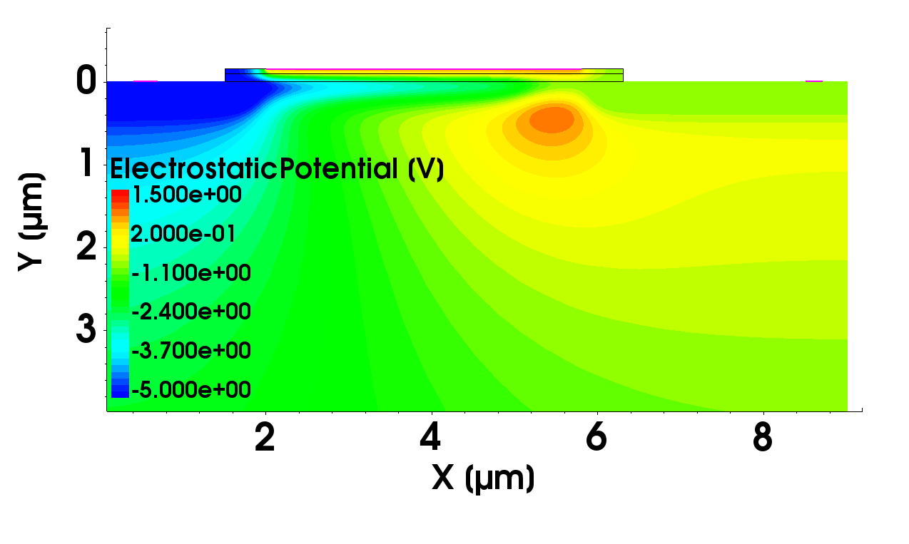
3) Super gq
gate
drain
gate
source
drain
source
additional n-implant
internal gate

Slide 12
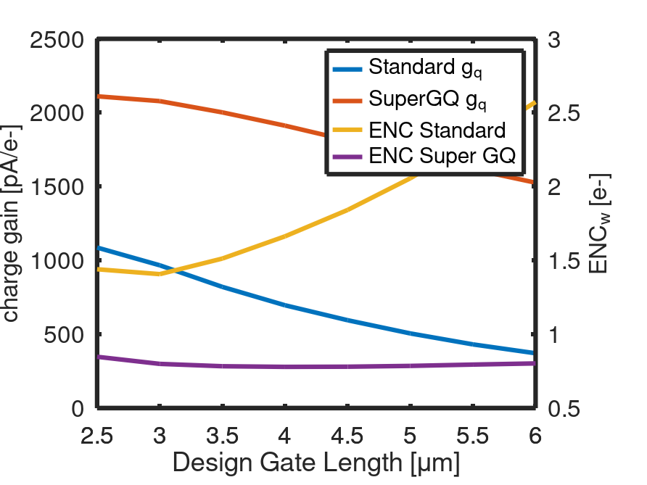
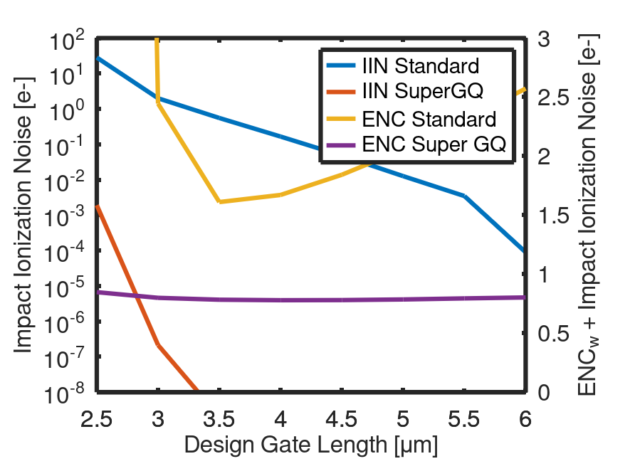
3) Super gq
super gq and scaling
charge gain
impact ionization

Slide 13
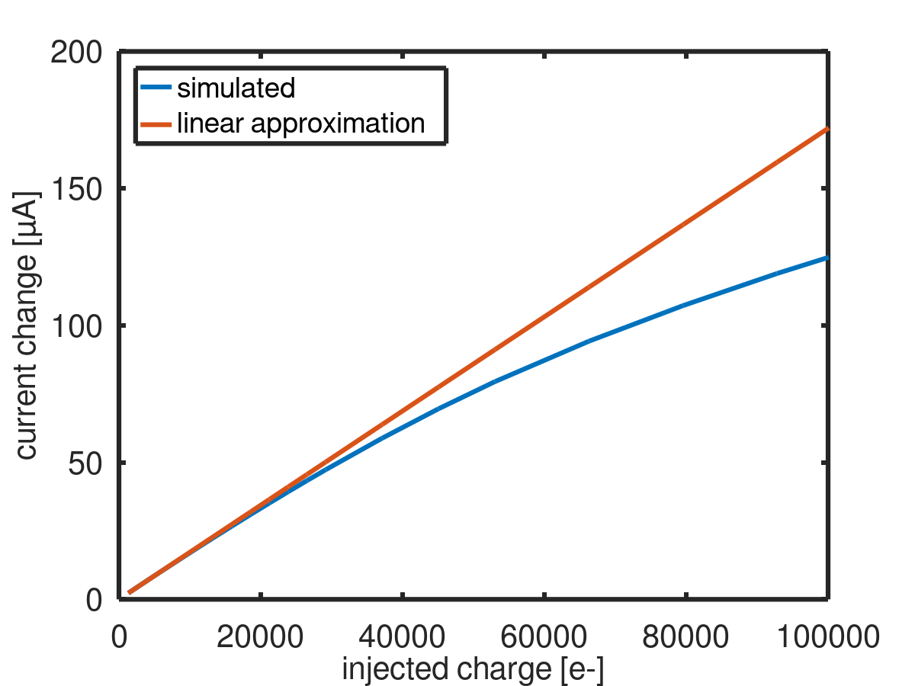
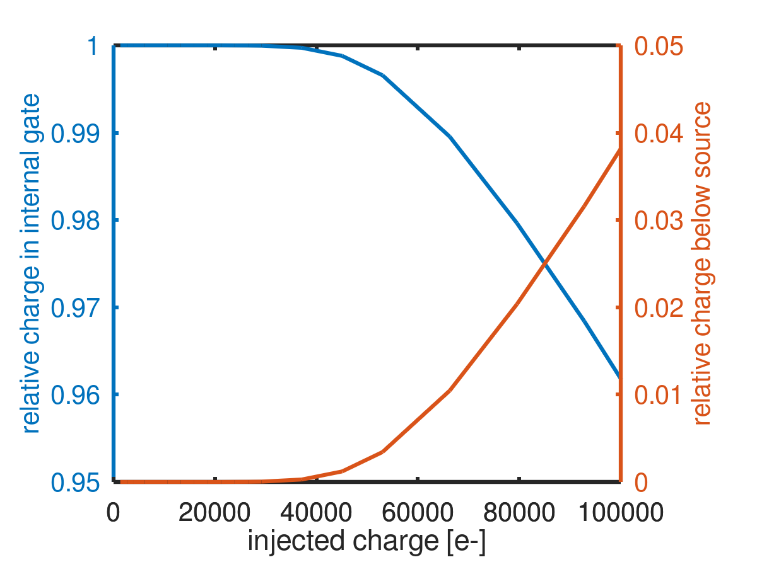
3) Super gq
trade off
L=5 µm
W=20 µm

Slide 14
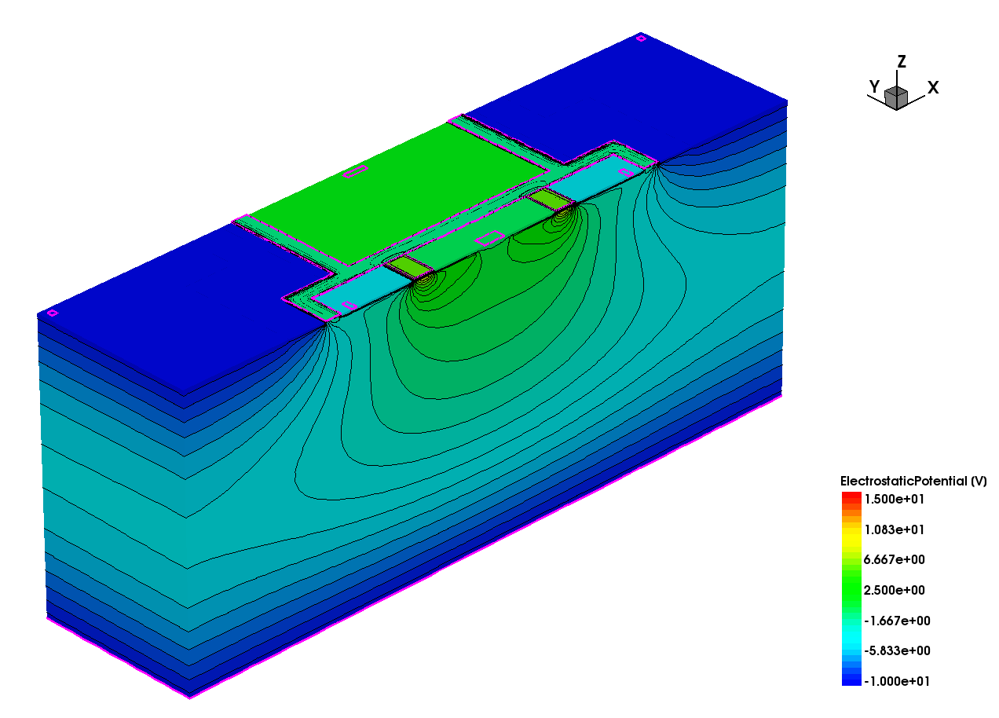
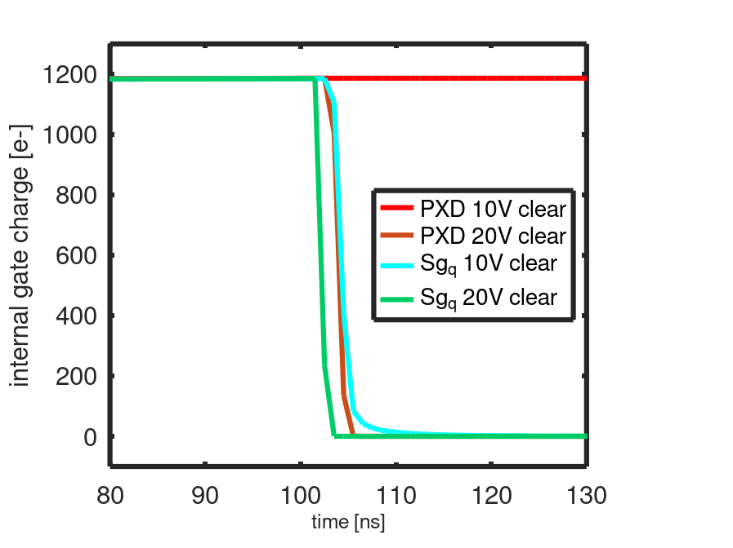
3) Super Gq 3d simulation of clear
Belle like geometry
super gq implant
simulation of clear process for different clear high voltages
clear
drain
gate
drift
source

Slide 15
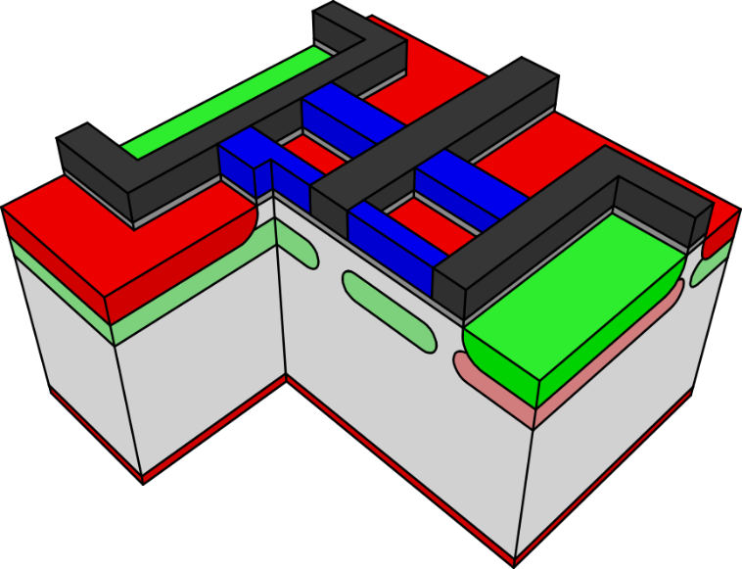
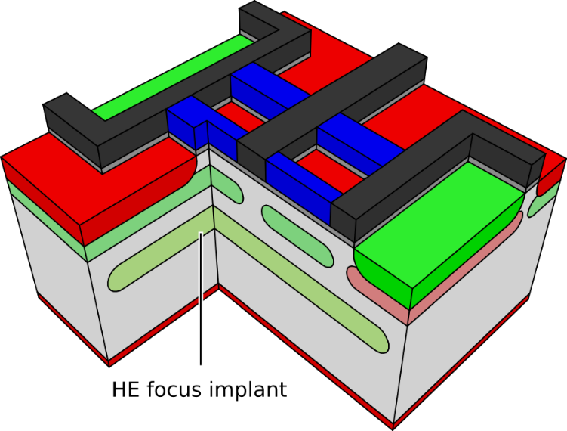
4) Focussing (HE) implant
Quadropix
4 DePFETs in one Superpixel
collection controllable by voltages
pixel border depends on collection state
For selected test structures
high energy implant aligned to pixel structure
Quadropix: reduce intrinsic asymmetry
DePFET: sharpen pixel borders; reduce susceptibility to bulk doping variations
Notes:
5 MeV implant @ ~3 µm depth; n-type

Slide 16
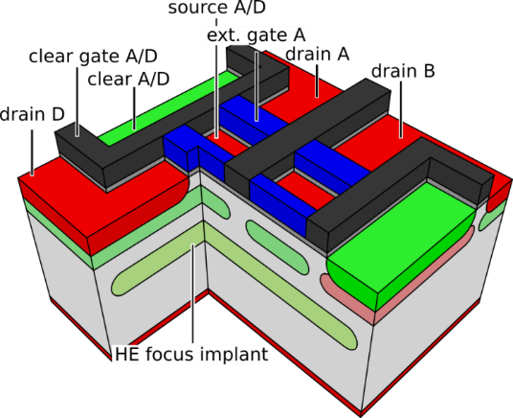
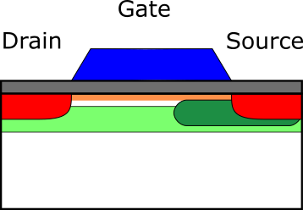
Technology
Standard: reference
Optimized:
optimized implants
improved S/N
Super g_{q}:
additional implant
drastic increase in S/N
HE implant
For example for Quadropix
Minimize asymmetry of
charge collection

Slide 17
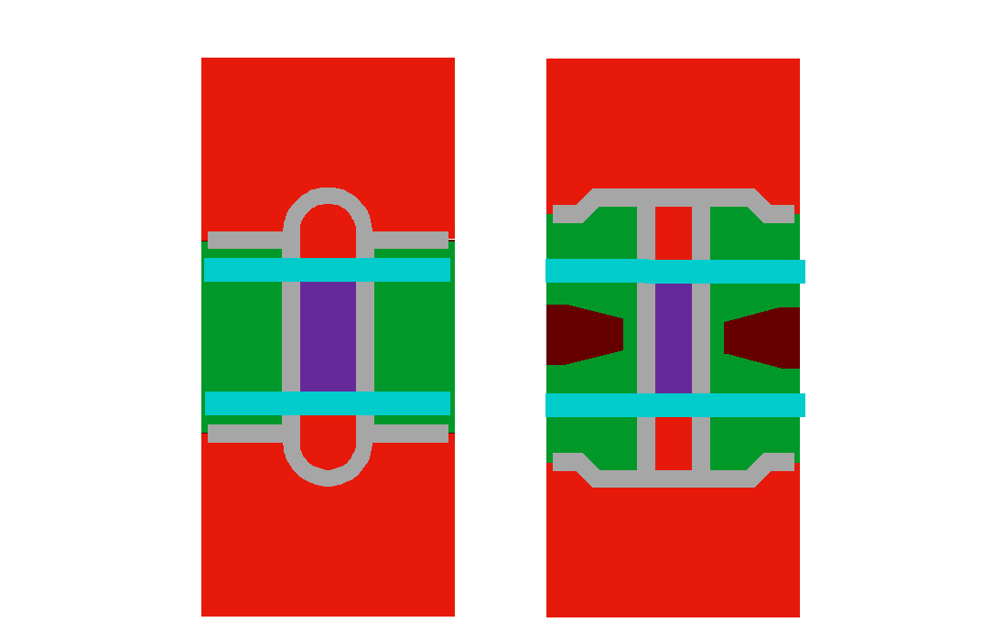
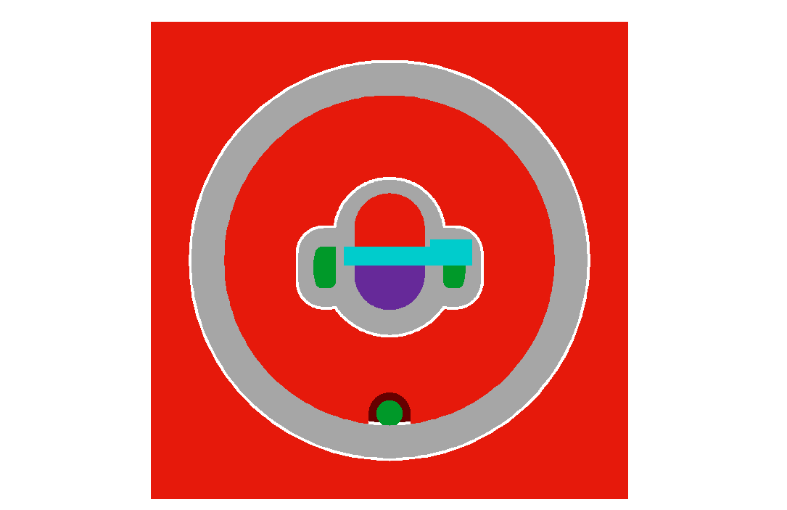
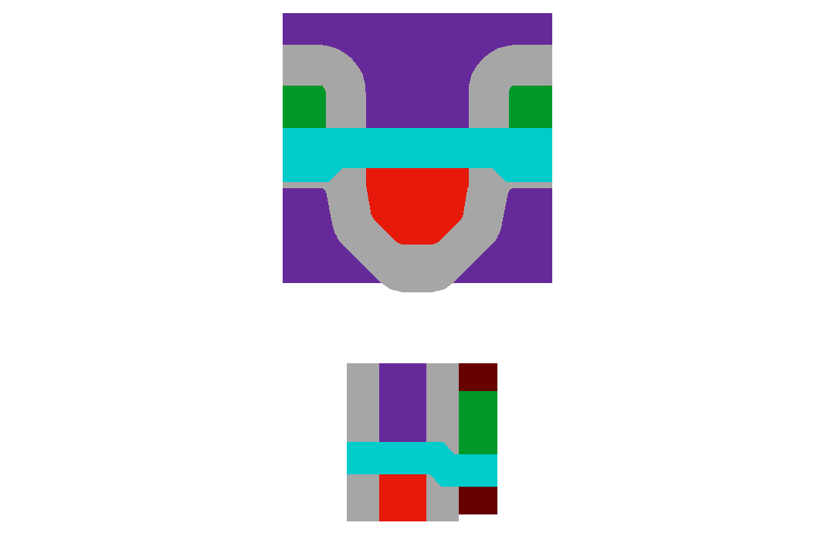
DePFET layouts
Standard
drift
drift
drift 2
S
CG
drift 1
G
D
D
G
G
D
D
S
CL
S
CL
CL
G
S
CG
S
CL
G
D
Belle Type
55 x 50 µm²
fast readout
Athena Type
130 x 130 µm²
imaging spectroscopy
Small Pixels
15 x 15 µm² to 30 x 30 µm²
“limit” test

Slide 18
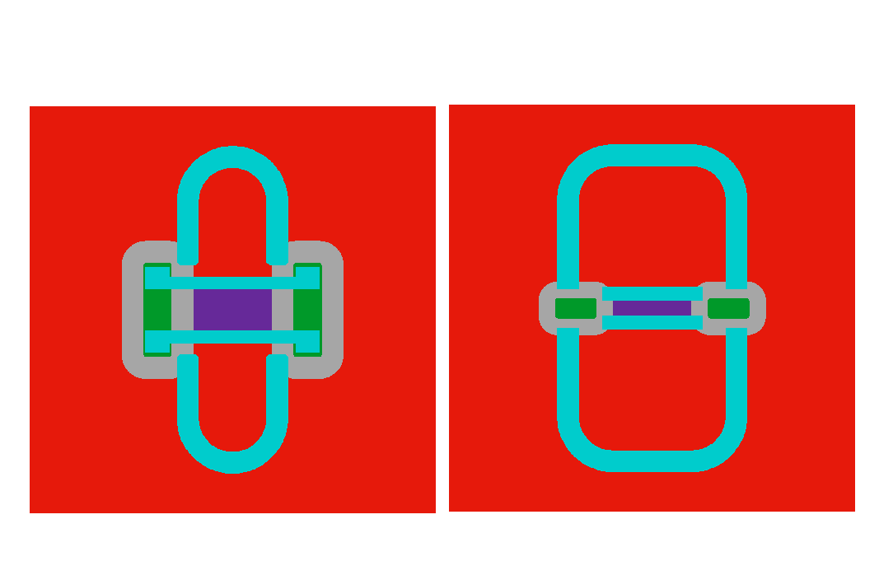
DePFET layouts
Multiple storages
RNDR DePFETs
S
D1
D4
G1
D1
G1
TG
D
CL
G1
CG
CG
CL
S
CL
S
G2
G2
G2
D2
CG
D2
D3
repetitive non destructive readout (RNDR)
subelectron noise
single electron resolution
Infinipix
2 storage nodes
selectable charge collection
suppress rolling shutter effects
Quadropix
4 storage nodes
selectable charge collection
suited for high precision polarimetry

Slide 19
Summary
DePFET technologies
reference (1)
reference + HE (1+HE)
optimized (2)
optimized version b (2B)
super g_{q} (3)
DePFET Layouts
Belle DePFET | fast readout
Athena DePFET | spectroscopy
Small DePFET | 15 – 30 µm test devices
Infinipix | 2 storage nodes per pixel
Quadropix | 4 storage nodes per pixel
RNDR DePFET | low noise (subelectron)
12 wafers in production
test production; minimum of inspection
same layout on all wafers
production started October 2022

Slide 20
outlook
finished mid to end of 2023
die level measurements – IV characteristics, yield measurements, noise measurements
test setup – operation of prototype matrices, detailed performance qualification

Slide 21
Thanks for your attention
Alexander Bähr

Slide 22
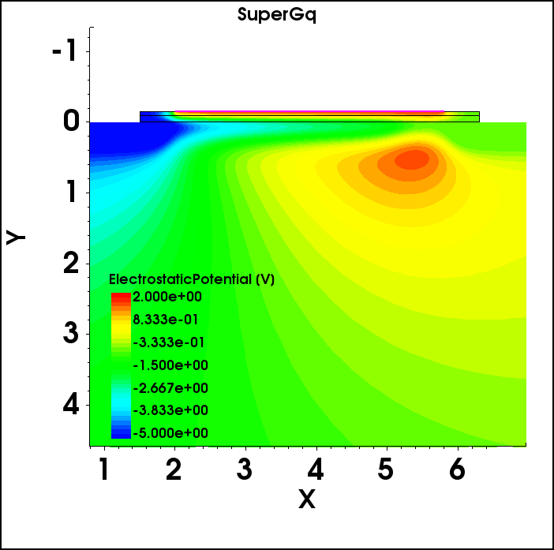
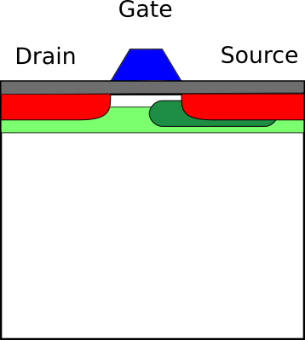
3) Technology option super gq
Add deep-n implant on source side
localize internal gate to part of the channel
potential distribution – DePFET internal gate
expected gq of ~1.3 nA/e⁻
@W/L =20/5 (design)
@20°C

