Slide 1
System & Housekeeping Software
Project Review 2022 – Martin Hensel

Slide 2
Outline
Developments of the last months:
Implementation of polynomial calculus in all core parts of the instrument server
Transition from linear to reactive data model
Future plans:
Application Programming Interface (API)
Rework of Server/Client communication interface (EPICS/MQTT/0MQ?)
Enduser Interface Design

Slide 3
System overview
Support by mhe
vimrg:
Overspanning user interface
vilib: Shared library
vicli: User interface for slow control
vasic: User interface for ASIC control
vilib: Shared library
vilib: Shared library
visrv: Server for actual slow control
xu1_cfg_sh: XU1 config scripts
switcher_sequence
vasic_plugins: User scripts started from the GUI
vilib
vires: Icons and graphics
vlogv: Log file analysis and presentation
vinst: Conda environment and installer
vidoc: Documentation framework
vilib: Shared library
Virtual Instrument Server (visrv)
Connect to a multitude of instruments, from I²C devices to bench power supplies.
Housekeeping cycles, automated and manual instrument control, defined system states with defined transitions between, fault detection and handling.
Virtual Instrument Manager (vimrg)
Support by mpo
User interface to control all aspects of the instrument server.
Acts as a container to control several servers and additional components (e.g. ASIC programming, system automation tasks)
Mounted on XU1
Support by chk
Support by anv
Qt support by mhe

Slide 4
Developments of the last monhs
The Virtual Instrument Suite (Manager, Client, Server, ASICs, shared libraries, no duplicate files) contains (as of 13/12/2022, latest development branch):
12 git repositories (one of them is duplicated four times for a total of 16)
107,674 lines of pure python code in 514 modules
24,065 lines of comments (mostly method and class documentation)
355,335 lines of json in 212 files, over 99.7% of which is auto-generated by scripts (settings, definitions, persistent states, ...)
Default tasks (always included):
Bug fixes
Dependency and package management
Code refactoring
Feature requests

Slide 5
Polynomial calculus in the server
All instrument related calculations on the server are represented as Polynomials:
Scaling (raw ↔ human readable values)
Allowed value ranges (blocking/warning)
Automated changes (new value calculation)
Margin checks (margin calculation)
All devices and sequences have been transitioned to the new system.
Conditions follow soon™.
Full implementation in the user interface to edit these polynomials.

Slide 6
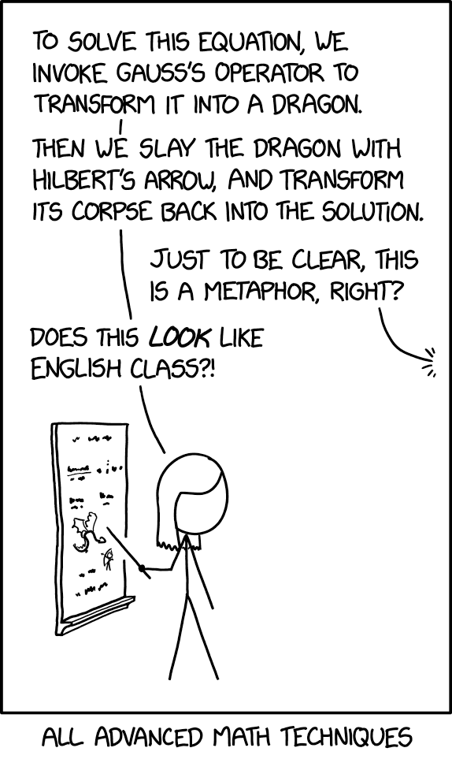
Polynomial calculus in the server
All instrument related calculations on the server are represented as Polynomials:
Scaling (raw ↔ human readable values)
Allowed value ranges (blocking/warning)
Automated changes (new value calculation)
Margin checks (margin calculation)
All devices and sequences have been transitioned to the new system.
Conditions follow soon™.
Full implementation in the user interface to edit these polynomials.
4 mathematical term types: y(x) =
Constant: a
Direct term: a ∙ x^{b}
Linked term: a ∙ w^{b}
Mixed term: a ∙ w^{b} ∙ x^{c}
2 programmatical term types: y() =
Constant string: „abcdef“
Linked string: „PPM_2018-002_c2021-06-01“
Mixing between the two types is for now not possible (adding numbers and strings together)

Slide 7
Transition from linear to reactionary data model
Old linear approach to data changes:
Server reads (raw) changes from the instruments (e.g. I2C, LAN, ...).
Channel data is updated and human readable values are calculated.
On every housekeeping cycle the sequences and conditions first recalculate the current and target conditions to account for changes and then decide what to do.
New reactionary approach:
Server reads (raw) changes from the instruments (e.g. I2C, LAN, ...).
Channel data is updated and human readable values are calculated.
If an actual change occurred (new != old) a signal is emitted.
All classes interested in that change are subscribed to the signal, are informed immediately about the change and can react.
No need to recalculate current and target conditions explicitly on every housekeeping cycle of sequences and conditions.

Slide 8
Future Plans – API
An increasing number of „clients“ has to communicate with the server and/or the GUI:
GUI: Regular updates about the instrument state, the sequences, fault conditions, ...
Calibration tools: Set and read back voltages and currents, control external calibration devices, ...
Optimization tools (e.g. DCD ADC scan by exp): Change the housekeeping cycle to a minimal cycle for maximum server speed, set external DCD current source, ...
Future developments ...
The current communication to the server is based on TCP/IP request/response system:
Connection is established once and can then be reused for subsequent requests.
All communication is initiated from the client side. The server has no way to notify clients about anything.
Data is a JSON formatted string, can contain an arbitrary amount of commands and data. Has to be formed from python objects in a single large chunk.
Data is deeply nested to gain access to the nested data/class structure of the server. Can be unintuitive.

Slide 9
Future Plans – API
Another important and new component joins the fray: ASIC configuration server (by anv).
Has its own needs, but they could probably be pressed into the current format.
No high-level user-space API available for the current system.
Every user has know the intricacies of the server data model.
Every user has to build their own logic to form the pre-JSON python data packets for the server.
We want to develop an API with high-level functions/classes for our users:
Remove connection handling from user space.
Intuitive functions to change server values, read back data, trigger complex changes (e.g. ASIC programming).
Unified user experience.
In-depth documentation so that users can actually understand and use the API.

Slide 10
Future Plans – Server/client interface
More drawbacks of the current communication system between server and client(s):
Clients don‘t know what changed on the server and the server does not know what the client already knows: Every time a client requests an update from the server, the full content of the server data store has to be sent out.
Could be mitigated by remembering on the server, when the last full update was sent to each client and what changed since then.
What happens when server or client loose their memories?
Communication is happening in the server process (python multithreading bottleneck).
This could be solved with a new process, that holds the latest data from the server and acts as the communication hub:
EPICS: Ideally a single instance on a network machine, database based, spams over the whole network, convenience functions like archiving.
MQTT: Ultra light weight, needs a broker, granular permissions system for data access data and r/w permissions.
ØMQ: Ultra light weight, no broker needed, strict data flow definitions, might need several connections/ports for full functionality.

Slide 11
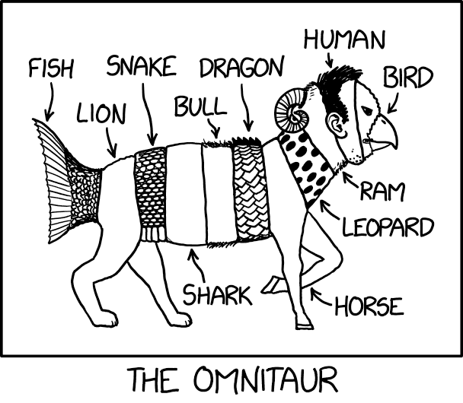
Future Plans – End-user interface design
Our current user interface is designed for experts and super-users.
Our camera end-users expect single button functionality.
Discuss!
Who defines what the end-user needs?
Who knows what the end-user actually wants?
Why are these two separate points?
May we interest you in our UI/UX portfolio? Do we have any?
Automation mechanisms and logics? Emergencies? Recovery?
How many deep neural networks and omni-potent AIs do we need? What can we offer our machine overloards in return?

Slide 12
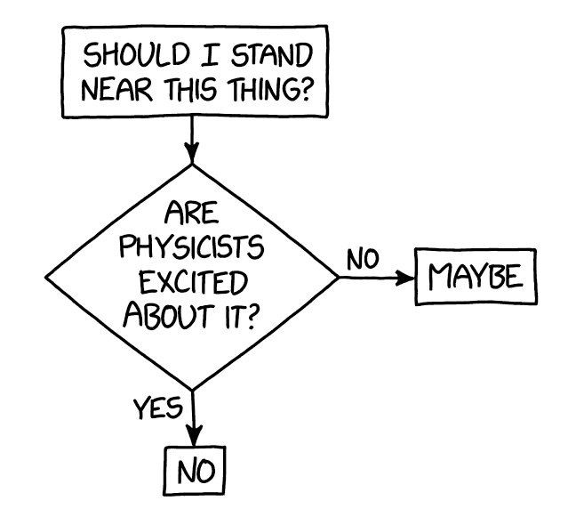
Thank you for your attention For questions please contact:
Max Planck Society – Semiconductor Laboratory
Martin Hensel
Otto-Hahn-Ring 6
81739 München
Tel.: +49 (0)89 839400-0 or -93 Fax: +49 (0)89 839400-11
E-Mail: hll-info@hll.mpg.de or hensel@hll.mpg.de Internet: www.hll.mpg.de

